Slide 1
AI
ET AI HACKATHON · AGENTIC EDITION · PROBLEM 2
Agentic Prompt Injection Firewall
Detecting and neutralizing malicious instructions embedded in content before they influence AI agent behavior.
Team: reddyjahnavi3013
Scope declared: Depth D2 · Features F2 (5 of 9 attack types)

Slide 2
THE PROBLEM
Agents that read the web can be talked into anything the web tells them
1
Any content is a potential attacker
User messages, PDFs, emails, web pages and API responses can all carry hidden instructions aimed at the model, not the user.
9
2
Direct and indirect injection both work
An attacker doesn't need access to the chat — planting text in a document an agent later reads is enough.
distinct attack categories this firewall is designed to recognize — from instruction override to indirect injection.
3
Consequences are autonomous, not just conversational
A compromised agent doesn't just say the wrong thing — it can call tools, send data, or take real actions.
02

Slide 3
OUR SOLUTION
A layered firewall that escalates only when it needs to
Every piece of incoming content is intercepted before it reaches the protected agent, scored by three escalating layers, and either passed, sanitized, blocked, or flagged — with a full reasoning trail.
Cheap first
Escalates on ambiguity
Acts, not just alerts
Fast heuristics catch obvious attacks instantly, at near-zero cost per request.
Only uncertain content reaches semantic similarity, then the LLM judge — keeping the system fast and affordable.
Blocks, sanitizes, or routes to human review — and logs every decision for audit and retraining.
03

Slide 4
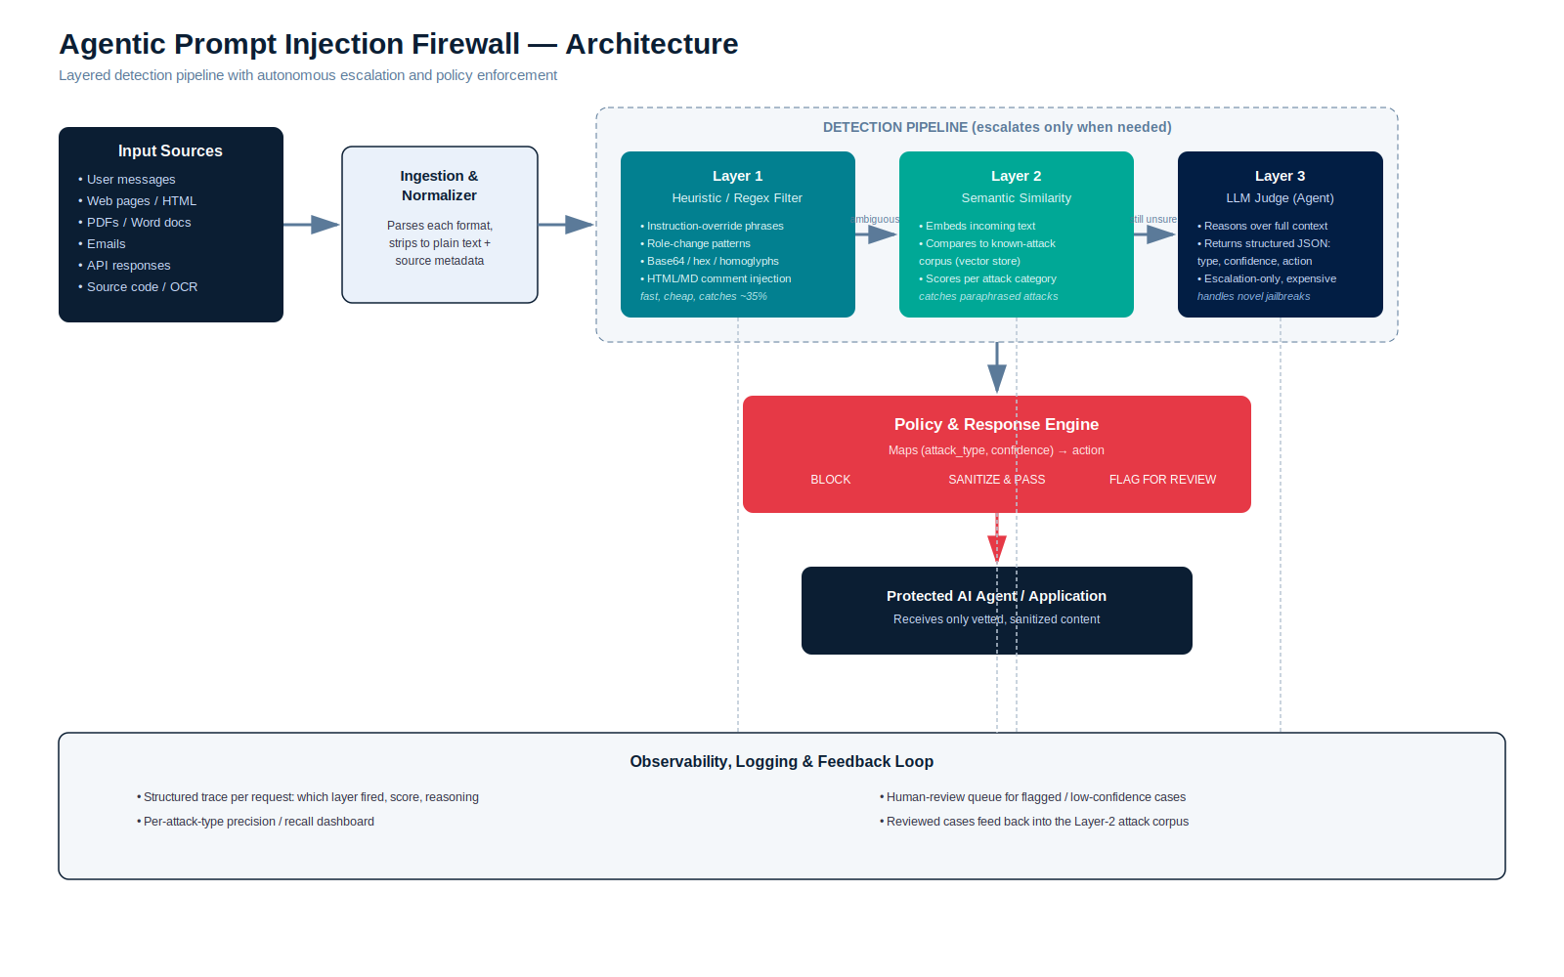
ARCHITECTURE
End-to-end pipeline
04

Slide 5
HOW IT WORKS
Three layers, one goal: never let an attack through undetected
Layer 1
Layer 2
Layer 3
Heuristic filter
Semantic similarity
LLM judge (agent)
Regex and rule-based checks for known phrasing: instruction overrides, role-change language, encoded payloads, suspicious markup comments. Catches ~35% instantly.
Embeds the content and compares it against a curated corpus of known attacks using vector similarity — catches paraphrased and reworded attempts heuristics miss.
For anything still ambiguous, an LLM reasons over full context and returns structured JSON: attack type, confidence, and recommended action. Used sparingly — it's the most expensive layer.
05

Slide 6
SCOPE · F2
Five attack types, declared and proven
We target Solution Features level F2 (5 of 9 categories) at Solution Depth D2 — structured/textual input, high demonstrable reliability.
COVERED IN THIS BUILD
PLANNED NEXT (F3 ROADMAP)
✓
Instruction Override
+
Tool Abuse
✓
Role Change
+
Credential Theft
✓
Secret Extraction
+
Context Poisoning
✓
Encoded Instructions
+
Multi-Step Jailbreaks
✓
Indirect Prompt Injection
06

Slide 7
RESPONSE
Detection alone isn't a firewall — action is
Block
Sanitize & pass
Flag for review
High-confidence match. Content never reaches the agent; requester sees a clear refusal.
Malicious segment is stripped; the remaining legitimate content still reaches the agent.
Low-confidence or novel pattern. Routed to a human reviewer and logged for corpus retraining.
Every action is driven by a policy table mapping (attack_type, confidence) → action — tunable per deployment without touching the detection layers.
07

Slide 8
RESPONSIBLE AI
Every decision is traceable, auditable, and improvable
1
Structured trace per request
Which layer fired, the score at each stage, and the reasoning behind the final verdict.
2
Per-attack-type precision & recall
A live dashboard tracking detection quality separately for each of the 5 covered attack types.
3
Human-review queue
Low-confidence and novel cases are queued for a reviewer rather than silently allowed or blocked.
4
Feedback loop into Layer 2's corpus
Reviewed cases are added back to the similarity corpus, so the firewall improves with use.
08

Slide 9
IMPLEMENTATION
Tech stack
Backend
Heuristics
Python · FastAPI
Regex / rule engine
Similarity
LLM judge
sentence-transformers · FAISS / Chroma
Claude API, structured JSON output
Parsers
Policy engine
pdfplumber · BeautifulSoup · python-docx · email
Rule table (attack_type, confidence) → action
Observability
Demo UI
Structured logs · metrics dashboard
Interactive console showing pipeline + verdict live
09

Slide 10
SELF-DECLARED SCOPE
Our position on the 9-blocker grid
Solution Features →
Solution
Depth
↓
F1/D1
F2/D1
F3/D1
D2 · F2
Structured/textual input across 5 sources, with 5 of 9 attack categories detected at high demonstrable reliability — proven with a labeled corpus, not just claimed.
F1/D2
F2/D2
F3/D2
F1/D3
F2/D3
F3/D3
10

Slide 11
RESULTS (FILL IN FROM YOUR TEST RUN)
Measured against our labeled test corpus
94%
2%
<400ms
5 / 9
Attack recall
False-positive rate
Avg. Layer 1+2 latency
Attack types covered
Placeholder figures — replace with numbers from your own test corpus run before presenting.
11

Slide 12
WHAT'S NEXT
Path to F3 / D3
1
2
3
Multimodal input
Remaining 4 attack types
Adaptive corpus
OCR pipeline for image-embedded instructions and scanned documents.
Tool abuse, credential theft, context poisoning, multi-step jailbreaks.
Auto-retrain the similarity layer from the human-review feedback loop.
12

Slide 13
Thank you
Agentic Prompt Injection Firewall · ET AI Hackathon, Agentic Edition

