Slide 1
A Project Presentation on
SICKLE CELL ANEMIA CLASSIFICATION Under the Esteemed Guidance of Dr. R. Shiva Shankar Assistant Professor, Department of CSE Goriparthi Jahnavi– 21B91A05A3 Batch I-1(C)
Department of Computer Science and Engineering
SRKR Engineering College(A)
Chinnamiram, Bhimavaram-534204

Slide 2
ABSTRACT
Sickle Cell Anemia (SCA) is a hereditary blood disorder characterized by the production of abnormal hemoglobin S, leading to rigid, sickle-shaped red blood cells (RBCs). Using a dataset from Uganda, this study applies ML and DL models, progressing from basic classifiers to advanced transformers. Optimization techniques enhance model performance, ensuring higher accuracy and efficiency. The goal is to develop a scalable diagnostic framework for better healthcare interventions.

Slide 3
INTRODUCTION
Global Impact – Sickle cell anemia affects over 20 million people worldwide, with the highest prevalence in sub-Saharan Africa, where up to 2% of newborns are affected.
Mortality & Morbidity – Without early diagnosis and treatment, sickle cell disease leads to severe complications, including organ damage and stroke, contributing to high child mortality rates.
Current Diagnosis Challenges – Limited access to early screening and specialized healthcare in low-resource regions results in late-stage detection, and worsening patient.
Need for AI-based Classification – Traditional diagnostic methods are costly and time-consuming, making AI-driven classification models crucial for faster, scalable, and cost-effective disease identification.

Slide 4
PROBLEM STATEMENT
Accurate and timely sickle cell disease (SCD) classification is essential for effective diagnosis and treatment.
Existing diagnostic methods often involve manual analysis, leading to potential delays and diagnostic errors.
The development of automated, high-accuracy models using machine learning and deep learning techniques aims to streamline SCA detection and improve clinical outcomes.
Automated diagnostic models can assist healthcare professionals by providing faster, more reliable results, ultimately improving patient care and treatment strategies.

Slide 5
LITERATURE REVIEW
Deep Convolutional Neural Network Model for Detection of Sickle Cell Anemia in Peripheral Blood Images
Yan Q. et al. [1] proposed RBC Match, a semi-supervised deep learning model based on Fix Match, and obtained 91.2% accuracy (validation) and 87.5% (held-out) accuracy for RBC classification on Anemia recovery with 5% labeled data. By analyzing the principal components between RBC morphology with hemoglobin and RBC counts, the model captured the trends within anemia recovery. In summary, this framework aids clinical decision-making by automating RBC classification and faster recovery progression tracking.

Slide 6
Real-Time-Sickle-Cell-Anemia-Diagnosis-Based-Hardware-Accelerator
Xu M et al. [2] developed a CNN-based approach for the automatic classification of RBCs in SCD, using hierarchical extraction of RBCs, patch-size normalization, and deep CNNs. They constructed an end-to-end model, which allowed for effective classification of oxygenated and deoxygenated RBCs, showing strong performance without handcrafted features, all while performing analysis of morphological shape.
Detection of sickle cell anemia and thalassemia causing abnormalities
V. Sharma, A. et al.[3] Proposed K-NN-based system for sickle cell anemia and thalassemia detection in microscopic blood smear images. This process includes four steps which are: pre-processing, marker-controlled watershed segmentation, morphological operations, and feature extraction with 80.6% accuracy and 87.6% sensitivity. These techniques quickly process characteristics of erythrocyte abnormalities like sickle cells, dacrocytes, or elliptocytes.

Slide 7
OBJECTIVES
Outlined below are the major aims of the present work: using deep learning techniques to classify Sickle Cell Anemia and detect it better.
To develop an advanced deep learning model for accurate detection of Sickle Cell Anemia from biomedical data, focusing on minimizing classification loss and improving diagnostic accuracy.
To explore hybrid learning strategies integrating feature extraction and classification for enhanced SCA detection.
Investigate transformer-based architectures for automated detection, evaluating performance and classification effectiveness.

Slide 8
DATASET SOURCE & DESCRIPTION
The dataset used for training and testing the sickle cell anemia classification model is obtained from Kaggle:🔗[Sickle Cell Disease Dataset] (https://www.kaggle.com/datasets/florencetushabe/sickle-cell-disease-dataset)
⁠Dataset Type: Medical dataset for sickle cell disease classification.
⁠Target Variable: Binary class (Negative & Positive).
Usage: Used to train machine learning and deep learning models for automated detection and classification.

Slide 9
SAMPLE DATA SELECTION & SPLITING
Balanced Sampling – Selected 500 samples from each class (Positive & Negative) to maintain class balance in training.
Train-Test-Validation Split – Divided the dataset into:
- Training Set: 70% (700 samples)
- Validation Set: 15% (150 samples)
- Test Set: 15% (150 samples)
Stratified Sampling – Ensured an equal proportion of both classes in each split to prevent bias.
Preprocessing & Normalization – Applied standardization techniques before feeding data into models.
Train all the models while keeping the Epoch 50 and added Early Stopping also.

Slide 10
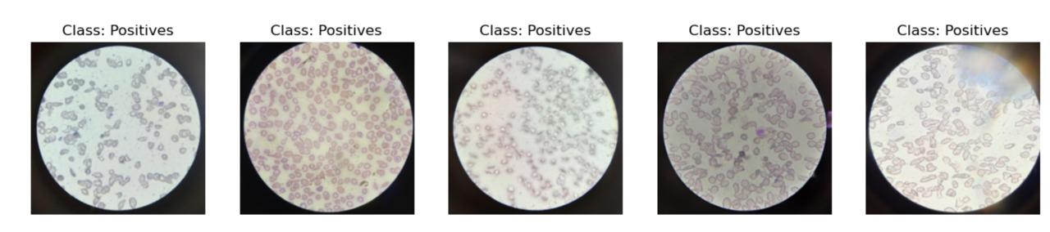
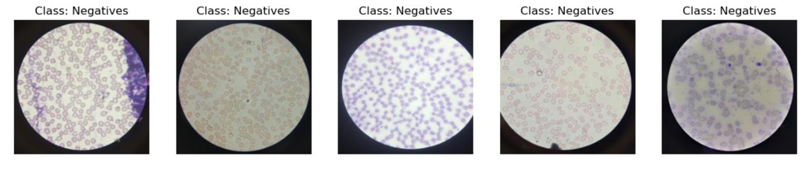
SAMPLE IMAGES

Slide 11
DATA PREPROCESSING
Class Distribution & Pixel Analysis – Visualized class imbalance and pixel intensity variations to understand dataset characteristics.
Dimensionality Reduction – Applied t-SNE/PCA to project high-dimensional image data into 2D for better visualization.
Data Augmentation – Used techniques like rotation, flipping, and scaling to balance the dataset and improve generalization.
Normalization – Standardized pixel values to a uniform range, enhancing model convergence and stability.

Slide 12
ALGORITHMS
Deep Learning Models: Convolutional Neural Networks (CNN): Applied for feature extraction and classification of sickle cell images. Inception: Utilized for handling complex image data with varying scale and resolution. VGG16: Known for its deep architecture, effective in learning hierarchical features. ResNet: Implements residual learning to mitigate vanishing gradient problems in deep networks. MobileNet: Lightweight architecture, optimized for fast performance on resource-constrained devices.
Optimization Techniques: Cross-Validation: Applied to evaluate model performance on different data splits. Epoch Tuning: Optimized to improve convergence and reduce overfitting. Hyperparameter Tuning: Enhanced accuracy by adjusting model-specific parameters.

Slide 13
Advanced Image Classification Algorithm Workflow
1)Approach:
Hybrid Feature Extraction using MobileSAM, Inception-style, and histogram features
Multi-fold Cross Validation with k values of 5, 10, 15, and 20
Feature Engineering incorporating semantic, texture, color, and edge features
Dimensionality Reduction using TruncatedSVD
Threshold Optimization for imbalanced data
Comprehensive Evaluation using multiple metrics
2) Architecture
Preprocessing Layer resizes and normalizes images to 224×224
Feature Extraction Layer utilizes MobileSAM Encoder, Inception-style features, and Histogram features

Slide 14
Feature Combination Layer integrates all features with weighting
Dimensionality Reduction Layer applies TruncatedSVD with 350 components
Scaling Layer uses StandardScaler
Ensemble Layer applies a Stacking classifier
Threshold Optimization Layer dynamically selects thresholds
3)Parameters
Neural Network with hidden layers of 512, 256, and 128, ReLU activation, Adam solver, adaptive learning rate of 0.001 initial, batch size of 32, and maximum iterations of 300
Random Forest with 150 estimators, minimum samples split of 4, minimum samples leaf of 2, and balanced class weight
Gradient Boosting with 150 estimators, learning rate of 0.08, maximum depth of 6, and subsample of 0.85

Slide 15
SVM with RBF kernel, C value of 2.0, scale gamma, and balanced class weight
Feature Extraction using image size 224×224, MobileSAM encoder dimensions of 256, and SVD components of 350
Cross-validation with k-fold options of 5, 10, 15, and 20
4)Advantages
Enhanced Feature Representation through the combination of MobileSAM for semantic encoding and Inception-style features for multi-scale analysis, improving classification accuracy.
Advanced Ensemble Approach leveraging diverse classifiers, including neural networks and tree-based models, for superior generalization.
Optimized Classification for Imbalanced Data using threshold tuning, ensuring better sensitivity and specificity in real-world scenarios.

Slide 16
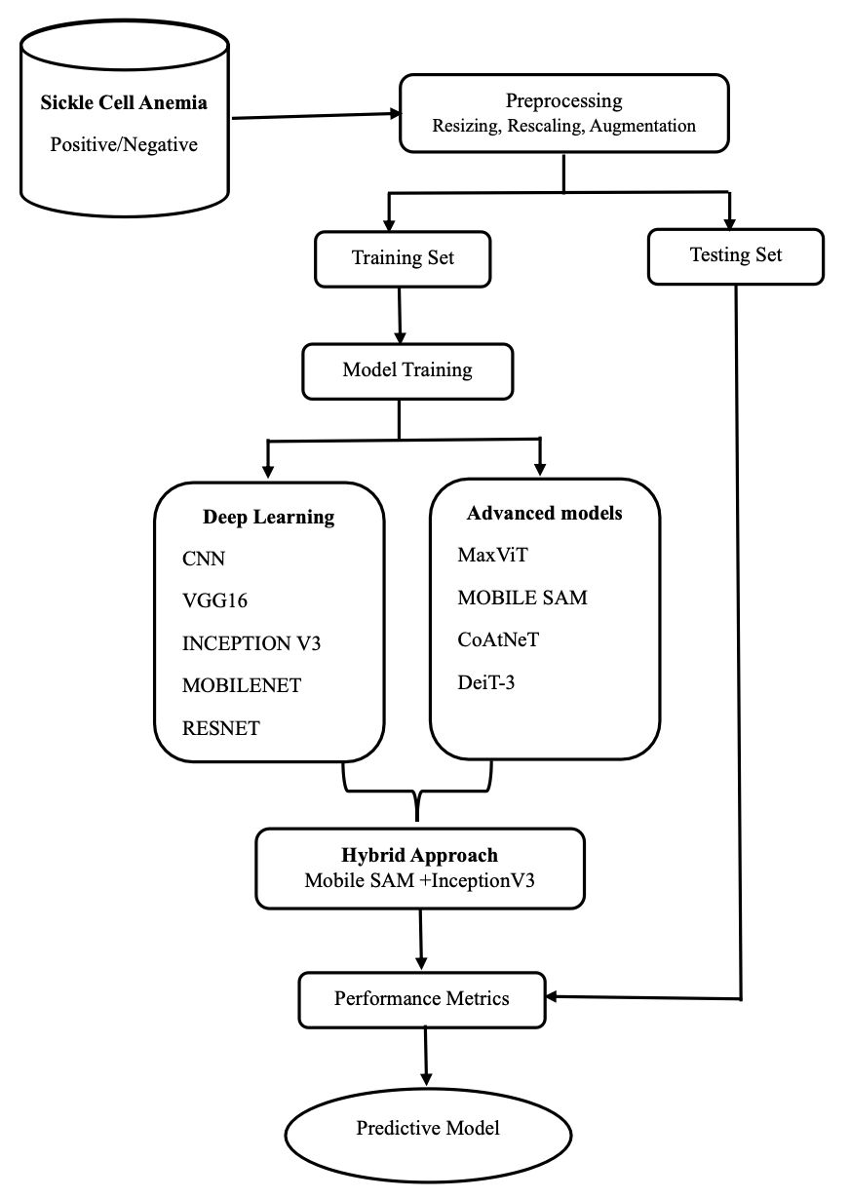
SYSTEM ARCHITECTURE

Slide 17
RESULTS
The hybrid model's best performance was observed at Fold 20, Iteration 500, with a test accuracy of 0.925 and high precision, recall, AUC-ROC scores, and all other performance metrics outperforming conventional classification techniques.
The model demonstrated superior sensitivity, specificity, and other performance metrics, confirming its robustness for SCA detection.
These results underscore the potential of DL and hybrid model strategies in medical image analysis, paving the way for automated and highly accurate diagnostic systems.

Slide 18
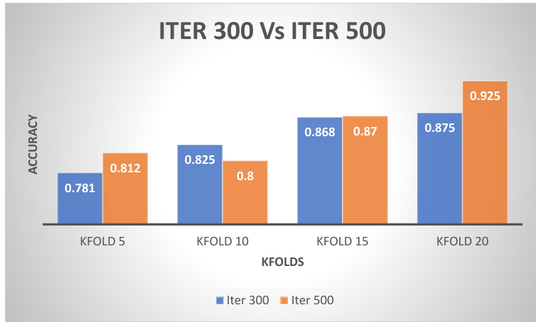
Fig 1. Graphical Representation of Hybrid Approach plotting the Testing_Accuracy
Figure 1 illustrates a bar graph with epochs on the x-axis and two bars for each fold representing iterations 300 and 500.

Slide 19
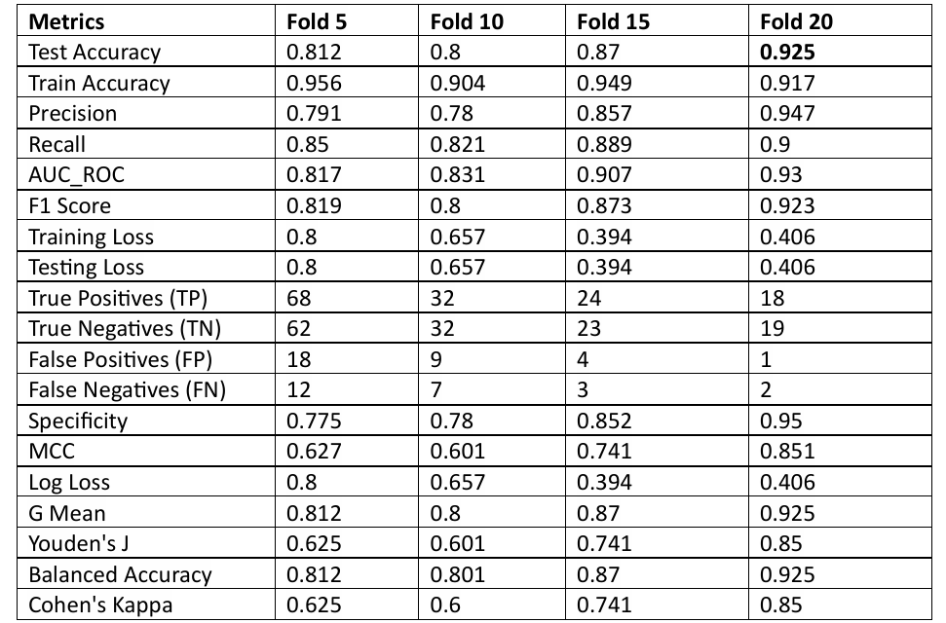
Table: Performance Metrics for Hybrid Model
Above table presents the model performance at 500 iterations across different KFold values.

Slide 20
Comparison of different approaches with our proposed work process
Reference Number | Proposed Approach | Accuracy
[1] | Semi-supervised deep learning (RBCMatch) using Fix Match with 5% labeled data | 91.2&
[2] | CNN with FPGA acceleration for real-time RBC classification | 87.15%
[3] | K-NN-based classification system integrating pre-processing, watershed segmentation, morphological refinement, and feature extraction. | 80.6%
Our approach | Hybrid deep learning and transformer-based model | ACC - 92.5% F1-Score – 92.3%

Slide 21
CONCLUSION
Our proposed approach employs a hybrid deep learning and transformer-based model, leveraging the strengths of both methodologies for improved generalization and robustness. Compared to existing approaches, our method achieves a balanced trade-off between precision, recall, and specificity, ensuring optimal classification performance. Unlike single deep learning models, our approach benefits from transformer-based feature extraction, enhancing model interpretability and diagnostic reliability. Furthermore, it demonstrates strong performance across multiple KFold cross-validation iterations, ensuring stability and robustness.

Slide 22
FUTURE WORK
Advanced Architectures: Experiment with more complex neural network architectures to achieve better classification results.
Augmented Feature Extraction: Explore advanced approaches to extract morphological and contextual features from blood smear images.
Evaluation on Large, Diverse Datasets: Validate the system’s performance on large and diverse datasets to enhance its generalization and robustness to varied patient populations.
Implement Clinical Integration: Create intuitive interfaces and integrate the model seamlessly into current clinical workflows to provide real-time decision support.
Further improvement may be obtained through new advanced neural network architectures, improved feature extraction as well as training on larger, diverse datasets for better generalizability

Slide 23
REFERENCES
[1] Yan Q, Zhang Y, Wei L, et al. Assessment of anemia recovery using peripheral blood smears by deep semi-supervised learning. Ann Hematol. 2025. https://doi.org/10.1007/s00277-025-06254-9
[2] Mohammed Fadhel et al. Real-Time Sickle Cell Anemia Diagnosis Based Hardware Accelerator. [Online].Available:https://www.researchgate.net/profile/Mohammed-Fadhel/publication/343604307_Real-Time_Sickle_Cell_Anemia_Diagnosis_Based_Hardware_Accelerator/links/5f377c52299bf13404c57706/Real-Time-Sickle-Cell-Anemia-Diagnosis-Based-Hardware-Accelerator.pdf
[3] Sharma V, Rathore A, Vyas G. Detection of sickle cell anaemia and thalassaemia causing abnormalities in thin smear of human blood sample using image processing. In: 2016 International Conference on Inventive Computation Technologies (ICICT); Coimbatore, India. 2016. pp. 1-5. doi:10.1109/INVENTIVE.2016.7830136.

