Slide 1
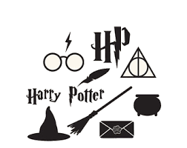
Sentiment Analysis with Harry Potter Series
Presented By
Jahnavi Sandhya Lanka

Slide 2
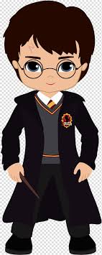
Index
Goal
Sentiment Analysis
Introduction
Basic Analysis with the Text
Creating Tidy Text
Word Frequency Analysis
Word Cloud
Sentiment Analysis
NRC
BING
AFINN
Comparison of three lexicons
Using Bigrams
Conclusion

Slide 3
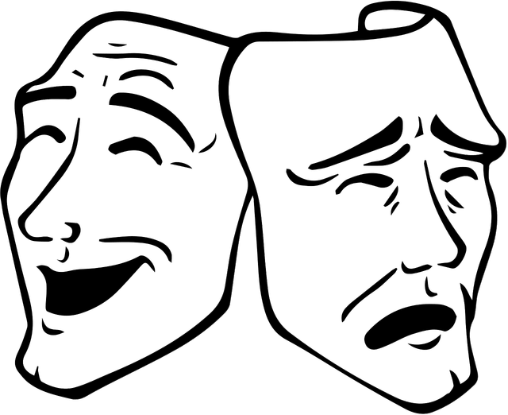
Goal
The goal of this project is to build a sentiment analysis model which will allow us to categorize words in the Harry Potter series based on their sentiments using the lexicons from the tidytext package
To get insights like what are the most frequent words used in the series, to know top positive-negative words, to determine which book has the highest negative or positive emotional score, comparing three lexicons, using bigrams

Slide 4

Sentiment Analysis
Sentiment analysis is the interpretation and classification of emotions within text data using text analysis techniques
Applications include:
Social Media Monitoring – Analyzing tweets and Facebook posts
Brand Monitoring – It is important to care, not only about if people are talking about the brand, but how they are talking about it
Customer Reviews - By automatically running sentiment analysis on incoming surveys, companies can detect customers who are strongly negative towards the product or service, so they can respond to them right away

Slide 5
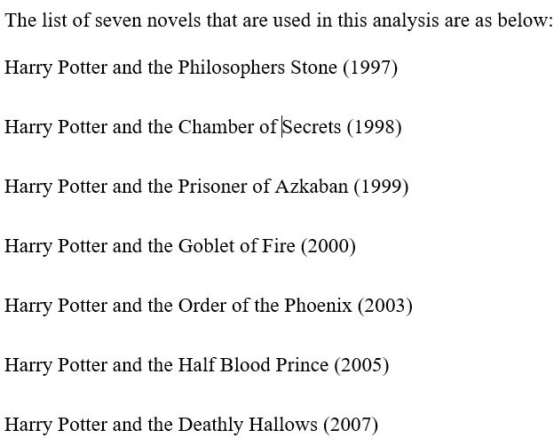
Introduction
The project is mainly based on Sentiment Analysis within R using tidytext package that comprises of sentiment lexicons like AFINN, BING and NRC that are present in the dataset of “sentiments”.
The text data that is used in this project was provided by the Harry Potter R package (harrypotter) on GitHub that contains the text for all seven books in the Harry Potter series, by JK Rowling.

Slide 6
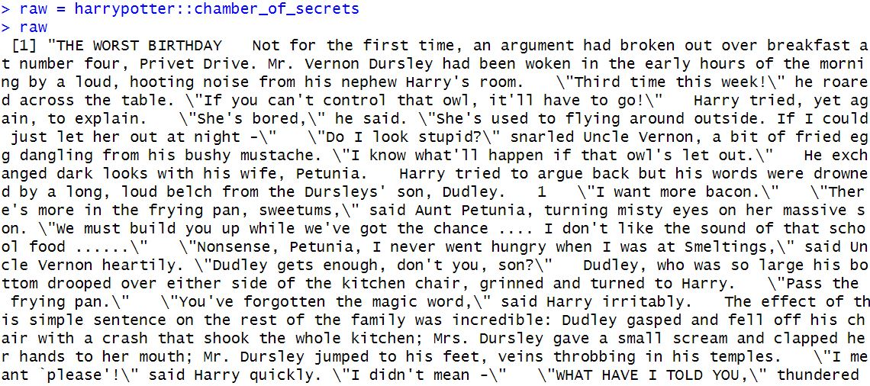
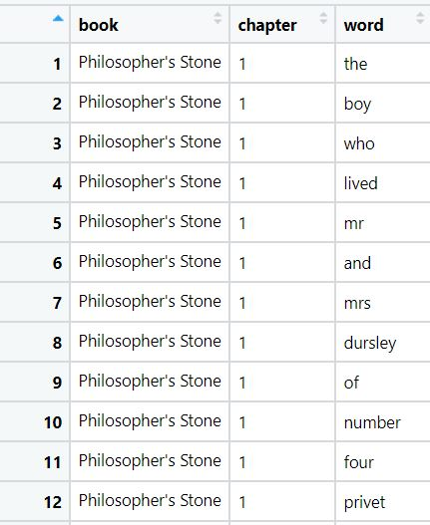
Creating Tidy Text
The raw text needed to be shaped properly as to perform sentiment analysis the data should be in the form of tidy format
Conversion of all the seven Harry Potter novels into a tibble that has each word by chapter by book using unnest_token function

Slide 7
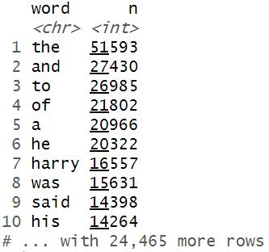
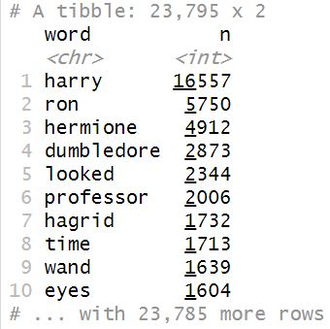
Word Frequency Analysis
Used count function to know what are the words that occur the most in the entire series
Stop words are words that do not have weight or meaning in the analysis like ‘the’, ‘an’, ‘and’, ‘a’ and many other
Removed the entire stop words from the text using the “anti_join” function

Slide 8
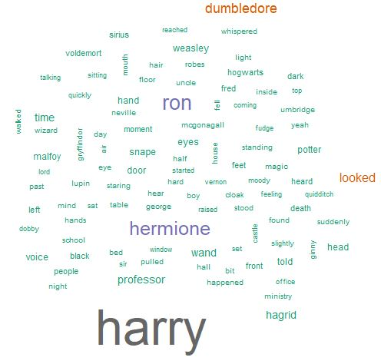
Word Cloud
In word cloud the tokens that appear frequently in the series appears to be in bigger size than the other words
One can understand “harry”, “ron”, “hermione” and “dumbeldore” are the important characters in the harry potter series as they tend to appear in bigger size when compared with other tokens.

Slide 9
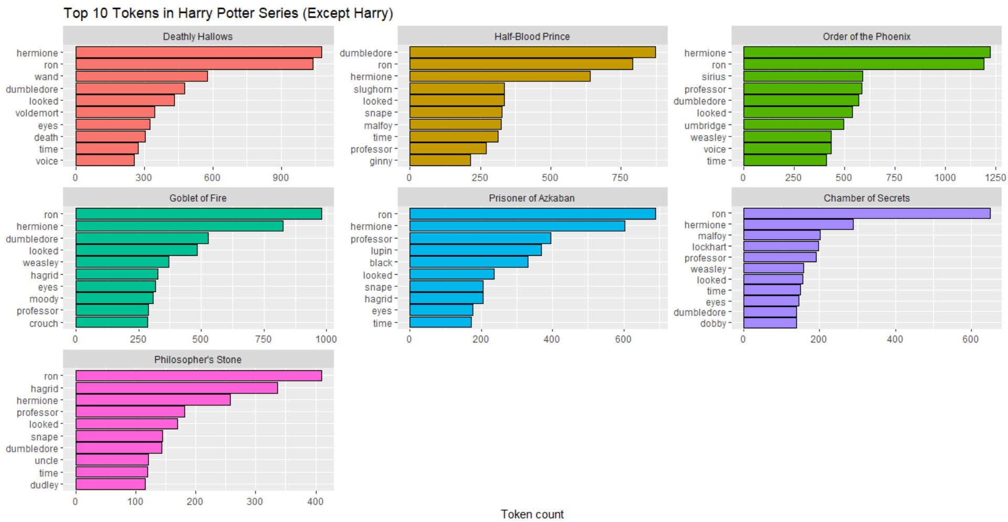

Slide 10

Sentiment Analysis

Slide 11
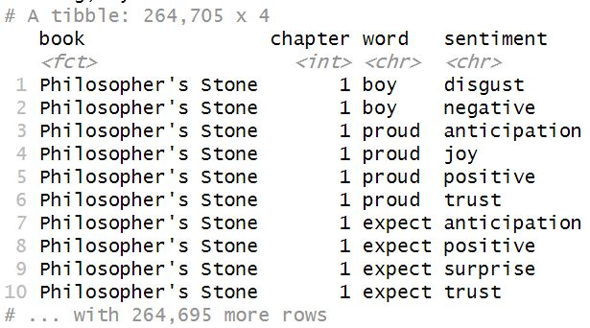
Nrc Lexicon
It is a list of English words and their associations with eight basic emotions: anger, fear, anticipation, trust, surprise, sadness, joy, and disgust and two sentiments: negative and positive
When applied to the text it separates each token with respect to their sentiment

Slide 12
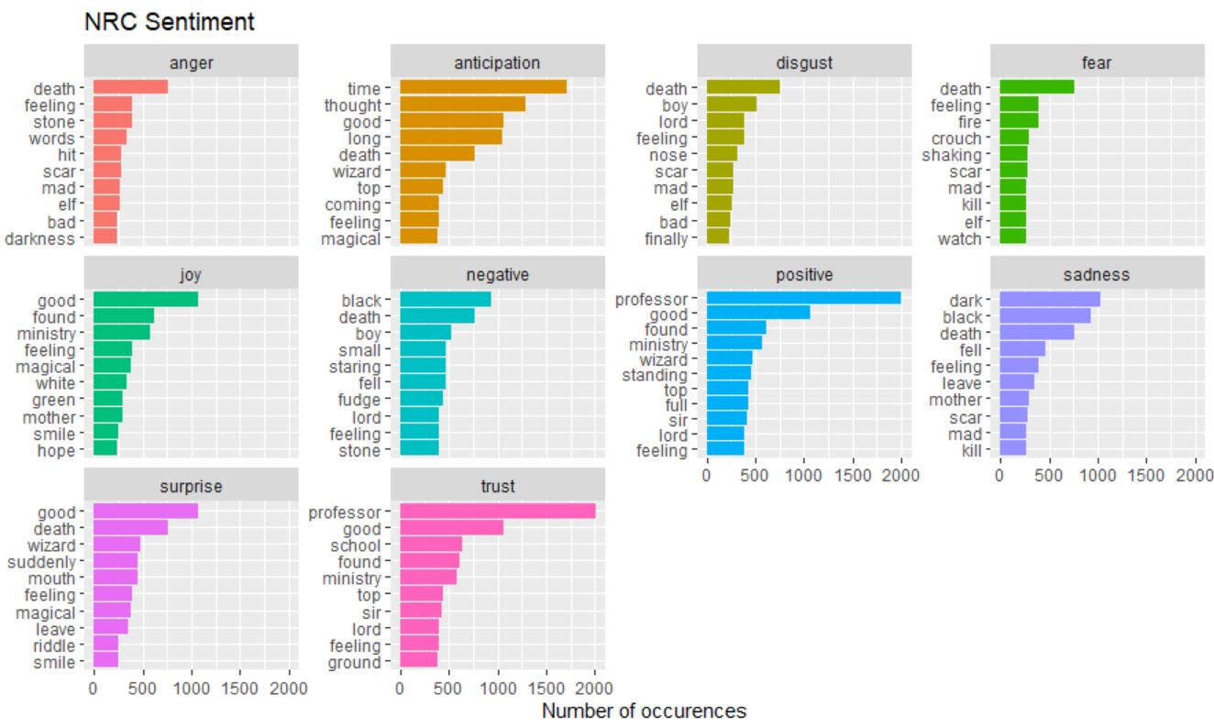

Slide 13
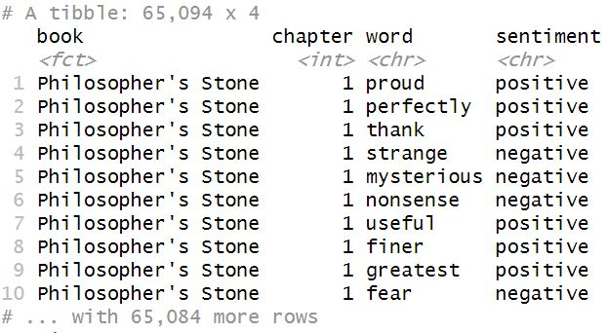
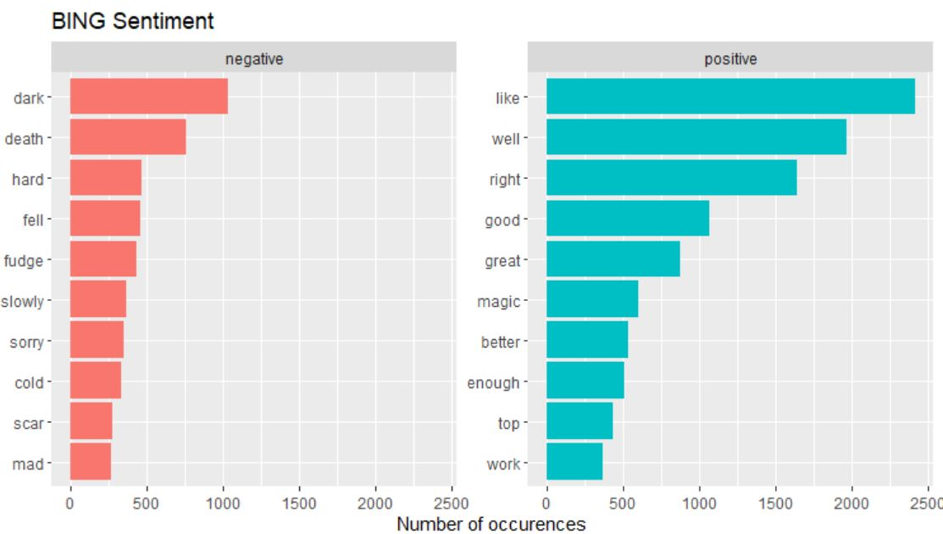
Bing Lexicon
It categorizes tokens in the text in a binary fashion into positive and negative categories

Slide 14
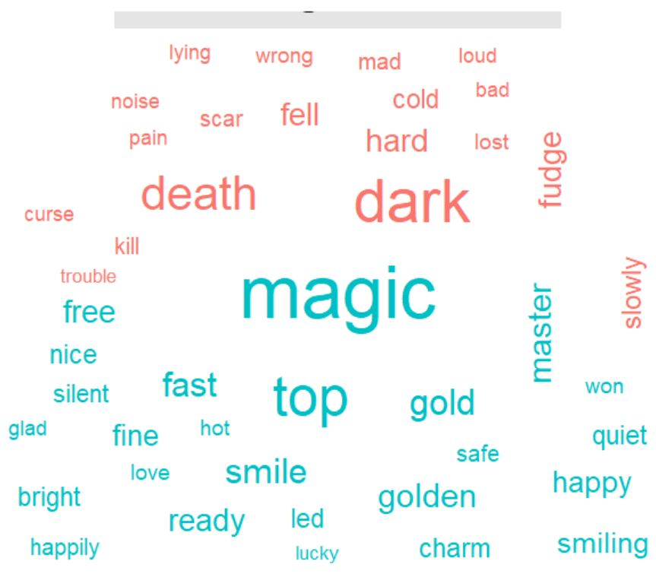
Bing Comparison Cloud
Used to make a comparison that displays the 50 most frequently occurring words in the series that were categorized by ‘bing’ and color-codes them based on negative or positive sentiment.

Slide 15
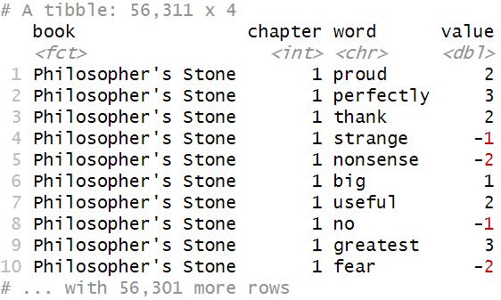
AFINN Lexicon
The AFINN lexicon assigns words with a score that runs between -5 and 5, with negative scores indicating negative sentiment and positive scores indicating positive sentiment.
One can observe that sentimental words like “proud”, “perfectly”, “thank”, “fear”, “strange” and many others have give their respective scores keeping positive and negative as their extremes.

Slide 16
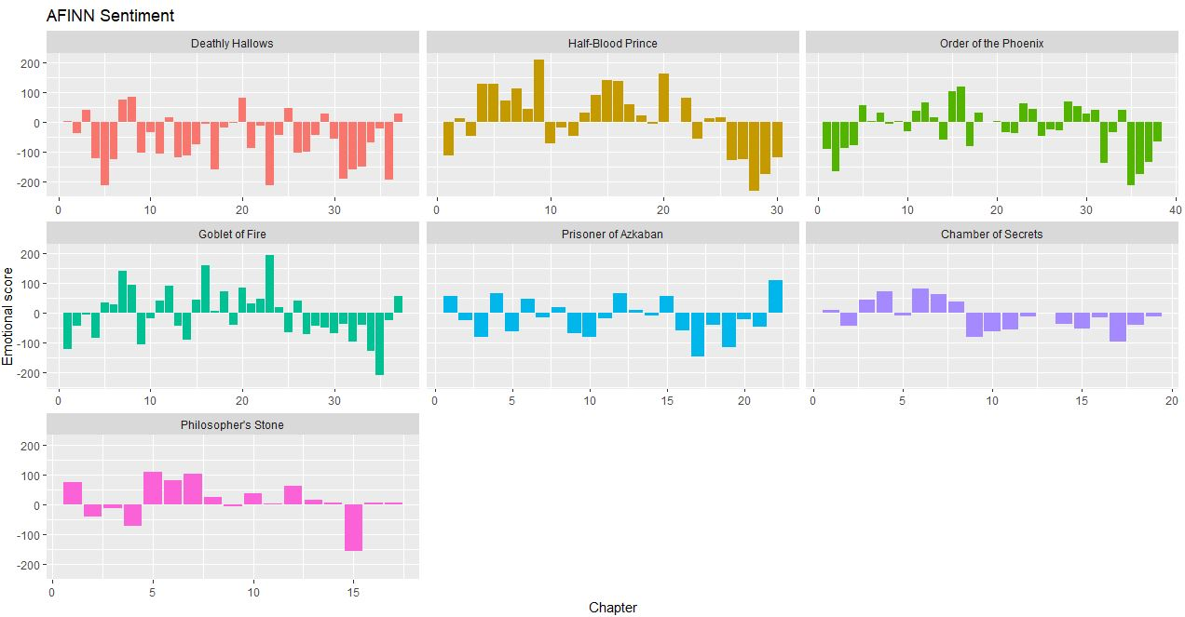

Slide 17
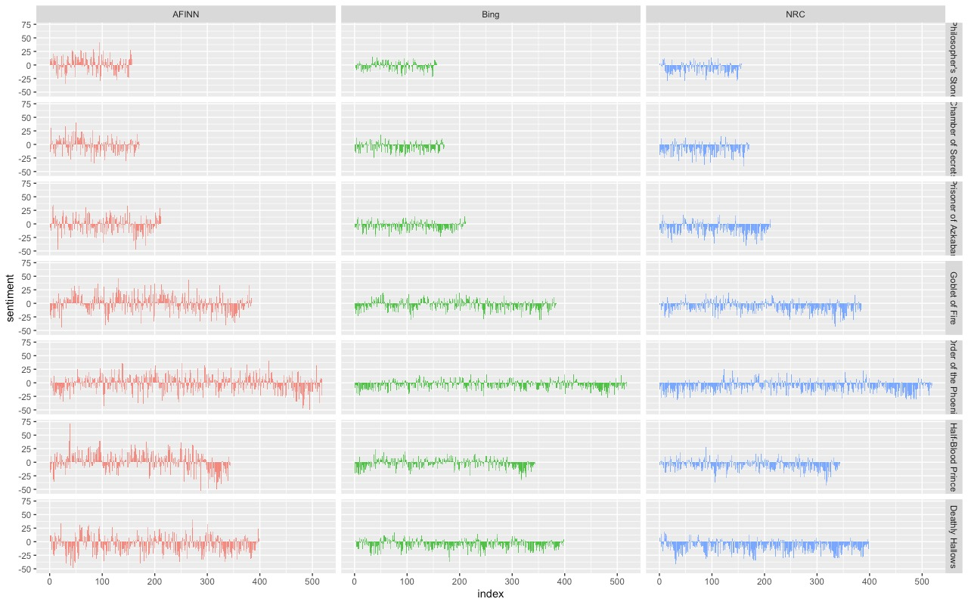
Comparison of three Lexicons
Observed similar dips and peaks in sentiment at about the same places in the novel, but the absolute values are significantly different.
In some instances, it apears the AFINN lexicon finds more positive sentiments than the NRC lexicon.

Slide 18
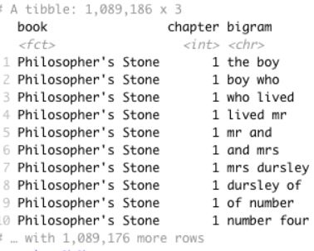
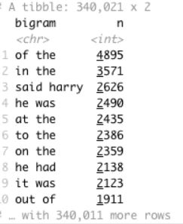
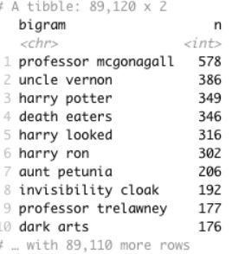
Bigrams
A bigram is a pair of words that appear consecutively in a text. For example, “Harry is my friend”, the bigrams we can extract would be (Harry, is), (is, my), and (my, friend).

Slide 19
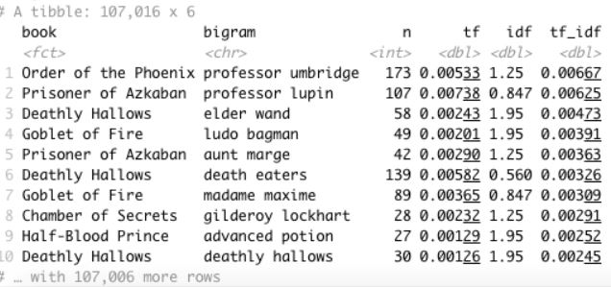
Term Frequency – Inverse Document Frequency
Td-idf is an analysis that seeks to identify how common a word is in a particular text, given how often it occurs in a group of texts
For example, Professor Lupin was a very prominent character in “The Prisoner of Azkaban”, but not so much in the other books
term frequency - number of times a token appears in a document divided by the total number of tokens in the document
inverse document frequency – total number of documents divided by the number of documents containing the token

Slide 20
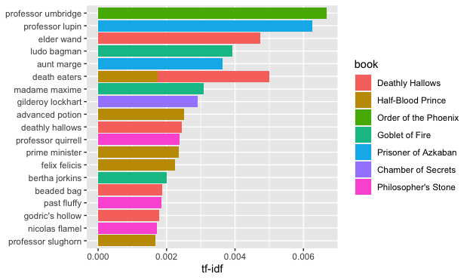
Term Frequency – Inverse Document Frequency

Slide 21
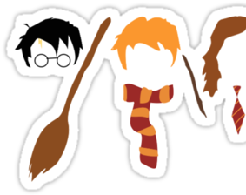
Conclusion
We saw how three lexicons show effect on the text by visualizing comparison cloud, emotional score and different categorized emotions using nrc lexicon
“Deathly Hallows” has the highest negative score in entire series and “Half Blood Prince” has the most positive score
Since mostly the series is dominated by negative words NRC and Bing lexicons showcased this properly
Using Bigrams made us analyze in even more detail about the top characters that played a prominent role in the entire series
“Order of Phoenix” is the lengthiest book keeping “Philosophers Stone” the shortest.

Slide 22
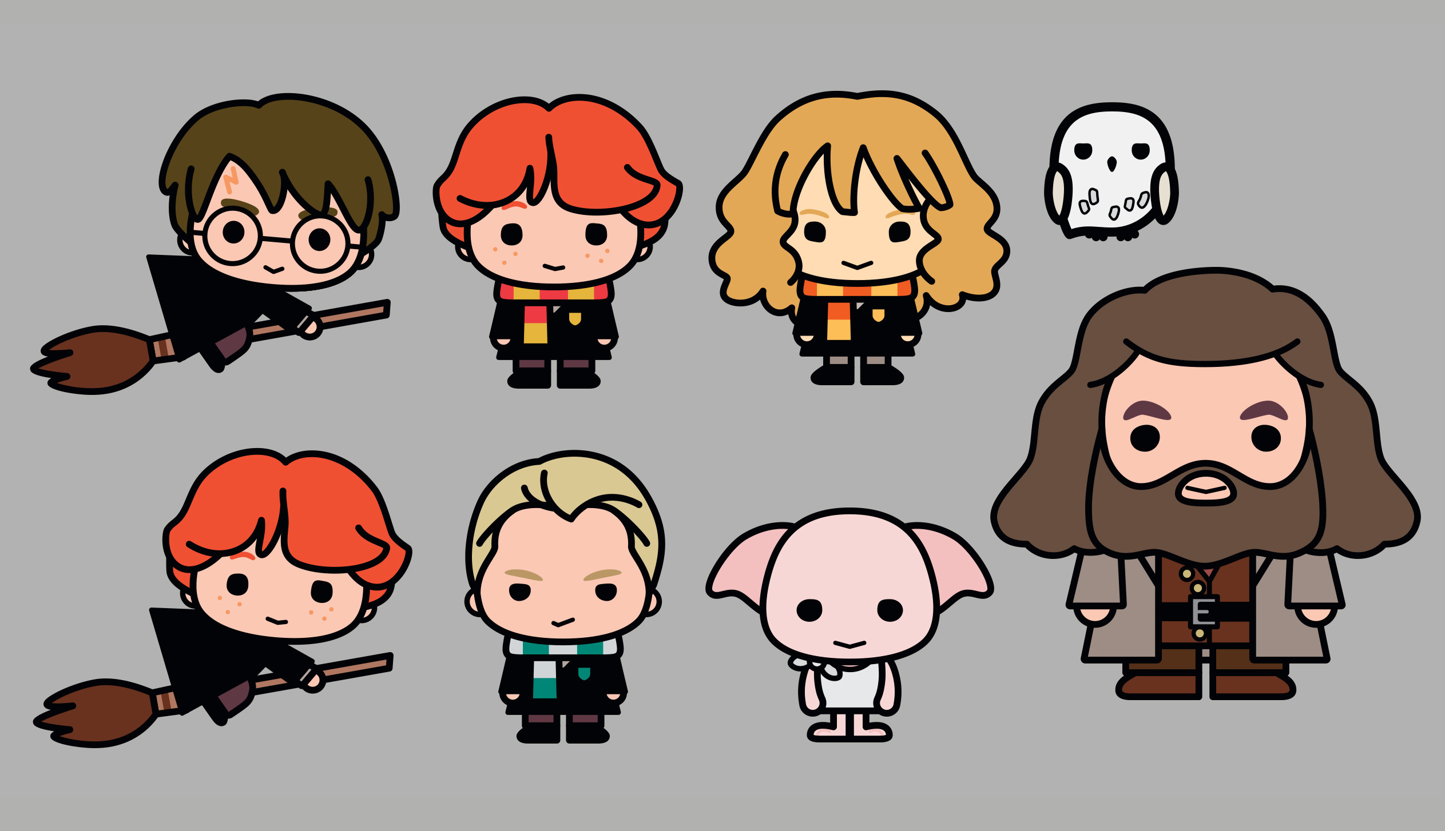
Thank You

