Slide 1
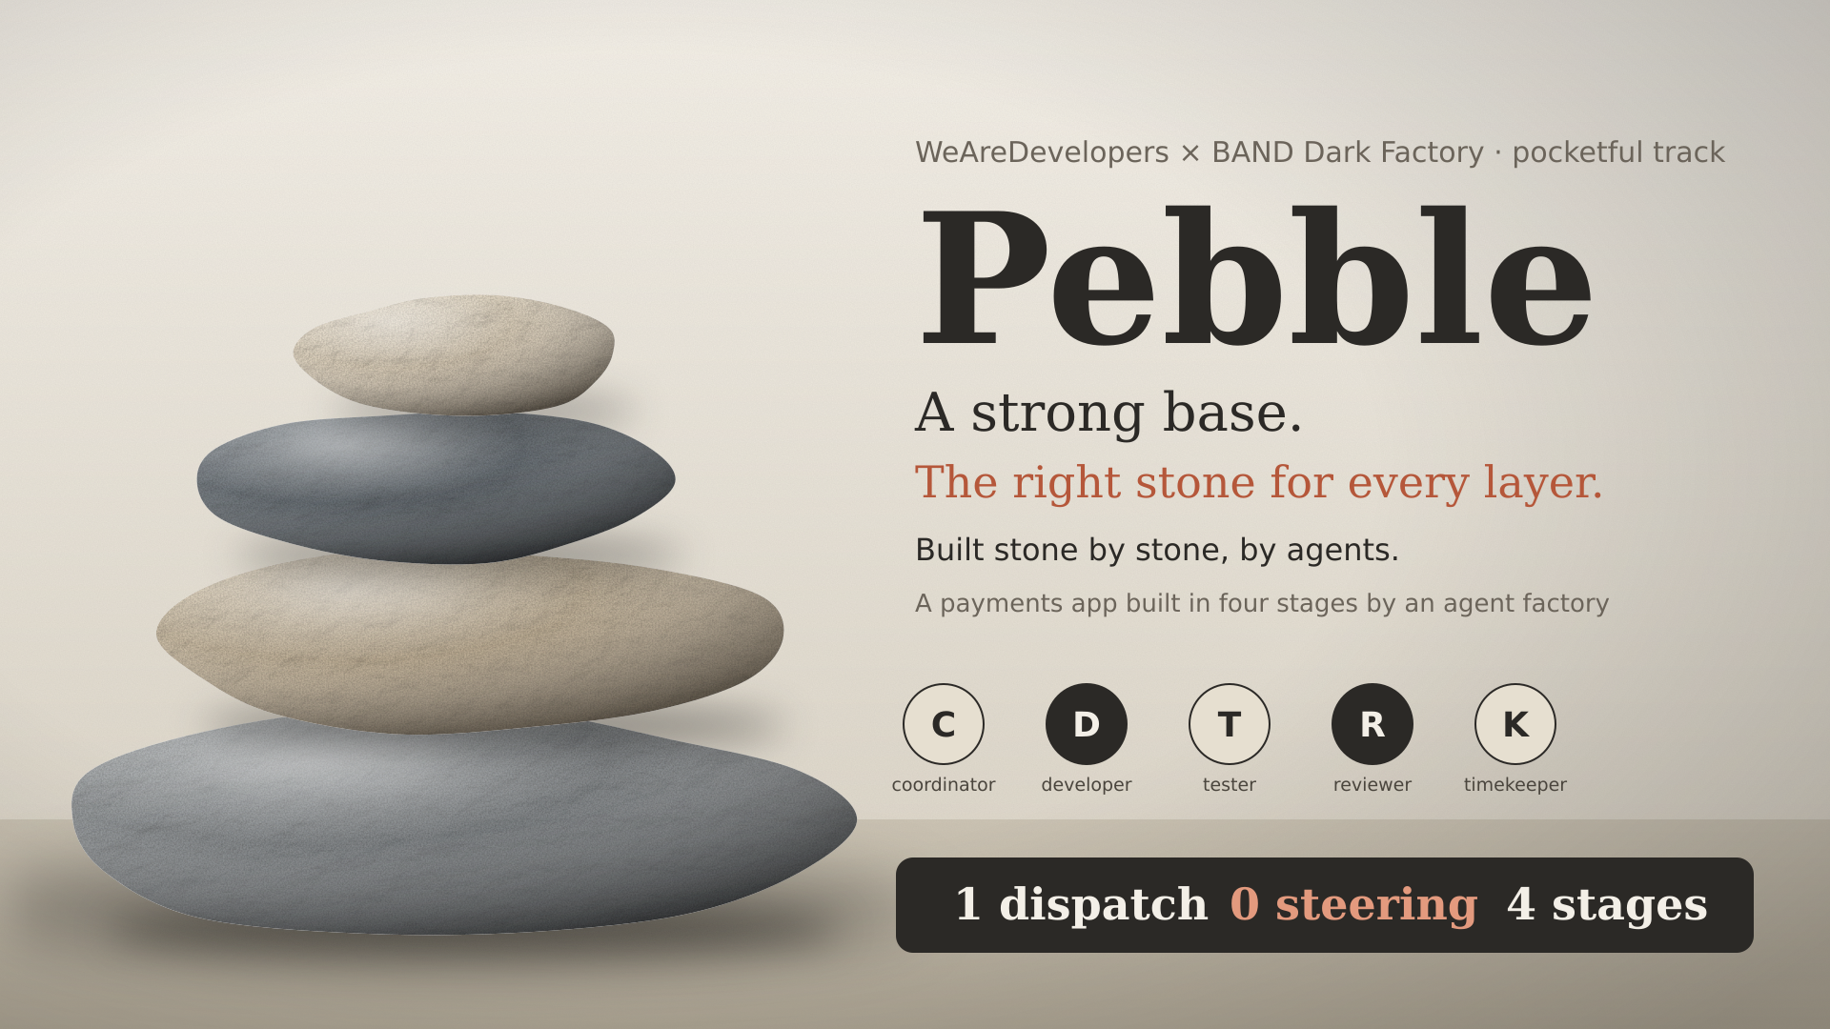
Notes:
Pebble: a payments app built in four stages by five agents from one dispatch. Adding agents does not add parallelism. Adding coordination does. This is the second run of the same build; the first run is our baseline.

Slide 2
Four stages built and verified from one dispatch
0
4 / 4
160
human messages after the dispatch (run 1: 5)
stages built, verified and merged
commits, every one by a seat
70 / 0 / 1
425
35
stage 4 acceptance: passed / failed / skipped
unit tests passing in stage 4
UI screenshots at 375 px and 1280 px
Wall-clock 29.8 h (about 9 h of it waiting on Claude session limits). Cost: Featherless about $25; Claude seats used about 49% of one Pro plan's weekly limit, plus a little paid extra at the end.
Run 2 of the same build. It is more reliable and better evidenced than run 1, and not cheaper or faster. The next slides show both sides.
Notes:
Lead with the result. Zero human messages after the dispatch, four stages verified, 160 seat commits. Then be honest in the same breath: it cost more than run 1.

Slide 3
Pebble: a shared-pot payments app, one stone at a time
1
2
3
4
JSON API
Web UI and holds
Statements and corrections
Refunds and batches
Sign-up, pay, request, split, operator settlements. Idempotent writes, atomic debit and credit.
Wallet, requests, split and authorizations screens at phone and desktop width. Held versus available money.
Balance statements with opening and closing, plus corrections that keep history intact.
Refunds, batch corrections, optimistic revisions, format-4 export and import.
147 checks
35 screenshots
41 acceptance
70 acceptance
Each stage folder carries the previous one forward and ships a Dockerfile and RUN.md. The service is one Python process, standard library only.
Notes:
Four stages, each carried forward into the next. Single Python process, nothing to install.

Slide 4
How the factory works: one dispatch, five seats
Developer
code and unit tests, one branch per batch
Human
Coordinator
Tester
main
one dispatch for all four stages
requirements, design, dependency graph, close-out
completeness review, black-box acceptance suite
fast-forward merges only, by the reviewer only
Reviewer
clean-copy review, screenshots, probes
Timekeeper: a script with no model. It wakes the coordinator only when the room has gone quiet.
One room per stage. At each stage end the coordinator writes handover.md and the timekeeper wakes it in the next room.
Notes:
The human sends one dispatch. The coordinator plans and routes. Developer and tester work in parallel. The reviewer is the only seat that merges, fast-forward only. A timekeeper script wakes the coordinator when the room goes quiet.

Slide 5
Models are routed by reasoning load
C
D
T
R
K
coordinator
developer
tester
reviewer
timekeeper
Claude Sonnet
GLM-5.3-Flash
GLM-5.3-Flash
Claude Sonnet
script, no model
Planning, corner cases, dependency graph, close-out. A weak plan costs the most downstream.
High-volume code and unit tests on a low-cost model.
Completeness review of the spec and the black-box acceptance suite.
Clean-copy review, stress probes, screenshots. The only merger.
Notices quiet rooms. Speaks only when something may be stuck.
The right stone for every layer. Reasoning where it pays, volume where it is cheap. A ten-seat toy rehearsal cost $12.40 for about 1.5 stages and was cut to five seats.
Notes:
Claude on the two seats where reasoning pays: coordinator and reviewer. A low-cost model on developer and tester, where volume is. The ten-seat rehearsal taught us fewer seats are better.

Slide 6
Run 1: a rejection that did not stop the line
19:50
20:04
22:32
22:57
Batch 2 rejected
Batch 3 is blocked
Batch 4: “still blocked”
Batch 5: “same blocker”
Two defects, reproduced with an independent probe.
Built directly on batch 2's tip: “I can't fast-forward without pulling in the unfixed defects.”
“…as batches 3 and 4 asked if the pipeline was stalled.”
Three batches stacked on one unfixed tip.
The mandate already said “A rejection takes priority over everything.”
It was not enough. The fix was verified at 23:21, 3 h 31 min later, and was still not mergeable because the branch had gone stale.
Notes:
This is the failure we found in run 1's room logs, not something we imagined. The rule existed. It was advice, and the agents ignored it under load.

Slide 7
A precondition holds. A priority rule doesn't
developer.md
Work becomes a dependency graph. A batch on top of a rejected batch is simply not ready.
1
“Start a batch only when every batch in its ‘builds on’ line is merged into main.”
developer.md
Branches like developer-s2-b3 replace one shared branch that went stale for everyone.
2
“One branch per review batch… created from the latest main revision.”
coordinator.md
Stages 2 and 3 record why batches 1 and 2, or 3 and 4, could not.
3
“Arrange the batches so that at least two can start in parallel.”
Notes:
The change is in the wording and the structure. A precondition cannot be skipped; advice can.

Slide 8
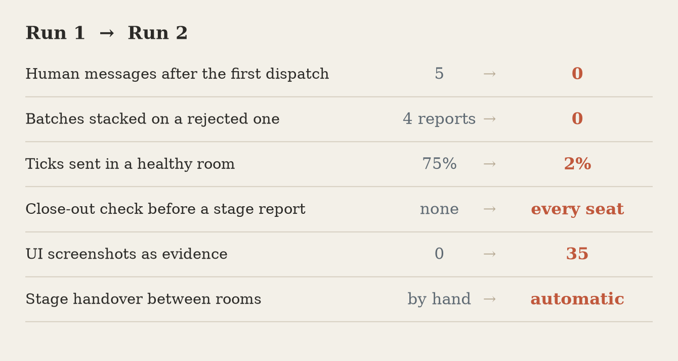
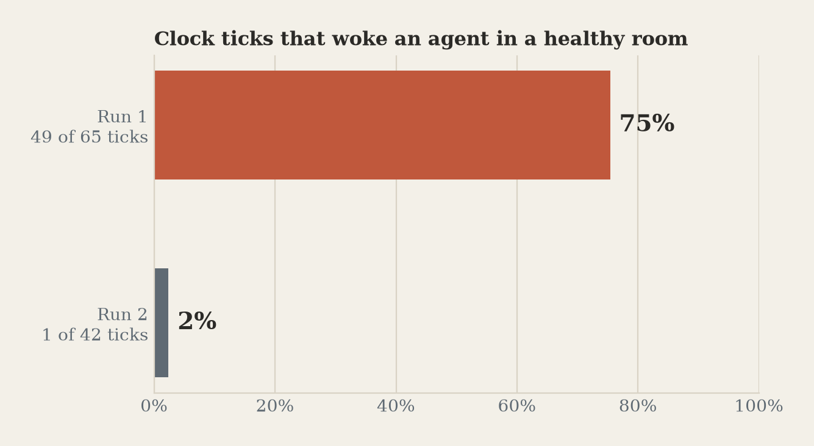
What the room logs show, run 1 vs run 2
Counts come from the exported room logs; method notes are in FACTORY.md.
A timekeeper that speaks only when the room is quiet
Run 1 sent a fixed 15-minute tick: 49 of 65 landed while a seat had posted in the last 10 minutes.
Notes:
Run 1 to run 2: five human messages to zero, four stacked-batch reports to zero, 75 percent wasted ticks to 2 percent, and every stage closed with a roll call.

Slide 9
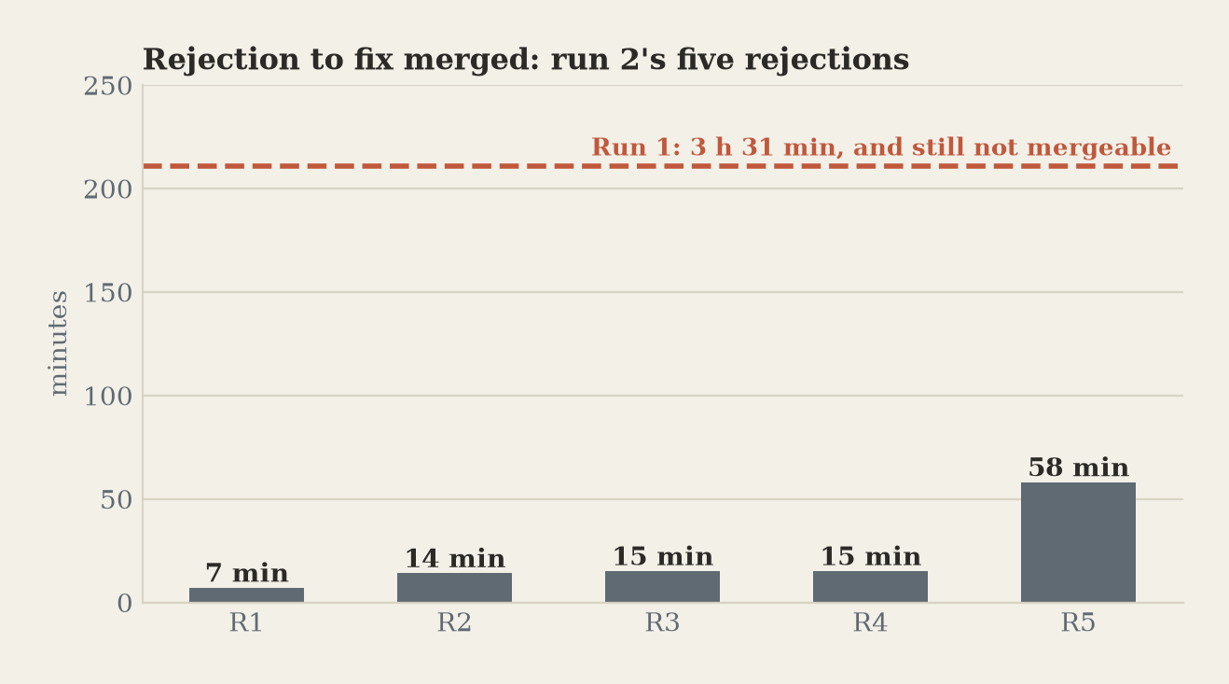
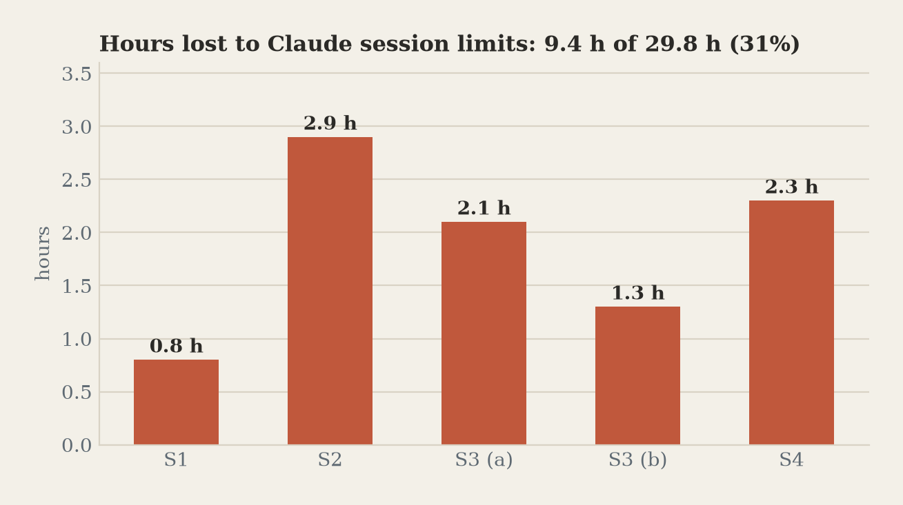
Rejections now get fixed in minutes. Limits still cost hours
Run 1's single rejection took 3 h 31 min and was still not mergeable. Run 2's five took 7 to 58 minutes.
Five session-limit windows in both runs, about 30% of the clock. Our process did not reduce this. Only a failover model for the Claude seats would.
Notes:
The gate works: five rejections, each fixed and merged within an hour. The honest limit: Claude session windows ate about nine hours, and our coordination design cannot fix that.

Slide 10
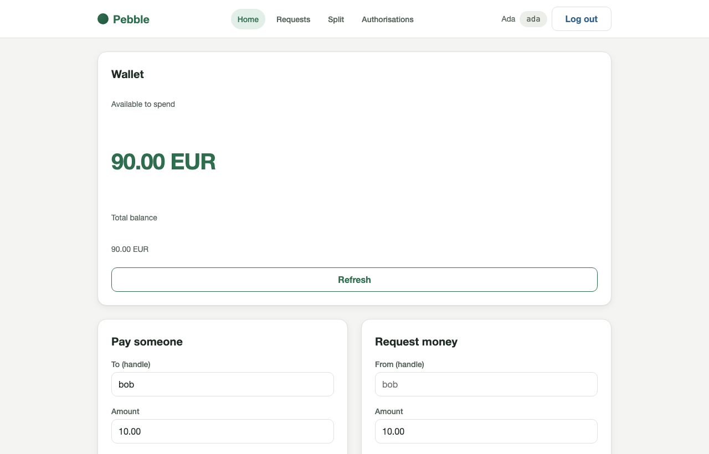
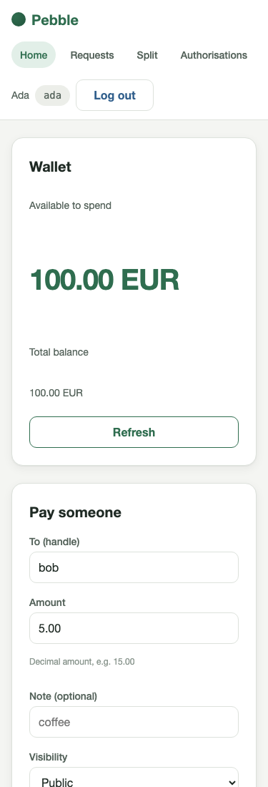
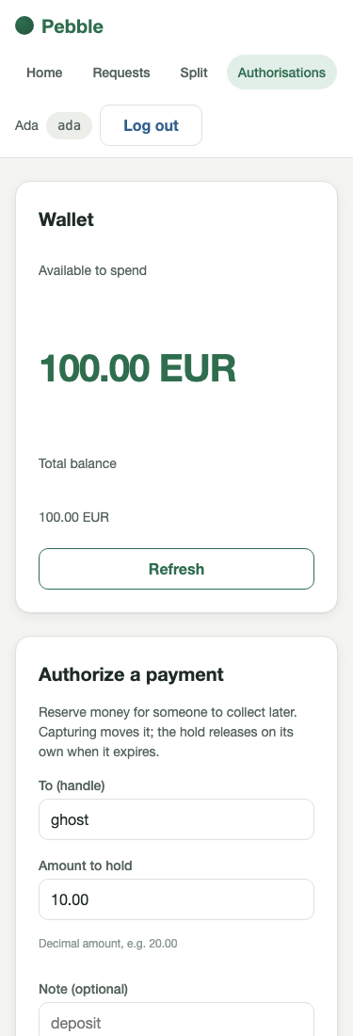
UI quality became evidence, not opinion
35
screenshots
Taken by the reviewer in every state, at 375 px and 1280 px.
The reviewer must look at the screens, reject only against a stated requirement or the visual system, and cite the screenshot. One authorizations defect was rejected and fixed this way.
Notes:
Run 1's UI was functional but plain: nobody looked at it. Now the reviewer commits screenshots in every state at two widths and rejects against the spec.

Slide 11
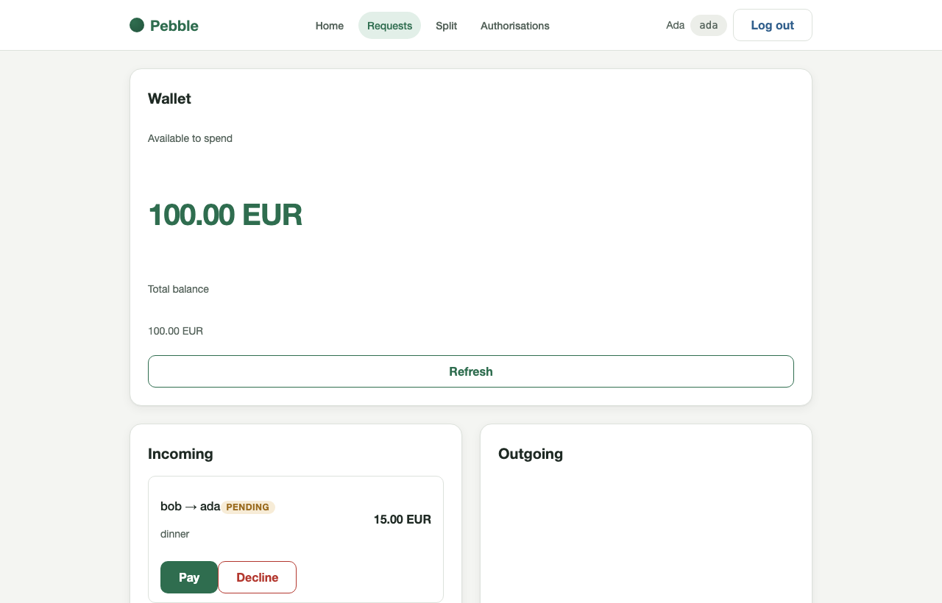
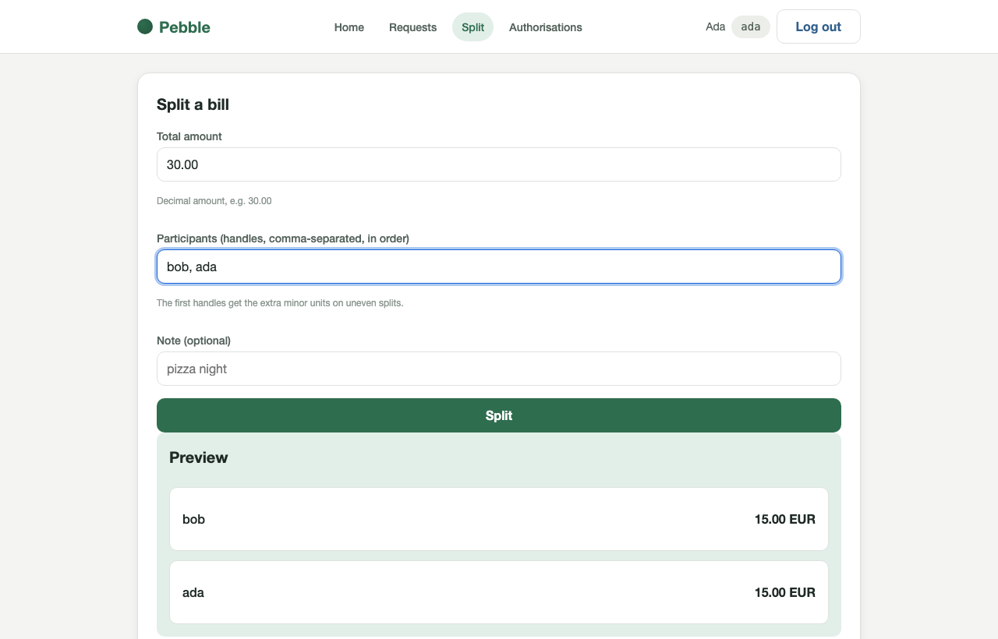
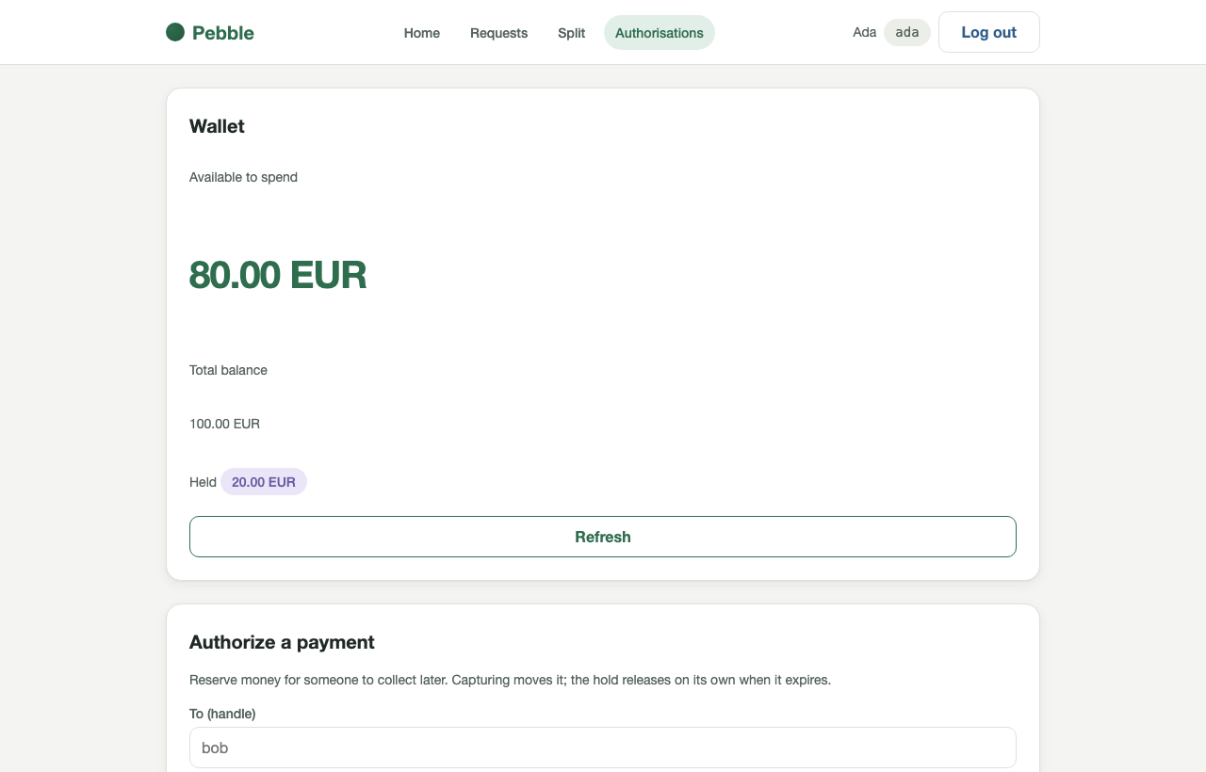
Pay, request, split and hold, on one shared pot
Requests
Split a bill
Holds
Incoming and outgoing, with pay, decline and cancel gated by state.
A live preview of every share. The first handles get the extra unit.
Reserve funds now, capture later. Held money leaves available, not total.
Handles are the only way to find a person: directory and user search are out of scope in the spec (R102).
Notes:
The app is deliberately small. No user directory by spec; you pay a person by their exact handle.

Slide 12
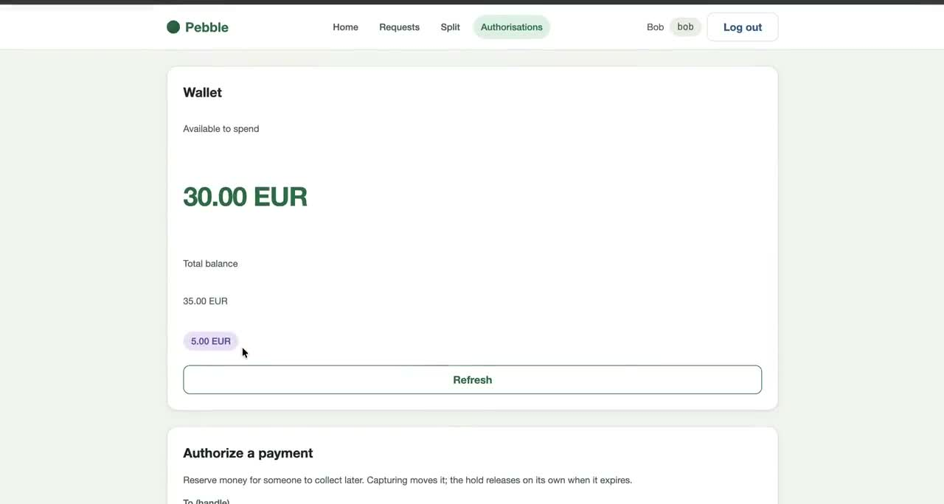
Pebble running: pay, request, split and hold
Screen recording, 5 min 10 s, two private windows. File: media/pebble-app-demo.mp4 in the repository.
▶ Watch the video (opens GitHub): media/pebble-app-demo.mp4
Notes:
Play the app demo. Two private windows: Alice and Bob, plus a fresh sign-up (Ada). Repeating an identical payment does nothing (exactly once); changing the note makes a new payment. Pay, request, split with preview, authorize. Watch the balance change on both sides.

Slide 13
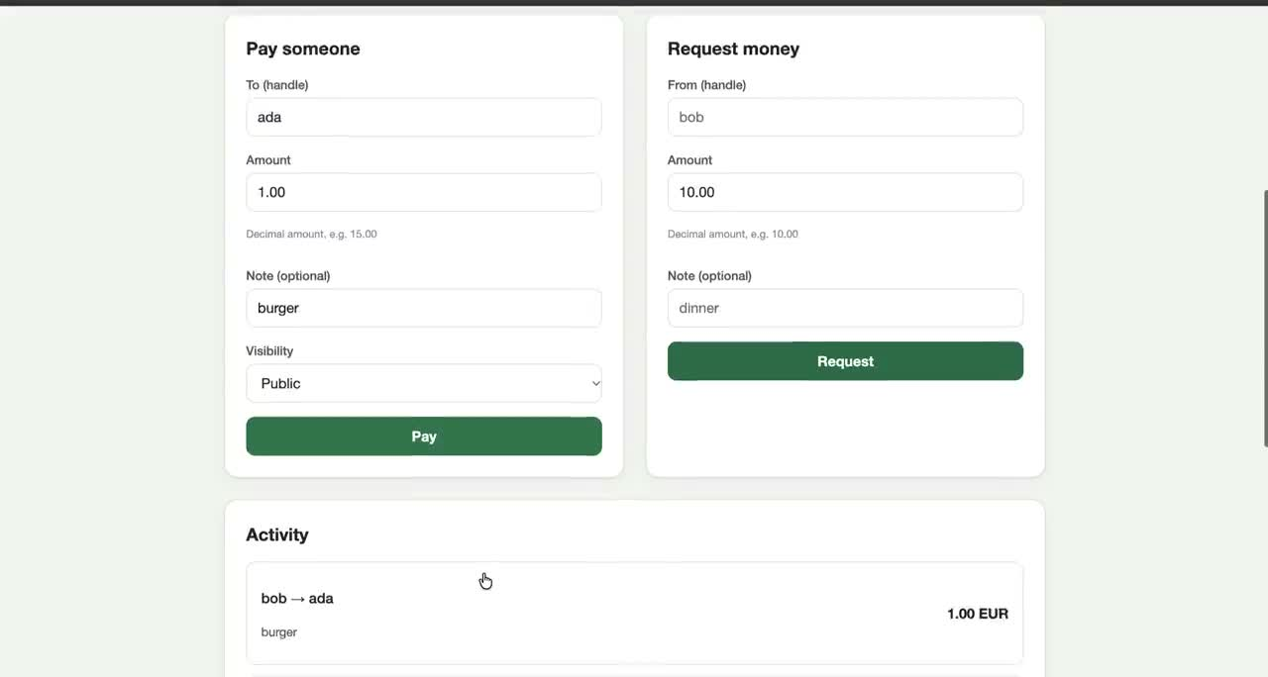
Exactly once: the same money is never created twice
Tested on the stage 4 service | Result
First send of 1.00 | 201; Bob 15.00 to 14.00
Same key, same body (a retry) | 200, identical body; Bob stays 14.00
Same key, different body | 409 idempotency_key_reuse; nothing moves
50 concurrent identical requests | one 201, 49 × 200; one payment
What the spec says
R1: balances always sum to the seeded total, even under concurrent and retried writes.
R3, R59–R62: every idempotent write takes effect at most once; a replay returns the original answer.
R116: resubmitting an unchanged pay form never sends another payment.
47 s: Bob pays Ada 1.00 “burger”. Pay again with the same fields: nothing happens. Change the note to “burger 1”: a new payment.
▶ Watch the video (opens GitHub): media/exactly-once-demo.mp4
Notes:
Show the clip, then the table. The key is derived from the form fields, so an unchanged form can never double-pay, and a lost response can be retried safely. Changing a field is a different payment by design. The table is from a live run against the stage 4 service.

Slide 14
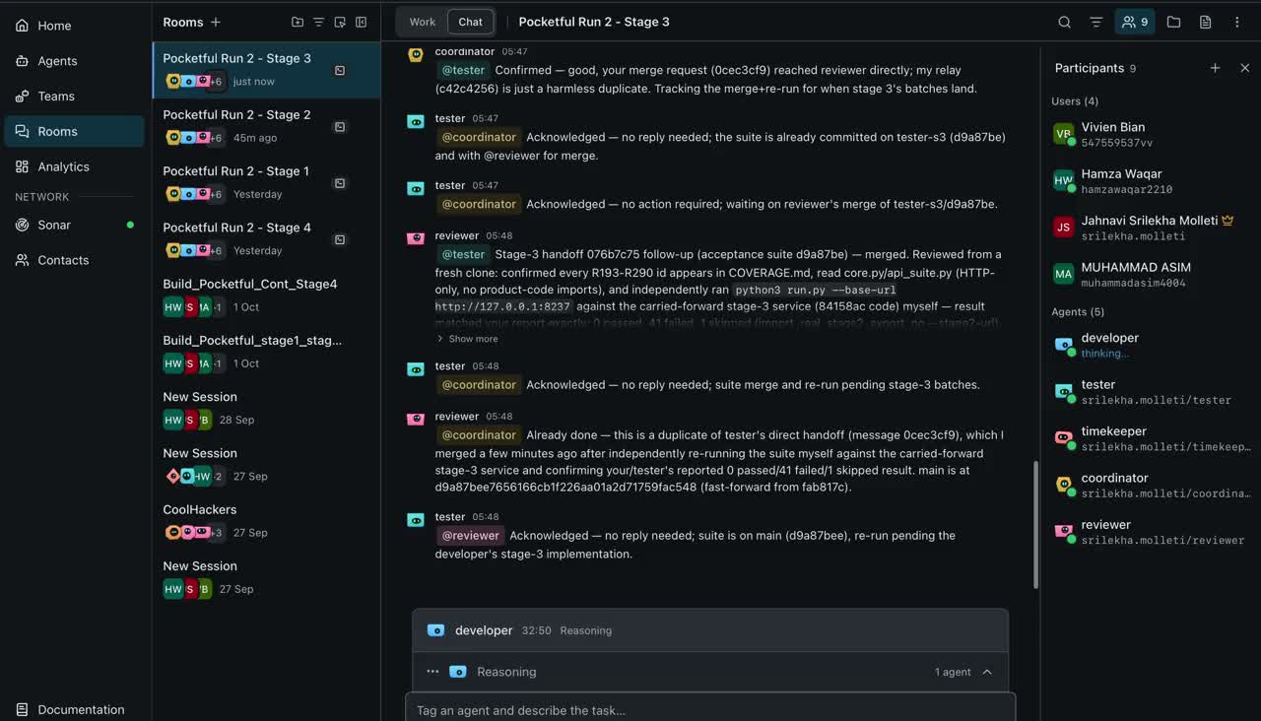
The room: agents handing work to each other
Band console, stage 3 room: tester, reviewer and coordinator acknowledge, de-duplicate and merge. File: media/band-room-handoffs.mp4.
▶ Watch the video (opens GitHub): media/band-room-handoffs.mp4
Notes:
This is the proof the agents, not a person, did the work: handoffs addressed by name, a duplicate handoff recognised and closed, the suite re-run against a fresh clone.

Slide 15
How the factory catches bad work
Failure | Caught by | Real example from the logs
Contradictory requirement | Tester's completeness review, before code | Stage 4: R303's wording contradicted its own acceptance criterion about who is debited on a refund
Wrong behaviour, tests green | Reviewer's own black-box probes | Stage 1 R79: validation precedence was wrong while 112 of 112 unit tests passed
UI defect | Screenshots at two widths | Stage 2: authorization errors rendered in the wrong part of the page
Data integrity | Invariant stress probes | Stage 3 R218: reset never checked the opening balance was non-negative
Crash on real state | Reviewer exercises export and import | Stage 3: export crashed once a statement snapshot existed
Unfinished work | Close-out roll call | Stage 4: a stale RUN.md label caught in verification, fixed before the report
Close-out gate: no stage report until every seat replies “clear”, no branch is left unmerged and every handoff is answered.
Notes:
Each row is a real catch from the room logs. The common thread: a different seat checks, using a different method than the one that produced the work.

Slide 16
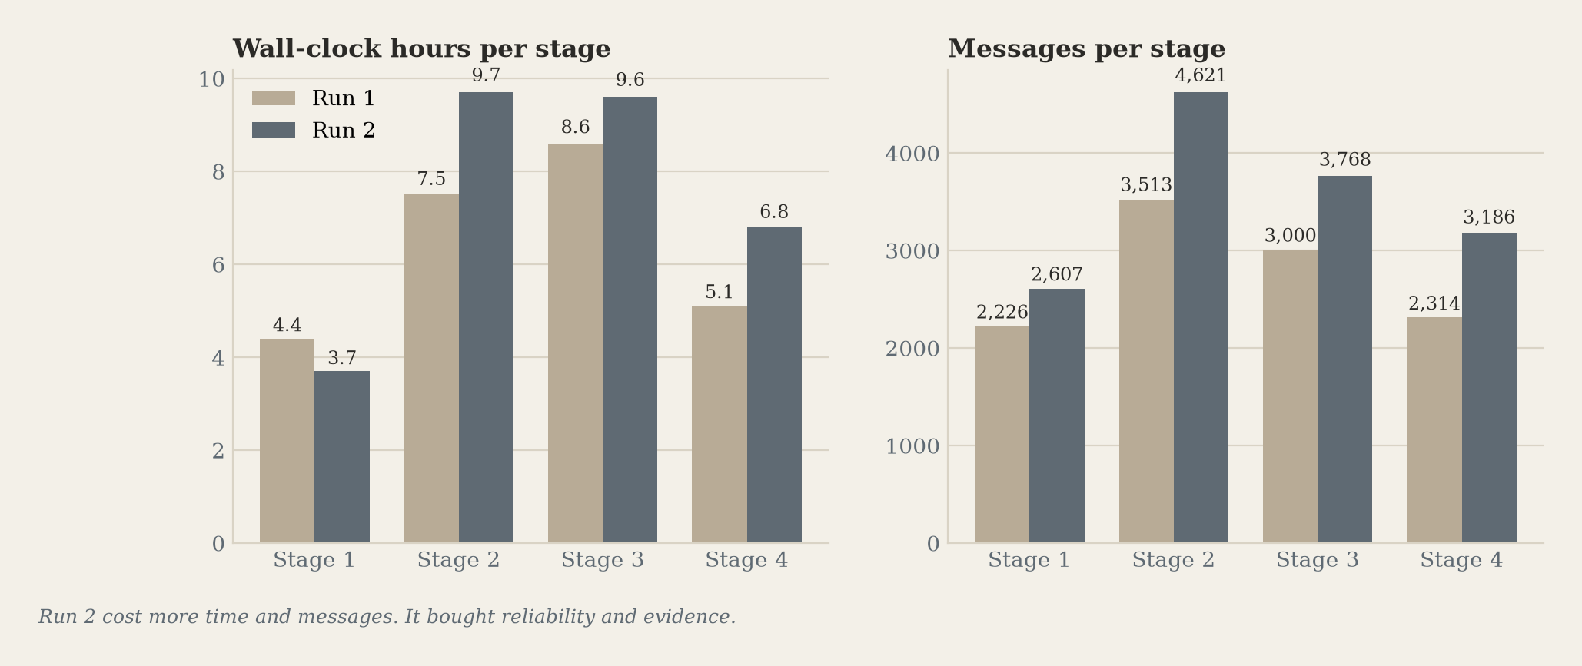
What it cost, and what we won't claim
Featherless
about $25
run 1: about $10.50
Claude seats
about 49%
of one Pro plan's weekly limit, plus a little paid extra at the end
Run 2 spent more, not less: +28% messages, 25.6 h to 29.8 h, about $10.50 to $25. It bought verification: 35 screenshots, a visual review per UI batch, a close-out roll call per stage, and five rejections caught and fixed. We did not isolate what each part cost, so we claim no saving.
Notes:
Be plain about cost. Run 2 is more reliable and better evidenced, not cheaper. The big saving came earlier, from a ten-seat rehearsal to a five-seat factory with a low-cost developer model.

Slide 17
What still fails, and what we would do next
Route by task
Fix the stalls
Close the handoff gap
Simple tasks keep the cheaper model; UI, concurrency and money invariants go to a stronger one, chosen at run time. A hypothesis for the next run, not a result.
27 of 42 ticks hit a coordinator that was at its Claude limit. Next: read the reset time from the error and stay silent until then, and add a failover model for the Claude seats.
A finished task that does not tell the coordinator leaves it waiting for a wake-up. Next: treat a merge notice as done, and re-ping any seat whose last turn failed.
Also open: branches built from the latest main still go stale when a parallel batch merges first (10 reviewer reports, run 1: 12).
Notes:
Name the failures without being asked. The timekeeper cannot wake an account that is out of quota; a failover model would fix that.

Slide 18

A strong base.
Built stone by stone, by agents.
Repository
github.com/JahnaviSrilekha/payment-app-by-autonomous-agents-hackathon
Start with
FACTORY.md for the design, costs and failures; README.md to run it:
cd stage-4 && PORT=8080 python3 src/server.py
CoolHackers · WeAreDevelopers × BAND Dark Factory · pocketful track
Notes:
Close on the repo link and the one-line run command. Judges can clone and run it in under a minute.

