Slide 1
Uninformed Search
Chapter 3
(Based on slides by Stuart Russell, Subbarao Kambhampati, Dan Weld, Oren Etzioni, Henry Kautz, Richard Korf, and other UW-AI faculty)

Slide 2
What is a State?
All information about the environment
All information necessary to make a decision for the task at hand.

Slide 3
Agent’s Knowledge Representation
Type | State representation | Focus
Atomic | States are indivisible; No internal structure | Search on atomic states;
Propositional (aka Factored) | States are made of state variables that take values (Propositional or Multi- valued or Continuous) | Search+inference in logical (prop logic) and probabilistic (bayes nets) representations
Relational | States describe the objects in the world and their inter-relations | Search+Inference in predicate logic (or relational prob. Models)
First-order | +functions over objects | Search+Inference in first order logic (or first order probabilistic models)

Slide 4
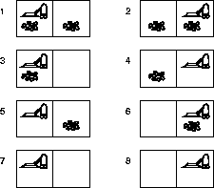
Illustration with Vacuum World
Propositional/Factored:
States made up of 3 state variables Dirt-in-left-room T/F
Dirt-in-right-room T/F Roomba-in-room L/R
Each state is an assignment of Values to state variables
2³ Different states
Atomic:
S1, S2…. S8
state is seen as an indivisible snapshot
All Actions are SXS matrices..
Actions can just mention the variables they affect
If you add a second roomba the state space doubles
Note that the representation is compact (logarithmic in the size of the state space)
Relational:
World made of objects: Roomba; L-room, R-room Relations: In (<robot>, <room>); dirty(<room>)
If you add a second roomba, or more rooms, only the objects increase.
If you want to consider noisiness
Of the rooms, the representation
Quadruples..
If you add a second roomba, the Representation increases by just one More state variable.
If you want to consider “noisiness” of rooms, we need two variables, one for Each room
If you want to consider noisiness, you just need to add one other relation

Slide 5
Atomic Agent
Input:
Set of states
Operators [and costs]
Start state
Goal state [test]
Output:
Path: start ⇒ a state satisfying goal test
[May require shortest path]
5

Slide 6
Why is search interesting?
Many (all?) AI problems can be formulated as search problems!
Examples:
Path planning
Games
Natural Language Processing
Machine learning
…

Slide 7
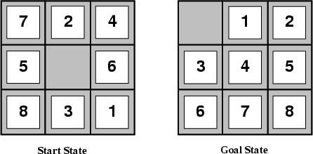
Example: The 8-puzzle
states?
actions?
goal test?
path cost?

Slide 8
Example: The 8-puzzle
states? locations of tiles
actions? move blank left, right, up, down
goal test? = goal state (given)
path cost? 1 per move
•
[Note: optimal solution of n-Puzzle family is NP-hard]

Slide 9
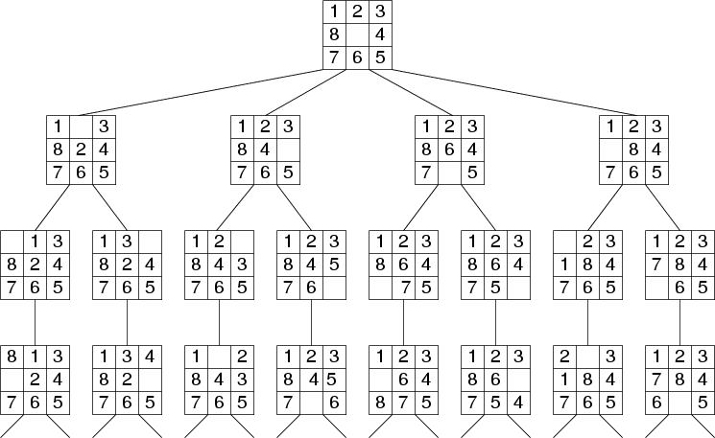
Search Tree Example: Fragment of 8-Puzzle Problem Space

Slide 10
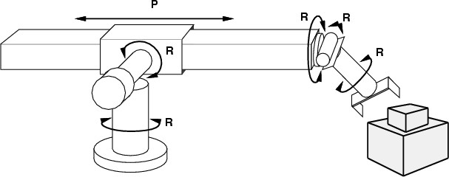
Example: robotic assembly
states?: real-valued coordinates of robot joint angles parts of the object to be assembled
•
actions?: continuous motions of robot joints
•
goal test?: complete assembly
•
path cost?: time to execute
•

Slide 11
Example: Romania
On holiday in Romania; currently in Arad.
Flight leaves tomorrow from Bucharest
•
Formulate goal:
be in Bucharest
–
Formulate problem:
states: various cities
actions: drive between cities
–
Find solution:
sequence of cities, e.g., Arad, Sibiu, Fagaras, Bucharest
–

Slide 12
Example: N Queens
Input:
Set of states
Operators [and costs]
Start state
Goal state (test)
Output
 |  | Q
Q
 |  |  | Q
 | Q

Slide 13
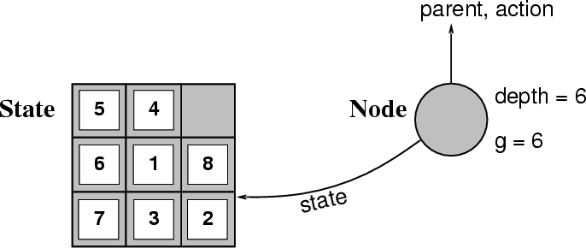
Implementation: states vs. nodes
A state is a (representation of) a physical configuration
A node is a data structure constituting part of a search tree includes state, parent node, action, path cost g(x), depth
The Expand function creates new nodes, filling in the various fields and using the
SuccessorFn of the problem to create the corresponding states.
•

Slide 14
Search strategies
A search strategy is defined by picking the order of node expansion
Strategies are evaluated along the following dimensions:
completeness: does it always find a solution if one exists?
time complexity: number of nodes generated
space complexity: maximum number of nodes in memory
optimality: does it always find a least-cost solution?
systematicity: does it visit each state at most once?
Time and space complexity are measured in terms of
b: maximum branching factor of the search tree
d: depth of the least-cost solution
m: maximum depth of the state space (may be ∞)

Slide 15
Uninformed search strategies
Uninformed search strategies use only the information available in the problem definition
Breadth-first search
Depth-first search
Depth-limited search
Iterative deepening search

Slide 16
Depth First Search
Maintain stack of nodes to visit
Evaluation
– Complete?
No
– Time Complexity?
O(b^{m})
O(bm)
a
– Space Complexity?
b
c
d
e
f
g
h

Slide 17
Breadth First Search: shortest first
Maintain queue of nodes to visit
Evaluation
– Complete?
Yes (b is finite)
– Time Complexity?
O(b^{d})
O(b^{d})
a
– Space Complexity?
b
c
– Optimal?
Yes, if stepcost=1
d
e
f
g
h

Slide 18
Uniform Cost Search: cheapest first
Maintain queue of nodes to visit
Evaluation
– Complete?
Yes (b is finite)
– Time Complexity?
_{O(b}(C*/e)₎
_{O(b}(C*/e)₎
a
1
b
– Space Complexity?
5
c
– Optimal?
Yes
2
6
1
3
4
d
e
f
g
h

Slide 19

DFS
http://www.youtube.com/watch?v=dtoFAvtVE4U

Slide 20

UCS
http://www.youtube.com/watch?v=z6lUnb9ktkE

Slide 21
Memory Limitation
Suppose:
2 GHz CPU
1 GB main memory
100 instructions / expansion 5 bytes / node
200,000 expansions / sec
Memory filled in 100 sec
… < 2 minutes
23

Slide 22
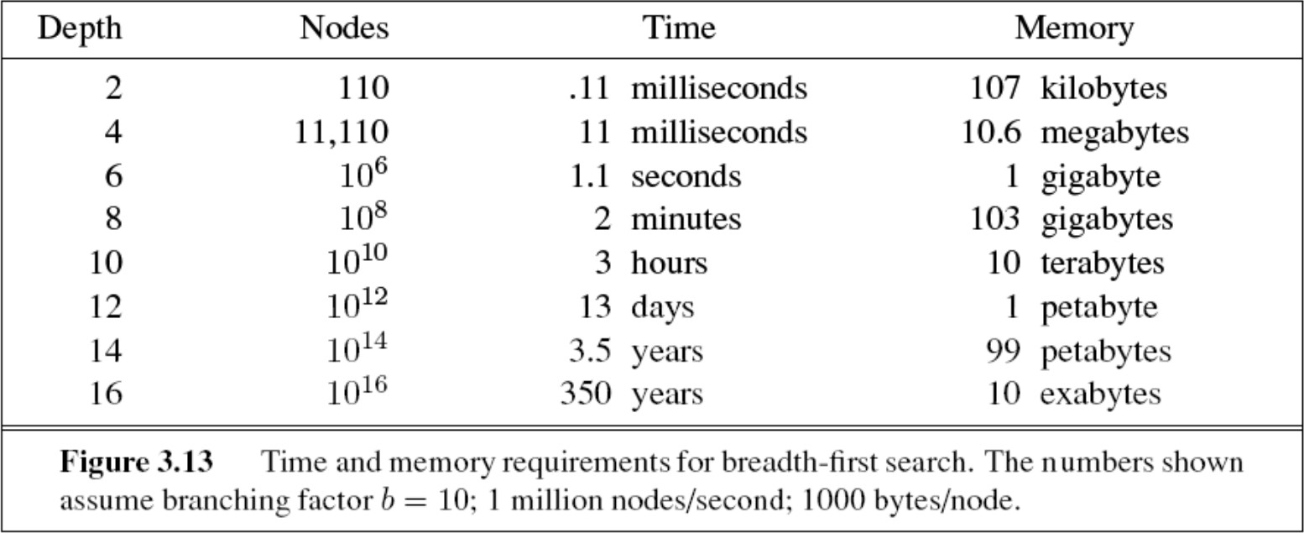
Time vs. Memory

Slide 23
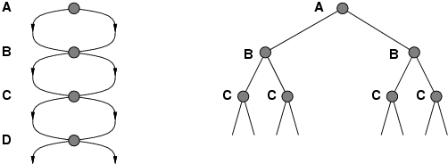
Repeated states
Failure to detect repeated states can turn a linear problem into an exponential one!
•

Slide 24
Idea 1: Beam Search
Maintain a constant sized frontier
Whenever the frontier becomes large
– Prune the worst nodes
Optimal: no Complete: no

Slide 25
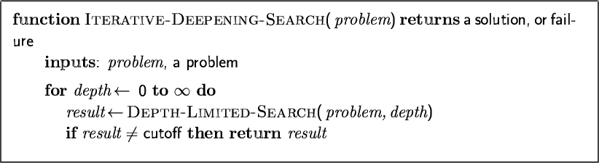
Idea 2: Iterative deepening search

Slide 26
Iterative deepening search l =0

Slide 27
Iterative deepening search l =1

Slide 28
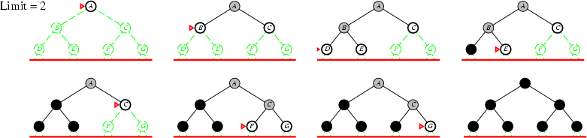
Iterative deepening search l =2

Slide 29
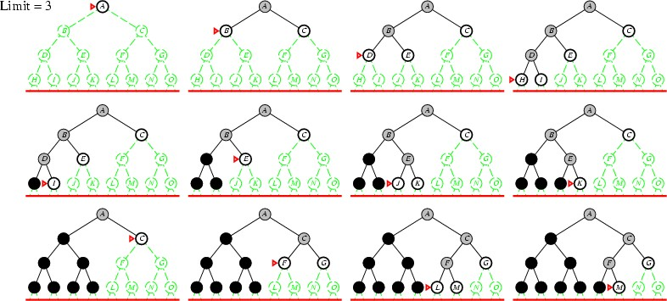
Iterative deepening search l =3

Slide 30
Iterative deepening search
Number of nodes generated in a depth-limited search to depth d with branching factor b:
N_{DLS} = b⁰ + b¹ + b² + … + b^{d-2} + b^{d-1} + b^{d}
Number of nodes generated in an iterative deepening search to depth d with branching factor b:
N_{IDS} = (d+1)b⁰ + d b^¹ + (d-1)b^² + … + 3b^{d-2} +2b^{d-1} + 1b^{d}
Asymptotic ratio: (b+1)/(b-1)
For b = 10, d = 5,
•
– N_{DLS} = 1 + 10 + 100 + 1,000 + 10,000 + 100,000 = 111,111
–
– N_{IDS} = 6 + 50 + 400 + 3,000 + 20,000 + 100,000 = 123,456
–
Overhead = (123,456 - 111,111)/111,111 = 11%

Slide 31
Iterative deepening search
Complete?
Yes
Time?
– (d+1)b⁰ + d b¹ + (d-1)b² + … + b^{d} = O(b^{d})
Space?
O(bd)
Optimal?
Yes, if step cost = 1
Can be modified to explore uniform cost tree (iterative lengthening)
Systematic?

Slide 32
Cost of Iterative Deepening
b | ratio ID to DLS
2 | 3
3 | 2
5 | 1.5
10 | 1.2
25 | 1.08
100 | 1.02

Slide 33
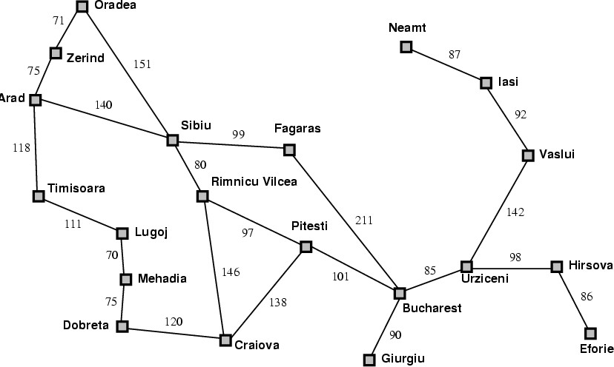
Forwards vs. Backwards
35

Slide 34
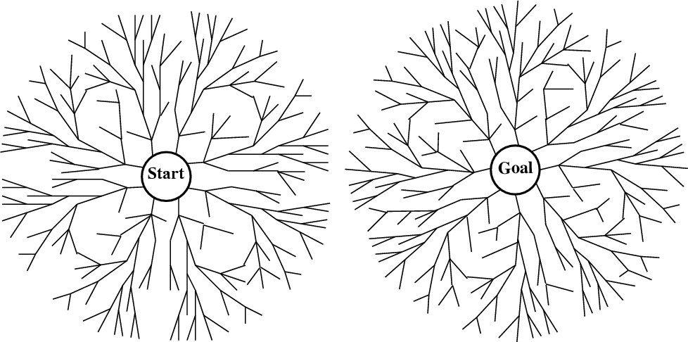
vs. Bidirectional
When is bidirectional search applicable?
Generating predecessors is easy
Only 1 (or few) goal states
36

Slide 35
Bidirectional search
Complete? Yes
Time?
– O(b^{d/2})
Space?
– O(b^{d/2})
Optimal?
– Yes if uniform cost search used in both directions

Slide 36
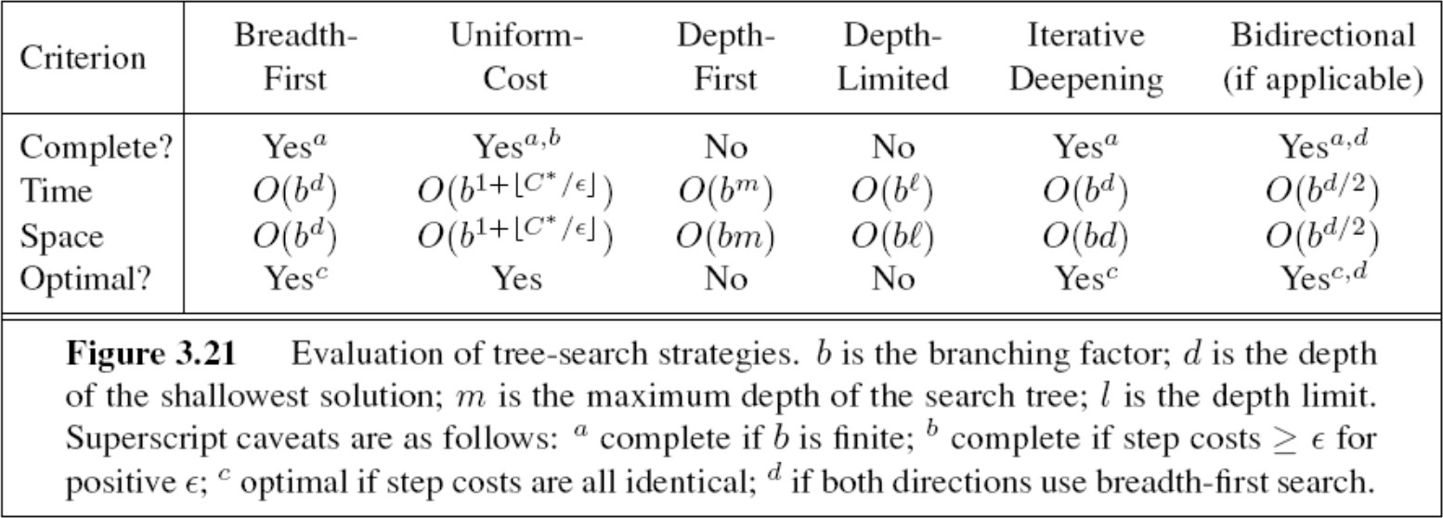
Summary of algorithms

Slide 37
A,B,G A,B,C,D,G
BFS:
DFS:
A
B
IDDFS:(A), (A, B, G)
Note that IDDFS can do fewer expansions than DFS on a graph
C
D
G
shaped search space.

Slide 38
A,B,G A,B,A,B,A,B,A,B,A,B
BFS:
A
DFS:
B
IDDFS:
(A), (A, B, G)
Note that IDDFS can do fewer expansions than DFS on a graph shaped search space.
C
D
G
Search on undirected graphs or directed graphs with cycles…
Cycles galore…

Slide 39
Graph (instead of tree) Search: Handling repeated nodes
Repeated expansions is a bigger issue for DFS than for BFS or IDDFS
Trying to remember all previously expanded nodes and comparing the new nodes with them is infeasible
Space becomes exponential
duplicate checking can also be expensive
Partial reduction in repeated expansion can be done by
Checking to see if any children of a node n have the same state as the parent of n
Checking to see if any children of a node n have the same state as any ancestor of n (at most d ancestors for n—where d is the depth of n)

Slide 40
Breadth-First goes level by level

Slide 41
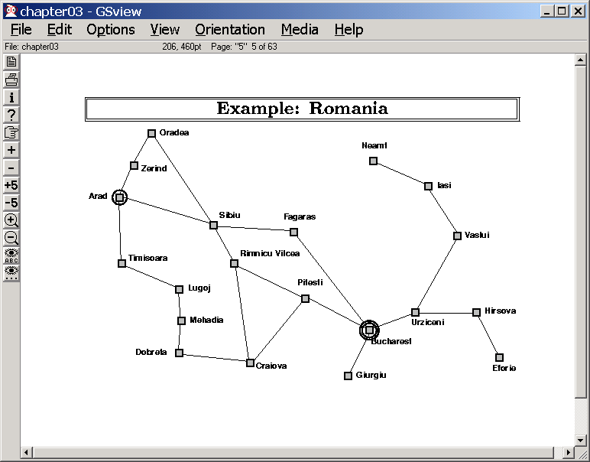
Visualizing Breadth-First & Uniform Cost Search
This is also a proof of optimality…
Breadth-First goes level by lev

Slide 42

Problem
All these methods are slow (blind)
© Jen Theodore
Solution → add guidance (“heuristic estimate”)
→ “informed search”
44

