Slide 1
BOX OFFICE PREDICTOR – ESTIMATING MOVIE REVENUES USING MACHINE LEARNING

Slide 2
Project Overview
Aim: Predict movie box office revenue using machine learning (ML).
Dataset: IMDb dataset from Kaggle.
Approach: Applied regression models with feature engineering and evaluation metrics.
Best Model: XGBoost with R² = 0.513.

Slide 3

Industry Context & Research Question
Current Trends:
Rise in production costs and digital distribution.
Use of ML for performance forecasting.
Research Question: What metadata most affects box office performance? How accurate are ML models in predicting revenue?

Slide 4

Objectives
Feature Selection: Filter and retain only the most significant features from the IMDb movie dataset.
Exploratory Data Analysis (EDA): Analyze relationships between metadata features (e.g., genre, rating, director) and box office revenue.
Model Development: Train and evaluate multiple machine learning models to predict movie revenue.
Model Evaluation: Compare models using standard performance metrics — RMSE, MAE, and R² Score — to identify the most effective one.
Feature Importance Analysis: Determine which metadata features contribute most to accurate revenue prediction.

Slide 5
Literature Insights
Ensemble models outperform linear ones (Li & Liu, 2022).
EDA improves feature selection (Murschetz et al., 2020).
Deep multimodal models like DMPCNN can enhance predictions (Madongo et al., 2024).
Common ML Models Used: Random Forest, Gradient Boosting, XGBoost, SVR.

Slide 6
Dataset and Features
Source: IMDb Movie Dataset on Kaggle (https://www.kaggle.com/datasets/yusufdelikkaya/imdb-movie-dataset)
Features Used: Title, Genre, Director, Year, Runtime, Rating, Votes, Meta score, Revenue
Data Cleaning Steps:
Dropped null values for essential fields
Encoded categorical features
Removed duplicates to ensure data quality

Slide 7
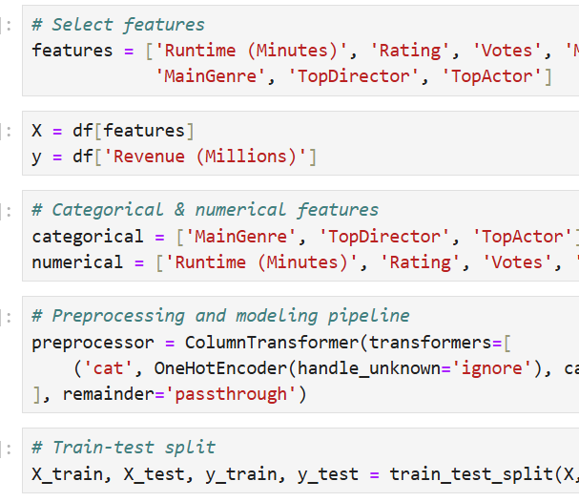
Methodology
🔧 Data Preprocessing
Handled missing values using Simple Imputer
Applied One-Hot Encoding to categorical features
Performed Normalization on numerical data
🧠 Feature Engineering
Created a new feature: Rating × Votes (Rating_Votes)
Simplified genre categories for clarity
Grouped infrequent actors and directors under "Other" to reduce noise
🤖 Models Trained
Linear Regression
Decision Tree
Random Forest
XGBoost

Slide 8
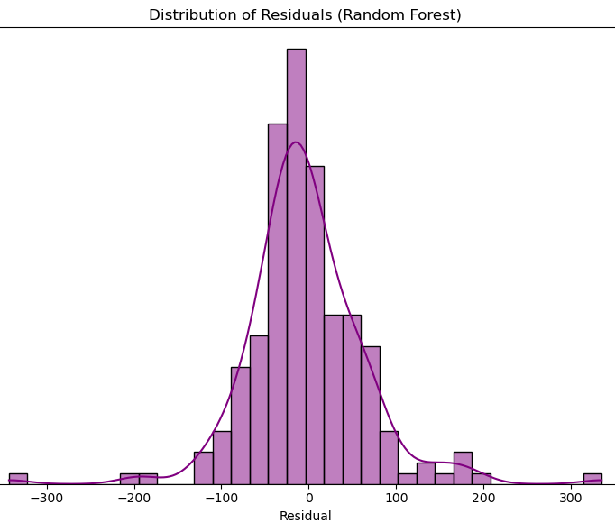
Evaluation Metrics
MAE (Mean Absolute Error): Measures the average magnitude of errors in predictions.
RMSE (Root Mean Squared Error): Similar to MAE but penalizes larger errors more heavily
R² Score (Coefficient of Determination): Indicates how well the model explains the variance in the target variable
Plots Used: Actual vs Predicted Plot
Residual Distribution Plot

Slide 9
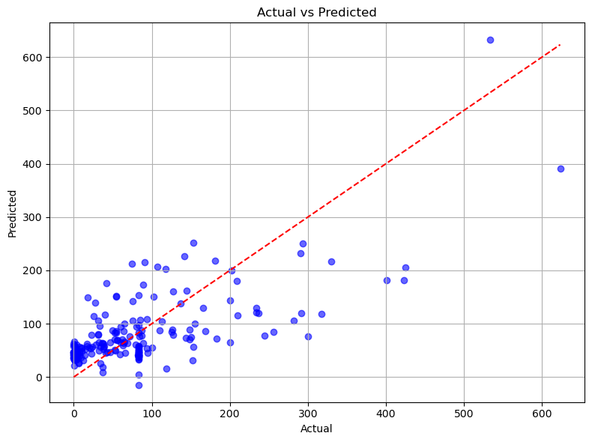
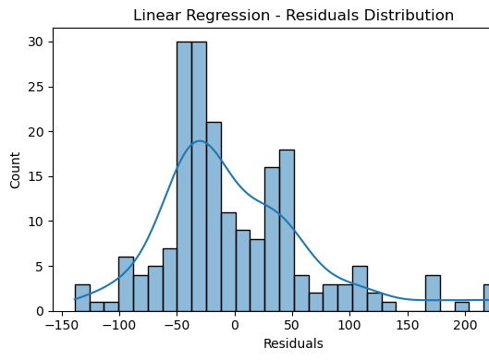
Results
The evaluation results showed that ensemble models, particularly Random Forest and XGBoost, outperformed traditional models like Linear Regression and Decision Tree in predicting outcomes from the dataset.
XGBoost achieved the highest R² score of 0.513, followed by Random Forest with 0.503, indicating their superior ability to capture non-linear and complex relationships within the data.
In comparison, Linear Regression and Decision Tree delivered lower R² scores of 0.488 and 0.379, respectively, highlighting their limitations with complex feature interactions.

Slide 10
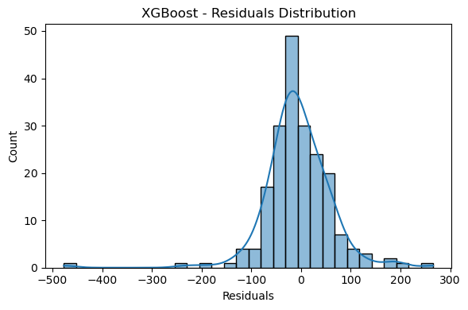
Analysis & Discussion
Ensemble models like Random Forest and XGBoost combine multiple decision trees to improve prediction accuracy and reduce the risk of overfitting.
By aggregating the outcomes of diverse learners, these models achieve strong generalization, especially on noisy or complex datasets.
This makes them well-suited for tasks involving movie metadata, where relationships between features—such as genre, rating, and box office revenue—are often non-linear
The residual distribution supports the model’s robustness, with most errors clustering closely around zero.

Slide 11

Conclusion & Recommendations
The findings suggest that ensemble-based models, particularly Random Forest, are well-suited for regression tasks involving a mix of categorical and numerical variables.
These models effectively capture non-linear relationships and feature interactions, such as those between ratings, votes, meta score, and genre.
For future work, incorporating additional predictive variables—such as movie budget, release month, production studio, and social media sentiment—could further enhance model performance.

Slide 12
Reference list
Murschetz, P.C., Bruneel, C., Guy, J.-L., Haughton, D., Lemercier, N., McLaughlin, M.-D., Mentzer, K., Vialle, Q., Zhang, C., Murschetz, P.C. and Bakhtawar, B. (2020). ‘Movie Industry Economics: How Data Analytics Can Help Predict Movies’ Financial Success’. Nordic Journal of Media Management, 1(3), pp.339–359. (Available at: doi:https://doi.org/10.5278/njmm.2597-0445.5871)
Oyewola, D.O. and Dada, E.G., 2022. Machine learning methods for predicting the popularity of movies. Journal of Artificial Intelligence and Systems, 4(1), pp.65-82.
Tang, S., 2024. The box office prediction model based on the optimized XGBoost algorithm in the context of film marketing and distribution. Plos one, 19(10), p.e0309227.
Udandarao, V. and Gupta, P., 2024. Movie revenue prediction using machine learning models. arXiv preprint arXiv:2405.11651.
Wang, D., Wu, Y., Gu, C., Wang, Y., Zhu, X., Zhou, W. and Lin, X.M., 2022. A movie box office revenues prediction algorithm based on human-machine collaboration feature processing. Journal of Engineering Research.

Slide 13
THANK YOU

