Slide 1

Human Resources
Employee Satisfaction Survey
Analysis of survey results and ideas to improve employee morale
Jahnvi Singh
UID: 26BCD10396 | BCA in Data Science
Notes:
Hello everyone. Today I will present my project on the HR employee satisfaction survey, which I analysed using Excel.

Slide 2
Introduction and how the survey was done
Why a satisfaction survey?
1
Find the strongest and weakest factors
Unhappy employees affect the quality of work and often leave. A survey shows how people really feel, so problems can be fixed early.
2
Compare the five departments
3
Suggest practical steps to improve morale
30
5
5
1 to 5
employees
departments
factors rated
rating scale
Notes:
The goal is to analyse the survey and suggest improvements. 30 employees from IT, HR, Marketing, Sales and Finance rated five factors from 1 to 5 and also said whether they would recommend the company. Only employee IDs were used, so answers stay anonymous.

Slide 3
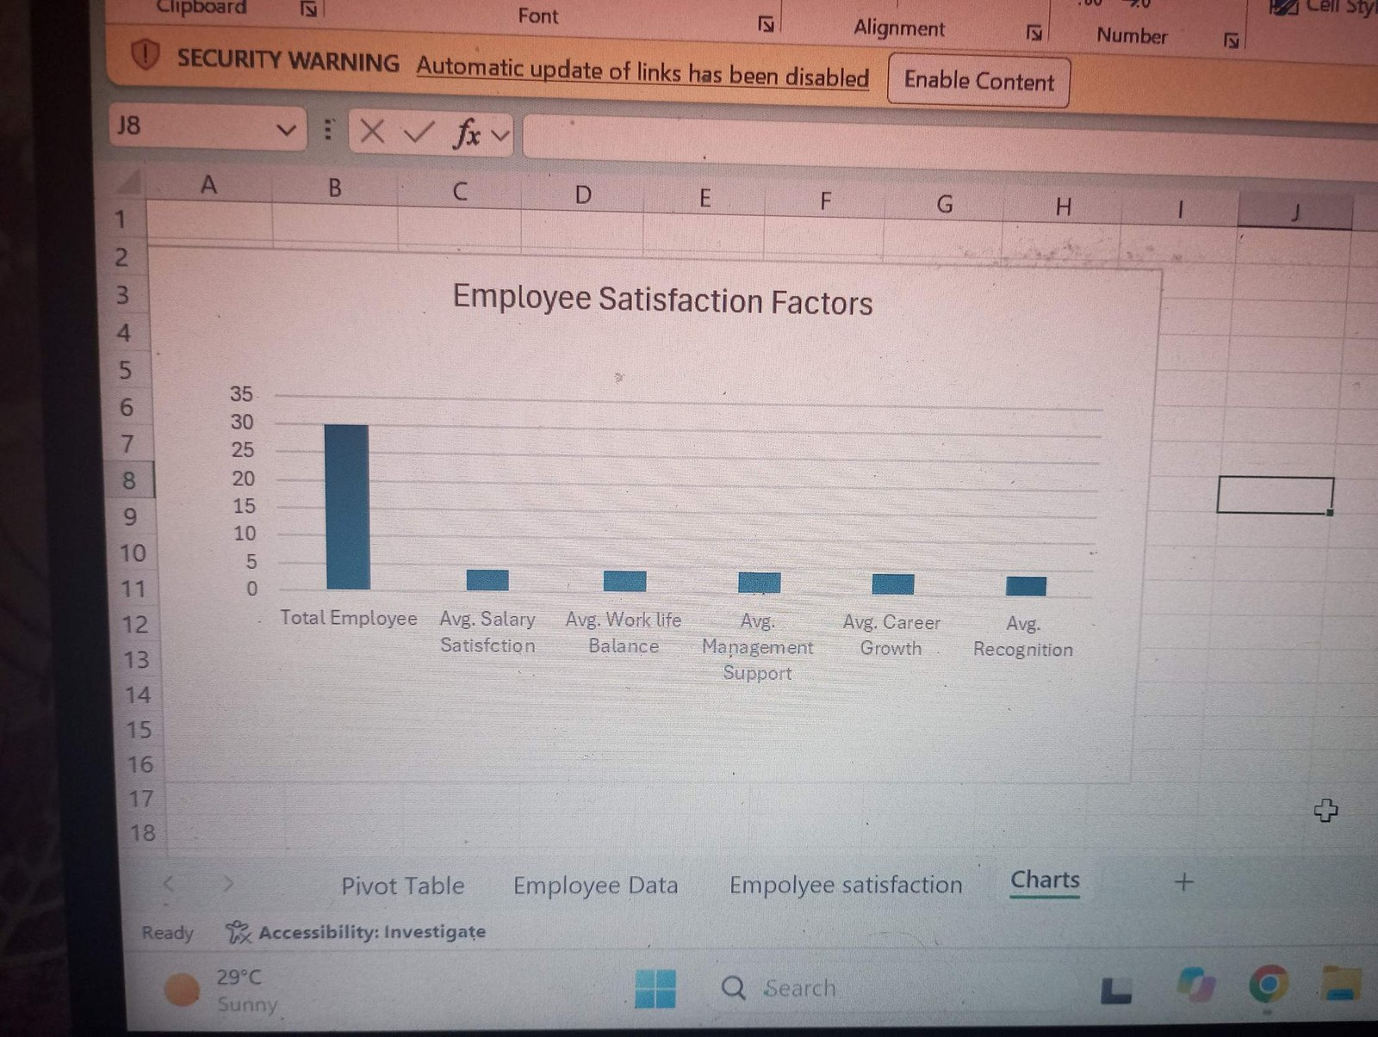
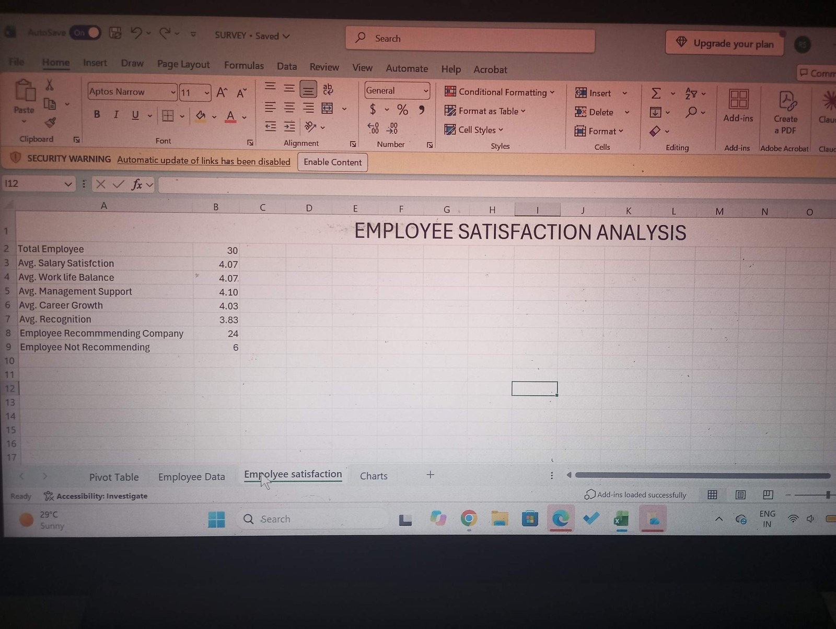
Overall satisfaction factors
Recognition (3.83) is the lowest rating. The first bar in the chart is total employees (30).
Notes:
All factors are above 3.8, which is good. But recognition is the lowest, and it is the only one below 4.

Slide 4
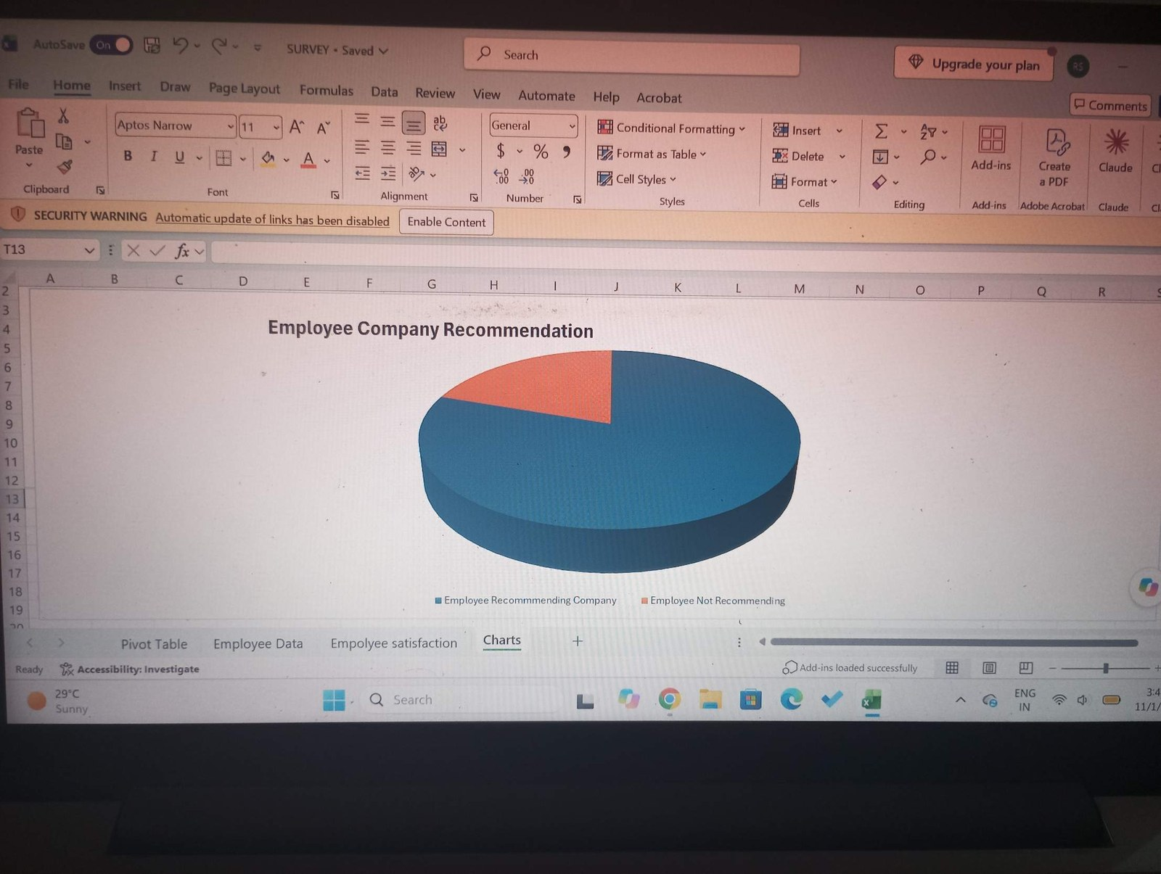
Would employees recommend the company?
24
would recommend
6
would not recommend
80%
said Yes overall
Notes:
Out of 30 employees, 24 said yes and 6 said no. That is 80 percent, which is good, but I wanted to see where the 6 come from.

Slide 5
Department-wise scores
Department | Salary | Work-Life | Mgmt Support | Career | Recognition
Finance | 3.25 | 3.75 | 3.75 | 4.25 | 3.50
HR | 4.40 | 4.00 | 4.60 | 3.80 | 3.80
IT | 4.29 | 4.29 | 4.00 | 4.57 | 4.29
Marketing | 4.00 | 3.40 | 3.20 | 3.60 | 3.00
Sales | 4.11 | 4.44 | 4.56 | 3.89 | 4.11
All employees | 4.07 | 4.07 | 4.10 | 4.03 | 3.83
Red = lowest score in that column. Marketing is lowest in four of the five factors.
Notes:
These numbers come from my pivot table. Marketing has the lowest value in four columns, and Finance has the lowest salary satisfaction.

Slide 6
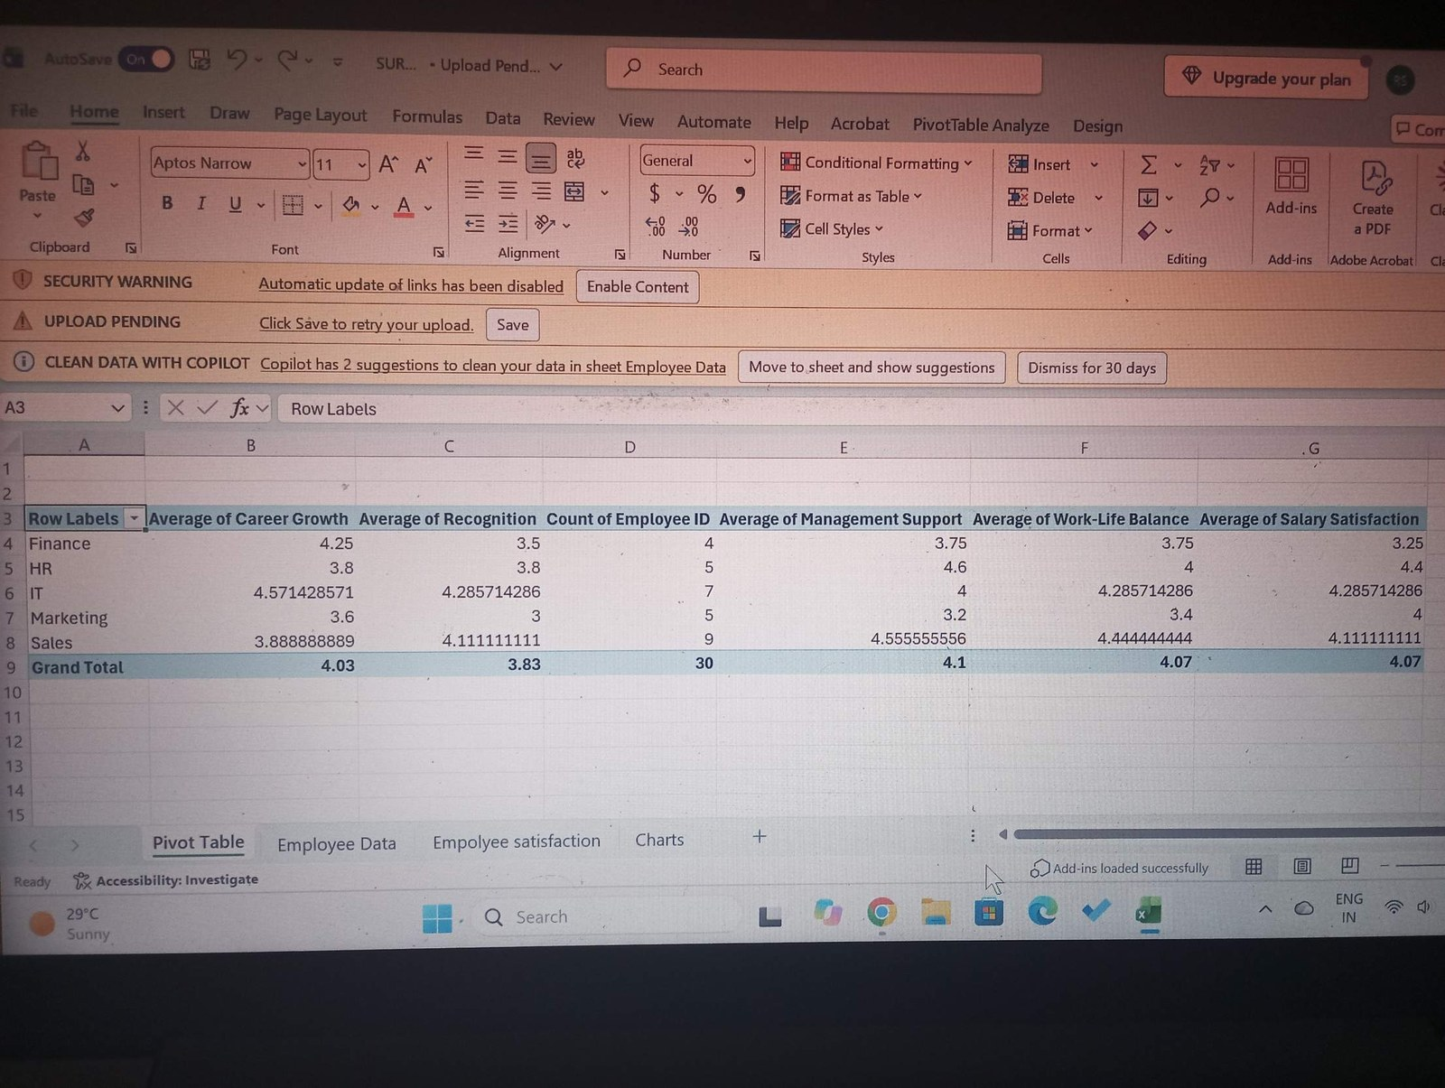
Pivot table from Excel
Group
Departments go in the rows, so each one gets its own average.
Count
Sales has 9 employees and Finance only 4, so Finance averages can change quickly.
Total
The grand total row gives the company-wide averages.
Notes:
This is the pivot table from my Excel file. It saved me from calculating each department by hand.

Slide 7
Recommendation by department
IT
HR
Sales
Marketing
Finance
100%
100%
78%
80%
25%
7 of 7 said Yes
5 of 5 said Yes
7 of 9 said Yes
4 of 5 said Yes
1 of 4 said Yes
IT and HR are fully positive. Half of all the No answers (3 of 6) come from Finance, even though it is the smallest department.
Notes:
This was my biggest finding. Only one of four Finance employees would recommend the company.

Slide 8
Areas of concern and what to do
1
Recognition
2
Marketing
3
Finance
Problem
Problem
Problem
Lowest factor overall (3.83) and only 3.00 in Marketing.
Lowest in management support, work-life balance, career growth and recognition.
Lowest salary satisfaction (3.25). Only 1 of 4 would recommend.
Suggestion
Suggestion
Suggestion
Start monthly appreciation, regular feedback and small rewards.
Talk with the team, check workload and offer a clear promotion path.
Compare pay with the market and talk privately with the team.
Notes:
These are the three places where the management should look first, with one practical step for each. I also suggest repeating the survey every six months.

Slide 9
Conclusion
The company is doing fairly well. Every factor scored above 3.8 out of 5.
Recognition is the weakest factor, and Marketing and Finance need the most attention.
Looking at departments, not just overall averages, showed hidden problems.
The sample is small (30 people), so the results are a guide, not final proof.
80%
of employees would recommend the company
Notes:
To sum up: the results are good overall, but recognition, Marketing and Finance need work.

Slide 10
Thank You
Any questions?
Jahnvi Singh | UID: 26BCD10396 | BCA in Data Science
Notes:
Thank you for listening. I am happy to answer any questions.

