Slide 1
Healthy Beats
Prepared By:
Jahnvi Gandhi
(001665157)

Slide 2
Problem Statement
To identify the causes for different health issues, depending upon various nutrients consumed throughout the day,
is a crucial task to keep the community healthy. This will help in learning how people's health gets affected
and eventually finding solutions to improve their health quality.

Slide 3
Proposed Solution
Our bodies are complicated machines that don't always offer immediate signs when there's a problem. Unfortunately, humans don't have a dashboard that lights up when we need maintenance. This is where tracking vital signs comes into play. Keeping up with blood pressure and pulse, for example, can give us insight into how our "engine" is running.
Monitoring vital signs is a simple habit that ultimately helps manage medical issues, point out potential health threats and avoid future health problems.

Slide 4
Solution (Conti.)
Along with constantly monitoring the fluctuations in vital sign, to support the identification of the issues causing some of the basic health problems, nutrients consumed throughout the day are monitored using the concept of IoT.
The patterns analyzed in vital signs based on the nutrients consumed are the likely solutions to derive what changes can be done the food habits to improve the health on daily basis.

Slide 5
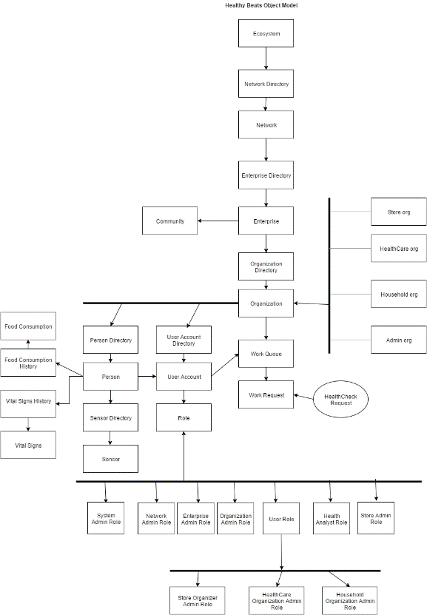
Object Model

Slide 6
Key Roles
System Admin – To monitor entire system
Network Admin – To monitor the communities which are part of the network
Enterprise Admin - To monitor the community (enterprise) and identify how the health of the community can be improved as a whole
Health Analyst – Responsible to perform all the analysis to identify how the changes in food consumption affects vital signs and to determine the likely health problems based on the analysis
User Role – The main role performed by the person whose vital signs and nutrient consumptions are monitored using sensors.

Slide 7
Key Roles
House Hold Organization Admin – To manage the houses/house holds which makes the community
Health Care Organization Admin – Responsible to monitor the relationships between the captured vital signs and consumed nutrients
Store Organization Admin/Store Admin – Manages the product purchase and consumption cycle [enhancement]

Slide 8
Features
Capture vital signs and nutrient consumption details using sensors
Request for health check every day
Analysis to study the variations in vital signs
Major analytical logics

Slide 9
Thank You!

