Slide 1

DoGo
TEAM PROMOCOM
Ayush Kumar - MT21020
Jahnvi Kadia - MT21123
Mukesh Yadav - 2018346
Sakshi Kumari - MT21141
Soni Naman Tarunkumar –MT21147

Slide 2
MOTIVATION
Wikipedia of dog breeds.
Dog breed recommendation based on certain filters.
Free of cost application.
Providing services
Dog breed recognition and recommendation.
Common symptoms and first aid for pet dogs
Pet supply stores re-direct links.
Dog adoption center details.

Slide 3
FEATURES
It will contain features like :
Dog breed recognition and information on various dog breeds.
Dog breed recommendation based on certain filters.
Login/sign-up functionality with favourites section.
Providing first aid information and common problems with pet dogs.
Pet supplies store redirect links
Dog adoption

Slide 4
FEATURES IMPLEMENTED SO FAR
Dog breed recognition
Information on various dog breeds(from database).
Login/sign-up functionality(with database connectivity).
Providing first aid information and Common problems with pet dogs(from database).
Pet supplies store redirect links(from database).

Slide 5
FEATURES TO BE IMPLEMENTED
Creating user’s profile page by taking more details from user at sign up.
Favourites section.
Improve UI of entire application.
Add more data to database for various sections like pet supplies,common symptoms and information etc.

Slide 6
INDIVIDUAL CONTRIBUTION:
Ayush Kumar - Dataset collection, Data preprocessing and Model implementation for breed identification and recommendation systems (flask application deployed on Heroku).
Jahnvi Kadia - UI Design (Landing Activity, Breed Info Activity, Favourites Activity and Common Symptoms Activity). Java connectivity
Mukesh Yadav - UI Design (Sign up Activity and Stores list Activity).
Sakshi Kumari - UI Design (Recommendation Activity and Profile Activity), Database Creation, Connection and Java connectivity.
Soni Naman Tarunkumar - UI Design (Login Activity, Base Activity and Camera Activity). Overall UI improvement.

Slide 7
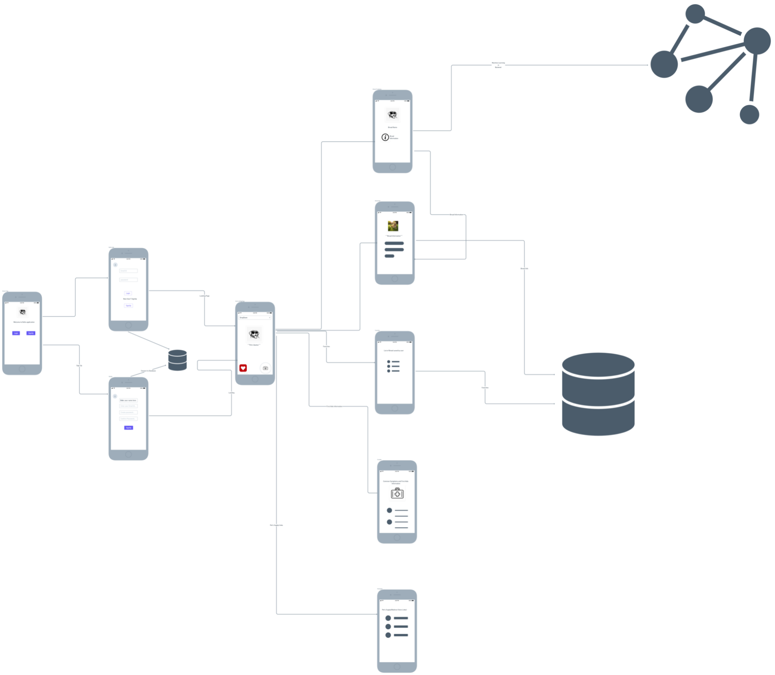

Slide 8
PROJECT OUTCOME
Wikipedia for various breeds
Favourite section for signed-in users
Identify breed in real-time
Sections for:
Common problems with pet dogs
Providing first aid information
Pet supplies store information

