Slide 1
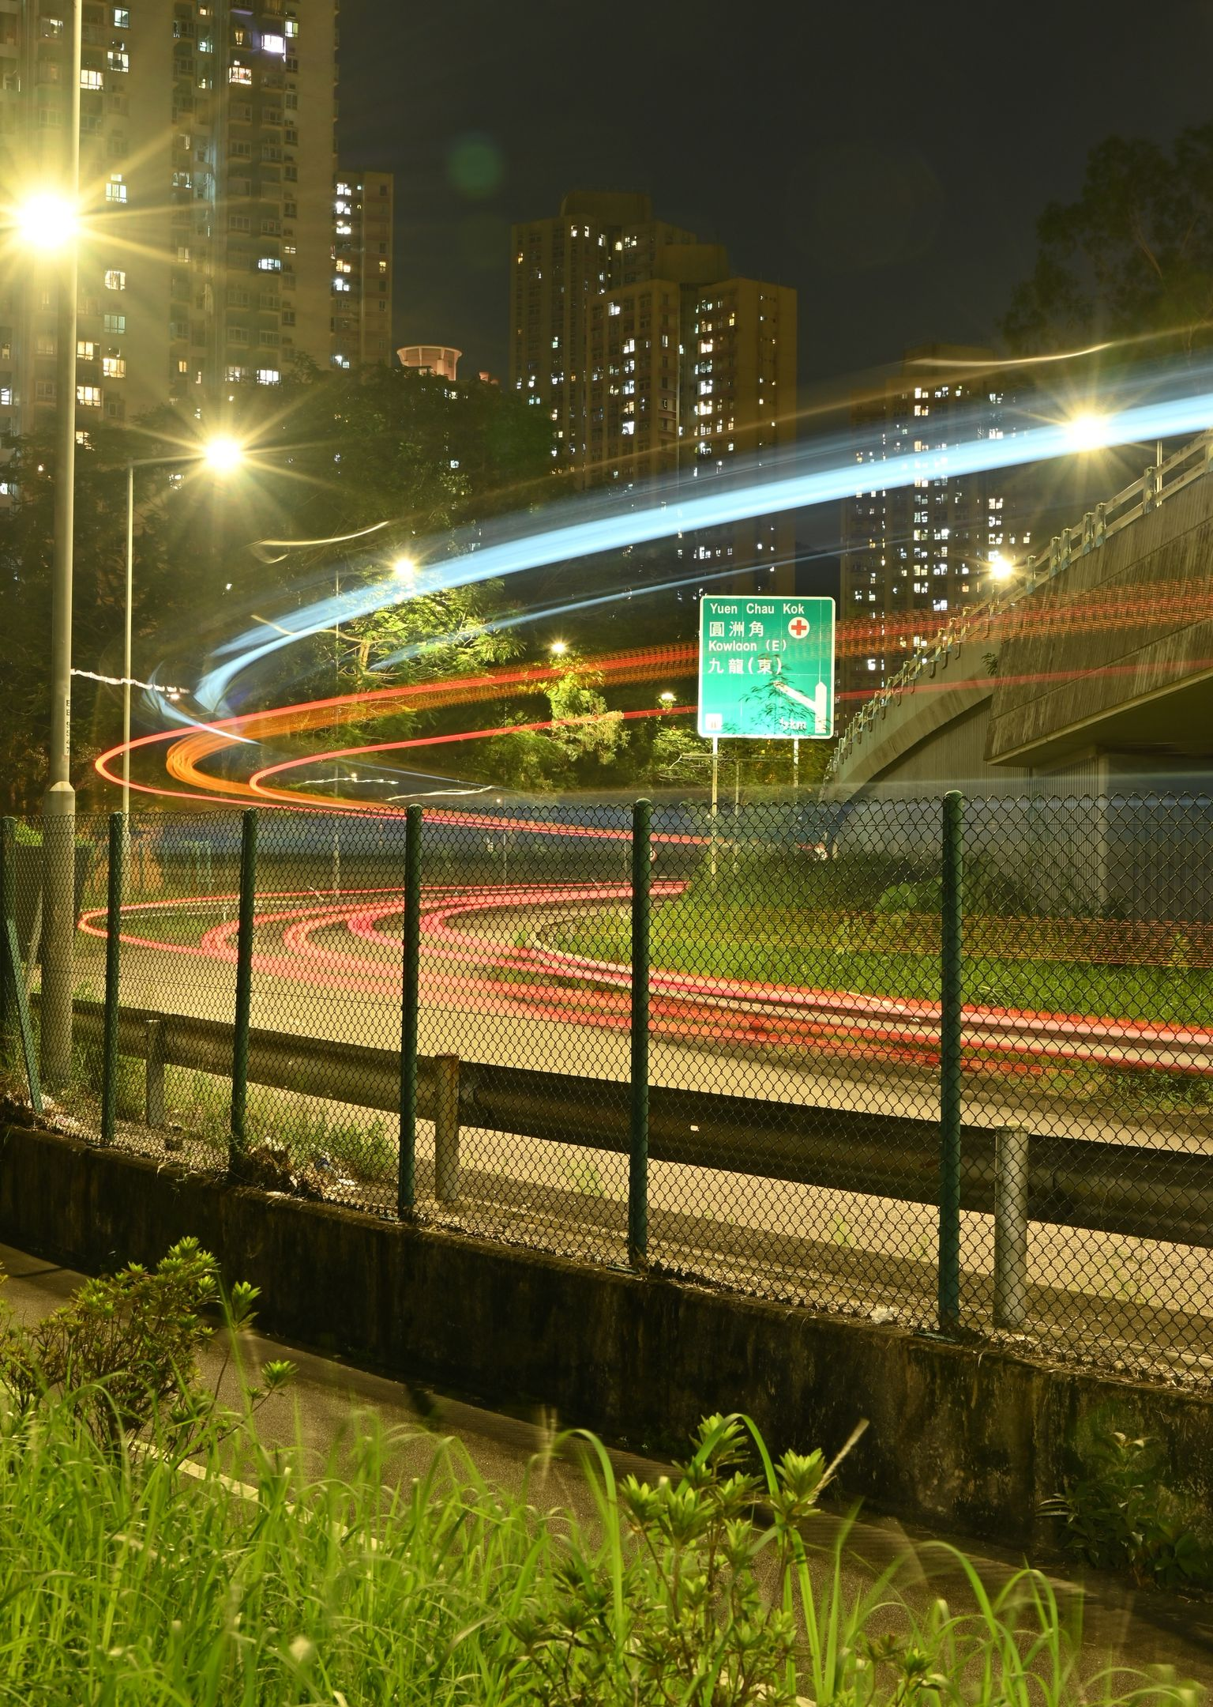
Motion that carries meaning
Animated PowerPoint, built from code and checked in PowerPoint.
Notes:
Open on the promise. The title floats in on its own, so the first click is yours.
The photo is the object Morph will carry into the next slide; the small vermilion square is the second one. Watch both.

Slide 2
Morph moves the eye
Give an object the same name on two slides, starting with two exclamation marks.
PowerPoint animates the position, size, crop and colour in between. No timeline to build.
!!hero !!pop
Notes:
This slide arrived by Morph: the photo shrank into its frame and the square stretched into the rule under the title. Nothing was keyframed.
The rule: same name on both slides, and a name that starts with two exclamation marks forces the match even when the shapes differ. The two names are on screen in mono.

Slide 3
Three kinds of motion, one job each
Entrance
Brings in the point you are about to make.
Emphasis
Points at what matters while you talk.
Exit
Clears what you have finished with.
Notes:
Three clicks build the three rows. On each, the marker moves down by a motion path and the word floats in with it, then the line fades in a beat later: the order tells the room what to read first.
Click four pulses Emphasis. Click five takes Exit away, which is what exits are for.

Slide 4
Each click is a short score
Seconds from each click on the previous slide.
With previous overlaps. After previous waits for the end.
Notes:
This chart is the real timing of the previous slide, read from the same code that wrote it, so it cannot drift from what plays.
Vermilion bars are effects playing; the gap before each bar is its delay. A native chart, so it stays editable in PowerPoint.

Slide 5
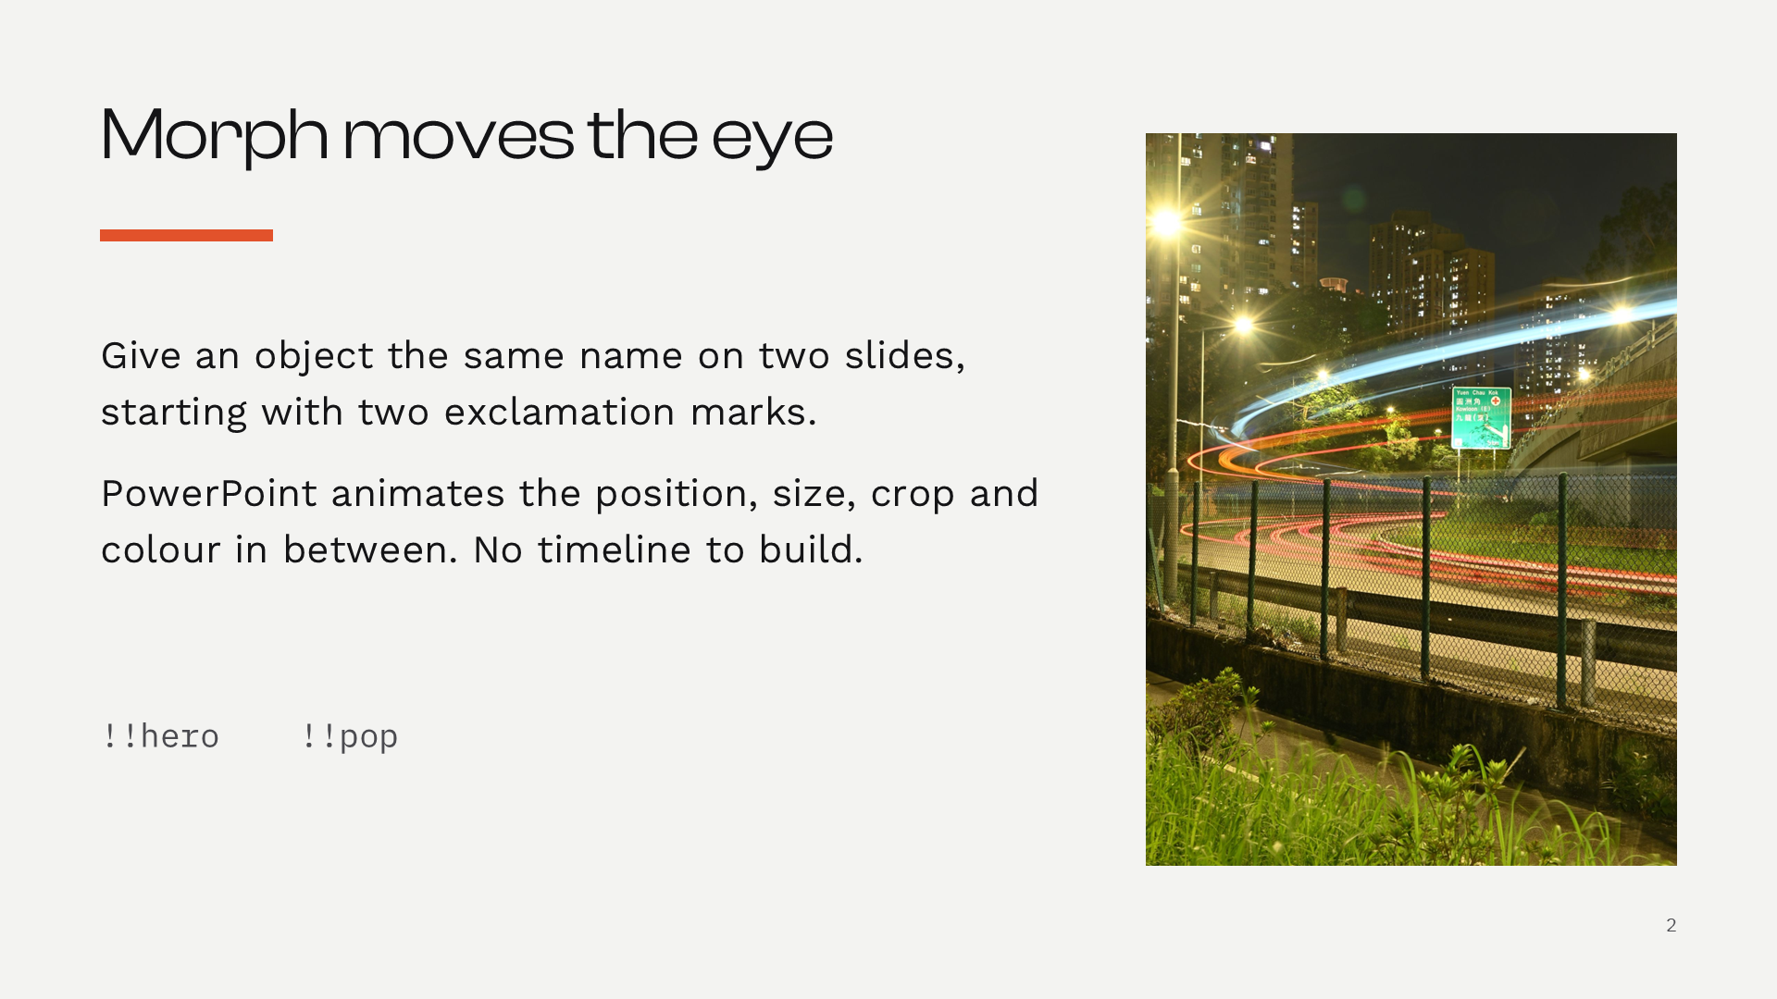
Zoom jumps in, then comes back
Click the frame to zoom into slide 2.
Then the show comes back here.
Why does it come back?
Return to zoom is on, so slide 2 hands control back to this slide.
Notes:
Slide Zoom: the frame is a live link into slide 2 that zooms in and, with return to zoom on, comes back here. Older viewers see a picture that jumps to slide 2.
The vermilion line is a trigger. Click it, not the slide, to reveal the answer: useful for questions you may or may not get.

Slide 6
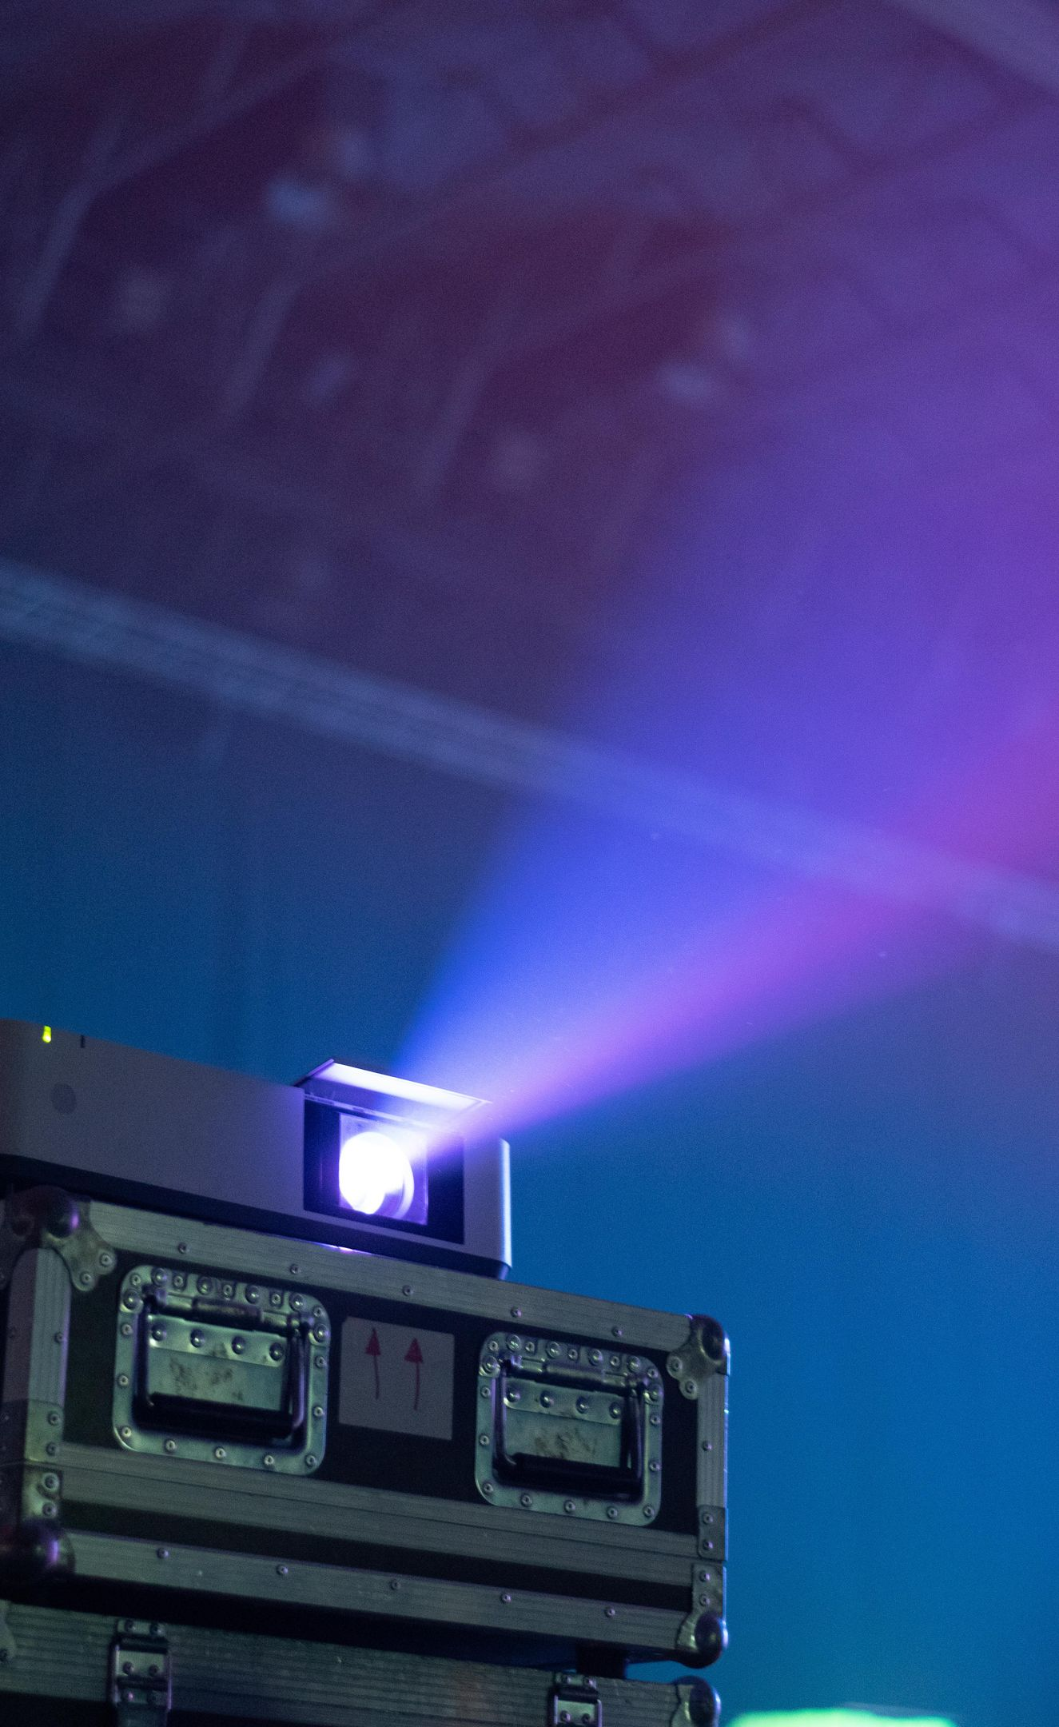
What only PowerPoint plays
Any viewer
Layouts, theme colours and fonts
Speaker notes and sections
Charts and links
PowerPoint only
Morph and Slide Zoom
Animation timing and triggers
Media that plays by itself
Notes:
Be honest about where this works. The left column survives Keynote, Google Slides, LibreOffice and a PDF. The right column needs PowerPoint 365 or 2019 and later.
So check every deck in PowerPoint before it goes in front of people; the render script does that part.

Slide 7
Build it, render it, then watch it in PowerPoint.
Z:\Claude\.claude\skills\decksmith
Back to the start
Notes:
The square from slide 6 grows into the whole right side: one more Morph, and the deck closes on the colour it opened with.
The button jumps back to slide 1 in the show. The skill lives at the path on screen.

