Slide 1
Daily News APP
-Darshan
-JaikAkaash
-Shiva

Slide 2
DESCRIPTION
News Aggregation: A news app serves as a platform that compiles news from various sources, providing users with quick and easy access to the latest happenings across different categories. It ensures that users stay updated with real-time information on politics, sports, technology, entertainment, business, and more.
Personalized Feed: Users can customize their news feed to focus on the topics they are most interested in, allowing for a tailored news experience that brings relevant content to the forefront.
Real-Time Notifications: The app sends instant notifications for breaking news, ensuring that users never miss out on important events and developments as they happen.
Offline Mode: This feature enables users to save articles and read them offline at their convenience, making it easier to catch up on news even without an internet connection.
Multimedia Content: In addition to text-based articles, the app provides rich multimedia content, including videos, images, and infographics, to enhance the news consumption experience.
Trusted Sources: Content is curated from reputable and verified sources, ensuring the information presented is credible and trustworthy

Slide 3
Login Activity.java:
@file:Suppress("DEPRECATION")package com.example.newsheadlinesimport android.content.Contextimport android.content.Intentimport android.os.Bundleimport androidx.activity.ComponentActivityimport androidx.activity.compose.setContentimport androidx.compose.foundation.Imageimport androidx.compose.foundation.backgroundimport androidx.compose.foundation.layout.*import androidx.compose.foundation.shape.RoundedCornerShapeimport androidx.compose.material.*import androidx.compose.material.icons.Iconsimport androidx.compose.material.icons.filled.Lockimport androidx.compose.material.icons.filled.Personimport androidx.compose.material3.Buttonimport androidx.compose.material3.ButtonDefaultsimport androidx.compose.material3.Dividerimport androidx.compose.material3.ExperimentalMaterial3Apiimport androidx.compose.material3.Iconimport androidx.compose.material3.MaterialThemeimport androidx.compose.material3.Textimport androidx.compose.material3.TextFieldimport androidx.compose.material3.TextFieldDefaultsimport androidx.compose.runtime.*import androidx.compose.ui.Alignmentimport androidx.compose.ui.Modifierimport androidx.compose.ui.graphics.Colorimport

Slide 4
androidx.compose.ui.res.painterResourceimport androidx.compose.ui.text.font.FontWeightimport androidx.compose.ui.text.input.PasswordVisualTransformationimport androidx.compose.ui.tooling.preview.Previewimport androidx.compose.ui.unit.dpimport androidx.compose.ui.unit.spimport com.example.newsheadlines.ui.theme.NewsHeadlinesThemeclass LoginActivity : ComponentActivity() { private lateinit var databaseHelper: UserDatabaseHelper override fun onCreate(savedInstanceState: Bundle?) { super.onCreate(savedInstanceState) databaseHelper = UserDatabaseHelper(this) setContent { LoginScreen(this, databaseHelper) } }}@OptIn(ExperimentalMaterial3Api::class)@Composablefun LoginScreen(context: Context, databaseHelper: UserDatabaseHelper) { var username by remember { mutableStateOf("") } var password by remember { mutableStateOf("") } var error by remember { mutableStateOf("") } Column( Modifier .fillMaxHeight() .fillMaxWidth() .padding(28.dp), horizontalAlignment = Alignment.CenterHorizontally, verticalArrangement = Arrangement.Center ) { Image(painter = painterResource(id = R.drawable.news), contentDescription = "") Spacer(modifier = Modifier.height(10.dp)) Row { Divider(color = Color.LightGray, thickness = 2.dp, modifier = Modifier .width(155.dp) .padding(top = 20.dp, end = 20.dp)) Text( text = "Login", color = Color(0xFF6495ED), fontWeight = FontWeight.Bold, fontSize = 24.sp, style = MaterialTheme.typography.headlineLarge ) Divider(color = Color.LightGray, thickness = 2.dp, modifier = Modifier .width(155.dp) .padding(top = 20.dp, start = 20.dp)) } Spacer(modifier = Modifier.height(10.dp)) TextField( value = username,

Slide 5
onValueChange = { username = it }, leadingIcon = { Icon(imageVector = Icons.Default.Person, contentDescription = "personIcon", tint = Color(0xFF6495ED)) }, placeholder = { Text(text = "Username", color = Color.Black) }, colors = TextFieldDefaults.textFieldColors(containerColor = Color.Transparent) ) Spacer(modifier = Modifier.height(20.dp)) TextField( value = password, onValueChange = { password = it }, leadingIcon = { Icon(imageVector = Icons.Default.Lock, contentDescription = "lockIcon", tint = Color(0xFF6495ED)) }, placeholder = { Text(text = "Password", color = Color.Black) }, visualTransformation = PasswordVisualTransformation(), colors = TextFieldDefaults.textFieldColors(containerColor = Color.Transparent) ) Spacer(modifier = Modifier.height(12.dp)) if (error.isNotEmpty()) { Text(text = error, color = MaterialTheme.colorScheme.error, modifier = Modifier.padding(vertical = 16.dp)) } Button( onClick = { if (username.isNotEmpty() && password.isNotEmpty()) { val user = databaseHelper.getUserByUsername(username) if (user != null && user.password == password) { error = "Successfully logged in" context.startActivity(Intent(context, MainActivity::class.java)) // Finish the LoginActivity if needed // (context as Activity).finish() } else { error = "Invalid username or password" } } else { error = "Please fill all fields" } }, shape = RoundedCornerShape(20.dp), colors = ButtonDefaults.buttonColors(containerColor = Color(0xFF77a2ef)), modifier = Modifier.width(200.dp).padding(top = 16.dp) ) { Text(text = "Log In", fontWeight = FontWeight.Bold) } Row(modifier = Modifier.fillMaxWidth()) {

Slide 6
TextButton(onClick = { context.startActivity(Intent(context, RegistrationActivity::class.java)) }) { Text(text = "Sign up", color = Color.Black) } Spacer(modifier = Modifier.width(100.dp)) TextButton(onClick = { /* Handle forgot password */ }) { Text(text = "Forgot password?", color = Color.Black) } } }}
registration activity:
package com.example.newsheadlinesimport android.content.Contextimport android.content.Intentimport android.os.Bundleimport androidx.activity.ComponentActivityimport androidx.activity.compose.setContentimport androidx.compose.foundation.Imageimport androidx.compose.foundation.backgroundimport androidx.compose.foundation.layout.*import androidx.compose.foundation.shape.RoundedCornerShapeimport androidx.compose.material.*import androidx.compose.material.icons.Iconsimport androidx.compose.material.icons.filled.Emailimport androidx.compose.material.icons.filled.Lockimport androidx.compose.material.icons.filled.Personimport androidx.compose.runtime.*import androidx.compose.ui.Alignmentimport androidx.compose.ui.Modifierimport androidx.compose.ui.graphics.Colorimport androidx.compose.ui.res.painterResourceimport androidx.compose.ui.text.font.FontWeightimport androidx.compose.ui.text.input.PasswordVisualTransformationimport androidx.compose.ui.tooling.preview.Previewimport

Slide 7
androidx.compose.ui.unit.dpimport androidx.compose.ui.unit.spimport androidx.core.content.ContextCompatimport com.example.newsheadlines.ui.theme.NewsHeadlinesThemeclass RegistrationActivity : ComponentActivity() { private lateinit var databaseHelper: UserDatabaseHelper override fun onCreate(savedInstanceState: Bundle?) { super.onCreate(savedInstanceState) databaseHelper = UserDatabaseHelper(this) setContent { RegistrationScreen(this,databaseHelper) } }}@Composablefun RegistrationScreen(context: Context, databaseHelper: UserDatabaseHelper) { var username by remember { mutableStateOf("") } var password by remember { mutableStateOf("") } var email by remember { mutableStateOf("") } var error by remember { mutableStateOf("") } Column( Modifier .background(Color.White) .fillMaxHeight() .fillMaxWidth(), horizontalAlignment = Alignment.CenterHorizontally, verticalArrangement = Arrangement.Center) { Row { Text( text = "Sign Up", color = Color(0xFF6495ED), fontWeight = FontWeight.Bold, fontSize = 24.sp, style = MaterialTheme.typography.h1 ) Divider( color = Color.LightGray, thickness = 2.dp, modifier = Modifier .width(250.dp) .padding(top = 20.dp, start = 10.dp, end = 70.dp) ) } Image( painter = painterResource(id = R.drawable.sign_up), contentDescription = "", modifier = Modifier.height(270.dp) ) TextField( value = username, onValueChange = { username = it }, leadingIcon = { Icon( imageVector = Icons.Default.Person, contentDescription = "personIcon", tint = Color(0xFF6495ED) ) }, placeholder = { Text( text = "username", color = Color.Black ) }, colors =

Slide 8
TextFieldDefaults.textFieldColors( backgroundColor = Color.Transparent ) ) Spacer(modifier = Modifier.height(8.dp)) TextField( value = password, onValueChange = { password = it }, leadingIcon = { Icon( imageVector = Icons.Default.Lock, contentDescription = "lockIcon", tint = Color(0xFF6495ED) ) }, placeholder = { Text(text = "password", color = Color.Black) }, visualTransformation = PasswordVisualTransformation(), colors = TextFieldDefaults.textFieldColors(backgroundColor = Color.Transparent) ) Spacer(modifier = Modifier.height(16.dp)) TextField( value = email, onValueChange = { email = it }, leadingIcon = { Icon( imageVector = Icons.Default.Email, contentDescription = "emailIcon", tint = Color(0xFF6495ED) ) }, placeholder = { Text(text = "email", color = Color.Black) }, colors = TextFieldDefaults.textFieldColors(backgroundColor = Color.Transparent) ) Spacer(modifier = Modifier.height(8.dp)) if (error.isNotEmpty()) { Text( text = error, color = MaterialTheme.colors.error, modifier = Modifier.padding(vertical = 16.dp) ) } Button( onClick = { if (username.isNotEmpty() && password.isNotEmpty() && email.isNotEmpty()) { val user = User( id = null, firstName = username, lastName = null, email = email, password = password ) databaseHelper.insertUser(user) error = "User registered successfully" // Start LoginActivity using the current context context.startActivity( Intent( context, LoginActivity::class.java ) ) } else { error = "Please fill all fields" } }, shape =

Slide 9
RoundedCornerShape(20.dp), colors = ButtonDefaults.buttonColors(backgroundColor = Color(0xFF77a2ef)), modifier = Modifier.width(200.dp) .padding(top = 16.dp) ) { Text(text = "Register", fontWeight = FontWeight.Bold) } Row( modifier = Modifier.padding(30.dp), verticalAlignment = Alignment.CenterVertically, horizontalArrangement = Arrangement.Center ) { Text(text = "Have an account?") TextButton(onClick = { context.startActivity( Intent( context, LoginActivity::class.java ) ) }) { Text(text = "Log in", fontWeight = FontWeight.Bold, style = MaterialTheme.typography.subtitle1, color = Color(0xFF4285F4) )} } }}private fun startLoginActivity(context: Context) { val intent = Intent(context, LoginActivity::class.java) ContextCompat.startActivity(context, intent, null)}
main activity:
package com.example.newsheadlinesimport android.content.Contextimport android.content.Intentimport android.content.Intent.FLAG_ACTIVITY_NEW_TASKimport android.os.Bundleimport android.util.Logimport android.widget.TextViewimport androidx.activity.ComponentActivityimport androidx.activity.compose.setContentimport androidx.activity.viewModelsimport androidx.compose.foundation.Imageimport androidx.compose.foundation.backgroundimport androidx.compose.foundation.clickableimport androidx.compose.foundation.layout.*import androidx.compose.foundation.lazy.LazyColumnimport androidx.compose.foundation.lazy.itemsIndexedimport androidx.compose.foundation.selection.selectableimport androidx.compose.foundation.shape.RoundedCornerShapeimport androidx.compose.material.Cardimport

Slide 10
androidx.compose.material.MaterialThemeimport androidx.compose.material.Surfaceimport androidx.compose.material.Textimport androidx.compose.runtime.*import androidx.compose.ui.Modifierimport androidx.compose.ui.graphics.Colorimport androidx.compose.ui.text.font.FontWeightimport androidx.compose.ui.text.style.TextAlignimport androidx.compose.ui.unit.dpimport androidx.compose.ui.unit.spimport androidx.compose.ui.viewinterop.AndroidViewimport androidx.core.text.HtmlCompatimport coil.compose.rememberImagePainterimport coil.size.Scaleimport coil.transform.CircleCropTransformationimport com.example.example.Articlesimport com.example.newsheadlines.ui.theme.NewsHeadlinesThemeclass MainActivity : ComponentActivity() { val mainViewModel by viewModels<MainViewModel>() override fun onCreate(savedInstanceState: Bundle?) { super.onCreate(savedInstanceState) setContent { NewsHeadlinesTheme { // A surface container using the 'background' color from the theme Surface(color = MaterialTheme.colors.background) { Column() { Text(text = "Latest NEWS", fontSize = 32.sp, modifier = Modifier.fillMaxWidth(), textAlign = TextAlign.Center) MovieList(applicationContext, movieList = mainViewModel.movieListResponse) mainViewModel.getMovieList() } } } } }}@Composablefun MovieList(context: Context, movieList: List<Articles>) { var selectedIndex by remember { mutableStateOf(-1) } LazyColumn { itemsIndexed(items = movieList) { index, item -> MovieItem(context,movie = item, index, selectedIndex) { i -> selectedIndex = i } } }}@Composablefun MovieItem(context: Context) { val movie =

Slide 11
Articles( "Coco", "", " articl" ) MovieItem(context,movie = movie, 0, 0) { i -> Log.i("wertytest123abc", "MovieItem: " +i) }}@Composablefun MovieItem(context: Context, movie: Articles, index: Int, selectedIndex: Int, onClick: (Int) -> Unit){ val backgroundColor = if (index == selectedIndex) MaterialTheme.colors.primary else MaterialTheme.colors.background Card( modifier = Modifier .padding(8.dp, 4.dp) .fillMaxSize() .selectable(true, true, null, onClick = { Log.i("test123abc", "MovieItem: $index/n$selectedIndex") }) .clickable { onClick(index) } .height(180.dp), shape = RoundedCornerShape(8.dp), elevation = 4.dp ) { Surface(color = Color.White) { Row( Modifier .padding(4.dp) .fillMaxSize() ) { Image( painter = rememberImagePainter( data = movie.urlToImage, builder = { scale(Scale.FILL) placeholder(R.drawable.placeholder) transformations(CircleCropTransformation()) } ), contentDescription = movie.description, modifier = Modifier .fillMaxHeight() .weight(0.3f) ) Column( verticalArrangement = Arrangement.Center, modifier = Modifier .padding(4.dp) .fillMaxHeight() .weight(0.8f) .background(Color.Gray) .padding(20.dp) .selectable(true, true, null, onClick = { Log.i("test123abc", "MovieItem: $index/n${movie.description}") context.startActivity( Intent(context, DisplayNews::class.java) .setFlags(Intent.FLAG_ACTIVITY_NEW_TASK) .

Slide 12
putExtra("desk", movie.description.toString()) .putExtra("urlToImage", movie.urlToImage) .putExtra("title", movie.title) ) }) ) { Text( text = movie.title.toString(), style = MaterialTheme.typography.subtitle1, fontWeight = FontWeight.Bold ) HtmlText(html = movie.description.toString()) } } } } @Composable fun HtmlText(html: String, modifier: Modifier = Modifier) { AndroidView( modifier = modifier .fillMaxSize() .size(33.dp), factory = { context -> TextView(context) }, update = { it.text = HtmlCompat.fromHtml(html, HtmlCompat.FROM_HTML_MODE_COMPACT) } ) }}
main view model:
package com.example.newsheadlinesimport android.util.Logimport androidx.compose.runtime.getValueimport androidx.compose.runtime.mutableStateOfimport androidx.compose.runtime.setValueimport androidx.lifecycle.ViewModelimport androidx.lifecycle.viewModelScopeimport com.example.example.Articlesimport kotlinx.coroutines.launchclass MainViewModel : ViewModel() { var movieListResponse: List<Articles> by mutableStateOf(listOf()) var errorMessage: String by mutableStateOf("") private val apiKey = "e46c2caff1134ba4859c25c1682726f2" // Your API key fun getMovieList() { viewModelScope.launch { val apiService = ApiService.getInstance() try {

Slide 13
// Now we pass the API key correctly val movieList = apiService.getMovies(apiKey = apiKey) // Pass the API key here movieListResponse = movieList.articles } catch (e: Exception) { errorMessage = e.message.toString() Log.e("MainViewModel", "Error fetching movies: $errorMessage") } } }}

Slide 14
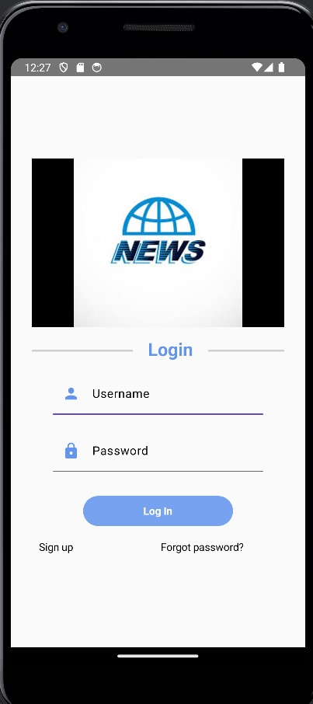
OUTPUT:

Slide 15
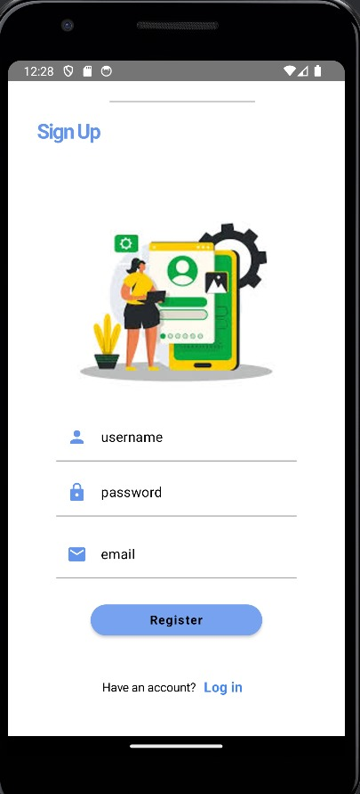

Slide 16
