Slide 1
BEVD305L-VLSI Technology
Course Project
Project Title : Chemical Mechanical Polishing Planarization Study and to analyse surface flatness improvement.
Presented By :
Jai B Shah (23BVD0056)
Shivain Khera (23BVD0058)
Faculty:
Dr. Palla Penchalaiah

Slide 2
CMP using Sentaurus TCAD
Introduction
Motivation
Applications of CMP Planarization
Background
Methodology
Mechanism of Chemical Mechanical Polishing (CMP)
Figure of Merit
Simulation of 2D Chemical Mechanical Polishing (CMP) Planarization
Limitations of current CMP models
Future Scope
Conclusion
References

Slide 3
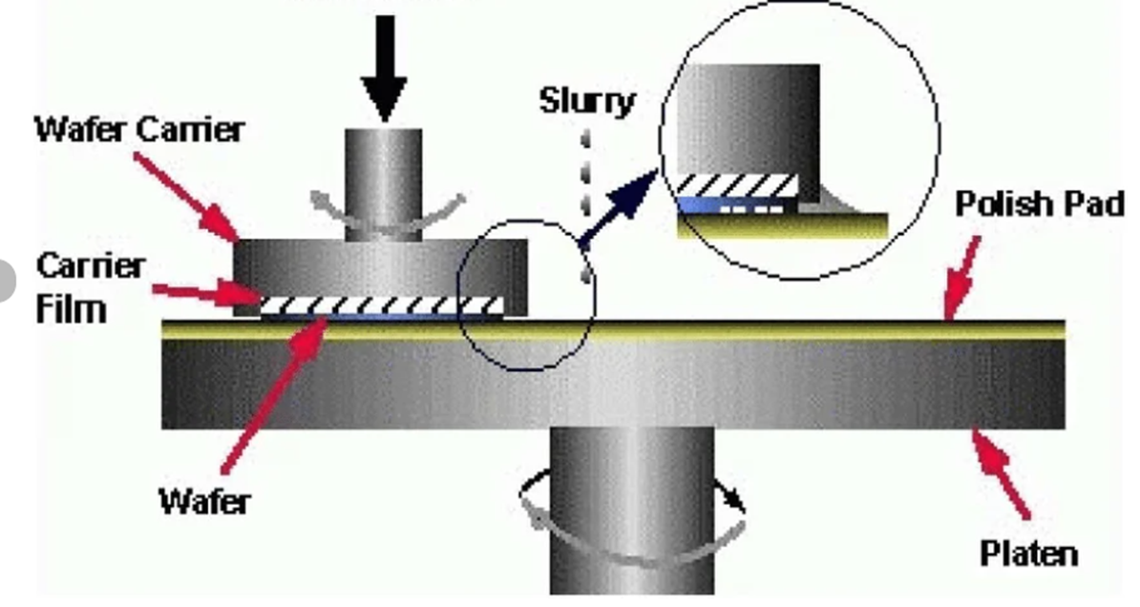
Introduction
Chemical Mechanical Polishing (CMP) is a critical planarization technique employed in modern semiconductor manufacturing to achieve global and local surface flatness across multiple interconnect and device layers. As device dimensions continue to scale into the nanometer regime, surface non-uniformities such as topography variation, dishing, and erosion significantly impact lithographic accuracy and device reliability. This project presents a detailed CMP planarization study using Sentaurus TCAD, with a primary focus on analyzing surface flatness improvement through Sentaurus SProcess simulations. The CMP process is modeled by incorporating material removal mechanisms influenced by mechanical pressure and chemical reactions. Surface profiles before and after CMP are analyzed to quantify planarization efficiency. Key metrics such as step height reduction, surface roughness, and planarization length are evaluated under varying process conditions. The results demonstrate the effectiveness of CMP in achieving uniform surfaces and highlight the impact of process parameters on planarization performance. This study provides insight into CMP optimization strategies for advanced semiconductor fabrication.
Diagram of Chemical Mechanical Polishing
D. Müller, S. Park, I. González, P. Nowak, J. Chen, and A. Rahman,“Nanoparticles for chemical mechanical planarization: A review,” Nanomaterials, vol. 15, no. 17, 2025.

Slide 4
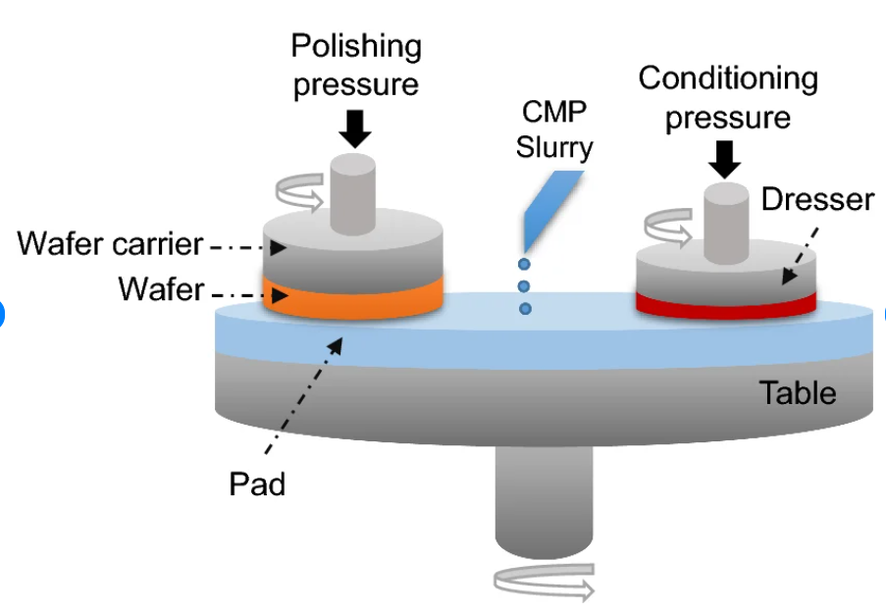
Motivation
Chemical Mechanical Polishing (CMP) is a critical planarization technique employed in modern semiconductor manufacturing to achieve global and local surface flatness across multiple interconnect and device layers. As device dimensions continue to scale into the nanometer regime, surface non-uniformities such as topography variation, dishing, and erosion significantly impact lithographic accuracy and device reliability. This project presents a detailed CMP planarization study using Sentaurus TCAD, with a primary focus on analyzing surface flatness improvement through Sentaurus SProcess simulations. The CMP process is modeled by incorporating material removal mechanisms influenced by mechanical pressure and chemical reactions. Surface profiles before and after CMP are analyzed to quantify planarization efficiency. Key metrics such as step height reduction, surface roughness, and planarization length are evaluated under varying process conditions. The results demonstrate the effectiveness of CMP in achieving uniform surfaces and highlight the impact of process parameters on planarization performance. This study provides insight into CMP optimization strategies for advanced semiconductor fabrication.
The schematic diagram of the CMP process
R. Srinivasan, Y. Nakamura, C. Dupont, A. Kovalenko, F. Bianchi, and E. Morales,“Nanoparticles for chemical mechanical planarization: A review,” Nanomaterials, vol. 15, no. 17, 2025.

Slide 5
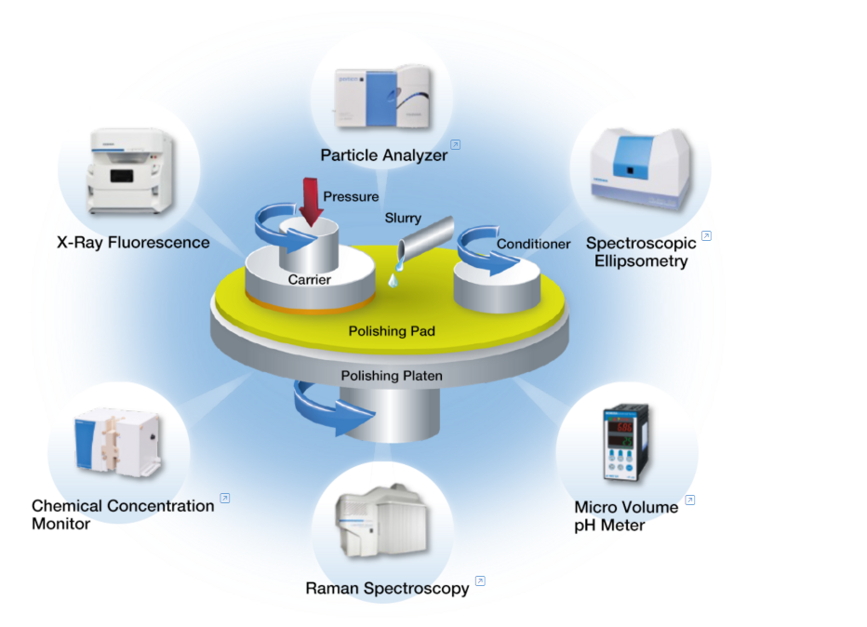
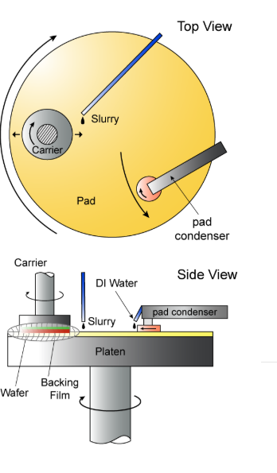
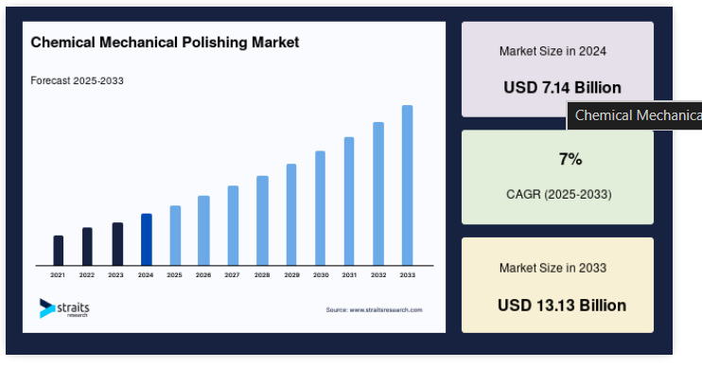
Applications of CMP Planarization
https://straitsresearch.com/report/chemical-mechanical-polishing-market

Slide 6
Background
Chemical Mechanical Planarization (CMP) is a critical surface planarization technique used in modern VLSI and ULSI fabrication to achieve a globally flat wafer surface before subsequent lithography steps. As device dimensions scaled down and multilevel interconnects became common, surface topography variations caused severe focus and alignment issues during photolithography. CMP overcomes this by combining chemical reactions at the wafer surface with mechanical abrasion from a polishing pad and slurry, enabling uniform material removal across the wafer. It is extensively used for shallow trench isolation (STI), interlayer dielectric (ILD) planarization, and copper damascene processes, making it indispensable for advanced CMOS technology nodes.
https://en.wikipedia.org/wiki/Chemical-mechanical_polishing

Slide 7
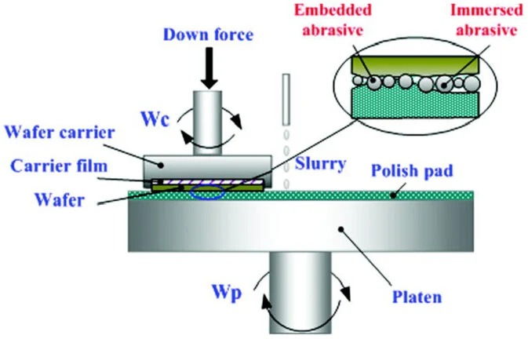
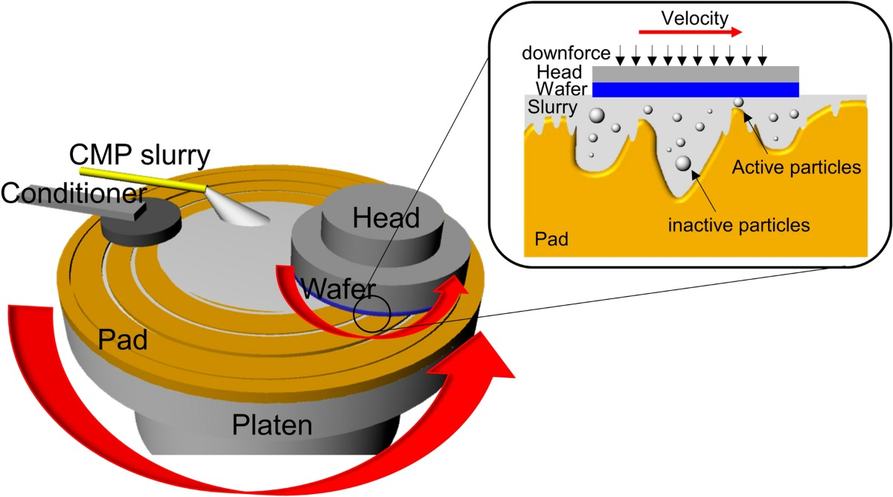
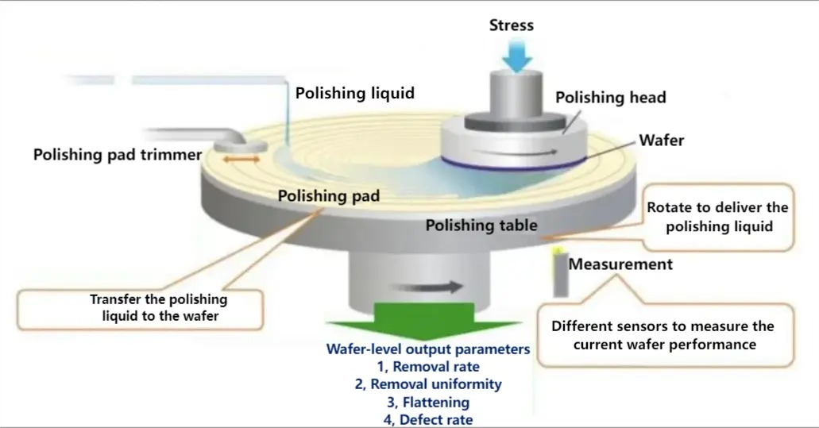
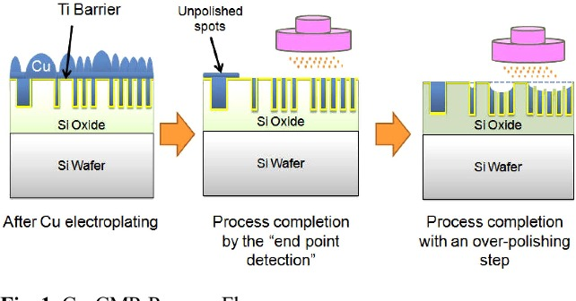
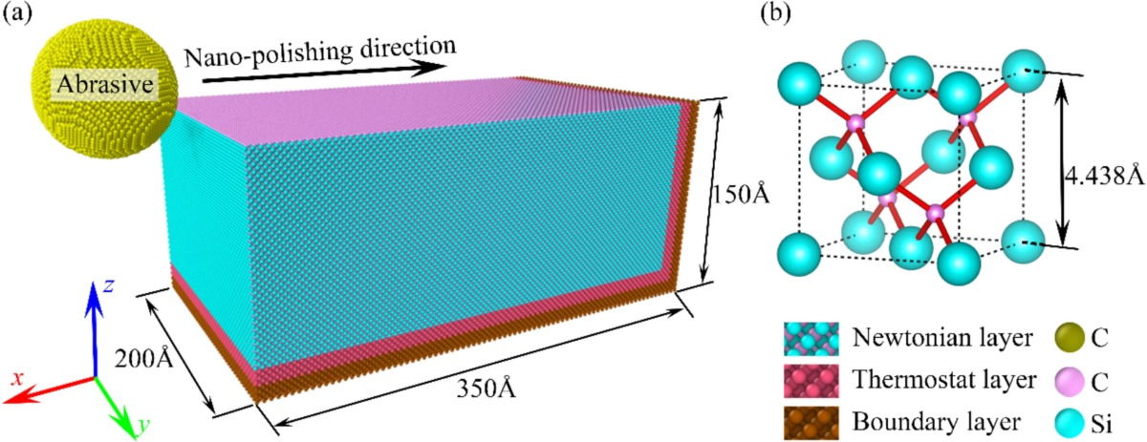
1980s – Birth of CMP (IBM Era)
1990s – Industrial Adoption
2000s – Mechanism Understanding
2010s – Advanced Materials & Scaling
2020s – Intelligent & Multi-Physics CMP
https://www.horiba.com/int/semiconductor/process/chemical-mechanical-planarization-cmp/
https://resources.pcb.cadence.com/blog/2020-cmp-process-flow-chemical-mechanical-processing-for-electronics
https://www.researchgate.net/figure/a-Diagram-of-the-CMP-process-for-a-silicon-wafer-and-b-the-three-body-polishing_fig1_377172018

Slide 8
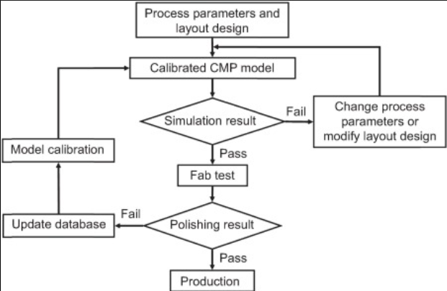
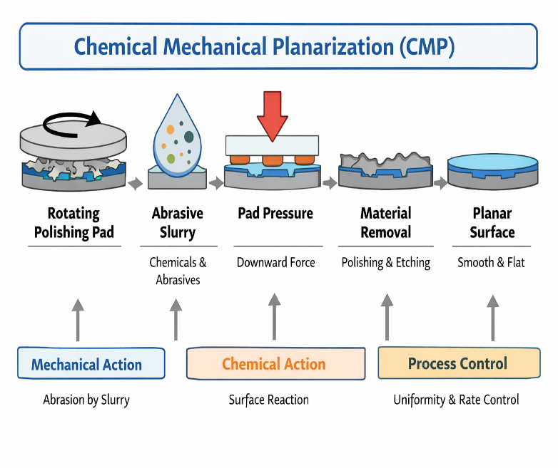
Methodology
Flowchart
https://www.sciencedirect.com/science/chapter/edited-volume/abs/pii/B9780128217917000198

Slide 9
Description:-
The simulation is carried out using Synopsys Sentaurus TCAD (SProcess) to model the fabrication and planarization steps in a 2D structure.
A silicon substrate is first initialized with a uniform phosphorus doping concentration of 1×1015 cm−31
A trench is then formed using anisotropic etching with a depth of 0.4 µm over a masked region (3–7 µm), creating surface topography.
An oxide layer is subsequently formed over the structure.
The oxide growth is described using the Deal–Grove oxidation model, which accounts for both reaction-limited and diffusion-limited oxidation mechanisms.
The deposition results in a non-planar oxide surface with overburden.
Planarization is then performed using a CMP process modeled based on the Preston equation, where the material removal rate depends on applied pressure and relative velocity.
This results in preferential removal of material from elevated regions, leading to surface planarization.

Slide 10
Mechanism of Chemical Mechanical Polishing (CMP)
Chemical Mechanical Polishing (CMP) is a synergistic surface planarization process in which chemical reactions at the wafer surface are continuously coupled with mechanical abrasion from a polishing pad and slurry abrasives. Unlike purely mechanical polishing or wet chemical etching, CMP achieves high planarity, selectivity, and surface quality, which are essential for advanced VLSI fabrication.
1. Chemical Mechanism
The chemical component of CMP involves controlled surface modification of the wafer material by the slurry chemistry.
Oxidizers (e.g., H₂O₂, Fe(NO₃)₃, KIO₃) react with the wafer surface.
A thin, softened reaction layer forms on the surface:
  For silicon: hydrated silicon oxide (SiOₓ·nH₂O)
  For copper: Cu₂O / CuO
Complexing agents (e.g., glycine, citric acid) stabilize dissolved ions and prevent redeposition.
pH regulators control reaction kinetics and material selectivity.
K. Tanaka, M. Rossi, J.-P. Laurent, H. Al-Mansoori, T. Becker, and V. Petrov,“Nanoparticles for chemical mechanical planarization: A review,” Nanomaterials, vol. 15, no. 17, 2025.

Slide 11
2. Mechanical Mechanism
The mechanical mechanism of chemical mechanical polishing is governed by the interaction between slurry abrasives, the polishing pad, and the wafer surface. The slurry contains nanoscale abrasive particles such as silica, alumina, or ceria, which become trapped between the wafer surface and the microscopic asperities of the polishing pad. When a downforce is applied and relative motion exists between the wafer and the pad, these abrasive particles induce micro-cutting and micro-plowing actions on the surface, while micro-fracture remains minimal in CMP. This controlled mechanical action contributes to material removal; however, mechanical abrasion alone would lead to surface scratches and damage, making the chemical component essential for gentle and controlled polishing.
2.1 Abrasive Action
Abrasive particles suspended in the slurry act as the primary agents of mechanical material removal. These particles are held at the pad–wafer interface by pad asperities and are pressed against the wafer surface under applied pressure. The relative motion between the pad and the wafer causes the abrasives to slide and roll, producing localized shearing and plowing of the chemically softened surface layer. Because the abrasives are nanoscale and the surface layer is weakened by chemical reactions, the removal process remains controlled and minimizes surface damage.
2.2 Pad–Wafer Contact
The polishing pad, typically made of polyurethane, contains micro-asperities and an interconnected porous structure that facilitates slurry transport to the contact interface. These asperities transmit the applied pressure, retain abrasive particles, and regulate the local material removal rate. The mechanical properties of the pad, including hardness and elasticity, strongly influence polishing uniformity, contact mechanics, and defect generation. The pad thus serves as a critical mediator between the applied mechanical load and the microscopic removal events at the wafer surface.
K. Tanaka, M. Rossi, J.-P. Laurent, H. Al-Mansoori, T. Becker, and V. Petrov,“Nanoparticles for chemical mechanical planarization: A review,” Nanomaterials, vol. 15, no. 17, 2025.

Slide 12
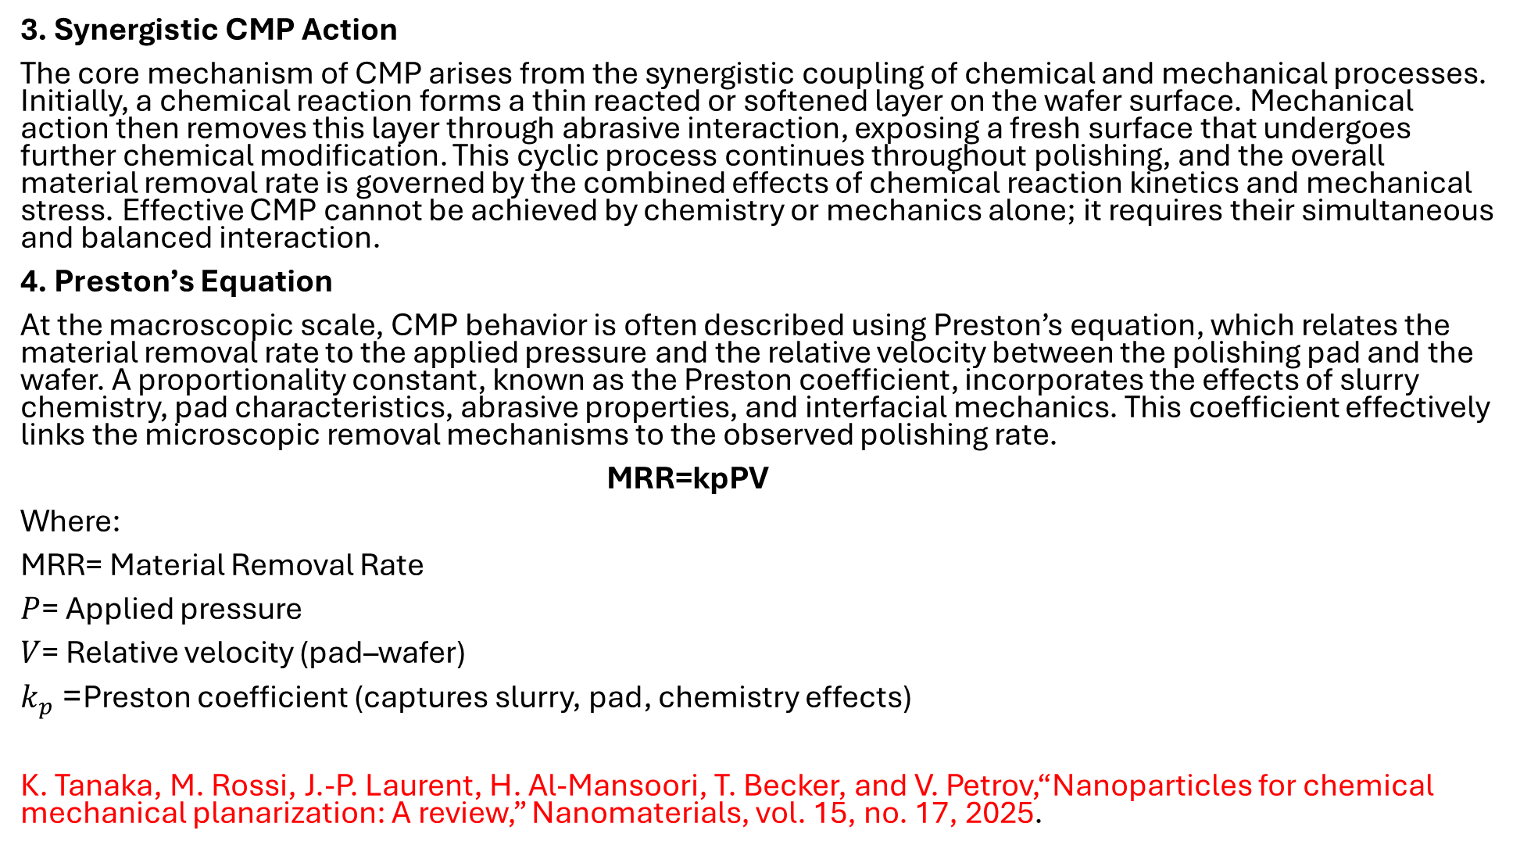
3. Synergistic CMP Action
The core mechanism of CMP arises from the synergistic coupling of chemical and mechanical processes. Initially, a chemical reaction forms a thin reacted or softened layer on the wafer surface. Mechanical action then removes this layer through abrasive interaction, exposing a fresh surface that undergoes further chemical modification. This cyclic process continues throughout polishing, and the overall material removal rate is governed by the combined effects of chemical reaction kinetics and mechanical stress. Effective CMP cannot be achieved by chemistry or mechanics alone; it requires their simultaneous and balanced interaction.
4. Preston’s Equation
At the macroscopic scale, CMP behavior is often described using Preston’s equation, which relates the material removal rate to the applied pressure and the relative velocity between the polishing pad and the wafer. A proportionality constant, known as the Preston coefficient, incorporates the effects of slurry chemistry, pad characteristics, abrasive properties, and interfacial mechanics. This coefficient effectively links the microscopic removal mechanisms to the observed polishing rate.
MRR=kp​PV
Where:
$\text{MRR}$= Material Removal Rate
$P$= Applied pressure
$V$= Relative velocity (pad–wafer)
$k_{p}$= Preston coefficient (captures slurry, pad, chemistry effects)
K. Tanaka, M. Rossi, J.-P. Laurent, H. Al-Mansoori, T. Becker, and V. Petrov,“Nanoparticles for chemical mechanical planarization: A review,” Nanomaterials, vol. 15, no. 17, 2025.

Slide 13
5. Material-Specific CMP Mechanisms
5.1 Oxide CMP
In oxide CMP, chemical hydration of silicon–oxygen bonds leads to the formation of silanol groups on the surface. These weakened bonds are more easily removed by abrasive action. Ceria-based slurries exhibit enhanced selectivity due to strong chemical interactions between ceria particles and silicon dioxide, resulting in efficient and controlled oxide removal.
5.2 Silicon CMP
Silicon CMP proceeds through an oxidation–removal cycle in which the silicon surface is first oxidized to form a thin silicon dioxide layer. This oxide layer is then mechanically removed by abrasive action, exposing fresh silicon that undergoes further oxidation. Repetition of this cycle enables controlled planarization of silicon surfaces.
5.3 Copper CMP
In copper CMP, the surface undergoes oxidation to form copper oxides, followed by complexation of copper ions in the slurry. Mechanical removal is carefully regulated using corrosion inhibitors such as benzotriazole to prevent excessive copper loss, dishing, and corrosion. Achieving the correct balance between oxidation, complexation, and mechanical abrasion is critical for reliable copper planarization.
6. Planarization Mechanism
Planarization in CMP occurs because material is preferentially removed from topographic high regions. Raised features experience higher local pressure, increased contact with pad asperities, and greater effective abrasive interaction compared to recessed areas. As a result, protrusions are removed more rapidly than valleys, leading to both local and global surface flattening.
K. Tanaka, M. Rossi, J.-P. Laurent, H. Al-Mansoori, T. Becker, and V. Petrov,“Nanoparticles for chemical mechanical planarization: A review,” Nanomaterials, vol. 15, no. 17, 2025.

Slide 14
7. Defect Generation Mechanisms
Defects in CMP arise when process conditions are not properly optimized. Scratches can form due to large abrasive particles or overly hard pads, while dishing occurs when excessive material is removed from wide features. Erosion is commonly associated with high pattern density regions, and corrosion results from overly aggressive slurry chemistry. Residual contamination may remain if post-polishing cleaning is insufficient, emphasizing the need for careful process control.
8. Key Control Parameters
CMP performance is governed by a combination of mechanical, chemical, slurry-related, and pattern-dependent parameters. Mechanical factors include applied pressure, polishing speed, and pad hardness. Chemical parameters involve slurry pH, oxidizer concentration, and inhibitor content. Slurry characteristics such as abrasive size and concentration influence removal behavior, while pattern density and feature geometry affect local polishing rates. Proper optimization of these parameters is essential for achieving uniform planarization with minimal defects.
K. Tanaka, M. Rossi, J.-P. Laurent, H. Al-Mansoori, T. Becker, and V. Petrov,“Nanoparticles for chemical mechanical planarization: A review,” Nanomaterials, vol. 15, no. 17, 2025.

Slide 15
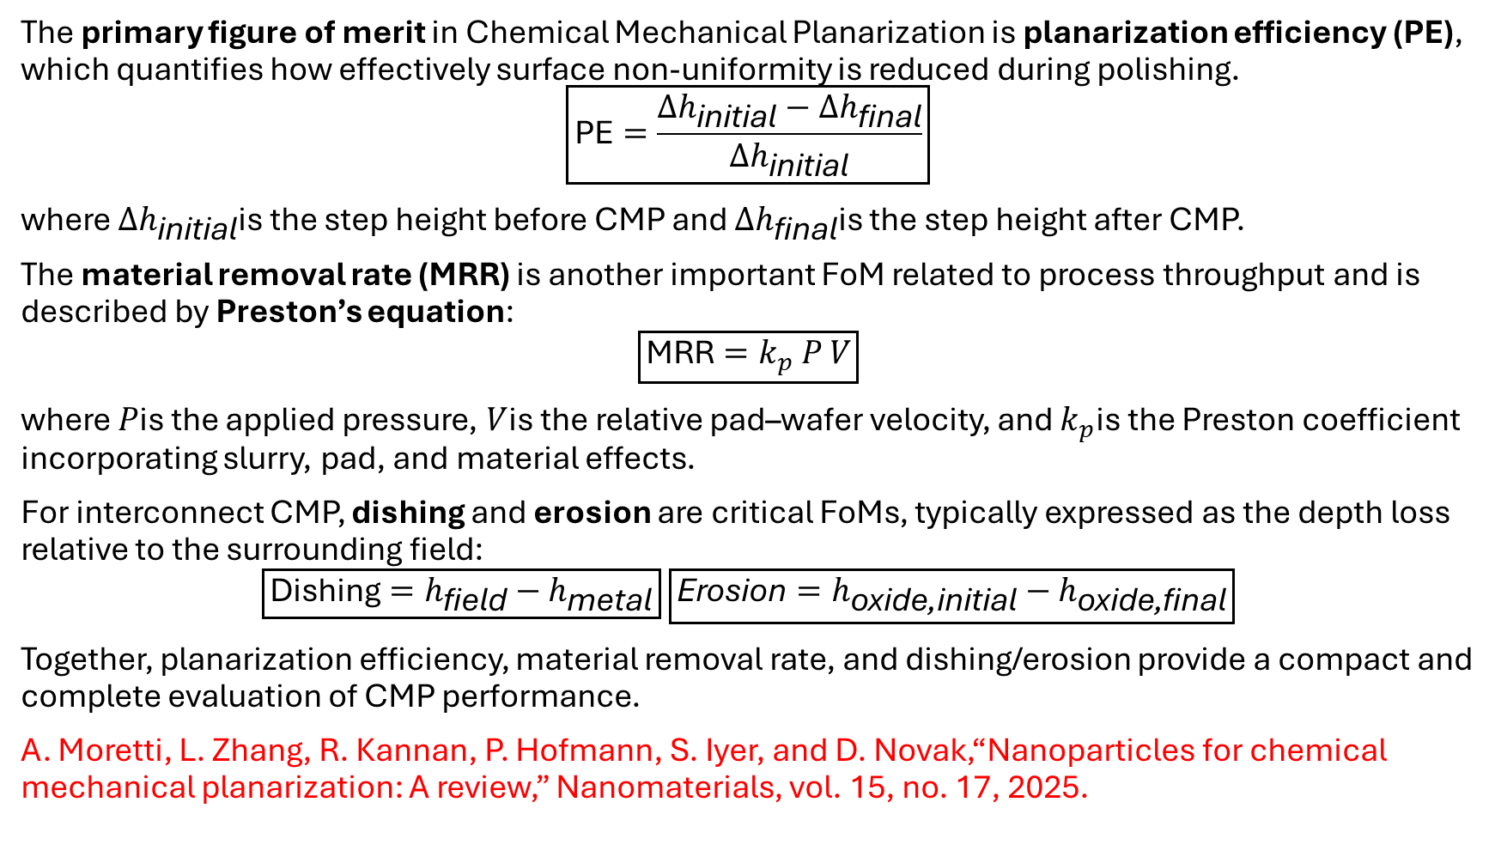
Figure of Merit
The primary figure of merit in Chemical Mechanical Planarization is planarization efficiency (PE), which quantifies how effectively surface non-uniformity is reduced during polishing.
$$\boxed{\text{PE}=\frac{Δh_{\text{initial}}−Δh_{\text{final}}}{Δh_{\text{initial}}}}$$
where $Δh_{\text{initial}}$is the step height before CMP and $Δh_{\text{final}}$is the step height after CMP.
The material removal rate (MRR) is another important FoM related to process throughput and is described by Preston’s equation:
$$\boxed{\text{MRR}=k_{p} P V}$$
where $P$is the applied pressure, $V$is the relative pad–wafer velocity, and $k_{p}$is the Preston coefficient incorporating slurry, pad, and material effects.
For interconnect CMP, dishing and erosion are critical FoMs, typically expressed as the depth loss relative to the surrounding field:
$$\boxed{\text{Dishing}=h_{\text{field}}−h_{\text{metal}}} \boxed{\text{Erosion}=h_{\text{oxide}\text{,}\text{initial}}−h_{\text{oxide}\text{,}\text{final}}}$$
Together, planarization efficiency, material removal rate, and dishing/erosion provide a compact and complete evaluation of CMP performance.
A. Moretti, L. Zhang, R. Kannan, P. Hofmann, S. Iyer, and D. Novak,“Nanoparticles for chemical mechanical planarization: A review,” Nanomaterials, vol. 15, no. 17, 2025.

Slide 16
Comparison of Figure of merit
SL NO | Paper/Journal Name | Planarization efficiency | Key reason
1 | [8]S. B. K. Vrudhula and S. Sapatnekar, “Statistical and machine learning methods for semiconductor manufacturing,”IEEE Transactions on Semiconductor Manufacturing, vol. 34, no. 3, pp. 321–335, Aug. 2021. | 83.14% | Strong chemical softening, good selectivity
2 | [9]S. Luo, D. A. Dornfeld, and F. Pei,“Material removal mechanism in chemical mechanical planarization: From wafer to molecular scale,”IEEE Transactions on Semiconductor Manufacturing,vol. 14, no. 2, pp. 112–133, May 2001. | 79% | Dishing, corrosion, electrochemical effects
3 | [10]S. Luo, D. A. Dornfeld, and F. Pei,“Mechanisms of defect generation in chemical mechanicalpolishing,”Wear, vol. 257, nos. 9–10, pp. 1005–1013, 2004. | 81.5% | High selectivity (oxide vs nitride)
4 | [11]H. Bellahsene, S. Sene, G. Félix, J. Larionova, M. Ferrari, and Y. Guari,“Nanoparticles for chemical mechanical planarization: A review,”Nanomaterials, vol. 13, no. 17, Article 2456, 2023. | 77.67% | Chemical + mechanical synergy
5 | [12]B. H. Cook,“Chemical processes in chemical mechanical polishing,”Journal of The Electrochemical Society,vol. 137, no. 6, pp. 1937–1944, 1990. | 72% | Stable but less selective

Slide 17
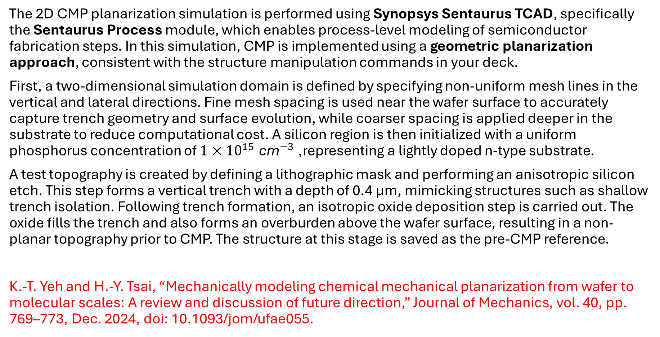
Simulation of 2D Chemical Mechanical Polishing (CMP) Planarization
The 2D CMP planarization simulation is performed using Synopsys Sentaurus TCAD, specifically the Sentaurus Process module, which enables process-level modeling of semiconductor fabrication steps. In this simulation, CMP is implemented using a geometric planarization approach, consistent with the structure manipulation commands in your deck.
First, a two-dimensional simulation domain is defined by specifying non-uniform mesh lines in the vertical and lateral directions. Fine mesh spacing is used near the wafer surface to accurately capture trench geometry and surface evolution, while coarser spacing is applied deeper in the substrate to reduce computational cost. A silicon region is then initialized with a uniform phosphorus concentration of $1×{10}^{15} {\text{cm}}^{−3}$, representing a lightly doped n-type substrate.
A test topography is created by defining a lithographic mask and performing an anisotropic silicon etch. This step forms a vertical trench with a depth of 0.4 µm, mimicking structures such as shallow trench isolation. Following trench formation, an isotropic oxide deposition step is carried out. The oxide fills the trench and also forms an overburden above the wafer surface, resulting in a non-planar topography prior to CMP. The structure at this stage is saved as the pre-CMP reference.
K.-T. Yeh and H.-Y. Tsai, “Mechanically modeling chemical mechanical planarization from wafer to molecular scales: A review and discussion of future direction,” Journal of Mechanics, vol. 40, pp. 769–773, Dec. 2024, doi: 10.1093/jom/ufae055.

Slide 18
CMP planarization is modeled using the transform cut command, which removes material above a specified reference plane across the entire lateral domain. This operation emulates an ideal CMP process by eliminating the oxide overburden while retaining oxide inside the trench. Although this approach does not explicitly model slurry chemistry, pad properties, or pressure distribution, it effectively captures the final planarized geometry. The post-CMP structure is then saved for comparison and analysis.
To evaluate planarization performance, one-dimensional vertical profiles are extracted at selected lateral positions using print.1d. A cut taken outside the trench represents the field region, while a cut through the center of the trench represents the filled region. By comparing these profiles before and after CMP, the remaining step height can be assessed, and planarization efficiency can be inferred. In this simulation, the near-zero height difference after the transform cut indicates ideal planarization.
Overall, this Sentaurus TCAD–based 2D CMP simulation provides a simplified yet effective means to study post-CMP geometry, trench fill quality, and planarization efficiency. While it does not capture physical CMP effects such as dishing, erosion, or slurry–pad interactions, it is well suited for structural verification and comparative planarization studies in early process development.
Tool Used:- Synopsys Sentaurus TCAD – SProcess module
SProcess is a topography and process simulator used to model fabrication steps such as etching, deposition, and CMP planarization in 2D/3D.
K.-T. Yeh and H.-Y. Tsai, “Mechanically modeling chemical mechanical planarization from wafer to molecular scales: A review and discussion of future direction,” Journal of Mechanics, vol. 40, pp. 769–773, Dec. 2024, doi: 10.1093/jom/ufae055.

Slide 19
Model Parameters used
Substrate Parameters
Material = Silicon
Dopant = Phosphorus
Dopant concentration = 1.0 × 10¹⁵ cm⁻³
Region bounds:
  xlo = Top
  xhi = Bottom
  ylo = Left
  yhi = Right
Mask Parameters
Mask name = trench_mask
Left boundary = 3.0 µm
Right boundary = 7.0 µm
K.-T. Yeh and H.-Y. Tsai, “Mechanically modeling chemical mechanical planarization from wafer to molecular scales: A review and discussion of future direction,” Journal of Mechanics, vol. 40, pp. 769–773, Dec. 2024, doi: 10.1093/jom/ufae055.

Slide 20
Etching Parameters
Material etched = Silicon
Etch type = Anisotropic
Etch depth (thickness) = 0.4 µm
Mask used = trench_mask
Deposition Parameters
Material deposited = Oxide (SiO₂)
Deposition type = Isotropic
Deposition time = 1
Deposition rate = 0.7 µm/unit time
Total deposited thickness ≈ 0.7 µm
CMP / Planarization Parameters
Cut minimum coordinates = (−0.3 µm, −1.0 µm)
Cut maximum coordinates = (2.0 µm, 11.0 µm)
K.-T. Yeh and H.-Y. Tsai, “Mechanically modeling chemical mechanical planarization from wafer to molecular scales: A review and discussion of future direction,” Journal of Mechanics, vol. 40, pp. 769–773, Dec. 2024, doi: 10.1093/jom/ufae055.

Slide 21
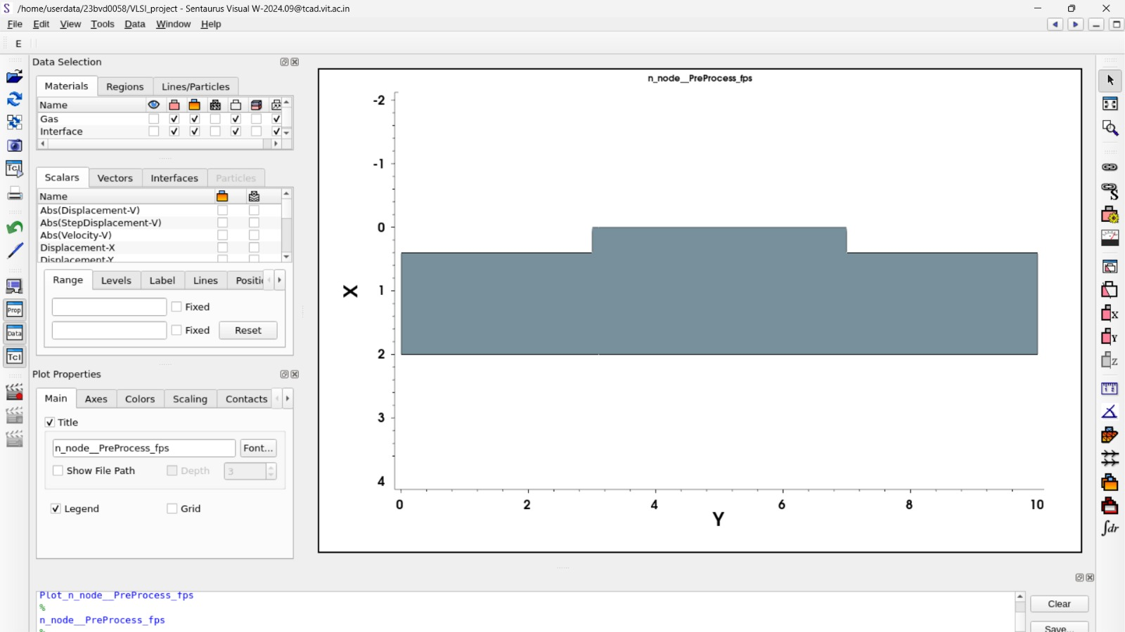
Sentaurus Simulation Strucutres:-
Pre-CMP:-
The figure titled “n_node__PreProcess_fps” represents a 2D cross-sectional structure generated in Sentaurus Visual during the preprocessing stage. The geometry is plotted with Y as the lateral axis (0–10 units) and X as the vertical axis (approximately –2 to 4 units). The structure consists of a single continuous layer with a non-uniform, step-like top surface profile. Specifically, the base of the structure is uniform at around X ≈ 2, while the top surface is lower (X ≈ 0.5) in the outer regions (Y ≈ 0–3 and 7–10) and rises to a higher level (X ≈ 0) in the region (Y ≈ 3–7), forming a central plateau. No scalar fields or physical quantities are visualized, indicating that this is purely a geometrical representation prior to further processing (e.g., etching or deposition). The plot settings show basic visualization with title and legend enabled, and no customized scaling or range selection applied.
K.-T. Yeh and H.-Y. Tsai, “Mechanically modeling chemical mechanical planarization from wafer to molecular scales: A review and discussion of future direction,” Journal of Mechanics, vol. 40, pp. 769–773, Dec. 2024, doi: 10.1093/jom/ufae055.

Slide 22
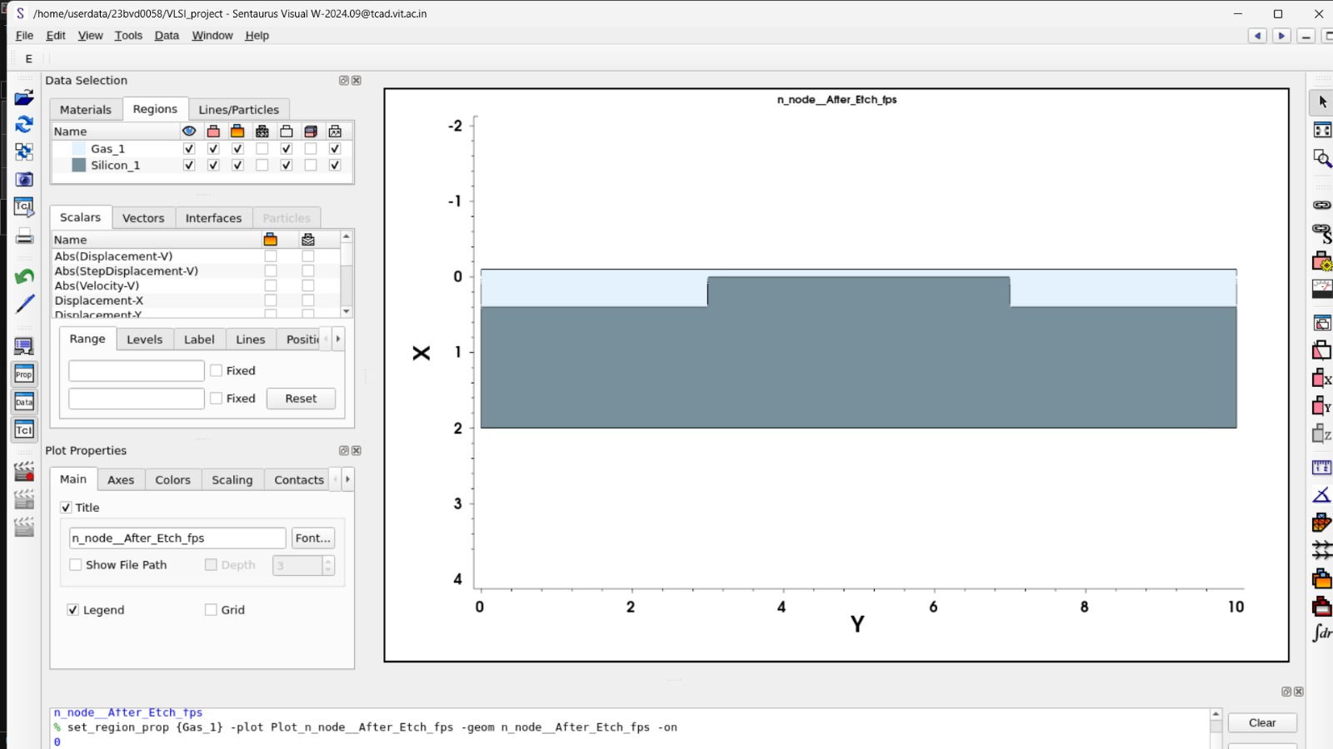
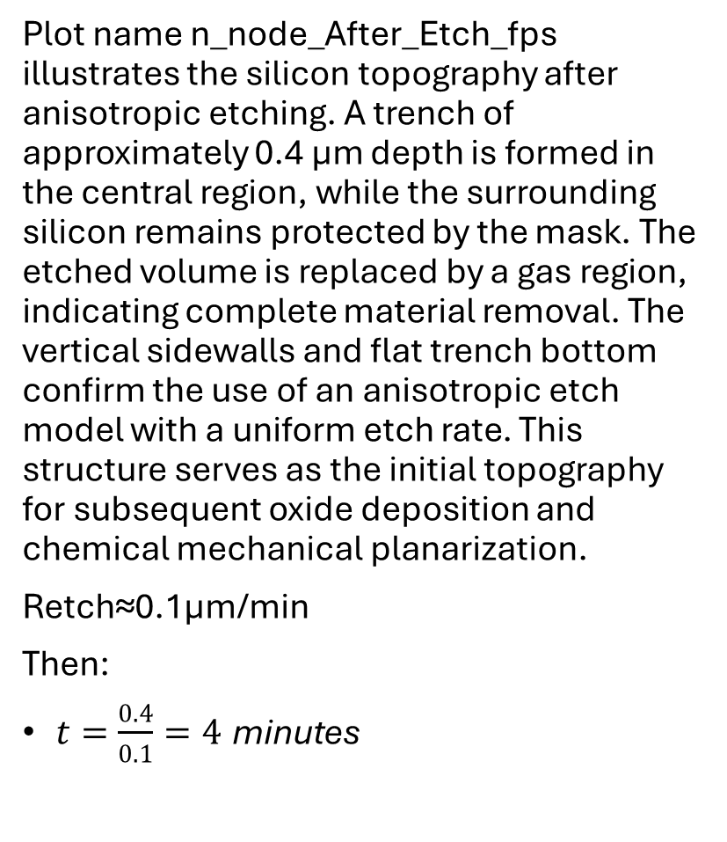
Plot name n_node_After_Etch_fps illustrates the silicon topography after anisotropic etching. A trench of approximately 0.4 µm depth is formed in the central region, while the surrounding silicon remains protected by the mask. The etched volume is replaced by a gas region, indicating complete material removal. The vertical sidewalls and flat trench bottom confirm the use of an anisotropic etch model with a uniform etch rate. This structure serves as the initial topography for subsequent oxide deposition and chemical mechanical planarization.
Retch​≈0.1μm/min
Then:
$t=\frac{0.4}{0.1}=4 \text{minutes}$
K.-T. Yeh and H.-Y. Tsai, “Mechanically modeling chemical mechanical planarization from wafer to molecular scales: A review and discussion of future direction,” Journal of Mechanics, vol. 40, pp. 769–773, Dec. 2024, doi: 10.1093/jom/ufae055.

Slide 23
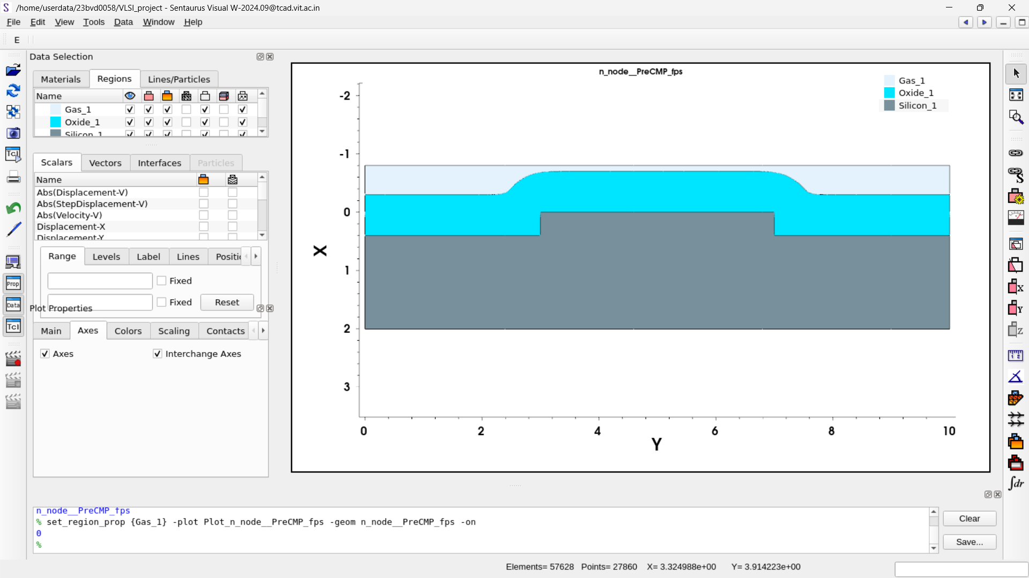
This image shows a 2D Pre-CMP structure simulated using Synopsys Sentaurus TCAD (SProcess). A silicon substrate is first initialized and then anisotropically etched by 0.4 µm to form a rectangular trench. After etching, an oxide layer is deposited isotropically with a deposition rate of 0.7 µm per unit time for time = 1, resulting in an oxide thickness of approximately 0.7 µm over the surface and inside the trench. This produces a non-planar topography with oxide overburden above the trench, which is the initial structure used for the subsequent CMP planarization step.
Image of Structure before CMP
K.-T. Yeh and H.-Y. Tsai, “Mechanically modeling chemical mechanical planarization from wafer to molecular scales: A review and discussion of future direction,” Journal of Mechanics, vol. 40, pp. 769–773, Dec. 2024, doi: 10.1093/jom/ufae055.

Slide 24
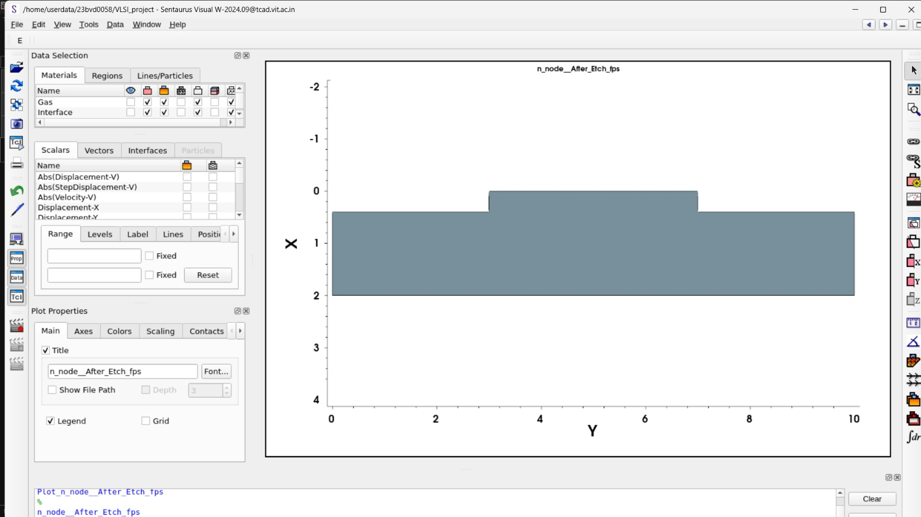
Post-CMP :-
The plot titled n_node_After_Etch_fps shows the post-etch silicon topography obtained using an anisotropic etch model in Sentaurus Process. A trench of approximately 0.4 µm depth is formed in the central region, corresponding to the mask opening between 3 µm and 7 µm. The anisotropic etch removes silicon predominantly in the vertical direction, producing near-vertical sidewalls and a flat trench bottom. The etched depth corresponds to the specified etch thickness, which can be related to the etch rate and process time. This etched profile serves as the initial topography for subsequent oxide deposition and CMP planarization.
K.-T. Yeh and H.-Y. Tsai, “Mechanically modeling chemical mechanical planarization from wafer to molecular scales: A review and discussion of future direction,” Journal of Mechanics, vol. 40, pp. 769–773, Dec. 2024, doi: 10.1093/jom/ufae055.

Slide 25
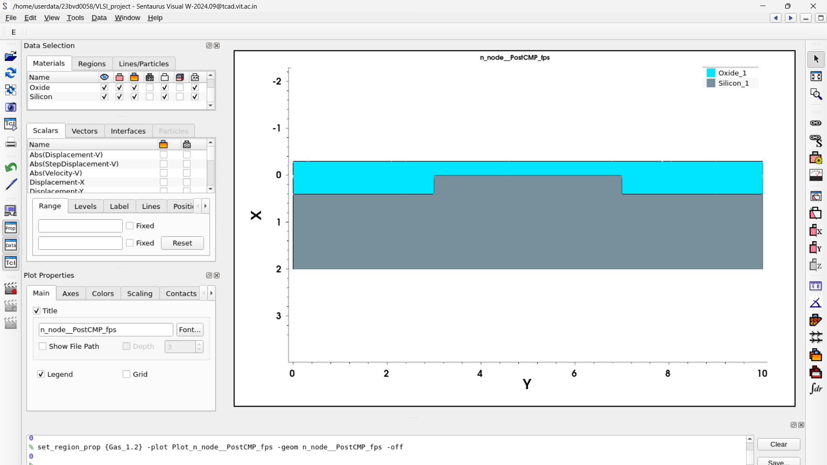
This image shows the 2D Post-CMP structure simulated using Synopsys Sentaurus TCAD (SProcess). After oxide deposition, the initially non-planar surface containing a central oxide overburden is planarized. The planarization is implemented using Chemical Mechanical Planarization (CMP) model. Based on the print.1d outputs at multiple lateral positions, the top oxide surface is observed at nearly the same depth (~ -0.299 µm), confirming that the surface has become uniformly flat.The resulting structure consists of a silicon substrate covered by a planar oxide layer with no significant height variation across the surface. This indicates successful removal of the central bump and achievement of global planarization. The CMP process is assumed to be ideal, with complete removal of surface topography and no dishing or erosion effects
Image of Structure after CMP
K.-T. Yeh and H.-Y. Tsai, “Mechanically modeling chemical mechanical planarization from wafer to molecular scales: A review and discussion of future direction,” Journal of Mechanics, vol. 40, pp. 769–773, Dec. 2024, doi: 10.1093/jom/ufae055.

Slide 26
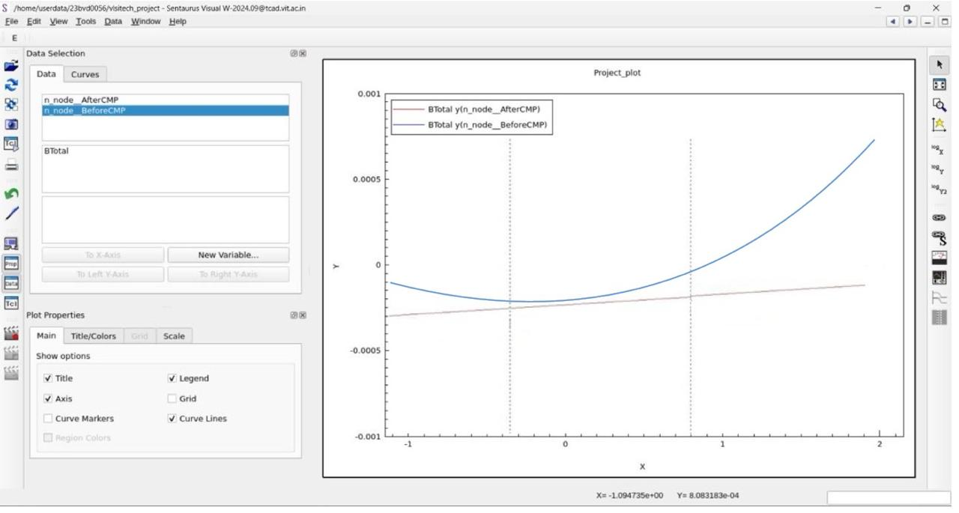
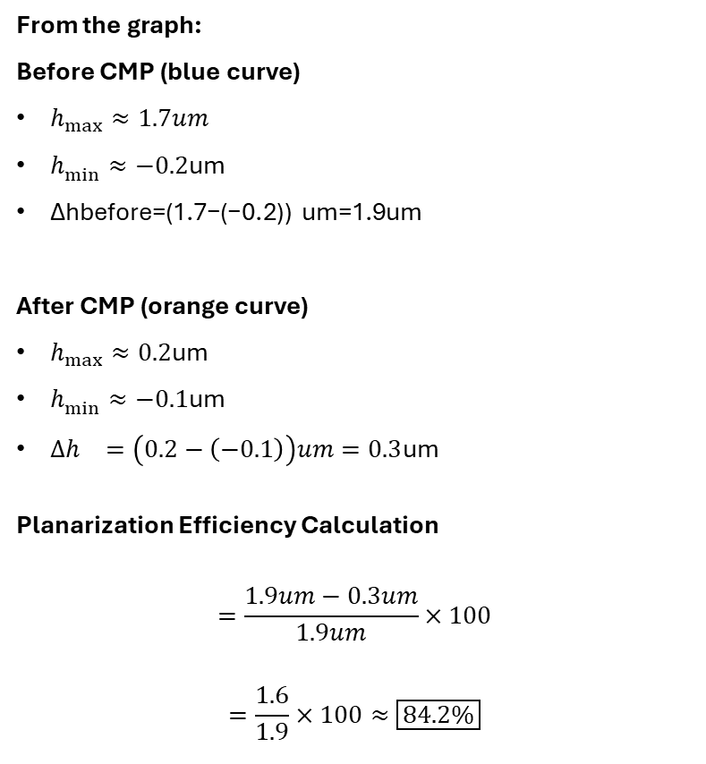
Calculation of Planarization Efficiency:-
From the graph:
Before CMP (blue curve)
$h_{max}^{⁡}≈1.7um$
$h_{min}^{⁡}≈−0.2$um
Δhbefore​=(1.7−(−0.2)) um=1.9um
After CMP (orange curve)
$h_{max}^{⁡}≈0.2$um
$h_{min}^{⁡}≈−0.1$um
$Δh_{}=\left(0.2−\left(−0.1\right)\right)um=0.3$um
Planarization Efficiency Calculation
$$=\frac{1.9um−0.3um}{1.9um}×100$$
$$=\frac{1.6}{1.9}×100≈\boxed{84.2\%}$$
Plot of PreCMP v/s PostCMP using Sentaurus Svisual

Slide 27
Limitations of current CMP models
Current Chemical Mechanical Planarization (CMP) models suffer from several inherent limitations due to the complex, multiscale nature of the process. Most widely used models, such as Preston-based models, assume a linear relationship between material removal rate, pressure, and velocity, which fails to capture nonlinear effects arising from slurry chemistry, pad aging, and temperature variations. These models treat the Preston coefficient as a constant, even though it strongly depends on local chemistry, abrasive interactions, and material properties.
Many CMP models rely on purely mechanical or purely geometric assumptions, neglecting the true chemical–mechanical synergy at the wafer–pad interface. As a result, they cannot accurately predict defect mechanisms such as dishing, erosion, scratching, or corrosion. In addition, pattern-density effects and feature-scale variations are often averaged out, limiting model accuracy for advanced, highly patterned interconnect layouts.
Another major limitation is the lack of microscale and nanoscale contact modeling. Real CMP involves stochastic pad asperity contacts and abrasive dynamics, which are difficult to represent using continuum-based or empirical models. Furthermore, most existing models are material-specific and require extensive experimental calibration, reducing their predictive capability and general applicability across different processes and materials.
M. Krishnan, J. W. Nalaskowski, and L. M. Cook, “Chemical Mechanical Planarization: Slurry Chemistry, Materials, and Mechanisms,” Chemical Reviews, 2009.

Slide 28
Future Scope
The scope of this work can be significantly expanded by moving beyond ideal CMP modeling to include physically realistic effects such as dishing, erosion, scratching, and non-uniform material removal.
Incorporating slurry chemistry parameters, pad wear, temperature effects, and pressure non-uniformity would allow a more accurate representation of industrial CMP processes.
Extending the simulations from 2D to full 3D structures would enable the study of layout- and pattern-density–dependent planarization effects, which are critical in advanced interconnect technologies.
Future studies may also focus on CMP of different materials such as copper, low-k dielectrics, and barrier layers to evaluate selectivity and defect mechanisms. Integration of CMP simulations with experimental calibration data can enhance model reliability and predictive capability.
Additionally, machine learning–assisted CMP optimization and multi-physics coupling (mechanical, chemical, and thermal) can be explored to improve process control and scalability for next-generation semiconductor technology nodes.

Slide 29
Conclusion
This project successfully demonstrates the role of Chemical Mechanical Planarization (CMP) in achieving surface flatness using Synopsys Sentaurus TCAD. A two-dimensional process flow involving trench etching, oxide deposition, and CMP planarization was modeled to study surface topography evolution. The results show that CMP effectively removes oxide overburden and produces a uniformly planar surface, which is essential for advanced semiconductor fabrication. Although the simulation assumes ideal CMP behavior and does not include defect mechanisms such as dishing or erosion, it provides clear insight into planarization efficiency and geometry evolution. Overall, the study highlights the usefulness of TCAD-based CMP modeling as a valuable tool for understanding and analyzing planarization processes in early-stage process development.

Slide 30
References
M. Krishnan, J. W. Nalaskowski, and L. M. Cook, “Chemical Mechanical Planarization: Slurry Chemistry, Materials, and Mechanisms,” Chemical Reviews, 2009.
P. B. Zantye, A. Kumar, and A. K. Sikder, “Chemical mechanical planarization for microelectronics applications,” Materials Science and Engineering R, vol. 45, pp. 89–220, 2004.
K. Gamagedara and D. Roy, “Experimental strategies for studying tribo-electrochemical aspects of chemical mechanical planarization,” Lubricants, vol. 12, no. 2, 2024.
T.-Y. Kwon, M. Ramachandran, and J.-G. Park, “Scratch formation and its mechanism in chemical mechanical planarization (CMP),” Friction, vol. 1, no. 4, pp. 279–305, Dec. 2013, doi: 10.1007/s40544-013-0026-y.
K.-T. Yeh and H.-Y. Tsai, “Mechanically modeling chemical mechanical planarization from wafer to molecular scales: A review and discussion of future direction,” Journal of Mechanics, vol. 40, pp. 769–773, Dec. 2024, doi: 10.1093/jom/ufae055.
G. Winkler, T. Rothe, M. A. Sayyed, L. Jäckel, J. Langer, H. Kuhn, and M. Stoll, “Machine learning in chemical–mechanical planarization: A comprehensive review of trends, applications, and challenges,” Advanced Engineering Informatics, vol. 68, Nov. 2025, Art. no. 103663, doi: 10.1016/j.aei.2025.103663.
D. Müller, S. Park, I. González, P. Nowak, J. Chen, and A. Rahman,“Nanoparticles for chemical mechanical planarization: A review,” Nanomaterials, vol. 15, no. 17, 2025.
S. B. K. Vrudhula and S. Sapatnekar,“Statistical and machine learning methods for semiconductor manufacturing,”IEEE Transactions on Semiconductor Manufacturing, vol. 34, no. 3, pp. 321–335, Aug. 2021.
S. Luo, D. A. Dornfeld, and F. Pei,“Material removal mechanism in chemical mechanical planarization: From wafer to molecular scale,”IEEE Transactions on Semiconductor Manufacturing,
vol. 14, no. 2, pp. 112–133, May 2001.
S. Luo, D. A. Dornfeld, and F. Pei,“Mechanisms of defect generation in chemical mechanical polishing,”
Wear, vol. 257, nos. 9–10, pp. 1005–1013, 2004.
H. Bellahsene, S. Sene, G. Félix, J. Larionova, M. Ferrari, and Y. Guari,“Nanoparticles for chemical mechanical planarization: A review,”Nanomaterials, vol. 13, no. 17, Article 2456, 2023.
B. H. Cook,“Chemical processes in chemical mechanical polishing,”Journal of The Electrochemical Society,vol. 137, no. 6, pp. 1937–1944, 1990.

