Slide 1
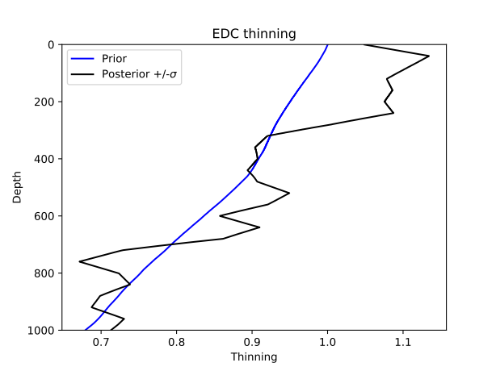
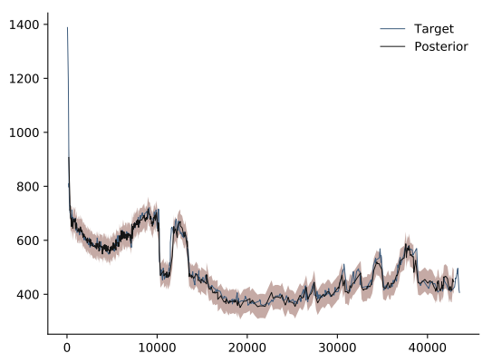
Problem : Synchronization can be achieved between two physically unrealistic chronologies. The AICC2012 prior sigmas are too high, and don’t appropriately weight the synchronization with respect to the priors. (Or the synchronization sigmas are too low, alternatively.)

Slide 2
Test :
Accumulation variance *1/2
LID variance * 1/2
Thinning variance *1/10
10000 iterations with 128 walkers (convergence ?)

Slide 3
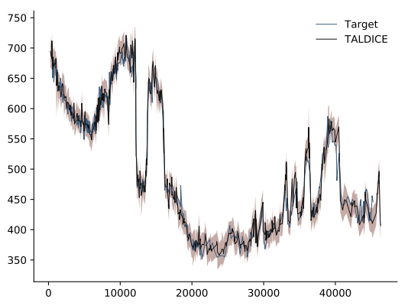
EDC
Methane synchronization between EDC and TALDICE, both cores free to vary
Synchronized series not difficult to achieve
CH₄ (ppmv)
Age (yr BP)

Slide 4
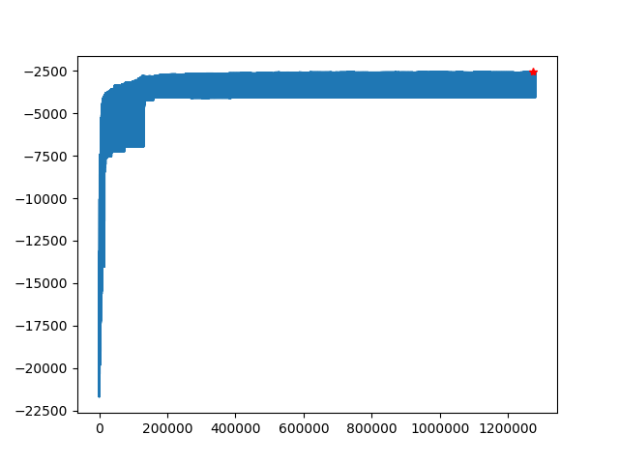
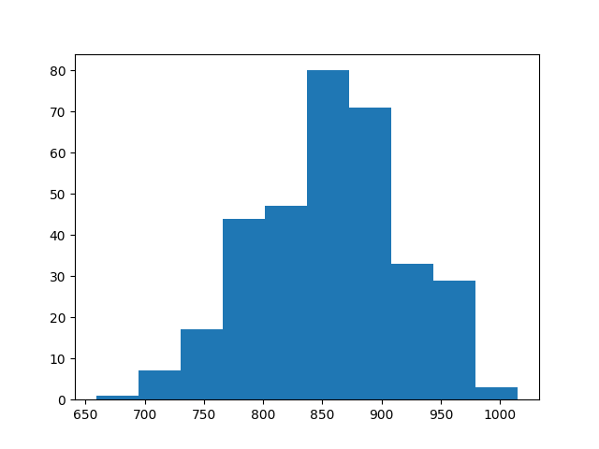
Cost function value
Number of chains
Iterations (flattened)
Autocorrelation time
Evolution of cost function with number of iterations, flattened over all walkers (i.e. 10000 iterations * 128 walkers) : appears to have roughly converged
Autocorrelation times of chains (I’m not sure if I have implemented the calculation correctly, but will check. This will be of use for assessing convergence and the effective number of independent samples.)

Slide 5
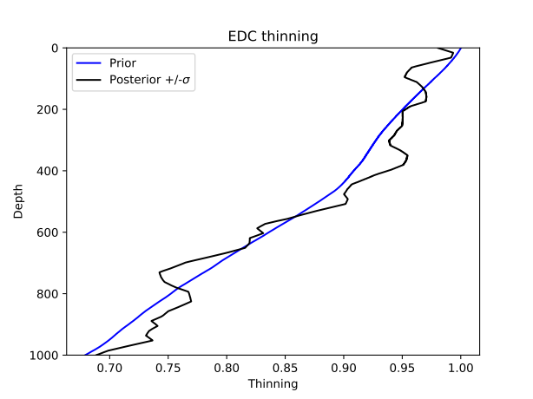
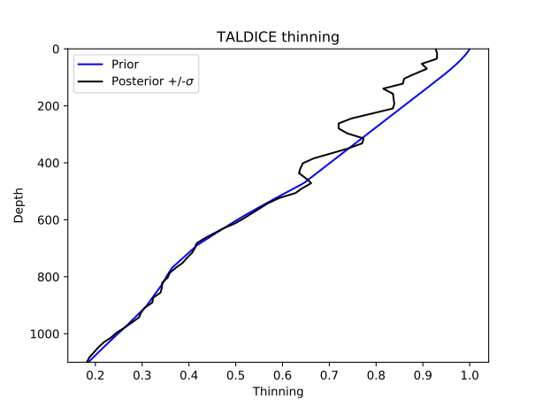
Thinning functions : results reasonably close to prior. Do we need to force tau = 0 at 0 meters depth ?

Slide 6
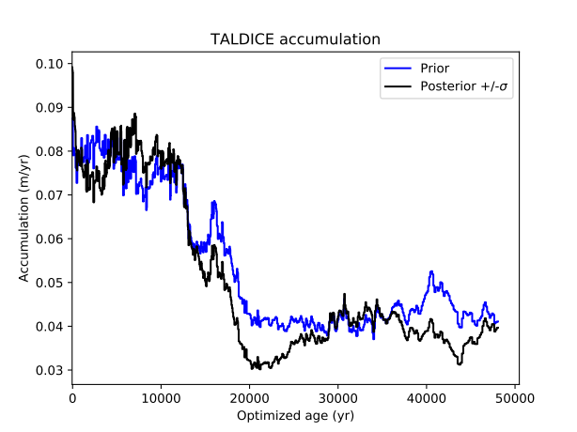
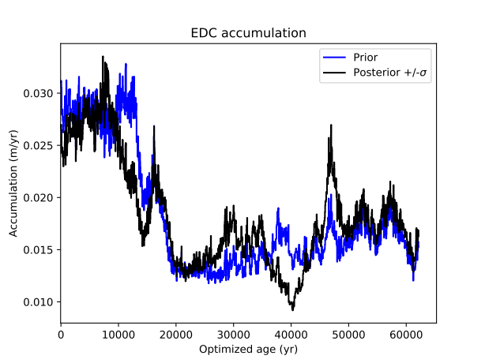
Accumulation : seems reasonably close to prior, but EDC does not appear to be correct in the Holocene. Should we be more confident in accumulation at EDC ?

Slide 7
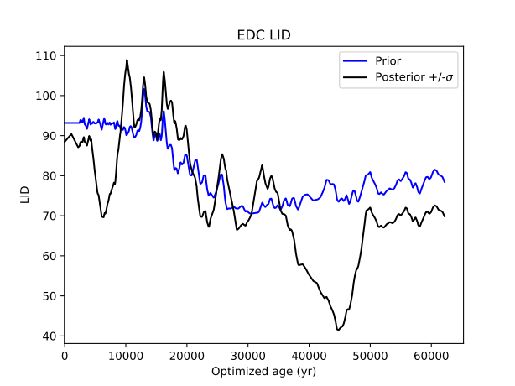
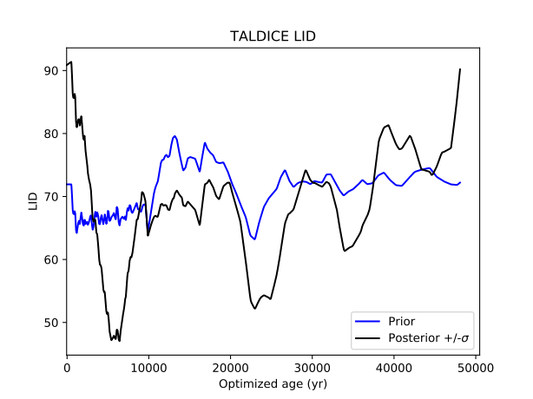
LID : varies considerably (should be parameter changed the most in gas phase synchronization). But again, we could assign more confidence.

Slide 8
Synchronization without external chronological information is an ill-posed problem.
The synchronization term dominates the cost function because we have so many points of information.
Reducing the prior sigmas can help balance the problem. In AICC2012, each of the prior sigmas were calculated via relationships with proxies, but these relationships included arbitrarily-defined constants. We could re-evaluate these constants.
Eventually, we should bring back discrete dated points and intervals to obtain a correct synchronization. Here too, though, we have to make sure that we are weighting the synchroniation term correctly with respect to the prior and discrete terms.
Question : should we adjust the prior sigmas or the synchronization sigmas ??
One « dirty » way to do so could be to look at the ratio of the sum of the cost function of the discrete synchronized points in AICC2012 with respect to the total AICC2012 cost function.

