Slide 1
Cyber Bullying Detection using Machine Learning
1814033 : Atharva Kitkaru
1814036 : Jai Mehta
1814037 : Rachit Mehta

Slide 2
Why do we need Cyberbullying Detection?
The radius of social network is increasing at an unfathomable rate.
With this continuously expanding network, there is an increase in the amount of cyberbullying attacks and crimes that happen on the applications and the sites that use this social network as the means of communication.
These activities, are a threat to other people, as they may lead to depression, anxiety, suicidal thoughts etc… in the targeted person.
To detect these cyberbullying threats and reduce their amount, we need an efficient system, that would be able to detect these, and would be able to bring down their amount considerably, thereby protecting the privacy of others using the social network.

Slide 3
What work has been done in this area?
There have been several trials on building this system in the past using the Machine Learning based approach.
Later on, the scientists chose Neural Networks (Convolutional and Recurrent) methods and deep learning in modelling of the language.
Besides this approach, there was a Lexicon approach too, that used to identify the sentiments behind the text. But, the machine learning approach was preferred over the Lexicon approach.
Few methods were also designed on the bases of personal data like the followers and friends of a person for bullying detection. These methods achieved an overall accuracy of approximately 86%

Slide 4
(Cont.)
The very famous example supporting this research would be the implementation of rumour detection in the social media app Whatsapp, which detects the messages that may be rumours and are spreading quickly through the network.
Even the application Instagram has a team that detects the presence of fake information and takes it down. In-fact Instagram, has a dedicated team to aid this detection of rumours.

Slide 5
Methodology

Slide 6
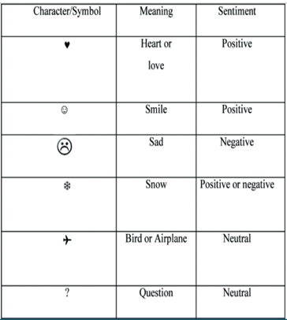
Pre-processing of Data
Issues with raw data:
Emoticons, folksonomies, slang, censored words. short message texts
Steps for preprocessing:
•Converting uppercase letters to lowercase
•Removal of URLS
•Removal of punctuations and hashtags..
•Appropriate conversion of symbols/emoticons into text.
•Removal of stop words(and, or, how, but).
•Word stemming into root form i.e. removal of prefixes and suffixes

Slide 7
Tokenization and Feature Extraction
Tokenization: splitting a phrase, sentence, paragraph, or an entire text document into smaller units, such as individual words or terms.
Word embeddings: Method of extracting features out of text so that we can input those features into a machine learning model to work with text data.
2 types of Word Embeddings: Frequency and prediction based
Examples of Frequency based : Bag of Words(BOW), CountVectorizer and TFIDF
Examples of Prediction based: Word2Vec, Glovec
For example, “The capital of California is Sacramento.”, the word “capital” can be encoded as [0 1 0 0 0 0] and Sacramento can be encoded as [0 0 0 0 0 1].

Slide 8
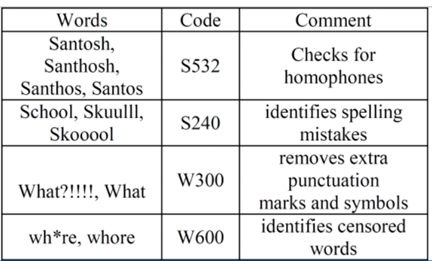
Bag of Phonetic Codes Representation
Converts phonetically similar words to same code using Soundex algorithm.
Each tweet is represented as a vector. The number of items in the vector representing a tweet corresponds to the number of unique phonetic codes in the vocabulary. It contains 18425 unique codes. So there will be that many elements for the vector

Slide 9
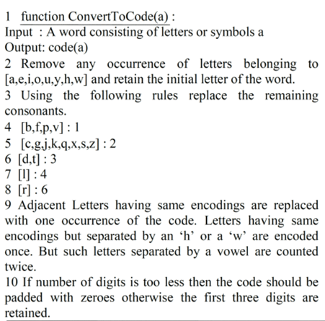
Soundex Algorithm

Slide 10
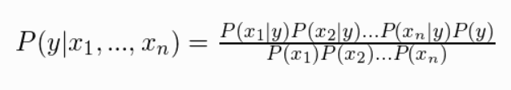
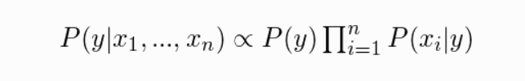
Naïve Bayes Classifier
A Naive Bayes classifier is a probabilistic machine learning model that’s used for classification task
Naive Bayes classifiers are a collection of classification algorithms based on Bayes’ Theorem.
All of them share a common principle, i.e. every pair of features being classified is independent of each other.
The model that has been used here is Multinomial Naive Bayes
Assuming x1,x2…xn are independent events
Since denominator is constant for a given input, we can remove that term and the equation becomes:

Slide 11
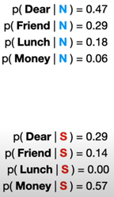

Example
Let's assume that there are 2 types of tweets : Bully (S) and not bully (N)
Probability of 4 words appearing in each message are given here
If a particular tweet contains ‘Dear Friend’, the probability of that message being a bullying or a non bullying tweet is given below
Since the the probability of tweet being not a bullying one is higher, it will get classified as ‘Non Bullying’

Slide 12
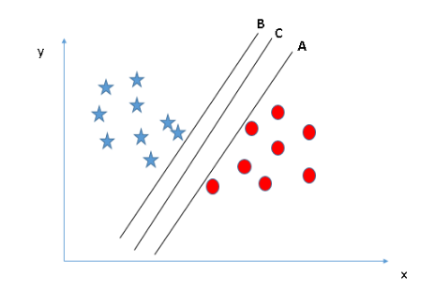
Support Vector Machine (SVM)
Each data item is a point in n-dimensional space.
We perform classification by finding the hyper-plane that differentiates the two classes with highest margin.
SVM selects the hyper-plane which classifies the classes accurately prior to maximizing margin
The dimension of the hyperplane depends upon the number of features.
2 Features: Line, 3 Features : plane
Support vectors : data points that are closer to the hyperplane and influence the position and orientation of the hyperplane.

Slide 13
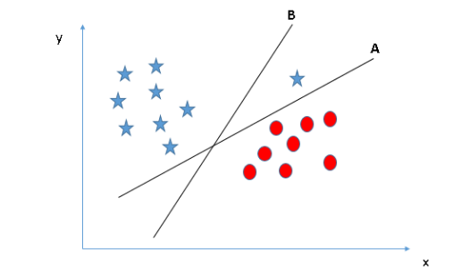
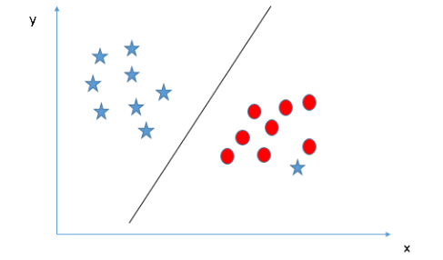
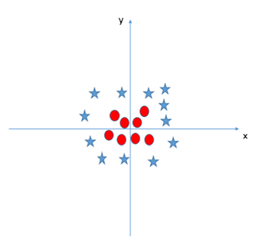
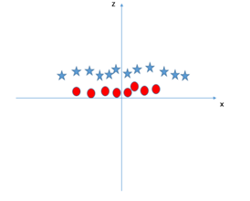
Scenario 1
Scenario 2: Outliers
Scenario 3: Linear hyperplane not possible. So extra feature is added.

Slide 14
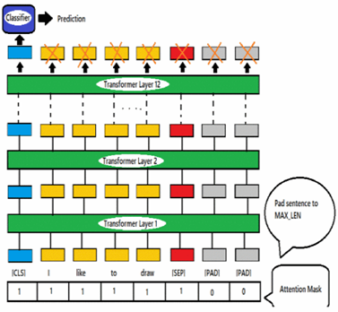
BERT (Bidirectional Encoder Representations from Transformers)
BERT makes use of Transformer, an attention mechanism that learns contextual relations between words (or sub-words) in a text.
Transformer encoder reads the entire sequence of words at once. Therefore it is considered bidirectional. This characteristic allows the model to learn the context of a word based on all of its surroundings
Input - provides required text sentences with the corresponding labels (0-not bully, 1-bully) to the BERT tokenization layer.

Slide 15
BERT (Bidirectional Encoder Representations from Transformers)
Tokenization - Tokenizer provided by the BERT model is used. It is used to convert the words in the text to integer tokens determined by the pre-trained vocabulary of BERT.
BERT-Base-Model - We have used the “BERT-base-uncased” model which provides a pre-trained model for lowercased English language and consists of 12 layers of transformer encoders to encode the language data. The model is fine-tuned on the dataset to learn dataset-specific vocabulary and generate the corresponding embeddings.
The special token [CLS] which is also the first token in the input to BERT contains the sentence embedding as a 768 sized vector which is then used to classify the sentence.

Slide 16
CNN
Convolutional filters learn relevant features from the pair of word embeddings using the ‘GloVe' property that comparable words have similar cosine distances, and cosine distances are similar to dot products, and the dot product is essentially a convolution
Because we only slide the window in one direction, 1-D convolution is used for text.
Padding is essential to ensure that the input and output are the same size.
Use max-pooling to get the maximum activation value from the convolution that passes through the entire text.
We apply more dense layers and a multi-layered perceptron, and train it for classification tasks.
GloVe: GloVe is a word vector representation acquisition algorithm that uses unsupervised learning. The GloVe model is trained on a global collection of word-word co-occurrence statistics, with the results revealing a linear structure of words in vector space.

Slide 17
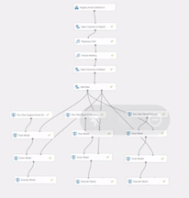
Implementation using Microsoft Azure

Slide 18
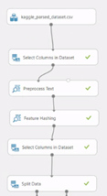
(Cont.)

Slide 19
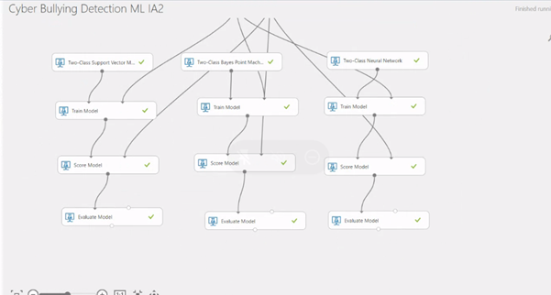
(Cont.)

Slide 20
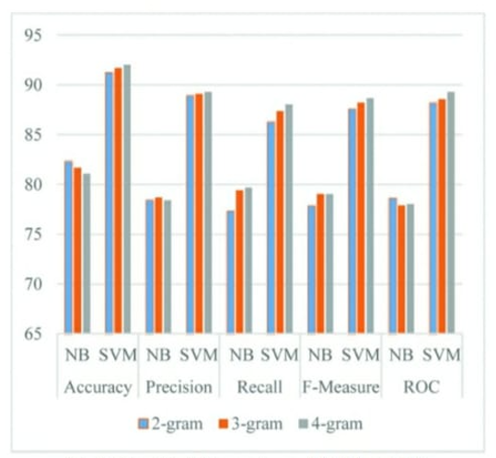
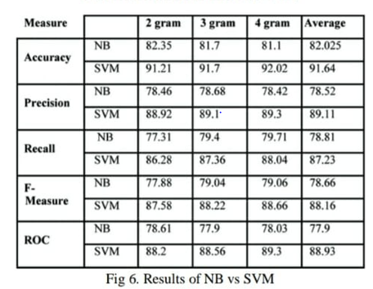
Results
SVM is better than NB based models

Slide 21
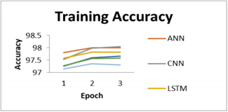
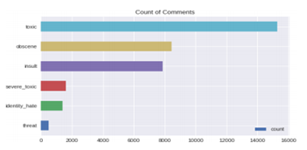
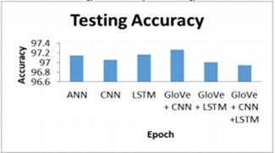
Results

Slide 22
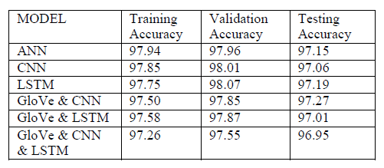

Where TP = True Positives, TN = True Negatives,
FP = False Positives, and FN = False Negatives.
In conclusion, Glove & CNN performs the best and Glove & CNN & LSTM performs the worst in terms of training and testing, loss and accuracy.

Slide 23
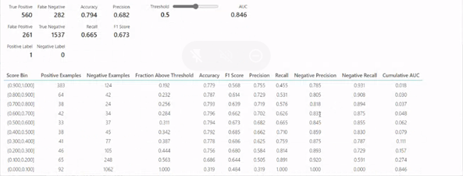
Result of Azure Model (SVM)

Slide 24
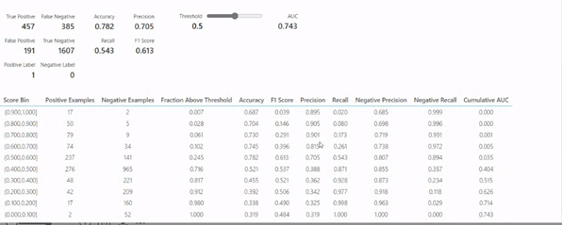
Result of Azure Model (Naive Bayes)

Slide 25
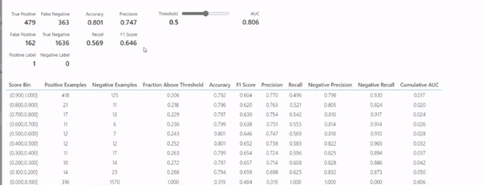
Result of Azure Model (Neural Networks)
We can conclude from our research that CNN performs the best in the detection of cyber- bullying on social media platforms. After CNN comes the SVM and last comes the Naïve Bayes.

Slide 26
Future Scope
These models can be used by social media platforms to enhance the performance of existing model and perhaps manual reporting of abusive comments won’t be needed anymore.
Accuracy of the neural networks can be increased by training it on a much larger database of texts and adding more layers in network to improve performance.

Slide 27
Challenges
Most of the texts are not explicitly dismissive but categorizing them becomes difficult because of the structure of the text.
Some texts use some quotes from some movie or a book that are intended to dismiss the relevant individual that are not necessarily picked up by these models.
To classify different types of text the models need to be trained beforehand and that is not always feasible.

Slide 28
References
[1 ]A. Shekhar and M. Venkatesan, "A Bag-of-Phonetic-Codes Model For Cyberbullying Detection in Twitter"
[2] J. O. Atoum, "Cyberbullying Detection Through Sentiment Analysis"
[3] J. Yadav, D. Kumar and D. Chauhan, "Cyberbullying Detection using Pre-Trained BERT Model"
[4] M. Anand and R. Eswari, "Classification of Abusive Comments in Social Media using Deep Learning"
[5] M. S. Nikhila, A. Bhalla and P. Singh, "Text Imbalance Handling and Classification for Crossplatform Cyber-crime Detection using Deep Learning"
[6] Desai Aditya, Kalaskar Shashank, Kumbhar Omkar, Dhumal Rashmi. “Cyber Bullying Detection on Social Media using Machine Learning.”
[7] Mody A, Shah S, Pimple R, Shekokar N. ,“Identification of Potential Cyber Bullying Tweets using Hybrid Approach in Sentiment Analysis”

Slide 29
Thank You!

