Slide 1

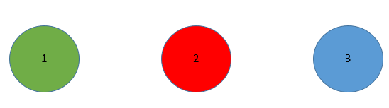
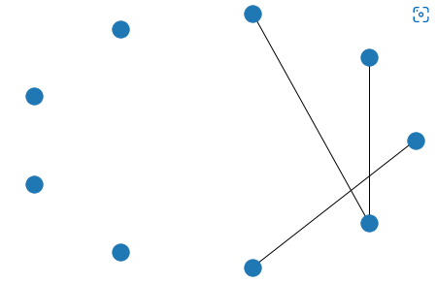
Building a Data Pipeline to Analyse Symmetries in Networks
Jai Prathap Gomathi Veerakumar, 201570386,
MSc Data Science and Analytics
Leeds University, 2021/22
LOGOS.
Can go
HERE.
LOGOS
Can go.
HERE.
Background
Graph and Group Theory are the mathematical concepts used to analyse symmetry.
Network symmetries can be used for dimension reduction in the analysis of dynamical processes on networks (Ward, 2021).
Results/stage of the work
Table.1 Number of graphs in each vertices
The number of graphs increases exponentially with the number of vertices.
Figure.1 A network with vertices 9
Vertex Orbit Length is 4. There are symmetries in this network.
Aim
To build a Data Pipeline to analyse the symmetries in a network
Mathematical Concepts
Figure.3 A simple 3 vertex graph
An example of the epidemic is taken to understand the symmetries. (S – Susceptible, I - Infected)
Possible Outcomes {SSS, ISS, SIS, SSI, SII, ISI, IIS, III} in the graph of figure 3.
Symmetries ISS = SSI and SII=IIS.
Symmetries are analysed to reduce the size of the dataset using the lower dimensional approximation method.
Vertices | Number of Graphs
2 | 2
3 | 4
4 | 11
5 | 34
6 | 156
7 | 1,044
8 | 12,346
9 | 274,668
10 | 12,005,168
11 | 1,018,997,864
Analysis Methods
Data Extraction
(McKay, n.d.)
Uploading Data and Installing Software in HPC
Auto morphism Analysis in GAP
Statistical Analysis and Visualisation in Python
Analyzing the Obtained results.
Literature cited
Ward, J. A. (2021). Dimension-reduction. RoyalSociety, 20.
McKay, B. (n.d.). Data fromat Page. Retrieved from https://users.cecs.anu.edu.au/~bdm/data/graphs.html
Acknowledgments
I like to thank my supervisor Jonathan A. Ward who taught me the mathematical concepts from the beginning and motivated and guided me successfully through the project.
Further information
Please email:
mm21jpgv@leeds.ac.uk
if you have a question or comment.
Notes:
Copyright Colin Purrington (http://colinpurrington.com/tips/academic/posterdesign).

