Slide 1

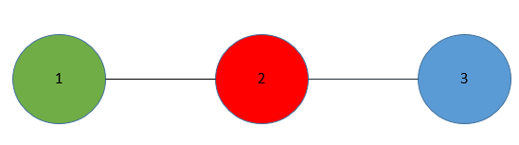
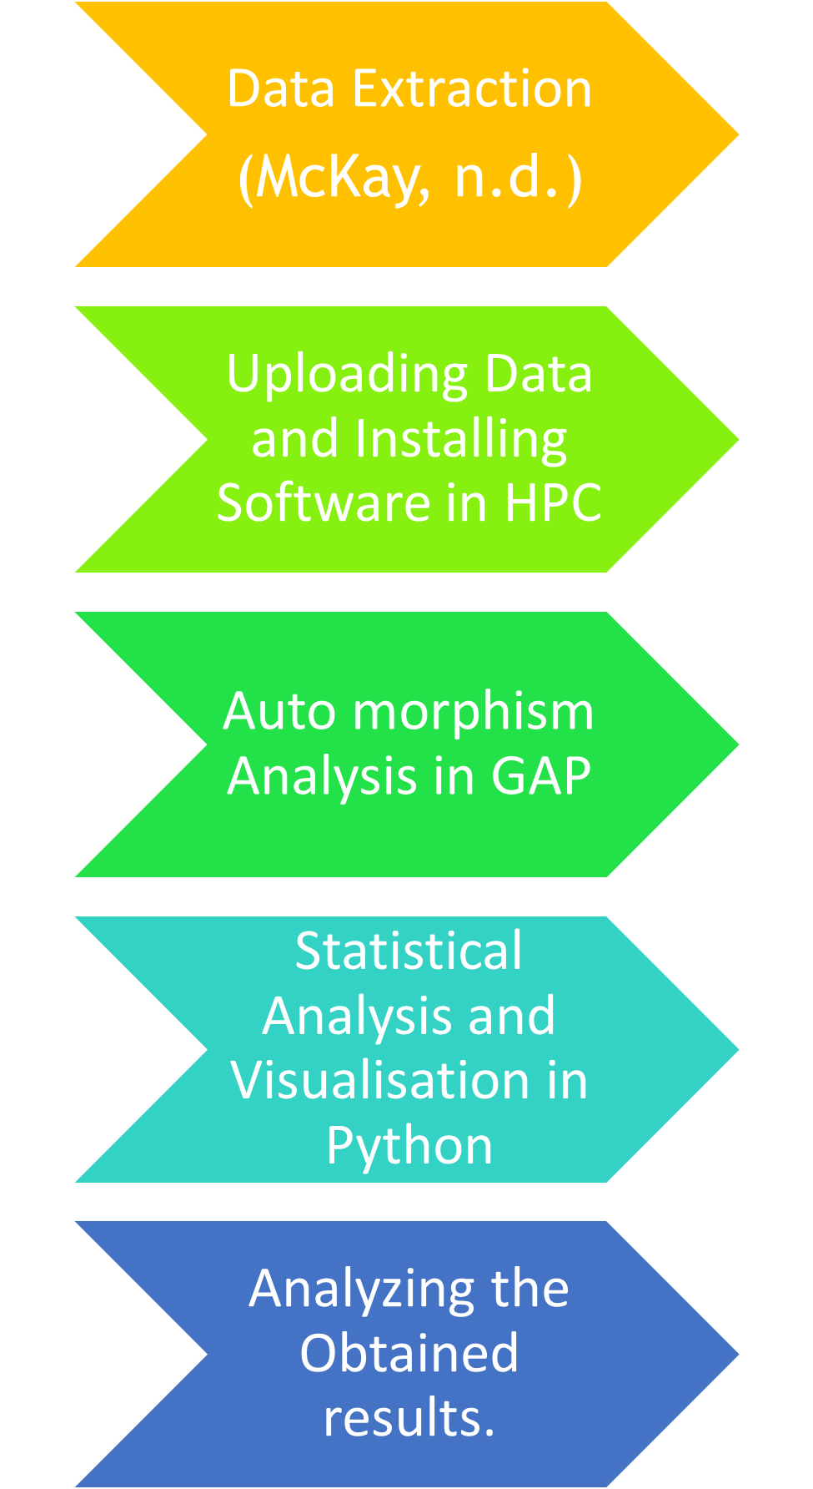
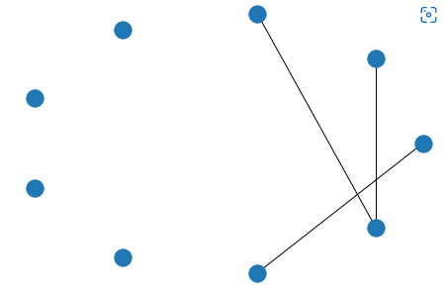
Jai Prathap Gomathi Veerakumar, 201570386,
MSc Data Science and Analytics
Leeds University, 2021/22
LOGOS.
Can go
HERE.
LOGOS
Can go.
HERE.
Background
Graph and Group Theory are the mathematical concepts used to analyse the auto morphism of graphs.
An automorphism of the graphs is carried out to analyse the symmetries in the network to reduce the dimension of the network (Ward, 2021).
Results/stage of the work
Table.1 Number of graphs in each vertices (McKay, n.d.)
The number of graphs increases with the increase in the vertices. There are possibilities of a network having 100 vertices, but the storage requirement is high.
Figure.1 A network with vertices 9
Vertex Orbit Length is 4. There are symmetries in this network.
Aim
To build a Data Pipeline to analyse the symmetries in a network
Mathematical Concepts
Figure.3 A simple 3 vertex graph
An example of the epidemic is taken to understand the symmetries. (S – Susceptible, I - Infected)
Possible Outcomes {SSS, ISS, SIS, SSI, SII, ISI, IIS, III} in the graph of figure 3.
Symmetries ISS = SSI and SII=IIS.
Symmetries are analysed to reduce the size of the dataset using the lower dimensional approximation method.
Vertices | Number of Graphs
2 | 2
3 | 4
4 | 11
5 | 34
6 | 156
7 | 1044
8 | 12346
9 | 274668
10 | 12005168
11 | 1018997864
Analysis Methods
Literature cited
Ward, J. A. (2021). Dimension-reduction. RoyalSociety, 20.
McKay, B. (n.d.). Data fromat Page. Retrieved from https://users.cecs.anu.edu.au/~bdm/data/graphs.html
Acknowledgments
I like to thank my supervisor Jonathan A. Ward who taught me the mathematical concepts from the beginning and motivated and guided me successfully through the project.
Further information
Please email:
mm21jpgv@leeds.ac.uk
if you have a question or comment.
Notes:
Copyright Colin Purrington (http://colinpurrington.com/tips/academic/posterdesign).

