Slide 1

RTOS
Jai Raja Saravanam S Emcog Solutions

Slide 2
Three ways of programming
Bare metal without interrupt (Super loop without interrupt)
Super loop with Interrupt
RTOS
Jai Raja Saravanam S Emcog Solutions

Slide 3

Activity 1
Glow three LED one after the other with one sec delay
Learning Objective :
Basic delay using HAL layer
Glow left to right
Jai Raja Saravanam S Emcog Solutions
Notes:
Round robin - time slice for every task in ready state
Priority based – based on priority

Slide 4
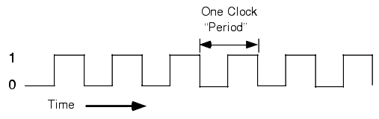


Timer
It is a register which increments (UP) or decrements(Down) based on input clock pulse
Consider 8 bit timer (UP),
t0
0 | 0 | 0 | 0 | 0 | 0 | 0 | 1
Decimal equivalent = 1
t1
0 | 0 | 0 | 0 | 0 | 0 | 1 | 0
Decimal equivalent = 2
t2
0 | 0 | 0 | 0 | 0 | 0 | 1 | 1
Decimal equivalent = 3
t3
0 | 0 | 0 | 0 | 0 | 1 | 0 | 0
.
Decimal equivalent = 4
.
.
Used to measure time
.
Overflow
.
tn
1 | 1 | 1 | 1 | 1 | 1 | 1 | 1
Decimal equivalent = 255
tn+1
0 | 0 | 0 | 0 | 0 | 0 | 0 | 0
Decimal equivalent = 0
Jai Raja Saravanam S Emcog Solutions

Slide 5
Timer
Timer
Timer
Counter
UP
UP
DOWN
DOWN
Based on Book definition : Uses internal clock
Based on Purpose : It is used to measure Time
Based on Book definition : Uses External clock
Based on Purpose : It is used to count event
Jai Raja Saravanam S Emcog Solutions

Slide 6
Timer
STM32F103C8T6
External Clock
Button
Timer
Prescaler
( 32 bit )
16 Bit timer register
Internal
Clock
ARR
16 Bit register
Jai Raja Saravanam S Emcog Solutions

Slide 7
STM32F103C8T6 – Timer Peripheral & Configuration
Timer 1 → Advanced Timer – 16 bit timer (APB2)
Timer 2 → General Purpose Timer – 16 bit timer (APB1)
Timer 3 → General Purpose Timer – 16 bit timer (APB1)
Timer 4 → General Purpose Timer – 16 bit timer (APB1)
Let’s configure tim3 to generate 1 sec with internal clock (Timer mode)
    To configure in this way . We need to know
    The clock source
    The input clock frequency
    The timer counter width
    Output frequency (Time delay needed)
    Calculate prescaler
    Find value of auto reload
    If postscaler is present Calculate for post scaler
- Internal Clock
Jai Raja Saravanam S Emcog Solutions

Slide 8
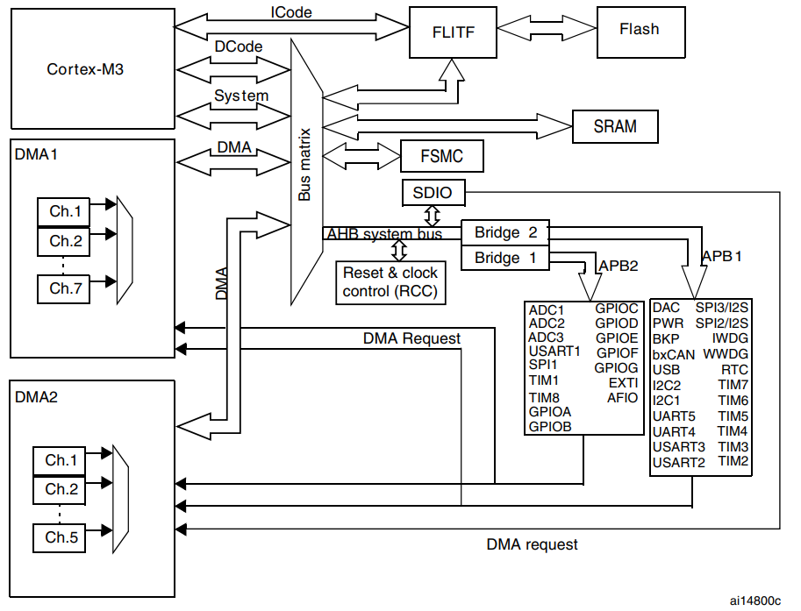
STM32F103C8T6 – Timer 3 – Input clock frequency
Timer 3 → General Purpose Timer – 16 bit timer (APB1)
Source : STM32 reference manual pg.367
Jai Raja Saravanam S Emcog Solutions

Slide 9
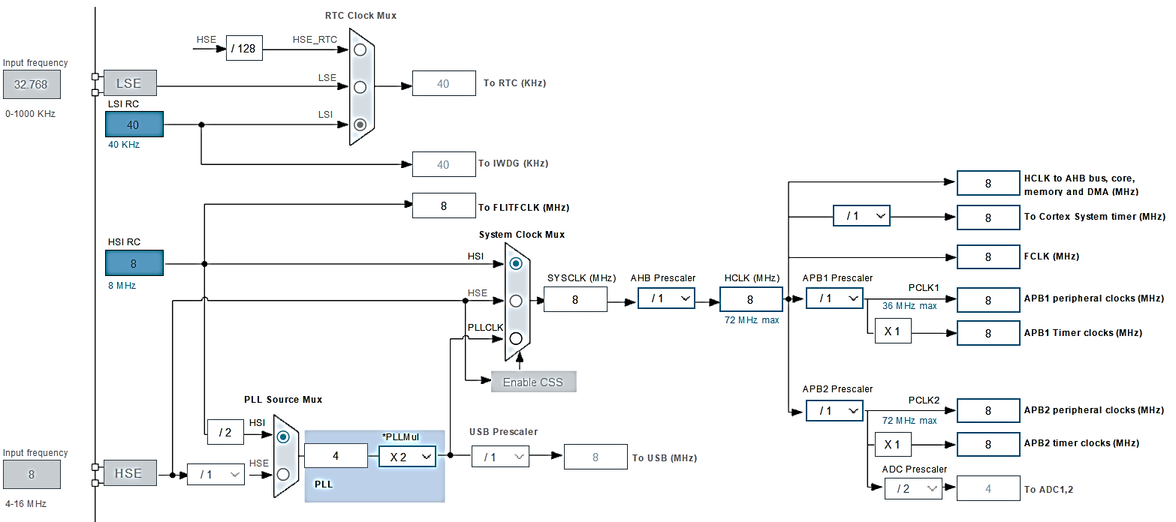
STM32F103C8T6 – Timer 3 – Input clock frequency
Source : STM32CubeIDE
Jai Raja Saravanam S Emcog Solutions

Slide 10
STM32F103C8T6 – Timer 3 Configuration
Let’s configure tim3 to generate 1 sec with internal clock (Timer mode)
    To configure in this way . We need to know
    The clock source
    The input clock frequency
    The timer counter width
    Output frequency (Time delay needed)
    Calculate prescaler
    Find value of auto reload
    If postscaler is present Calculate for post scaler
- Internal Clock
- 8MHz
- 16 bit – 2^16 = 65535 count value
- 1Hz – 1 second
Jai Raja Saravanam S Emcog Solutions

Slide 11
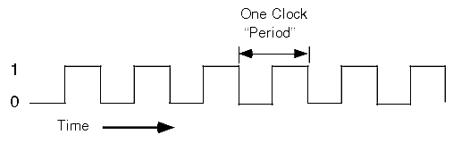
STM32F103C8T6 – Timer 3 Configuration
Prescaler – 16 bit
So it can store a value of upto 2^16 = 65535
For Example, If we choose prescaler = 2 , then for 2 pulse , the counter is incremented 1 .
AutoReloadRegister – 16 bit
So it can store a value of upto 2^16 = 65535
For Example, If we store 1000 , The auto Reload register clear the counter regiter and generate a Update Event
We are going to make 1Hz from 8MHz using Prescaler and AutoReloadRegister
Prescaler
Input Clock
Clock to timer
Auto Reload
U - Update Event
U
- Event
Clock to timer
Tim counter
Jai Raja Saravanam S Emcog Solutions

Slide 12
STM32F103C8T6 – Timer 3 Configuration
Let us consider different case to understand prescaler and AutoReloadRegister
1. Prescaler – 1 and AutoReloadRegister – 65535
8Mhz / Prescaler = 8Mhz / 1 = 8Mhz
One pulse time is T = 1 / f = 1/ 8Mhz = 0.125 usec
So totally (65535 + 1) counts = 65536 pulse = 0.125usec X 65536
Time = 8192 usec = 8.192 msec
2. Prescaler – 1 and AutoReloadRegister – 32767
8Mhz / Prescaler = 8Mhz / 1 = 8Mhz
One pulse time is T = 1 / f = 1/ 8Mhz = 0.125 usec
So totally (32767 + 1) counts = 32768 pulse = 0.125usec X 32768
Time = 4092 usec = 4.092 msec
So by Reducing AutoReloadRegister → time period is decreased → Frequency will get increased
8.192 msec
4.092 msec
Jai Raja Saravanam S Emcog Solutions

Slide 13
STM32F103C8T6 – Timer 3 Configuration
Let us consider different case to understand prescaler and AutoReloadRegister
1. Prescaler – 2 and AutoReloadRegister – 65535
8Mhz / Prescaler = 8Mhz / 2 = 4Mhz
One pulse time is T = 1 / f = 1/ 4Mhz = 0.25 usec
So totally (65535 + 1) counts = 65536 pulse = 0.25usec X 65536
Time = 16384 usec = 16.384 msec
2. Prescaler – 1 and AutoReloadRegister – 65535
8Mhz / Prescaler = 8Mhz / 1 = 8Mhz
One pulse time is T = 1 / f = 1/ 8Mhz = 0.125 usec
So totally (65535 + 1) counts = 65536 pulse = 0.125usec X 65536
Time = 8192 usec = 8.192 msec
So by Reducing Prescaler → time period is decreased → Frequency will get increased
16.384 msec
8.192 msec
Jai Raja Saravanam S Emcog Solutions

Slide 14
STM32F103C8T6 – Timer 3 configuration
The final formula
Timer output Frequency = Input Frequency / (Prescaler * AutoReloadRegister)
Time = 1 / Timer output Frequency
To Make 1Hz , There are two ways
To make directly 1Hz from timer (or)
Make a small time unit and repeat the time unit for Multiple times to get the required delay Eg. 1msec Time unit .Run 1000 times to make (generally preferred)
Note :
The minimum Time Period can be created using tim3 with 8MHz is 1 / [ 8Mhz/ (1 * 1) ] = 0.125usec
The Maximum Time Unit that can be made is 1 / [8MHz / (65536 *65536)] = 536.8709 sec
We can use the timer within this limit only at a single throw .
Jai Raja Saravanam S Emcog Solutions

Slide 15
STM32F103C8T6 – Timer 3 configuration
To make 1msec Time Unit
1 msec = 1kHz
To make 1KHz from 8Mhz
Timer output Frequency = Input Frequency / (Prescaler * AutoReloadRegister)
So 1kHz = 8MHz / (Prescaler * ARR)
Prescaler * ARR = 8K
Prescaler = 1000 ARR = 8000
This will give a 1msec Time unit , Run 1000 times to make 1sec Time delay
Jai Raja Saravanam S Emcog Solutions

Slide 16
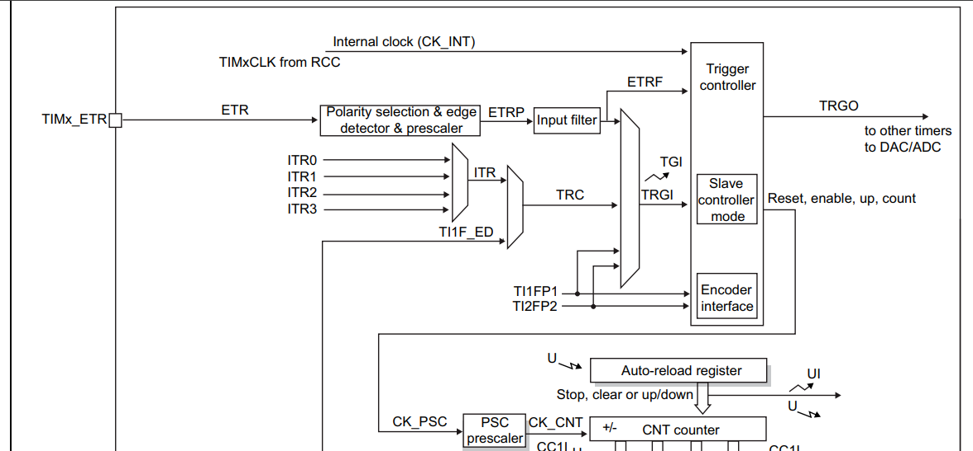
STM32F103C8T6 – Timer 3
Timer 3 → General Purpose Timer – 16 bit timer (APB1)
Source : STM32 reference manual pg.367
Jai Raja Saravanam S Emcog Solutions

Slide 17
Activity 2
Blink single led for every 1 second using Timer 3 (Polling method)
Learning Objective :
Gain knowledge on working with timers
Polling strategy
Make a basic delay using Timers
Jai Raja Saravanam S Emcog Solutions
Notes:
Round robin - time slice for every task in ready state
Priority based – based on priority

Slide 18
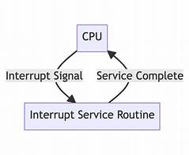
Interrupt
An interrupt is a signal that temporarily pauses the normal program execution to handle an urgent event
Interrupt Service Routine is a special function that runs automatically when an interrupt event occurs. ISR must be very small .
Because interrupt should not affect the main task . If the interrupts are large, after interrupting the main task for long time , the main task won’t run properly.
Some task (Main task) can withstand small delay
Jai Raja Saravanam S Emcog Solutions
Notes:
Round robin - time slice for every task in ready state
Priority based – based on priority

Slide 19
Activity 3
Blink single led for every 1 second using Timer 3 (Interrupt method)
Learning Objective :
Gain knowledge on working with timer interrupts
Jai Raja Saravanam S Emcog Solutions
Notes:
Round robin - time slice for every task in ready state
Priority based – based on priority

Slide 20
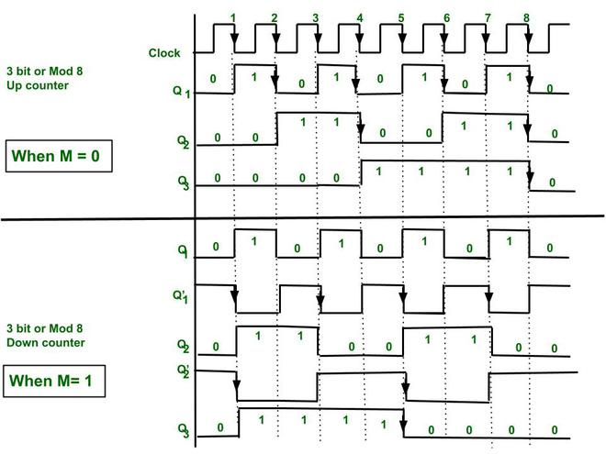
Activity 4
Blink 3 led with the given period Using Timer Interrupt
LED 1 – 2 second
LED 2 – 4 second
LED 3 – 8 second
Tip : use 1 sec as Time unit
Learning Objective :
Understand Real time system – Multiple Time Requiring system
Understand how to make logic for this complex system using Timer interrupt
LED 1
LED 2
LED 3
Jai Raja Saravanam S Emcog Solutions
Notes:
Round robin - time slice for every task in ready state
Priority based – based on priority

Slide 21
Activity 5
Blink 3 led with the given period using RTOS
LED 1 – 2 second
LED 2 – 4 second
LED 3 – 8 second
Learning Objective :
Understand how to import RTOS into STMCubeIDE
Understand RTOS – Task , scheduler , Delay API
Understand Advantage of RTOS
LED 1
LED 2
LED 3
Jai Raja Saravanam S Emcog Solutions
Notes:
Round robin - time slice for every task in ready state
Priority based – based on priority

Slide 22
Activity 6
Blink 3 led with the given period using Superloop
LED 1 – 2 second
LED 2 – 4 second
LED 3 – 8 second
Note : For simplicity use HAL_delay API
Learning Objective :
Understand the importance of Interrupts and RTOS
LED 1
LED 2
LED 3
Jai Raja Saravanam S Emcog Solutions
Notes:
Round robin - time slice for every task in ready state
Priority based – based on priority

Slide 23
Advantage of RTOS over Timer interrupt
Timer Interrupt
RTOS
RTOS
Scheduler
Receive flag variable
2
1
4
1
2
3
Main Task
-Receive Flag variable
Interrupt
-Update flag variable
Main Task
Interrupt
-Update flag variable
3
6
4
5
Interrupt
Task
Interrupt
Task
Jai Raja Saravanam S Emcog Solutions
Notes:
Round robin - time slice for every task in ready state
Priority based – based on priority

Slide 24
Activity
Example
Task 1 (Priority – 1) (low priority) | Not periodic and not triggered by external events
Task 2 (Priority – 2) | Every 1 sec
Task 3 (Priority – 3) (High priority) | Event driven . Needs when external button pressed
Task 1
- Led blink
Task 2
- Read Sensor data
(1 sec)
Task 3
- Alarm beep
(External Event)
- Every 1 sec
- Button pressed
Jai Raja Saravanam S Emcog Solutions

Slide 25


Activity
Super loop (without interrupt)
Task 1
- Led blink
int main(){
Initial_setup();
while(1){
Task1();
Task2();
Task3();
}
return 0; }
Task 2
- Read Sensor data
(1 sec)
Task 3
- Alarm beep
(External Event)
- Every 1 sec
- Button pressed
Task 1
Task 2
Task 3
Task 1
Task 2
Task 3
Task 1
Task 2
Task 3

Slide 26
Activity
Super loop (with interrupt)
int main()
{
Initial_setup();
while(1){
Task1();
}
return 0;
}
Void timer_int_Handler()
{
Task2();
}
Void Ext_int_Handler()
{
Task3();
}
Task 1
Task 2
Task 3
Task 1
Task 3
Task 2(rem)
Task 1
Task 3
Task 2(rem)
Task 1(rem)

Slide 27
Activity
RTOS
int main()
{
os_Initial_setup();
task_creation();
while(1){
}
return 0; }
Void task1()
{
}
Void task2()
{
}
Void task3()
{
}
Task 1
Task 2
Task 3
Task 1
Task 3
Task 2(rem)
Task 1(rem)
Task 3
Task 2(rem)
Task 1

Slide 28
Why It's Great – And Why It's Not
Super loop (without interrupt) | Super loop (with interrupt) | RTOS
Why it’s great Simple Suitable for small projects Easy to learn | Why it’s great Better responsiveness with hardware interrupts 2) Allows time-critical operation | Why it’s great True multitasking with priority-based scheduling Excellent responsiveness . Easier to organize complex applications Built-in features (semaphores, queues, timers, etc.) Scalable for larger embedded systems and real-time needs
Why it’s not great Poor responsiveness Blocking tasks delay the entire system Not scalable | Why it’s not great 1) Limited scalability for multitasking | Why it’s not great Requires more memory and processing power Harder to debug due to concurrency Steeper learning curve for beginners Overkill for very simple applications
Jai Raja Saravanam S Emcog Solutions

Slide 29
Types of Real Time System
Real Time System
Hard
Soft
- A system which has deadline
Missing the deadline leads to system failure
Missing the deadline degrades the performance of the system .(No system failure)
Jai Raja Saravanam S Emcog Solutions

Slide 30
Terminologies
Mutex
Queue
Pre-emption
Task
scheduler
Round Robin
Idle Task
And
Timer task
Semaphore
Co-operative
Stack
Task Control Block
Task Notification
Rtos tick
Context Switching
Jai Raja Saravanam S Emcog Solutions

Slide 31
Task
It is a c function
Runs infinitely
Has its own stack, priority, and Task Control Block (TCB)
Practically, It is a piece of code that is schedulable
RTOS API
It is the pointer to task handler (Implementation)
BaseType_t xTaskCreate ( TaskFunction_t pxTaskCode,
const char * const pcName,
const configSTACK_DEPTH_TYPE usStackDepth,
void * const pvParameters,
UBaseType_t uxPriority,
TaskHandle_t * const pxCreatedTask )
x → It is the return type of the function .It returns value of type Basetype_t
Task →It represent the location (File) where the function is stored . It is present in Tasks.c
Create →It tells about the action that it performs.
Amount of stack memory allocated to this task in words (word – stack width (32 bit)) (Not in bytes)
Descriptive Name of the task
Pointer of the data which is passed to the Task handler (Implementation) once it gets scheduled
Priority of the task
Lower the number → lower the priority
Stores the TCB of the task
Jai Raja Saravanam S Emcog Solutions
Notes:
Taskhandle stores the address of tcb
configMAX_PRIORITIES = 7
Then 0, 1, 2, 3, 4, 5, 6 levels are possible (0 to configMAX_PRIORITIES – 1 )

Slide 32
Task Control Block
The Task Control Block (TCB) is a data structure used internally by FreeRTOS to store all information about a task
Every task has its own TCB
The scheduler uses TCBs to decide which task to run, when to switch, and how to restore context.
These are the contents of TCB
Stack pointer
Task name
Task priority
Task state
Stack start address
Stack end address
Task parameters
Tcb list item
Running time
Delay/timeout information
Notification value , state
Event list item
Jai Raja Saravanam S Emcog Solutions
Notes:
It is like id card . Like it has all the information

Slide 33
Task
RTOS API
BaseType_t xTaskCreate ( TaskFunction_t pxTaskCode,
const char * const pcName,
const configSTACK_DEPTH_TYPE usStackDepth,
void * const pvParameters,
UBaseType_t uxPriority,
TaskHandle_t * const pxCreatedTask )
xTaskCreate(task1_handler, "task1", 100 , ‘‘Hi’’ , 2 , &task1_handle);
pxTaskCode
pcName
usStackDepth
pvParameters
uxPriority
pxCreatedTask
Jai Raja Saravanam S Emcog Solutions
Notes:
It is like id card . Like it has all the information
Taskhandle stores the address of tcb

Slide 34
How to create a Task
1. Create a task
xTaskCreate( task1_handler , "task1", 100 , ‘‘Hi’’ , 2 , &task1_handle );
2. Implement the task
Void task1_handler(){
for(;;){
        //Infinite loop
        //Task application code
}
}
What is create a task ?
Allocating stack ,TCB and inserting the task in ready queue
Stack has pointer of task Handler, Program counter, Link register ,Status Register Registers R0,R1, etc.
Jai Raja Saravanam S Emcog Solutions
Notes:
It is like id card . Like it has all the information

Slide 35
Activity 7
Create two tasks to send data from MCU to PC using UART. Assigning Priority 1 (lower) to task1 that sends ‘RTOS’ and Priority 2 (higher) to the task2 that sends ‘Course’.
Learning Objective:
Import RTOS to STM32CubeIDE
How to create a task
Understand how task priority affects CPU time allocation, and learn how to ensure that a lower-priority task also gets CPU execution time.
Jai Raja Saravanam S Emcog Solutions
Notes:
It is like id card . Like it has all the information

Slide 36
State of a task
Running
Not running
Not Using CPU time
Uses CPU time
Jai Raja Saravanam S Emcog Solutions

Slide 37
State of a task
Ready state
Running state
Blocked state
Suspended state
Not running
Suspended
VTaskSuspend()
vTaskSuspend()
vTaskResume()
Ready
Schedule
Running
Create new task
Pre-empt / yield
Event
vTaskAbortDelay()
Blocking Api Called
Blocked

Slide 38
State of a task
Ready state
  The task is ready to run, but the CPU is busy running another task of equal or higher priority.
Running state
  The task is currently being executed by the CPU.
Blocked state
The task is waiting for a RTOS resource like queue , semaphore or event
It can also wait for a delay to finish
Suspended state
The task is completely stopped manually using vTaskSuspend(TaskHandle_t handle); .It can only resume after any running task calls vTaskResume(TaskHandle_t handle);
Jai Raja Saravanam S Emcog Solutions

Slide 39
Delay
USES
To create a delay for the next program
To implement periodic task
Blocking Delay
This temporarily blocks the task for the a period of time without engaging the Processor (CPU)
1. vTaskDelay (const TickType_t xTicksToDelay); - Delay is baed on Relative time at when this api function is called.
2. vTaskDelayUntil ( TickType_t *pxPreviousWakeTime, const TickType_t xTimeIncrement ); - Delay is based on absolute time
3.3v
0v
RTOS
Tick
1000
2000
3000
4000
5000
6000
7000
Notes:
Round robin - time slice for every task in ready state
Priority based – based on priority

Slide 40
Delay contd.
vTaskDelay ( )
void vTaskFunction( void * pvParameters )
{
const TickType_t xDelay = 1000 / portTICK_PERIOD_MS;
for( ;; )
{
vToggleLED();
vTaskDelay( xDelay );
}
}
- Delay API called Time
1100
3300
5100
3.3v
2200
4400
6100
0v
RTOS
Tick
1000
2000
3000
4000
5000
6000
7000
Notes:
Round robin - time slice for every task in ready state
Priority based – based on priority

Slide 41
Delay contd.
vTaskDelayUntil ( )
void vTaskFunction( void * pvParameters )
{
TickType_t xLastWakeTime;
const TickType_t xFrequency = 1000;
xLastWakeTime = xTaskGetTickCount ();
for( ;; )
{
vToggleLED() ;
vTaskDelayUntil( &xLastWakeTime, xFrequency ) ;
} }
- Delay API called Time
3.3v
0v
RTOS
Tick
1000
2000
3000
4000
5000
6000
7000
Notes:
Round robin - time slice for every task in ready state
Priority based – based on priority

Slide 42
Delay contd.
vTaskDelay ( )
vTaskDelayUntil ( )
xLastWakeTime = 0
vToggleLED(); 0 ms
vTaskDelayUntil ( ) ; 0 ms
vToggleLED(); 0 ms
vTaskDelay( xDelay ); 100 ms
xLastWakeTime = 1000
1000 ms
1000 ms
vToggleLED(); 1000 ms
vTaskDelayUntil ( ) ; 1100 ms
vToggleLED(); 1100 ms
vTaskDelay( xDelay ); 1150 ms
xLastWakeTime = 2000
900 ms
1000 ms
vToggleLED(); 2000 ms
vTaskDelayUntil ( ) ; 2500 ms
vToggleLED(); 2150 ms
vTaskDelay( xDelay ); 2150 ms
xLastWakeTime = 3000
500 ms
vToggleLED(); 3000 ms
vTaskDelayUntil ( ) ; 3900 ms
Jai Raja Saravanam S Emcog Solutions
Notes:
Round robin - time slice for every task in ready state
Priority based – based on priority

Slide 43
Delay contd.
vTaskDelay ( )
vTaskDelayUntil ( )
void task1_handler (void* parameter){
int i,j =0;
const TickType_t xFrequency = 1000; // 1000 ticks = 100ms = 1 sec
TickType_t xLastWakeTime ;
BaseType_t xWasDelayed ;
xLastWakeTime = xTaskGetTickCount ();
for(;;){
xWasDelayed = xTaskDelayUntil(&xLastWakeTime,xFrequency);
HAL_UART_Transmit(&huart1,parameter , 3, 1000);
for(i=0;i<5;i++)
for(j=0;j<10000;j++);
}
}
void task1_handler (void* parameter){
int i,j =0;
for(;;){
HAL_UART_Transmit(&huart1,parameter ,
3, 1000);
for(i=0;i<5;i++)
for(j=0;j<10000;j++);
vTaskDelay(pdMS_TO_TICKS(1000));
}
}
Jai Raja Saravanam S Emcog Solutions
Notes:
Round robin - time slice for every task in ready state
Priority based – based on priority

Slide 44
Activity 8
Create a single UART task using vTaskDelay() and xtaskdelayuntil() .
Learning Objective:
To understand the difference between vtaskdelay() and xtaskdelayuntil()
Jai Raja Saravanam S Emcog Solutions
Notes:
It is like id card . Like it has all the information

Slide 45
Types of Task
Periodic Task - Runs for every certain period
Aperiodic task - Runs based on certain events
Jai Raja Saravanam S Emcog Solutions
Notes:
Round robin - time slice for every task in ready state
Priority based – based on priority

Slide 46
Scheduler
The scheduler is the core of FreeRTOS.
It decides which task should run next, based on priority and state.
It uses a tick timer interrupt (e.g., every 1 ms) to check task status and preempt if needed.
Scheduler
Task1
Task2
Task3
Task N
Jai Raja Saravanam S Emcog Solutions

Slide 47
Job of a scheduler
Scheduling Tasks
Task switching / Context Switching
Handling Interrupts
Resource optimization
Deadline Awareness
Scheduler
Scheduler
Scheduler
Scheduler
Task 1
Task 1
Task 2
Task 2
Task 3
Task 3
Scheduler
Task 1
Scheduler
Task 2
Scheduler
Task 3
CPU
t
Notes:
Context switching – saving the execution context of running task and retrieving the execution context of new task

Slide 48
Types of scheduling mechanism
1. Pre - emptive scheduling - forceful replacement of a running task with a new task .
Round robin (cyclic) – No priority – Fixed Time slice
Priority based
2. Cooperative Scheduling - A running task willingly gives the CPU to scheduler
Scheduler
configUSE_PREEMPTION = 1
configUSE_PREEMPTION = 0
Pre-emptive Scheduling
Co-operative Scheduling
Jai Raja Saravanam S Emcog Solutions
Notes:
Round robin - time slice for every task in ready state
Priority based – based on priority

Slide 49
Types of scheduling mechanism
Round robin (cyclic) – No priority – Fixed Time slice
Task1
Task2
Task3
Task4
Ready List
Scheduler
Task1
Scheduler
Task2
Scheduler
Task3
Scheduler
Task4
Scheduler
Task1
Fixed Time
slice
Fixed Time
slice
Fixed Time
slice
Fixed Time
slice
Fixed Time
slice
Jai Raja Saravanam S Emcog Solutions
Notes:
Round robin - time slice for every task in ready state
Priority based – based on priority

Slide 50
Types of scheduling mechanism
Priority Based
Task1
Priority 2
Task2
Priority 4
Task3
Priority 1
Task4
Priority 2
Ready List
Blocking
Scheduler
Task2
Scheduler
Task2
Scheduler
Task4
Scheduler
Task1
Scheduler
Task4
Scheduler
Task1
Jai Raja Saravanam S Emcog Solutions
Notes:
Round robin - time slice for every task in ready state
Priority based – based on priority

Slide 51
Types of scheduling mechanism
Co operative scheduling
Task1
Priority 2
Task2
Priority 4
Task3
Priority 3
Task4
Priority 2
Ready List
Yielding
Yielding
Scheduler
Task2
Scheduler
Task3
Scheduler
Task1
Jai Raja Saravanam S Emcog Solutions
Notes:
Round robin - time slice for every task in ready state
Priority based – based on priority

Slide 52
Activity 9
Create two tasks (UART) with same priority and use
Round Robin Scheduling Mechanism .
Priority Based Preemptive scheduling
Co operative scheduling
Learning Objective:
    To understand Round Robin scheduling mechanism
    To understand Priority Based Preemptive scheduling mechanism
    To understand Co operative scheduling mechanism
Jai Raja Saravanam S Emcog Solutions
Notes:
Round robin - time slice for every task in ready state
Priority based – based on priority

Slide 53
Process Synchronization
It is a 32 bit array of notification value.
It is a event sent directly to a task. When notification is sent, the receiving task gets unblocked.
RTOS API
Note :
1. configUSE_TASK_NOTIFICATIONS in FreeRTOSConfig.h must be set 1 to enable direct to task notification feature
2. configTASK_NOTIFICATION_ARRAY_ENTRIES sets the number of indexes in each task's array of task notifications.
xTaskNotifyWait()
xTaskNotify()
Jai Raja Saravanam S Emcog Solutions
Notes:
Round robin - time slice for every task in ready state
Priority based – based on priority

Slide 54
Direct to Task Notification
It has a 32 bit array of notification value and has a state .
It is a event sent directly to a task. When notification is sent, the receiving task gets unblocked and optionally its notification value is updated.
When to use ?
1. Small amount of data (32bit) can be transmitted
2. Only one task needs the data
RTOS API
Note :
1. configUSE_TASK_NOTIFICATIONS in FreeRTOSConfig.h must be set 1 to enable direct to task notification feature
2. configTASK_NOTIFICATION_ARRAY_ENTRIES sets the number of indexes in each task's array of task notifications.
xTaskNotifyWait()
xTaskNotify()
Jai Raja Saravanam S Emcog Solutions
Notes:
Round robin - time slice for every task in ready state
Priority based – based on priority

Slide 55
Task Notification
RTOS API
xTaskNotifyGive() / xTaskNotifyGiveIndexed() vTaskNotifyGiveFromISR() / vTaskNotifyGiveIndexedFromISR() | ulTaskNotifyTake() / ulTaskNotifyTakeIndexed() → Increments the receiving tasks notification value
xTaskNotify() / xTaskNotifyIndexed() xTaskNotifyFromISR() / xTaskNotifyFromISRIndexed() | xTaskNotifyWait() / xTaskNotifyWaitIndexed()
xTaskNotifyAndQuery() / xTaskNotifyAndQueryIndexed() xTaskNotifyAndQueryFromISR / xTaskNotifyAndQueryFromISRIndexed()/
xTaskNotifyStateClear() / xTaskNotifyStateClearIndexed() | → Read notication value or explicitly call this to clear pending state
ulTasknotifyValueClear() / ulTasknotifyValueClearIndexed() | → Clears a bit in notification value of a task
Notes:
Round robin - time slice for every task in ready state
Priority based – based on priority

Slide 56
Task Notification
xTaskNotify()
BaseType_t xTaskNotify ( TaskHandle_t xTaskToNotify, uint32_t ulValue, eNotifyAction eAction );
xTaskToNotify → Handle of a task
ulValue → Value of notification
eAction → eNoAction, eSetBits, eIncrement, eSetValueWithOverwrite, eSetValueWithoutOverwrite,
eNoAction - No action is made to Receiving task’s value .
eSetBits – The notification value of Receiving task is bitwise Ored with ulValue.
eIncrement - The notification value of the target task will be incremented by one . Equivalent to xTaskNotifyGive()
eSetValueWithOverwrite – The notification value of the target task is unconditionally set to ulValue .
eSetValueWithoutOverwrite - If the target task does not already have a notification pending then its notification
value will be set to ulValue.
If the target task already has a notification pending then its notification value is not updated as to do so would overwrite the previous value before it was used. In this case the call to xTaskNotify() fails and pdFALSE is returned.
Jai Raja Saravanam S Emcog Solutions
Notes:
Round robin - time slice for every task in ready state
Priority based – based on priority

Slide 57
Task Notification
Return:
pdPASS is returned in all cases other than when eAction is set to eSetValueWithoutOverwrite and the target task's notification value cannot be updated because the target task already had a notification pending
Jai Raja Saravanam S Emcog Solutions
Notes:
Round robin - time slice for every task in ready state
Priority based – based on priority

Slide 58
Task Notification
Task Notification
xTaskNotifyWait()
BaseType_t xTaskNotifyWait( uint32_t ulBitsToClearOnEntry, uint32_t ulBitsToClearOnExit,
uint32_t *pulNotificationValue, TickType_t xTicksToWait );
ulBitsToClearOnEntry → Clears the bit in notification right after calling this function
ulBitsToClearOnExit → Clears the bit in notification right before exiting the function
pulNotificationValue → Stores the notification value that is sent by the sender task before clearing on exit
xTicksToWait → The maximum time for the task to wait in blocked state before receiving a
notification .If no notification is received the function will return pdFALSE and
exit the function
portMAX_DELAY – The task waits infinitly.
Jai Raja Saravanam S Emcog Solutions
Notes:
Round robin - time slice for every task in ready state
Priority based – based on priority

Slide 59
Task Notification
Task Notification
Return :
pdTRUE if a notification was received, or a notification was already pending when xTaskNotifyWait() was called.
pdFALSE if the call to xTaskNotifyWait() timed out before a notification was received.
Jai Raja Saravanam S Emcog Solutions
Notes:
Round robin - time slice for every task in ready state
Priority based – based on priority

Slide 60
Activity 10
void button_handler(){
int prev_button,cur_button=0;
TickType_t time ;
while(1){
cur_button = HAL_GPIO_ReadPin(GPIOA, GPIO_PIN_0);
if(cur_button==1){
if(prev_button==0){
xTaskNotify(led_handle,NULL,eNoAction);
}
}
prev_button = cur_button;
xTaskDelayUntil(&time,pdMS_TO_TICKS(50));
}
}
void led_handler(){
BaseType_t status;
while(1){
Status=xTaskNotifyWait(0x0,0x0,NULL,portMAX_DELAY);
if(status == pdTRUE)
HAL_GPIO_TogglePin(GPIOC, GPIO_PIN_13);
}
}
Jai Raja Saravanam S Emcog Solutions
Notes:
Round robin - time slice for every task in ready state
Priority based – based on priority

Slide 61
Interrupt
0
1
Non Maskable by FreeRTOS
.
4 bits used for priority – so total 16 levels of hardware interrupt priority
0 to 15 levels
0 is has the highest priority level (Opposite of RTOS priority level )
FreeRTOS uses critical section to prevent its resource (like queue ,task list , semaphore )from getting corrupted by interrupt . This masks some of the lower level hardware interrupts
FreeRTOS has a feature by which it seperates this two levels – higher and lower level Hardware interrupt priority
configKERNEL_INTERRUPT_PRIORITY → type the lowest possible priority level – 15
configMAX_SYSCALL_INTERRUPT_PRIORITY → below which are considered as higher priority – 5 (The interrupts with priority level 0 to 4 can preempt critical section)
.
.
5
.
.
Maskable by FreeRTOS
.
NVIC
15
1
1
5
Jai Raja Saravanam S Emcog Solutions
Notes:
Round robin - time slice for every task in ready state
Priority based – based on priority

Slide 62
Interrupt
RTOS Api that can be used in interrupts are named as FROMISR
Eg : xTaskNotifyFromISR(led_handle,100,eSetValueWithOverwrite,&xHigherPriorityTaskWoken);
These are called ISR safe APIs.
These API can be used in interrupt handlers
But these cannot be used inside in interrupts that has high priority above configMAX_SYSCALL_INTERRUPT_PRIORITY
Jai Raja Saravanam S Emcog Solutions
Notes:
Round robin - time slice for every task in ready state
Priority based – based on priority

Slide 63
Activity 11
Create two task .
Task1 → Keeps the led high when button (PA2) is pressed. (Change the priority level high and low about task2 to analyze the impact of priority on interrupt)
Task2 → Handles interrupt from another external button (PA3) and blink the led fast for three times
Learning Objective:
Understand how interrupts in FreeRTOS task ,works.
ISR API function.
Understand how priority and interruots work .
Face a problem while programming. Comment the line in 4996 line in task.c
Jai Raja Saravanam S Emcog Solutions
Notes:
Round robin - time slice for every task in ready state
Priority based – based on priority

Slide 64
Queue
Queue is a built-in communication mechanism that lets tasks and ISRs safely send and receive data to each other
Note :
configSUPPORT_DYNAMIC_ALLOCATION must be set to 1 in FreeRTOSConfig.h, or left undefined (in which case it will default to 1), for this RTOS API function to be available.
Consider Queue of 5 characters (1 byte),
xQueueCreate ( UBaseType_t uxQueueLength,UBaseType_t uxItemSize );
Head
Queue_handle = xQueueCreate ( 5, 1 );
Back
Front
Tail
Jai Raja Saravanam S Emcog Solutions
Notes:
Round robin - time slice for every task in ready state
Priority based – based on priority

Slide 65
Queue
Char data = ‘j’;
BaseType_t xQueueSendToBack(QueueHandle_t xQueue, const void * pvItemToQueue, TickType_t xTicksToWait);
BaseType_t xQueueSendToBack(Queue_handle, &data, 1000);
Head
j
Front
Back
Head
Tail
Char data = ‘a’;
a
j
Front
Back
Tail
Jai Raja Saravanam S Emcog Solutions
Notes:
Round robin - time slice for every task in ready state
Priority based – based on priority

Slide 66
Queue
Char data = ‘j’;
BaseType_t xQueueSendToFront(QueueHandle_t xQueue, const void * pvItemToQueue, TickType_t xTicksToWait);
BaseType_t xQueueSendToFront(Queue_handle, &data, 1000);
Head
j
Front
Back
Head
Tail
Char data = ‘a’;
j
a
Front
Back
Tail
Jai Raja Saravanam S Emcog Solutions
Notes:
Round robin - time slice for every task in ready state
Priority based – based on priority

Slide 67
Queue
Char data =‘0’;
BaseType_t xQueueReceive(QueueHandle_t xQueue, const void * pvbuffer, TickType_t xTicksToWait);
BaseType_t xQueueReceive(Queue_handle, &data, 1000);
Head
j
a
Front
Back
Data = ‘a’;
Tail
Head
j
j
Front
Back
Data = ‘j’;
Tail
Jai Raja Saravanam S Emcog Solutions
Notes:
Round robin - time slice for every task in ready state
Priority based – based on priority

Slide 68
Queue
RTOS API
1. QueueHandle_t xQueueCreate ( UBaseType_t uxQueueLength,UBaseType_t uxItemSize );
2. BaseType_t xQueueSendToBack (QueueHandle_t xQueue,const void * pvItemToQueue, TickType_t
xTicksToWait );
3. BaseType_t xQueueReceive ( QueueHandle_t xQueue, void *pvBuffer, TickType_t xTicksToWait );
4. BaseType_t xQueuePeek ( QueueHandle_t xQueue, void *pvBuffer, TickType_t xTicksToWait );
Jai Raja Saravanam S Emcog Solutions
Notes:
Round robin - time slice for every task in ready state
Priority based – based on priority

Slide 69
Queue
QueueHandle_t xQueueCreate ( UBaseType_t uxQueueLength,UBaseType_t uxItemSize );
Creates a new queue and returns a handle by which the queue can be referenced.
Parameters :
uxQueueLength → The maximum number of items the queue can hold at any one time
uxItemSize → The size, in bytes, required to hold each item in the queue.
Return :
If the queue is created successfully then a handle to the created queue is returned. If the memory required to create the queue could not be allocated then NULL is returned
Jai Raja Saravanam S Emcog Solutions
Notes:
Round robin - time slice for every task in ready state
Priority based – based on priority

Slide 70
Queue
2. BaseType_t xQueueSend (QueueHandle_t xQueue,const void * pvItemToQueue, TickType_t
xTicksToWait );
Post an item on a queue. The item is queued by copy, not by reference.
Parameters :
xQueue → The handle to the queue on which the item is to be posted
pvItemToQueue → A pointer to the item that is to be placed on the queue.
xTicksToWait → The maximum amount of time the task should block waiting for space to become available on the queue
Return :
  pdPASS if the item was successfully posted,
  errQUEUE_FULL otherwise
Jai Raja Saravanam S Emcog Solutions
Notes:
Round robin - time slice for every task in ready state
Priority based – based on priority

Slide 71
Queue
3. BaseType_t xQueueReceive ( QueueHandle_t xQueue, void *pvBuffer, TickType_t xTicksToWait );
Receive an item from a queue.
Parameters :
xQueue → The handle to the queue from which the item is to be received
pvBuffer → Pointer to the buffer into which the received item will be copied
xTicksToWait → The maximum amount of time the task should block waiting for an item to receive should the queue be empty at the time of the call
Return :
  pdPASS if an item was successfully received (removed) from the queue,
  errQUEUE_FULL otherwise
Jai Raja Saravanam S Emcog Solutions
Notes:
Round robin - time slice for every task in ready state
Priority based – based on priority

Slide 72
Queue
4. BaseType_t xQueuePeek ( QueueHandle_t xQueue, void *pvBuffer, TickType_t xTicksToWait );
Receive an item from a queue without removing the item from the queue.
Parameters :
xQueue → The handle to the queue from which the item is to be received
pvBuffer → Pointer to the buffer into which the received item will be copied
xTicksToWait → The maximum amount of time the task should block waiting for an item to receive should the queue be empty at the time of the call
Return :
  pdPASS if an item was successfully received (peeked) from the queue,
  errQUEUE_FULL otherwise
Jai Raja Saravanam S Emcog Solutions
Notes:
Round robin - time slice for every task in ready state
Priority based – based on priority

Slide 73
Queue
General RTOS API
uxQueueMessagesWaiting() (ISR) | Returns the number of message stored in queue
uxQueueSpacesAvailable() | Returns the number of free space
vQueueDelete() | freeing all the memory allocated for storing of items placed on the queue
xQueueReset() | Resets a queue to its original empty state
xQueueIsQueueEmptyFromISR | Queries a queue to determine if the queue is empty. This function should only be used in an ISR.
xQueueIsQueueFullFromISR | Queries a queue to determine if the queue is full. This function should only be used in an ISR.
Jai Raja Saravanam S Emcog Solutions
Notes:
Round robin - time slice for every task in ready state
Priority based – based on priority

Slide 74
Activity 12
Create two task, one fills the queue and another empties the queue and send the data to PC through UART
Learning Objective :
Understand how Queue can be used between processes
Jai Raja Saravanam S Emcog Solutions
Notes:
Round robin - time slice for every task in ready state
Priority based – based on priority

Slide 75
Activity
Create two task with same priority which access UART peripheral
Learning objective :
What is race condition
How to avoid race condition using FreeRtos API feature
What is mutual exclusion
How to use binary semaphore and Mutex
Jai Raja Saravanam S Emcog Solutions
Notes:
Round robin - time slice for every task in ready state
Priority based – based on priority

Slide 76


Synchronization
The Process of Coordinating the activities of two or more task to achieve the intended work
Eg:
UnSynchronised
Synchronised
Manager schedule the meeting tomorrow
Manager schedule the meeting tomorrow at 10 am
9,10,11,12 am
10 am
2 pm
Jai Raja Saravanam S Emcog Solutions
Notes:
Round robin - time slice for every task in ready state
Priority based – based on priority
Mutual exclusion is avoiding a task to execute the critical section (shared entity) which is already own by another task for execution
Binary semaphore
It is a kernel object . So it can be used by multiple tasks

Slide 77
Synchronization
The Process of Coordinating the activities of two or more task to achieve the intended work
Eg:
Synchronized using Interrupt or RTOS service
Polling
Task
Task
Checking
UART Buffer
UART Buffer
Signal
Checking
Jai Raja Saravanam S Emcog Solutions
Notes:
Round robin - time slice for every task in ready state
Priority based – based on priority
Mutual exclusion is avoiding a task to execute the critical section (shared entity) which is already own by another task for execution
Binary semaphore
It is a kernel object . So it can be used by multiple tasks

Slide 78
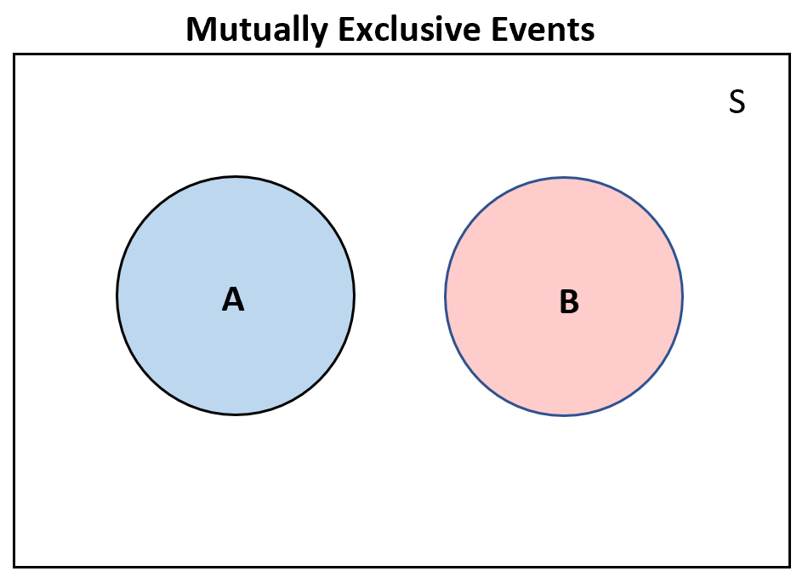
Mutual Exclusion
Protect shared entity only one task access the shared resource
Jai Raja Saravanam S Emcog Solutions
Notes:
Round robin - time slice for every task in ready state
Priority based – based on priority
Mutual exclusion is avoiding a task to execute the critical section (shared entity) which is already own by another task for execution
Binary semaphore
It is a kernel object . So it can be used by multiple tasks

Slide 79
Semaphore
Semaphores are synchronization primitives(Kernel object) that help manage shared resource access or coordinate between tasks and ISRs. Internally they are implemented using queue api with item size 0 bytes (since no actual data needs to be transmitted).
Semaphore
Binary Semaphore
Counting Semaphore
Synchronisation
Mutual Exclusion
Synchronisation
Resource Management
Counting Events
Jai Raja Saravanam S Emcog Solutions
Notes:
Round robin - time slice for every task in ready state
Priority based – based on priority
Mutual exclusion is avoiding a task to execute the critical section (shared entity) which is already own by another task for execution
Binary semaphore
It is a kernel object . So it can be used by multiple tasks

Slide 80
Semaphore
1. Binary Semaphore
When to use ?
Use a binary semaphore when multiple tasks need synchronized access to the same shared resource or require synchronization between ISR and multiple tasks.
A binary semaphore is slower than direct-to-task notifications because it involves the FreeRTOS queue mechanism.
If only one specific task needs to be signaled or synchronized (e.g., from another task or an ISR), use direct-to-task notification instead — it’s faster and uses less RAM.
Jai Raja Saravanam S Emcog Solutions
Notes:
Round robin - time slice for every task in ready state
Priority based – based on priority
Mutual exclusion is avoiding a task to execute the critical section (shared entity) which is already own by another task for execution
Binary semaphore
It is a kernel object . So it can be used by multiple tasks

Slide 81
Semaphore
Note :
1. configSUPPORT_DYNAMIC_ALLOCATION must be set to 1 in FreeRTOSConfig.h, or left undefined
2. The semaphore must be given initially before it can be taken by a task
RTOS API
1. SemaphoreHandle_t xSemaphoreCreateBinary ( void );
SemaphoreHandle_t xSemaphoreCreateCounting ( UBaseType_t uxMaxCount, UBaseType_t
uxInitialCount );
3. BaseType_t xSemaphoreTake ( SemaphoreHandle_t xSemaphore, TickType_t xTicksToWait );
BaseType_t xSemaphoreGive ( SemaphoreHandle_t xSemaphore );
void vSemaphoreDelete ( SemaphoreHandle_t xSemaphore );
Jai Raja Saravanam S Emcog Solutions
Notes:
Round robin - time slice for every task in ready state
Priority based – based on priority
Mutual exclusion is avoiding a task to execute the critical section (shared entity) which is already own by another task for execution
Binary semaphore
It is a kernel object . So it can be used by multiple tasks

Slide 82
Semaphore
SemaphoreHandle_t xSemaphoreCreateBinary ( void )
Creates a binary semaphore, and returns a handle by which the semaphore can be referenced.
Return
NULL The semaphore could not be created because there was insufficient FreeRTOS heap available.
Any other value The semaphore was created successfully. The returned value is a handle by which the semaphore can be referenced.
Jai Raja Saravanam S Emcog Solutions
Notes:
Round robin - time slice for every task in ready state
Priority based – based on priority
Mutual exclusion is avoiding a task to execute the critical section (shared entity) which is already own by another task for execution
Binary semaphore
It is a kernel object . So it can be used by multiple tasks

Slide 83
Semaphore
SemaphoreHandle_t xSemaphoreCreateCounting ( UBaseType_t uxMaxCount, UBaseType_t
uxInitialCount );
Creates a counting semaphore and returns a handle by which the newly created semaphore can be referenced.
Parameters:
uxMaxCount → The maximum count value that can be reached. When the semaphore reaches this value it can no longer be 'given'.
uxInitialCount → The count value assigned to the semaphore when it is created.
Return
NULL The semaphore could not be created because there was insufficient FreeRTOS heap available.
If the semaphore is created successfully then a handle to the semaphore is returned.
Jai Raja Saravanam S Emcog Solutions
Notes:
Round robin - time slice for every task in ready state
Priority based – based on priority
Mutual exclusion is avoiding a task to execute the critical section (shared entity) which is already own by another task for execution
Binary semaphore
It is a kernel object . So it can be used by multiple tasks

Slide 84
Semaphore
3. BaseType_t xSemaphoreTake ( SemaphoreHandle_t xSemaphore, TickType_t xTicksToWait );
Macro to obtain a semaphore.
Parameters:
xSemaphore → A handle to the semaphore being taken - obtained when the semaphore was created.
xTicksToWait → The time in ticks to wait for the semaphore to become available.
Return:
pdTRUE if the semaphore was obtained.
pdFALSE if xTicksToWait expired without the semaphore becoming available
Jai Raja Saravanam S Emcog Solutions
Notes:
Round robin - time slice for every task in ready state
Priority based – based on priority
Mutual exclusion is avoiding a task to execute the critical section (shared entity) which is already own by another task for execution
Binary semaphore
It is a kernel object . So it can be used by multiple tasks

Slide 85
Semaphore
4. BaseType_t xSemaphoreGive ( SemaphoreHandle_t xSemaphore );
Macro to release a semaphore.
Parameters:
xSemaphore → A handle to the semaphore being released. This is the handle returned when the semaphore was created.
Return:
pdTRUE if the semaphore was released.
pdFALSE if an error occurred. Semaphores are implemented using queues. An error can occur if there is no space on the queue to post a message - indicating that the semaphore was not first obtained correctly.
Jai Raja Saravanam S Emcog Solutions
Notes:
Round robin - time slice for every task in ready state
Priority based – based on priority
Mutual exclusion is avoiding a task to execute the critical section (shared entity) which is already own by another task for execution
Binary semaphore
It is a kernel object . So it can be used by multiple tasks

Slide 86
Semaphore
5. void vSemaphoreDelete ( SemaphoreHandle_t xSemaphore )
Deletes a semaphore, including mutex type semaphores and recursive semaphores.
Do not delete a semaphore that has tasks blocked on it (tasks that are in the Blocked state waiting for the semaphore to become available).
Parameters:
xSemaphore → The handle of the semaphore being deleted
Jai Raja Saravanam S Emcog Solutions
Notes:
Round robin - time slice for every task in ready state
Priority based – based on priority
Mutual exclusion is avoiding a task to execute the critical section (shared entity) which is already own by another task for execution
Binary semaphore
It is a kernel object . So it can be used by multiple tasks

Slide 87
Semaphore – Activity 13
Create two tasks that share access to the UART peripheral, and use a binary semaphore to ensure Synchronization during UART communication.
Learning objective:
Understand how to create semaphore .
Understand how semaphore works and where to use semaphore
Use of Binary semaphore in Synchronization
Jai Raja Saravanam S Emcog Solutions
Notes:
Round robin - time slice for every task in ready state
Priority based – based on priority
Mutual exclusion is avoiding a task to execute the critical section (shared entity) which is already own by another task for execution
Binary semaphore
It is a kernel object . So it can be used by multiple tasks

Slide 88
Semaphore – Activity 14
Create a button interrupt task and led task . Use counting semaphore to latch events between task.
Learning objective:
Understand how to counting semaphore works.
Understand importance of counting semaphore.
Jai Raja Saravanam S Emcog Solutions
Notes:
Round robin - time slice for every task in ready state
Priority based – based on priority
Mutual exclusion is avoiding a task to execute the critical section (shared entity) which is already own by another task for execution
Binary semaphore
It is a kernel object . So it can be used by multiple tasks

Slide 89
Semaphore – Activity
Create a button interrupt task and led task . Use counting semaphore to manage resources.
Learning objective:
Understand how to manage resources using counting semaphore
Jai Raja Saravanam S Emcog Solutions
Notes:
Round robin - time slice for every task in ready state
Priority based – based on priority
Mutual exclusion is avoiding a task to execute the critical section (shared entity) which is already own by another task for execution
Binary semaphore
It is a kernel object . So it can be used by multiple tasks

Slide 90
Semaphore - Activity
1.Create two tasks that share access to the UART peripheral, and use a binary semaphore to ensure mutual exclusion during UART communication.
Learning objective:
Understand how to create binary semaphore .
Understand how semaphore works and where to use semaphore
2.Create a button handler task and understand the benefits of counting semaphore to handle multiple interrupt
Handler task - external interrupt give semaphore
Led task - activate only for every 2 sec
Learning objective:
Understand how to create counting semaphore .
Understand how semaphore works and where to use semaphore
Jai Raja Saravanam S Emcog Solutions
Notes:
Round robin - time slice for every task in ready state
Priority based – based on priority
Mutual exclusion is avoiding a task to execute the critical section (shared entity) which is already own by another task for execution
Binary semaphore
It is a kernel object . So it can be used by multiple tasks

Slide 91
Mutex
A mutex (short for mutual exclusion) is a special kind of semaphore designed to protect shared resources so that only one task at a time can use them.
Note :
configSUPPORT_DYNAMIC_ALLOCATION and configUSE_MUTEXES must both be set to 1 in FreeRTOSConfig.h for xSemaphoreCreateMutex() to be available
RTOS API
SemaphoreHandle_t xSemaphoreCreateMutex( void )
Creates a mutex, and returns a handle by which the created mutex can be referenced. Mutexes cannot be used in interrupt service routines.
Return:
If the mutex type semaphore was created successfully then a handle to the created mutex is returned.
If the mutex was not created because the memory required to hold the mutex could not be allocated then NULL is returned.
Jai Raja Saravanam S Emcog Solutions
Notes:
Round robin - time slice for every task in ready state
Priority based – based on priority
Mutual exclusion is avoiding a task to execute the critical section (shared entity) which is already own by another task for execution
Binary semaphore
It is a kernel object . So it can be used by multiple tasks

Slide 92
Advantage of semaphore over mutual exclusion
Task Ownership Not Required
Any task (or even an ISR) can "give" a binary semaphore, not necessarily the one that "took" it.
Useful for task synchronization between two different tasks or between ISR and task.
Better for Signaling Events
Can be used to signal that something happened (e.g., data ready from UART, sensor interrupt).
Mutex is only for resource protection, not signaling.
ISR Compatibility
Binary semaphores can be given from ISR context using xSemaphoreGiveFromISR().
Mutexes cannot be used in ISR context.
Jai Raja Saravanam S Emcog Solutions
Notes:
Round robin - time slice for every task in ready state
Priority based – based on priority
Mutual exclusion is avoiding a task to execute the critical section (shared entity) which is already own by another task for execution
Binary semaphore
It is a kernel object . So it can be used by multiple tasks

Slide 93
Advantage of mutual exclusion over semaphore
Priority Inheritance
Mutex supports priority inheritance to prevent priority inversion.
Binary semaphores don’t have this mechanism, so low-priority tasks holding a semaphore might block high-priority tasks unnecessarily.
Resource Locking Pattern
Mutex is specifically designed for mutual exclusion when accessing shared resources (e.g., UART, SPI, I²C, file system).
Binary semaphore can still work for resource locking, but mutex is more reliable for this use case.
Owner Tracking
Mutex keeps track of which task currently owns the lock, which helps ensure only the same task releases it.
Binary semaphore doesn’t care who gives it back.
Jai Raja Saravanam S Emcog Solutions
Notes:
Round robin - time slice for every task in ready state
Priority based – based on priority
Mutual exclusion is avoiding a task to execute the critical section (shared entity) which is already own by another task for execution
Binary semaphore
It is a kernel object . So it can be used by multiple tasks

Slide 94
Activity
Send a list of menu to computer using uart and get data from computer through uart to glow three leds in three different pattern .
Learning Objective :
Get deep understanding of Queue
Pattern 1
Pattern 2
Pattern 3
Glow left to right
Glow right to left
Blink all leds with period 1second
Jai Raja Saravanam S Emcog Solutions
Notes:
Round robin - time slice for every task in ready state
Priority based – based on priority

Slide 95
Activity
Tasks
Send menu
Receive command
Led control
Print
Send menu
Receive command
Led control
Print
Menu
Pattern 1 → Enter ‘1’
Pattern 2 → Enter ‘2’
Pattern 3 → Enter ‘3’
uart interrupt triggers this task and this task dequeue data from ‘uart_rec queue’ and decode the data and notify ‘send menu task’ and ‘led control task’
Glow the led according to the command
If uart_send queue has data , it triggers the print task to send data to PC
Send this menu to uart_send queue and notify task ‘Receive command’
Jai Raja Saravanam S Emcog Solutions
Notes:
Round robin - time slice for every task in ready state
Priority based – based on priority

