Slide 1
Ted Talk Views Prediction
An In-Depth Exploration
with R
Submitting by: P.Jai venkat

Slide 2
Content:
development of the code
Step-by-Step Breakdown of the Approach
data summary
Industry Overview: GPU Kernel Performance
Business Problem Statement
Dataset Description and Plan of Action
Exploratory Data Analysis (EDA)
Histogram of data
Correlation matrix
Boxplot,linear regression plot,scatter plot’s
Data Processing
Data splitting
Conclusion

Slide 3
This R code performs various exploratory data analysis (EDA) and statistical modeling tasks on a TED Talks dataset.
Summary Statistics: Provides summary statistics for numerical columns (views, comments, duration), including measures like mean, median, and range.
Distribution of Views: A histogram visualizes the distribution of views across TED Talks, using a bin width of 1 million, to show the spread and concentration of views.
Top 10 Most Viewed Talks: Selects and visualizes the top 10 most-viewed TED Talks using a horizontal bar plot where the talk titles are reordered by their view counts.
Correlation Matrix: Computes and visualizes a correlation matrix for the views, comments, and duration variables, using a color-coded plot with correlation coefficients.
Distribution of Topics: Cleans the topics column, splits it into individual topics, and then counts their frequency. The top 10 most frequent topics are visualized using a horizontal bar plot.
Linear Regression:
Views vs Duration: A simple linear regression model explores the relationship between views and duration. The model summary provides details like the coefficient and R-squared. A scatter plot shows data points and the regression line.
Views vs Comments: Similarly, another regression model is built for views vs comments, with a scatter plot showing the relationship along with a fitted line.
These analyses offer insight into the distribution, correlation, and predictive relationships in the dataset.

Slide 4
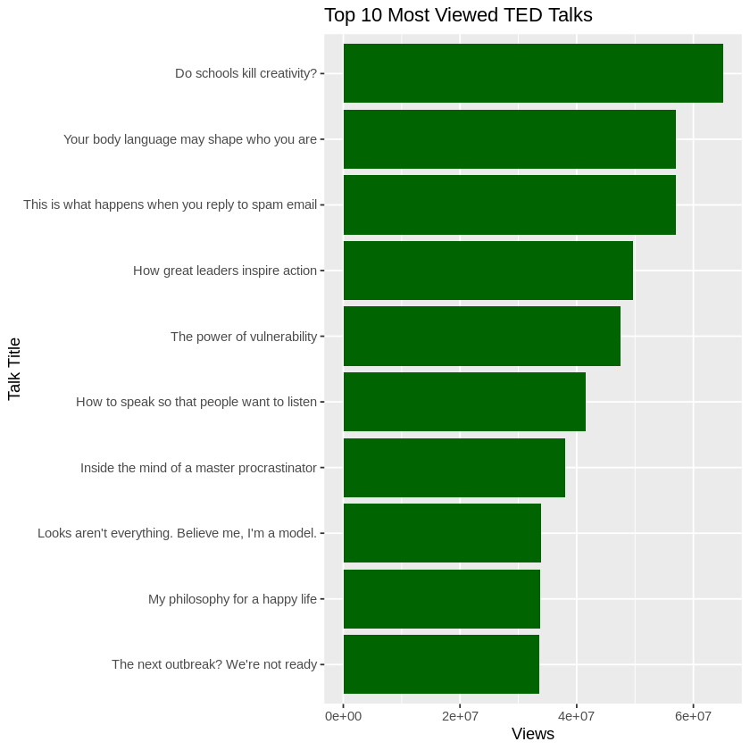
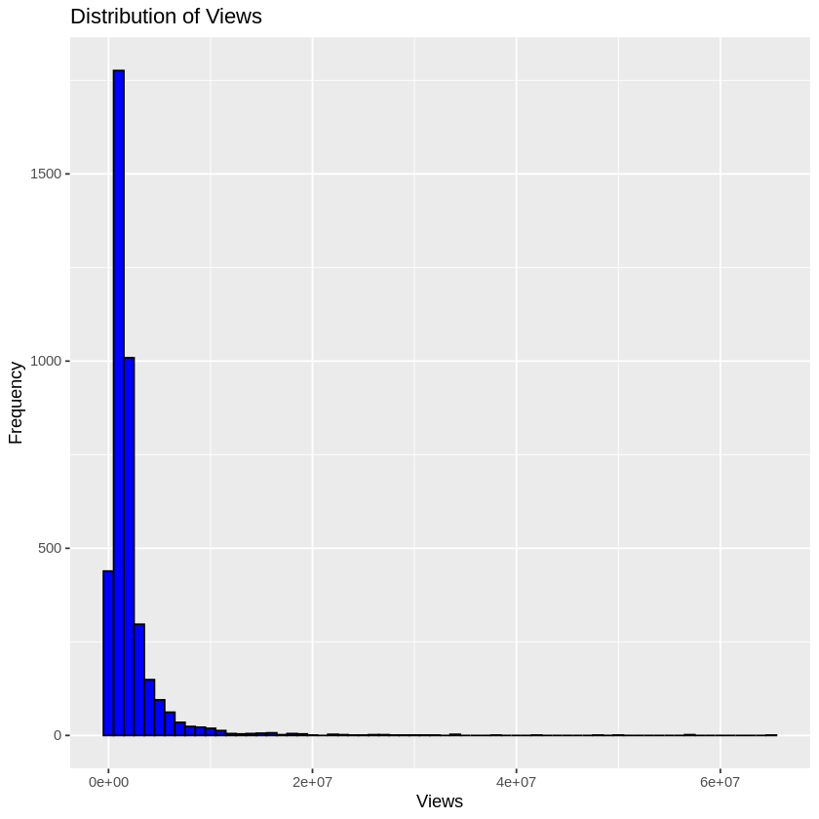

Slide 5
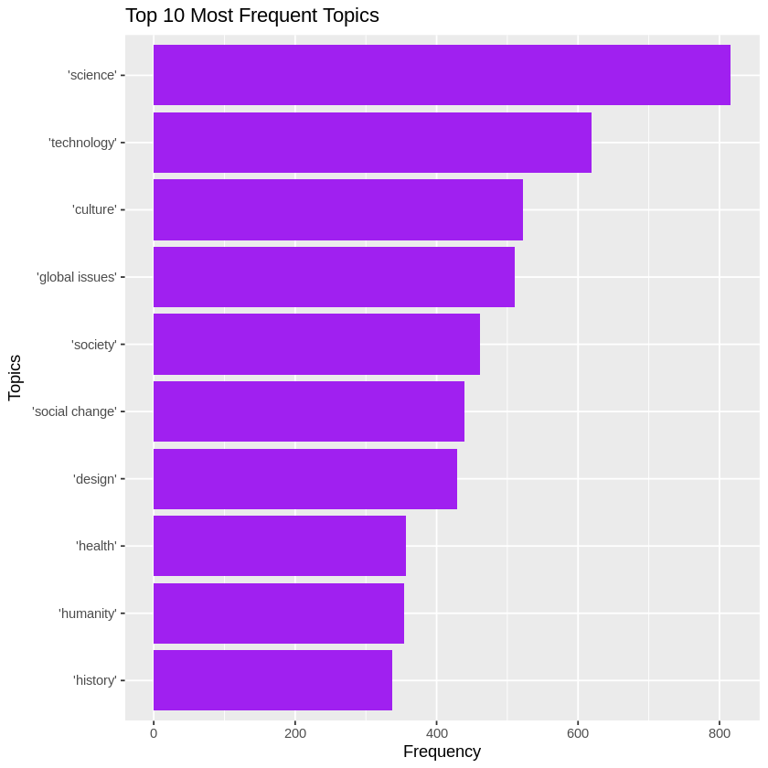
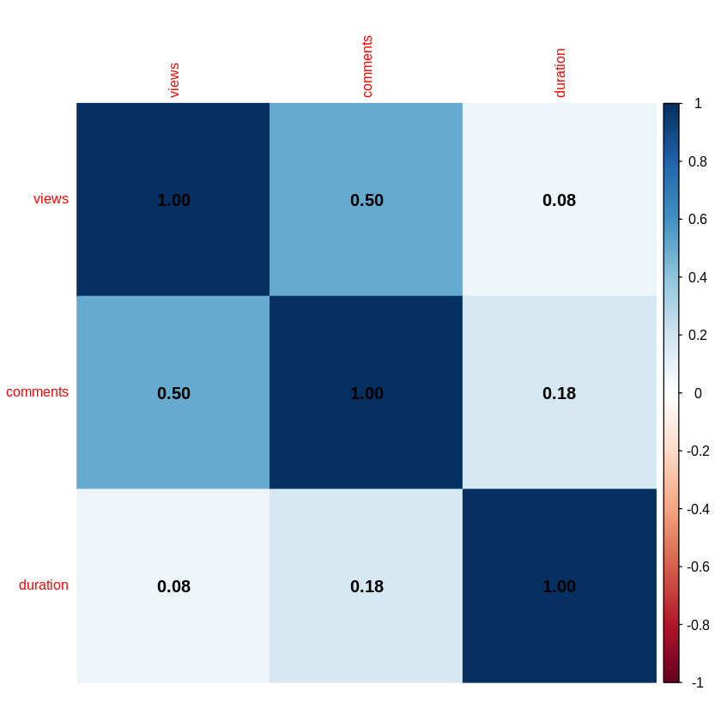

Slide 6
This R code performs data cleaning, multiple linear regression, and visualization on the TED Talks dataset.
Loading Libraries and Dataset: It loads necessary libraries (ggplot2) and imports the ted_talks.csv dataset.
Dataset Structure Check: The str() function checks the structure of the dataset, displaying its variables and data types.
Data Cleaning: Rows with missing values in the comments, views, and duration columns are removed using na.omit() to ensure a clean dataset for analysis.
Multiple Linear Regression:
A multiple linear regression model (lm_model) is built to predict views based on two predictors: duration and comments.
The summary() function outputs detailed model statistics, including coefficients, R-squared, and p-values to evaluate the significance of predictors.
Scatter Plots with Regression Lines:
Two scatter plots are created to visualize the relationships between views and each of the predictors (duration and comments).
The plots show data points and regression lines fitted using geom_smooth() to highlight trends in the data. One plot shows Views vs Duration (red regression line), and the other shows Views vs Comments (blue regression line).
This code offers insights into how views depend on duration and comments using regression analysis and graphical representation.

Slide 7
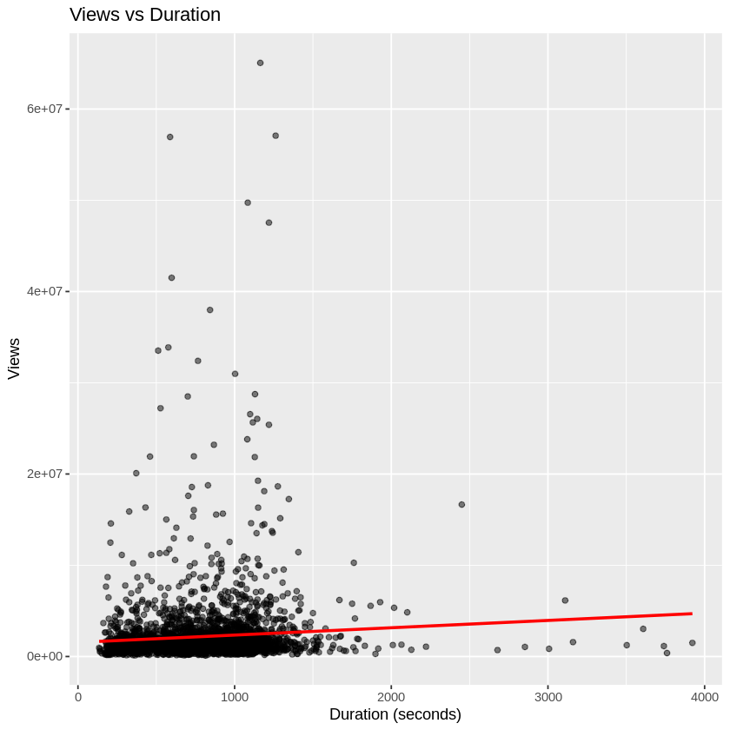
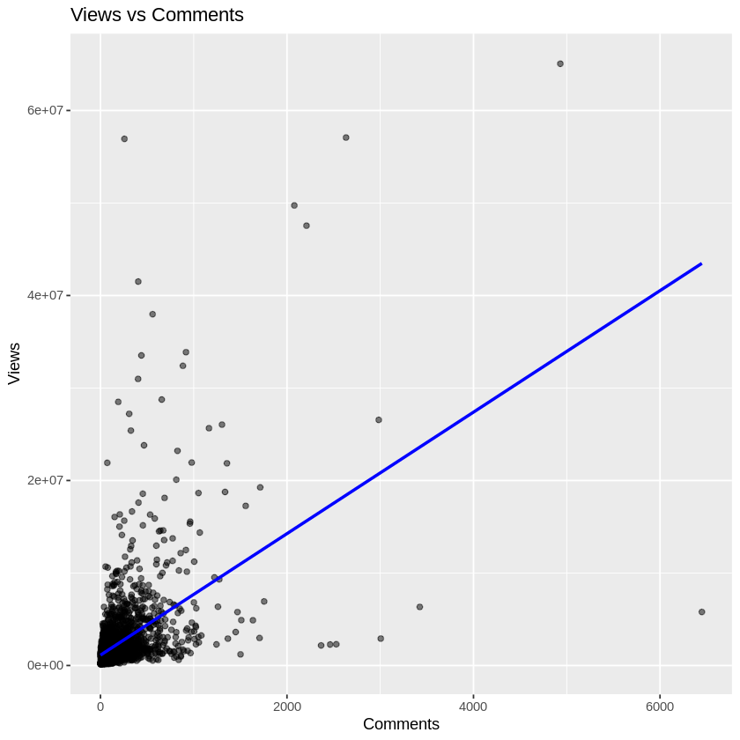

Slide 8
This R code performs multiple linear regression analysis on the TED Talks dataset and evaluates the model's performance.
Loading Libraries and Dataset:
It imports the Metrics library for calculating error metrics and loads the TED Talks dataset.
Data Cleaning:
Missing values are removed, and only the views, comments, and duration columns are retained for analysis.
Multiple Linear Regression:
A linear regression model (lm_model) is fitted with views as the dependent variable and duration and comments as independent variables.
The summary(lm_model) provides model statistics, including coefficients and R-squared.
Predictions:
The model's predictions are calculated using predict().
Performance Evaluation:
RMSE (Root Mean Squared Error) is calculated using the rmse() function to measure the prediction error.
R-squared is calculated manually using the total sum of squares (SST) and the residual sum of squares (SSR) to assess the proportion of variance explained by the model.
The code assesses the fit of the regression model using RMSE and R-squared metrics

Slide 9
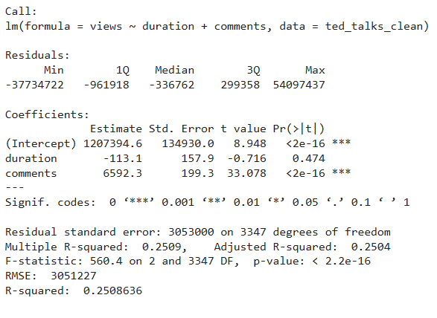

Slide 10
Conclusion:
Summary Statistics: The dataset provides key metrics for TED Talks, such as views, comments, and duration. These statistics help understand the general scale and spread of each variable.
Views Distribution: The histogram shows that the majority of TED Talks have views concentrated in lower ranges, with a few highly popular talks having a much larger number of views.
Top 10 Most Viewed Talks: The most popular TED Talks are visualized, highlighting which talks gained the most attention. The horizontal bar plot clearly shows the disparity between the highest viewed talks and the rest.
Correlation Analysis: A correlation matrix shows the relationship between views, comments, and duration. The results provide insights into how these variables are related, with comments and views showing a higher correlation than duration.
Topic Distribution: The top 10 most frequent topics in TED Talks are visualized. This offers insight into the subjects that are most commonly addressed in the talks.
Linear Regression:
Views vs Duration: The regression analysis shows that duration has a significant but not strong effect on views. The scatter plot reinforces this with a weak positive relationship.
Views vs Comments: The regression model and scatter plot indicate a stronger positive relationship between comments and views, suggesting that more comments are associated with higher view counts.

Slide 11
Thank you

