Slide 1
Census-2011
Data Cleaning & Pipeline

Slide 2
Problem Statement
The task is to clean, process, and analyze census data from a given source, including data renaming, missing data handling, state/UT name standardization, new state/UT formation handling, data storage, database connection, and querying. The goal is to ensure uniformity, accuracy, and accessibility of the census data for further analysis and visualization.

Slide 3
Task 1: Rename the Column names
For uniformity in the datasets and taking into consideration the census year, we need
to rename some columns.
⮚ State name to State/UT
⮚ District name to District
⮚ Male_Literate to Literate_Male
⮚ Female_Literate to Literate_Female
⮚ Rural_Households to Households_Rural
⮚ Urban_ Households to Households_Urban
⮚ Age_Group_0_29 to Young_and_Adult
⮚ Age_Group_30_49 to Middle_Aged
⮚ Age_Group_50 to Senior_Citizen
⮚ Age not stated to Age_Not_Stated

Slide 4
Task 2: Rename State/UT Names
The State/UT names are in all caps in the census data, For uniformity across datasets we use the names so that only the first character of each word in the name is in upper case and the rest are in lower case. However, if the word is “and” then it should be all lowercase.
Examples:
  Andaman and Nicobar Islands
  Arunachal Pradesh
  Bihar

Slide 5
Task 4: Find and process Missing Data
Find and store the percentage of data missing for each column.
Some data can be found and filled in by using information from other cells. Try to find the correct data by using information from other cells and filling it in. Find and store the percentage of data missing for each column.
Hint:
  Population = Male + Female
  Literate = Literate_Male + Literate_Female
  Population = Young_and_Adult+ Middle_Aged + Senior_Citizen +
  Age_Not_Stated
  Households = Households_Rural + Households_Urban

Slide 6
Task 5: Save Data to MongoDB
Save the processed data to mongoDB with a collection named “census”

Slide 7
Task 6: Database connection and data upload
Data should be fetched from the mongoDB and to be uploaded to a relational database using python code . The table names should be the same as the file names without the extension.
The primary key and foreign key constraints should be included in the tables wherever required.

Slide 8
Task 7: Run Query on the database and show output on streamlit
1. What is the total population of each district?
2. How many literate males and females are there in each district?
3. What is the percentage of workers (both male and female) in each district?
4. How many households have access to LPG or PNG as a cooking fuel in each district?
5. What is the religious composition (Hindus, Muslims, Christians, etc.) of each district?
6. How many households have internet access in each district?
7. What is the educational attainment distribution (below primary, primary, middle, secondary, etc.) in each district?
8. How many households have access to various modes of transportation (bicycle, car, radio, television, etc.) in each district?
9. What is the condition of occupied census houses (dilapidated, with separate kitchen, with bathing facility, with latrine facility, etc.) in each district?
10.How is the household size distributed (1 person, 2 persons, 3-5 persons, etc.) in each district?
11. What is the total number of households in each state?
12.How many households have a latrine facility within the premises in each state?
13.What is the average household size in each state?

Slide 9
Task 7: Run Query on the database and show output on streamlit
14.How many households are owned versus rented in each state?
15.What is the distribution of different types of latrine facilities (pit latrine, flush latrine, etc.) in each state?
16.How many households have access to drinking water sources near the premises in each state?
17.What is the average household income distribution in each state based on the power parity categories?
18.What is the percentage of married couples with different household sizes in each state?
19.How many households fall below the poverty line in each state based on the power parity categories?
20.What is the overall literacy rate (percentage of literate population) in each state?

Slide 10
Tools Used
Programming Language – Python
            Pandas
            Sqlalchemy
            Pymongo
            Openpyxl
            Plotly
            streamlit
Version Control: Git
Database – Relational: Postgresql
  Non-Relational: Mongodb

Slide 11
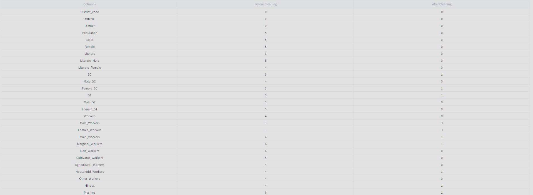
Missing Data Before and After
Missing Data before cleaning – 3622 records
Missing Data after cleaning – 2091 records

Slide 12
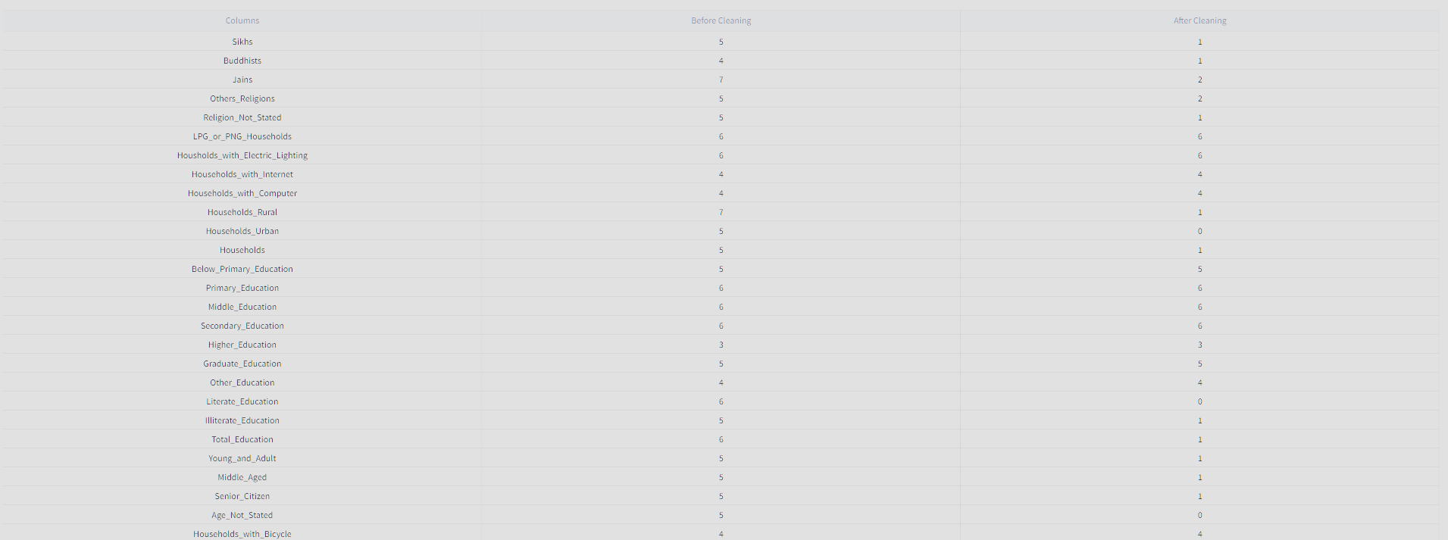
Missing Data Before and After

Slide 13
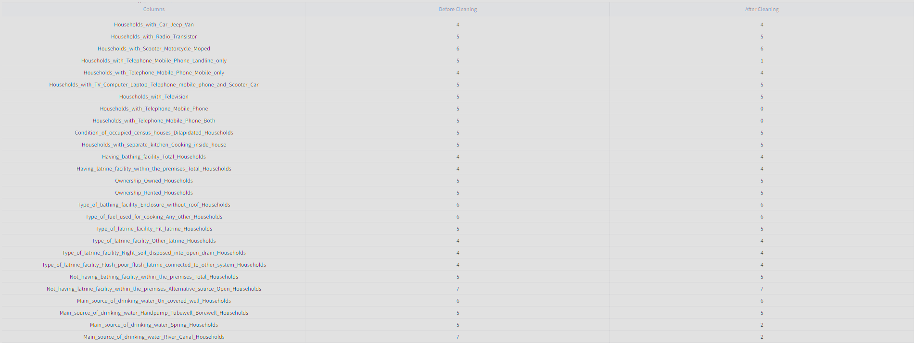
Missing Data Before and After

Slide 14
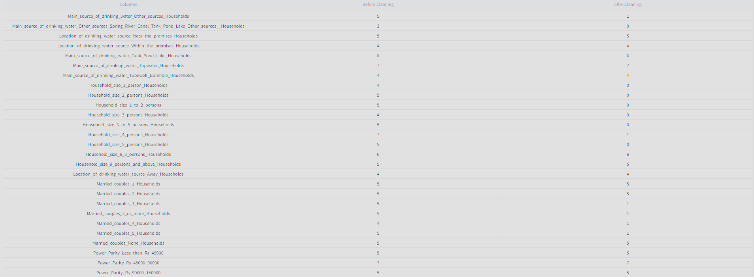
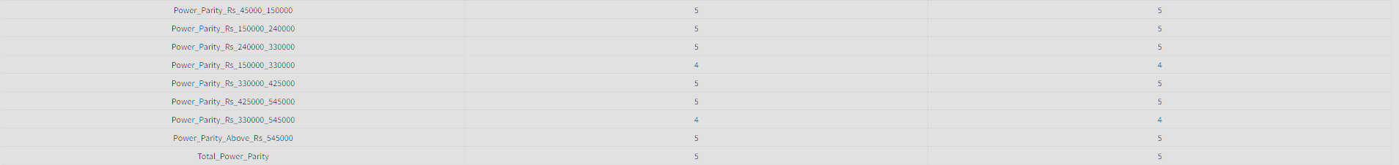
Missing Data Before and After

Slide 15
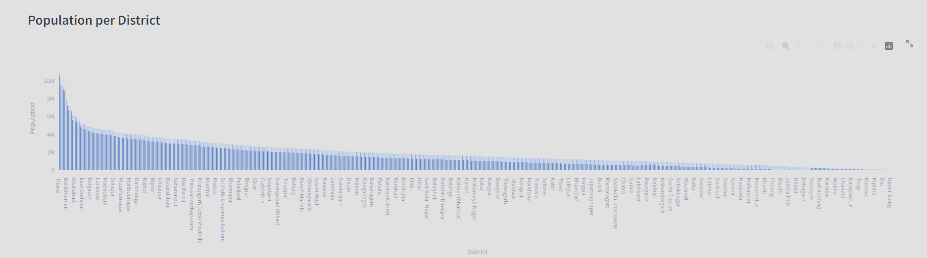
What is the total population of each district?
Densely populated District is Thane : 11,06015 Million
District with lowest population Dibung Valley : 8,004

Slide 16
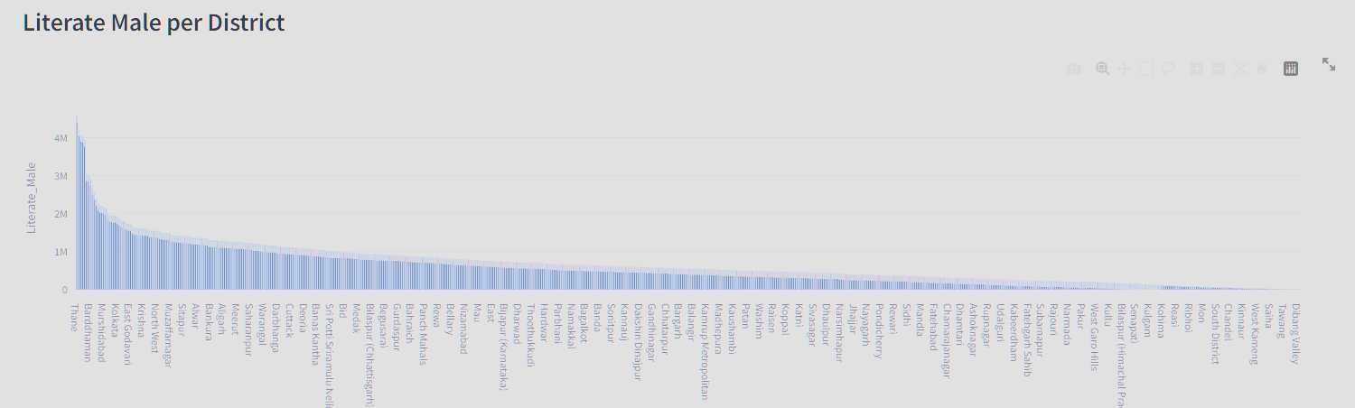
How many literate males and females are there in each district?
Districts with high Female and Male literates:
Male Literate : Thane – 4.591 Million
Female Literate : Thane – 3.635 Million
Districts with low Female and Male Literates:
Male Literate : Dibung Valley – 2,614
Female Literate : Dibung Valley – 1822

Slide 17
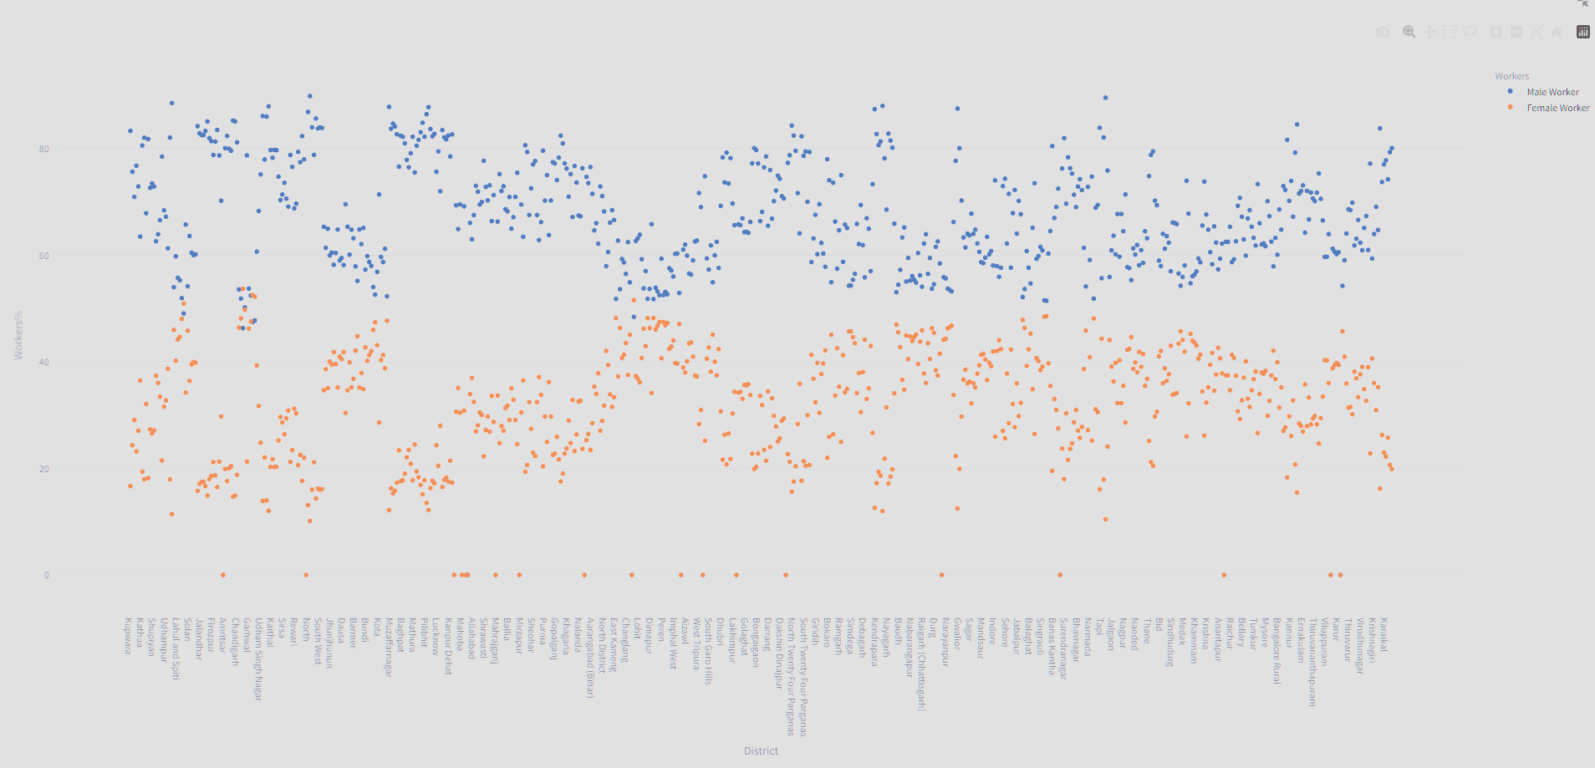
What is the percentage of workers (both male and female) in each district?
District with Highest Male workers : North East with nearly 90%
District with Highest Female workers: Rudraprayag with nearly 54%
District with Lowest Male workers : Rudraprayag with nearly 47%
District with Lowest Female workers : North East with nearly 10%

Slide 18
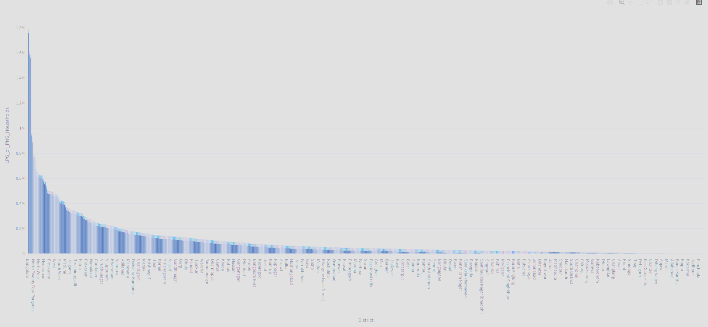
How many households have access to LPG or PNG as a cooking fuel in each district?
Bangalore has the highest LPG connections with nearly 1.8 Million
Kiphire from Nagaland has the lowest LPG connections with just 120

Slide 19
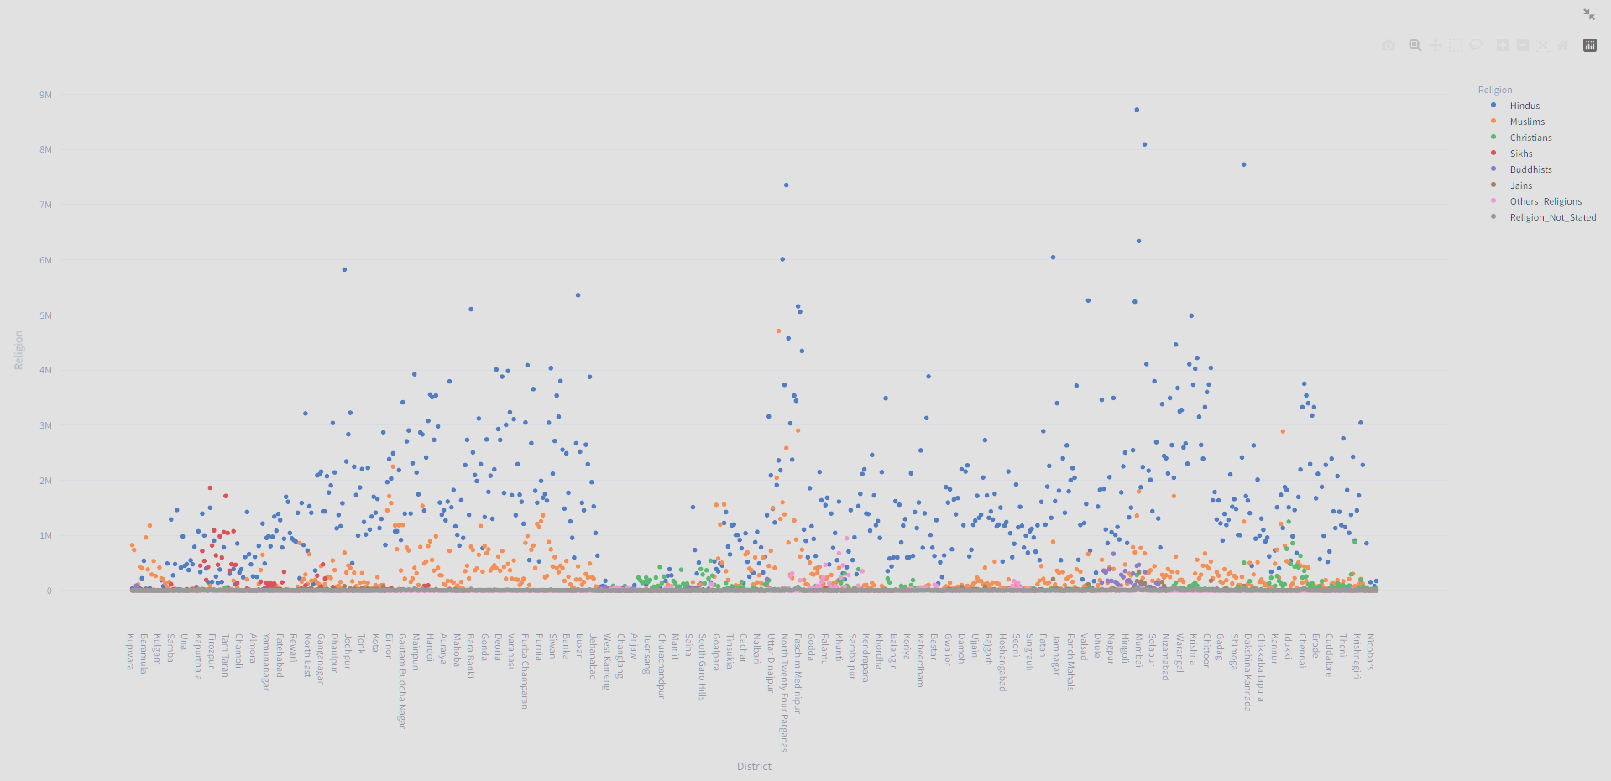
What is the religious composition (Hindus, Muslims, Christians, etc.) of each district?
Thane has the highest Hindu Population of around 8.8 Million
Malapuram has the highest Muslim Population of around 2.8 Million
Ernakulam has the highest Christian Population of around 1.25 Million
Ludhiana with highest Sikhs of around 1.9 Million
Nagpur with highest Buddhists of around 6.8 lakhs
Mumbai Suburban with highest Jains of around 3.4 lakhs
Pashchimi Singhbhum has the highest other religions with 9.4 lakhs

Slide 20
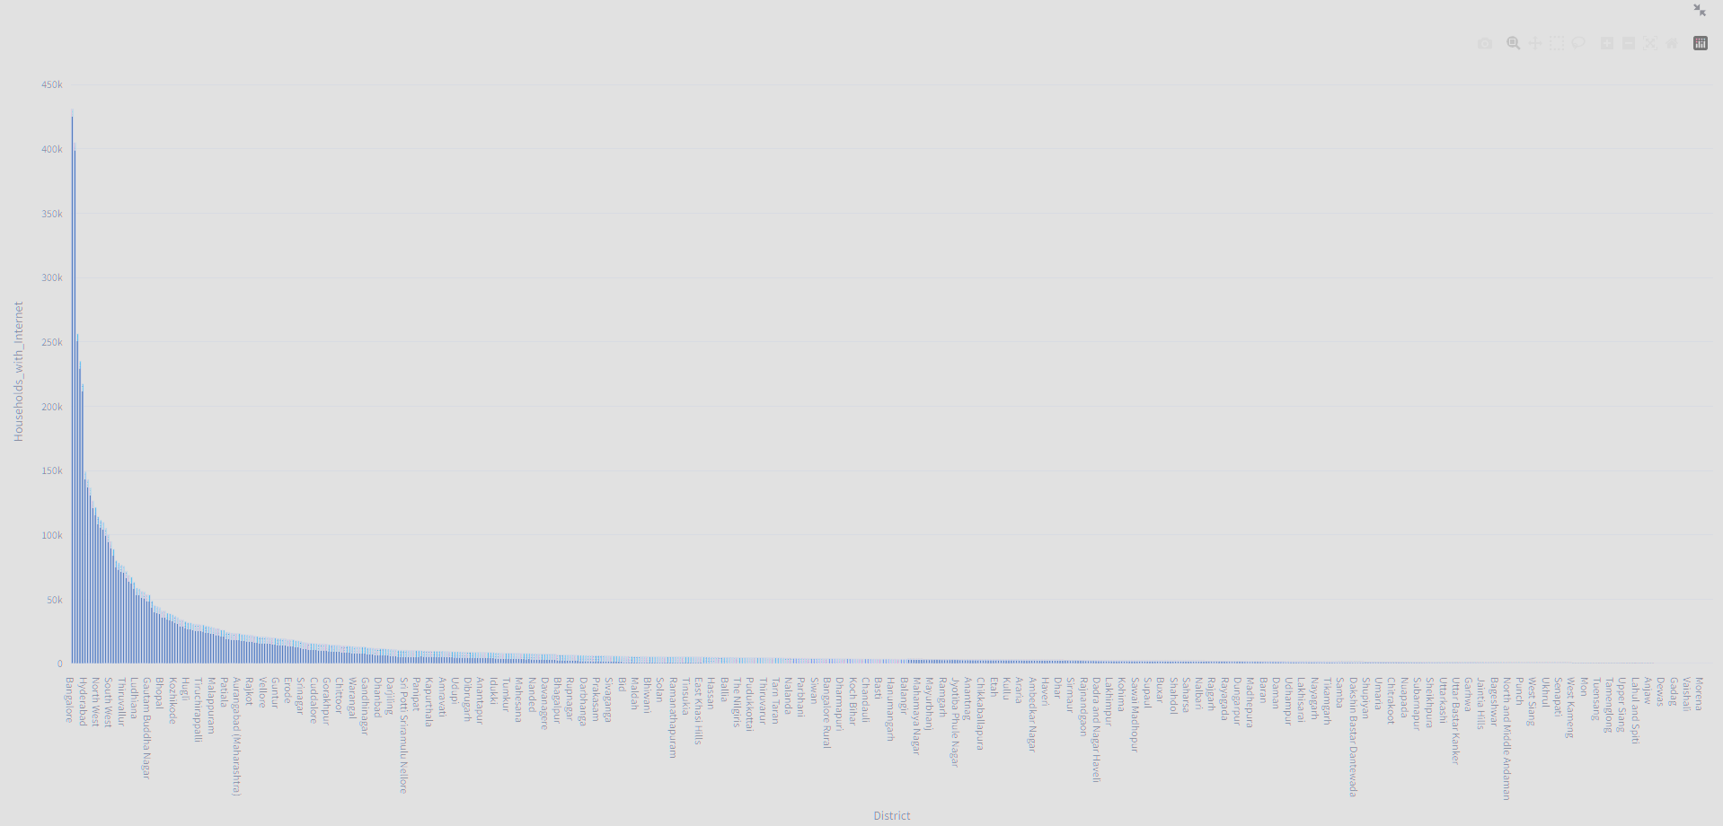
How many households have internet access in each district?
Bangalore has the highest Internet consumption with 4.3 lakhs
Dibang Valley being the lowest with 17

Slide 21
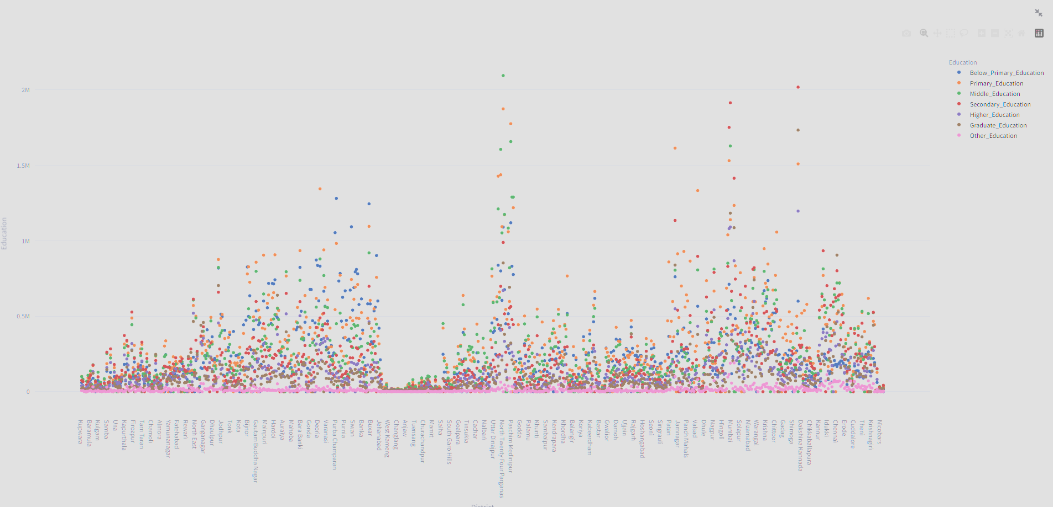
What is the educational attainment distribution (below primary, primary, middle, secondary, etc.) in each district?
Purba Champaran has the most no of below primary educated people with 1.2 miIllion
North Twenty Four Paragans has the most no of people with Primary education with 1.87 Million
North Twenty Four Paragans has the most no of people with Middle education with 2.09 Million
Bangalore has the highest secondary education with 2 miIllion
Bangalore has the highest Higher education with 1.2 miIllion
Bangalore has the highest Graduates with 1.7 miIllion
Bangalore has the highest other education with 1.9 lakhs

Slide 22
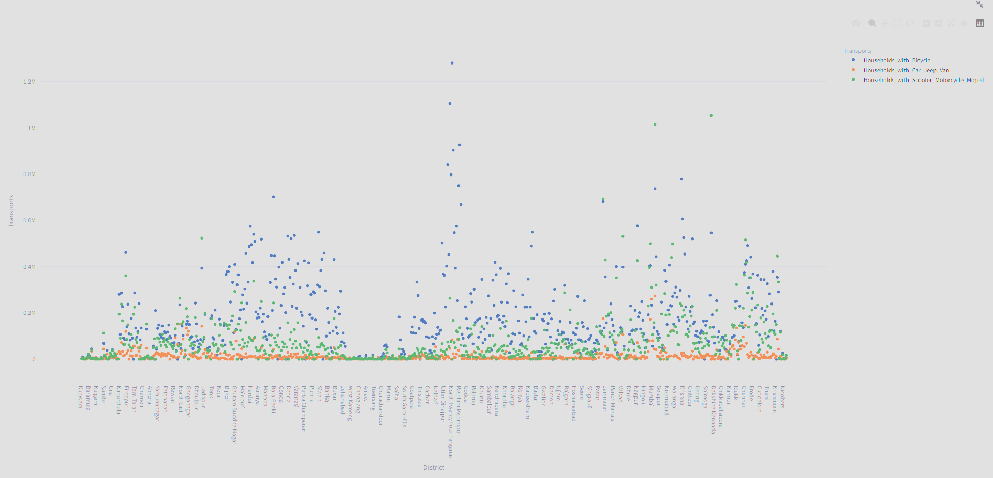
How many households have access to various modes of transportation
(bicycle, car, etc.) in each district?
North Twenty Four Paragans has the highest no of people using Bicycle with 1.27 Million
Pune has more No. of Cars/Van/Jeep with 2.73Lakhs people using
Bangalore has more two wheelers with 1.2 Million

Slide 23
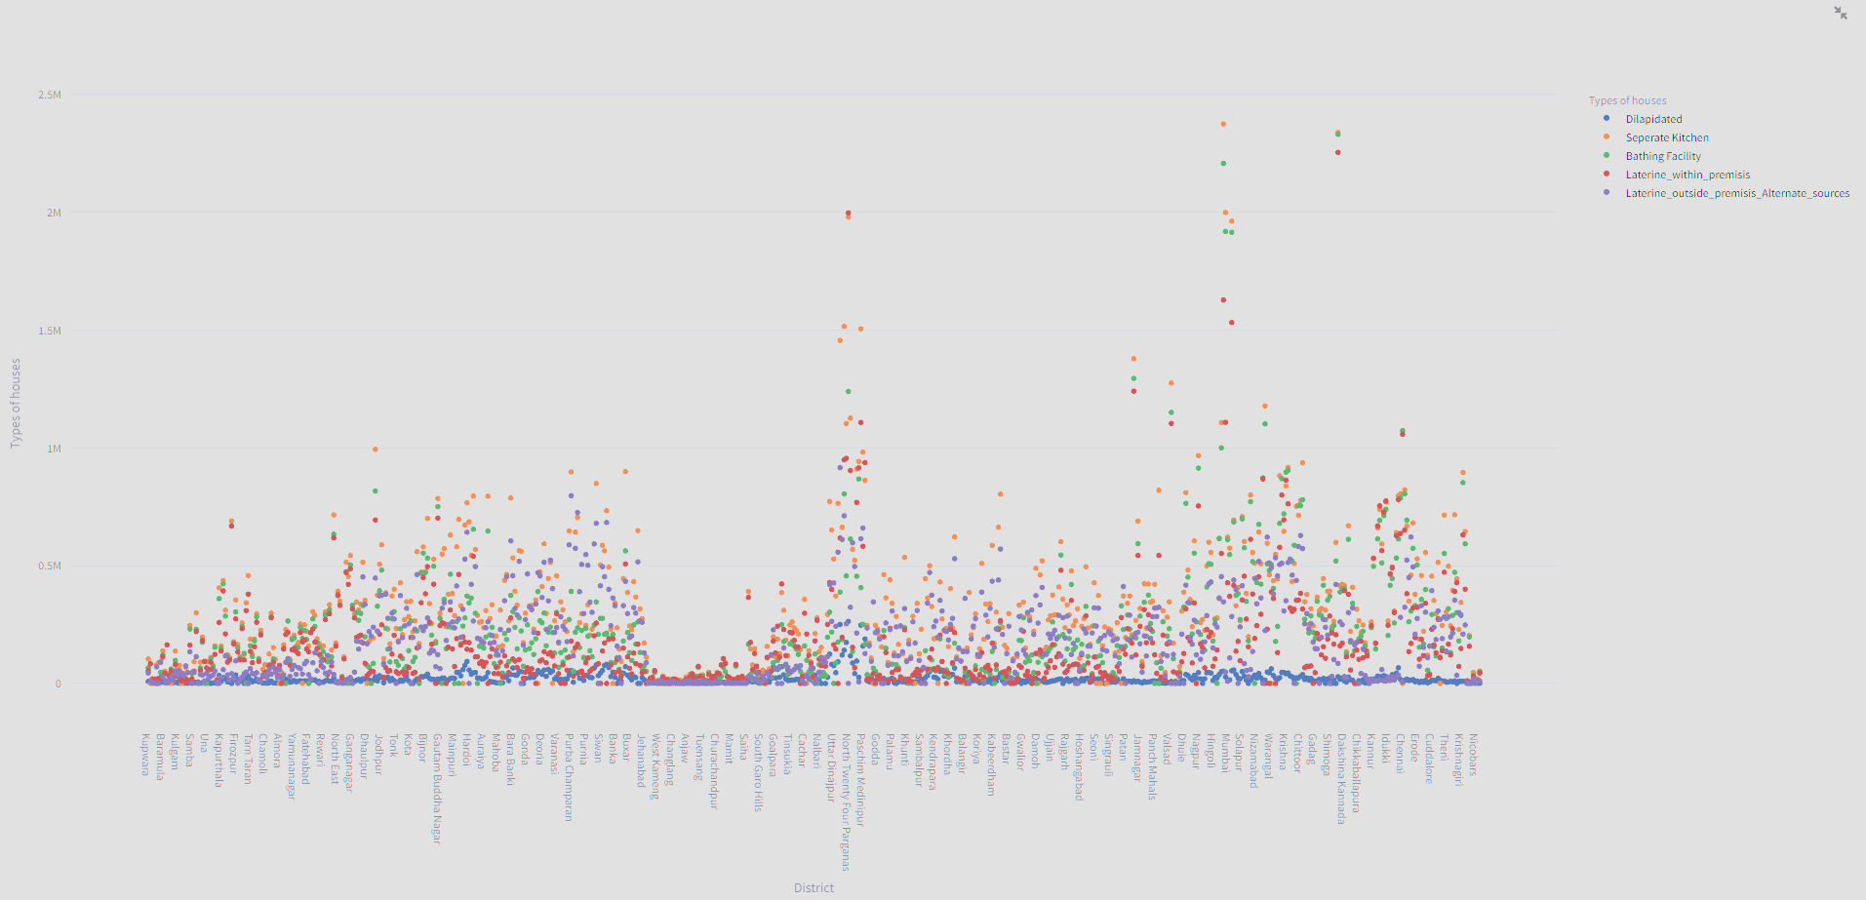
What is the condition of occupied census houses (dilapidated, with separate kitchen, with bathing facility, with latrine facility, etc.) in each district?
North Twenty Four Paragans has the highest no of people using Dilapidated Houses with 2.6 Lakhs
Thane has majority of the houses with Separate Kitchen with 2.37 Million
Bangalore has the highest houses with Bathing facility with 2.33 Million
Bangalore has the highest houses with Laterine facility with 2.2 Million
Murshidabad has the highest houses with laterne facility outside or with other alternate sources 9.8 Lakhs

Slide 24
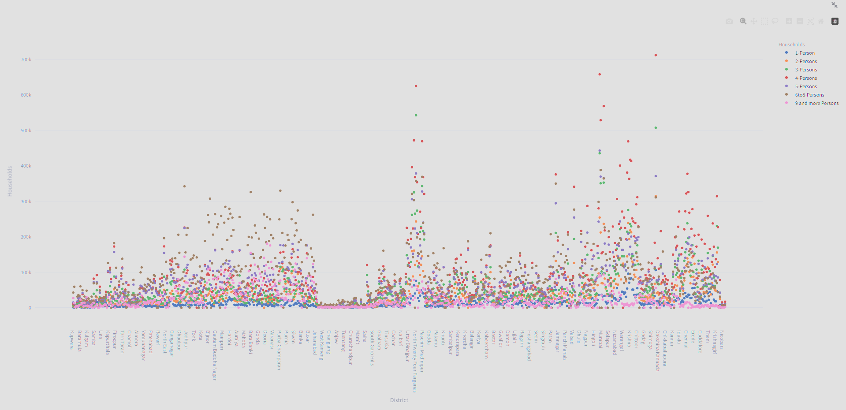
How is the household size distributed (1 person, 2 persons, 3-5 persons, etc.) in each district?
Bangalore is having the largest no. of 1 household -1.06 Lakhs
Bangalore is having the largest no. of 2 households -3 Lakhs
NorthTwentyFourParagons is having the largest no. of 3 households – 5.4 Lakhs
Bangalore is having the largest no. of 4 households -7.01 Lakhs
Thane is having the largest no. of 5 households –4.01 Lakhs
MumbaiSuburban is having the largest no. of 6-8 households – 3.8 Lakhs
Azamgargh is having the largest no. of households > 9 – 1.8 Lakhs

Slide 25
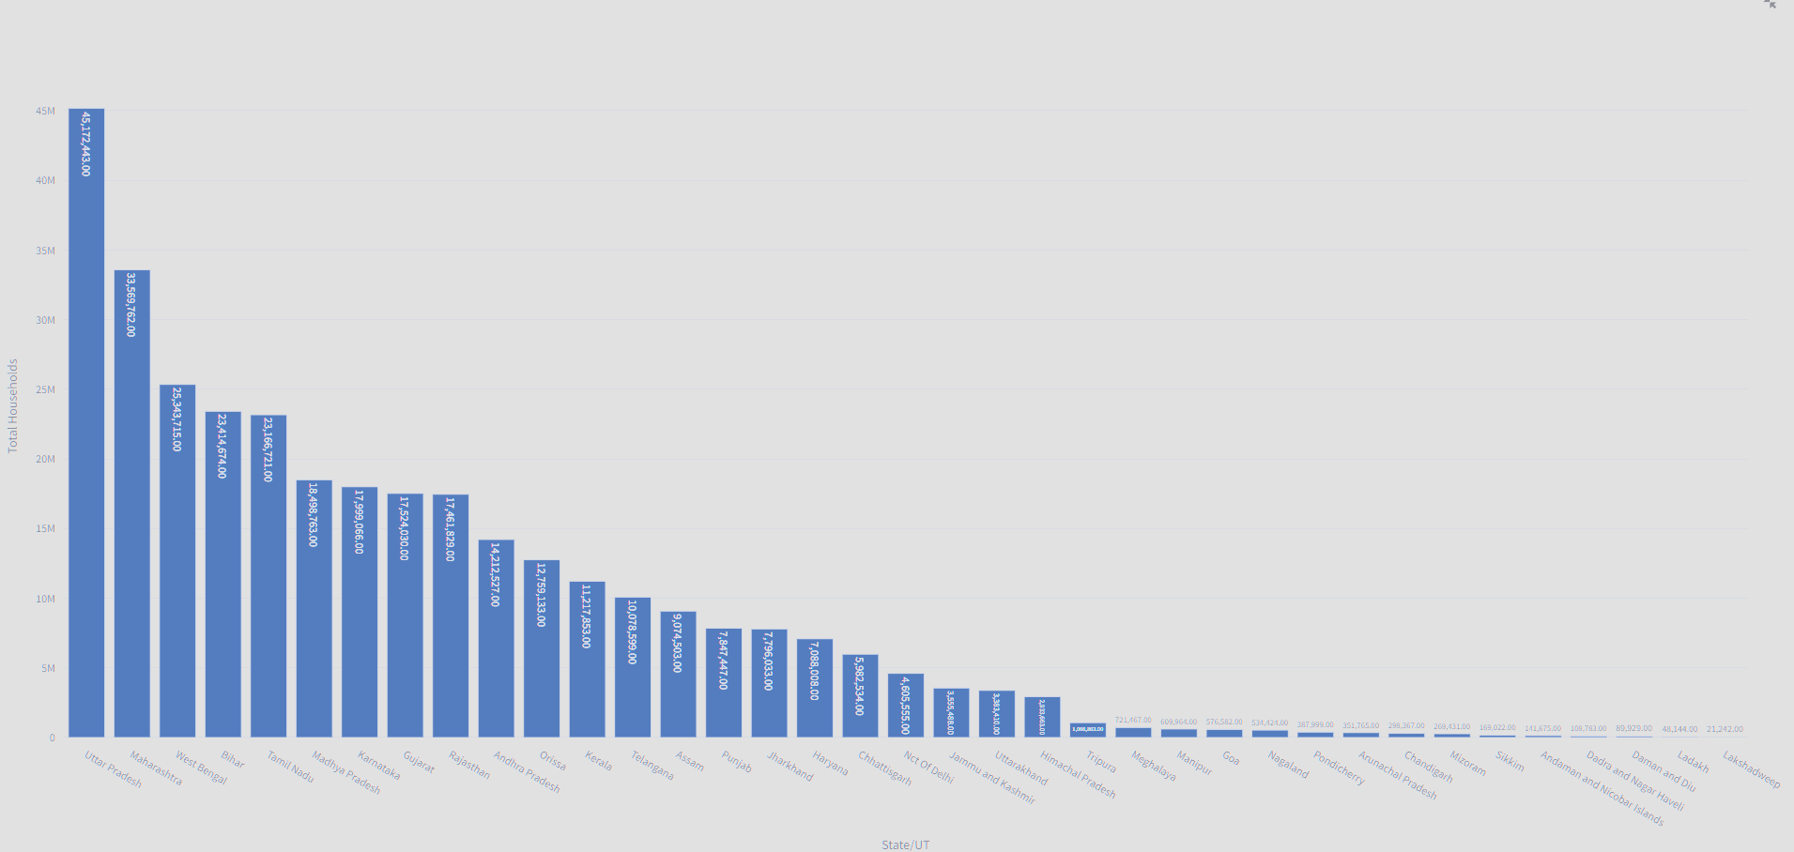
What is the total number of households in each state?
Uttar Pradesh has around 45.1 Million Households
Lakshwadeep has around 21.24 Thousand Households

Slide 26
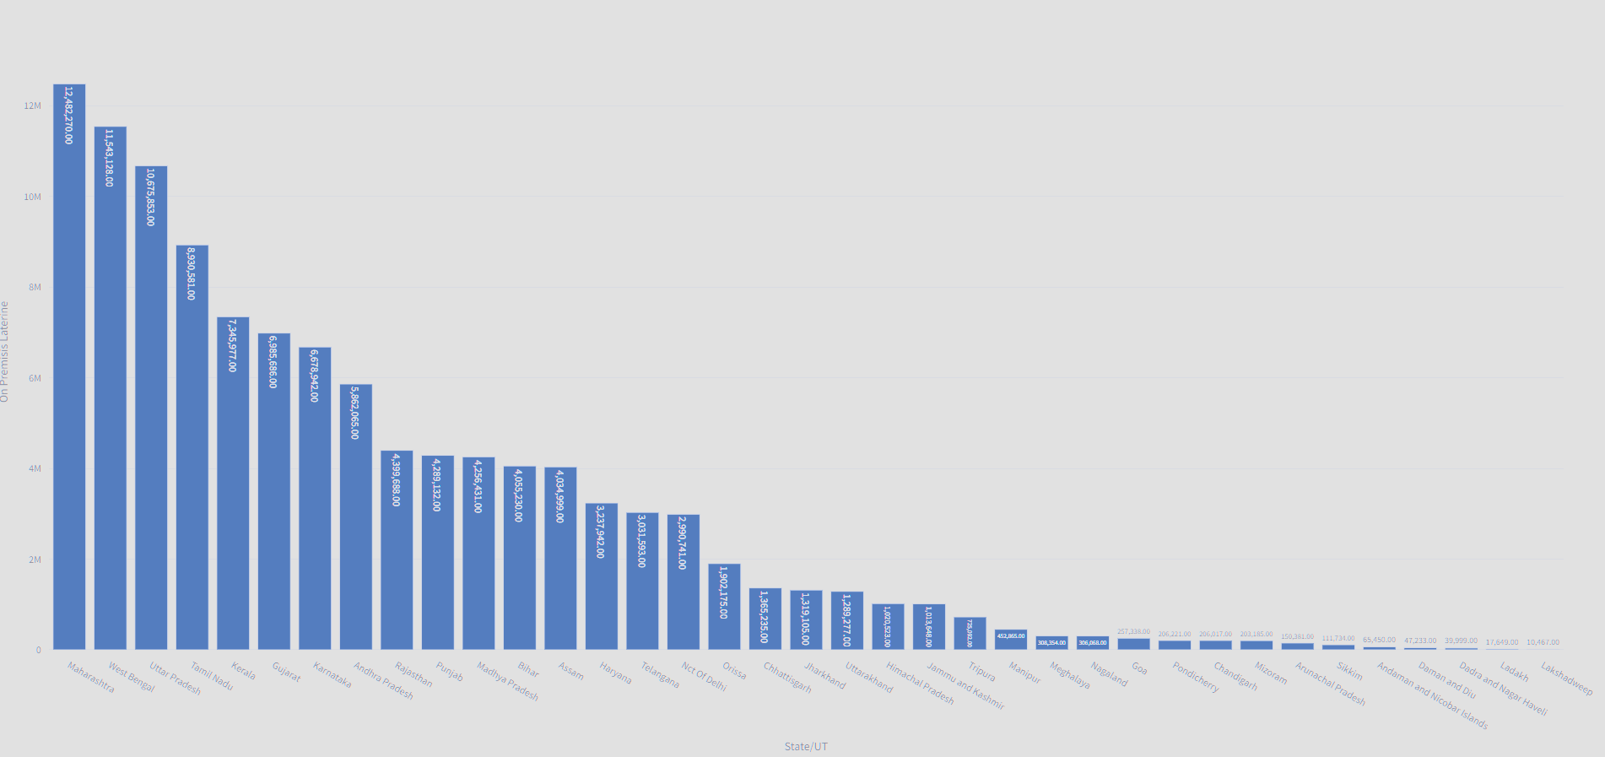
How many households have a latrine facility within the premises in each state?
Maharashtra has around 12.5 Million Households
Lakshwadeep has around 10.46 Thousand Households

Slide 27
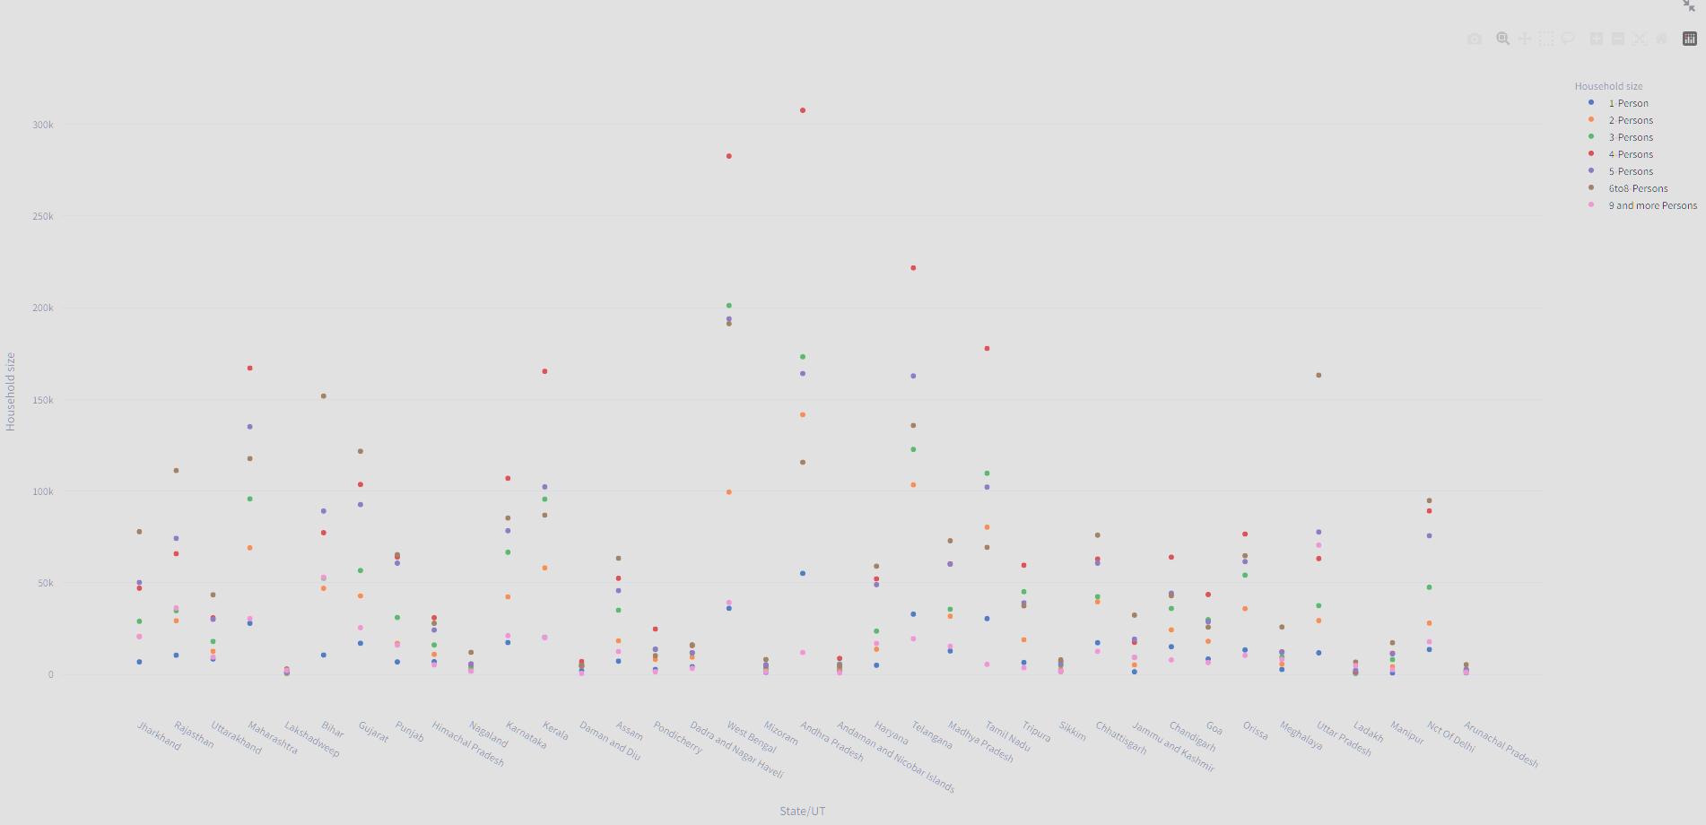
What is the average household size in each state?
AndhraPradesh is having the largest no. of 1 household -55 Thousand
AndhraPradesh is having the largest no. of 2 households -1.1 Lakhs
WestBengal is having the largest no. of 3 households – 2.01 Lakhs
AndhraPradesh is having the largest no. of 4 households -3.07 Lakhs
WestBengal is having the largest no. of 5 households –1.9 Lakhs
WestBengal is having the largest no. of 6-8 households – 1.9 Lakhs
UttarPradesh is having the largest no. of households >9 – 70 Thousand

Slide 28
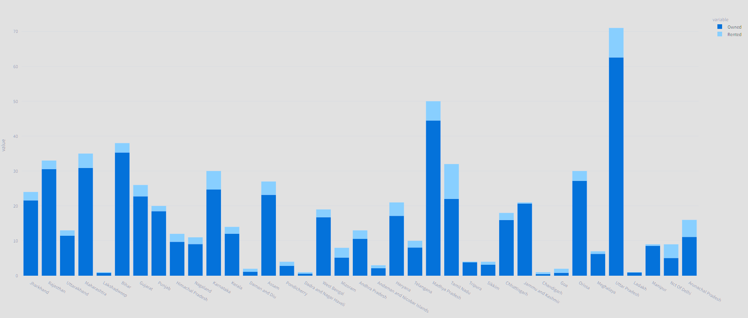
How many households are owned versus rented in each state?
All the states have more no of Owned houses than the Rented

Slide 29
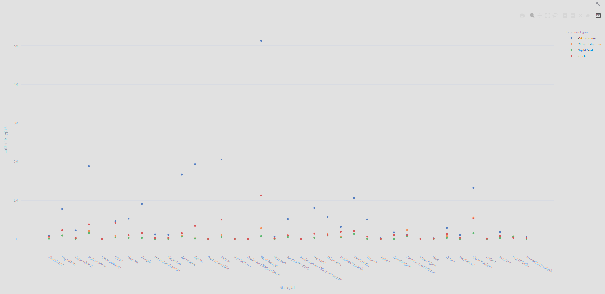
What is the distribution of different types of latrine facilities (pit latrine, flush latrine, etc.) in each state?
WestBengal are the largest users of Pit Latrine with 5.1 Million
UttarPradesh are the largest users of other Latrine methods with 5.5 Lakhs
Maharashtra are the largest users of Night Soil with 1.54 Lakhs
WestBengal are the largest users of Flush with 1.2 Million

Slide 30
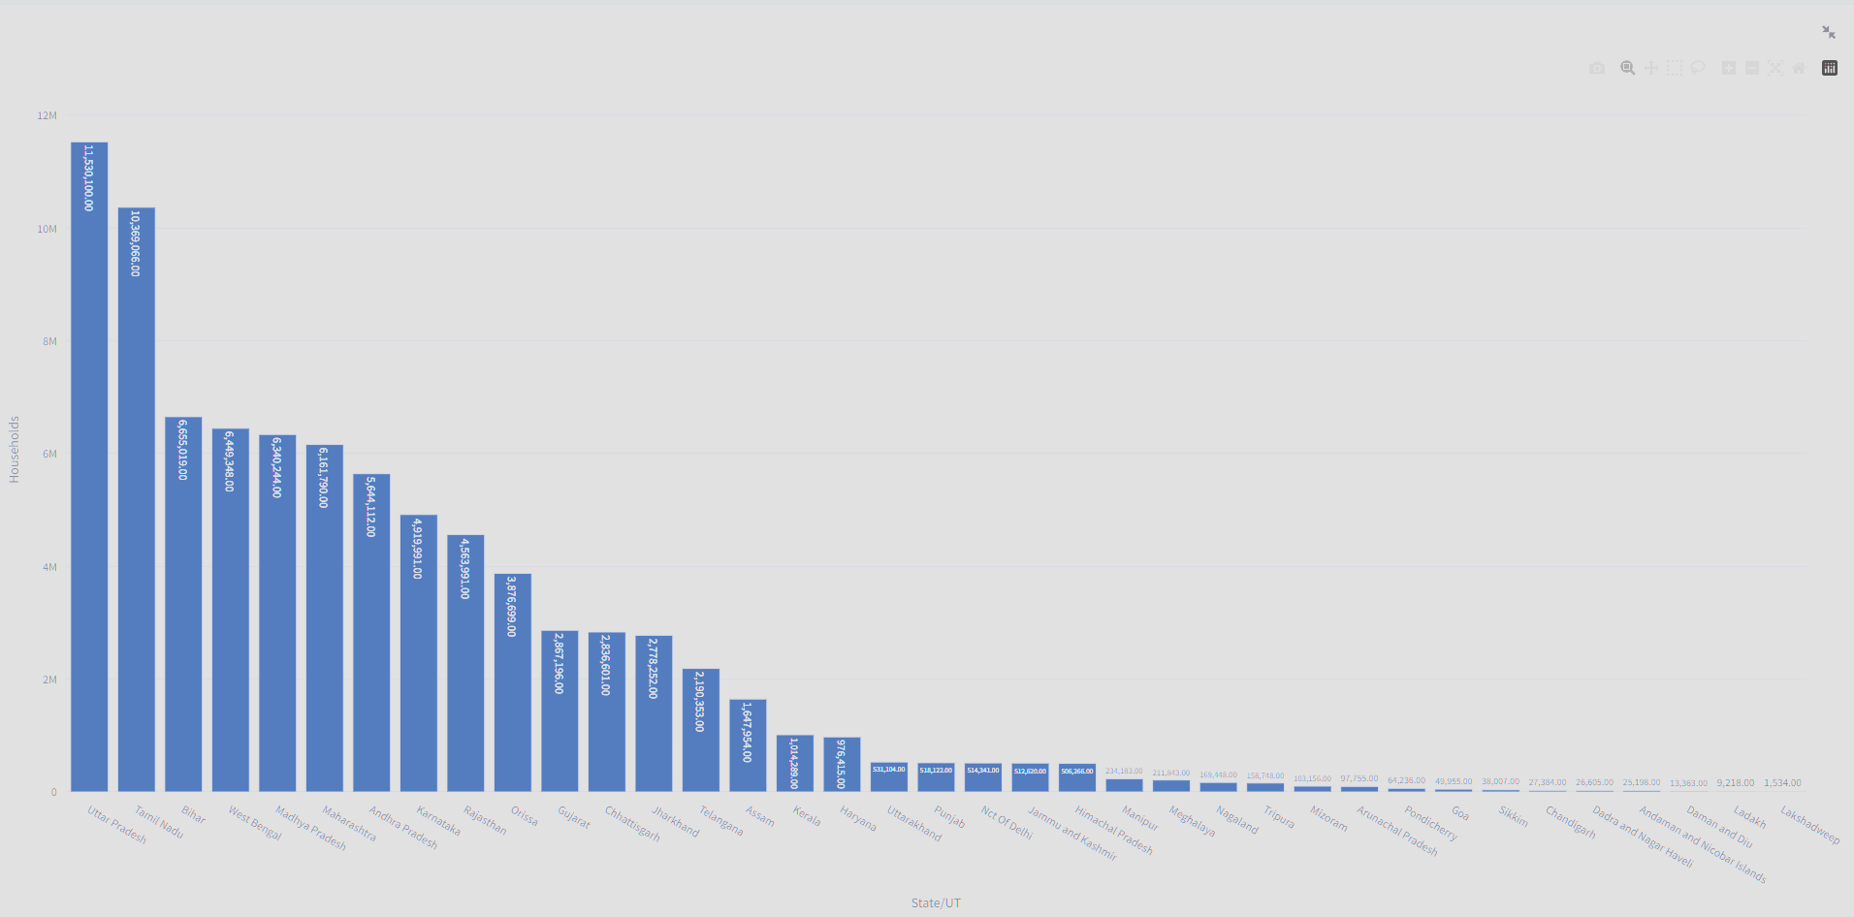
How many households have access to drinking water sources near the premises in each state?
UttarPradesh being the largest city with people having drinking water near the premises with 11.5 Million
Lakshwadeep has the lowest people having drinking water near the premises with 1500

Slide 31
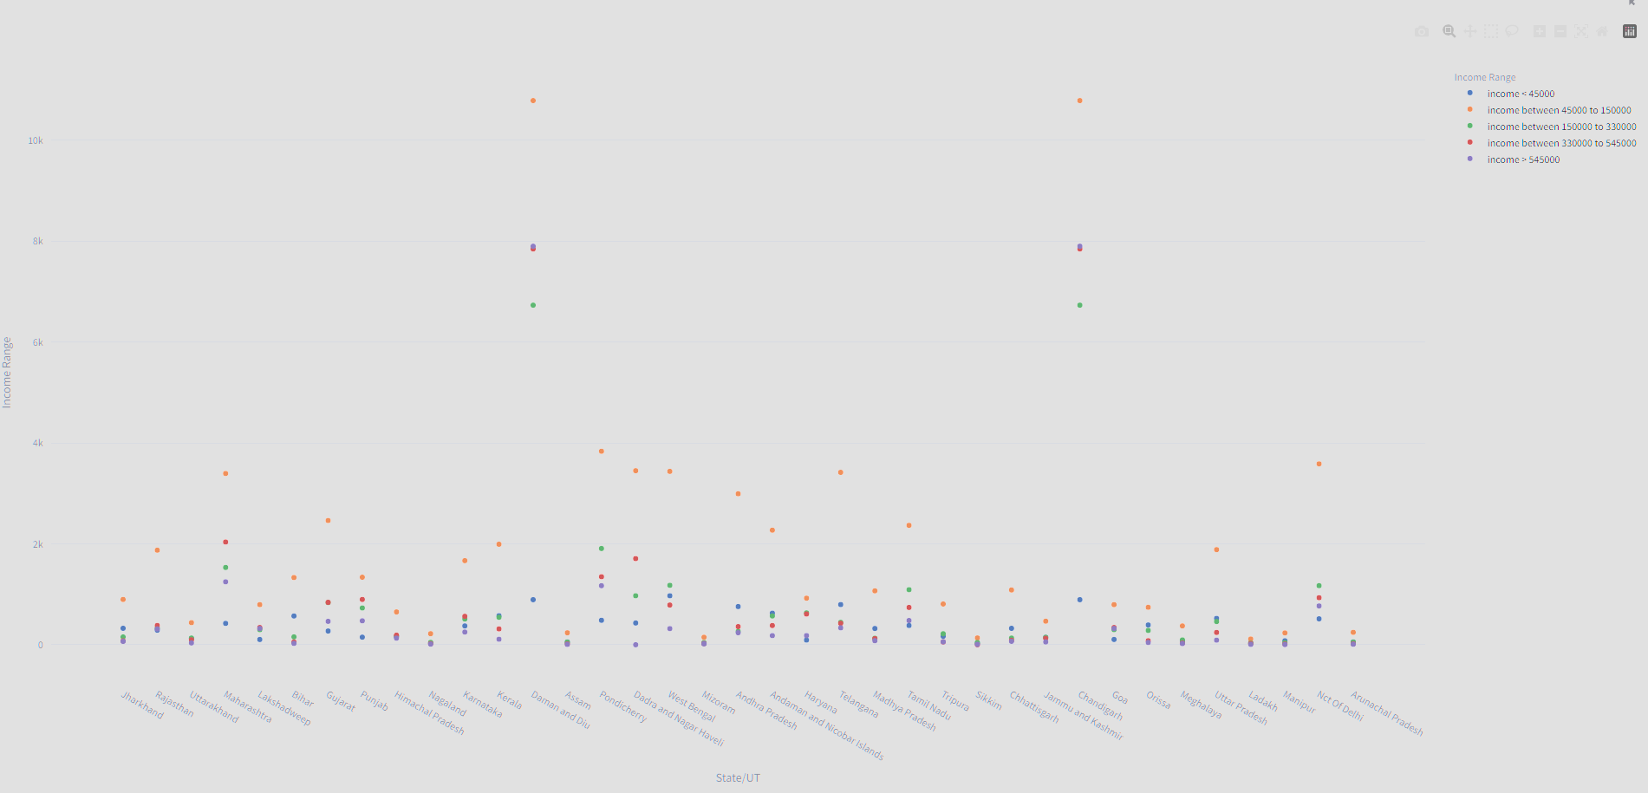
What is the average household income distribution in each state based on the power parity categories?
WestBengal has large no. of people with income <45000 - 9.7 Lakhs
Daman and Diu has large no. of people with income between 45000 to 150000 -10 lakhs
Daman and Diu has large no. of people with income between income between 150000 to 330000-6729
Daman and Diu and Chandigargh has large no. of people with income between 330000 to 545000 – 7843
Daman and Diu and Chandigargh has large no. of people with income > 545000- 7897

Slide 32
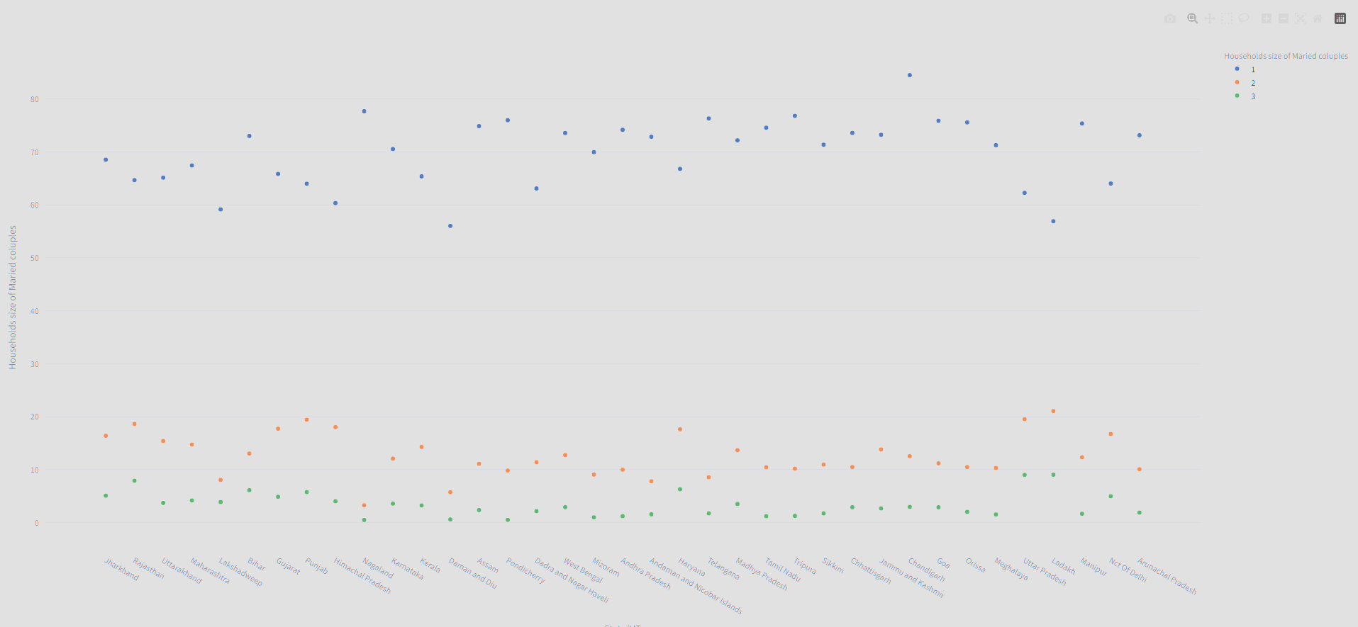
What is the percentage of married couples with different household sizes in each state?
Chandigargh has the highest % of married couples with 1 Household -84%
Ladakh has the highest % of married couples with 2 Households -21%
Ladakh has the highest % of married couples with 3 Households -9%

Slide 33
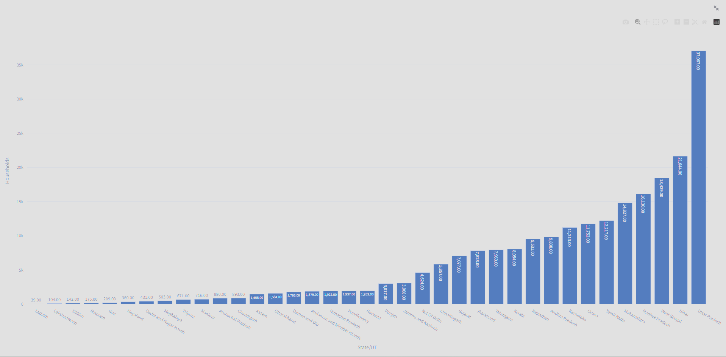
How many households fall below the poverty line in each state based on the power parity categories?
UttarPradesh has the highest No.of Households below poverty line around 32 Thousand
Ladakh has the highest No.of Households below poverty line - 39

Slide 34
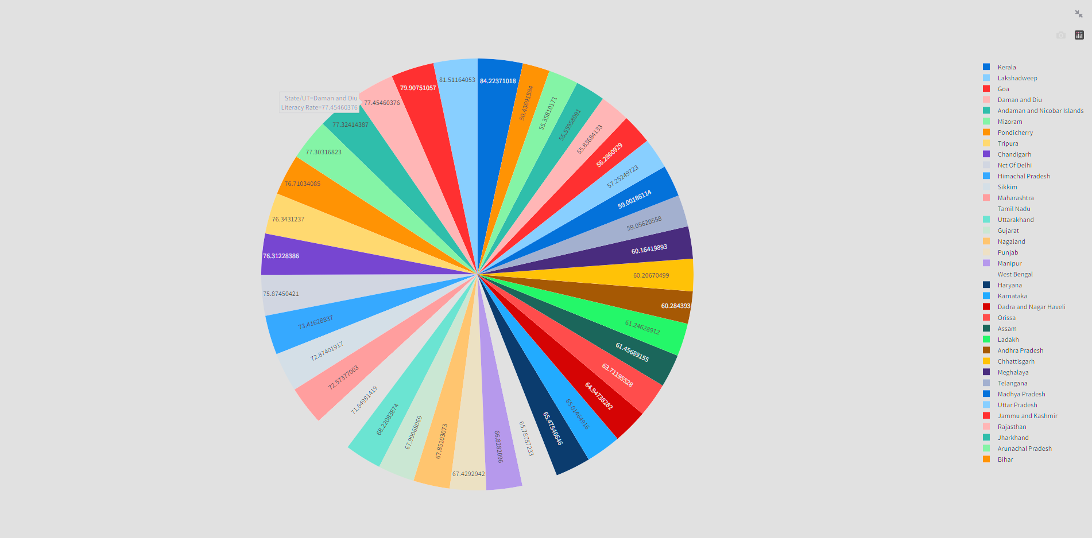
What is the overall literacy rate (percentage of literate population) in each state?
Kerala has the highest literacy rate – 84.2%
Bihar has the lowest literacy rate – 50.43%

