Slide 1
IMPLEMENTING GRAPH COLORING PROBLEM USING BACKTRACKING APPROACH
By :- Project batch number: CSEMPBNUM_F01
Ganeshna Jaya Sriram (2210316614)
Piska Mallikarjuna Vaibhav (2210316648)
Inampudi Vikranth (2210316623)
Muddam Ganesh Goud (2210316641)
Project Guide
Ms. N. Asha Jyothi

Slide 2
ABSTRACT
Graph coloring also called Vertex coloring is a process of assigning colors to all the vertices of the graph such that no two adjacent vertices of it are assigned the same color. In other words, there must not be any edge in the graph whose end vertices are colored with the same color. Such a graph is called a properly colored graph.
The minimum number of colors required to color any graph such that no two adjacent vertices of it are assigned the same color is called Chromatic Number. Unfortunately, there is no efficient algorithm available for coloring a graph with a minimum number of colors as the problem is a known NP-Complete problem. Our goal is to find the chromatic number for a given graph with n vertices by using the backtracking approach

Slide 3
CONTENTS
BACKTRACKING
GRAPH COLORING
APPLICATION
GRAPH COLORING USING BACKTRACKING
MAP COLORING USING FOUR COLOR THEOREM
CONCLUSION

Slide 4
BACKTRACKING
Backtracking can be defined as a general algorithmic technique that considers searching every possible combination in order to solve a computational problem.
dead end
?
dead end
dead end
?
start
?
?
dead end
dead end
?
success!

Slide 5
GRAPH COLORING
Graph Coloring is an assignment of colors to the vertices of a graph such that no two adjacent vertices have the same color that too by using the minimum number of colors.
Chromatic Number: The smallest number of colors needed to color a graph G is called its chromatic number. For example, the following can be colored minimum 3 colors.

Slide 6
APPLICATIONS
Helps in Scheduling Problems
Register allocation
Pattern matching
Map Coloring
Designing seating plans
Designing Time-Table
Solving sudoku

Slide 7
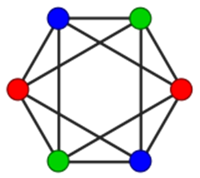
GRAPH COLORING USING BACKTRACKING
Given an undirected graph and a number m, the solution is to color the graph with at most m colors such that no two adjacent vertices of the graph are colored with same color.
In this, the graph is represented by its boolean adjacency matrix G[1:n,1:n]. Here K is the index of the next vertex to color.

Slide 8
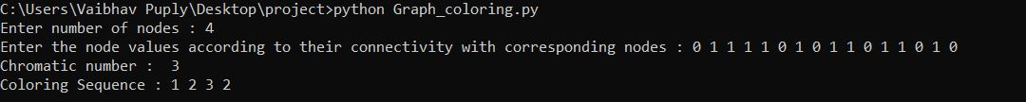
GRAPH COLORING USING BACKTRACKING
INPUTS:
i. Number of nodes.
ii. Node values according to their connectivity with corresponding nodes .
OUTPUTS:
i. Chromatic Number
ii. Coloring Sequence

Slide 9
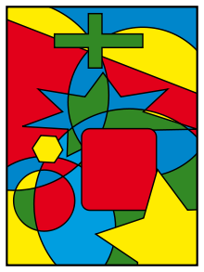
MAP COLORING USING FOUR COLOR THEOREM
The four-color theorem states that any map in a plane can be colored using four-colors in such a way that regions sharing a common boundary (other than a single point) do not share the same color.

Slide 10
MAP COLORING USING FOUR COLOR THEOREM
ALGORITHM:
Detecting all non-white regions (eg. provinces or states).
Converting the input map to a simple planar graph: There will be a node for each region. Two nodes will be adjacent, if and only if their corresponding regions have a common border on the map.
Using backtracking for coloring that graph (it's a recursive function that produces all valid colorings).
Displaying all produced colorings on the given map

Slide 11
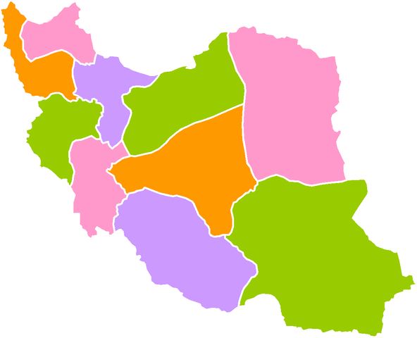
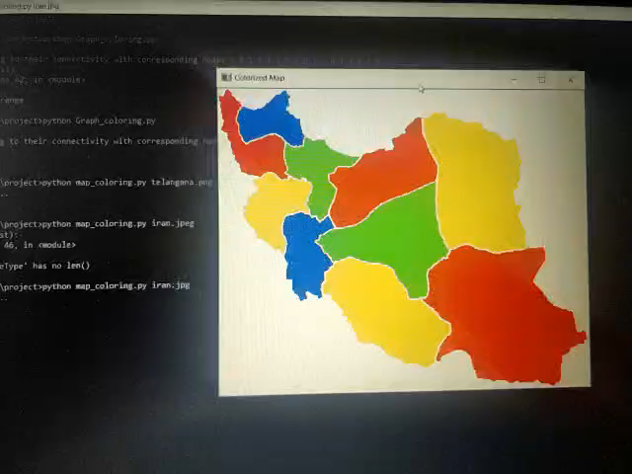
Input:
Output:

Slide 12
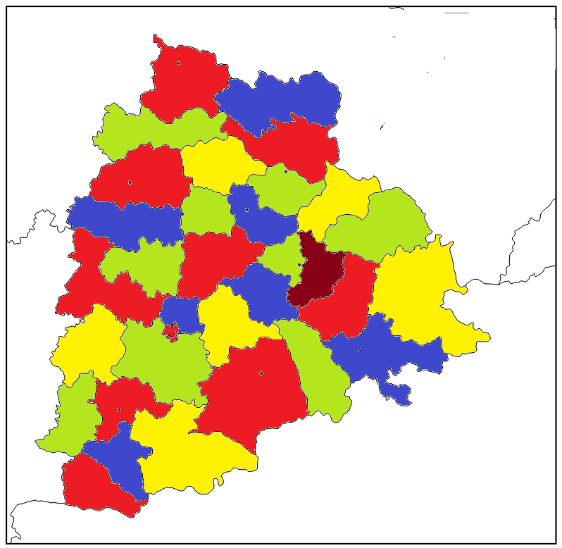
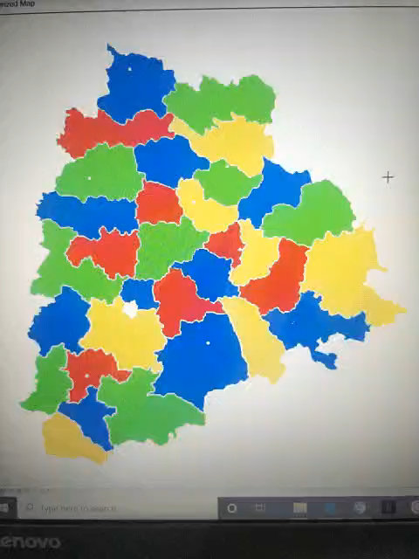
Input:
Output:

Slide 13
CONCLUSION
The proposed project clearly demonstrates implementation of graph coloring problem using backtracking and its application i.e, Implementation of Four color Theorem for map colouring.
The four-color theorem states that any map in a plane can be colored using four-colors in such a way that regions sharing a common boundary (other than a single point) do not share the same color.
We can say that, given any separation of a plane into contiguous regions, producing a figure called a map, no more than four colors are required to color the regions of the map so that no two adjacent regions have the same color.
Graph coloring enjoys many practical applications as well as theoretical challenges. Beside the classical types of problems, different limitations can also be set on the graph, or on the way a color is assigned, or even on the color itself.
It has even reached popularity with the general public in the form of the popular number puzzle Sudoku. Graph coloring is still a very active field of research

Slide 14
THANKYOU

