Slide 1
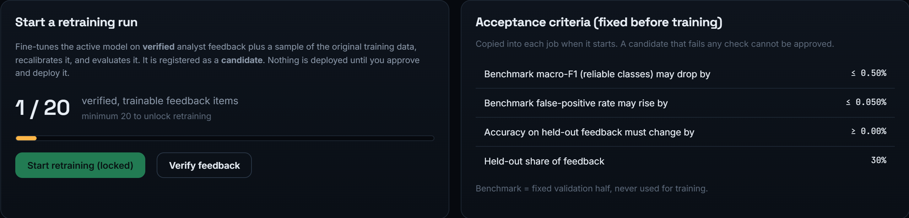
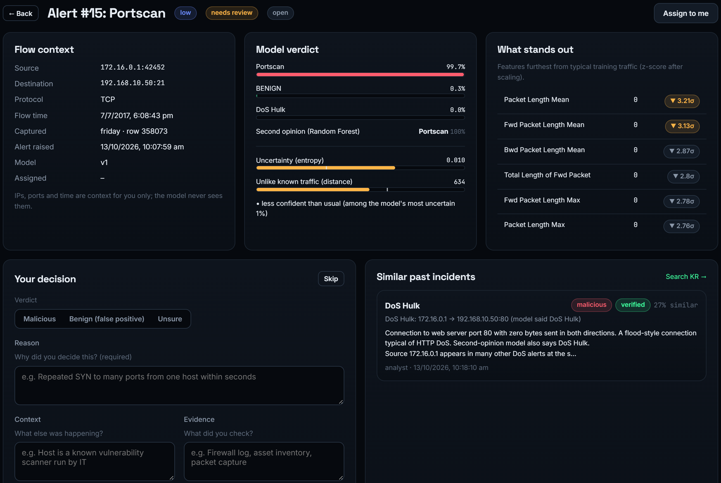

VIT
MINI PROJECT — POSTER
COMP
ENGG
Human-in-the-Loop Intrusion Detection with Uncertainty-Aware Routing
Jai Chavan, Jeet Mane | Guide: Prof. Divya Nimbalkar
Department of Computer Engineering, Vidyalankar Institute of Technology, Mumbai (Autonomous, affiliated to the University of Mumbai)
Corresponding author: jai.chavan@vit.edu.in
Abstract
3
Proposed Methodology / Architecture
4
Results
Intrusion detectors score above 99% on benchmark splits, yet a deployed model will meet attacks it was never trained on, and its own confidence gives no warning when it is wrong. We built Sentinel, a working human-in-the-loop IDS. A CNN-LSTM labels each network flow; an uncertainty router combining temperature-scaled entropy, Mahalanobis distance on the 128-d embedding and a Random Forest second opinion decides whether the verdict can be acted on or must go to a security analyst. Analyst decisions are stored in a searchable Knowledge Repository and change the model only through administrator-approved retraining with acceptance rules fixed in advance. On 257,222 untouched CIC-IDS2017 test flows, only 1.48% of traffic is referred, that queue holds 98.9% of the model's errors, and traffic handled automatically is 99.999% correct. With one attack family withheld from training, the router keeps silent misses at or below 10.2% for five of six families.
Each flow is classified by a CNN-LSTM; an uncertainty router either acts on the verdict or refers the flow to an analyst, whose verified decisions retrain the model only under fixed rules.
3.1 Research Design
Experimental and computational: deep and tree models compared under strict leakage control with 3 seeds, then tested on unseen attacks and unseen days.
3.2 Data / Participants
Improved CIC-IDS2017, 5 days of lab traffic: 2,099,976 flows, 1,714,812 after removing duplicates; 13 classes; stratified 70/15/15 split, test set used once.
Keywords: intrusion detection, human-in-the-loop, uncertainty estimation, CNN-LSTM, out-of-distribution detection, CIC-IDS2017
3.3 Materials and Tools
Introduction
Python, PyTorch (CNN-LSTM, RTX 2050 GPU), scikit-learn and LightGBM baselines, FastAPI + SQLite back end, React web portal.
Fig. 3 — Binary F1 on the held-out test set (mean of 3 seeds) vs. the reference paper
1
3.4 Procedure
Never-seen attack | CNN-LSTM alone | With router
Web attack | 97.0% | 5.0%
Port scan | 39.7% | 4.3%
Botnet | 12.4% | 10.2%
Learning-based IDSs reach 99%+ on random splits of benchmark data, so accuracy alone no longer separates a usable detector from an unusable one
Real networks drift and new attack families appear; a softmax score is often confidently wrong on them, so mistakes are silent
Objective: decide which flows the model may handle alone and which a security analyst must check first
Contribution: a complete HITL IDS: CNN-LSTM, uncertainty router, analyst console, Knowledge Repository and gated, reversible retraining
Clean and de-duplicate, keep 64 features; train Conv1D 64 > Pool > Conv1D 128 > LSTM 128 > 13 classes; calibrate; set routing thresholds on validation; replay test traffic.
Table 2 — Share of a withheld attack closed as normal (lower is better), leave-one-attack-out
Network flow
(64 features)
CNN-LSTM
classifier
Uncertainty
router
Analyst +
retraining
Closed automatically · 82.4%
Alert · 16.1%
Analyst · 1.48%
Fig. 4 — Where the 257,222 test flows went: closed automatically, confident alert, or sent to an analyst
2
Literature Review / Related Work
5
Discussion
Engelen et al., 2021; Liu et al., 2022 [2]-[3]: label and duplicate errors in CIC-IDS2017; we use the corrected release
Arp et al., 2022 [4]: identifier columns and leakage inflate ML security results
Sommer & Paxson, 2010 [5]: real networks are open-world, so unseen activity is the norm
Gap: no system combines uncertainty routing, an analyst knowledge store and controlled retraining
Fig. 1 — Sentinel pipeline: confident flows are closed or alerted automatically; doubtful ones go to an analyst
With leakage removed, every model exceeds 99.7% binary F1; the Random Forest is slightly ahead of the CNN-LSTM, and all beat the paper's 94.3%
The network's own confidence let up to 97% of a never-seen attack through; adding the RF second opinion cut this to at most 10.2% for 5 of 6 families
On test traffic only 2 of 43,706 attack flows were closed as normal and 0 of 213,516 benign flows raised an alarm
Limitations: SSH brute force evades per-flow detection; the rule was chosen after the withheld-attack study; analysts were the authors
3.5 Data Analysis
Accuracy, precision, detection rate, F1, macro-F1 and FPR (mean of 3 seeds); referral rate vs error on auto-handled flows; leave-one-attack-out and day-split tests.
3.6 Uncertainty Routing
Work | Spots unfamiliar inputs | Analyst feedback loop
[1] CNN-LSTM + cWGAN-GP | Entropy only | Feedback, not verified
[8], [9] OOD detection | Softmax / distance | None
Sentinel (ours) | Entropy + distance + RF | Verified, gated, reversible
A flow goes to the analyst if temperature-scaled entropy or Mahalanobis distance on the 128-d embedding exceeds its validation threshold, or the Random Forest is unsure or disagrees.
3.7 Human-in-the-Loop Retraining
Takeaway: Sentinel handles 98.5% of traffic alone at 99.999% accuracy and hands the 1.48% where almost all its mistakes are to a human.
Table 1 — How Sentinel differs from the closest prior work
Analyst verdict, reason, context and evidence are stored in the Knowledge Repository. An admin verifies them; a candidate is retrained and deployed only if macro-F1 drops ≤ 0.5 pt, FPR rises ≤ 0.05 pt and feedback accuracy does not fall. Rollback takes one click.
98.9%
1.48%
Sample Output
of model errors land in the analyst's queue
of traffic needs a human
99.999%
0
correct on flows handled without a human
false alarms on 213,516 benign flows
Fig. 2 — Admin retraining page: progress to the 20-decision minimum and the acceptance rules fixed before training
Headline results on 257,222 held-out test flows (CIC-IDS2017)
Key Contribution
Applications / Use Cases
A combined router (entropy + embedding distance + Random Forest second opinion) that sends 98.9% of the model's errors and most never-seen attacks to a human while referring only 1.48% of traffic.
Security Operations Centres: analysts review only the ~1.5% of doubtful flows instead of every alert
Campus and enterprise networks: routine traffic handled automatically, novel attacks checked by a person
Analyst training and audit: a searchable record of past incidents, reasons and evidence
Any high-stakes ML deployment where a confident wrong decision is costly
Tools & Technologies
Fig. 5 — Analyst console: a referred flow with the model's verdict, uncertainty scores, unusual features and similar past incidents
Python
PyTorch
scikit-learn
LightGBM
FastAPI · SQLite
React portal
6
Conclusion
7
Future Work
Scan for full paper
Under strict leakage control our CNN-LSTM exceeds the reference paper's figures, but its own uncertainty misses novel attacks. Adding a Random Forest second opinion fixes most of this: 1.48% of traffic reaches a human, holding 98.9% of the errors, and analyst knowledge reaches the model only through verified, approved and reversible retraining.
Host-level features over time windows to catch SSH brute force and botnets; retraining the Random Forest alongside the network; testing on CSE-CIC-IDS2018 (a different network); evaluation with working security analysts and real login.
References
[1] C. M. de Nascimento and J. Hou, "Uncertainty-aware adaptive intrusion detection using hybrid CNN-LSTM with cWGAN-GP augmentation and HITL feedback," Safety, vol. 11, no. 4, Art. 120, 2025.
[2] G. Engelen, V. Rimmer, and W. Joosen, "Troubleshooting an intrusion detection dataset: the CICIDS2017 case study," in Proc. IEEE SPW, 2021, pp. 7–12.
[3] L. Liu et al., "Error prevalence in NIDS datasets: CIC-IDS-2017 and CSE-CIC-IDS-2018," in Proc. IEEE CNS, 2022.
[4] D. Arp et al., "Dos and don'ts of machine learning in computer security," in Proc. USENIX Security, 2022, pp. 3971–3988.
[5] R. Sommer and V. Paxson, "Outside the closed world: On using machine learning for network intrusion detection," in Proc. IEEE S&P, 2010, pp. 305–316.
[6] S. Hochreiter and J. Schmidhuber, "Long short-term memory," Neural Computation, vol. 9, no. 8, pp. 1735–1780, 1997.
[7] L. Breiman, "Random forests," Machine Learning, vol. 45, no. 1, pp. 5–32, 2001.
[8] D. Hendrycks and K. Gimpel, "A baseline for detecting misclassified and out-of-distribution examples in neural networks," in Proc. ICLR, 2017.
[9] K. Lee et al., "A simple unified framework for detecting out-of-distribution samples and adversarial attacks," in Proc. NeurIPS, 2018.
[10] C. Guo et al., "On calibration of modern neural networks," in Proc. ICML, 2017, pp. 1321–1330.
jai.chavan@vit.edu.in · jeet.mane@vit.edu.in
Full paper (PDF) on Google Drive: scan the QR code
Acknowledgements: Prof. Divya Nimbalkar (guide) and the Department of Computer Engineering, VIT Mumbai, for guidance and lab facilities

