Slide 1
Café in District of Melbourne
Coursera Capstone final project – The battle of neighborhood

Slide 2
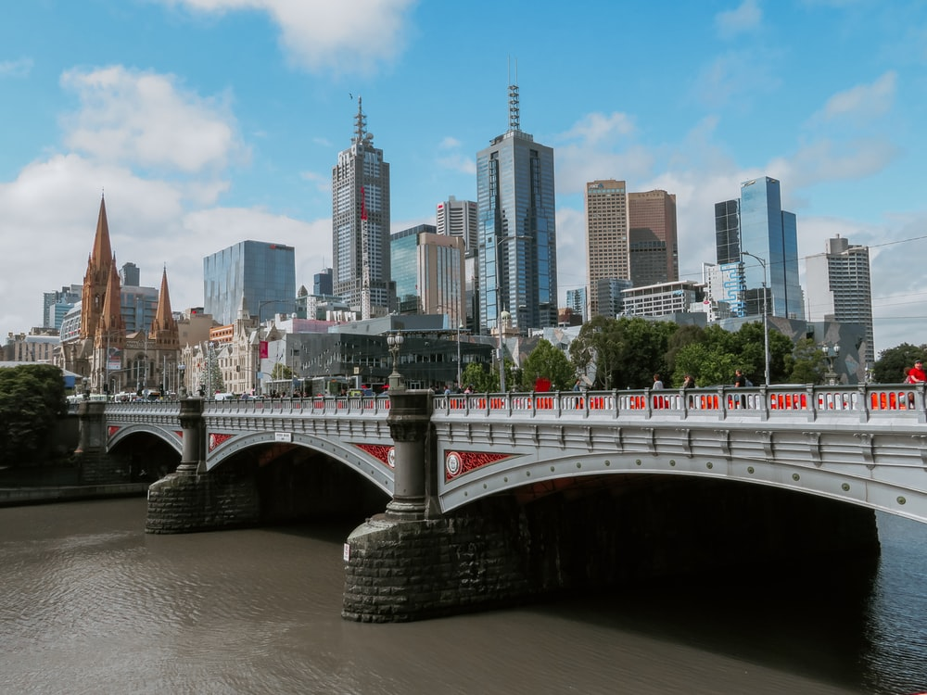
Introduction:
We want to open a new coffee shop in Melbourne. We want to identify current locations where we have coffee shops. We will use `Four Square` data to determine which district in Melbourne currently have coffee shops. This will tell us which districts have more coffee shops and which have less

Slide 3
Business Problem:
`Melbourne` is the capital and most-populous city of the Australian state of Victoria, and the second-most populous city in Australia and Oceania.
Melbourne is known for its bars, street art and coffee culture. As a coffee lover city, it makes complete sense to open a coffee shop. The challenge is to understand which district is the best option to open the new coffee shop.
Target Audience:
Entrepreneurs who wants to open a new coffee shop in the city however, are not sure where to open a new shop
People who already have a shop and want to open a new franchise in different district
Data Description:
Brief information about Melbourne: https://en.wikipedia.org/wiki/Melbourne
Link of Melbourne Districts: https://en.wikipedia.org/wiki/Postal_district_numbers_of_Melbourne
Four Square API link: https://developer.foursquare.com/docs/

Slide 4
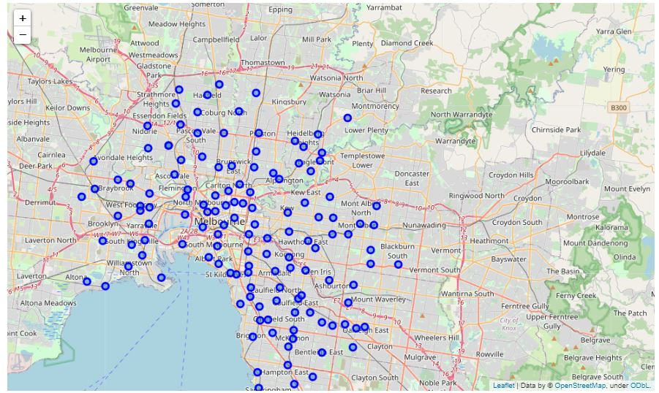
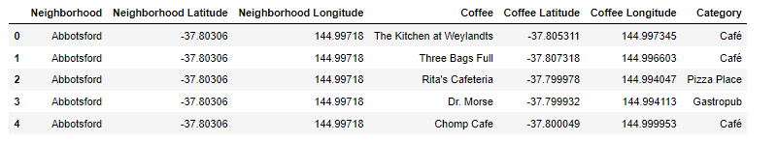
Methodology:
We used request and beautiful soup libraries to extract data from Link of Melbourne Districts
This list was then converted into a data frame
Then using Geographical Coordinates, we got Lat and Long of Melbourne and then we got Lat and Long of all the districts in our data frame
We visualized our data to see how spread they are in Melbourne
Using Four Square API we successfully extracted, list of locations where category included Coffee

Slide 5
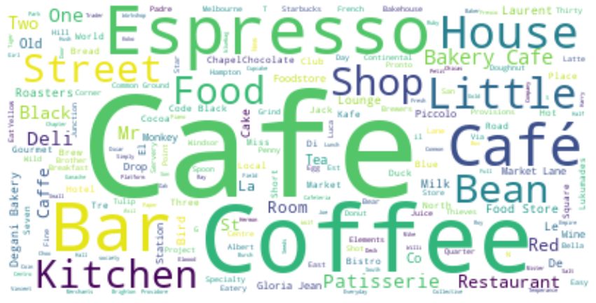
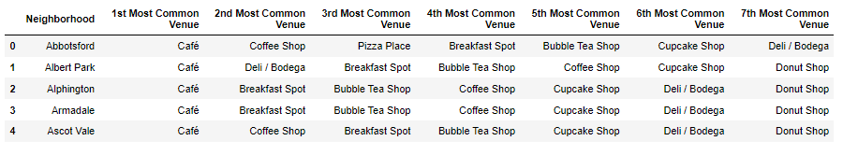
Methodology:
We created a word cloud to see the most repeated word in our category column
We cleaned our data by excluding all the shops which do not belong to Café
We included top 7 venues to each district
We visualized each top venue
We applied one hot encoder on this dataset and grouped them by their mean frequency
This data was then clustered into 4 different using KMeans Clustering

Slide 6
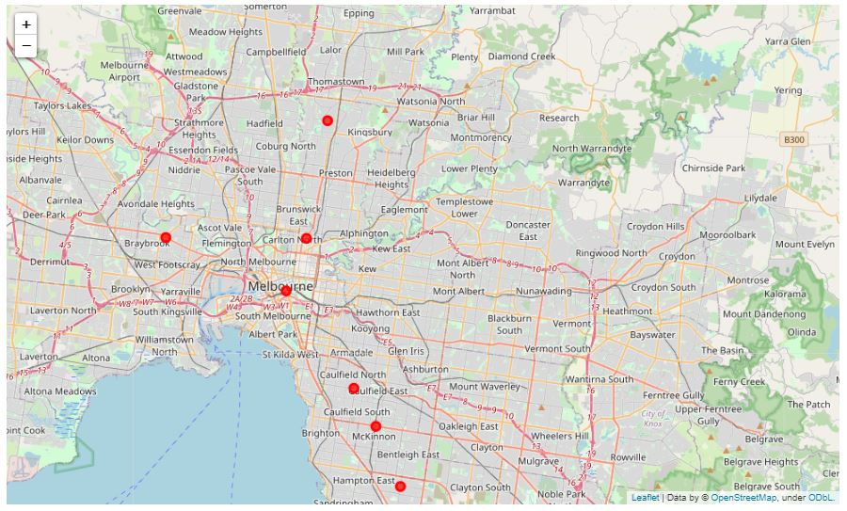
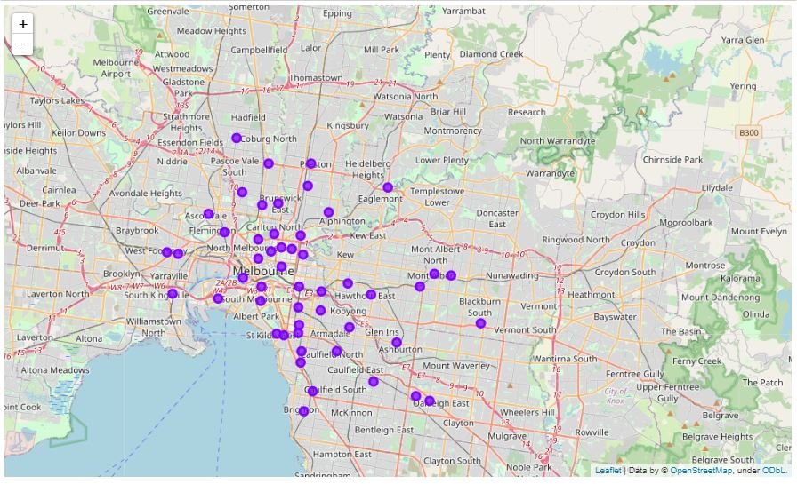
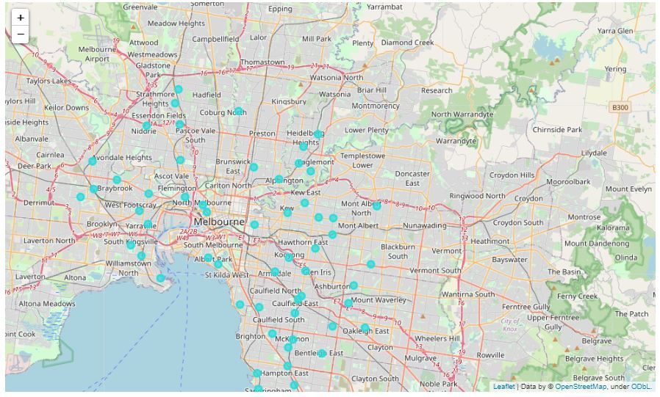
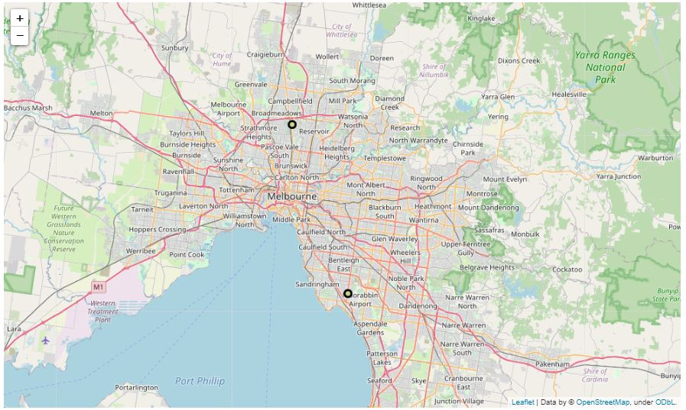
Results and Discussions:
Our analysis shows that there are many coffee options in Cluster number 2 and 3. There is an opportunity to open a coffee house in Cluster number 1 and 4. Number 4 is interesting as it is nearby Airport and ideally should be good location.
Cluster 2 and 3 are more towards the main suburb, whereas, cluster 1 and 4 are little far off.
From the above analysis, we can also understand in cluster 1 and 4 there are not many dedicated coffee shops, which states that many restaurants/bar may be selling coffee. This gives an opportunity to the new business to open a fancy coffee shop and be successful.
Cluster 2 and 3, may have lot of coffee shops. On further analysis it was observed both clusters are close to Albert Park and Melbourne Station. Albert Part is famous for Formula 1 race track and we have multiple sporting activities near Melbourne station such as Melbourne Cricket Ground, Melbourne Tennis Stadium. This justifies why so many cafes are around these landmark point

Slide 7
Conclusion:
Purpose of this project was to cluster Melbourne districts based on coffee shops and we were able to do it successfully. If any business wants to open a new coffee shop in Melbourne, we can assist them with the clustering we have done on the district. Cluster 2 and Cluster 3 are more towards down town, whereas, cluster 1 and 4 are more spread out.
Final decision will be made by the stakeholder in which cluster they are looking to open a new cafe.

Slide 8
THANK YOU

