Slide 1
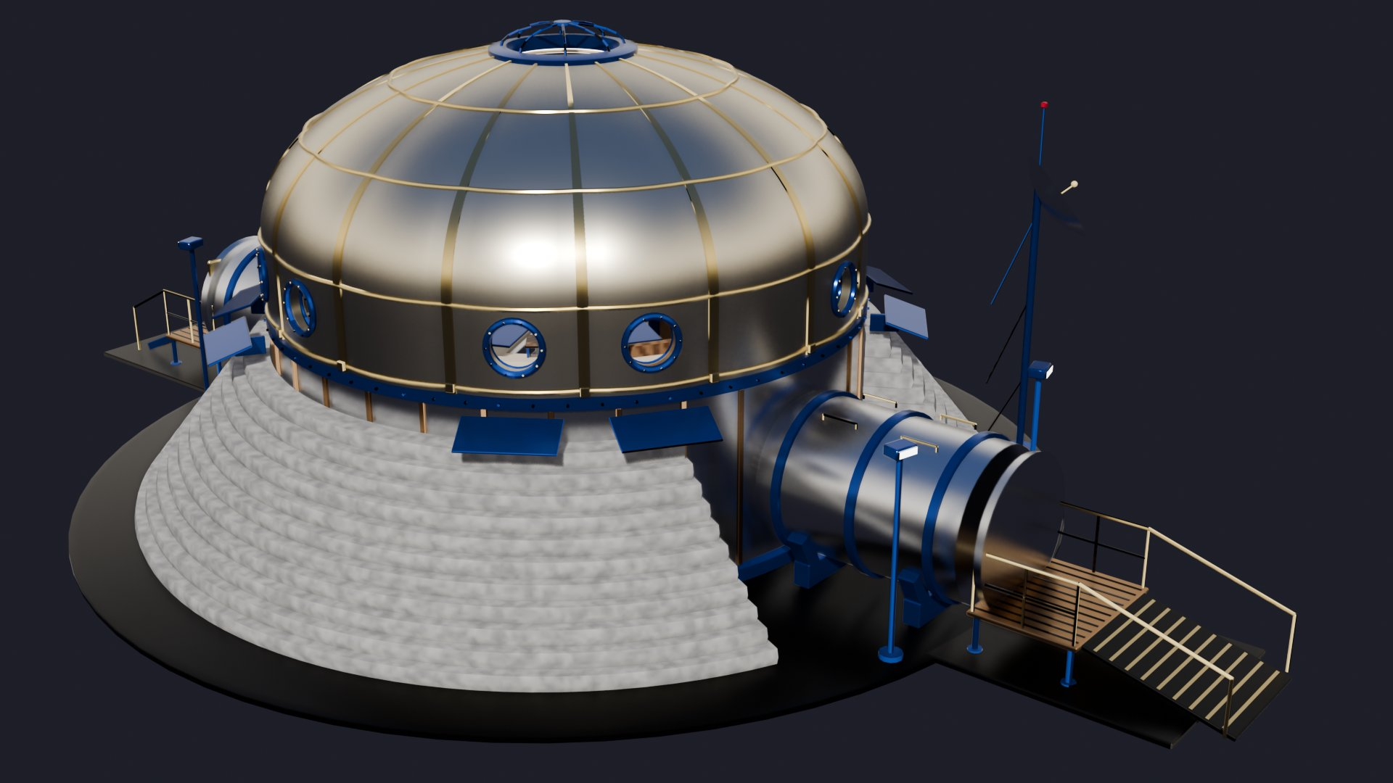
Eleven lunar habitat models, checked against the proposal
Benefits, cons and rubric fit | NASA HUNCH Lunar Smart Adaptive Habitat
Notes:
This deck compares all eleven Blender models in the Nasa folder. The rubric used is the project's own research and proposal document, because no separate scoring rubric file was available.

Slide 2
The rubric: seven things the proposal asks a habitat to do
Size and crew
2 to 4 astronauts; about 10–15 m long, 8–10 m wide, 5–8 m tall; at least 20 m³ per person
Power
Solar arrays with storage, plus nuclear fission backup
1
5
Structure
Two storeys: rigid metallic lower deck with an inflatable upper deck
Mental health
AI monitoring, adaptive lighting, VR relaxation room, plants and private space
2
6
Eight NASA zones
Quarters, galley, hygiene, workstations, medical, storage, ECLSS, airlock; airlock beside hygiene, away from quarters
Modular
Expandable with extra modules; robots and 3D printing for upkeep
3
7
Regolith shielding
3D-printed or piled lunar regolith for radiation and micrometeoroid protection
Source: project research and proposal document (NASA requirements table, dimensions section, HUNCH key considerations). It is not an official HUNCH scoring sheet.
4
Notes:
These seven criteria are condensed from the proposal's requirement tables. Every model on the following slides is judged against the same seven.

Slide 3
Only the proposal-built habitats meet most of the rubric
Model | Size and crew | Structure | Zones | Shielding | Power | Mental health | Modular
Lunar Smart Adaptive Habitat (full site) | Meets | Meets | Meets | Meets | Meets | Meets | Meets
Crew Wellness Dome | Meets | Meets | Meets | Meets | Partial | Meets | Partial
Pill habitat, base only | Meets | Meets | Meets | Meets | Misses | Meets | Partial
Models kit (16 modules) | Partial | Meets | Meets | Partial | Meets | Meets | Meets
Model 5: modular surface base | Misses | Partial | Partial | Partial | Partial | Meets | Meets
Model 4: regolith-covered hub | Misses | Misses | Partial | Meets | Partial | Meets | Meets
Model 3: vertical capsule | Partial | Misses | Partial | Misses | Partial | Meets | Misses
Model 2: ring station | Misses | Misses | Partial | Misses | Partial | Meets | Partial
Model 1: dome city | Misses | Misses | Misses | Misses | Partial | Meets | Partial
Hard-shelled habitat | Misses | Misses | Partial | Partial | Partial | Misses | Misses
Base1: outpost map | Misses | Misses | Misses | Partial | Meets | Misses | Meets
Ratings are my reading of what each Blender file contains (object names, measured sizes, model notes). They are not official scores.
Notes:
Green means the model shows the requirement, gold means it is partly shown, red means it is missing or contradicts the requirement. Concept models 1 to 5 score well on mental-health features but miss on size and structure.

Slide 4
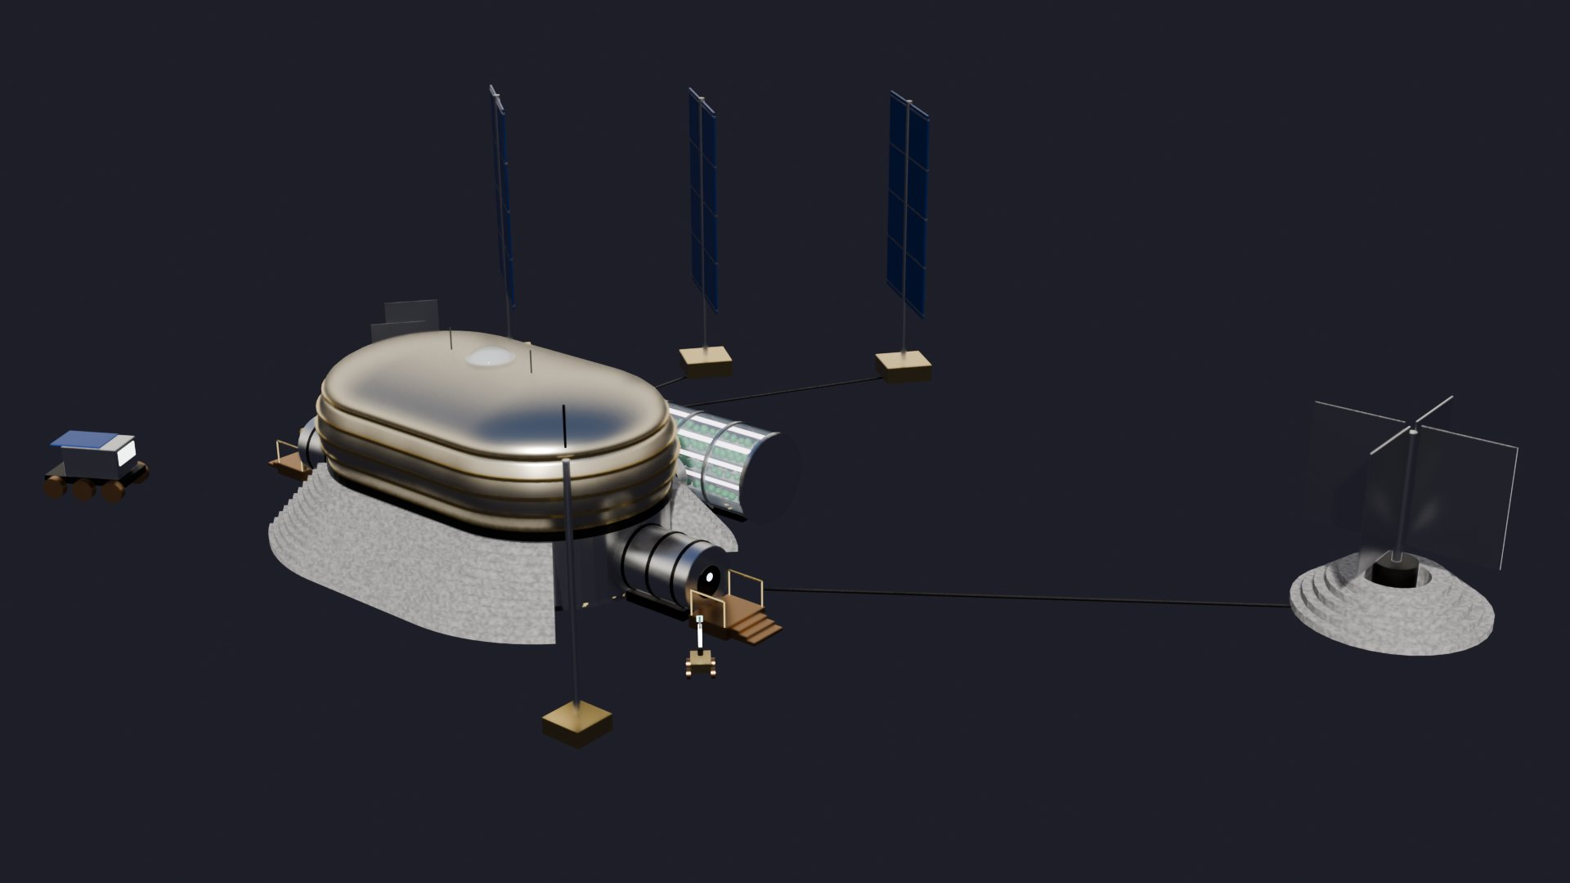
Lunar Smart Adaptive Habitat: closest match to the rubric
Benefits
Built straight from the proposal: rigid lower deck, inflatable upper deck, stepped regolith shield, two airlocks
All eight zones plus a sanctuary and VR room, exercise area and adaptive lights in each crew pod
Full power story on site: three solar towers, fission reactor and battery storage, with a greenhouse and robots
Cons
About 215 m² of floor, well above the 127 m² reference design
9 m wide hull is wider than the 8.4 m launch fairing the rubric mentions
From outside, the pill shape says little about the mental-health idea
Rubric fit
Meets all seven criteria. Best choice as the main submission model.
Habitat 15 × 9 × 7.5 m, two decks, 4 crew; site about 53 m across
Notes:
Lunar Smart Adaptive Habitat: closest match to the rubric. Meets all seven criteria. Best choice as the main submission model.

Slide 5
Crew Wellness Dome: a shape that shows mental health
Benefits
A living tree in a central atrium rises through both decks to a glass oculus; every room opens onto it
All eight zones, with hygiene beside EVA prep and crew quarters on the upper deck
Floor area close to the 127 m² reference; rigid hull, inflatable dome and 11-layer regolith shield
Cons
Medical is not next to ECLSS; the greenhouse lab sits between them
Only small solar panels on the model; no fission unit or battery bank
108 m³ per person is under the 120 m³ comfort figure; one expansion port only
Rubric fit
Meets five criteria, partial on power and modularity. Best model for telling the wellbeing story.
10 m round, 8.0 m tall, two decks, 4 crew, about 132 m² and 108 m³ per person
Notes:
Crew Wellness Dome: a shape that shows mental health. Meets five criteria, partial on power and modularity. Best model for telling the wellbeing story.

Slide 6
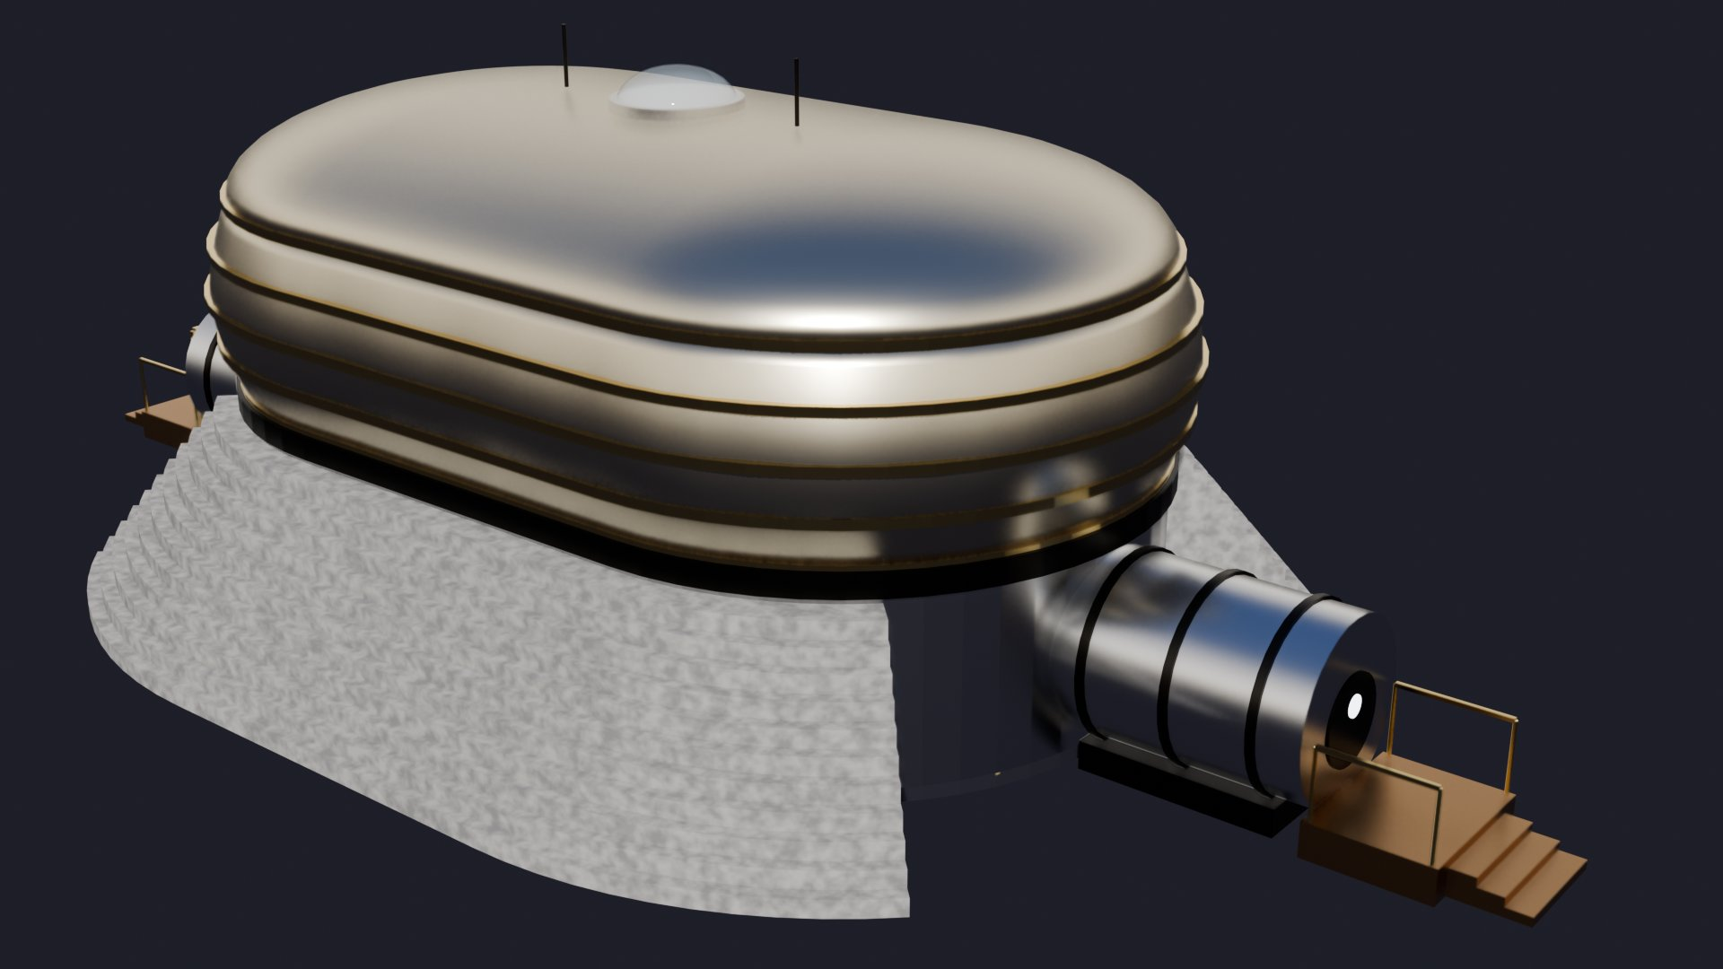
Pill habitat, base only: the print-ready version
Benefits
Same two-deck habitat and zoning as the full-site model, without the surrounding equipment
Already split into six 1:50 print parts, which covers the physical scale model deliverable
Simplest file to copy into other scenes
Cons
No solar, fission or battery in the file, so power is not shown
No greenhouse or expansion module attached
Repeats the full-site habitat, so it adds no new design idea
Rubric fit
Meets five criteria, misses power. Use it for the 3D print, not as a separate design.
27.3 × 14.2 × 8.4 m including airlocks and shield; same interior as the full site
Notes:
Pill habitat, base only: the print-ready version. Meets five criteria, misses power. Use it for the 3D print, not as a separate design.

Slide 7
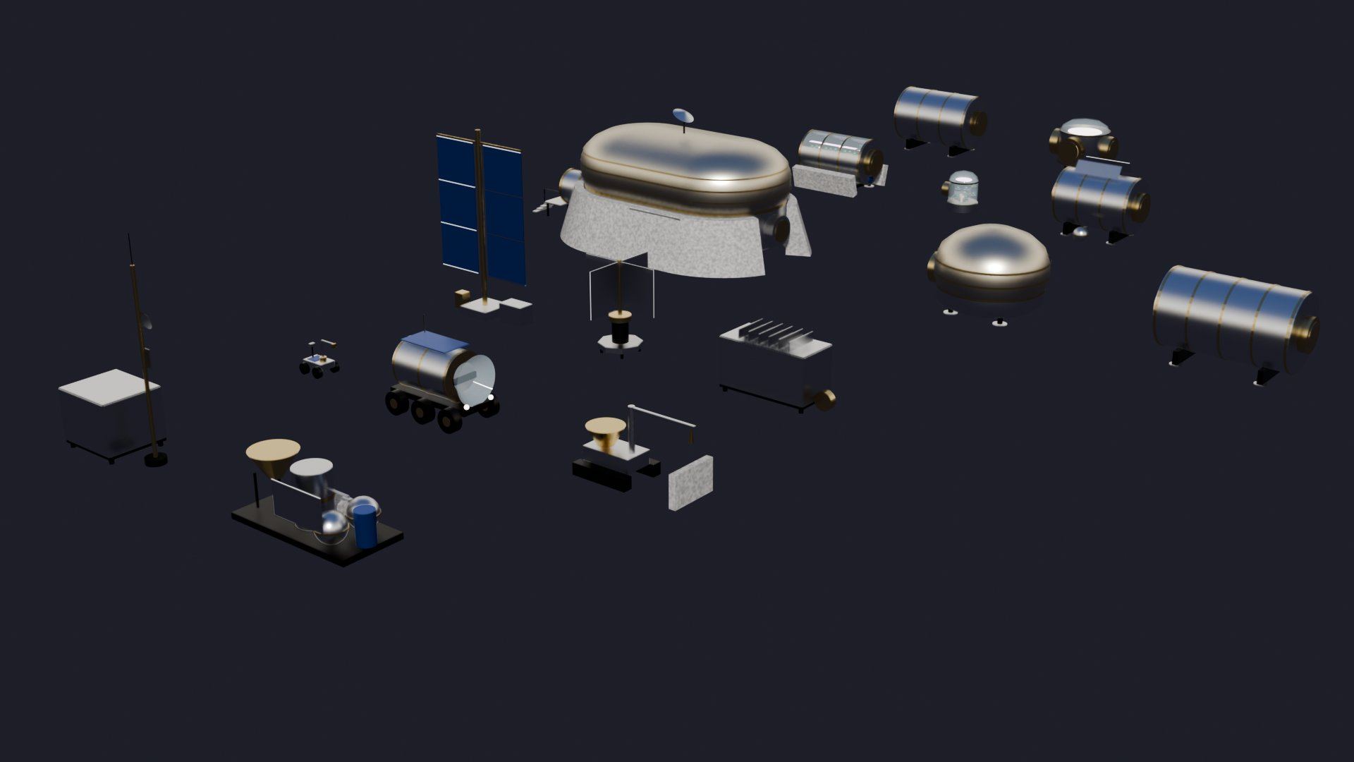
Models kit: sixteen parts that cover almost every system
Benefits
Includes solar tower, 10 kW fission backup and energy storage, matching the power requirement
Comms and AI data hub with crew health dashboards; personal greenhouse pod with an AI mood panel
Connector node, logistics module and ISRU plant show how the base expands
Cons
A set of parts, not one connected base, so adjacency cannot be judged
Only 5 of the 16 modules are specified in the proposal; the rest are extrapolations
Crew expansion module adds pods 5 and 6, beyond the 4-crew peak
Rubric fit
Meets five criteria, partial on size and shielding. Works best as supporting slides for expansion.
16 separate modules in 7 colour-coded types, laid out as a catalogue
Notes:
Models kit: sixteen parts that cover almost every system. Meets five criteria, partial on size and shielding. Works best as supporting slides for expansion.

Slide 8
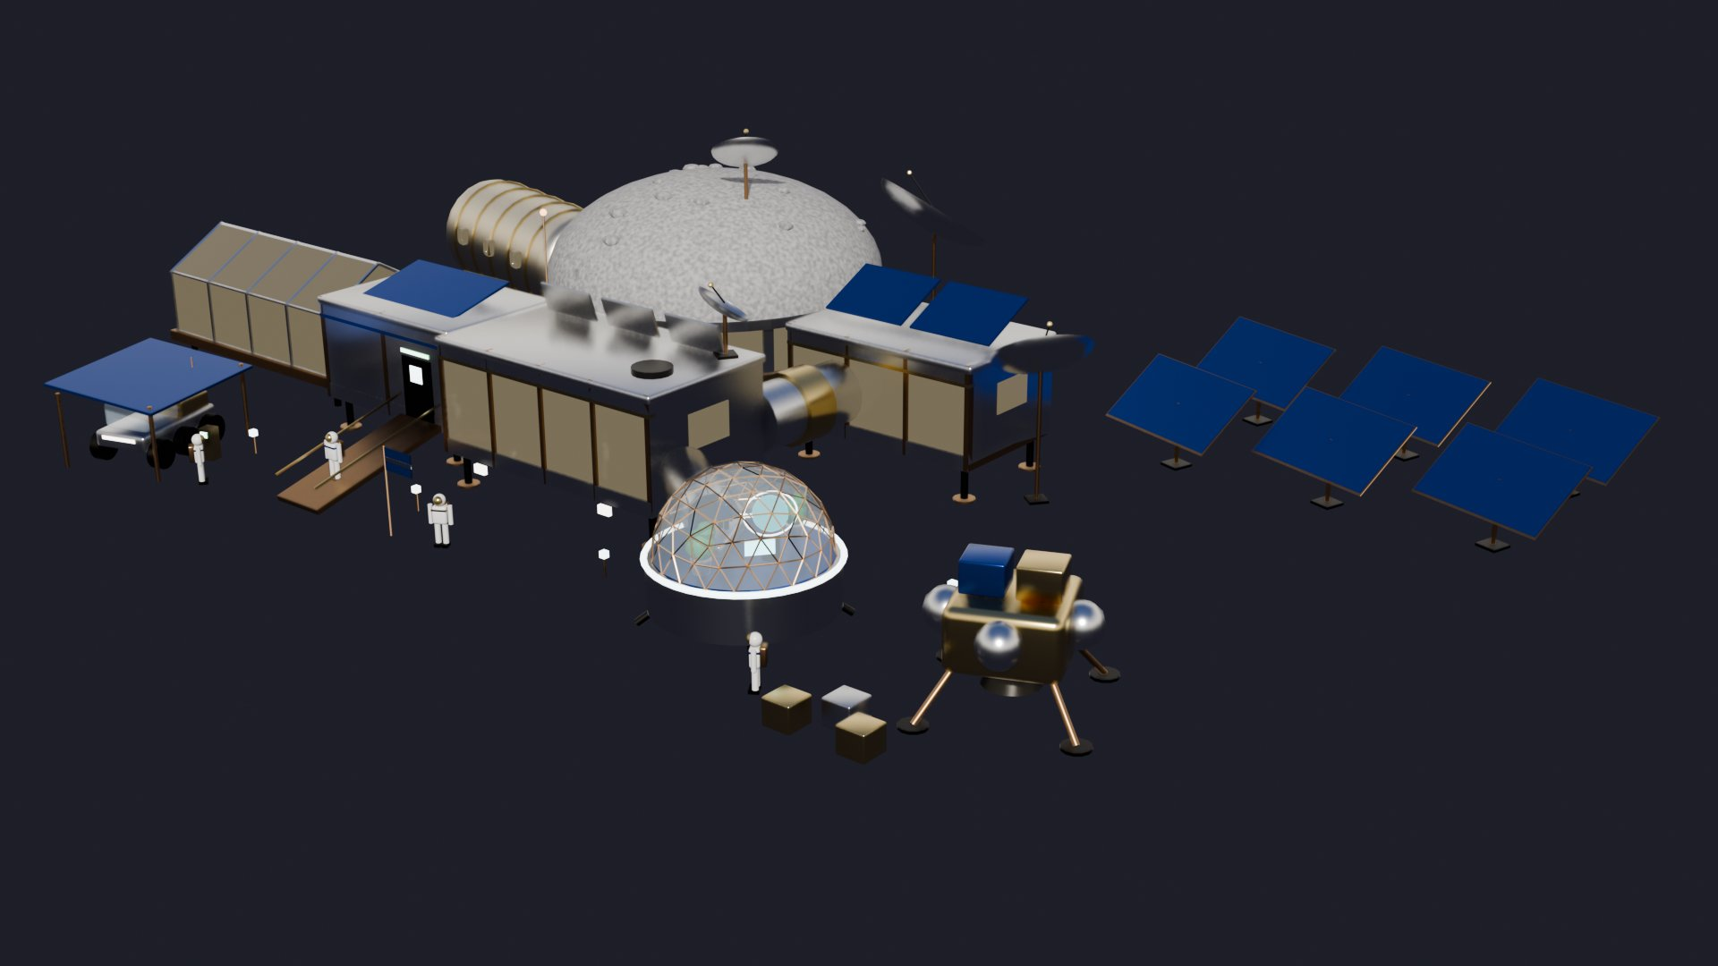
Model 5, modular surface base: good features, too spread out
Benefits
Dedicated AI wellness pod with therapy recliner, biometric display and psych-monitor hologram
Entry suit bay has a dust shower arch, which supports dust mitigation
Shielded core dome with storm shelter, inflatable quarters, ECLSS rack and battery stacks
Cons
Far larger than the 10–15 m footprint, and sized for more than 4 crew
The inflatable is a separate tube, not an upper deck on a rigid base
No medical or hygiene areas modelled; solar and batteries only
Rubric fit
Meets two criteria, partial on four, misses size. Borrow the wellness pod and dust shower ideas.
About 54 × 33 × 11 m overall, single storey, 6 crew cabins
Notes:
Model 5, modular surface base: good features, too spread out. Meets two criteria, partial on four, misses size. Borrow the wellness pod and dust shower ideas.

Slide 9
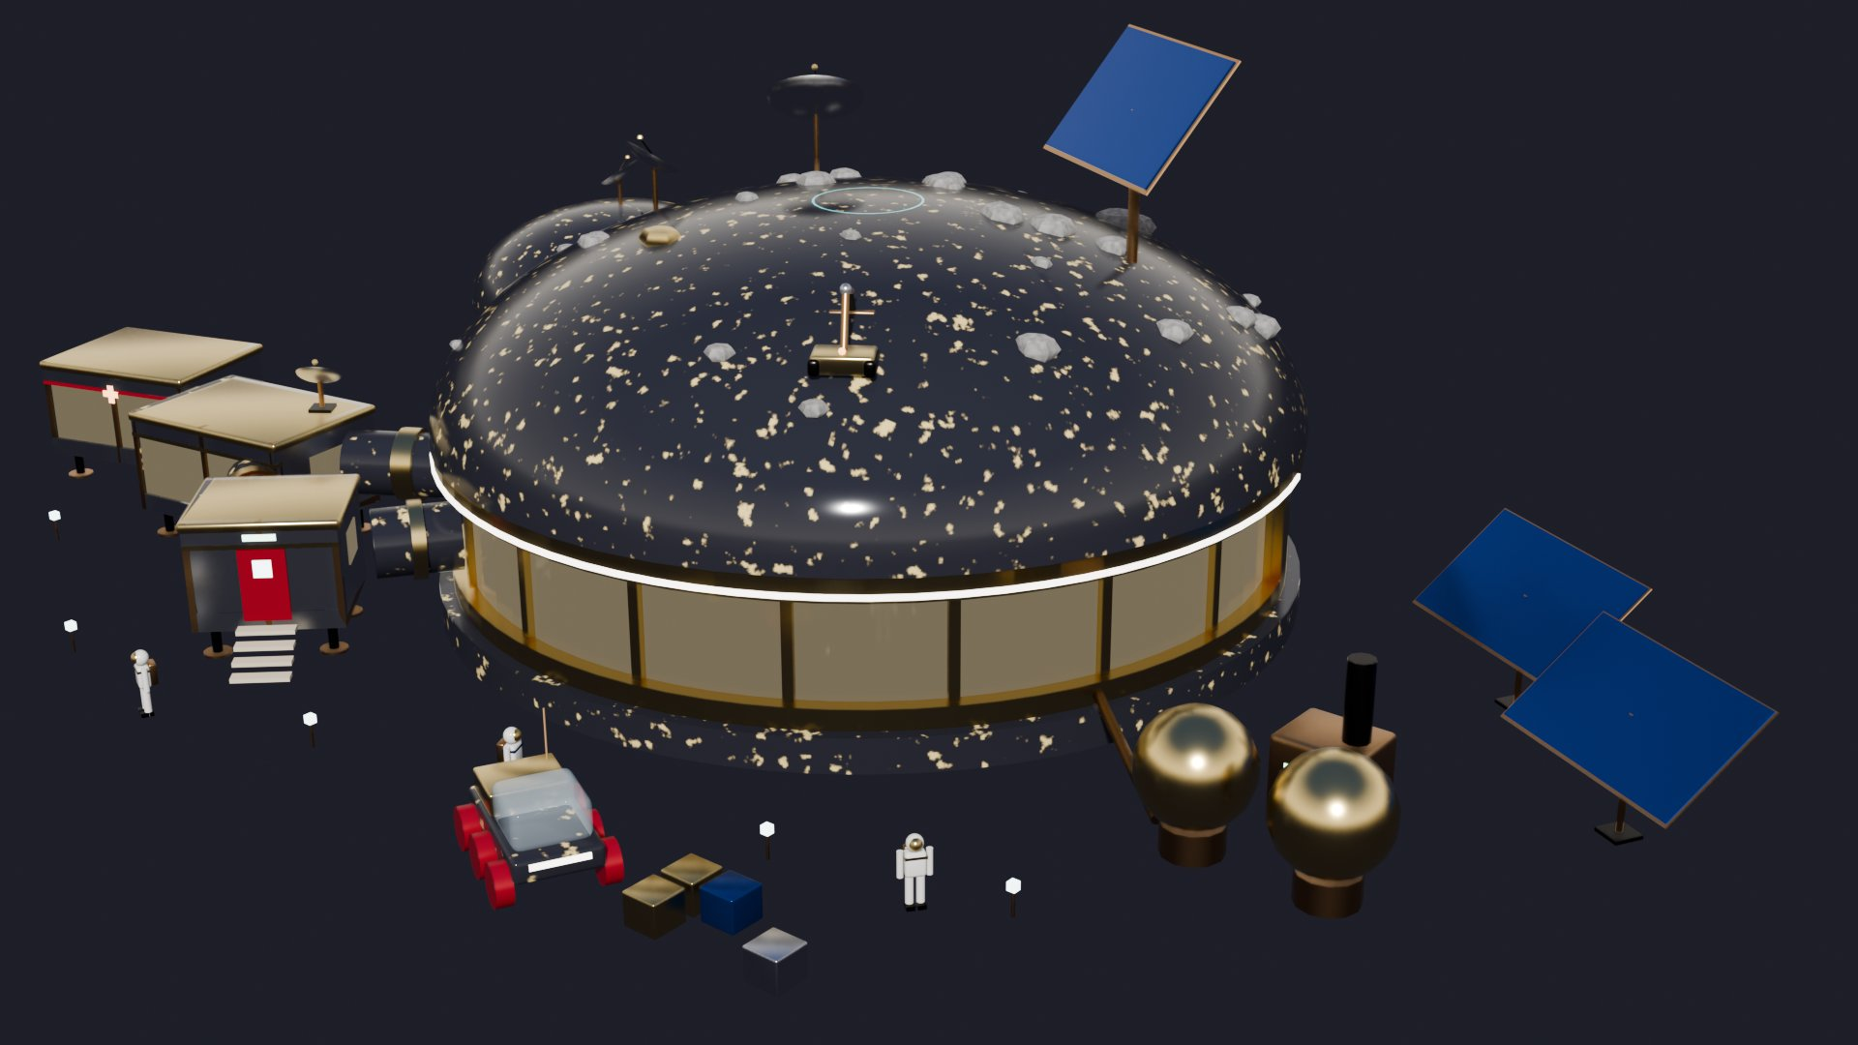
Model 4, regolith-covered hub: best radiation protection
Benefits
Regolith shield over the hub plus a storm shelter core with a sunlight pipe
Regolith 3D-printer robot and ISRU oxygen plant show use of local resources
Separate medical bay, geology lab, EVA airlock and greenhouse dome modules
Cons
Hub is several times wider than the 8–10 m limit
One storey with no inflatable upper deck
No hygiene area modelled, and no nuclear backup
Rubric fit
Meets three criteria, misses size and structure. Strong reference for shielding and in-situ construction.
About 56 × 35 × 16 m overall, single-storey hub, 5 crew cabins
Notes:
Model 4, regolith-covered hub: best radiation protection. Meets three criteria, misses size and structure. Strong reference for shielding and in-situ construction.

Slide 10
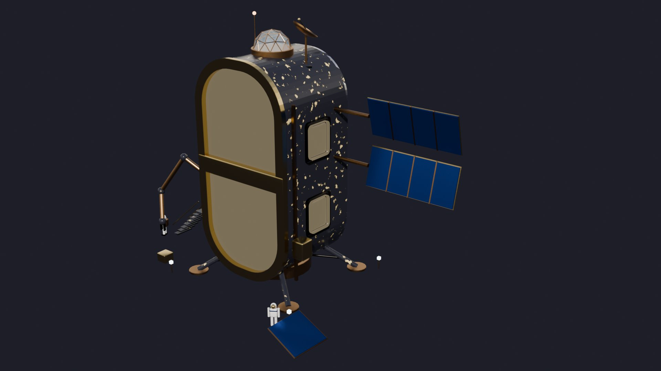
Model 3, vertical capsule: compact but unshielded
Benefits
Smallest footprint of the concept models; arrives as one landed unit
Stargazing cupola, circadian lights, citrus tree and AI wellness display support wellbeing
Quiet sleep loft is separated from the greenhouse and living decks
Cons
Stands in the open with no regolith shielding
Three decks and roughly 20 m of height against a 5–8 m, two-storey target
No medical or hygiene areas modelled; ladders only; solar only
Rubric fit
Meets one criterion, partial on three. Useful for the cupola and circadian-lighting ideas.
About 20 m tall on landing legs, three decks, 3 bunks
Notes:
Model 3, vertical capsule: compact but unshielded. Meets one criterion, partial on three. Useful for the cupola and circadian-lighting ideas.

Slide 11
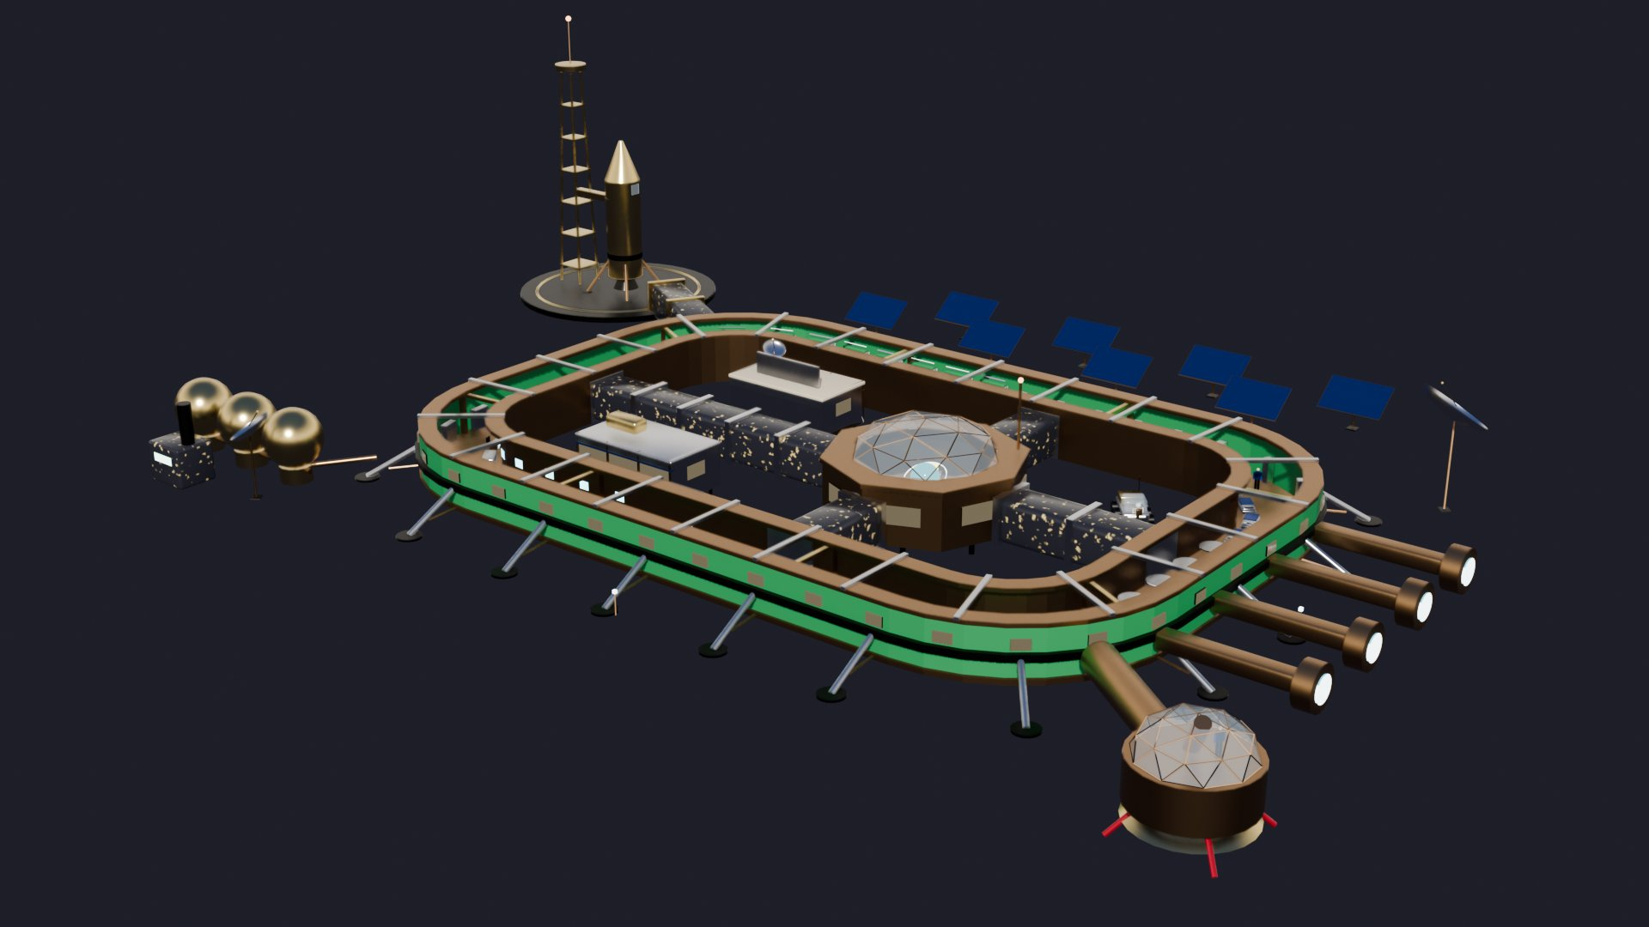
Model 2, ring station: good crew flow, wrong scale
Benefits
Rooms sit around one continuous ring, so every zone is a short walk from the next
AI command hub in the courtyard and three AI wellness stations
Fabrication workshop with 3D printer, rover garage and oxygen plant
Cons
Roughly seven times the target length and sized for 10 crew
Raised on struts with no regolith shielding and no inflatable deck
No airlock with dust mitigation and no hygiene area modelled
Rubric fit
Meets one criterion, misses size, structure and shielding. Keep the loop-circulation idea only.
About 101 × 65 × 25 m, raised ring, 10 bunks
Notes:
Model 2, ring station: good crew flow, wrong scale. Meets one criterion, misses size, structure and shielding. Keep the loop-circulation idea only.

Slide 12
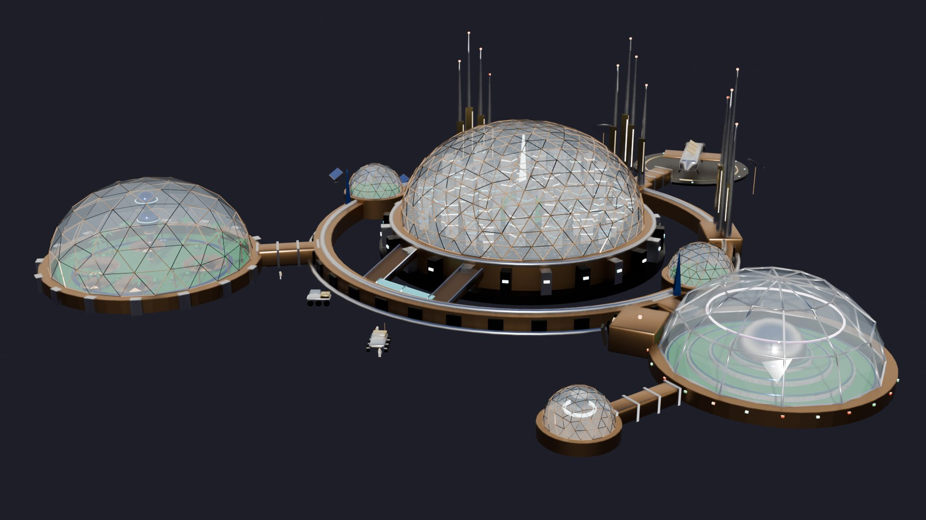
Model 1, dome city: inspiring, far beyond the brief
Benefits
Strongest green-space concept: palm garden biodome and terraced crop dome
AI core spire and observatory domes give a clear long-term vision
Linked domes show growth by adding modules
Cons
More than ten times the target size and nothing like a 2–4 crew habitat
Glass domes with no regolith shielding
None of the eight NASA zones are laid out; no rigid and inflatable structure
Rubric fit
Meets one criterion, misses four. Use only as a future-vision image.
About 175 × 185 × 43 m, city scale
Notes:
Model 1, dome city: inspiring, far beyond the brief. Meets one criterion, misses four. Use only as a future-vision image.

Slide 13
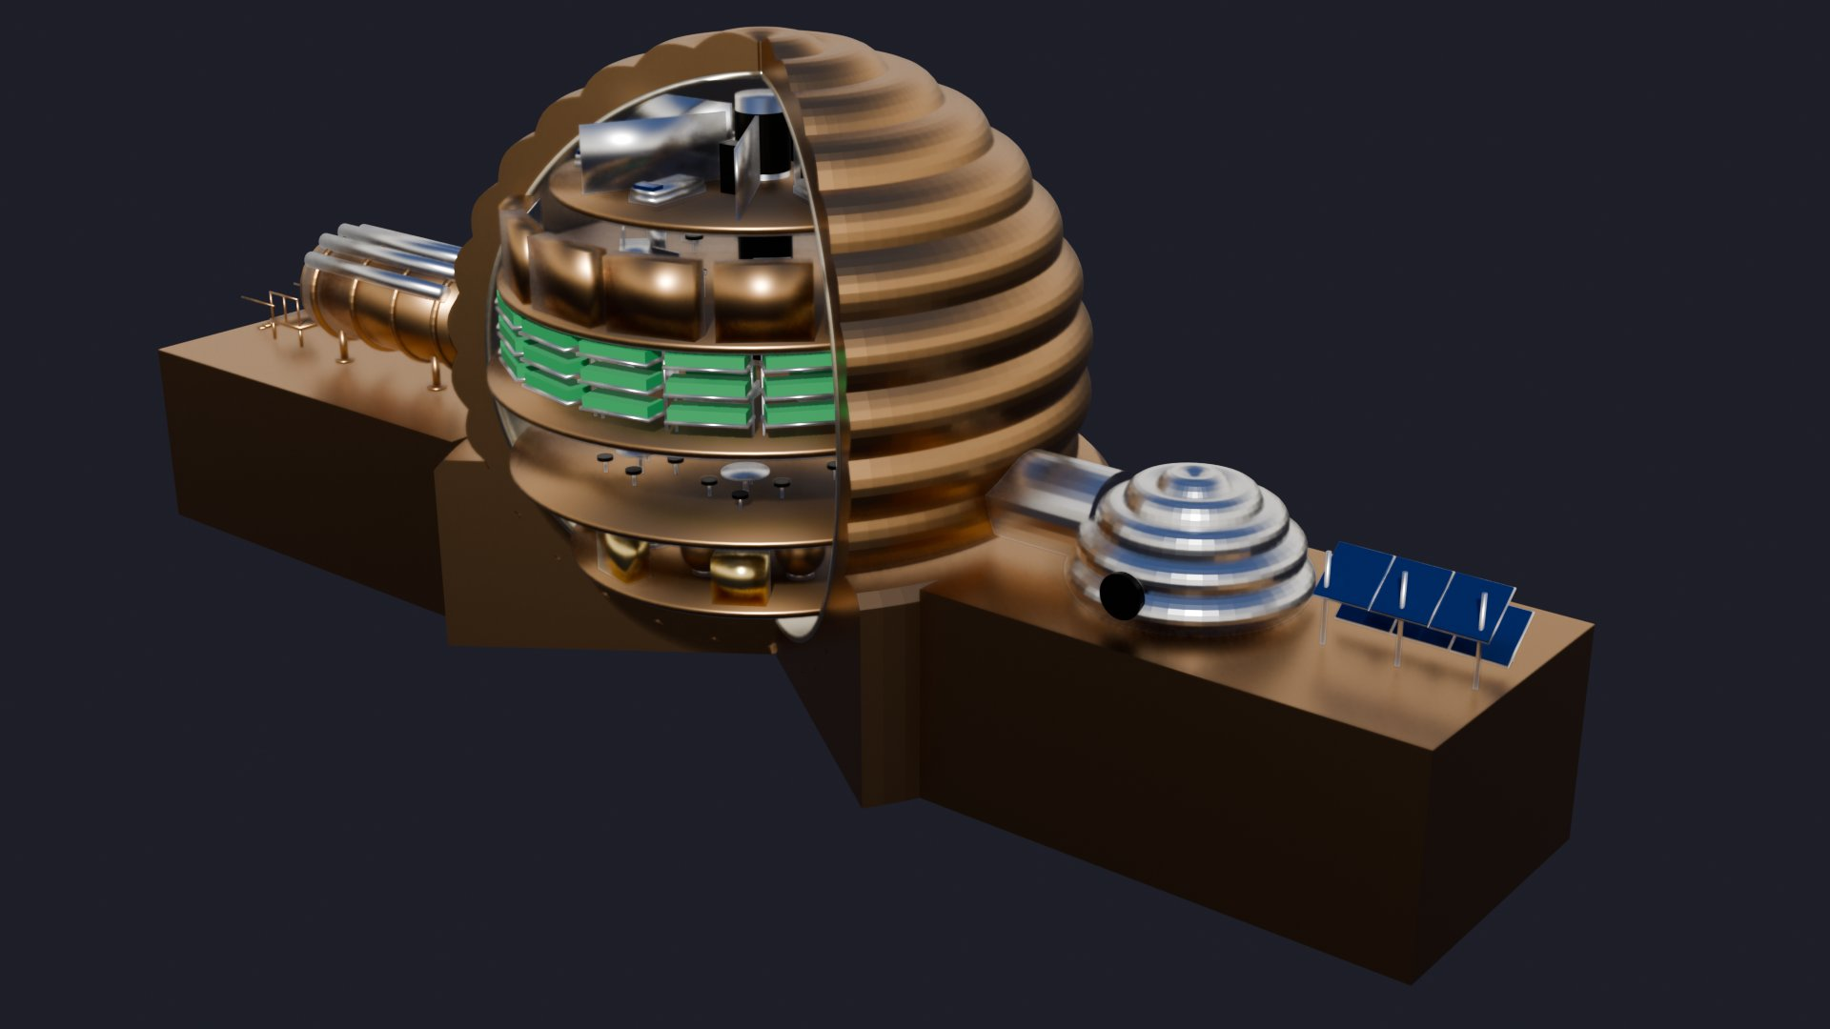
Hard-shelled habitat: clear cutaway, little rubric content
Benefits
Cutaway shows five stacked levels at a glance: storage, wardroom, hydroponics, lab, quarters
Rigid shell suggests durability; a hydroponics level is included
Lightest file, quick to open and present
Cons
Scale is far above the target, with five levels in place of two
No AI, VR, adaptive lighting or other mental-health features modelled
No medical, hygiene or ECLSS areas; lowest detail of all the models
Rubric fit
Meets none fully, partial on three. Lowest fit; keep only as a diagram of vertical zoning.
Sphere on a plinth, about 142 m long overall, five levels
Notes:
Hard-shelled habitat: clear cutaway, little rubric content. Meets none fully, partial on three. Lowest fit; keep only as a diagram of vertical zoning.

Slide 14
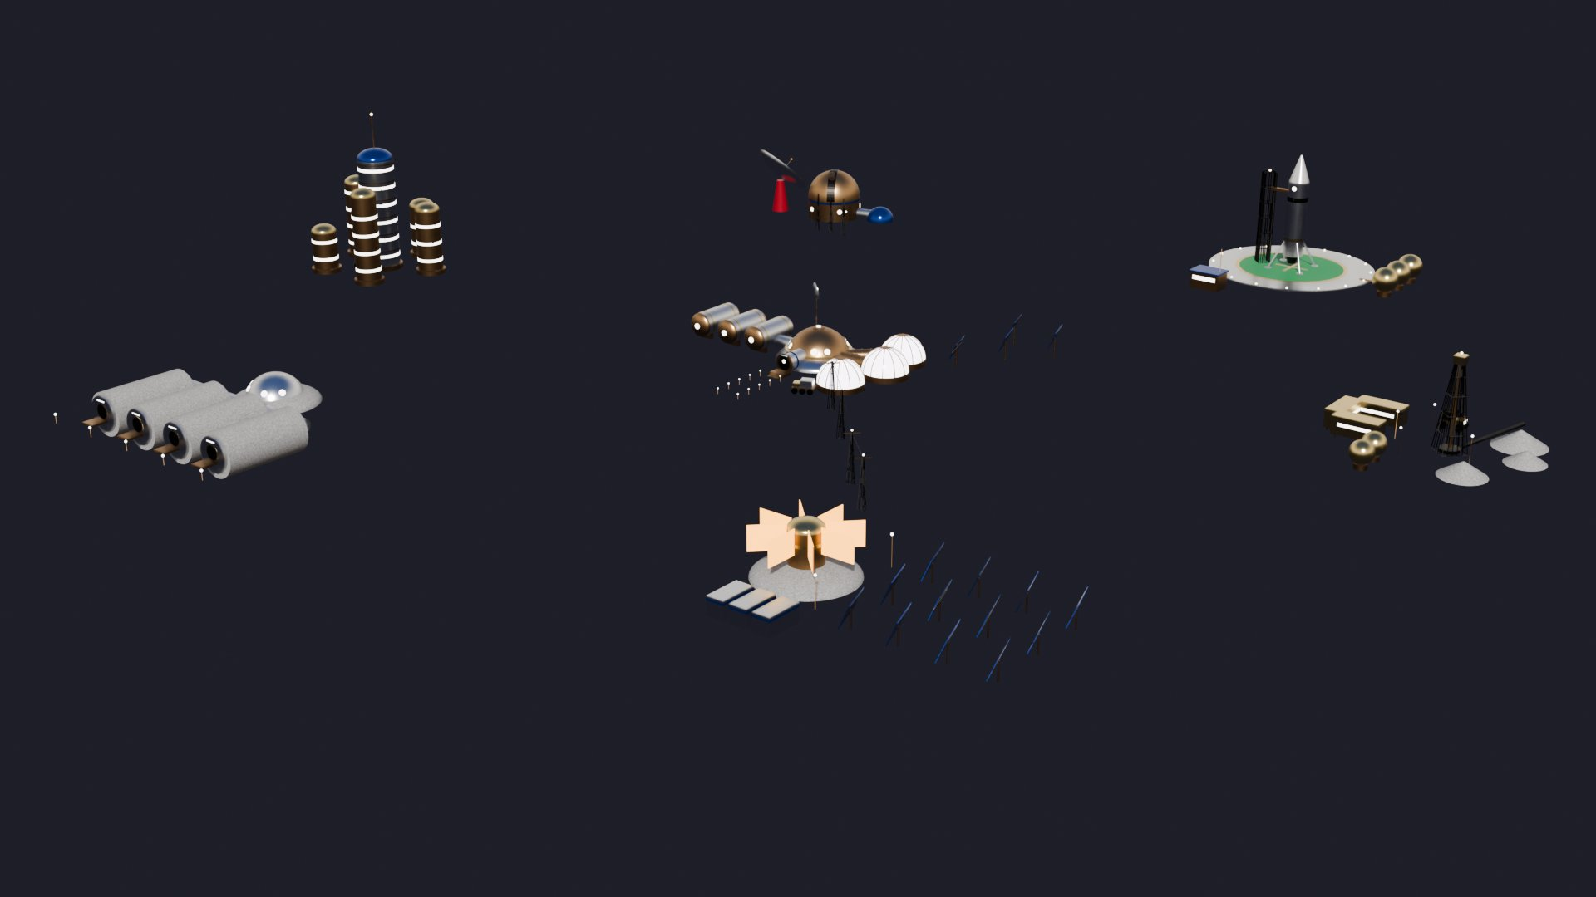
Base1, outpost map: shows expansion, not a habitat
Benefits
Power station has a reactor, a 12-panel solar field and battery banks
Buried barracks tubes are covered in regolith
Shows how a first habitat could grow into a wider base
Cons
A colony map, well outside a 2–4 crew habitat brief
No interiors, so zoning and adjacency cannot be shown
No mental-health features; detail is soft up close
Rubric fit
Meets power and modularity, misses four. Background context only.
About 200 × 195 m of outposts: mining, observatory, launch pad, towers, barracks, power station
Notes:
Base1, outpost map: shows expansion, not a habitat. Meets power and modularity, misses four. Background context only.

Slide 15
Recommendation: lead with two models, borrow from the rest
Lead model
Lunar Smart Adaptive Habitat
Meets every criterion. Present it as the engineered answer to the proposal.
Wellbeing model
Crew Wellness Dome
Makes the mental-health idea visible. Add a fission unit and move medical beside ECLSS to close its gaps.
Scale model
Pill habitat, base only
Already split for 1:50 printing, which covers the physical model deliverable.
Ideas worth borrowing: regolith printer robot and storm shelter (Model 4), dust shower and AI wellness pod (Model 5), stargazing cupola (Model 3), fission and energy storage modules (Models kit).
Notes:
Recommendation: present the full-site habitat as the main design, use the wellness dome to explain the mental-health concept, and print the base-only pill habitat.

