Slide 1


A Scalable and Modern Infrastructure at CARFAX

Slide 2

About Me
Jai Hirsch – Senior Systems Architect, Data Technologies at CARFAX
Long-time Java and Database Developer
Data and Distributed Processing Enthusiast
Github: https://github.com/JaiHirsch Twitter: @JaiHirsch https://twitter.com/JaiHirsch LinkedIn: http://www.linkedin.com/pub/jai-hirsch/8/a89/335

Slide 3
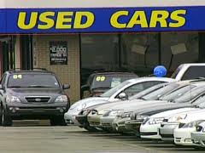
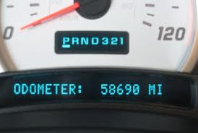
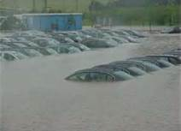
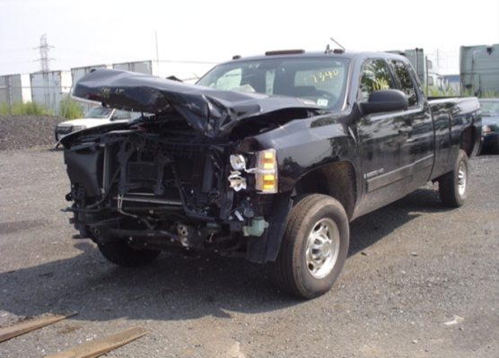
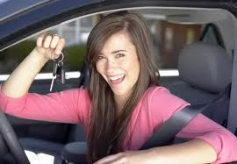
“CARFAX helps millions of people buy and sell used cars with more confidence”

Slide 4
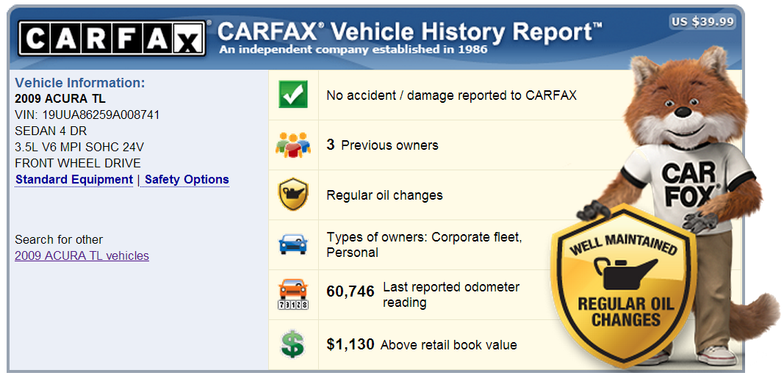
CARFAX Vehicle History Report

Slide 5
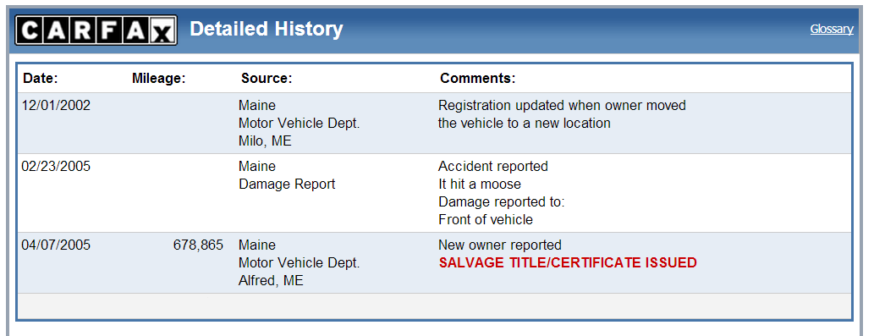
Documents on the Report

Slide 6
NoSQL Before it Was Cool
Proprietary Key Value Store on OpenVMS Developed by CARFAX in 1984

Slide 7
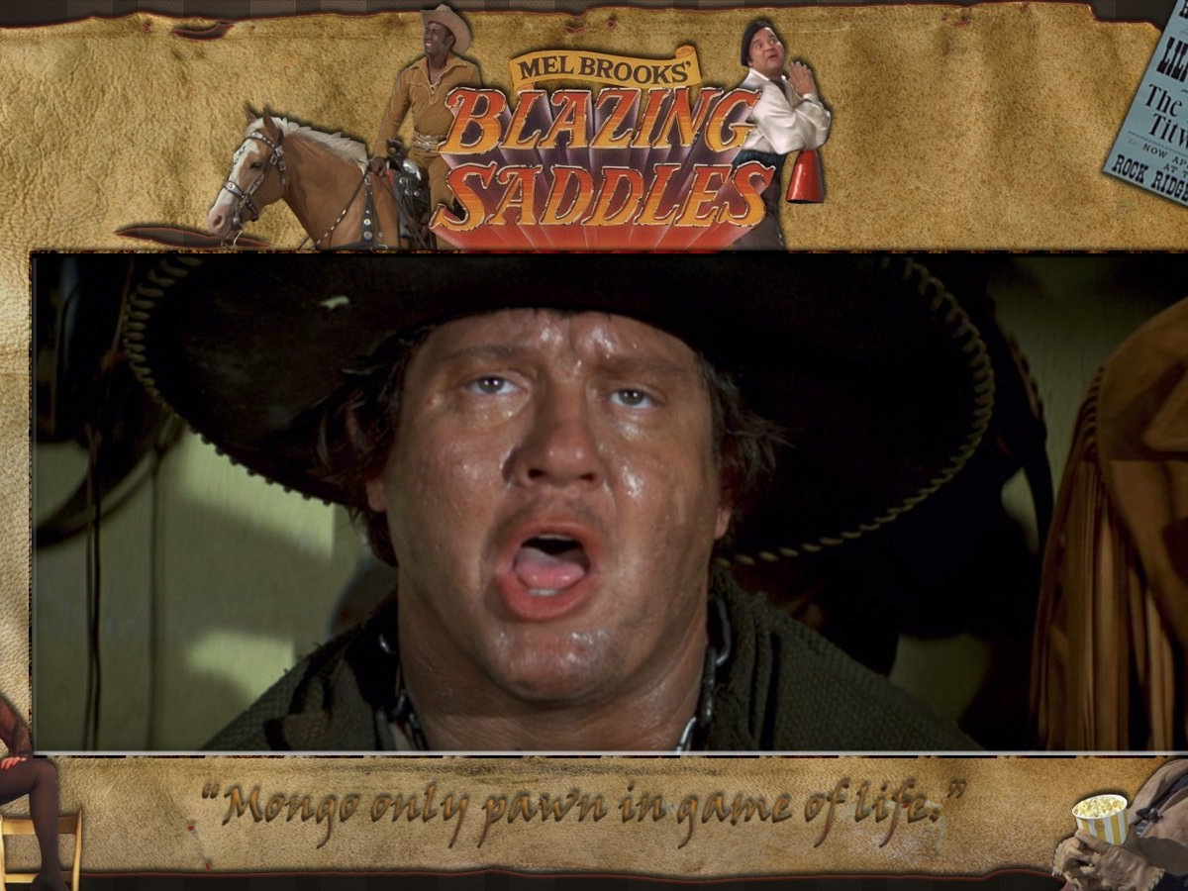
Never mind that sh*t! Here comes Mongo!

Slide 8
Why MongoDB?
Legacy structures mapped to documents
High availability using replica sets
Platform Independence
Support

Slide 9
MongoDB at CARFAX
Our Production Environment
The Legacy Database and High Volume Loads
High Availability Reads

Slide 10
Our Production Environment

Slide 11
Server Deployment
AUTOMATE
AUTOMATE
AUTOMATE
AUTOMATE

Slide 12
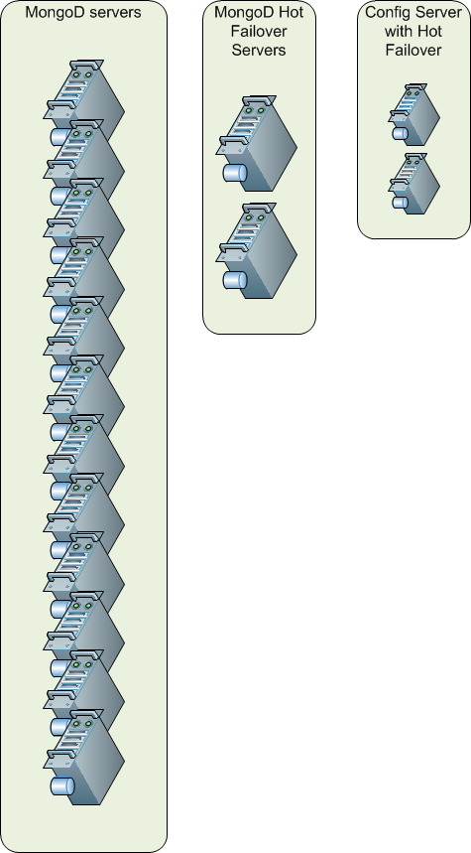
Server Configuration
12 Shards with two spare servers racked for failover
OS: Linux
MongoDB 2.4.9
128 GIGs of RAM
1.8 TB of Drive Space
10K RPM SAS Drives

Slide 13
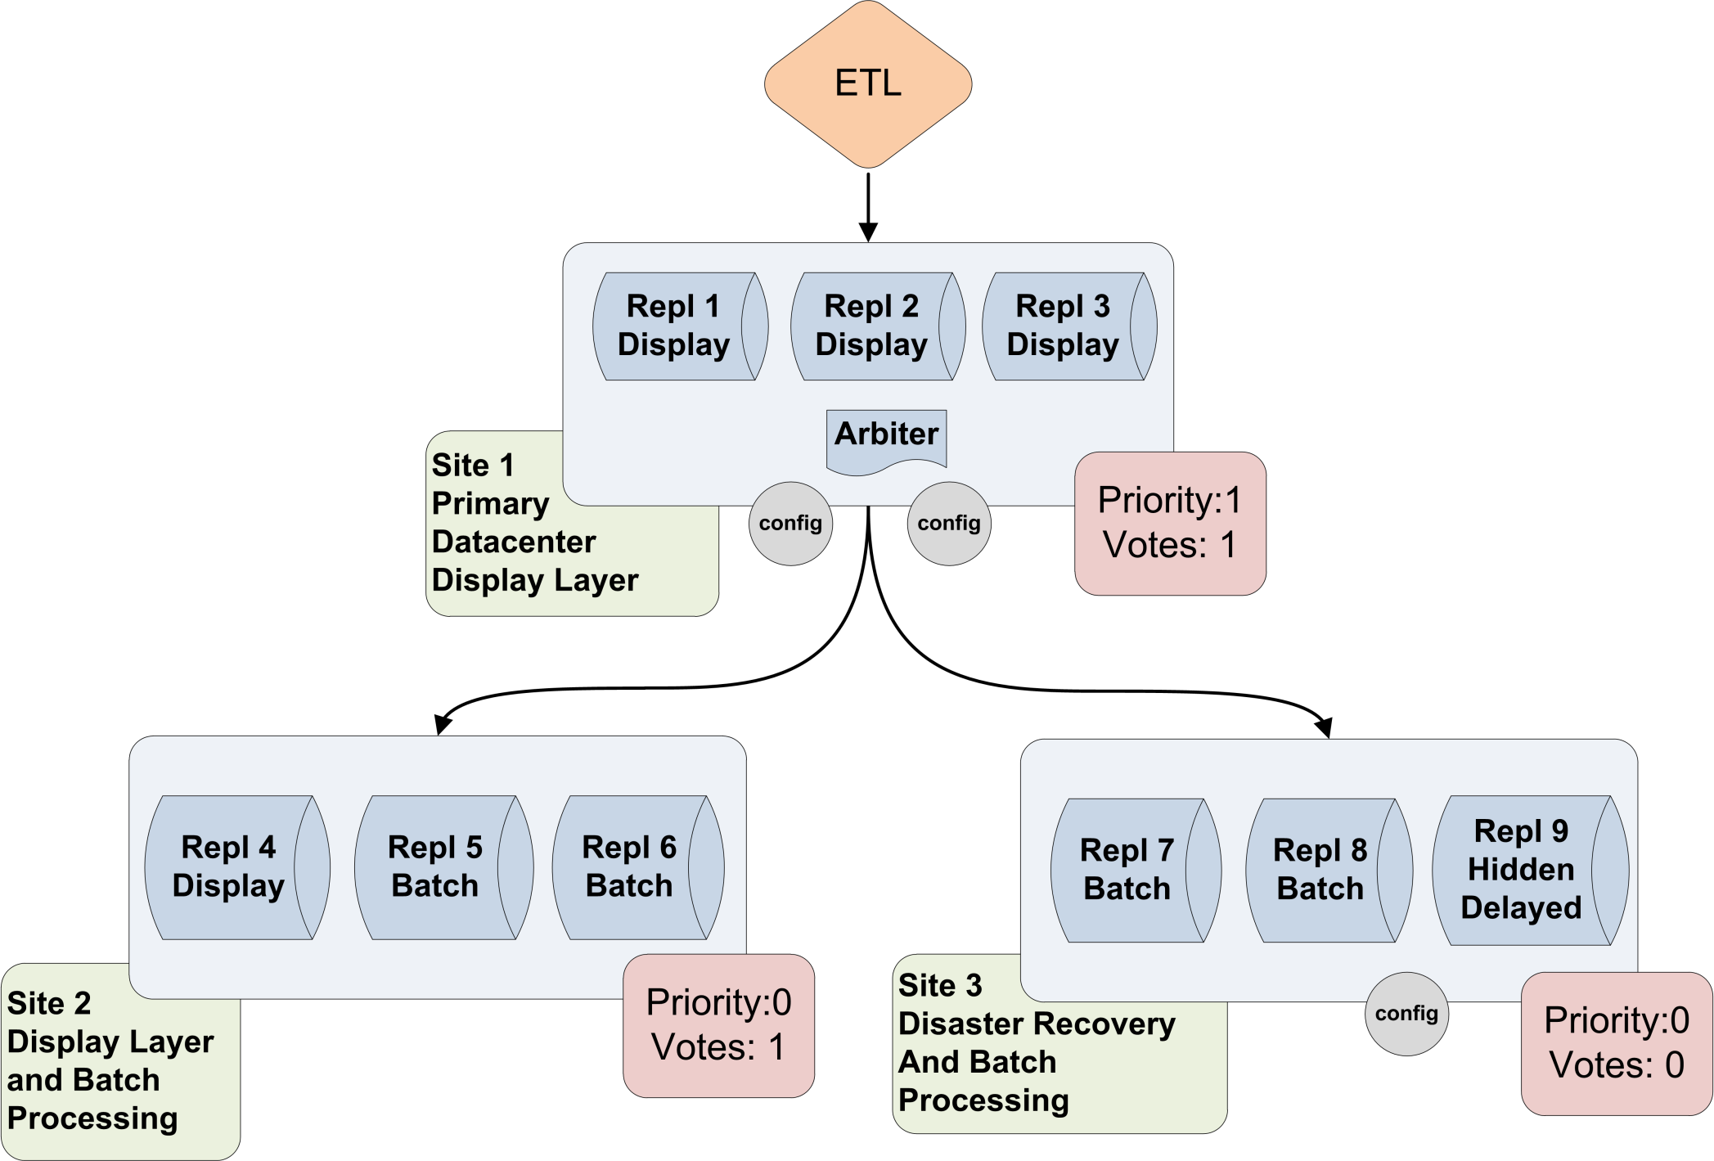

Slide 14
The Future

Slide 15
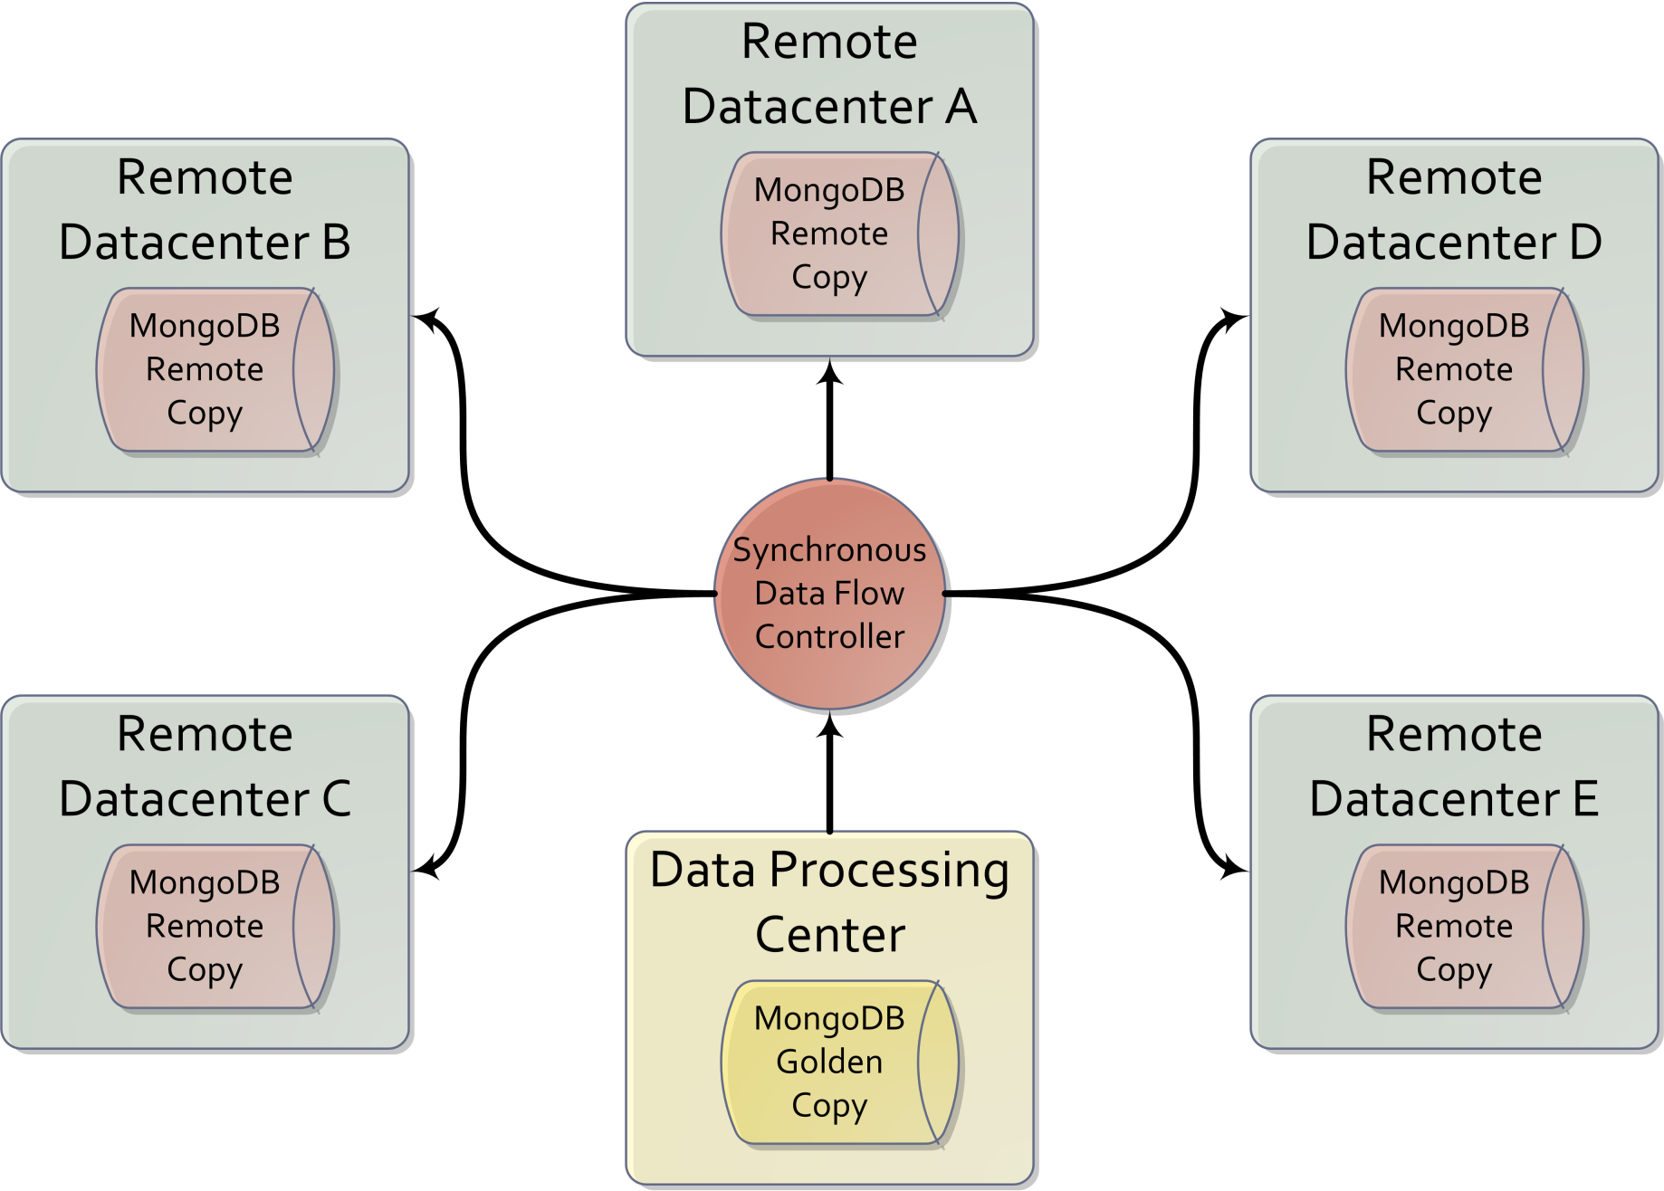

Slide 16
Extract, Transform, Load

Slide 17
Loading Millions to Billions of Records per Day
AUTOMATE
AUTOMATE
AUTOMATE
AUTOMATE

Slide 18
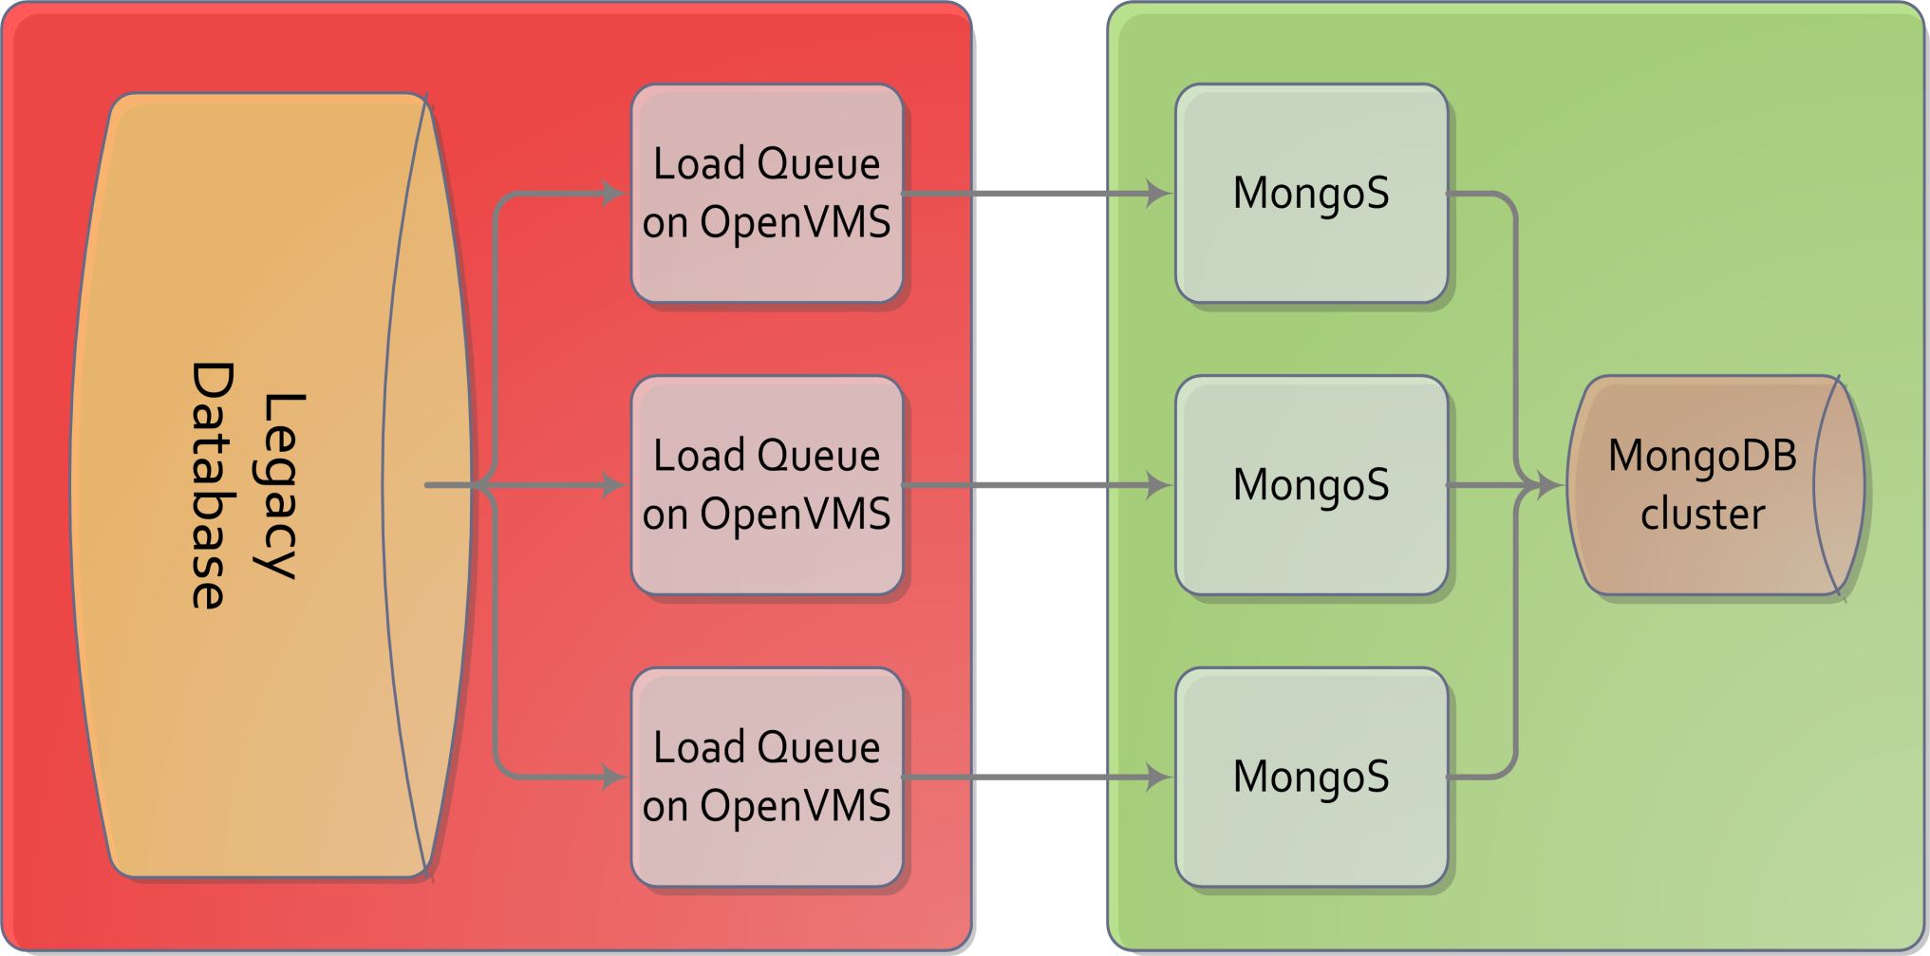
First Attempt To Load Was Completely CPU Bound

Slide 19
Not Acceptable!
45 Days to Backload the Legacy Database

Slide 20
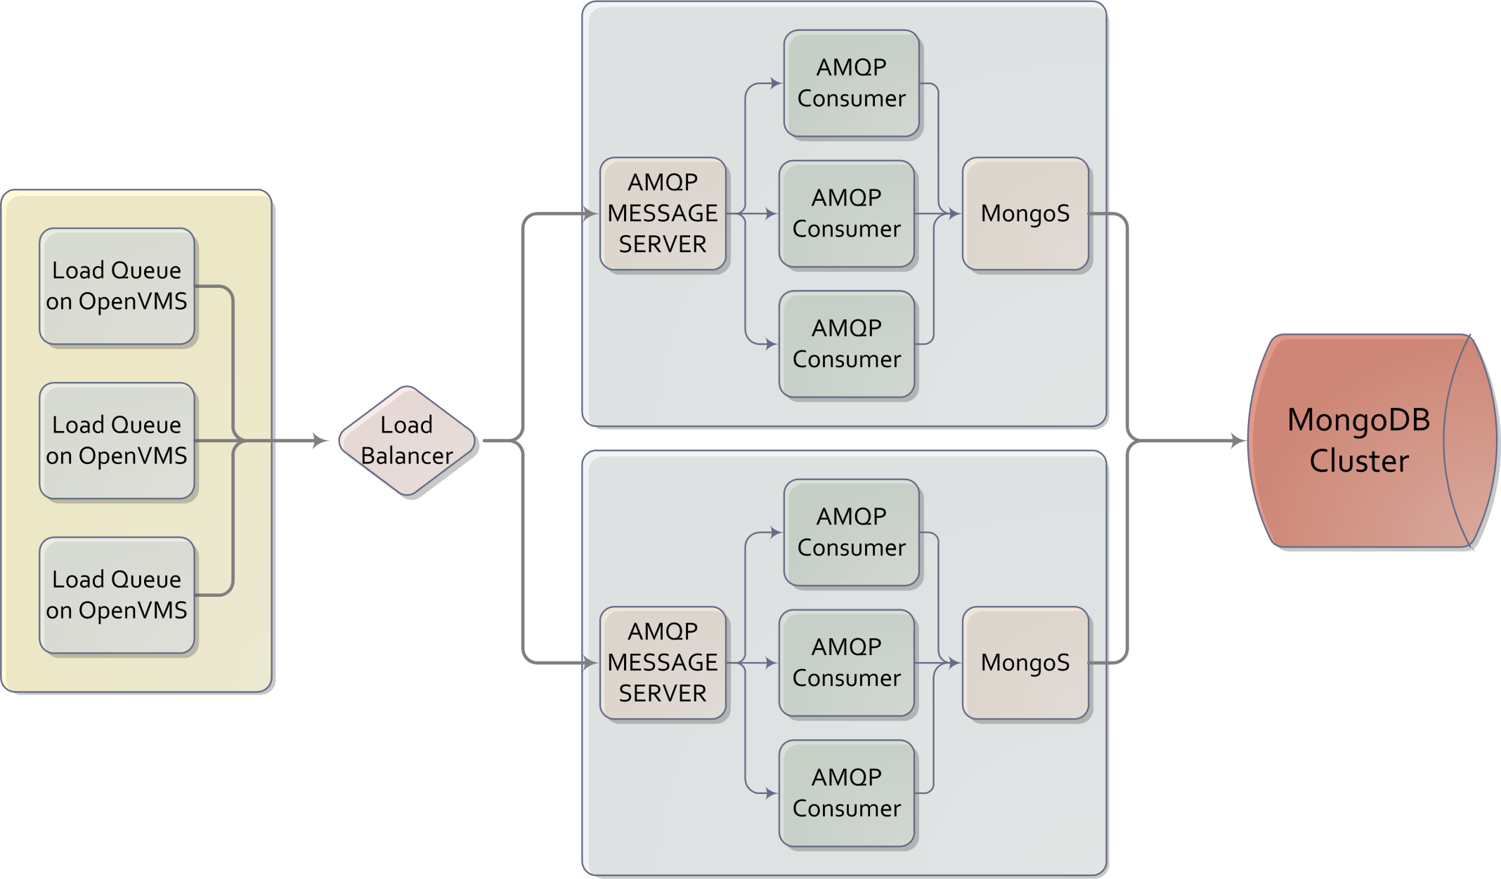
Distributed Processing

Slide 21
Acceptable!
Billion+ inserts per Day!
9 Days to Backload

Slide 22
The MongoDB Implementation
13 billion+ documents
1.5 billion+ new documents per year
Document size: ~ 795 Bytes
VHR uses 200+ documents

Slide 23
High Availability Reads

Slide 24
Millions of Reports per Day
AUTOMATE
AUTOMATE
AUTOMATE

Slide 25
Read Scalability With Tagging

Slide 26
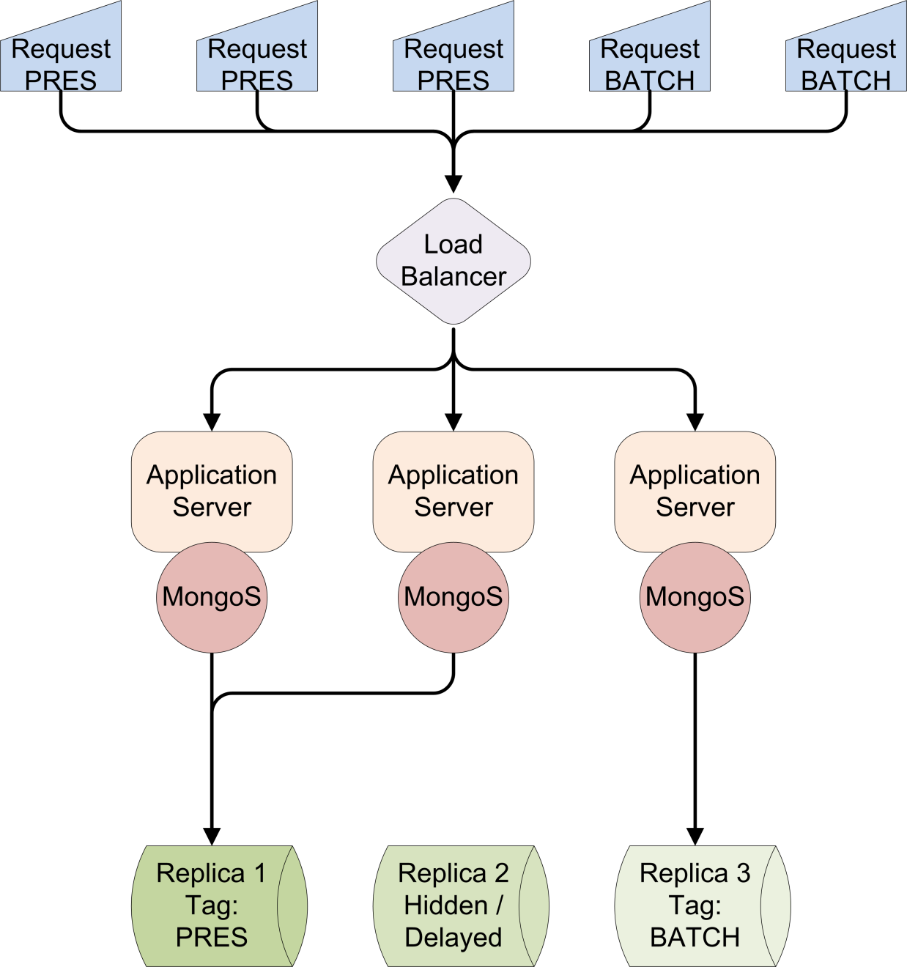
Each Data center is Tagged
Each Replica Set is Tagged

Slide 27
5X More Reports per Second

Slide 28
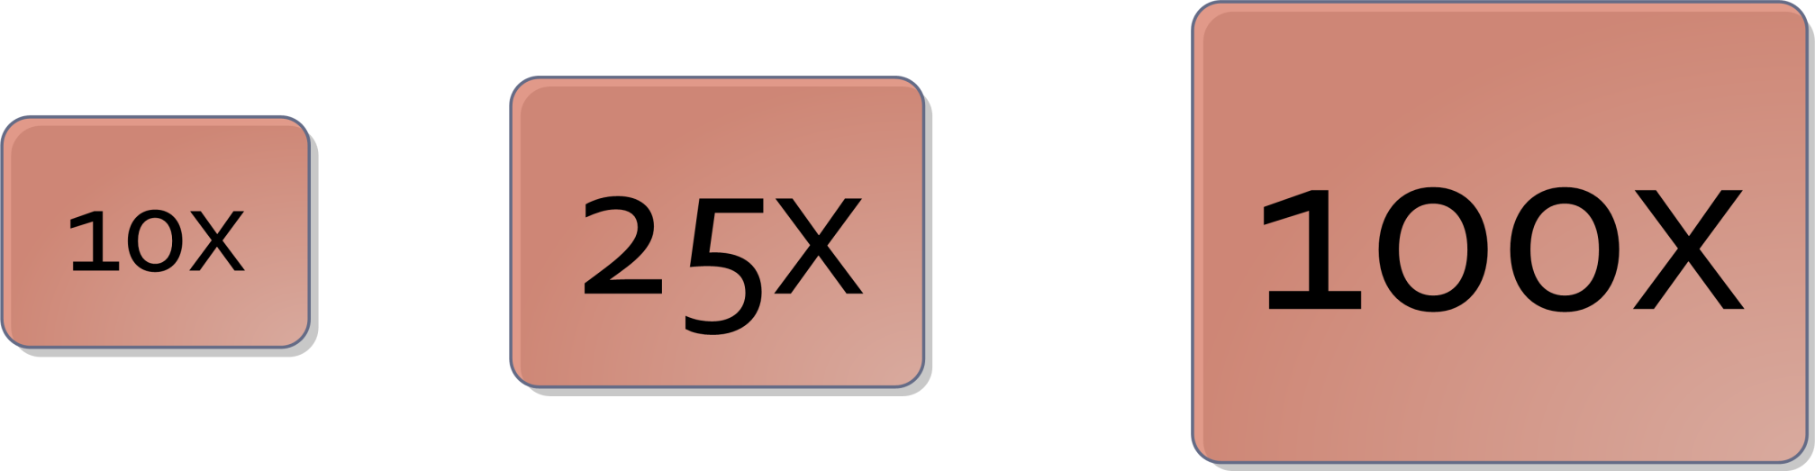
But we can do More!

Slide 29
Lets Wrap It Up
Don’t buy a used car without a CARFAX report
Grok your data and working set
Architect for your load volume
Scale your reads to meet demand

Slide 30
Keys To Success
AUTOMATE EVERYTHING
Test Many Configurations
Grid Computing is Awesome
Shard Early, Shard Often

Slide 31
And Remember

Slide 32
Friends Don’t Let Friends Use Default Ulimits!

Slide 33

Thank You!
The migration was a success due to the incredible teams at CARFAX and MongoDB
We are always looking for great people to join us.
www.carfax.com/careers

