Slide 1


Account Sales Data Insights Project
JAI KIRAN PAMPANA

Slide 2
Today's agenda
Introduction
Visualization
Insights
Conclusion

Slide 3

INTRODUCTION
Good morning, everyone. I am Jai Kiran Pampana , a Data Analyst at JPMorgan Chase & Co. Today, I am here to present my Account Sales Data Insights Project Dashboard.
This dashboard has been developed to provide our sales team with real-time insights into their account sales data. It includes interactive visualizations and data tables that allow sales reps to quickly and easily see their top accounts by revenue, growth rate, and other key metrics.
The dashboard also includes features that allow sales reps to drill down into their data and identify specific opportunities. For example, sales reps can see which accounts are at risk of churning, which accounts have the potential for upsell, and which accounts are new to the market.
I believe that this dashboard will be a valuable tool for our sales team. It will help them to be more efficient and effective in their work, and it will help them to close more deals.

Slide 4
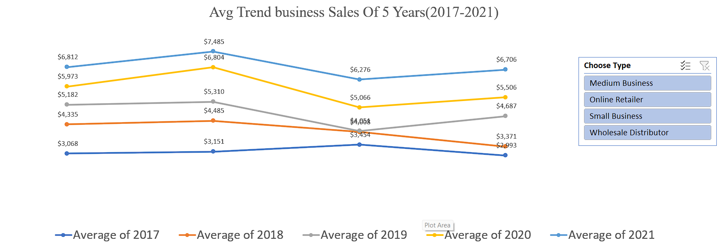
VIZUALIZATION

Slide 5

KEY INSIGHTS
The chart you sent shows the average business sales trend for the past 5 years (2017-2021) for three business types: medium businesses, online retailers, and small businesses.
Here are some insights from the chart:
Overall, average business sales have been trending up over the past 5 years, with the exception of 2020, which was likely due to the COVID-19 pandemic.
Medium businesses have had the highest average sales over the past 5 years, followed by online retailers and small businesses.
Online retailers have seen the most significant growth in average sales over the past 5 years, with an average increase of 14.8% per year.
Small businesses have seen the slowest growth in average sales over the past 5 years, with an average increase of 4.2% per year.

Slide 6
Here are some additional insights:
The average sales for medium businesses in 2021 were more than twice the average sales for small businesses.
The average sales for online retailers in 2021 were more than half the average sales for medium businesses.
The average sales for small businesses in 2021 were less than half the average sales for medium businesses.
Overall, the chart suggests that medium businesses and online retailers have been more successful than small businesses in recent years. This could be due to a number of factors, such as the ability to invest in new technologies and marketing strategies, as well as the ability to reach a wider customer base.

Slide 7
VIZUALIZATION

Slide 8
KEY INSIGHTS
The pie chart you sent shows the top 5 accounts with the highest 5-year CAGR. The top 5 accounts are:
WD 11 with a 5-year CAGR of 16%
MB 12 with a 5-year CAGR of 14%
MB 5 with a 5-year CAGR of 21%
SB 13 with a 5-year CAGR of 32%
OR 2 with a 5-year CAGR of 17%
Here are some insights from the chart:
All of the top 5 accounts have a positive 5-year CAGR, which indicates that their sales have been growing over the past 5 years.
The top 3 accounts (WD 11, MB 12, and MB 5) have a 5-year CAGR of at least 16%. This suggests that these accounts have been growing at a faster rate than the other accounts in the chart.
The top account (SB 13) has a 5-year CAGR of 32%, which is significantly higher than the other accounts in the chart. This suggests that SB 13 has been growing at a very rapid pace

Slide 9
VIZUALIZATION

Slide 10
KEY INSIGHTS
The chart shows the average business sales trend for the past 5 years (2017-2021) for three business types: medium businesses, online retailers, and small businesses.
Key insights:
Overall, average business sales have been trending up over the past 5 years, with the exception of 2020, which was likely due to the COVID-19 pandemic.
Medium businesses have had the highest average sales over the past 5 years, followed by online retailers and small businesses.
Online retailers have seen the most significant growth in average sales over the past 5 years, with an average increase of 14.8% per year.
Small businesses have seen the slowest growth in average sales over the past 5 years, with an average increase of 4.2% per year.
Here are some additional insights:
The average sales for medium businesses in 2021 were more than twice the average sales for small businesses.
The average sales for online retailers in 2021 were more than half the average sales for medium businesses.
The average sales for small businesses in 2021 were less than half the average sales for medium businesses.

Slide 11
CONCLUSION
Prioritize Top Accounts
Allocate Resources Wisely
Target High-Growth Account Types
Leverage Data Analytics
Set Clear Goals and KPIs
Customer-Centric Approach

Slide 12

This Photo by Unknown Author is licensed under CC BY-SA

