Slide 1
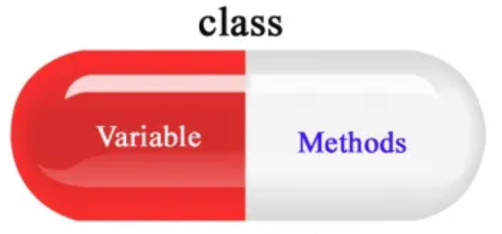

ENCAPSULATION
January 2023

Slide 2
Agenda
01. Introduction to Encapsulation.
02. Access Modifiers
03. Setter and Getter Methods
04. Encapsulation in Java.
05. Types and Benefits of Encapsulation.

Slide 3
INTRODUCTION
It is a process of binding Data with Methods together within a class as a single unit.
It secures the internal contents of a class like a capsule.
That is, confining all of an object's relevant activities and data within that object. It protects the data and code from outside intervention.
With encapsulation, we can protect the fields of a class.
Containers are just one example of encapsulation in coding where data and methods are bundled together into a single package.

Slide 4
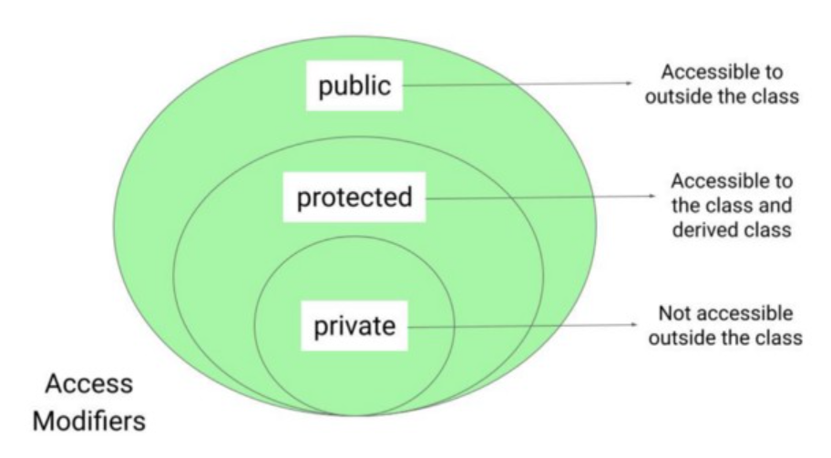
ACCESS MODIFIERS
Public
Protected
The public access specifier provides the access specifications to a class so that it can be accessed from anywhere within the program.
The protected class members' access level or scope is limited to within the current or same package, as well as from another package if and only if a class is inherited from another package.
Default
Private
If there is no access modifiers keyword is defined, it will be used as default. The default members' access is limited to the current or the same package.
The private access specifier provides access to the data members, and the data methods limit to the class itself.

Slide 5
GETTER & SETTER IN JAVA
Getter and Setter in Java are two conventional methods used to retrieve and update values of a variable. They are mainly used to create, modify, delete and view the variable values.
Getter Methods (Accessors)
Setter Methods (Mutators)
Getter methods return the field by getData() Method.
Setter methods let us create and change the value of the field in setData() Method.
SIGNIFICANCE
We can achieve immutability by declaring the fields as private and using only getters
Getters and setters also allow additional functionalities like validation, error handling that could be added more easily in the future. Thus, we can add conditional logic and provide behavior according to the needs
We can provide different access levels to the fields; for example, the get (read-access) may be public, while the set (write-access) could be protected.

Slide 6
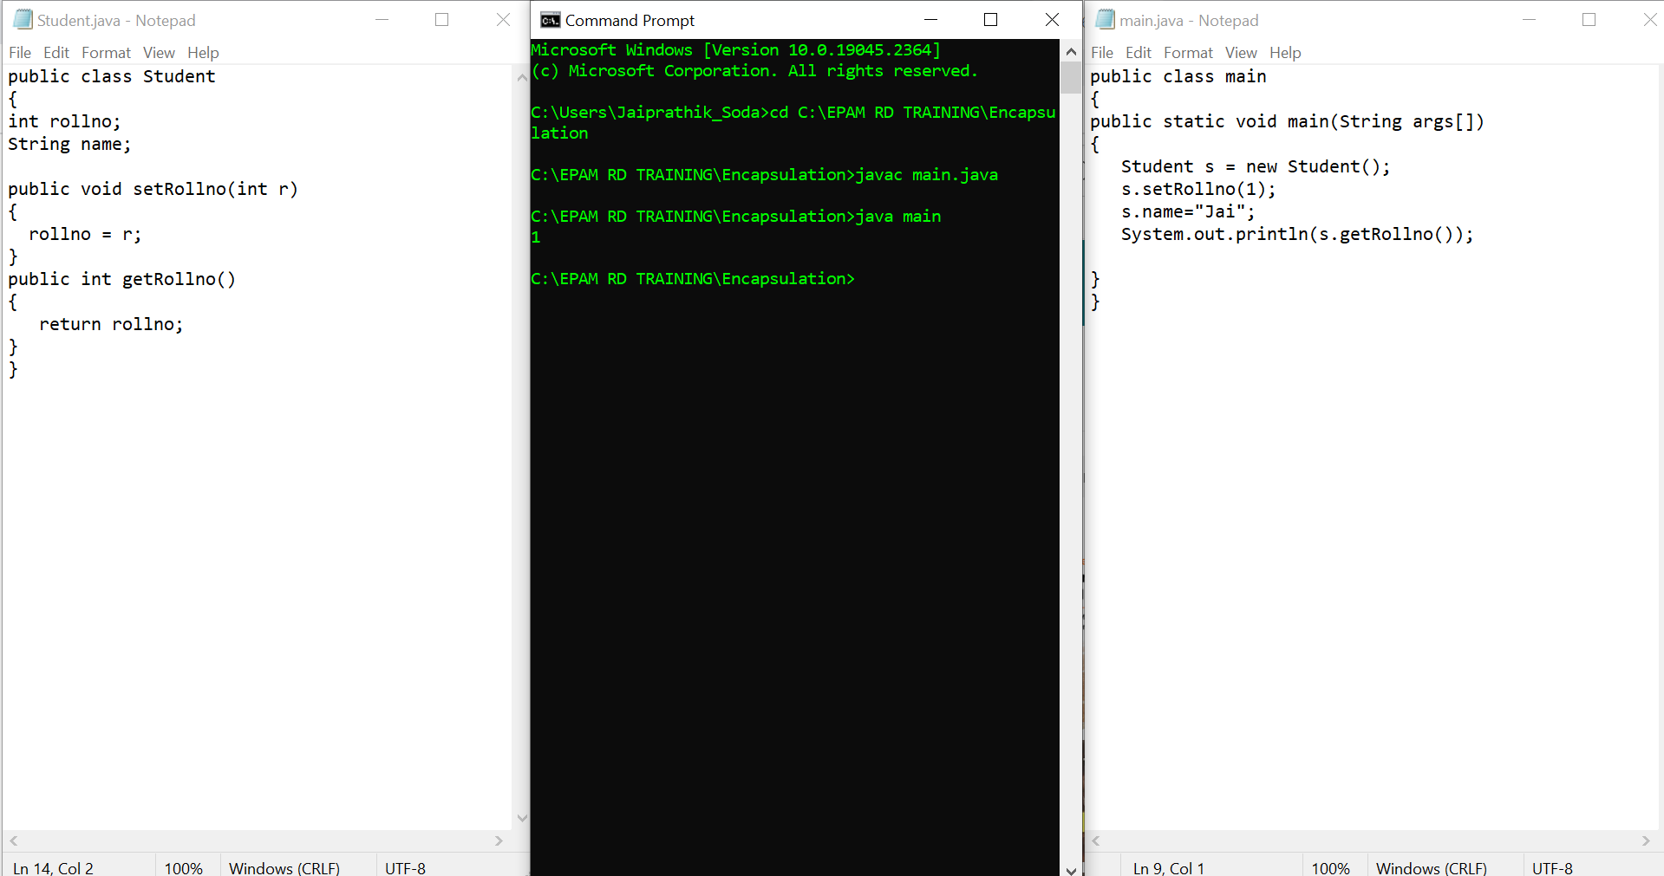
Practical Implementation of Setter’s and Getter’s.

Slide 7
ENCAPSULATION IN JAVA
When we attempt to achieve encapsulation in Java, it is essential to complete two tasks.
The first task is to define the fields (variable) of the class as private, as this act can confirm the security that encapsulation provides.
The second task we can complete to achieve encapsulation is to provide setter and getter methods that are public.
Completing this task makes it possible to view and edit the values of the relevant variables without compromising privacy or security.

Slide 8
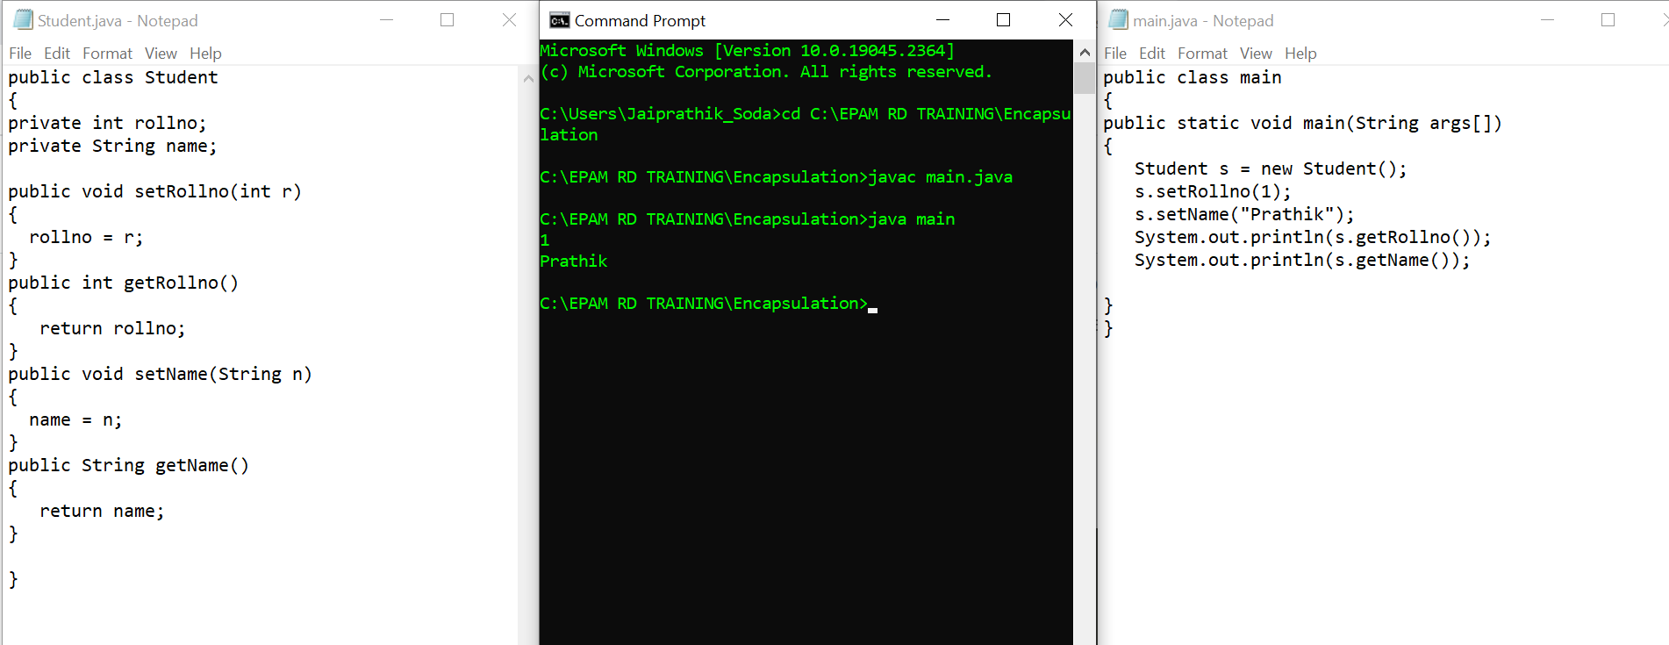
Practical Implementation of Encapsulation.

Slide 9
TYPES OF ENCAPSULATION
Member Variable Encapsulation All data members should be defined as Private members of the Class. Setters and Getters functions should be used by any object that wants to change or retrieve the value of a data member.
Function Encapsulation We can hide methods used for internal implementation that does not need to be visible to public.
Class Encapsulation It is used for internal API implementations. It contains an internal implementation of a class that stores and processes specific information. We encapsulate that class by defining it as private and hiding it from user access. These classes should not be included in any API's public interface

Slide 10



BENEFITS:
Better Control and functionality
Data Security and Information Hiding
Encapsulation provides ultimate control over the data members and methods inside the class and Functionality is also described only in a single location rather than multiple locations.
Encapsulation prevents access to data members and data methods by any external classes. The encapsulation process improves the security of the encapsulated data.
Improved Code Maintenance and Flexibility
Getter and Setter
The standard IDEs provide in-built support for ‘Getter and Setter’ methods, which increases the programming pace.
Changes made to one part of the code can be successfully implemented without affecting any other part of the code.

Slide 11
Thank You

