Slide 1
EV CHARGING SYSTEM
Jaisal Srivastava (1DT18IS038)
Sai Prakash Reddy.K(1DT18IS043)

Slide 2
Motivation: Our motivation was the lack of present websites to check for cost and charging time for an EV
Objective: We hope that any user can easily calculate the charging time and the costs involved in charging , and his mileage through our website and plan ahead.
Minimum system requirements : a web browser any operating system, access to the internet
Tools Used : HTML , CSS, Java Script and Bootstrap 5

Slide 3
Introduction To EV charging system
The rate at which electric vehicles (EV) can be charged is becoming a key differentiator in this rapidly developing market, for a very straightforward reason: charging an EV’s battery is currently a lot slower than refilling a tank with petrol to go the same distance.
Slow chargers are typically rated at 3kW, and are mostly used in homes, ideally through a dedicated wall-box. They’re not really suitable for public use because they charge too slowly.
Fast chargers are found in public places, such as car parks and shopping centres, and may charge at rates of 7kW or 22kW. A 22kW charger could charge our generic 60kWh EV from zero to a full charge in around two and half to three hours.
Also it will be different charging time from car to car and model to model and depenting on power supply of charging station

Slide 4
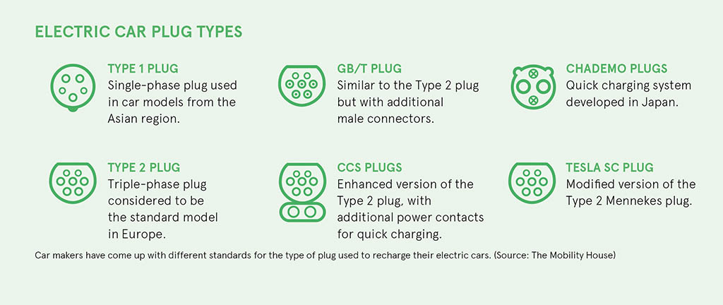
How is it useful for people?
As all the charging stations doesn’t work same , people will be facing some issues such as type of charging pin of their model,time taken for their vehicle to get full charged ,no of kwatt needed an so on
In order to avoid such problems , We’ve created this website that helps people in getting out of such problems

Slide 5
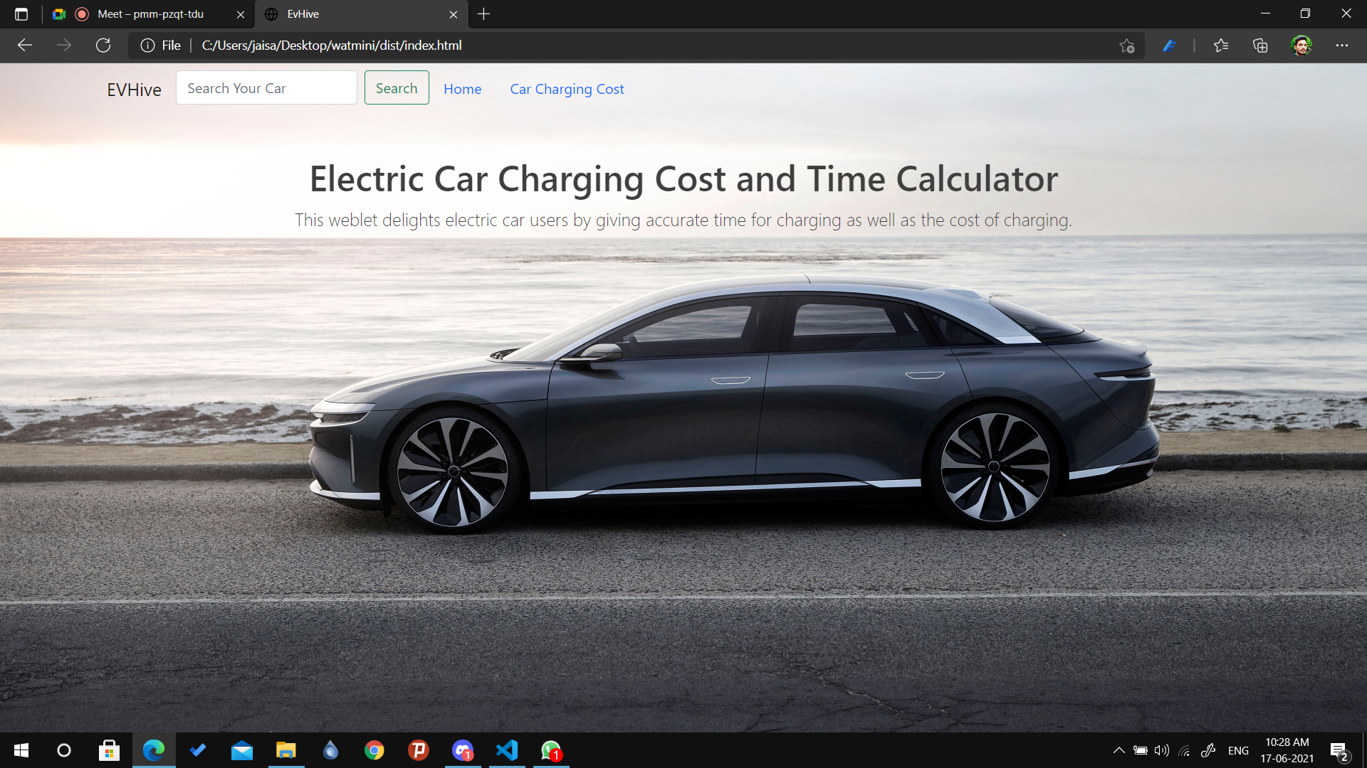
Fig. represents the home page of the website

Slide 6
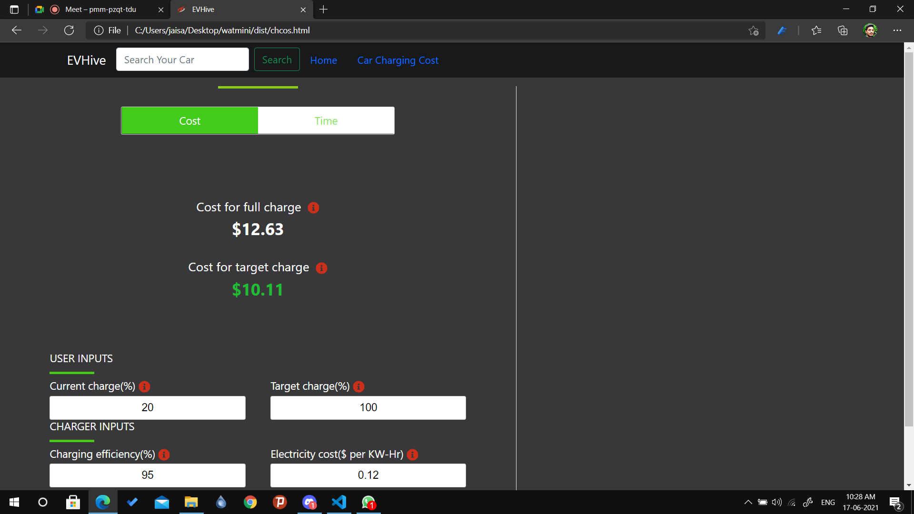
Contents of home page :
Search bar :
Can search for a particular model and make of a EV
Car charging cost calculator :
Used to calculate the cost per Kwatt and so on .
And the page looks as shown below

Slide 7
Minimum Requirements
Any Device with a Web Browser support
Stable Internet Connection

Slide 8
Flow Diagram
START
Charging cost
Milage
Charging time
STOP

Slide 9
THANK YOU

