Slide 1

AI-Powered Hospital Readmission Risk Predictor
Midde Jai Surya
B.Tech Artificial Intelligence and Machine Learning
Predict Hospital Readmission Risk Using Machine Learning
Notes:
Good morning everyone. I'm Midde Jai Surya, and I'm excited to share my project on an AI-Powered Hospital Readmission Risk Predictor. This work is all about using predictive analytics to make a real difference in patient care, especially for diabetic patients. We're focusing on how machine learning can help healthcare providers make better, faster decisions. My goal is to show you how we can leverage AI to improve outcomes and streamline care.

Slide 2

PROBLEM STATEMENT
Hospital readmission within 30 days of discharge is a major healthcare quality indicator and is often considered preventable.
Diabetic patients have a significantly higher risk of early readmission, leading to increased healthcare costs and resource utilization.
In the United States, approximately 1 in 5 Medicare patients is readmitted within 30 days, resulting in annual costs exceeding $26 billion.
Hospitals with excessive readmission rates may face financial penalties under healthcare policies.
Therefore, predicting high-risk patients before discharge can support preventive care, improve patient outcomes, and reduce healthcare expenses.
"The Solution: Develop an ML based system to predict hospital readmission risk and assist healthcare providers in early intervention
Notes:
Building on that, let's talk about the critical challenge we're addressing: hospital readmissions. This isn't just a financial drain, costing billions annually; it's a serious threat to patient well-being, particularly for those with chronic conditions like diabetes. Frequent readmissions mean decreased quality of life and higher mortality risks. Our AI-driven system aims to tackle this head-on, identifying high-risk patients before they even leave the hospital. This allows for targeted preventive care, ultimately reducing costs and improving patient outcomes.

Slide 3

DATASET: DIABETES 130-US HOSPITALS
Source
Key Attribute Categories
10 years (1999–2008) of clinical care at 130 US hospitals.
Category
Examples
Scope
Demographics
Age, Race, Gender
101,766 instances representing unique hospital encounters for diabetic patients.
Clinical Data
Diagnoses (ICD-9), Medications
Hospitalization
Time in Hospital, Emergency Visits
Target Variable
Procedures
Lab Procedures, Inpatient Visits
Readmission status categorized into: <30 days, >30 days, or No readmission.
Notes:
To build this predictor, we needed a robust foundation, and that came from the 'Diabetes 130-US Hospitals' dataset. This comprehensive dataset spans 10 years of clinical care, capturing over 100,000 unique hospital encounters. It includes everything from patient demographics and detailed clinical data like diagnoses and medications, to hospitalization specifics such as time spent in the hospital and emergency visits. Our key objective was to predict the patient's readmission status: whether they'd be readmitted within 30 days, after 30 days, or not at all.

Slide 4





DATA PREPROCESSING PIPELINE
Missing Value Handling
Feature Refinement
Categorical Encoding
Scaling
Systematic removal or imputation of null values in weight, payer code, and specialty.
Removal of low-variance features and irrelevant identifiers like encounter ID.
One-Hot Encoding for nominal data and Ordinal Encoding for age groups.
Standardized scaling for the “Data from Different Domains”
Outcome: A refined, high-dimensional dataset optimized for Machine Learning model training.
Notes:
Working with raw clinical data presents its own set of challenges, so a robust data preprocessing pipeline was essential. We started by meticulously handling missing values, which are common in healthcare records, through systematic removal or imputation. Next, we refined our features by removing low-variance and irrelevant identifiers to ensure only meaningful data remained. We then employed categorical encoding, using one-hot encoding for nominal variables and ordinal encoding for age groups to preserve their inherent order. Finally, we used Random Forest Feature Importance to pinpoint the most predictive variables, transforming messy data into machine-ready features. This prepared our data for the next crucial step: identifying the key drivers of readmission.

Slide 5



MACHINE LEARNING MODELS EXPLORED
Logistic Regression
Decision Tree Classifier
Random Forest Classifier
Pros: High interpretability and fast
training times.
Pros: Easy to understand and visualize; captures non-linear relationships.
Pros: Excellent at handling high-dimensional data
and non-linear patterns.
Cons: Struggles with non-linear relationships
and imbalanced healthcare data.
Cons: Prone to overfitting and sensitive to small changes in data.
Cons: More computationally intensive than
linear models.
Optimizations:
1. Class Weight balancing
2. Decision Threshold Tuning
3. Regularization Strength Tuning
Optimizations:
1. Hyperparameter Tuning
2. Top 10 Feature Model using Feature Importance (Age – Ordinal Encoded)
3. Top 10 Feature Model using Feature Importance (Age – Mapped)
No parameter Optimization
Base – Line Model
The Verdict
Random Forest was selected as the final model due to its superior ability to handle the imbalanced nature of healthcare data and provide better recall.
Notes:
After identifying the most impactful features, we needed to select the right predictive model. We explored two primary models: Logistic Regression and Random Forest. Logistic Regression is simple and interpretable, but it struggles with complex, non-linear relationships and imbalanced datasets. Our healthcare data is quite imbalanced, with far fewer readmissions than non-readmissions. Random Forest, an ensemble method, excels at handling these challenges. It combines multiple decision trees, making it robust against imbalances and better at capturing intricate patterns. This is why we chose Random Forest as our final model. Now, let's dive into how Random Forest actually works.

Slide 6

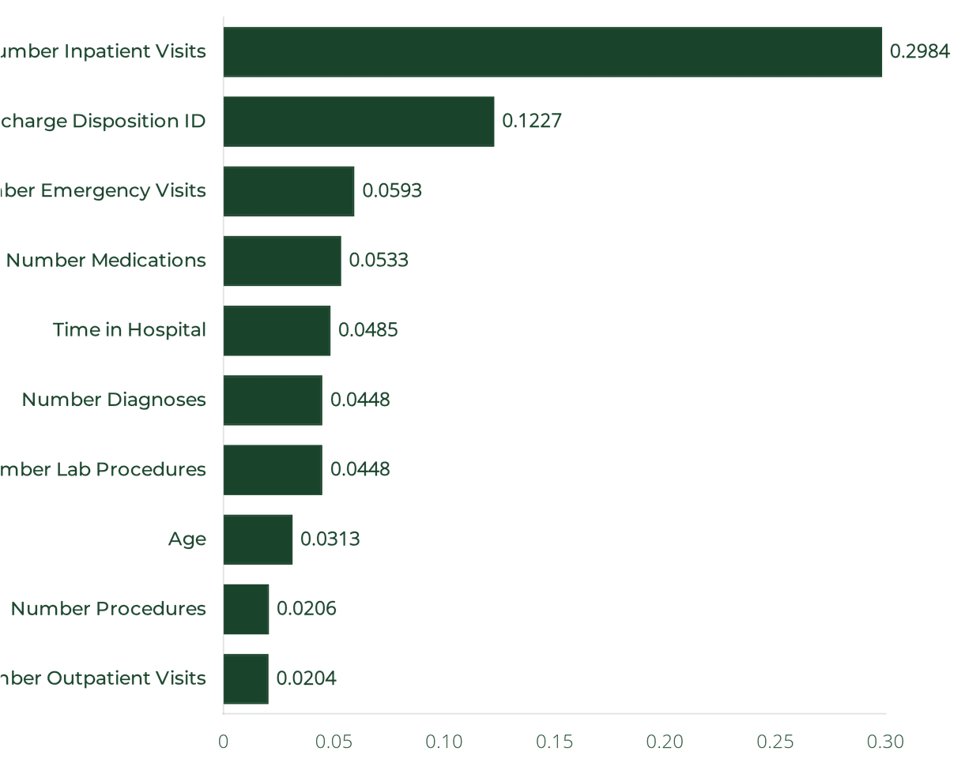
IDENTIFYING THE DRIVERS OF READMISSION
Top Predictive Factors
1
Number Inpatient Visits:
Strongest predictor of risk.
2
Discharge Disposition ID:
Destination after discharge.
3
Number Emergency Visits:
Frequency of urgent care.
4
Number Medications:
Complexity of treatment.
5
Time in Hospital:
Duration of clinical stay.
6
Number Diagnoses:
Total medical conditions.
7
Number Lab Procedures:
Intensity of monitoring.
8
Age:
Physiological vulnerability.
9
Number Procedures:
Non-lab medical actions.
10
Number Outpatient Visits:
Prior outpatient care.
*Analysis based on Random Forest Feature Importance scores.
Notes:
After our thorough preprocessing, we moved to identifying the true drivers of readmission, and the results were quite insightful. Our analysis, based on Random Forest Feature Importance, clearly showed that the 'Number of Inpatient Visits' is the strongest predictor of future risk. This makes intuitive sense; a history of frequent hospitalizations often signals underlying complexities. Other critical factors include the patient's 'Discharge Disposition,' meaning where they go after leaving the hospital, and the 'Number of Emergency Visits,' indicating prior urgent care needs. These top features give us a clear picture of what truly influences a patient's readmission risk, guiding our model's predictive power.

Slide 7
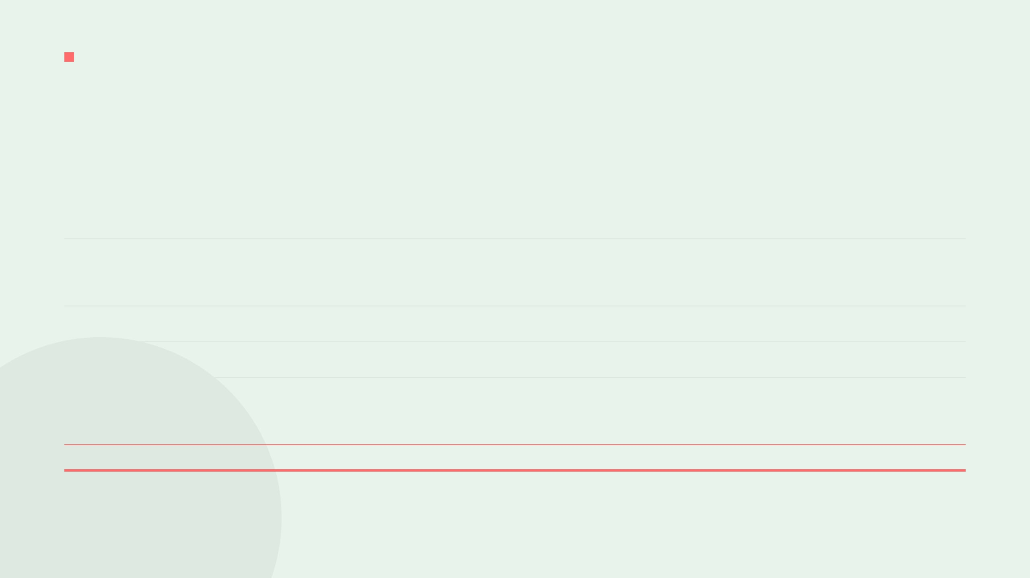

MODEL OPTIMIZATION AND PERFORMANCE COMPARISON
MODEL
OPTIMIZATION APPLIED
ACCURACY
PRECISION
RECALL
F1 SCORE
Logistic Regression
Default Model
88.8%
47%
1%
2%
Logistic Regression
Class Weight Balancing
65.8%
17%
54%
26%
Threshold Tuning
Regularization Tuning (C)
Decision Tree
Default Model (No Optimization)
80.6%
17%
18%
17%
Random Forest
Default Model
88.9%
54%
1%
1%
Hyperparameter Tuning
65.1%
18%
60%
28%
Random Forest
OPTIMIZED
Feature Importance Selection
Age Encoding & Mapping Optimization
"Although optimized Random Forest achieved lower accuracy, it significantly improved Recall (60%) and F1 Score (28%), making it more suitable for healthcare applications where identifying high-risk patients is more important than maximizing overall accuracy."
Notes:
We just discussed the importance of Recall, and this slide shows how we optimized our models to achieve that. You'll notice that while the optimized Random Forest has a slightly lower accuracy than some default models, its Recall is significantly higher at 60%. This is a critical trade-off in healthcare. We prioritize identifying as many high-risk patients as possible, even if it means a few more false positives. This optimization process involved hyperparameter tuning and careful feature selection, ensuring our model is clinically relevant. This focus on recall directly supports our goal of proactive patient care, which we'll see in action with the system workflow.

Slide 8







SYSTEM WORKFLOW
User Input
Preprocessing
Model Inference
Risk Categorization
Decision Support
Clinician enters patient data into the Streamlit interface.
Automated cleaning and encoding of raw clinical features.
Random Forest calculates readmission probability.
Patients assigned to Low, Moderate, or High Risk groups.
Actionable insights provided for clinical intervention.
Seamless integration of Machine Learning into the clinical decision-making process.
Notes:
Now, let's connect these pieces and see how the system operates in a real-world clinical setting. The workflow begins when a healthcare provider enters patient data into our Streamlit interface. This raw data then goes through an automated preprocessing pipeline, where it's cleaned and encoded. Our Random Forest model then takes this processed data and calculates the probability of readmission. Based on this probability, patients are categorized into low, moderate, or high-risk groups. This isn't just a prediction; it's actionable decision support, guiding clinicians toward appropriate interventions. This seamless integration ensures that our AI tool becomes a valuable asset in patient care.

Slide 9

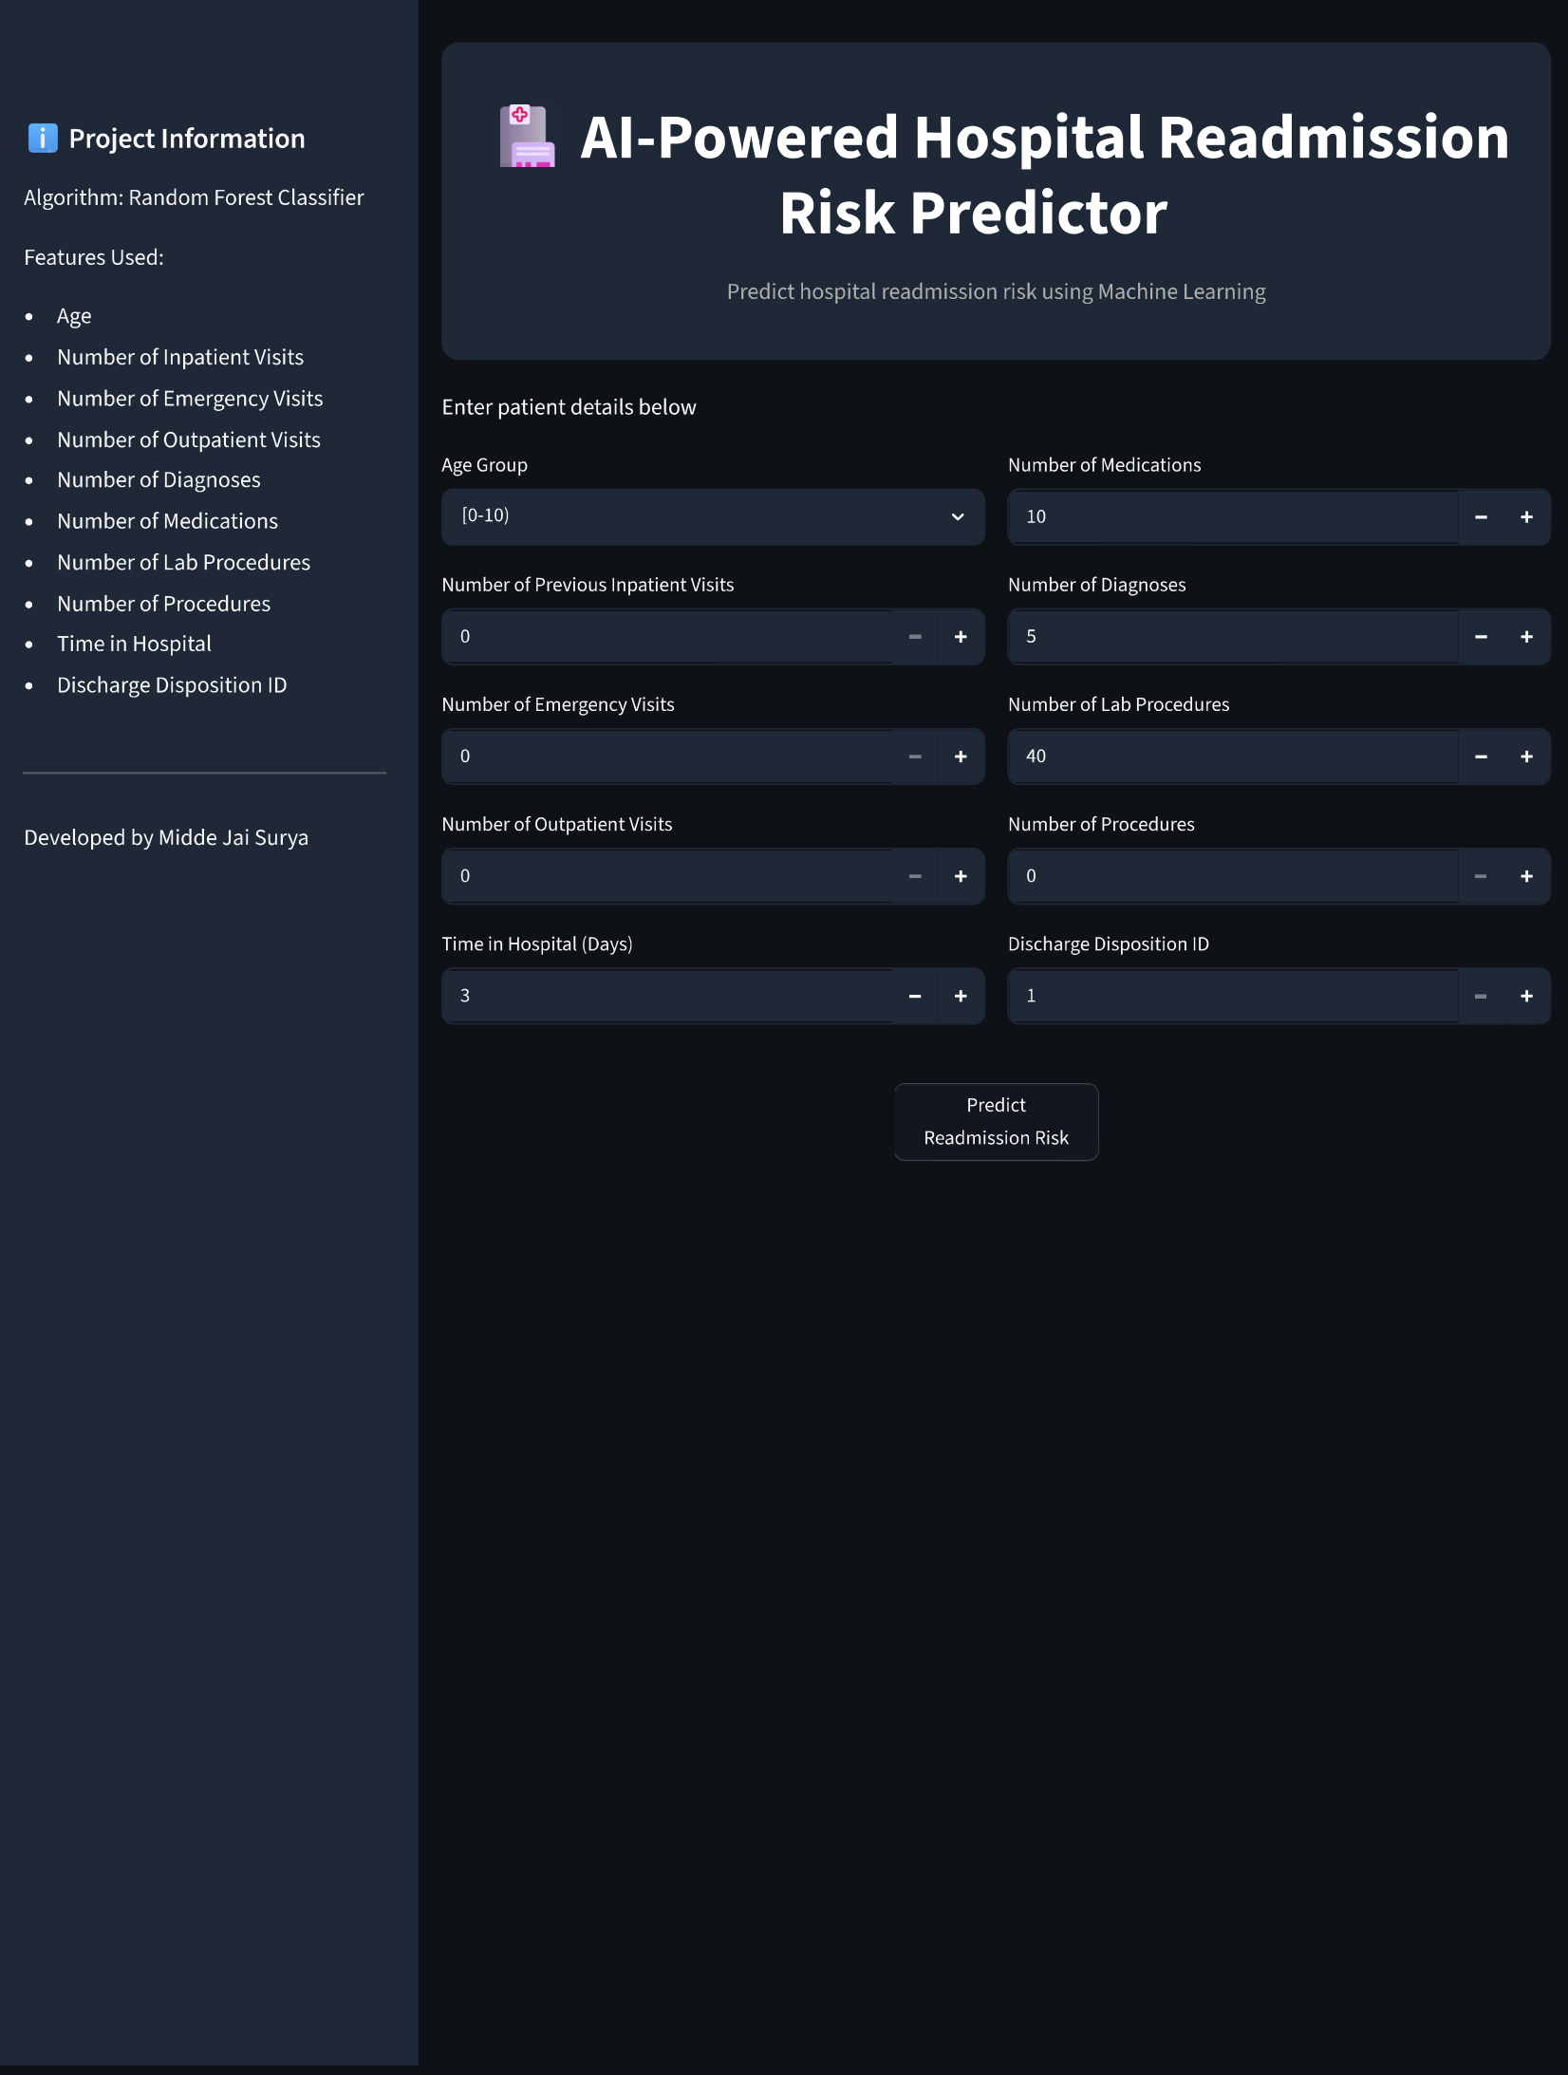
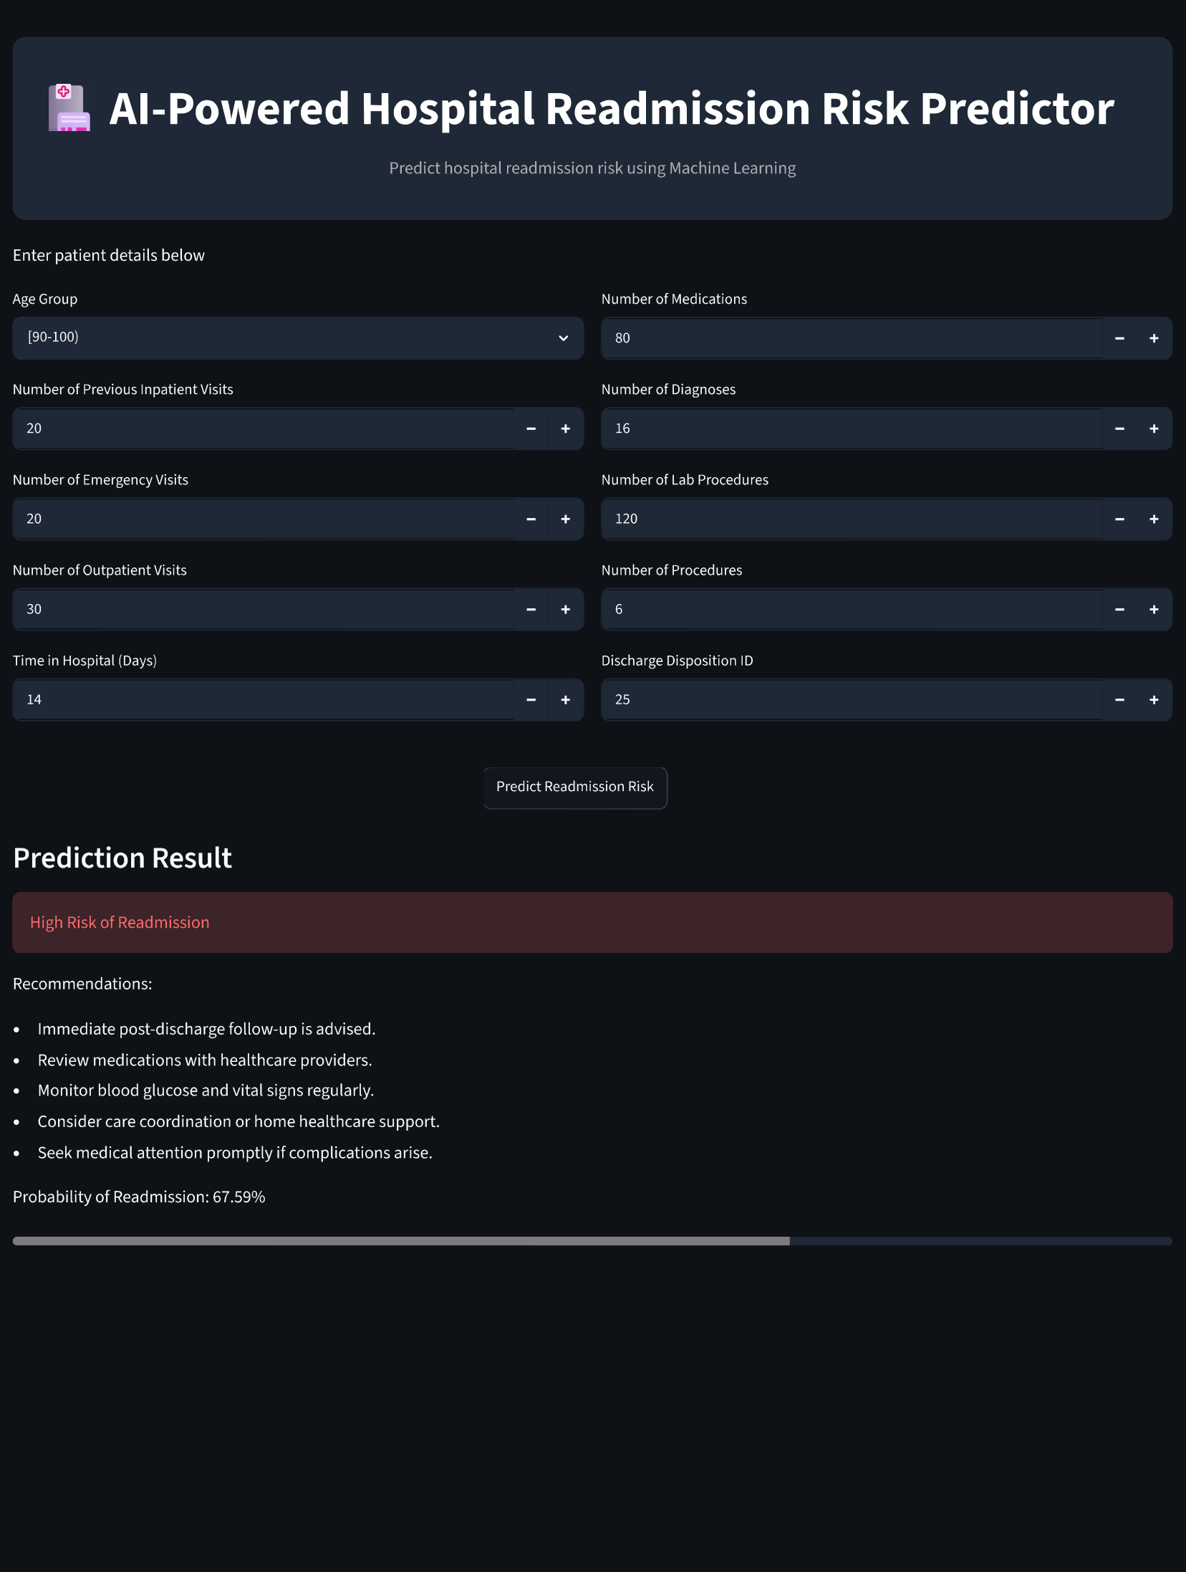

Interface with sidebar (Contains Dataset details)
Real Time – Prediction - Image
Notes:
So, what have we achieved, and where do we go from here? This project successfully demonstrates how machine learning can identify at-risk diabetic patients, potentially reducing hospital readmission rates. Our focus on recall ensures we prioritize patient safety. Looking ahead, real-time integration with Electronic Health Records is a critical next step. We also plan to incorporate Explainable AI techniques like SHAP and LIME. This will provide clinicians with transparent reasoning for each risk flag. And finally, we aim to expand this framework to other chronic conditions, scaling AI for better healthcare delivery.

Slide 10


CONCLUSION & FUTURE SCOPE
Project Conclusion
Future Roadmap
The proposed Random Forest model successfully predicts hospital readmission risk and categorizes patients into Low, Moderate, and High Risk groups through a deployable web application.. By prioritizing Recall, the system provides a robust safety net for clinical decision-making.
EHR Integration
Connecting directly with Electronic Health Records for real-time
risk assessment.
Explainable AI (XAI)
Integrating SHAP/LIME to provide clinicians with transparent
Technologies Used
reasoning for each risk flag.
Tools : Jupyter Notebook, VSCode, GitHub
Programing Language : PYTHON
Packages / Modules : Pandas, NumPy, Scikit-learn, Matplotlib, Joblib
FrameWork : STREAMLIT
Expanded Scope
Adapting the predictive framework for other chronic conditions
like heart failure.
"Scaling AI to bridge the gap between clinical data and proactive patient care."
Notes:
So, what have we achieved, and where do we go from here? This project successfully demonstrates how machine learning can identify at-risk diabetic patients, potentially reducing hospital readmission rates. Our focus on recall ensures we prioritize patient safety. Looking ahead, real-time integration with Electronic Health Records is a critical next step. We also plan to incorporate Explainable AI techniques like SHAP and LIME. This will provide clinicians with transparent reasoning for each risk flag. And finally, we aim to expand this framework to other chronic conditions, scaling AI for better healthcare delivery.

Slide 11

THANK YOU
AI-Powered Hospital Readmission Risk Predictor
Midde Jai Surya
B.Tech | AIML
"Open for Discussion"
Notes:
Thank you for your time and attention today. This project represents a significant step towards leveraging AI for proactive patient care. I am Midde Jai Surya, and I'm now open to any questions you might have. Let's discuss how this AI-powered predictor can make a real difference in healthcare.

