Slide 1
SALESTORM
10,000 buyers. 100 units. Zero oversold, zero double-charged, zero lost orders.
High-scale flash-sale system design · SYSCRAFTERS 2026 Design-First Hackathon
Notes:
Opening (10s). We are the architecture team for SALESTORM. Our claim: when 10,000 customers compete for 100 units, every transaction stays correct.

Slide 2
10,000 buyers race for 100 units in a few seconds
10,000
100
500k/s
simultaneous “Buy Now” clicks
units of Product X in stock
peak requests we design for (50×)
What must never happen
✕
Overselling
✕
Duplicate transactions
✕
Lost orders
101st unit sold, or stock goes negative
double reservation, double charge, double order
customer paid, but no order exists after a failure
Pipeline: Discovery → Cart → Inventory Check → Reservation → Checkout → Payment → Order → Fulfilment → Shipment → Notification → Tracking
Notes:
Problem (30s). Read-heavy, contention-heavy, write-light: 99% of buyers must hear 'sold out' fast and cheaply; the 100 winners must be processed perfectly. The three failures on screen are what we design against.

Slide 3
Strict guarantees vs measurable targets
Strict guarantees – never violated
Targets – measured and alerted
0 oversells: sold ≤ 100, available ≥ 0
No duplicate reservation, payment or order per idempotency key
Every captured payment ends CONFIRMED or refunded
Strong consistency for inventory, payment, order rows
Card data never stored (PCI scope minimised)
Reserve API p99 < 200 ms; sold-out reply p99 < 50 ms
Absorb 500k req/s at the edge, 20k reserve attempts/s
99.95% availability for reserve, checkout, payment
Expired holds released within 30 s
RPO 0 for payments/orders, RTO < 5 min
Assumptions: login required · 1 unit per customer · 10-minute hold · 95% payment success, 5% failure, 2% duplicates · Order Service may be down 30 s
Notes:
Requirements (30s). We split the brief into guarantees, which the architecture makes impossible to violate, and targets, which we measure. Everything that follows serves the left-hand column.

Slide 4
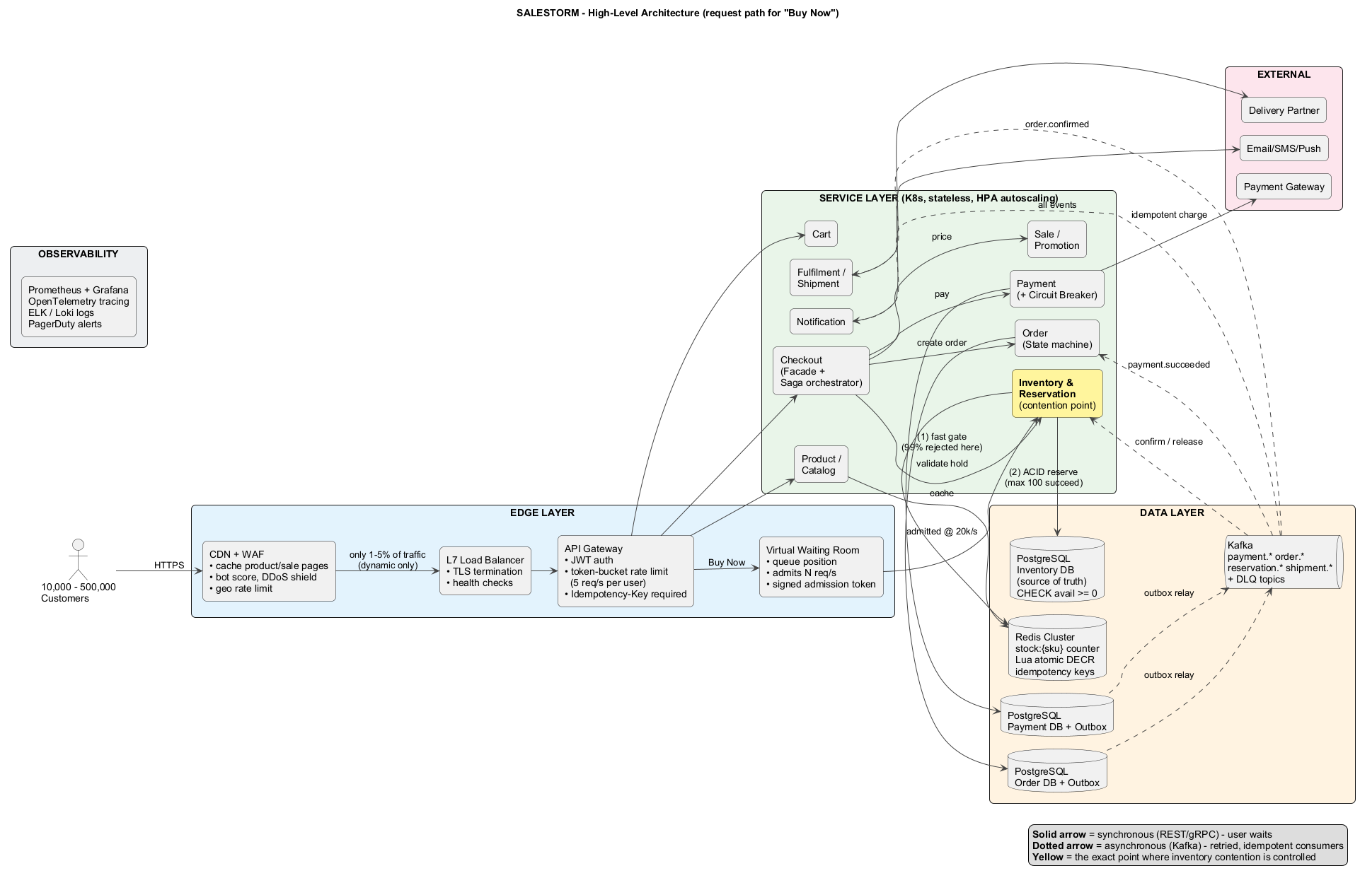
Filter at the edge, serialise in one place, recover async
1
Edge absorbs the flood
CDN/WAF serves cached pages; gateway rate-limits; waiting room admits 20k/s
2
One contention point
Inventory Service: Redis Lua gate + one PostgreSQL transaction
3
Async after payment
Outbox → Kafka → idempotent consumers; DLQ + reconcilers
Notes:
HLD (60s). Walk left to right. Solid arrows are synchronous, the user waits. Dotted arrows are Kafka events, retried and idempotent. The yellow box is the only place inventory contention is controlled. Services are stateless on Kubernetes across 3 AZs and pre-scaled 30 minutes before the sale; state lives only in Redis, PostgreSQL and Kafka.

Slide 5
How 10,000 requests become exactly 100 reservations
10,000 arrive CDN/WAF drops bots · gateway: JWT + 5 req/s per user
<1 ms per reject
~9,800 admitted Waiting room issues signed admission tokens at 20k/s
Redis Lua gate 100 OK · ~9,700 SOLD_OUT in < 1 ms · ~200 duplicates replayed
PostgreSQL txn 100 conditional UPDATEs commit (≈1 ms each on the hot row)
100 reserved 0 oversold
Failed payments (~5%) release units → waiting room re-admits the next buyers → converges to exactly 100 SOLD.
Notes:
Critical design (part 1, 25s). Each layer removes load: the DB hot row is touched only about 100 times, so it is never the bottleneck. 2% duplicates are answered from the idempotency store.

Slide 6
Consistency is guaranteed by one SQL statement
Layer 1 · Redis Lua gate (speed)
Layer 2 · PostgreSQL (the guarantee)
if SISMEMBER buyers cust → LIMIT_REACHED
if GET stock < qty → SOLD_OUT
DECRBY stock qty
SADD buyers cust
SET idem:key PENDING EX 900
return OK
BEGIN;
UPDATE inventory
SET available = available - 1,
reserved = reserved + 1
WHERE sale_id = :s AND available >= 1;
INSERT reservation (... idempotency_key UNIQUE);
INSERT outbox_event (...);
COMMIT;
Atomic, one script at a time: the 101st caller sees stock = 0
CHECK (available >= 0) and available + reserved + sold = total
?
Last unit, two requests at the same instant
Redis serialises the scripts, so only one sees stock = 1. Even if Redis were wrong, the row lock plus “WHERE available >= 1” lets exactly one UPDATE succeed; the other gets 0 rows → 409 SOLD_OUT. Every failure errs toward underselling, never overselling.
Notes:
Critical design (part 2, 25s). Answer to 'where exactly is consistency guaranteed': the conditional UPDATE inside the reservation transaction, backed by the CHECK constraint. Redis only decides who may try. If DB fails after Redis said OK we compensate Redis; a StockReconciler resyncs every 10 s.

Slide 7
Why not plain locking? Five approaches compared
Approach | Behaviour with 10,000 → 100 on one row | Verdict
Pessimistic lock (SELECT … FOR UPDATE) | Lock convoy: 10k transactions queue on one row, pool exhaustion, timeouts | Rejected alone
Optimistic lock (version column) | Almost every attempt conflicts and retries → retry storm, livelock | Rejected
Atomic conditional UPDATE | Correct in one statement, lock held microseconds; still one hot row | Chosen: truth
Redis Lua atomic counter | 100k+ ops/s on one key, sub-ms; needs sync with DB | Chosen: gate
Single-consumer queue per SKU | Perfect FIFO, but async answer and extra latency | Scale-out path
Selected: Redis Lua gate in front of an atomic conditional UPDATE (ADR-003). Fast rejection from Redis, hard guarantee from PostgreSQL.
Notes:
Backup / jury slide. Optimistic locking is wrong under extreme contention because nearly every request loses the version race. Pessimistic locking is correct but forms a lock convoy. We combine the two fastest correct primitives.

Slide 8
Every payment outcome has a defined, idempotent path
1
Succeeds (95%)
2
Fails (5%)
Payment SUCCEEDED + outbox event in one txn → Kafka → Order CONFIRMED, reservation SOLD, customer notified
Payment FAILED → reservation released (DB + Redis) → next buyer admitted → order CANCELLED
3
Times out
4
Duplicate request (2%)
Outcome unknown → TIMED_OUT; reconciler queries gateway + webhook → resolves to success or failure. Never a blind retry
Same Idempotency-Key returns the stored payment; gateway gets the same merchant reference → no second charge
Circuit breaker on the gateway (50% failures → open 30 s) · 10 s timeout · secondary provider via Factory + Adapter · reservation held until expiry while the gateway recovers
Notes:
Payment (25s). Four rows of the brief's table, four defined responses. Key line: after a timeout we never assume failure and never charge again; we query status with the same merchant reference.

Slide 9
Paid, then Order Service down 30 s: no order lost
1
2
3
4
5
Atomic write
Durable event
Service down
Recovery
Safety net
Payment row + outbox event commit in one local transaction
Relay publishes to Kafka (RF=3, acks=all)
Offset not committed; event waits safely in Kafka
Redelivered; deduped by event_id; order → CONFIRMED
5 retries → DLQ + alert; reconciler re-drives or refunds
Lifecycles
Reservation
AVAILABLE
RESERVED
PAYMENT_PENDING
CONFIRMED
SOLD
Failure paths: PAYMENT_FAILED → RELEASED · TIMEOUT (10 min) → RELEASED → back to AVAILABLE
Order
CREATED
PAYMENT_PENDING
CONFIRMED
PROCESSING
SHIPPED
OUT_FOR_DELIVERY
DELIVERED
CANCELLED from PAYMENT_PENDING / CONFIRMED / PROCESSING, with refund + release as compensation
Notes:
Order (20s). The transactional outbox removes the dual-write problem, Kafka holds the event while the Order Service is down, and idempotent consumers make redelivery safe. If an order truly cannot be confirmed, we compensate with a refund.

Slide 10
SOLID and design patterns in the critical modules
S
ReservationService, ExpiryJob, PaymentReconciler: one reason to change each
Strategy
Factory + Adapter
Pricing: FlashSale, Coupon, Regular
PaymentGatewayFactory → Razorpay / Stripe
O
New pricing rule or payment provider = new class, core untouched
State
Observer
L
Any PaymentGateway (incl. CircuitBreaker decorator) is substitutable
OrderState classes allow only legal transitions
Order events → Notification, Fulfilment
I
Small interfaces: StockGate, ReservationRepository, ProcessedEventStore
Facade
Circuit Breaker
D
Services depend on StockGate / Repository / EventPublisher abstractions
CheckoutFacade orchestrates the saga
Wraps every external gateway call
Adding PayU = one PayUAdapter class + one factory entry. PaymentService, CheckoutFacade, events and schema stay unchanged.
Notes:
LLD (45s). Point at one example: ReservationService depends only on interfaces, so the Redis gate can be swapped for an in-memory fake in tests (DIP + LSP). Full class, sequence and state diagrams are in 03_LLD.

Slide 11
Ready for 50× traffic and any single failure
DB primary fails
Sync standby promoted in ~30 s, RPO 0; Redis resynced from DB
At 50× (500k buyers)
Waiting room mandatory, randomised fair admission
Stock bucketing: 100 units over 10 Redis keys on different shards
CDN flips to a static sold-out page on inventory.sold_out
Pre-scale 30 min before start; autoscaling is too slow for a 5 s spike
DB still sees only ~100 winners, so correctness is unchanged
Redis fails
Replica promoted; stock re-seeded from DB; DB still enforces
Payment gateway down
Breaker opens, fail fast or switch provider; holds kept
Order Service down
Events wait in Kafka; idempotent replay
AZ outage
3-AZ pods, DBs, brokers; LB routes away
Notes:
Scalability & reliability (30s). Name the bottleneck: the hot inventory key. Stock bucketing spreads it. Observability: alert P1 on any inventory invariant violation, payment failure spike, Kafka lag or paid-not-confirmed orders.

Slide 12
100 units, 10,000 clicks: from arrival to confirmed orders
1
CDN/WAF and gateway drop bots and enforce 5 req/s per user
5
Checkout creates order PAYMENT_PENDING and calls Payment
2
Waiting room admits buyers at 20k/s with signed tokens
6
Idempotent charge; failures release units to the next buyers
3
Redis Lua gate: 100 OK, the rest SOLD_OUT in < 1 ms
7
payment.succeeded via Kafka: reservation SOLD, order CONFIRMED
4
One DB transaction per winner: UPDATE + reservation + outbox
8
Fulfilment and notifications; reconcilers catch any stragglers
Result: exactly 100 SOLD · 0 negative stock · 0 double charges · every paid order CONFIRMED or refunded
Notes:
Final jury question. Use this as the walk-through script. Steps 3 and 4 (amber) are where correctness is decided.

Slide 13
Trade-offs we chose on purpose
Consistency over availability for inventory · hybrid sync/async · SQL for truth, Redis for speed
Thank you. Questions?
Notes:
Close. We accept brief reservation pauses during DB failover, a few seconds of 'confirming order', and two stores to reconcile, in exchange for never overselling and never losing a paid order. Full deliverables and 12 ADRs are in the submission folder.

