Slide 1
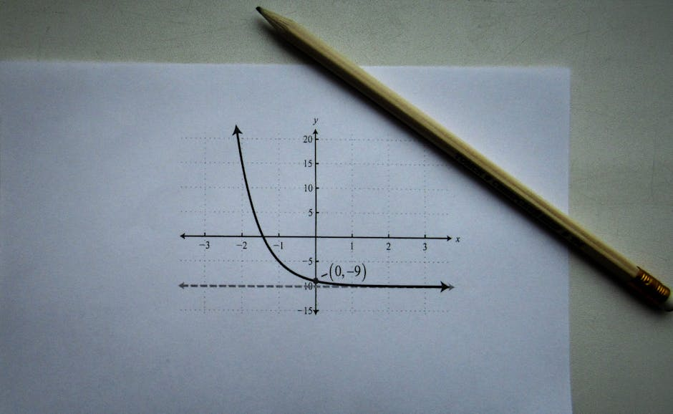
Linear Regression in Machine Learning
• Linear regression is a fundamental concept in machine learning, used for predicting continuous outcomes.
• It is a supervised learning algorithm that learns from labeled data to make predictions on new, unseen data.
• Linear regression has numerous applications in fields such as economics, finance, and engineering.
• In this presentation, we will delve into the core concepts, applications, and examples of linear regression.
• We will also explore the mathematical foundations and computational aspects of linear regression.

Slide 2

Introduction to Linear Regression
• Linear regression is a linear approach to modeling the relationship between a dependent variable and one or more independent variables.
• The goal of linear regression is to create a linear equation that best predicts the value of the dependent variable based on the values of the independent variables.
• Linear regression assumes a linear relationship between the variables, which can be represented by a straight line.
• The linear equation is typically represented in the form of y = β0 + β1x + ε, where y is the dependent variable, x is the independent variable, β0 is the intercept, β1 is the slope, and ε is the...
• The coefficients β0 and β1 are estimated using ordinary least squares (OLS) method, which minimizes the sum of the squared errors.

Slide 3

Core Concepts in Linear Regression
• The coefficient of determination (R-squared) measures the proportion of the variance in the dependent variable that is predictable from the independent variable.
• The F-statistic is used to determine the significance of the regression model, and the p-value is used to determine the significance of the coefficients.
• The residuals are the differences between the observed and predicted values, and they are used to evaluate the model's performance.
• The variance inflation factor (VIF) is used to detect multicollinearity, which occurs when two or more independent variables are highly correlated.
• Regularization techniques, such as L1 and L2 regularization, are used to prevent overfitting by adding a penalty term to the loss function.

Slide 4

Real-World Applications of Linear Regression
• Linear regression is used in finance to predict stock prices, credit scores, and portfolio risk.
• In economics, linear regression is used to model the relationship between economic variables, such as GDP, inflation, and unemployment.
• In engineering, linear regression is used to model the relationship between physical variables, such as temperature, pressure, and flow rate.
• In healthcare, linear regression is used to predict patient outcomes, such as disease progression and treatment response.
• In marketing, linear regression is used to predict customer behavior, such as purchase likelihood and customer lifetime value.

Slide 5
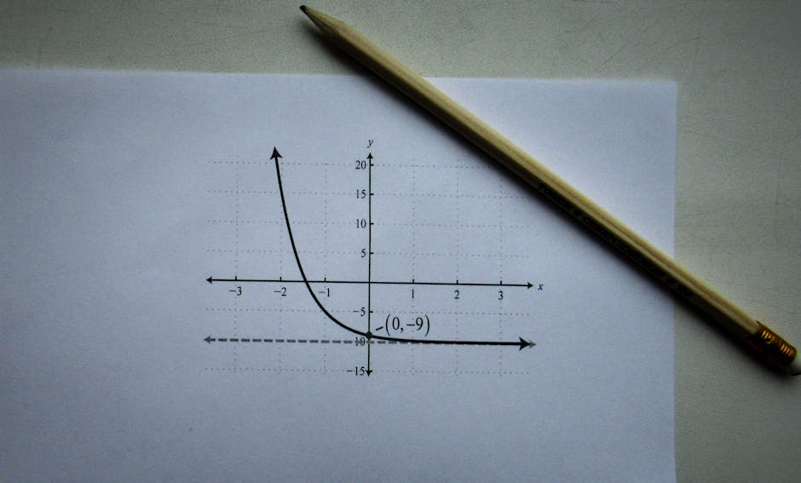
Assumptions and Limitations of Linear Regression
• Linear regression assumes a linear relationship between the variables, which may not always be the case.
• Linear regression assumes that the residuals are normally distributed, which may not always be the case.
• Linear regression assumes that the residuals have constant variance, which may not always be the case.
• Linear regression is sensitive to outliers, which can affect the model's performance.
• Linear regression can be prone to overfitting, especially when dealing with high-dimensional data.

Slide 6

Linear Regression Quiz
• What is the primary goal of linear regression?
• What is the difference between simple and multiple linear regression?
• What is the role of the coefficient of determination (R-squared) in linear regression?
• What is the purpose of regularization techniques in linear regression?
• What is the effect of multicollinearity on the model's performance?

Slide 7

Common Challenges in Linear Regression
• Dealing with missing values, which can affect the model's performance and accuracy.
• Handling high-dimensional data, which can lead to overfitting and poor model performance.
• Addressing non-linear relationships, which can require the use of non-linear models or transformations.
• Dealing with outliers, which can affect the model's performance and accuracy.
• Interpreting the results, which requires a deep understanding of the model and its limitations.

Slide 8

Summary of Linear Regression
• Linear regression is a widely used algorithm in machine learning for predicting continuous outcomes.
• It assumes a linear relationship between the variables and uses ordinary least squares (OLS) method to estimate the coefficients.
• Linear regression has numerous applications in various fields, including finance, economics, engineering, and healthcare.
• It is essential to understand the assumptions and limitations of linear regression to apply it effectively.
• Regularization techniques and model evaluation metrics are crucial for preventing overfitting and evaluating the model's performance.

