Slide 1
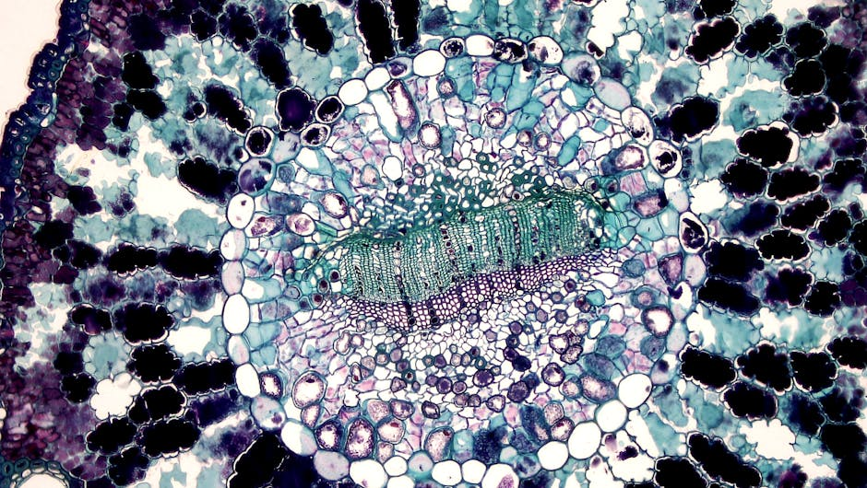
Introduction to Photosynthesis
Photosynthesis is the process by which plants, algae, and some bacteria convert light energy from the sun into chemical energy in the form of glucose.
This process is essential for life on Earth as it provides the primary source of energy for nearly all organisms.
Photosynthesis occurs in specialized organelles called chloroplasts, which are present in plant cells.
The overall equation for photosynthesis is 6 CO2 + 6 H2O + light energy → C6H12O6 (glucose) + 6 O2.
Understanding photosynthesis is crucial for understanding the natural world and our impact on the environment.

Slide 2

Overview of Photosynthesis
Photosynthesis involves the conversion of carbon dioxide and water into glucose and oxygen using sunlight as an energy source.
The process requires chlorophyll, a green pigment found in chloroplasts, to absorb light energy.
Light-dependent reactions and light-independent reactions (Calvin cycle) are the two stages of photosynthesis.
The light-dependent reactions generate ATP and NADPH, which are then used in the Calvin cycle to produce glucose.
Factors such as light intensity, temperature, and water availability can affect the rate of photosynthesis.

Slide 3

Core Concept: Light-Dependent Reactions
The light-dependent reactions occur in the thylakoid membranes of the chloroplast and involve the absorption of light energy by chlorophyll and other pigments.
This energy is used to generate ATP and NADPH through the transfer of electrons.
The process involves the formation of a proton gradient across the thylakoid membrane, which drives the production of ATP.
The light-dependent reactions are essential for providing the energy and reducing power required for the Calvin cycle.
The overall equation for the light-dependent reactions is light energy → ATP + NADPH + H+.

Slide 4

Core Concept: Calvin Cycle
The Calvin cycle, also known as the light-independent reactions, takes place in the stroma of the chloroplast and uses the ATP and NADPH produced in the light-dependent reactions.
The cycle involves the fixation of CO2 into a three-carbon molecule called 3-phosphoglycerate (3-PGA) via the enzyme RuBisCO.
The 3-PGA is then reduced to form glyceraldehyde-3-phosphate (G3P) using the ATP and NADPH produced in the light-dependent reactions.
The G3P molecules are then used to synthesize glucose and other carbohydrates.
The Calvin cycle is essential for producing the organic compounds required by plants to grow and develop.

Slide 5
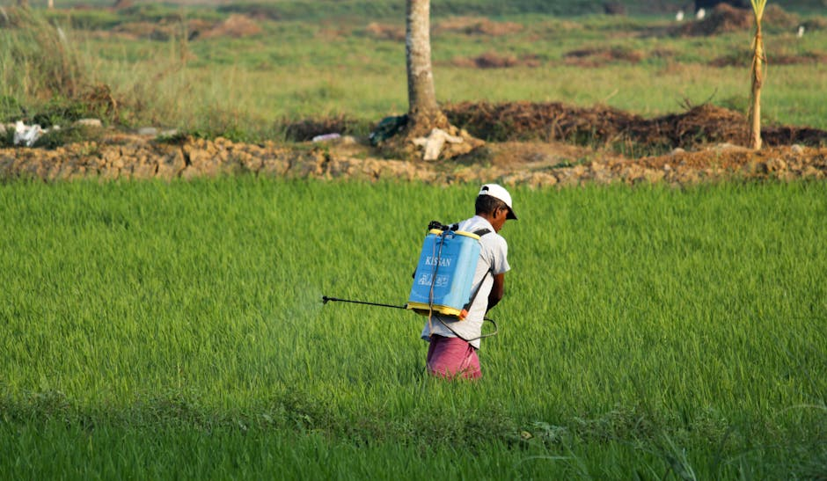
Real-World Examples and Applications
Photosynthesis has numerous real-world applications, including agriculture, where it is used to produce crops and support food security.
Understanding photosynthesis is essential for developing strategies to address climate change, as it plays a critical role in the carbon cycle.
Photosynthesis is also used in biofuels, such as ethanol, which is produced from plant biomass.
In addition, photosynthesis inspires the development of artificial photosynthetic systems, which could potentially be used to produce clean energy.
Studying photosynthesis can also inform strategies for improving crop yields and developing more efficient agricultural practices.

Slide 6

Quiz: Photosynthesis
What is the overall equation for photosynthesis?
What is the role of chlorophyll in photosynthesis?
What are the two stages of photosynthesis?
What is the product of the light-dependent reactions?
What is the importance of photosynthesis in agriculture?

Slide 7

Summary: Photosynthesis
Photosynthesis is the process by which plants, algae, and some bacteria convert light energy into chemical energy.
The process involves the light-dependent reactions and the Calvin cycle, which work together to produce glucose and oxygen.
Photosynthesis is essential for life on Earth, as it provides the primary source of energy for nearly all organisms.
Understanding photosynthesis is crucial for addressing climate change, improving agricultural practices, and developing new technologies.
In conclusion, photosynthesis is a vital process that supports life on Earth and has numerous real-world applications.

