Slide 1

Linear Regression in Machine Learning
An Advanced Technical Deep-Dive

Slide 2

Introduction to Linear Regression
• Linear regression is based on the idea that a linear relationship exists between the input features and the target variable, which can be represented by a linear equation.
• The linear equation is typically represented as y = β0 + β1x + ε, where y is the target variable, x is the input feature, β0 is the intercept, β1 is the slope, and ε is the error term.
• The goal of linear regression is to find the optimal values of β0 and β1 that minimize the sum of the squared errors between observed and predicted values.
• Linear regression can be simple, involving only one input feature, or multiple, involving more than one input feature.
• The choice of linear regression model depends on the complexity of the problem and the number of input features.

Slide 3
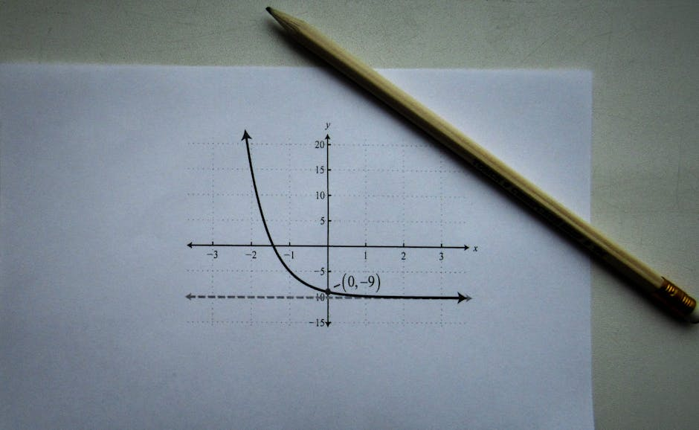
Core Concepts of Linear Regression
• The coefficient of determination, denoted as R-squared, measures the proportion of variance in the target variable that is explained by the input features.
• The R-squared value ranges from 0 to 1, where 1 indicates a perfect fit and 0 indicates no correlation between the input features and the target variable.
• The mean squared error (MSE) is another important metric used to evaluate the performance of a linear regression model, which calculates the average squared difference between observed and predicted values.
• The choice of evaluation metric depends on the specific problem and the characteristics of the data.
• Regularization techniques, such as L1 and L2 regularization, are used to prevent overfitting in linear regression models by adding a penalty term to the loss function.

Slide 4
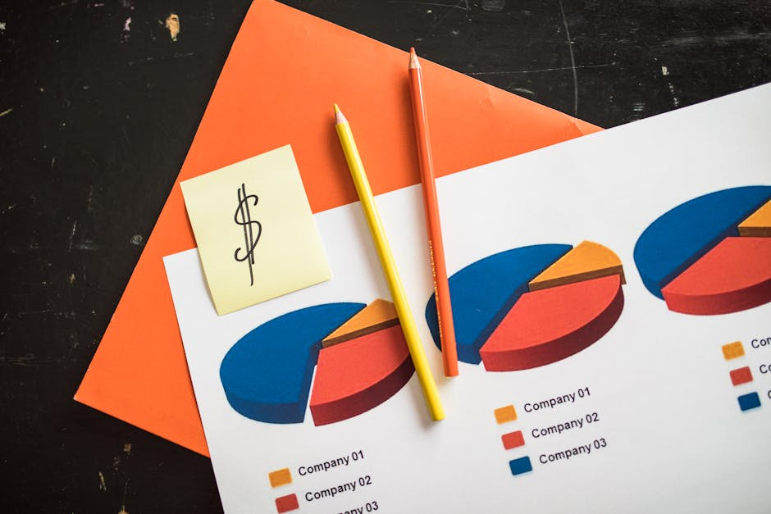
Real-World Applications of Linear Regression
• Linear regression is widely used in economics to model the relationship between economic variables, such as the impact of interest rates on inflation.
• In finance, linear regression is used to predict stock prices and portfolio returns based on historical data and market trends.
• In social sciences, linear regression is used to analyze the relationship between demographic variables, such as age and income, and social outcomes, such as education and health.
• Linear regression is also used in engineering to model the relationship between design variables and performance metrics, such as the impact of material properties on structural integrity.
• The applications of linear regression are diverse and continue to grow as the field of machine learning evolves.

Slide 5
Assumptions and Limitations of Linear Regression
• Linear regression assumes that the relationship between the input features and the target variable is linear, which may not always be the case in real-world scenarios.
• The model also assumes that the error term is normally distributed and has constant variance, which may not be true if the data is skewed or has outliers.
• Linear regression is sensitive to multicollinearity, which occurs when two or more input features are highly correlated, leading to unstable estimates of the model parameters.
• The model is also sensitive to outliers, which can significantly affect the estimates of the model parameters and the overall fit of the model.
• Regularization techniques and robust regression methods can be used to address these limitations and improve the reliability of the model.

Slide 6
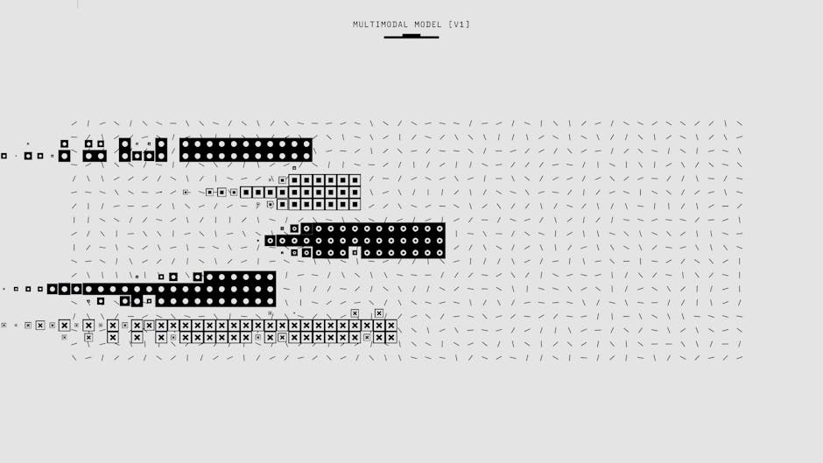
Linear Regression Quiz
• What is the primary goal of linear regression?
• What is the difference between simple and multiple linear regression?
• What is the role of regularization in linear regression?
• How do you evaluate the performance of a linear regression model?
• What are some common applications of linear regression?

Slide 7

Advanced Topics in Linear Regression
• Ridge regression is a type of linear regression that uses L2 regularization to reduce the impact of multicollinearity on the model parameters.
• Lasso regression is a type of linear regression that uses L1 regularization to select a subset of the most important input features.
• Elastic net regression is a type of linear regression that combines L1 and L2 regularization to achieve a balance between model simplicity and accuracy.
• Generalized linear models (GLMs) are an extension of linear regression that can handle non-normal response variables, such as binary or count data.
• GLMs are widely used in many fields, including medicine, social sciences, and engineering.

Slide 8
Summary of Linear Regression
• Linear regression is a fundamental concept in machine learning that is used for predicting continuous outcomes based on one or more input features.
• The model assumes a linear relationship between the input features and the target variable, which may not always be the case in real-world scenarios.
• Linear regression has many applications in various fields, including economics, finance, social sciences, and engineering.
• The model can be evaluated using metrics such as R-squared, mean squared error, and cross-validation.
• Regularization techniques and robust regression methods can be used to address the limitations of linear regression and improve the reliability of the model.

