Slide 1

Photosynthesis: The Green Miracle
• Photosynthesis is the process by which plants, algae, and some bacteria convert light energy from the sun into chemical energy in the form of organic compounds, such as glucose.
• This process is essential for life on Earth as it provides the primary source of energy for nearly all organisms.
• Photosynthesis occurs in specialized organelles called chloroplasts, which are present in plant cells.
• The overall equation for photosynthesis is 6 CO2 + 6 H2O + light energy → C6H12O6 (glucose) + 6 O2.
• Understanding photosynthesis is crucial for appreciating the interconnectedness of our ecosystem and the importance of preserving plant life.

Slide 2
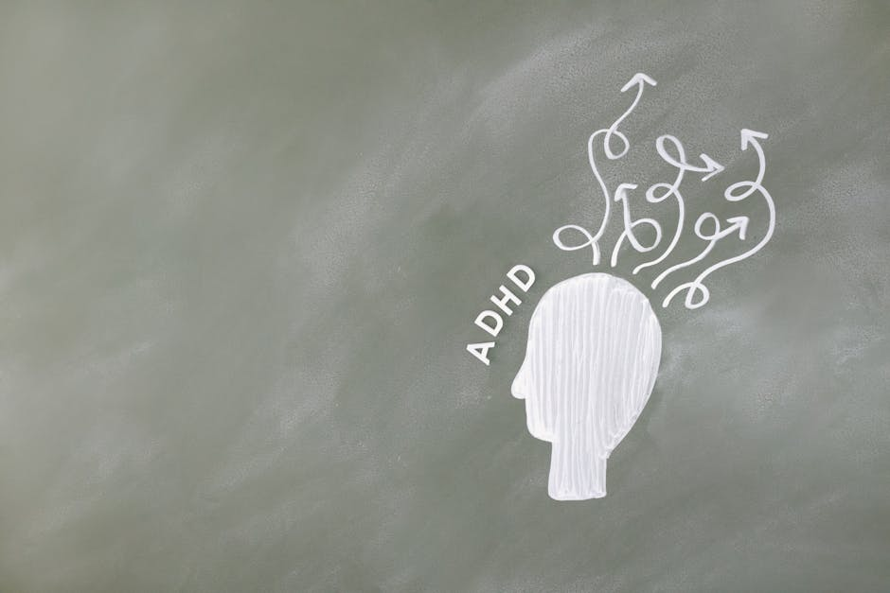
Introduction to Photosynthesis
• The process of photosynthesis can be divided into two main stages: the light-dependent reactions and the light-independent reactions (Calvin cycle).
• The light-dependent reactions occur in the thylakoid membranes of the chloroplast and involve the conversion of light energy into ATP and NADPH.
• The Calvin cycle takes place in the stroma of the chloroplast and uses the ATP and NADPH produced in the light-dependent reactions to convert CO2 into glucose.
• Water is absorbed by the roots and transported to the leaves, where it is used in the photosynthetic process.
• Oxygen is released as a byproduct of photosynthesis and is essential for the survival of most living organisms.

Slide 3

Core Concepts of Photosynthesis
• Chlorophyll, a green pigment found in chloroplasts, plays a critical role in absorbing light energy for photosynthesis.
• Other pigments, such as carotenoids and phycobiliproteins, also contribute to the absorption of light energy and the protection of the plant from excessive light.
• The structure of the chloroplast, including the thylakoid membranes and stroma, is optimized for the efficient capture of light energy and the conversion of CO2 into glucose.
• Factors such as light intensity, temperature, water availability, and CO2 concentration can affect the rate of photosynthesis.
• Understanding these core concepts is essential for appreciating the complexity and importance of photosynthesis in our ecosystem.

Slide 4

Real-World Examples and Applications
• Agriculture relies heavily on photosynthesis, as crops such as corn, wheat, and soybeans are the primary producers in many ecosystems.
• Forests, which cover about 30% of the Earth's land surface, are vast repositories of biodiversity and play a critical role in the global carbon cycle through photosynthesis.
• Algae and cyanobacteria, which are capable of photosynthesis, are being explored for their potential in biofuel production and wastewater treatment.
• Understanding photosynthesis is also essential for addressing environmental issues such as climate change, deforestation, and pollution.
• By appreciating the importance of photosynthesis, we can work towards developing sustainable practices that preserve and protect our planet's natural resources.

Slide 5

Photosynthesis in Everyday Life
• The oxygen we breathe is a direct result of photosynthesis, highlighting the intimate connection between human life and the natural world.
• Many of the foods we eat, including fruits, vegetables, and grains, are produced through photosynthesis.
• Photosynthesis also influences the Earth's climate, as it removes CO2 from the atmosphere and releases oxygen, which helps regulate the planet's temperature.
• In addition, photosynthesis supports the aquatic food chain, as phytoplankton and other aquatic plants produce energy through photosynthesis, which is then consumed by zooplankton and other animals.
• By recognizing the significance of photosynthesis in our daily lives, we can foster a deeper appreciation for the natural world and our place within it.

Slide 6

Photosynthesis Quiz
• What is the primary function of chlorophyll in photosynthesis?
• Which stage of photosynthesis produces ATP and NADPH?
• What is the byproduct of photosynthesis that is essential for human life?
• Which of the following is an example of an organism that undergoes photosynthesis?
• What is the overall equation for photosynthesis?

Slide 7
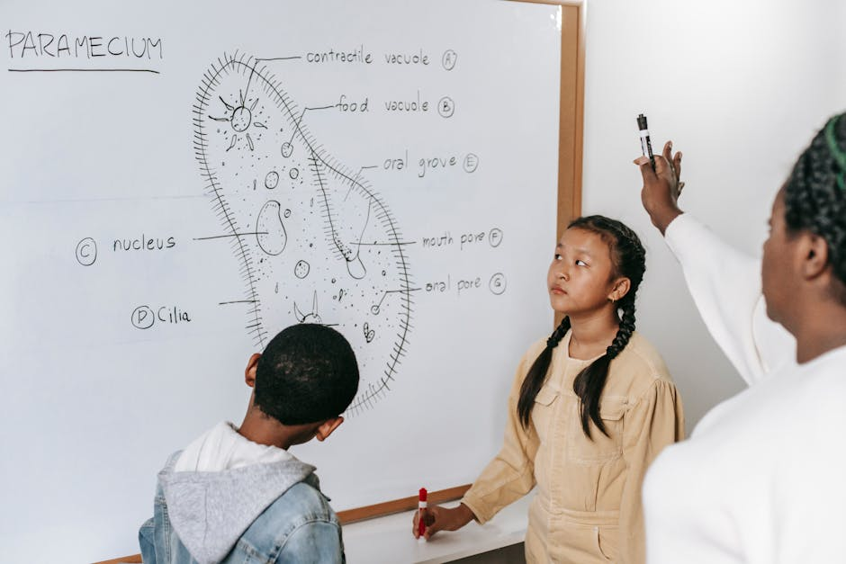
Summary of Photosynthesis
• Photosynthesis is the process by which plants, algae, and some bacteria convert light energy into chemical energy.
• The process involves the conversion of CO2 and H2O into glucose and O2, using energy from sunlight.
• Chlorophyll and other pigments play a crucial role in absorbing light energy for photosynthesis.
• Factors such as light intensity, temperature, and water availability can affect the rate of photosynthesis.
• Understanding photosynthesis is essential for appreciating the importance of preserving plant life and addressing environmental issues.

