Slide 1

Linear Regression in Machine Learning
A Technical Deep-Dive for College Students

Slide 2

Overview of Linear Regression
• Linear Regression is based on the idea of finding a linear relationship between a dependent variable (target variable) and one or more independent variables (features).
• The linear relationship is modeled using a linear equation, where the coefficients of the independent variables represent the change in the dependent variable for a one-unit change in the independent variable.
• The goal of Linear Regression is to find the best-fitting linear line that minimizes the sum of the squared errors between the observed and predicted values.
• Linear Regression can be simple (one independent variable) or multiple (more than one independent variable), depending on the number of features used in the model.
• The model is typically evaluated using metrics such as mean squared error, mean absolute error, and R-squared.

Slide 3
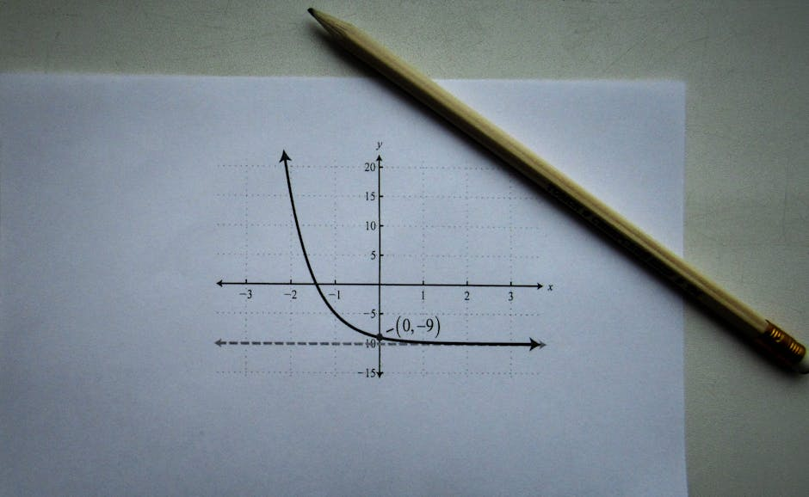
Core Concepts and Mathematical Formulations
• The linear regression equation is typically represented as Y = β0 + β1X + ε, where Y is the dependent variable, X is the independent variable, β0 is the intercept, β1 is the slope, and ε is the error term.
• The ordinary least squares (OLS) method is commonly used to estimate the coefficients (β0 and β1) of the linear regression model.
• The OLS method minimizes the sum of the squared errors between the observed and predicted values, providing the best-fitting linear line.
• The coefficients of the linear regression model can be interpreted as the change in the dependent variable for a one-unit change in the independent variable, while holding all other variables constant.
• The model's assumptions, such as linearity, independence, homoscedasticity, normality, and no multicollinearity, must be met to ensure the validity of the results.

Slide 4

Real-World Applications of Linear Regression
• Linear Regression is widely used in finance to predict stock prices, credit scores, and portfolio returns based on historical data and economic indicators.
• In economics, Linear Regression is used to model the relationship between economic variables, such as GDP, inflation, and unemployment rates.
• In social sciences, Linear Regression is used to study the relationship between variables, such as the impact of education on income or the effect of advertising on sales.
• Linear Regression is also used in engineering to predict continuous outcomes, such as energy consumption or material strength, based on various input factors.
• The model's interpretability and simplicity make it a popular choice for many real-world applications.

Slide 5
Quiz: Linear Regression Concepts
• What is the primary goal of Linear Regression?
• What is the difference between simple and multiple Linear Regression?
• What is the ordinary least squares (OLS) method used for in Linear Regression?
• What are some common applications of Linear Regression in real-world scenarios?
• What are some assumptions that must be met for Linear Regression to be valid?

Slide 6
Common Challenges and Limitations
• Linear Regression assumes a linear relationship between the dependent and independent variables, which may not always be the case in real-world scenarios.
• The model is sensitive to outliers and non-normality of the error term, which can affect the accuracy of the results.
• Multicollinearity between independent variables can lead to unstable estimates of the coefficients and affect the model's interpretability.
• Linear Regression can be prone to overfitting, especially when dealing with a large number of independent variables.
• The model's simplicity can also be a limitation, as it may not capture complex relationships between variables.

Slide 7
Summary: Linear Regression in Machine Learning
• Linear Regression is a fundamental concept in Machine Learning, used for predicting continuous outcomes based on one or more input features.
• The model is based on the idea of finding a linear relationship between the dependent and independent variables.
• Linear Regression has numerous applications in various fields, including finance, economics, and social sciences.
• The model's assumptions, such as linearity, independence, and homoscedasticity, must be met to ensure the validity of the results.
• Despite its limitations, Linear Regression remains a widely used and interpretable algorithm in Machine Learning.

