Slide 1
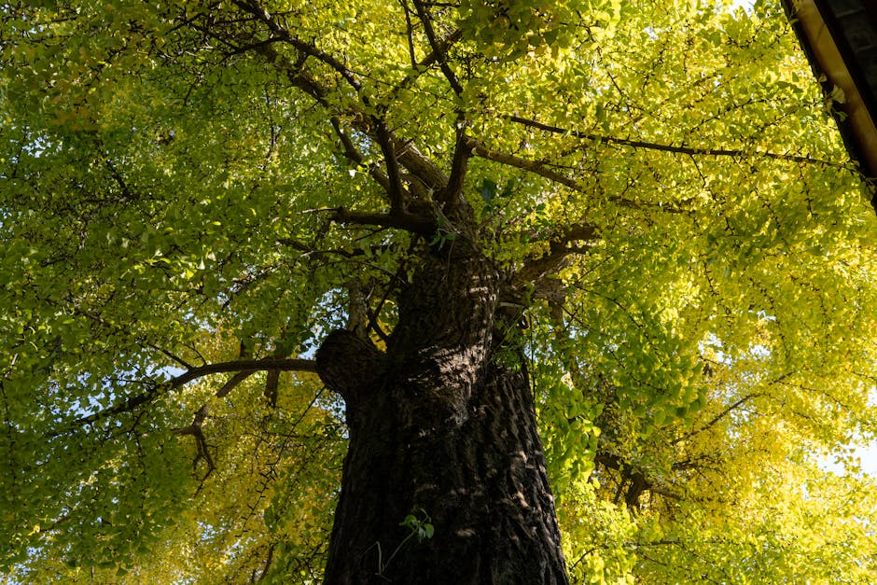
Photosynthesis in Plants

Slide 2
What is Photosynthesis?
Photosynthesis is how plants make food
It involves sunlight, water, and air
Plants use energy from sunlight to grow
This process happens in leaves
It's essential for plants to survive

Slide 3
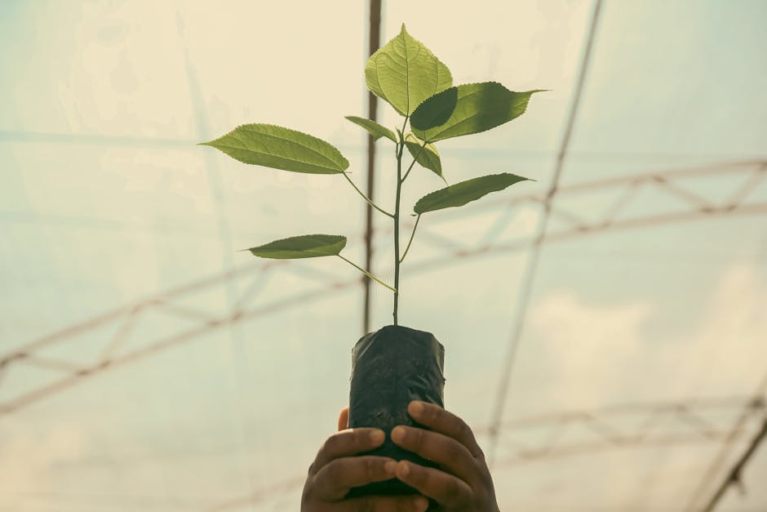
How Does Photosynthesis Work?
Plants absorb water through their roots
They take in carbon dioxide from the air
Sunlight gives them the energy they need
They release oxygen as a byproduct
This oxygen is what humans and animals need to breathe

Slide 4
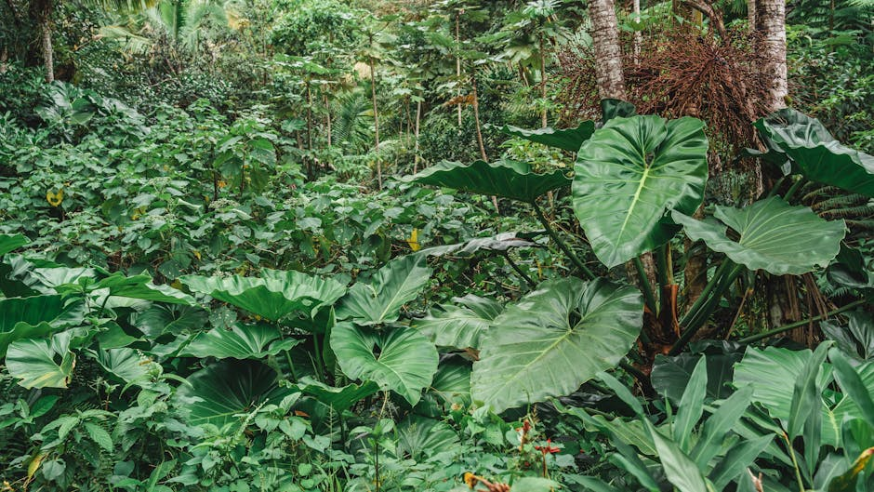
Photosynthesis in Action
Forests help purify the air we breathe
Crops grown through photosynthesis feed us
Aquatic plants support life in oceans and rivers
Photosynthesis occurs in all green plants
Even small plants like algae contribute

Slide 5
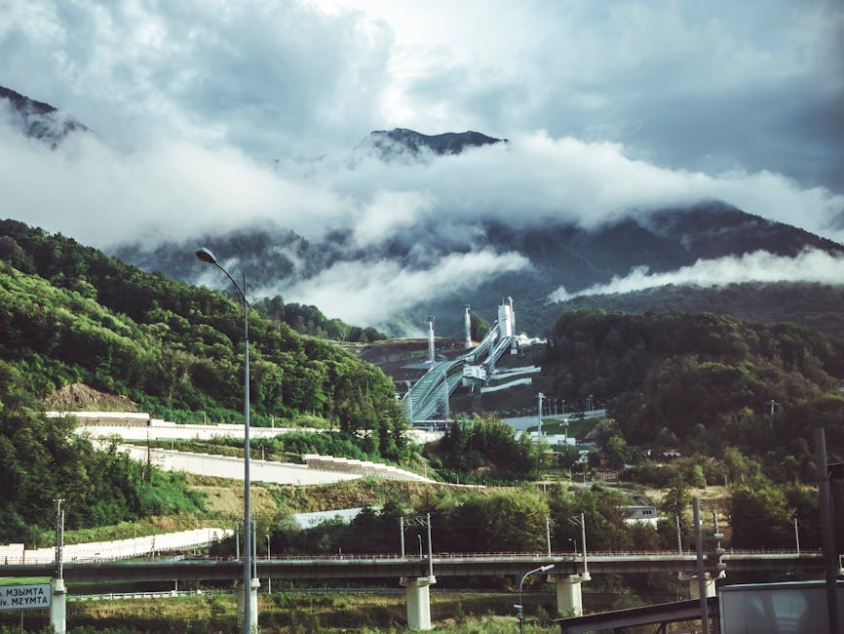
Why is Photosynthesis Important?
Provides oxygen for humans and animals
Supports the food chain
Helps regulate Earth's climate
Essential for plant growth and development
Impacts the quality of our air and water

Slide 6

Key Takeaways
Photosynthesis is how plants make food using sunlight
It produces oxygen essential for life
Occurs in all green plants
Supports the food chain and climate regulation
Is crucial for life on Earth

