Slide 1
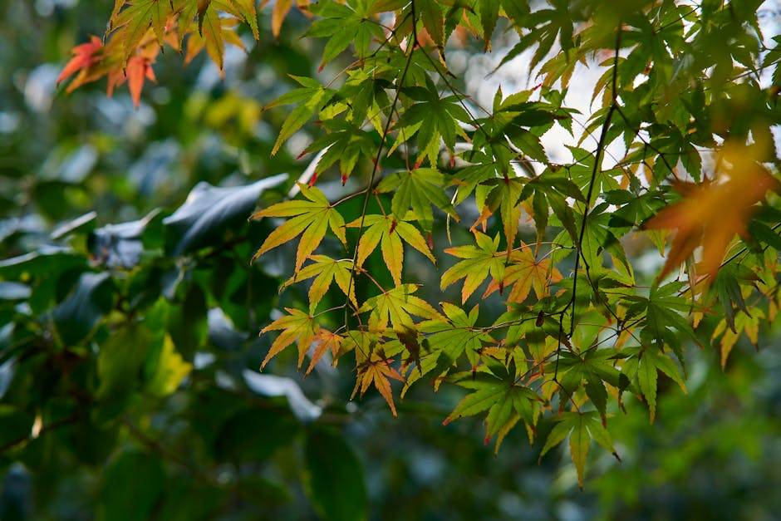
photosynthesis in plants

Slide 2
photosynthesis in plants – Part 1
Key concept 1
Key concept 2
Key concept 3

Slide 3
photosynthesis in plants – Part 2
Key concept 4
Key concept 5
Key concept 6

Slide 4
photosynthesis in plants – Part 3
Key concept 7
Key concept 8
Key concept 9

Slide 5
photosynthesis in plants – Part 4
Key concept 10
Key concept 11
Key concept 12

Slide 6
Key Takeaways
Main idea of photosynthesis in plants
Most important concepts
How this connects to real life

