Slide 1
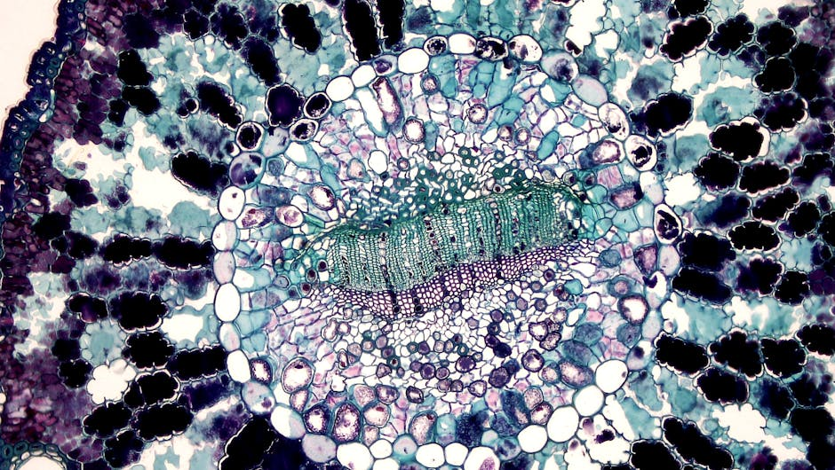
Photosynthesis: The Green Revolution
Photosynthesis is the process by which plants, algae, and some bacteria convert light energy from the sun into chemical energy in the form of organic compounds, such as glucose.
This process is essential for life on Earth as it provides the primary source of energy for nearly all organisms.
Photosynthesis occurs in specialized organelles called chloroplasts, which contain the pigment chlorophyll.
Chlorophyll is responsible for absorbing light energy, which is then used to power the conversion of carbon dioxide and water into glucose and oxygen.
Understanding photosynthesis is crucial for understanding the natural world and our impact on the environment.
In this presentation, we will explore the process of photosynthesis, its importance, and real-world examples of its applications.

Slide 2

Introduction to Photosynthesis
Photosynthesis is a complex process that involves the conversion of light energy into chemical energy through a series of reactions.
The overall equation for photosynthesis is: 6 CO2 + 6 H2O + light energy → C6H12O6 (glucose) + 6 O2.
Photosynthesis occurs in two stages: the light-dependent reactions and the light-independent reactions (Calvin cycle).
The light-dependent reactions involve the absorption of light energy by chlorophyll and the transfer of electrons to generate ATP and NADPH.
The Calvin cycle uses the ATP and NADPH produced in the light-dependent reactions to convert CO2 into glucose.
Photosynthesis is an essential process that supports life on Earth, from the tiniest microbe to the mightiest tree.

Slide 3

Light-Dependent Reactions
The light-dependent reactions occur in the thylakoid membranes of the chloroplast and involve the absorption of light energy by pigments such as chlorophyll.
The energy from light is used to generate a high-energy molecule called ATP and a reducing agent called NADPH.
The light-dependent reactions involve the transfer of electrons from water to a special molecule called an electron acceptor, resulting in the formation of ATP and NADPH.
The light-dependent reactions are essential for the production of ATP and NADPH, which are used in the Calvin cycle to produce glucose.
The light-dependent reactions are also responsible for the production of oxygen as a byproduct, which is released into the atmosphere.
Understanding the light-dependent reactions is crucial for understanding the overall process of photosynthesis.

Slide 4

Calvin Cycle
The Calvin cycle is a series of reactions that occur in the stroma of the chloroplast and use the ATP and NADPH produced in the light-dependent reactions to convert CO2 into glucose.
The Calvin cycle involves the fixation of CO2 into a three-carbon molecule called 3-phosphoglycerate (3-PGA) via the enzyme RuBisCO.
The 3-PGA is then reduced to form glyceraldehyde 3-phosphate (G3P) using the ATP and NADPH produced in the light-dependent reactions.
The G3P molecules are then used to synthesize glucose through a series of reactions.
The Calvin cycle is an essential stage of photosynthesis, where CO2 is converted into glucose, which is used by the plant to grow and develop.
The Calvin cycle is also responsible for the production of other organic compounds, such as amino acids and lipids.

Slide 5
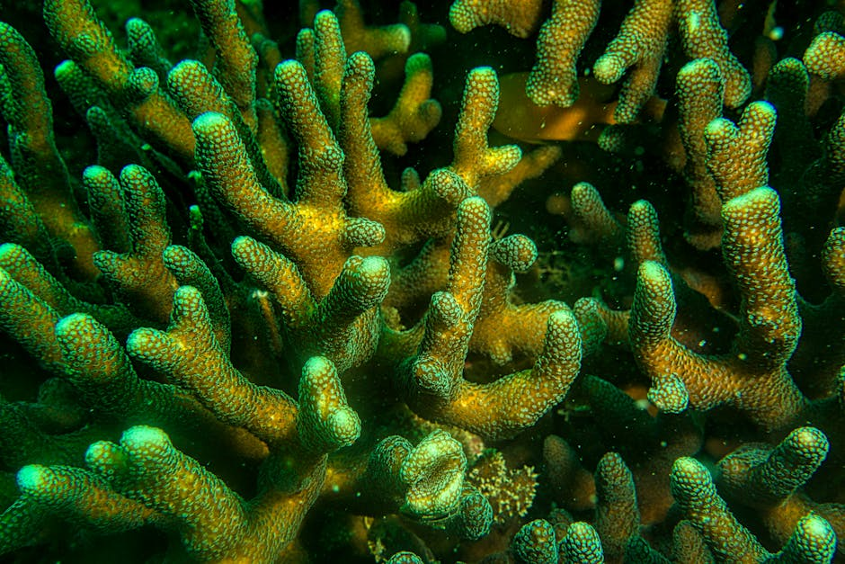
Real-World Examples of Photosynthesis
Photosynthesis is not just limited to plants; it also occurs in algae and some bacteria, which are the primary producers of aquatic ecosystems.
Phytoplankton, such as algae and cyanobacteria, are responsible for producing up to 70% of the Earth's oxygen through photosynthesis.
Corals and other marine organisms have symbiotic relationships with photosynthetic algae, which provide them with nutrients and oxygen.
Photosynthesis is also used in agriculture to produce crops, such as corn and wheat, which are used to feed humans and animals.
Understanding photosynthesis is essential for developing sustainable agriculture practices and reducing our impact on the environment.
Photosynthesis is also being used in biotechnology to produce biofuels, such as ethanol, and other valuable compounds.

Slide 6

Applications of Photosynthesis
Photosynthesis is being used in biotechnology to produce biofuels, such as ethanol, and other valuable compounds.
Understanding photosynthesis is essential for developing sustainable agriculture practices and reducing our impact on the environment.
Photosynthesis is also being used to develop new technologies, such as artificial photosynthesis, which could potentially produce clean energy.
Photosynthesis is an important area of research, with many potential applications in fields such as medicine, agriculture, and energy production.
By understanding photosynthesis, we can develop new strategies for improving crop yields, reducing pesticide use, and promoting sustainable agriculture practices.
Photosynthesis is a fascinating process that has many potential applications in the real world.

Slide 7

Summary of Photosynthesis
Photosynthesis is the process by which plants, algae, and some bacteria convert light energy into chemical energy.
The overall equation for photosynthesis is: 6 CO2 + 6 H2O + light energy → C6H12O6 (glucose) + 6 O2.
Photosynthesis occurs in two stages: the light-dependent reactions and the light-independent reactions (Calvin cycle).
The light-dependent reactions involve the absorption of light energy and the transfer of electrons to generate ATP and NADPH.
The Calvin cycle uses the ATP and NADPH produced in the light-dependent reactions to convert CO2 into glucose.
Photosynthesis is an essential process that supports life on Earth and has many real-world applications.

Slide 8

Quiz: Photosynthesis
What is the overall equation for photosynthesis?
What are the two stages of photosynthesis?
What is the role of chlorophyll in photosynthesis?
What is the byproduct of photosynthesis that is released into the atmosphere?
What is the importance of photosynthesis in supporting life on Earth?
What are some real-world applications of photosynthesis?

