Slide 1

Basics of Cybersecurity for College Students
• In this presentation, we will explore the fundamental concepts of cybersecurity and their importance for college students.
• We will discuss various types of cyber threats, security measures, and best practices to ensure a safe online experience.
• By the end of this presentation, you will have a solid understanding of how to protect yourself from cyber attacks and maintain a secure digital presence.
• You will also learn about the latest trends and technologies in cybersecurity, including encryption, firewalls, and password management.
• Further details: This knowledge will enable you to make informed decisions about your online activities and take steps to safeguard your personal data.; Additionally, we will examine the role of cybersecurity in...

Slide 2

Introduction to Cybersecurity
• Cybersecurity refers to the practice of protecting digital information, networks, and systems from unauthorized access, use, disclosure, disruption, modification, or destruction.
• It involves a set of technologies, processes, and practices designed to safeguard digital assets from various types of cyber threats, including malware, phishing, and denial-of-service attacks.
• The importance of cybersecurity cannot be overstated, as it affects not only individuals but also organizations, governments, and the economy as a whole.
• A robust cybersecurity system is essential for maintaining confidentiality, integrity, and availability of digital information.
• Further details: It also requires a deep understanding of human behavior, as many cyber attacks rely on social engineering tactics to trick users into divulging sensitive information.; Moreover, cybersecurity is an...

Slide 3
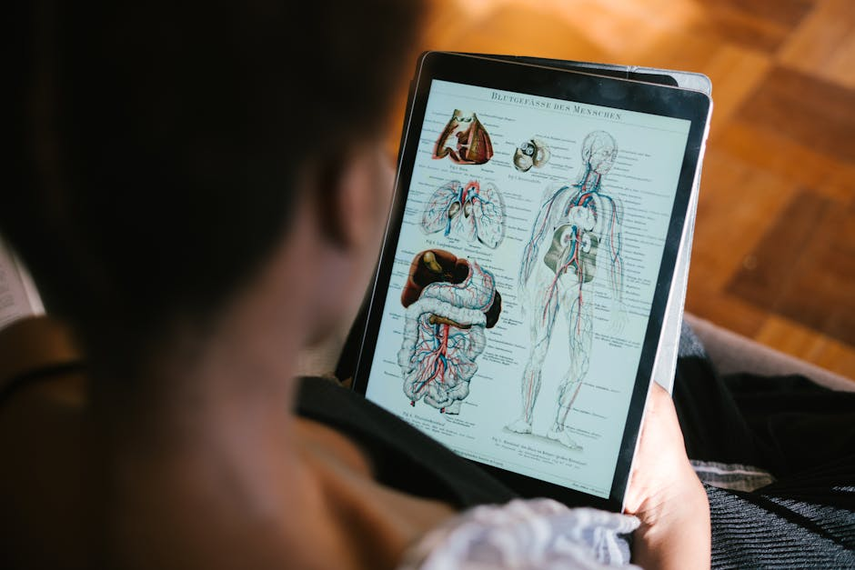
Core Concepts of Cybersecurity
• One of the core concepts of cybersecurity is the CIA triad, which stands for confidentiality, integrity, and availability.
• Confidentiality refers to the protection of sensitive information from unauthorized access, while integrity ensures that data is accurate and not modified without authorization.
• Availability refers to the ability to access data and systems when needed, and it's essential for maintaining business continuity and productivity.
• Another crucial concept is the principle of least privilege, which states that users should only have access to the resources and data necessary to perform their tasks.
• Further details: This principle helps to reduce the attack surface and prevent lateral movement in case of a security breach.; Additionally, cybersecurity relies on various security controls, including firewalls,...

Slide 4

Real-World Applications of Cybersecurity
• Cybersecurity has numerous real-world applications, including online banking and financial transactions, which require secure authentication and encryption to protect sensitive information.
• E-commerce websites also rely on cybersecurity measures to safeguard customer data and prevent fraud.
• In the healthcare industry, cybersecurity is critical for protecting patient records and medical research data, which are highly sensitive and valuable.
• Moreover, cybersecurity plays a vital role in the energy sector, where a security breach could have catastrophic consequences for the power grid and national security.
• Further details: The transportation sector also depends on cybersecurity to ensure the safe operation of autonomous vehicles and prevent hacking incidents.; Furthermore, cybersecurity is essential for maintaining the...

Slide 5

Best Practices for Cybersecurity
• To maintain good cybersecurity hygiene, it's essential to use strong and unique passwords for all accounts, and enable two-factor authentication whenever possible.
• Keeping software and operating systems up to date is also crucial, as updates often include security patches and bug fixes.
• Using antivirus software and a firewall can help protect against malware and unauthorized access.
• Being cautious when clicking on links or opening email attachments from unknown sources is also vital, as these can be phishing attempts or malware vectors.
• Further details: Regularly backing up important data can help prevent losses in case of a security breach or system failure.; Additionally, using a virtual private network (VPN) can help encrypt internet traffic and...

Slide 6

Cybersecurity Quiz
• What is the primary goal of a firewall in a network?
• Which type of malware is designed to demand payment in exchange for restoring access to data?
• What is the term for a type of attack that involves tricking users into divulging sensitive information?
• Which security control is designed to detect and prevent intrusion attempts?
• Further details: What is the purpose of encryption in cybersecurity?; Which type of password is considered the most secure?

Slide 7

Summary of Cybersecurity Basics
• In this presentation, we covered the fundamental concepts of cybersecurity, including the CIA triad, security controls, and best practices.
• We also explored real-world applications of cybersecurity and examined the importance of staying informed and adapting to the changing landscape.
• Cybersecurity is a shared responsibility that requires the active participation of individuals, organizations, and governments.
• By following best practices and staying vigilant, we can reduce the risk of cyber attacks and maintain a secure digital presence.
• Further details: Remember, cybersecurity is an ongoing process that requires continuous learning and improvement.; Stay safe online, and thank you for your attention!

