Slide 1

Human Digestive System
• The human digestive system is a complex process that involves the breakdown and absorption of nutrients from the food we eat.
• It is essential for our body to function properly and maintain overall health.
• In this presentation, we will explore the different parts of the digestive system and their functions.
• We will also learn about the importance of a healthy diet and how it affects our digestive system.
• By the end of this presentation, you will have a better understanding of how your body processes food and how to maintain a healthy digestive system.

Slide 2
Introduction to the Digestive System
• The digestive system is a long, winding tube that starts at the mouth and ends at the anus.
• It is responsible for breaking down the food we eat into smaller molecules that can be absorbed and used by the body.
• The digestive system is made up of several organs, including the mouth, esophagus, stomach, small intestine, and large intestine.
• Each of these organs plays a unique role in the digestion and absorption of nutrients.
• The digestive system also includes accessory organs, such as the pancreas and liver, which produce digestive enzymes and bile to help break down food.

Slide 3
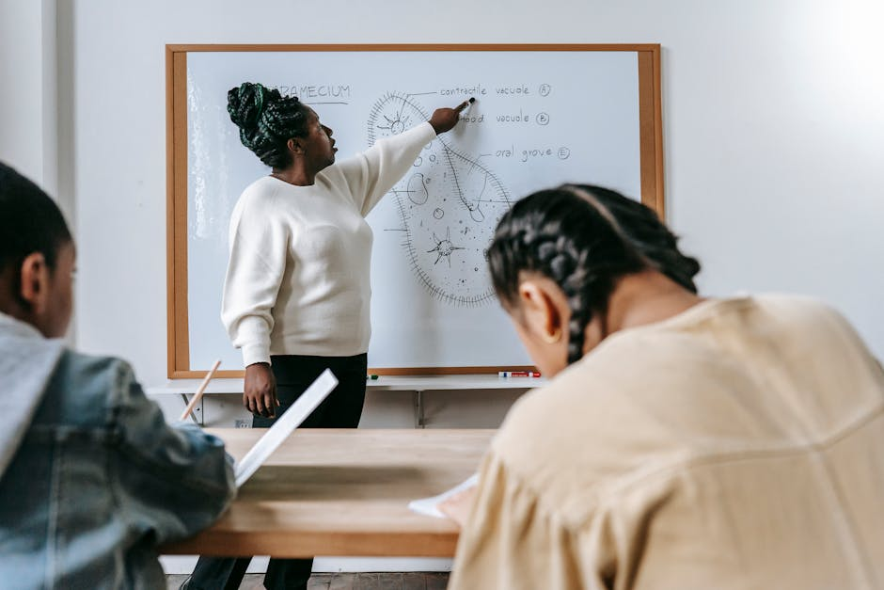
The Mouth and Esophagus
• The mouth is the beginning of the digestive system, where food is broken down into smaller pieces by the teeth and mixed with saliva that contains enzymes to break down carbohydrates.
• The esophagus is a muscular tube that carries food from the mouth to the stomach using a process called peristalsis.
• The esophagus is lined with mucous membranes that help to lubricate food and make it easier to swallow.
• The mouth and esophagus work together to prepare food for digestion in the stomach.
• The stomach is a sac-like organ that produces digestive enzymes and acids to break down proteins and fats.

Slide 4
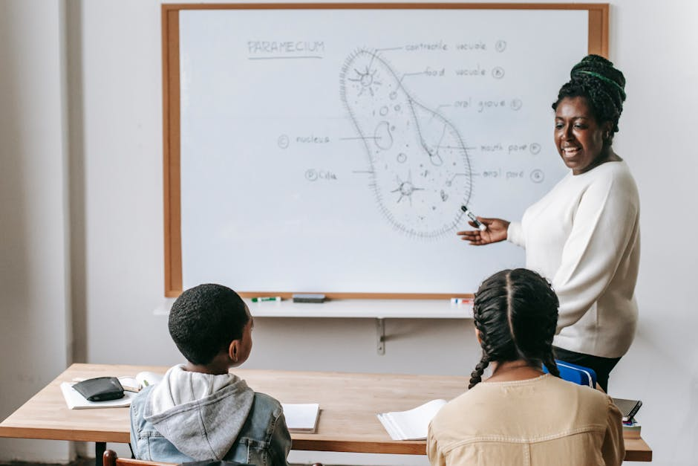
The Stomach and Small Intestine
• The stomach is a sac-like organ that produces digestive enzymes and acids to break down proteins and fats.
• The stomach churns and mixes food with these enzymes and acids for about an hour, breaking it down into a liquid mixture called chyme.
• The small intestine is a long, thin tube where most of our nutrient absorption takes place.
• The walls of the small intestine are lined with finger-like projections called villi, which increase the surface area for absorption.
• The small intestine is also where most of our vitamin and mineral absorption takes place.

Slide 5
The Large Intestine and Accessory Organs
• The large intestine, also known as the colon, is a wide, thin tube that absorbs water and electrolytes from the remaining waste material.
• The large intestine is also home to trillions of microorganisms, known as the gut microbiome, which play a crucial role in our overall health.
• The pancreas is an accessory organ that produces digestive enzymes to break down carbohydrates, proteins, and fats.
• The liver is another accessory organ that produces bile to help break down fats and absorbs vitamins and minerals.
• The gallbladder stores bile from the liver and releases it into the small intestine to aid in fat digestion.

Slide 6

Quiz Time!
• What is the main function of the stomach in the digestive system?
• What is the role of the small intestine in the digestive process?
• What is the function of the pancreas in the digestive system?
• What is the role of the liver in the digestive process?
• What is the function of the gallbladder in the digestive system?

Slide 7
Summary
• The human digestive system is a complex process that involves the breakdown and absorption of nutrients from the food we eat.
• The digestive system is made up of several organs, including the mouth, esophagus, stomach, small intestine, and large intestine.
• Each of these organs plays a unique role in the digestion and absorption of nutrients.
• The digestive system also includes accessory organs, such as the pancreas and liver, which produce digestive enzymes and bile to aid in digestion.
• Maintaining a healthy digestive system is essential for overall health and well-being.

