Slide 1
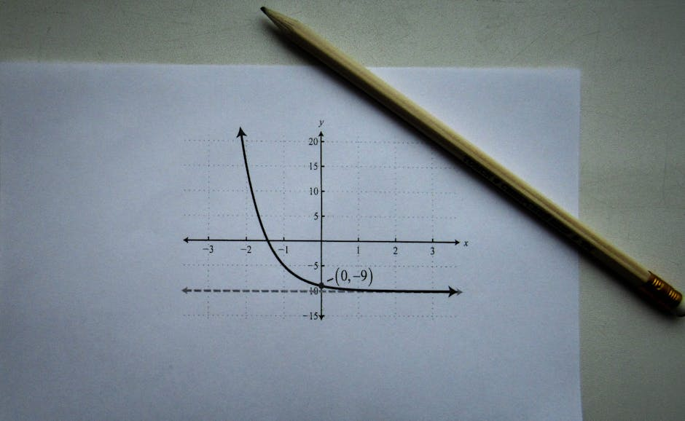
Linear Regression in Machine Learning
• Linear regression is a fundamental concept in machine learning, used for predicting continuous outcomes
• It is a supervised learning algorithm that learns from labeled data to make predictions on new, unseen data
• The goal of linear regression is to find the best-fitting linear line that minimizes the difference between predicted and actual values
• It has numerous applications in fields such as economics, finance, and engineering
• Further details: Linear regression is a simple yet powerful tool for data analysis and modeling; It provides a foundation for understanding more complex machine learning algorithms

Slide 2

Introduction to Linear Regression
• Linear regression is based on the idea that a linear relationship exists between a dependent variable and one or more independent variables
• The linear regression equation is typically represented as Y = β0 + β1X + ε, where Y is the dependent variable, X is the independent variable, β0 is the intercept, β1 is the slope, and ε is the error...
• The coefficients β0 and β1 are estimated using ordinary least squares (OLS) method, which minimizes the sum of the squared errors
• Linear regression assumes that the data is normally distributed, and the relationship between the variables is linear
• Further details: It also assumes that the variance of the errors is constant across all levels of the independent variable; These assumptions are important to ensure the validity and reliability of the linear...

Slide 3

Core Concepts in Linear Regression
• The coefficient of determination (R-squared) measures the proportion of the variance in the dependent variable that is predictable from the independent variable
• The F-statistic is used to determine the overall significance of the regression model, and the t-statistic is used to determine the significance of individual coefficients
• The residuals are the differences between the observed and predicted values, and they are used to evaluate the fit of the model
• The residual plot is a graphical representation of the residuals, and it is used to check for non-linearity and heteroscedasticity
• Further details: The multicollinearity problem occurs when two or more independent variables are highly correlated, and it can lead to unstable estimates of the coefficients; Regularization techniques, such as L1 and...

Slide 4

Real-World Applications of Linear Regression
• Linear regression is widely used in economics to model the relationship between economic variables, such as GDP and inflation
• In finance, linear regression is used to predict stock prices and portfolio returns, and to estimate the risk of investment portfolios
• In engineering, linear regression is used to model the relationship between design variables and performance metrics, such as fuel efficiency and speed
• In healthcare, linear regression is used to model the relationship between patient outcomes and treatment variables, such as dosage and response
• Further details: Linear regression is also used in social sciences to model the relationship between social variables, such as crime rates and socioeconomic factors; It is a versatile tool that can be applied to a...

Slide 5

Challenges and Limitations of Linear Regression
• Linear regression assumes a linear relationship between the variables, which may not always be the case in real-world problems
• Non-linearity and heteroscedasticity can lead to biased and inaccurate estimates of the coefficients
• Multicollinearity can lead to unstable estimates of the coefficients and make it difficult to interpret the results
• Linear regression is sensitive to outliers and missing values, which can affect the accuracy of the model
• Further details: It is also sensitive to the choice of independent variables, and the model can be improved by selecting the most relevant variables; Regularization techniques and other methods can be used to address...

Slide 6

Linear Regression Quiz
• What is the primary assumption of linear regression?
• What is the purpose of regularization in linear regression?
• How is the coefficient of determination (R-squared) interpreted?
• What is the difference between a simple and multiple linear regression model?
• Further details: How can non-linearity and heteroscedasticity be addressed in linear regression?; What is the role of the F-statistic in linear regression?

Slide 7

Summary of Linear Regression
• Linear regression is a powerful tool for predicting continuous outcomes and understanding the relationships between variables
• It is based on the assumption of a linear relationship between the variables, and it uses ordinary least squares (OLS) method to estimate the coefficients
• The coefficient of determination (R-squared) measures the proportion of the variance in the dependent variable that is predictable from the independent variable
• Linear regression has numerous applications in fields such as economics, finance, engineering, and healthcare
• Further details: However, it is not without its challenges and limitations, including non-linearity, multicollinearity, and sensitivity to outliers and missing values; Regularization techniques and other methods can...

