Slide 1

Photosynthesis for Class 10 Students
Welcome to the world of photosynthesis, a vital process that supports life on Earth.
In this presentation, we will explore the concept of photosynthesis and its significance in our ecosystem.
We will also look at real-world examples and applications of photosynthesis.
By the end of this presentation, you will have a deep understanding of photosynthesis and its importance.
You will be able to explain the process of photosynthesis and identify its role in our daily lives.
Let's start our journey into the world of photosynthesis.

Slide 2
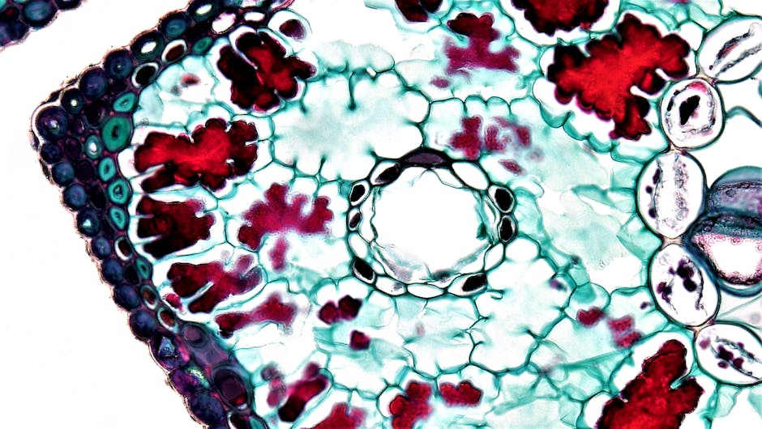
Introduction to Photosynthesis
Photosynthesis is the process by which plants, algae, and some bacteria convert light energy from the sun into chemical energy in the form of glucose.
This process occurs in specialized organelles called chloroplasts, which contain the pigment chlorophyll.
Chlorophyll absorbs light energy from the sun and transfers it to a molecule called ATP, which is then used to convert carbon dioxide and water into glucose and oxygen.
The equation for photosynthesis is 6 CO2 + 6 H2O + light energy → C6H12O6 + 6 O2.
Photosynthesis is an essential process that supports life on Earth, as it provides energy and organic compounds for food chains.
It also helps regulate the Earth's atmosphere by removing carbon dioxide and producing oxygen.

Slide 3

Core Concepts of Photosynthesis
The light-dependent reactions of photosynthesis occur in the thylakoid membranes of chloroplasts and involve the conversion of light energy into ATP and NADPH.
The light-independent reactions, also known as the Calvin cycle, occur in the stroma of chloroplasts and involve the conversion of CO2 into glucose using the ATP and NADPH produced in the light-dependent reactions.
The overall equation for photosynthesis is a summary of the light-dependent and light-independent reactions.
Photosynthesis requires several factors, including light, water, carbon dioxide, and chlorophyll.
The rate of photosynthesis can be affected by factors such as light intensity, temperature, and water availability.
Understanding the core concepts of photosynthesis is essential for appreciating its importance in our ecosystem.

Slide 4
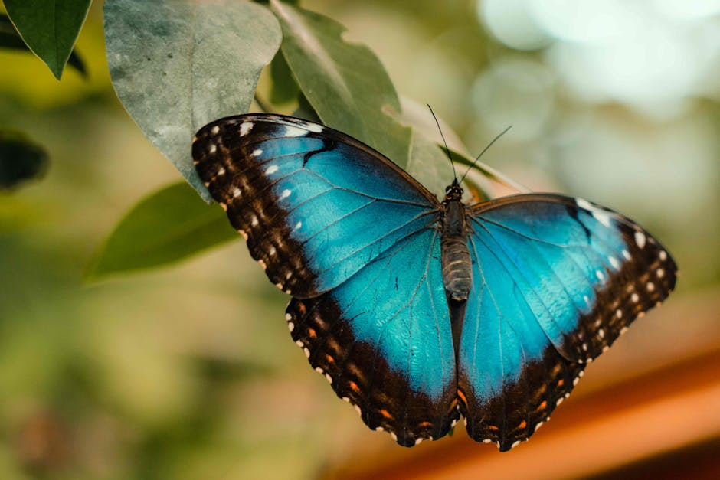
Real-World Examples and Applications of Photosynthesis
Photosynthesis is the basis for agriculture, as it provides the energy and organic compounds needed for plant growth.
Forests and other ecosystems rely on photosynthesis to regulate the Earth's atmosphere and support biodiversity.
Photosynthesis is also used in aquaculture, where aquatic plants and algae are cultivated for food and other products.
In addition, photosynthesis has inspired the development of new technologies, such as artificial photosynthesis and bio-inspired solar cells.
Understanding photosynthesis can also inform strategies for addressing climate change, such as carbon sequestration and reforestation.
By applying the principles of photosynthesis, we can develop more sustainable and environmentally-friendly practices.

Slide 5
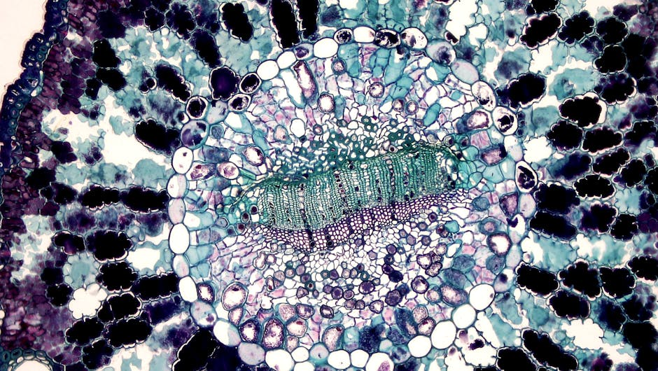
Photosynthesis Quiz
What is the primary pigment responsible for absorbing light energy in photosynthesis?
What is the equation for photosynthesis?
What is the role of the light-dependent reactions in photosynthesis?
What is the product of the light-independent reactions in photosynthesis?
How does photosynthesis support life on Earth?
What is one way that humans can apply the principles of photosynthesis to address environmental challenges?

Slide 6

Summary of Photosynthesis
Photosynthesis is the process by which plants, algae, and some bacteria convert light energy into chemical energy.
The process occurs in chloroplasts and involves the conversion of carbon dioxide and water into glucose and oxygen.
Photosynthesis is essential for life on Earth, as it provides energy and organic compounds for food chains.
The core concepts of photosynthesis include the light-dependent and light-independent reactions.
Photosynthesis has many real-world applications and implications, including agriculture, forestry, and environmental sustainability.
By understanding photosynthesis, we can appreciate the importance of this process and develop strategies for addressing environmental challenges.

