Slide 1

Photosynthesis: The Green Process
• Welcome to the world of photosynthesis, where plants, algae, and some bacteria produce their own food using sunlight, water, and carbon dioxide.
• This process is essential for life on Earth, providing oxygen and organic compounds for all living organisms.
• In this presentation, we will explore the concept of photosynthesis, its importance, and real-world examples.
• By the end of this presentation, you will have a deeper understanding of this vital process and its impact on our environment.

Slide 2
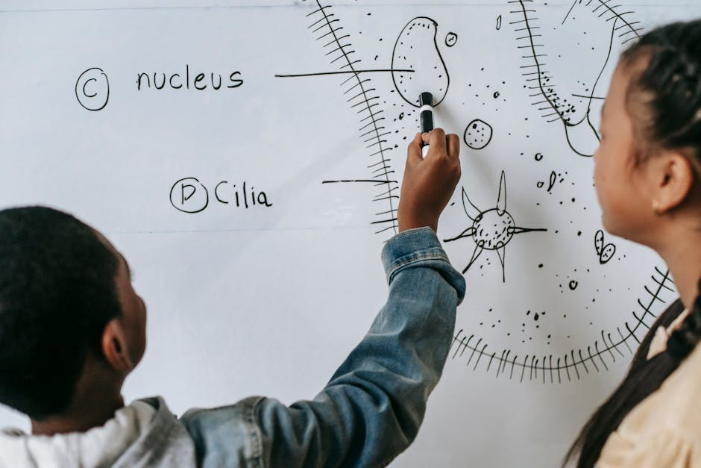
Introduction to Photosynthesis
• Photosynthesis is the process by which green plants, algae, and some bacteria convert light energy from the sun into chemical energy in the form of organic compounds.
• This process occurs in specialized organelles called chloroplasts, which contain pigments such as chlorophyll that absorb light energy.
• The overall equation for photosynthesis is 6 CO2 + 6 H2O + light energy → C6H12O6 (glucose) + 6 O2.
• Photosynthesis is an essential process that supports life on Earth, providing energy and organic compounds for food chains and ecosystems.

Slide 3
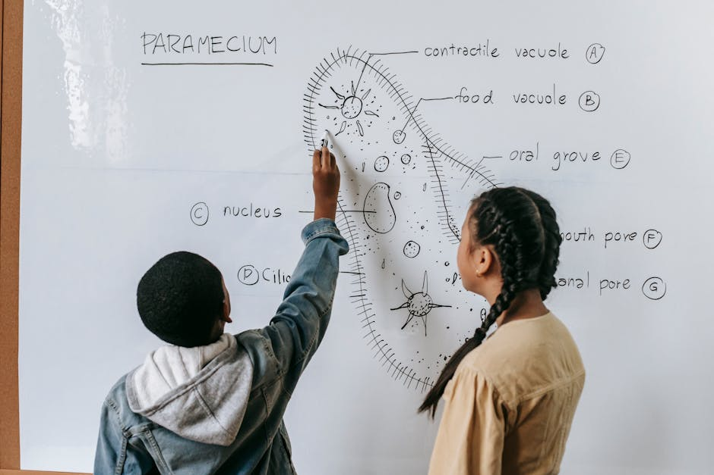
The Process of Photosynthesis
• The process of photosynthesis occurs in two stages: the light-dependent reactions and the light-independent reactions (Calvin cycle).
• In the light-dependent reactions, light energy is absorbed by pigments and converted into ATP and NADPH.
• The Calvin cycle uses the ATP and NADPH produced in the light-dependent reactions to convert CO2 into glucose.
• The overall process of photosynthesis requires water, carbon dioxide, and light energy, and produces glucose and oxygen as byproducts.

Slide 4

Importance of Photosynthesis
• Photosynthesis is essential for life on Earth, providing oxygen for aerobic respiration and organic compounds for food chains and ecosystems.
• Photosynthesis supports the food chain by producing energy-rich molecules that are consumed by herbivores and eventually by carnivores.
• Photosynthesis also plays a critical role in regulating Earth's climate, removing CO2 from the atmosphere and releasing O2.
• In addition, photosynthesis is the basis for many industrial processes, including the production of biofuels, pharmaceuticals, and other chemicals.

Slide 5

Real-World Examples of Photosynthesis
• Agriculture relies heavily on photosynthesis, with crops such as corn, wheat, and soybeans producing energy-rich molecules through photosynthesis.
• Forests and other ecosystems also depend on photosynthesis, with trees and other plants producing oxygen and organic compounds.
• Photosynthesis is used in aquaculture, where algae and other aquatic plants produce food for fish and other aquatic organisms.
• In addition, photosynthesis is being explored as a potential source of biofuels, with scientists researching ways to harness the energy from photosynthesis to power vehicles and other machines.

Slide 6

Challenges and Limitations of Photosynthesis
• Photosynthesis is limited by factors such as light intensity, temperature, and water availability, which can affect the rate of photosynthesis.
• In addition, photosynthesis can be affected by environmental stressors such as drought, pollution, and climate change.
• Scientists are working to improve the efficiency of photosynthesis, using techniques such as genetic engineering and precision agriculture.
• Understanding the challenges and limitations of photosynthesis can help us develop strategies to optimize this process and improve crop yields.

Slide 7

Photosynthesis Quiz
• What is the overall equation for photosynthesis?
• What is the role of chlorophyll in photosynthesis?
• What are the two stages of photosynthesis?
• What is the importance of photosynthesis for life on Earth?

Slide 8
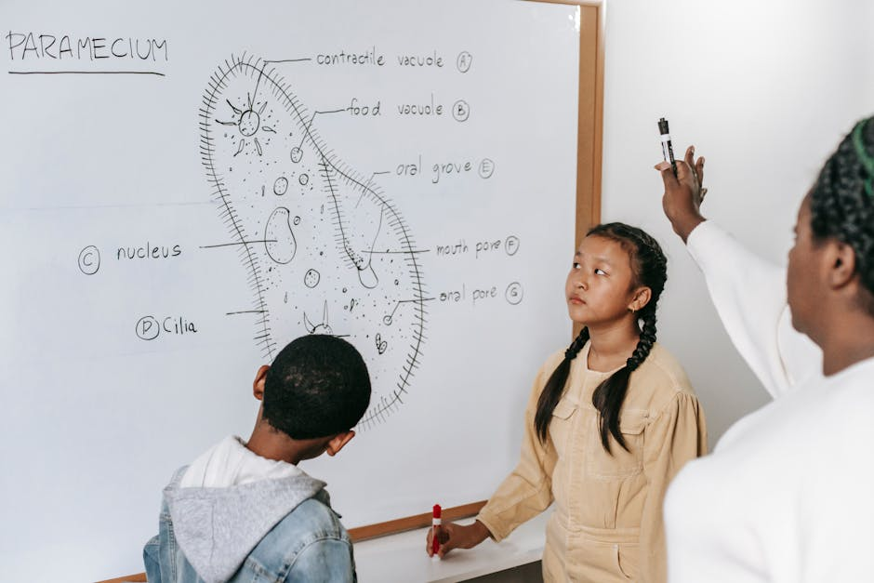
Summary of Photosynthesis
• Photosynthesis is the process by which green plants, algae, and some bacteria produce their own food using sunlight, water, and carbon dioxide.
• The process of photosynthesis occurs in two stages: the light-dependent reactions and the light-independent reactions (Calvin cycle).
• Photosynthesis is essential for life on Earth, providing oxygen and organic compounds for food chains and ecosystems.
• Understanding photosynthesis can help us develop strategies to optimize this process and improve crop yields, as well as address environmental challenges such as climate change.

