Slide 1
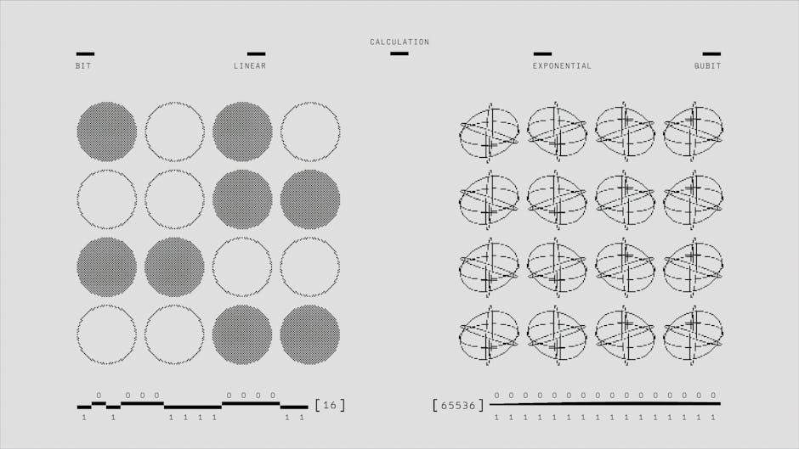
Linear Regression in Machine Learning
• Linear regression is a fundamental concept in machine learning, used for predicting continuous outcomes.
• It is a supervised learning algorithm that learns from labeled data to make predictions on new, unseen data.
• Linear regression has numerous applications in fields such as economics, finance, and engineering.
• In this presentation, we will delve into the core concepts, real-world examples, and applications of linear regression.
• We will also explore the mathematical formulations and techniques used in linear regression.
• By the end of this presentation, you will have a comprehensive understanding of linear regression and its role in machine learning.

Slide 2
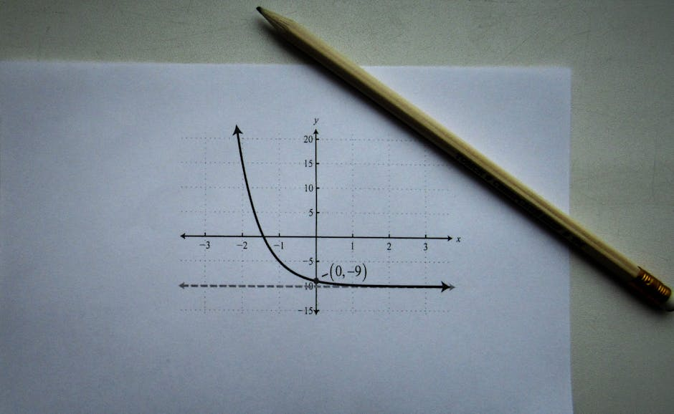
Introduction to Linear Regression
• Linear regression is a linear approach to modeling the relationship between a dependent variable and one or more independent variables.
• The goal of linear regression is to create a linear equation that best predicts the value of the dependent variable based on the values of the independent variables.
• Linear regression assumes a linear relationship between the variables, which can be represented by a straight line.
• The equation for linear regression is Y = β0 + β1X + ε, where Y is the dependent variable, X is the independent variable, β0 is the intercept, β1 is the slope, and ε is the error term.
• Linear regression can be simple, with only one independent variable, or multiple, with more than one independent variable.
• The choice of linear regression depends on the research question and the nature of the data.

Slide 3

Core Concepts in Linear Regression
• The coefficient of determination, R-squared, measures the proportion of the variance in the dependent variable that is predictable from the independent variable.
• The F-statistic is used to determine the overall significance of the regression model, while the t-statistic is used to determine the significance of individual coefficients.
• The residual plot is a graphical representation of the residuals, which can help identify patterns and outliers in the data.
• The normality assumption states that the residuals should be normally distributed, while the homoscedasticity assumption states that the variance of the residuals should be constant.
• The independence assumption states that the observations should be independent of each other, while the linearity assumption states that the relationship between the variables should be linear.
• Understanding these core concepts is crucial for effectively applying linear regression in machine learning.

Slide 4

Real-World Examples and Applications
• Linear regression is widely used in economics to model the relationship between economic variables, such as GDP and inflation.
• In finance, linear regression is used to predict stock prices and portfolio returns based on historical data.
• In engineering, linear regression is used to model the relationship between design parameters and performance metrics, such as fuel efficiency and speed.
• In healthcare, linear regression is used to model the relationship between patient outcomes and treatment variables, such as dosage and response.
• Linear regression is also used in social sciences to model the relationship between social variables, such as education and income.
• These examples illustrate the versatility and applicability of linear regression in various fields.

Slide 5

Quiz: Linear Regression
• What is the primary assumption of linear regression?
• What is the purpose of the residual plot in linear regression?
• What is the difference between simple and multiple linear regression?
• How is the coefficient of determination, R-squared, interpreted?
• What is the role of the F-statistic in linear regression?
• What is the main limitation of linear regression?

Slide 6

Summary and Conclusion
• Linear regression is a powerful tool for modeling the relationship between variables in machine learning.
• Understanding the core concepts, assumptions, and limitations of linear regression is crucial for effective application.
• Linear regression has numerous applications in various fields, including economics, finance, engineering, and healthcare.
• The coefficient of determination, R-squared, and the F-statistic are essential metrics for evaluating the performance of linear regression models.
• Linear regression is a fundamental concept in machine learning, and its understanding is essential for advancing to more complex techniques.
• By mastering linear regression, you will be well-prepared to tackle more advanced topics in machine learning.

