Slide 1

AUDITEDGE
AI-Powered Assistant for
Chartered Accountants

Slide 2
Challenges Faced by CAs
Demand-Supply Gap
Growing data volumes
Limited Access
India has only 1.5 lakh active
CAs serving, projected to require 30 lakh CAs by 2047
make manual audits and fraud detection inefficient and error-prone
to affordable AI-powered tools tailored specifically for CAs.

Slide 3
Existing Solutions and Their Limitations
QuickBooks and Tally
streamline bookkeeping but lack advanced AI-driven automation for complex tasks
TaxDome and Docyt
automate document management but are expensive and not fully adapted to Indian-specific tax laws

Slide 4
Solution :
AuditEdge offers an AI-powered assistant that automates routine accounting tasks, streamlines audits, simplifies tax filing, and provides actionable financial insights.
The solution enhances productivity, accuracy, and efficiency for CAs by leveraging advanced AI algorithms.

Slide 5
Initial Requirement Gathering
Independant CA - (practicing in Chennai)
“ Each Client comes with a unique problem statement that requires problem specific adjustments ”
CA employed in a firm - (Naga Consultancy)
employs around 100 CA for various client needs :
“ Working Closely with clients from specific sectors and catering to their needs ”

Slide 6
Services by CA :
Audit & Assurance
Financial & Business Advisory
Statutory Audit, Tax Audit, Internal Audit, Stock Audit (verifying inventory records)
Business Valuation, Financial Planning & Forecasting, Investemnt Advisory, Due Diligence
Taxation Services
Corporate & Legal Compliance
Direct Tax Advisory, GST Services, Tax Litigation & Representation, Transfer Pricing Advisory
Company Incorporation & ROC FIlings, FEMA & RBI Compliance, Corporate Governance Advisory

Slide 7
BUSINESS VALUATION PROCESS
(comes under financial and business advisory)
Preparing the Valuation Report
Adjustments & Final Computation
5
Collecting Financial & Business Information
Valuation Methods
4
Understanding the Purpose of Valuation
3
2
1
Non-operating assets/liabilities,
Premiums for control,
Discounts for lack of marketability
Assumptions & Limitations, Financial Data & Adjustments, Final Business Valuation & Conclusion
Asset-Based Approach, Income-Based Approach,
Market-Based Approach
Financial Documents and Operation Information
Mergers, investment analysis, IPO & Fundraising

Slide 8
IMPLEMENTATION STEPS FOR MARKET-DRIVEN VALUATION
with AI integrations
AI identifies key metrics
Machine learning adjusts metrics based on client-specific factors.
AI creates a detailed valuation report with methodology, assumptions, and results.
Ensures clarity for both the client and the CA.
Used Chatgpt
Data Collection
Comparable Analysis:
Valuation Calculation
Report Generation:
Recent transactions of comparable companies gathered.
Client voice inputs refine company selection.
Apply identified multiples to estimate business value.
AI automates calculations with real-time market updates.
(Used SerpAPI for websearch through Google search)
(for voice-to-text transcribe we use whisper model )

Slide 9
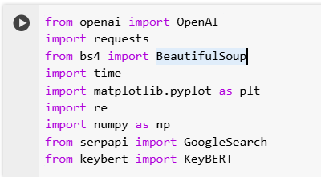
BACKEND CODE IMPLEMENTATION
1.Modules for the code:

Slide 10
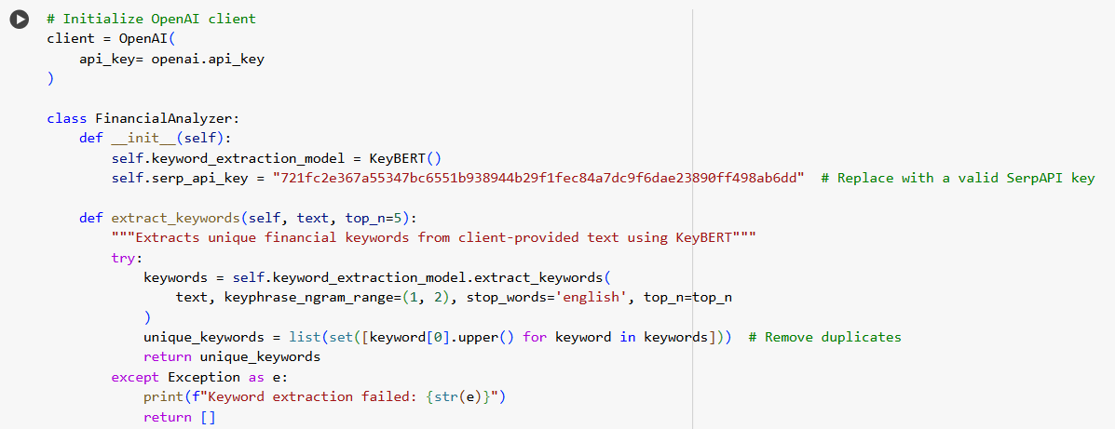
2.Main module:

Slide 11
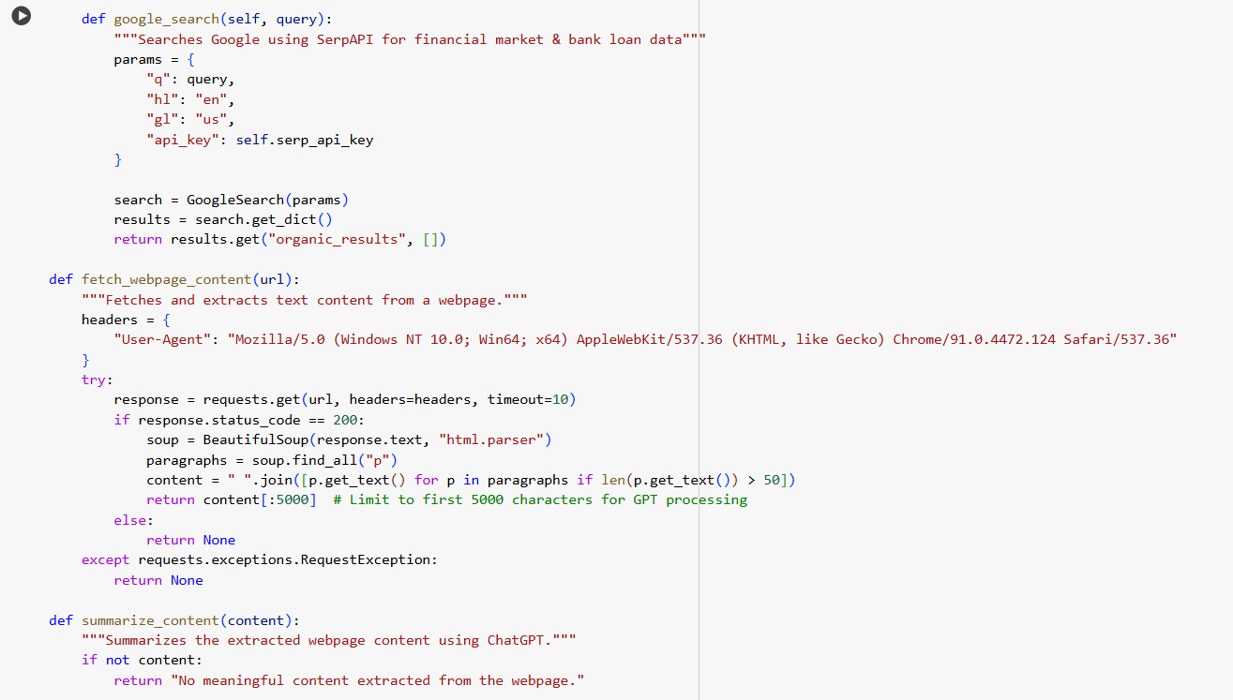
2.Main module:

Slide 12
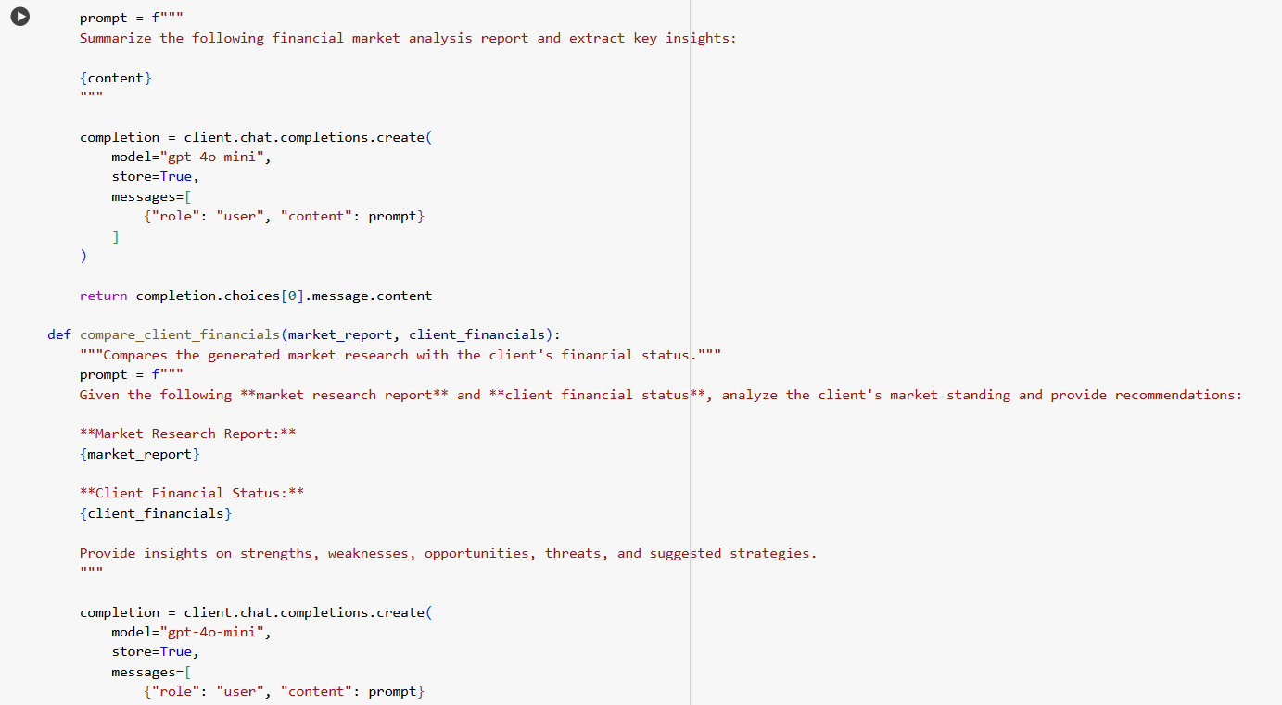
2.Main module:

Slide 13
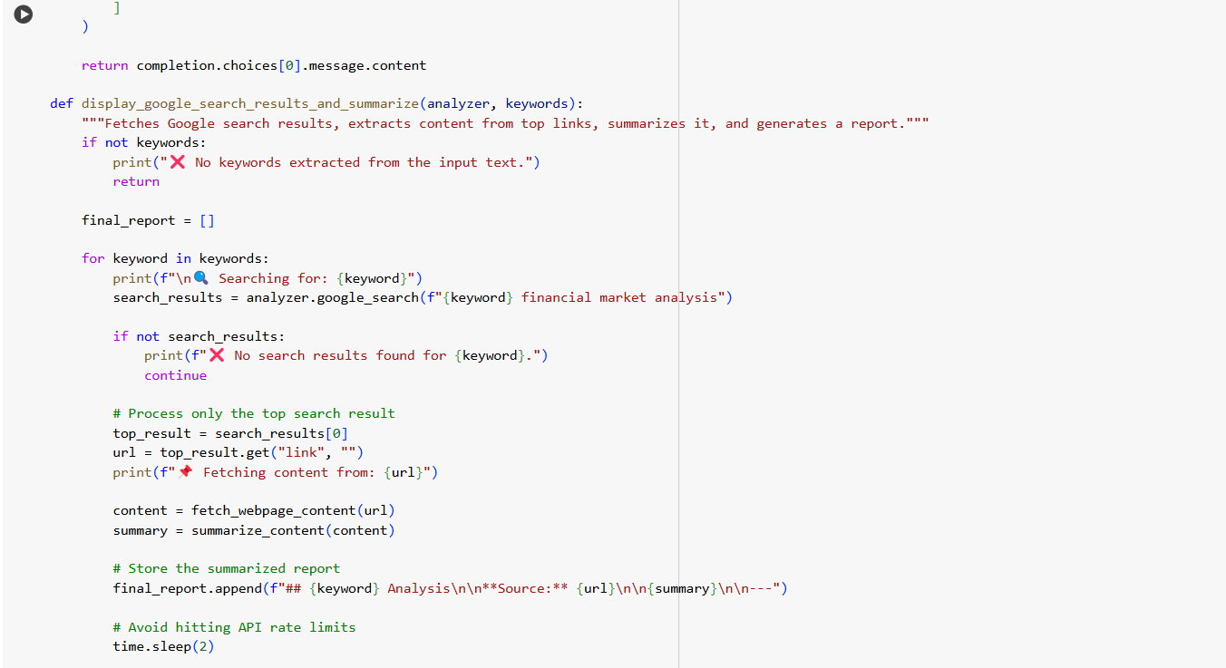
2.Main module:

Slide 14
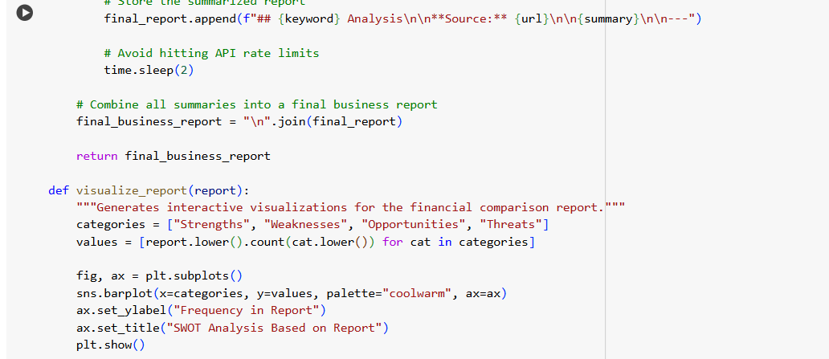
2.Main module:

Slide 15
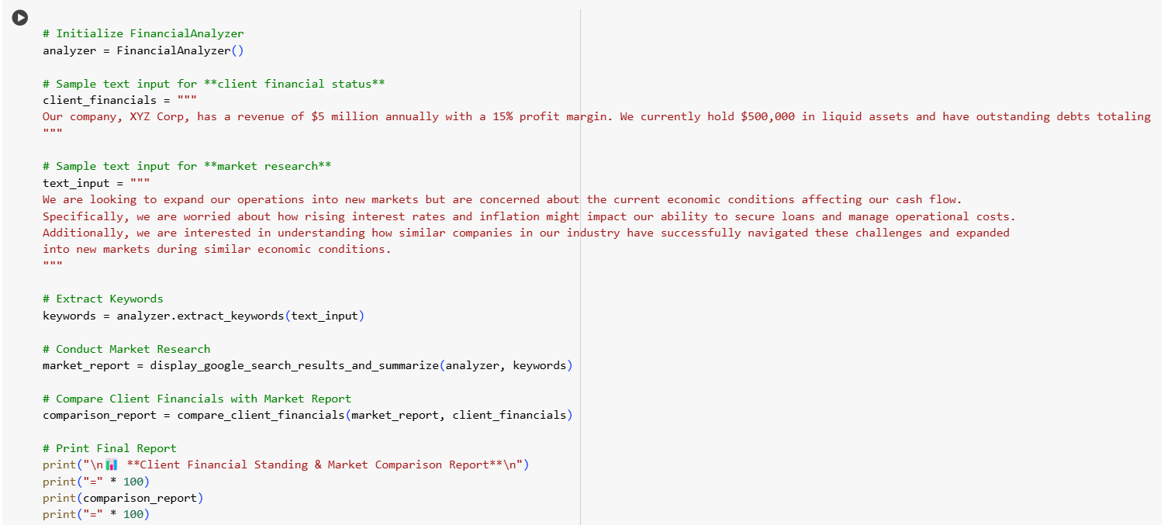
3.Sample Report Visualization:

Slide 16
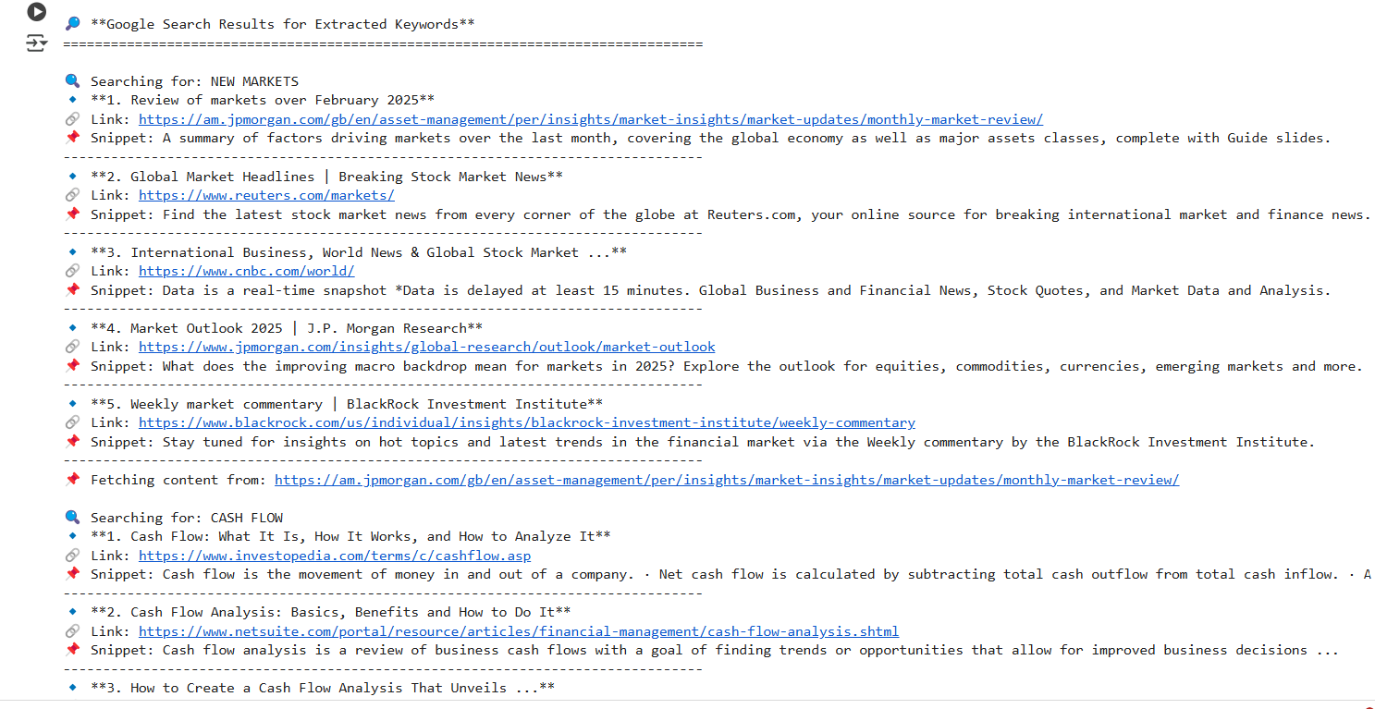
OUTPUT:

Slide 17
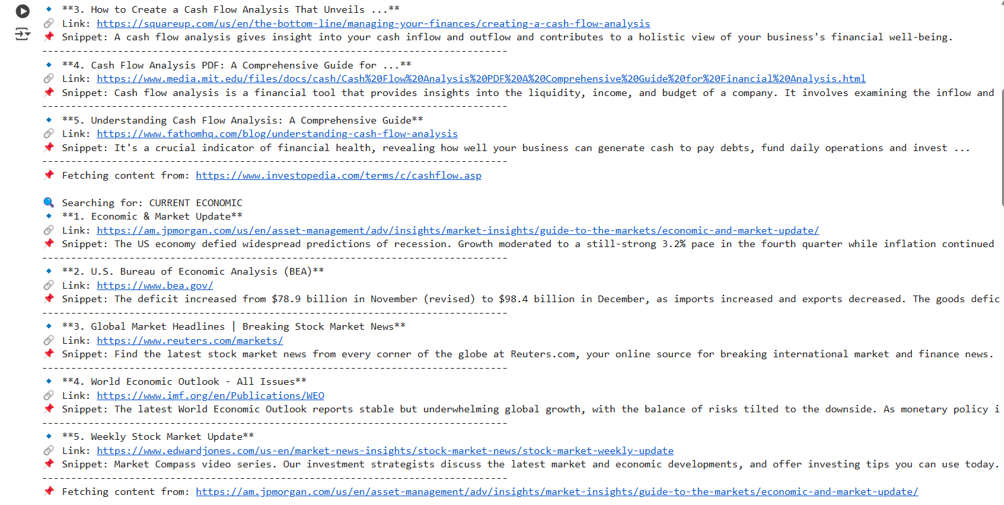

Slide 18
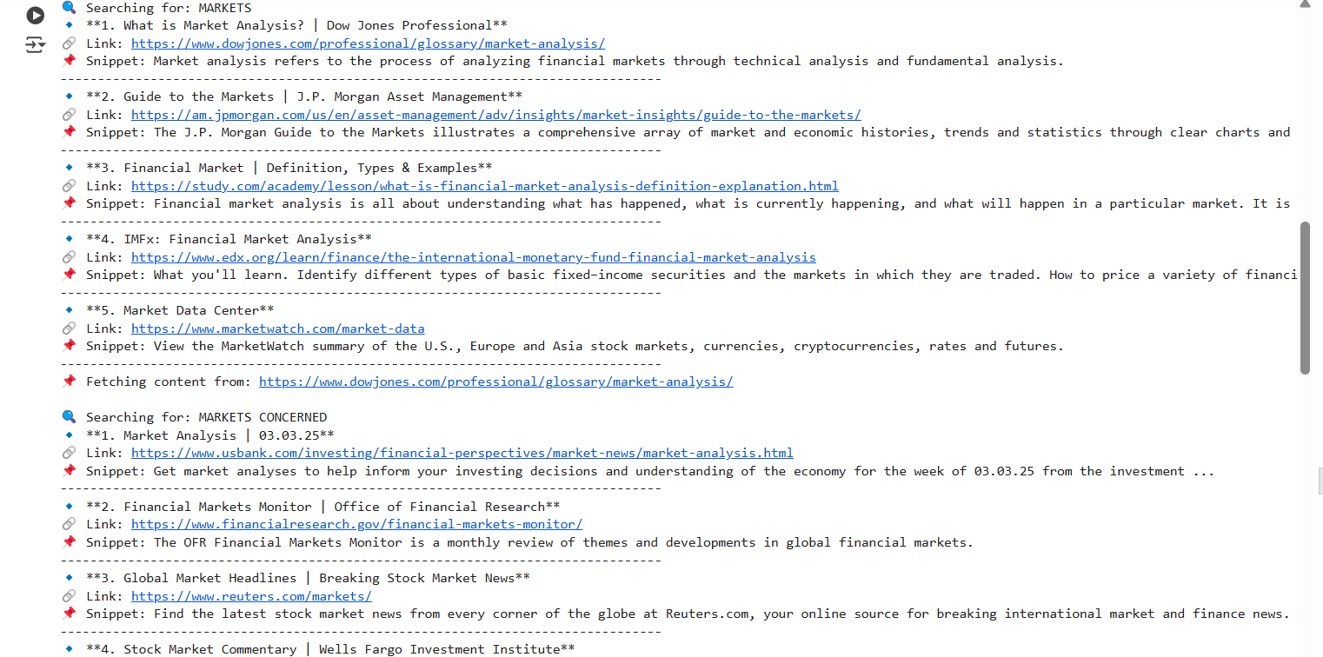

Slide 19
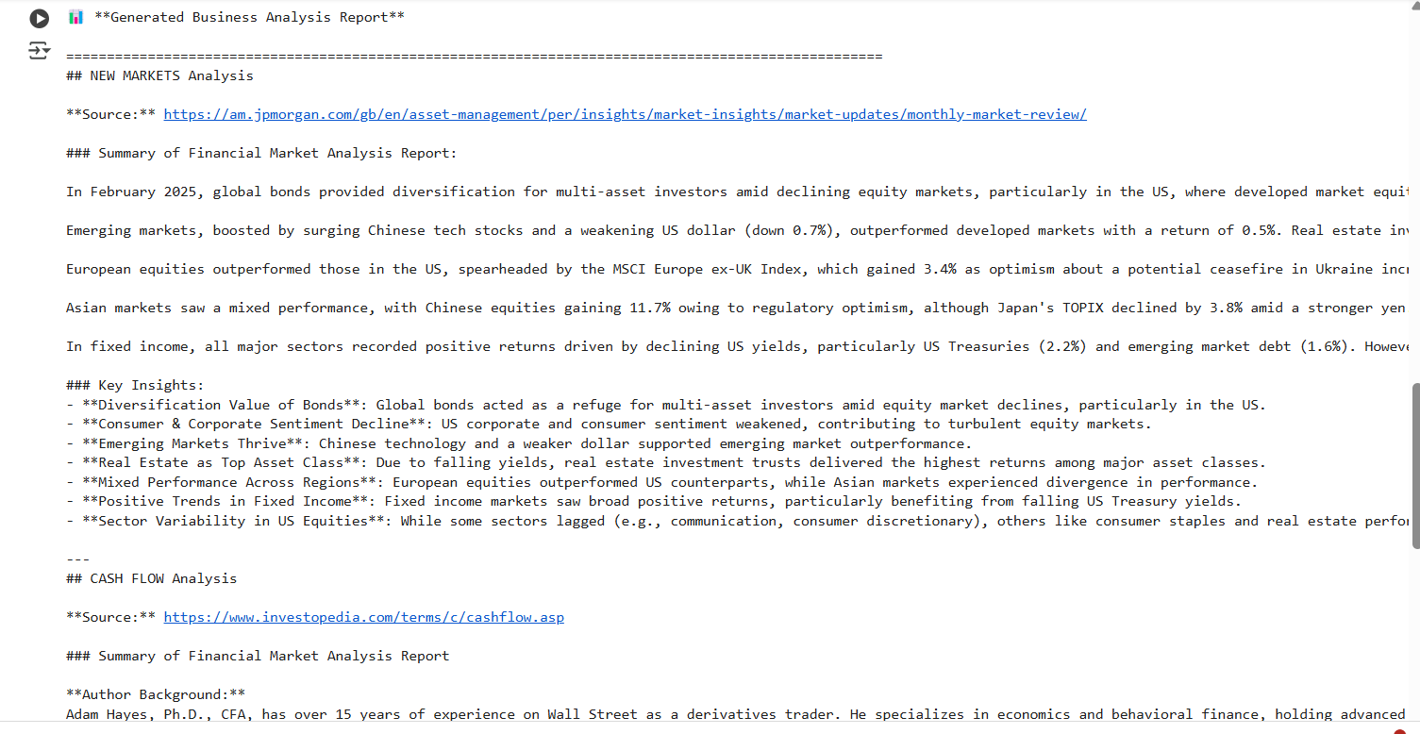

Slide 20
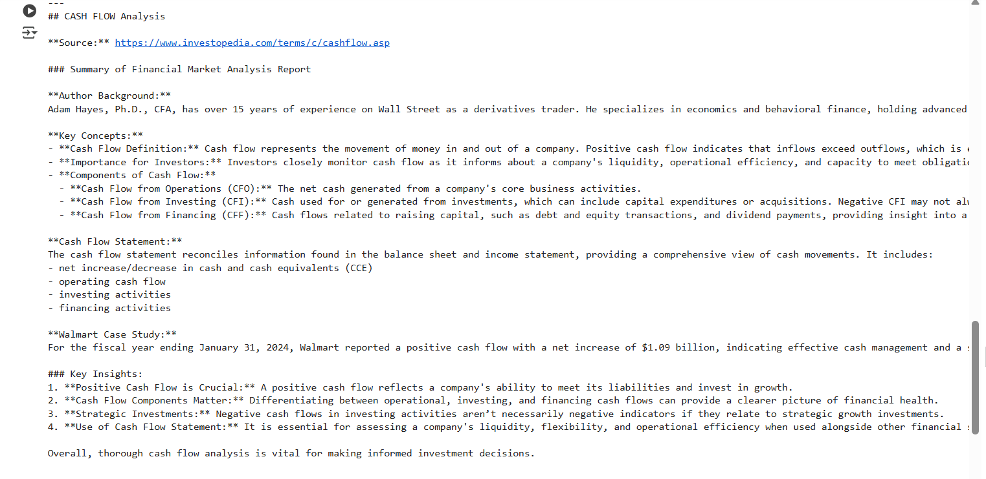

Slide 21
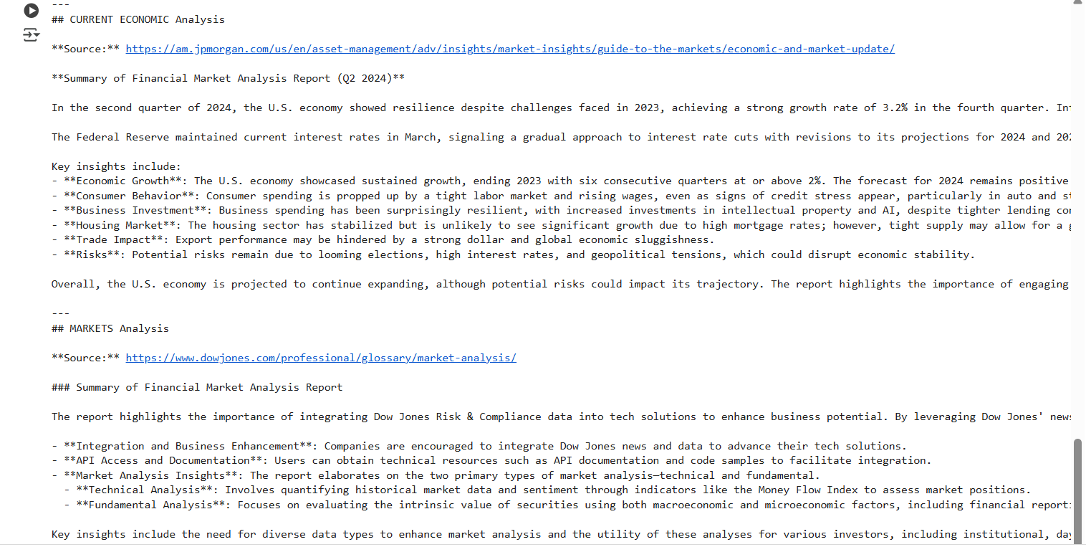

Slide 22
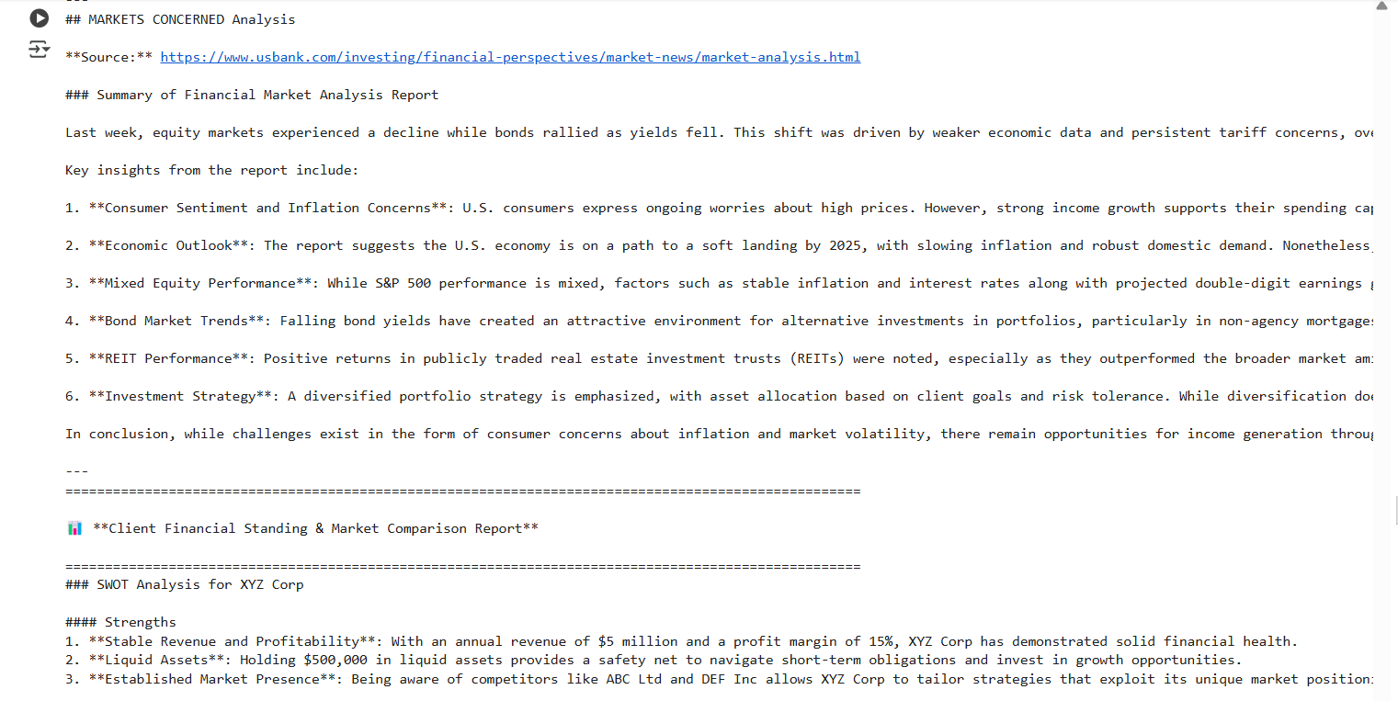

Slide 23
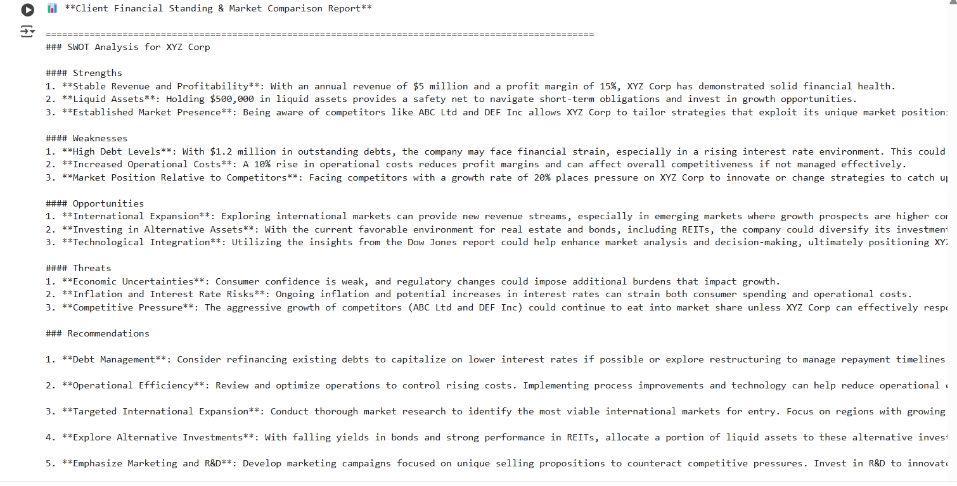

Slide 24
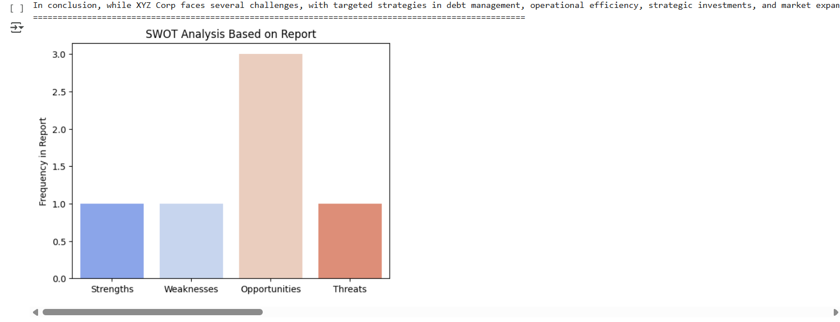
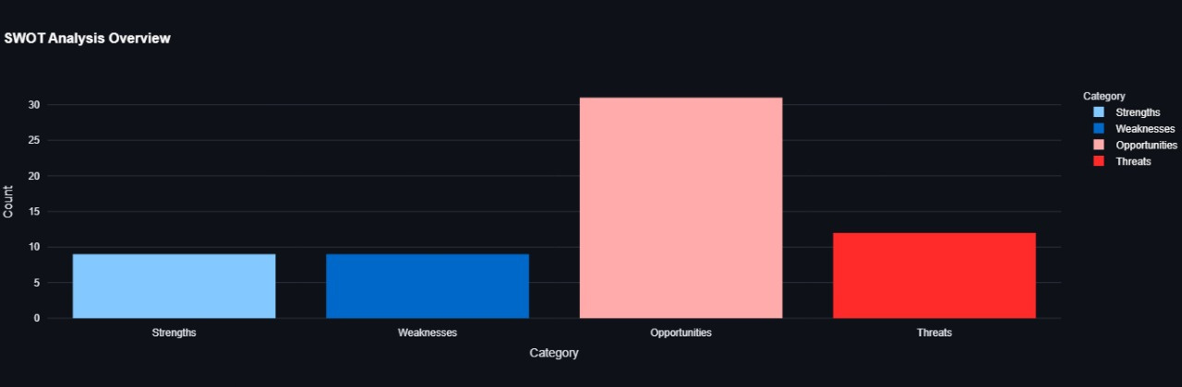

Slide 25
Thank You

