Slide 1
LINEAR ATTENTION / EXPERIMENT REVIEW
Where linear attention stops being a safe substitute
Measured boundary + a negative adaptive-router result
Cheaper attention is possible.
Safe replacement is input-dependent.
Synthetic opportunity
Real-model outcome
Long inputs can benefit when their attention is easy to approximate.
The tested router does not accelerate Qwen2.5-0.5B at measured lengths.
Tesla T4 experiments | 5 October 2026 | Jaiadithya A
01
Notes:
Supervisor review. No claim of a new successful model accelerator. All measurements are taken from repository CSVs; no data generated for this deck.
Source snapshot: 8096d83526f4d134778e438484fc02a5ff1f2af7. Repository: https://github.com/Jaiadithya71/linear-attention-benchmark
Tesla T4 experiments | 5 October 2026 | Jaiadithya A

Slide 2
LINEAR ATTENTION / EXPERIMENT REVIEW
The question is cost AND preserved behavior
Can a router choose the cheapest acceptable feature count per input/head?
Exact softmax
Kernelized linear
Each query compares with all keys.
All-pairs work grows roughly as N².
Optimized SDPA avoids our dense score matrix.
Compress keys and values into a summary.
At fixed feature width, work grows roughly as N.
Compression can blur a precise lookup.
N = sequence length. Faster arithmetic is not enough if the returned information changes.
Source: lab/attention.py; lab/adaptive.py; run_router_detailed.py
02
Notes:
Source snapshot: 8096d83526f4d134778e438484fc02a5ff1f2af7. Repository: https://github.com/Jaiadithya71/linear-attention-benchmark
Source: lab/attention.py; lab/adaptive.py; run_router_detailed.py

Slide 3
LINEAR ATTENTION / EXPERIMENT REVIEW
Four connected tests, one router decision
A head is one parallel attention lookup. Rank is the number of random features.
1 / Harness
2 / Retrieval
3 / Qwen swap
4 / Router audit
GPU latency, allocated memory, finiteness
One matching key among many distractors
Pretrained weights, no fine-tuning
Probe reliability, tails, drift and crossover
16 exact probe queries → try 64 / 256 / 1024 features → choose first passing rank
Default gate: mean relative output-vector error ≤ 0.1. If none passes, exact fallback.
The forced-rank variant uses 1024 even when the gate fails. It is not a safe fallback.
Source: run_efficiency.py; run_retrieval.py; run_qwen.py; run_adaptive.py; lab/router_detailed.py
03
Notes:
Source snapshot: 8096d83526f4d134778e438484fc02a5ff1f2af7. Repository: https://github.com/Jaiadithya71/linear-attention-benchmark
Source: run_efficiency.py; run_retrieval.py; run_qwen.py; run_adaptive.py; lab/router_detailed.py

Slide 4
LINEAR ATTENTION / EXPERIMENT REVIEW
Run design keeps speed and quality separate
Original Colab measurements and detailed follow-up are distinct cohorts.
Original cohort | Detailed follow-up
T4; torch 2.11.0+cu130 / CUDA 13.0 | T4; torch 2.11.0+cu128 / CUDA 12.8
Basic: N=512..65,536; fp16/fp32 | 18 synthetic regimes; 3 sensitivity seeds
Retrieval: 300 seeded trials per cell | 9 tolerances; 6 probe counts; ranks 64/256/1024
Qwen swap: 16 windows, context 2048 | Matched Qwen: 16 held-out windows, 32,752 tokens
Adaptive: separate 8-window Qwen test | Quality at 2048; model timing at 1024..8192
CUDA events + measured allocation peaks + saved failures. Prefill timing excludes the vocabulary head.
Source: results/run_config_*.json; results/router_detailed*/manifest.json; qwen_data_manifest.json
04
Notes:
Source snapshot: 8096d83526f4d134778e438484fc02a5ff1f2af7. Repository: https://github.com/Jaiadithya71/linear-attention-benchmark
Source: results/run_config_*.json; results/router_detailed*/manifest.json; qwen_data_manifest.json

Slide 5
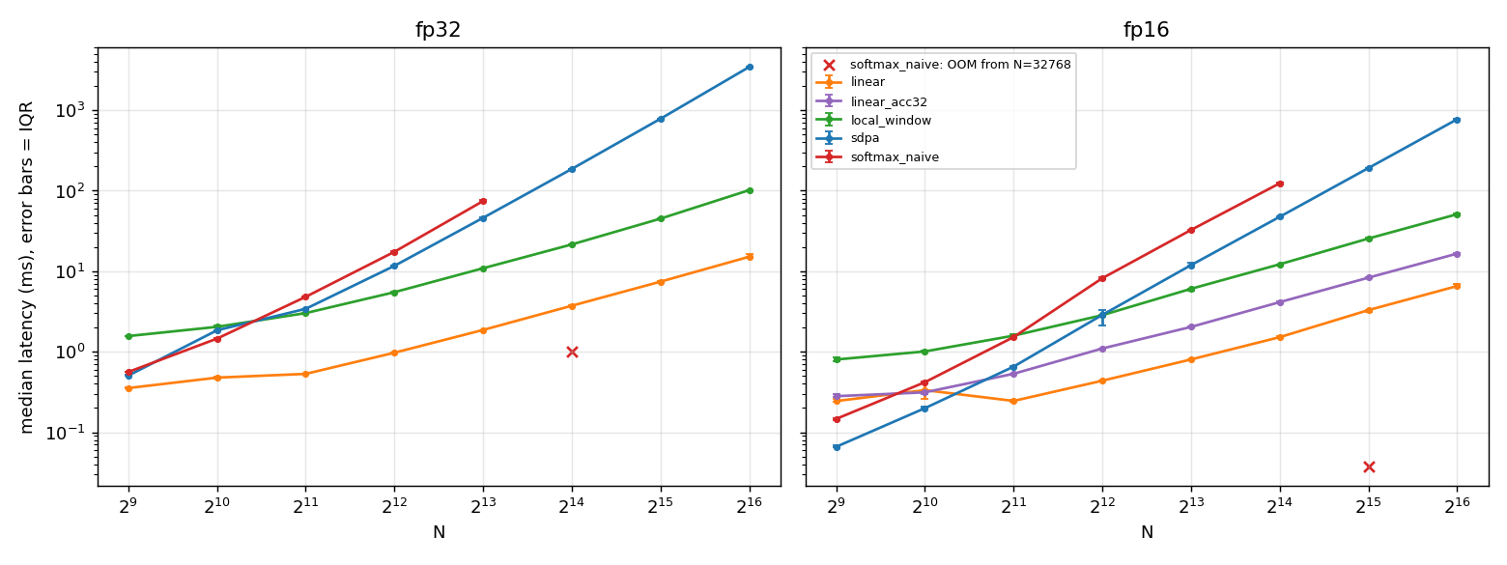
LINEAR ATTENTION / EXPERIMENT REVIEW
Basic linear attention is fast at long lengths
Attention-only, noncausal; batch 1, 8 heads, dimension 64. Log latency axes.
At 65,536: fp32 SDPA 3,446 ms vs linear 15.1 ms. This is not a quality claim.
Source: results/efficiency.csv; figures/latency.png
05
Notes:
fp16 SDPA 771.616 ms; linear 6.546 ms but nonfinite. fp16 linear_acc32 16.562 ms and finite. Naive first OOM: fp32 N16384, fp16 N32768. See next slide for memory.
Source snapshot: 8096d83526f4d134778e438484fc02a5ff1f2af7. Repository: https://github.com/Jaiadithya71/linear-attention-benchmark
Source: results/efficiency.csv; figures/latency.png

Slide 6
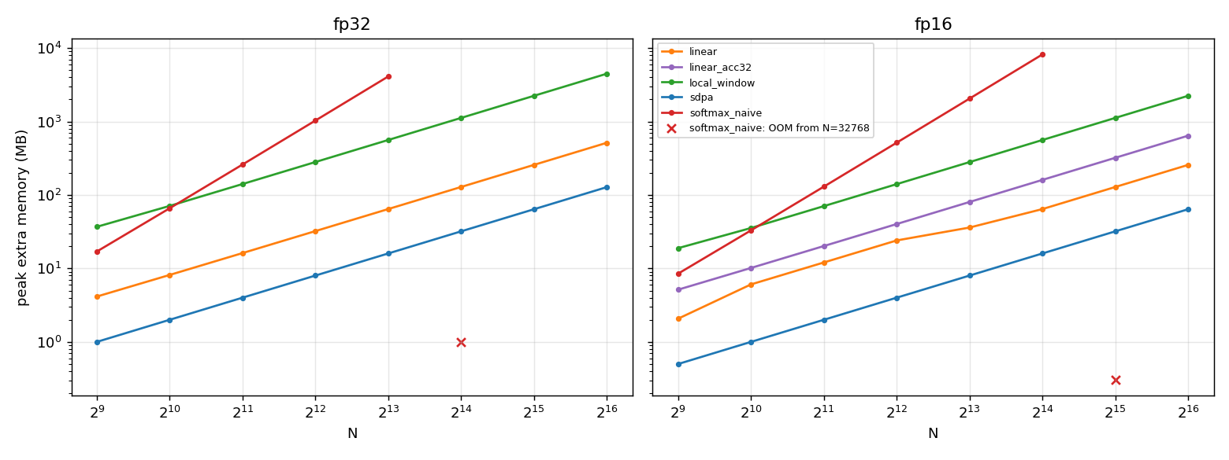
LINEAR ATTENTION / EXPERIMENT REVIEW
Memory and numerical stability qualify the speed claim
Memory chart: extra PyTorch allocated memory above inputs; code units are MiB.
SDPA uses less extra allocation than basic linear here. Pure fp16 linear fails at 32k+.
Source: results/efficiency.csv; figures/memory.png
06
Notes:
At N65536 fp32 extra MiB: SDPA128, linear514.0967; fp16 SDPA64, linear257.0483, linear_acc32642.0967. fp16 linear nonfinite at32768/65536; acc32 finite. OOMs not plotted as zero. Native math and complexity do not imply lower measured allocation than optimized exact kernels.
Source snapshot: 8096d83526f4d134778e438484fc02a5ff1f2af7. Repository: https://github.com/Jaiadithya71/linear-attention-benchmark
Source: results/efficiency.csv; figures/memory.png

Slide 7
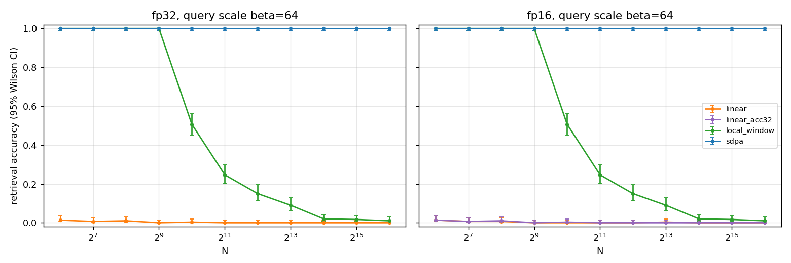
LINEAR ATTENTION / EXPERIMENT REVIEW
The lookup boundary: fast can mean unable to select
Original chart excerpt: beta=64, fp32/fp16. 300 identical seeded trials per cell.
fp32, beta=64, N=4096: SDPA 300/300; local-window 45/300; linear 0/300.
Source: results/retrieval.csv; figures/retrieval.png
07
Notes:
Beta scales the query to make selection sharp. At fp32 beta64 N1024: local152/300, linear1/300; N65536 local3/300 linear0/300. SDPA 300/300 all settings. Wilson95 upper bound at0/300 is1.2643%; observed zero is not a true-probability guarantee. CIs in source.
Source snapshot: 8096d83526f4d134778e438484fc02a5ff1f2af7. Repository: https://github.com/Jaiadithya71/linear-attention-benchmark
Source: results/retrieval.csv; figures/retrieval.png

Slide 8
LINEAR ATTENTION / EXPERIMENT REVIEW
Untrained Qwen swaps damage language quality
Perplexity = next-token surprise; lower is better on the same test windows.
Original 16-window variant | Perplexity at context 2048
SDPA baseline | 12.64966
Head-expanded SDPA (sdpa_mha) | 12.64988
Local-window swap | 61.38022
Basic linear swap | 4,532.95279
No training or fine-tuning. This rejects an untrained swap here, not trained linear-attention models.
The head-expanded exact path is the fair efficient baseline on this T4 setup; API path choice matters.
Source: results/qwen_quality.csv; results/qwen_prefill.csv
08
Notes:
Source snapshot: 8096d83526f4d134778e438484fc02a5ff1f2af7. Repository: https://github.com/Jaiadithya71/linear-attention-benchmark
Source: results/qwen_quality.csv; results/qwen_prefill.csv

Slide 9
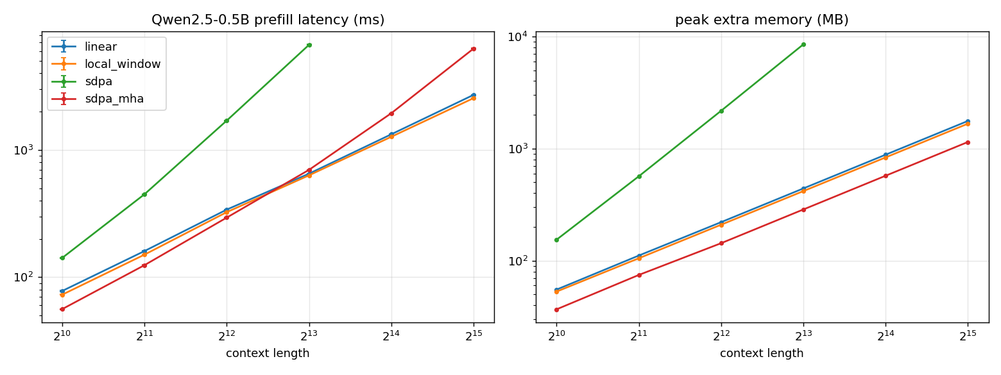
LINEAR ATTENTION / EXPERIMENT REVIEW
Original Qwen prefill needs a fair exact baseline
Transformer body only; pretrained fp16 weights. Faster swaps are not quality-preserving.
Head-expanded SDPA changes the timing baseline. Read speed together with the quality table.
Source: results/qwen_prefill.csv; figures/qwen_prefill.png
09
Notes:
Original cohort only. sdpa_mha expands grouped key/value heads. Do not pool original timings with the detailed CUDA12.8 cohort. N1024..32768, peak extra allocation measured. Untrained linear/local-window quality is worse on the matched original 16 windows.
Source snapshot: 8096d83526f4d134778e438484fc02a5ff1f2af7. Repository: https://github.com/Jaiadithya71/linear-attention-benchmark
Source: results/qwen_prefill.csv; figures/qwen_prefill.png

Slide 10
LINEAR ATTENTION / EXPERIMENT REVIEW
Initial adaptive results motivated the stricter follow-up
Different heads can choose different ranks. That alone does not establish accuracy.
Mild synthetic inputs
Pretrained Qwen
fp32, N=65,536, small-scale:
rank 256 for all 8 heads
router 116.8 ms vs SDPA 3,546.0 ms
fixed rank 256: 69.9 ms
8-window test:
forced ranks nonfinite on all windows
exact fallback on 2667/2688 heads
PPL 11.59157 vs baseline 11.59154
Selection has a cost. Forced ranks can fail. Near-baseline quality can simply mean "choose exact."
Source: results/adaptive_efficiency.csv; adaptive_retrieval.csv; adaptive_qwen_quality.csv
10
Notes:
Source snapshot: 8096d83526f4d134778e438484fc02a5ff1f2af7. Repository: https://github.com/Jaiadithya71/linear-attention-benchmark
Source: results/adaptive_efficiency.csv; adaptive_retrieval.csv; adaptive_qwen_quality.csv

Slide 11
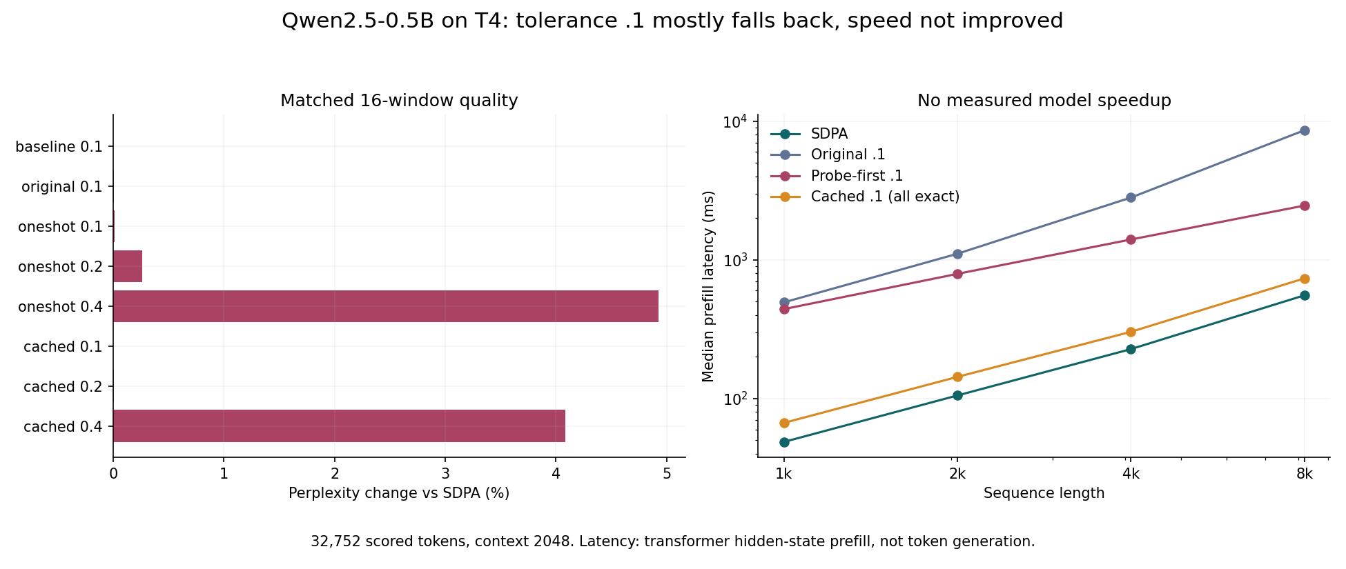
LINEAR ATTENTION / EXPERIMENT REVIEW
Detailed Qwen: no measured acceleration
Same 16 held-out windows for every method. Quality at 2048; speed at 1k..8k.
At .1: quality nearly holds, but every router is slower. At .4: quality worsens, still no speedup.
Source: results/router_detailed_qwen/qwen_quality.csv; qwen_prefill.csv
11
Notes:
Baseline PPL13.145472858. Original.1 13.146236413, oneshot.1 13.146910145, cached.1 baseline. Oneshot.4 +4.9255%, cached.4 +4.0813%. Timing transformer hidden-state prefill, not decode. Charts are original repository assets, not redrawn.
Source snapshot: 8096d83526f4d134778e438484fc02a5ff1f2af7. Repository: https://github.com/Jaiadithya71/linear-attention-benchmark
Source: results/router_detailed_qwen/qwen_quality.csv; qwen_prefill.csv

Slide 12
LINEAR ATTENTION / EXPERIMENT REVIEW
Good quality is mostly an exact-fallback result
Do not interpret unchanged perplexity as successful linear reuse.
0 / 1,344
8 / 1,344
0 / 280
Cached .1 chose zero linear heads across the four timing inputs.
Original/one-shot .1 chose linear for only 0.60% of timing choices.
Captured-activation cases accepted linear at .1 with 16 probes.
N=2048 prefill | Baseline | Original .1 | Probe-first .1 | Cached .1
Median latency | 105.3 ms | 1,106.0 ms | 792.3 ms | 143.4 ms
Counts are from timing/capture inputs, not the 16 quality windows. Cached .4: 64/1,344 linear choices.
Source: results/router_detailed_qwen/qwen_choices.csv; qwen_activation_heads.csv; qwen_prefill.csv
12
Notes:
Source snapshot: 8096d83526f4d134778e438484fc02a5ff1f2af7. Repository: https://github.com/Jaiadithya71/linear-attention-benchmark
Source: results/router_detailed_qwen/qwen_choices.csv; qwen_activation_heads.csv; qwen_prefill.csv

Slide 13
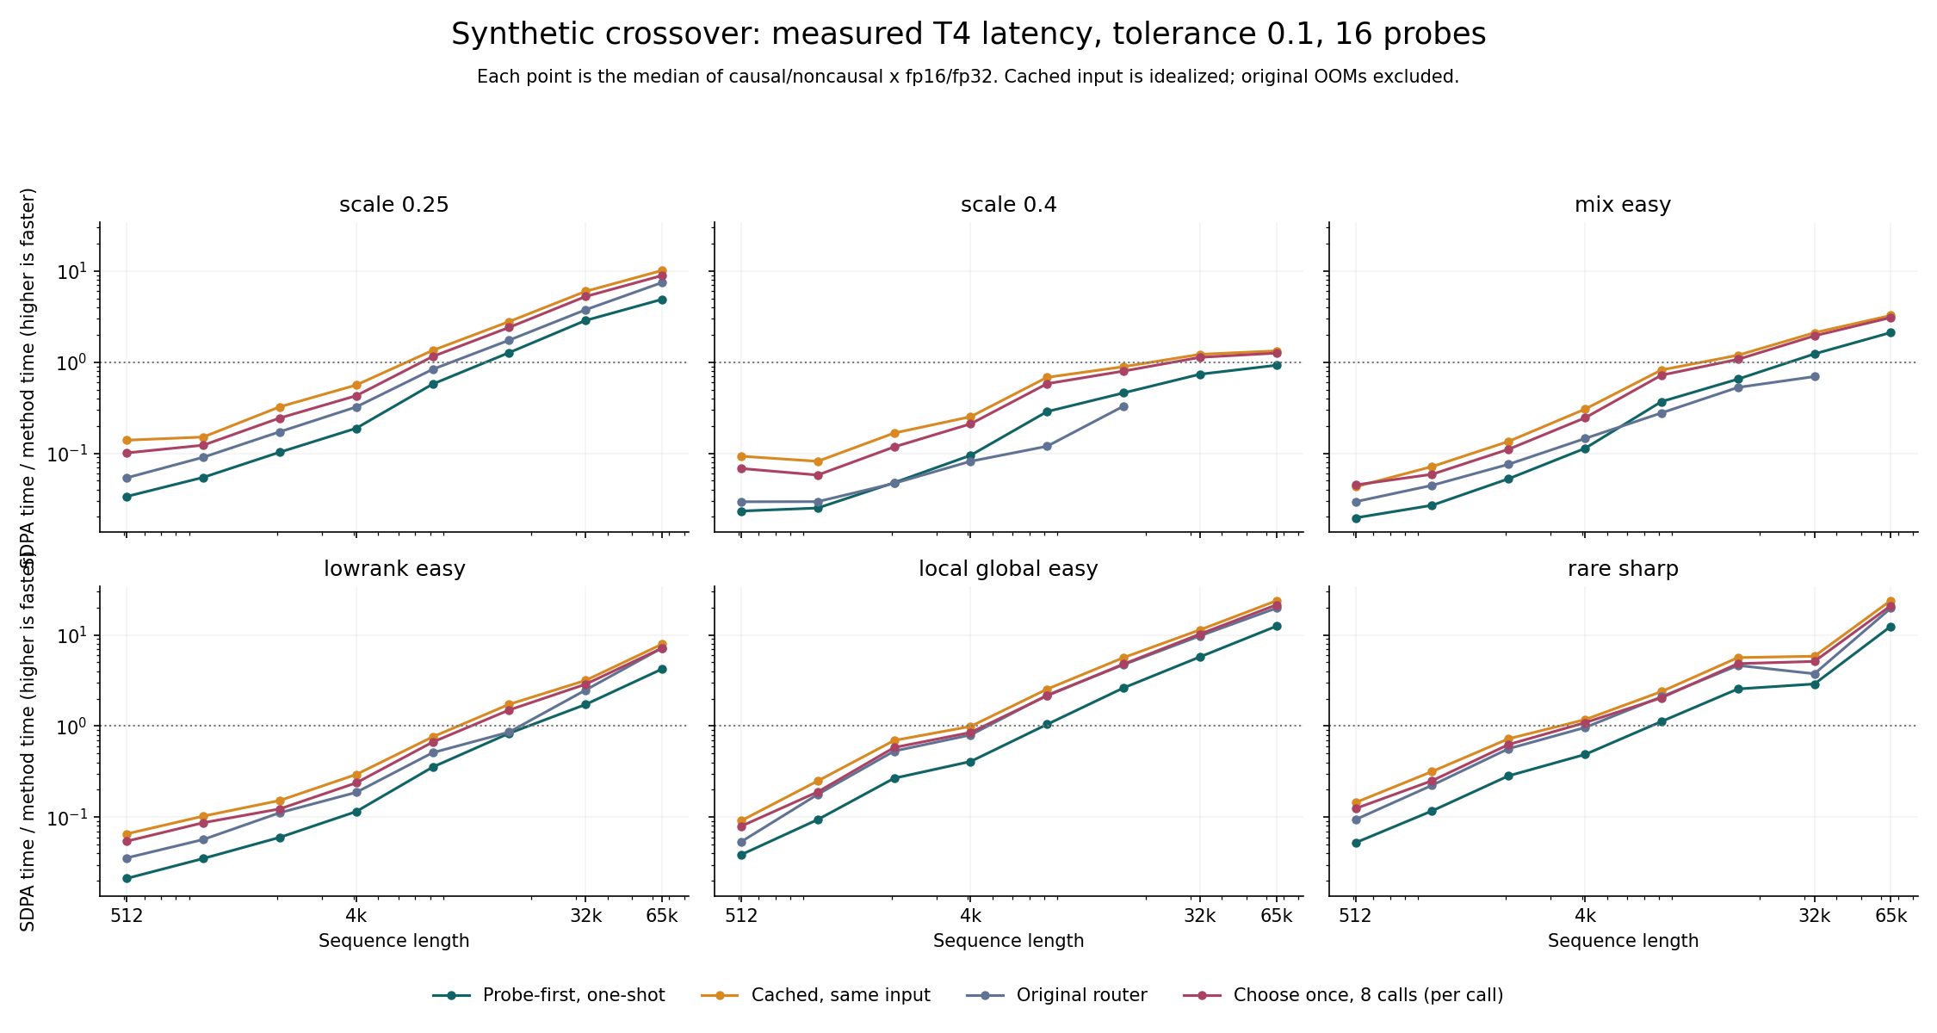
LINEAR ATTENTION / EXPERIMENT REVIEW
Synthetic wins emerge only under favorable conditions
Speedup >1 is faster than matched SDPA. Both axes are logarithmic.
One-shot median: 0.486x at 8k → 1.725x at 32k → 3.558x at 65,536.
Source: results/router_detailed/scaling.csv; make_router_detailed_report.py
13
Notes:
Six regimes x causal/noncausal x fp16/fp32. One-shot wins62/192 cells. Cached same-input84/192. Original59/178 successful;14/192 OOMs. Original survivor medians optimistic. Cached_same idealized, not deployment. Repeated8-call curve measured total normalized by actual8 calls.
Source snapshot: 8096d83526f4d134778e438484fc02a5ff1f2af7. Repository: https://github.com/Jaiadithya71/linear-attention-benchmark
Source: results/router_detailed/scaling.csv; make_router_detailed_report.py

Slide 14
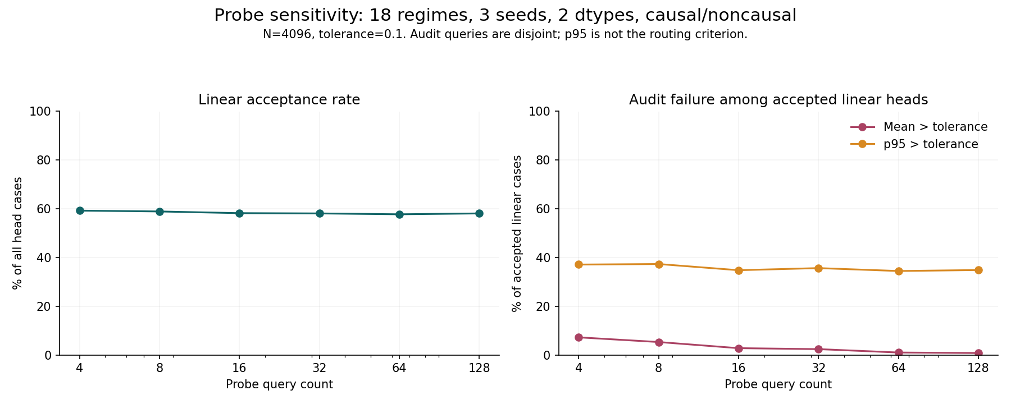
LINEAR ATTENTION / EXPERIMENT REVIEW
Passing sampled probes is not an accuracy guarantee
Mean relative L2 = average output-vector difference relative to the exact output size.
Of 1,006 accepted linear cases at .1 / 16 probes: 2.8% fail audit mean; 34.8% fail p95.
Source: results/router_detailed/sensitivity_heads.csv
14
Notes:
Default filter tol=.1,n_probe16,rank>0. 1006/1728 accepted;28 mean failures;350 p95 failures. Audits256 disjoint rows. Gate checks mean only, not p95. More probes reduce mean false acceptance, not a tail guarantee.
Source snapshot: 8096d83526f4d134778e438484fc02a5ff1f2af7. Repository: https://github.com/Jaiadithya71/linear-attention-benchmark
Source: results/router_detailed/sensitivity_heads.csv

Slide 15
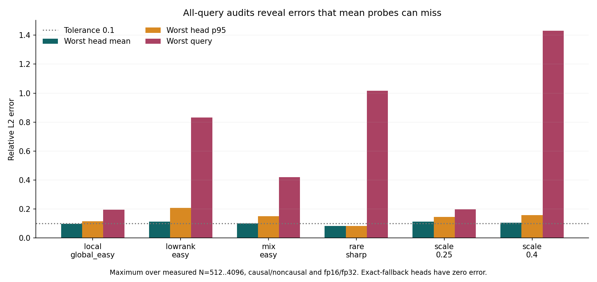
LINEAR ATTENTION / EXPERIMENT REVIEW
A small mean can hide a severe rare-query error
All-query audit through N=4096. The p95 is the error below which 95% of queries fall.
Rare-sharp: mean and p95 <0.1, but worst-query relative error reaches 1.015.
Source: results/router_detailed/scaling_heads.csv; validation_scope=all_query_rows
15
Notes:
38/684 selected-linear head cases have full-query mean>.1. Chart max aggregation across512..4096 and both masks/dtypes. Rare max1.015, relative L2 not "2x wrong" and not model perplexity. Full-query audits beyond4096 unmeasured.
Source snapshot: 8096d83526f4d134778e438484fc02a5ff1f2af7. Repository: https://github.com/Jaiadithya71/linear-attention-benchmark
Source: results/router_detailed/scaling_heads.csv; validation_scope=all_query_rows

Slide 16
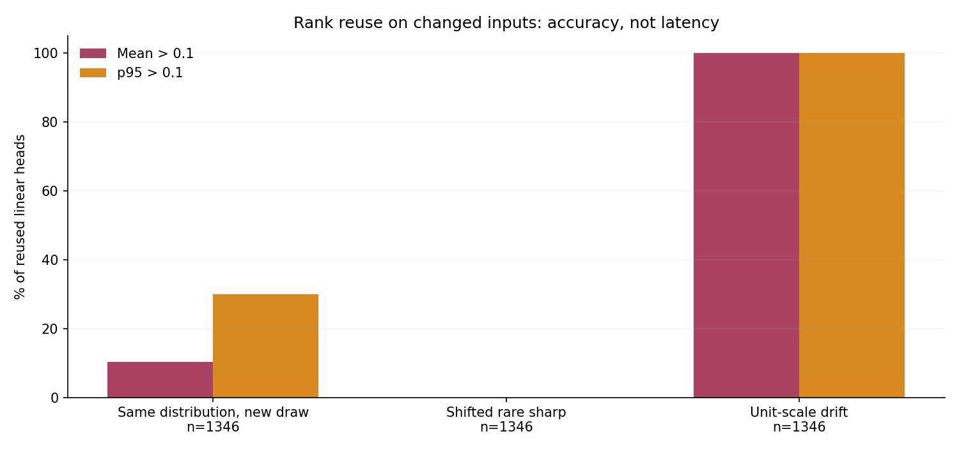
LINEAR ATTENTION / EXPERIMENT REVIEW
Cached ranks become unsafe under tested drift
Reuse must be checked on changed inputs, not justified by same-input timing alone.
Every tested unit-scale drift case exceeds .1 mean and p95 error (1,346 reused-linear heads).
Source: results/router_detailed/scaling_heads.csv; nonempty cache_target, rank>0
16
Notes:
Each drift group has1346 reused-linear head cases. Same-distribution new draws sometimes fail. Shifted rare-sharp passes sampled mean/p95, but all-query rare-sharp result rules out interpreting sampled success as universal safety.
Source snapshot: 8096d83526f4d134778e438484fc02a5ff1f2af7. Repository: https://github.com/Jaiadithya71/linear-attention-benchmark
Source: results/router_detailed/scaling_heads.csv; nonempty cache_target, rank>0

Slide 17
LINEAR ATTENTION / EXPERIMENT REVIEW
Limits are part of the result
A benchmark boundary is useful only when its scope is explicit.
Evidence stops here
Execution history is preserved
One T4, one model, one corpus
16 quality windows, selected layers
Qwen quality only at 2048
Detailed model speed only through 8192
Full-query synthetic audit only through 4096
First follow-up failed at Qwen capture:
a two-value return was unpacked as three.
One-line fix + regression test.
Only Qwen resumed; settings unchanged.
Original source and partial manifest retained.
Finite outputs ≠ safe approximation. No decode result. No extrapolated Qwen crossover.
Source: manifests; qwen_data_manifest.json; results/router_detailed/post_result_changes.md
17
Notes:
Source snapshot: 8096d83526f4d134778e438484fc02a5ff1f2af7. Repository: https://github.com/Jaiadithya71/linear-attention-benchmark
Source: manifests; qwen_data_manifest.json; results/router_detailed/post_result_changes.md

Slide 18
LINEAR ATTENTION / EXPERIMENT REVIEW
Conclusion: keep the negative result intact
The contribution is a measured boundary and a tested failure mode, not a speedup claim.
What the evidence says
What a next version must prove
Long synthetic inputs can be cheaper.
Sharp selection is fragile.
Mean-probe acceptance misses tails.
The current router is not a Qwen accelerator.
Tail / worst-query acceptance criteria
Numerical stability on real activations
Drift-aware cache invalidation
Matched real-model latency + quality wins
Proposed tests are future work, not implemented capabilities or predicted successes.
Source: all repository CSVs; current SUMMARY.md
18
Notes:
Source snapshot: 8096d83526f4d134778e438484fc02a5ff1f2af7. Repository: https://github.com/Jaiadithya71/linear-attention-benchmark
Source: all repository CSVs; current SUMMARY.md

Slide 19
LINEAR ATTENTION / EXPERIMENT REVIEW
Reproducibility and review map
Every number is traceable to CSV rows. Charts are the original repository figures.
Review topic | Primary saved evidence
Basic speed / memory / lookup | results/efficiency.csv; retrieval.csv
Original model swaps / adaptive tests | results/qwen_*.csv; adaptive_*.csv
Detailed synthetic speed / errors / drift | router_detailed/: scaling, scaling_heads, sensitivity_heads CSVs
Detailed Qwen quality / latency / fallback | router_detailed_qwen/: quality, prefill, choices CSVs
Environment / failure / provenance | Run configs; manifests; original source; change disclosure
Repository: github.com/Jaiadithya71/linear-attention-benchmark
Newcomer documentation: docs/PROJECT_GUIDE.md
Recreate detailed figures: python make_router_detailed_report.py
Source snapshot: 8096d83526f4d134778e438484fc02a5ff1f2af7
19
Notes:
Source snapshot: 8096d83526f4d134778e438484fc02a5ff1f2af7. Repository: https://github.com/Jaiadithya71/linear-attention-benchmark
Source snapshot: 8096d83526f4d134778e438484fc02a5ff1f2af7

