Slide 1
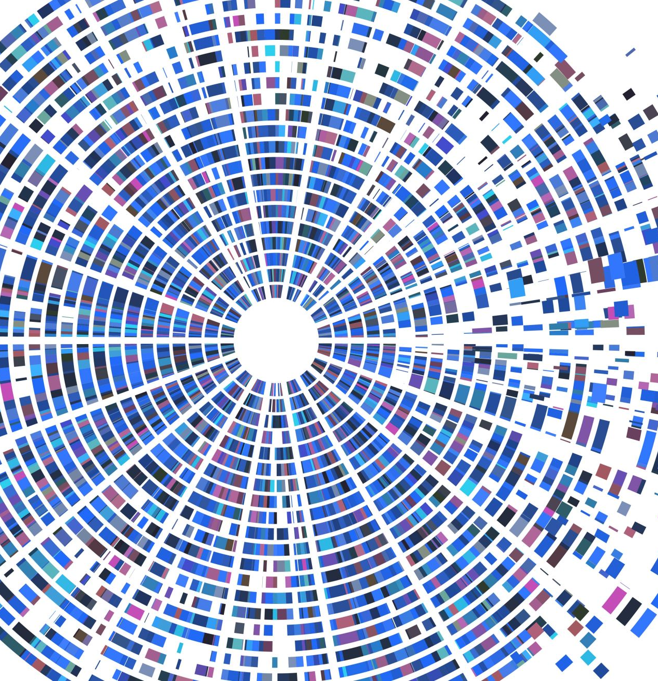
SENTIMENTAL ANALYSIS OF USER COMMENTS ON YOUTUBE VIDEOS
TEAM MEMBERS:
JAIDEEP SHARMA – 2010030374
NIHAL AGARWAL – 2010030413
T VENKATA SAI SATHVIK – 2010030361
SHAIK ABDUL SHAAN – 2010030153
MENTOR :- Dr. Arpita Gupta

Slide 2
TABLE OF CONTENTS
TOPIC | SLIDE NO
PROBLEM STATEMENT | 3
MOTIVATION | 4
LITERATURE SURVEY | 5-6
DATASET COLLECTION | 9-14
TECHNIQUES | 15
CONCLUSIONS | 16
ENHANCEMENTS | 17
REFERENCES | 18
SUGGESTIONS | 19
THANKYOU | 20
2/04/2022
SENTIMENTAL ANALYSIS OF USER COMMENTS ON YOUTUBE VIDEO
2

Slide 3
PROBLEM STATEMENT
The classification of YouTube data based on sentiment Analysis aims to provide efficient and accurate graphical representation of like, views from the dataset using sentiment Analysis. To overcome all these problems, we are designing a system for YouTube creators to have an overview of what customers think about the product they launch. There are many comments which takes a huge time to analyze and understand customer’s POV. Through our model creators can understand the customer’s review whether it is positive, negative or neutral. This metadata serve the purpose of helping community to filter relevant opinions more efficiently.
2/04/2022
SENTIMENTAL ANALYSIS OF USER COMMENTS ON YOUTUBE VIDEO
3

Slide 4
MOTIVATION
YouTube is the online streaming flatform. Which provides many user to post their content to provides education, entertainment, Daily News Updates, Movie Release Information and Review etc. YouTube provides a comment section for user feedback. So that it encourage the youtuber to make more content related to that. So Many people do spam in the comment section to defame the youtuber. So, we want to analysis the comments and detect spam user and give the feedback to that video. As YouTube is also working in this, They are detecting the comments if any user share any kind of links in the comment section. But still spammer find many other to do it. So, we want to give a proper analysis to that video so that the youtuber can be recognized for his/her content and make more videos. So, basically Comments are analyzed for polarity and are further segregated as positive or negative.
2/04/2022
SENTIMENTAL ANALYSIS OF USER COMMENTS ON YOUTUBE VIDEO
4

Slide 5
LITERATURE SURVEY
S.No. | Authors | Title | Publishing | Techniques & Datasets | Pros | Cons
1 | Parabhoi, Lambodara, and Payel Saha. "Sentiment analysis of YouTube comments on Koha open source software videos." Int J Libr Inf | Sentiment Analysis of YouTube Comments on Koha Open Source Software Videos | Stud (2018): 2231-4911. | Keywords: Sentiment Analysis, Koha, YouTube Comments, YouTube Videos. | Review of 404 comments on the video was done for sentiments. | No proper scraping of spam, fake comments.
2 | Tripto, Nafis Irtiza, and Mohammed Eunus Ali. "Detecting multilabel sentiment and emotions from bangla youtube comments." | Detecting Multilabel Sentiment and Emotions from Bangla YouTube Comments | In 2018 International Conference on Bangla Speech and Language Processing (ICBSLP), pp. 1-6. IEEE, 2018 | Keyword: Bangla language | 10% more accuracy was achieved for the analysis data. | Only sentimental analysis of Bangla language was done.
2/04/2022
SENTIMENTAL ANALYSIS OF USER COMMENTS ON YOUTUBE VIDEO
5

Slide 6
S.NO | Authors | Title | Publishing | Techniques & Datasets | Pros | Cons
3 | Novendri, Risky, Annisa Syafarani Callista, Danny Naufal Pratama, and Chika Enggar Puspita. | Sentiment Analysis of YouTube Movie Trailer Comments Using Naïve Bayes | "Sentiment analysis of YouTube movie trailer comments using naïve bayes." Bulletin of Computer Science and Electrical Engineering 1, no. 1 (2020): 26-32. | Keywords: Sentiment analysis, Naïve Bayes, Money Heist, Youtube, Opinion Mining | They have done analysis of movie trailer reviews and comments, which achieved 81% of accuracy.
4 | K.M.KavithaAshaShettyBryanAbreoAdlineD’SouzaAkarshaKondana Department of Computer Science & Engineering, St Joseph Engineering College, Vamanjoor, Mangaluru 575028, India | Analysis and Classification of User Comments on YouTube Videos | Available online 11 November 2020, Version of Record 11 November 2020. | Keywords YouTube Comments Classification Video Description Association list Bag of words | Comments are divided into 4 segments , which are relevant, irrelevant, positive, negative. | Was only able to analyse comments in one language.
2/04/2022
SENTIMENTAL ANALYSIS OF USER COMMENTS ON YOUTUBE VIDEO
6

Slide 7
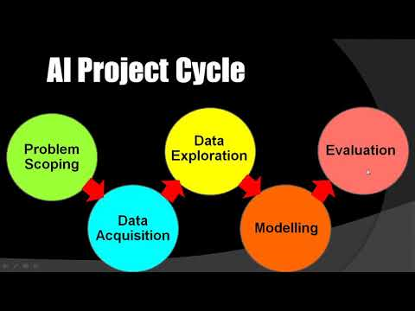
AI CYCLE
2/04/2022
SENTIMENTAL ANALYSIS OF USER COMMENTS ON YOUTUBE VIDEO
7

Slide 8
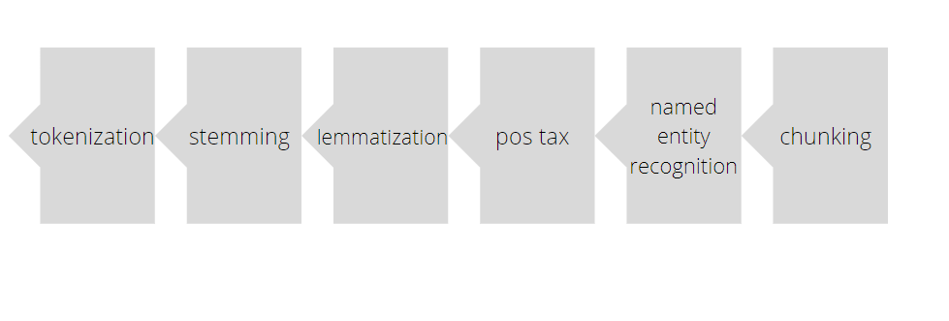
SIX STEPS TOWARDS NLP
2/04/2022
SENTIMENTAL ANALYSIS OF USER COMMENTS ON YOUTUBE VIDEO
8

Slide 9
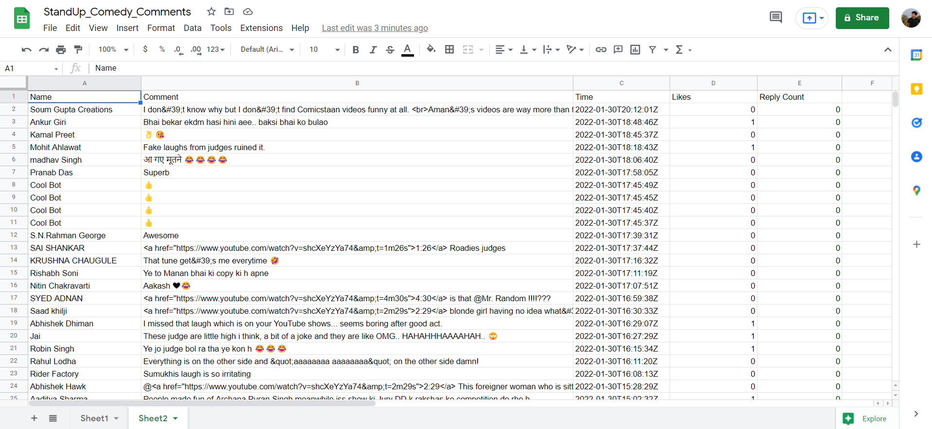
DATA SET:
Our project is based on sentimental analysis on YouTube Comments. So, we must extract a comments of a particular video. So, we are choosing this link to extract the comments. (https://www.youtube.com/watch?v=shcXeYzYa74). we are using YouTube API 3 to extract the comments.
2/04/2022
SENTIMENTAL ANALYSIS OF USER COMMENTS ON YOUTUBE VIDEO
9

Slide 10
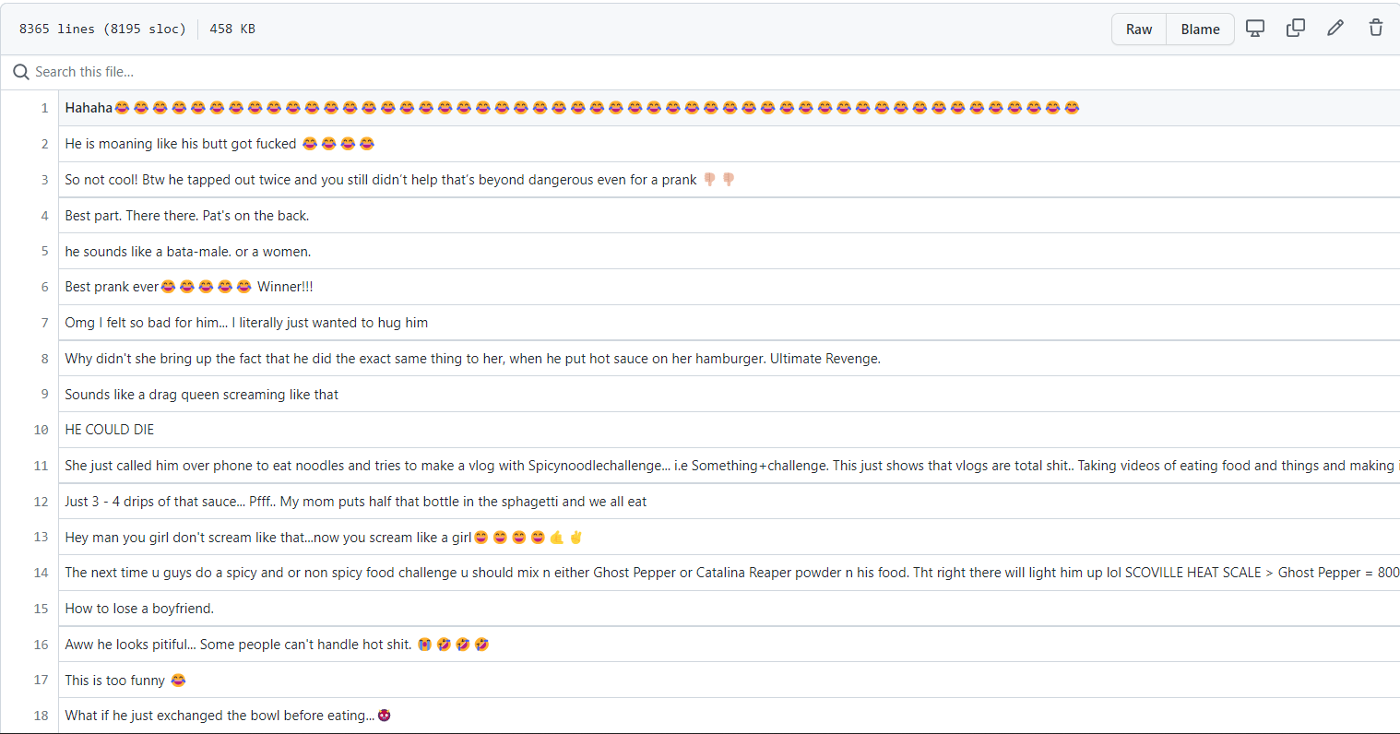
DATA SET:
We have found the dataset with name commentscraperfile.csv, which is available in the following link (https://github.com/Anshnarad/Youtube-Comment-Analysis/blob/master/commentscraperfile.csv) , here the developer has used python packages and YouTube Data API to extract comments and then use of NLTK is made to work with human language data that is comments.
2/04/2022
SENTIMENTAL ANALYSIS OF USER COMMENTS ON YOUTUBE VIDEO
10

Slide 11
FEATURE ENGINEERING
The main role of feature engineering is data cleaning. Which is the toughest and most kinky part of the work, as we have a lot of raw data that needs to be cleaned to get the perfect analysis.
It is a process if extracting useful features from raw data using math, statistics and domain knowledge of the field.
2/04/2022
SENTIMENTAL ANALYSIS OF USER COMMENTS ON YOUTUBE VIDEO
11

Slide 12
FEATURE SELECTION
Feature selection is the process of reducing the input variable to your model by using our only relevant data and getting rid of unnecessary data.
using feature selection can lead to the following
1. prevent learning from noise.
2. improved accuracy.
3. reduce training time.
There are two types of methods for performing the reduction
Supervised
Unsupervised
By using selection methods, we can reduce the input comments which are not needed or doesn’t make a difference in analysis
2/04/2022
SENTIMENTAL ANALYSIS OF USER COMMENTS ON YOUTUBE VIDEO
12

Slide 13
DATA PRE-PROCESSING
Pre-processing of data plays an important role because the data on which we work is always noisy, it also has missing and false values.
Feature selection and feature extraction are the important methods that can perform the data preprocessing.
Feature selection:-Selecting relevant features, and discarding irrelevant features as seen above.
Feature extraction:- Is a method that converts m attributes of our data to n attributes of our data.
Methods for feature extraction are
Count vectorizer
TFIDF vectorizer
Word embeddings
One-hot vector
Bag of words
2/04/2022
SENTIMENTAL ANALYSIS OF USER COMMENTS ON YOUTUBE VIDEO
13

Slide 14
DATA PRE-PROCESSING
In machine learning data is split into training dataset and testing dataset.
Training Set: A subset of dataset to train the machine learning model, and we already know the output.
Test set: A subset of dataset to test the machine learning model, and by using the test set, model predicts the output.
2/04/2022
SENTIMENTAL ANALYSIS OF USER COMMENTS ON YOUTUBE VIDEO
14

Slide 15

TECHNIQUES:
We are using YouTube API 3 to extract the comments.
To clean the data probably using the selenium tool.
To detect the spam comments, we will be using some heuristic methods like N-gram
2/04/2022
SENTIMENTAL ANALYSIS OF USER COMMENTS ON YOUTUBE VIDEO
15

Slide 16
ENHANCEMENT
There is no proper project and analysis done on YouTube comment sentiment Analysis. There are analysis done on twitter comments, there is a different dataset prepared on twitter.
So the change which we are brining is, we will do graphical analysis using data visualisation for YouTube comments. We will be filtering out the spam comments and do the analysis. It will help the creator to understand the review for his video/product more faster and easier rather than checking at sentiment analysis score. He can understand the highs and lows in the graph according to the time lapse. This is a enhancement and suggestion which we wanted to bring.
2/04/2022
SENTIMENTAL ANALYSIS OF USER COMMENTS ON YOUTUBE VIDEO
16

Slide 17
CONCLUSION
This project will simplify the work for YouTube and content creators by understanding about the product’s review given by the customers. By extracting their comments into a dataset based on their views, likes and comments, we can understand what kind of positive, negative comment has occurred on that video so user can analyze about the work they need to do to develop and improve their video more and uploading more videos.
2/04/2022
SENTIMENTAL ANALYSIS OF USER COMMENTS ON YOUTUBE VIDEO
17

Slide 18
Reference:
Aiyar, Shreyas, and Nisha P. Shetty. "N-gram assisted YouTube spam comment detection." Procedia computer science 132 (2018): 174-182. N-Gram Assisted YouTube Spam Comment Detection. In this they are using Random forest, Support Vector Machine algorithm to detect the spam, along with this they used certain custom heuristic such as N-Gram which has a efficient in detecting the spam comments. (https://www.sciencedirect.com/science/article/pii/S1877050918309153)
Kantchelian, Alex, Justin Ma, Ling Huang, Sadia Afroz, Anthony Joseph, and J. D. Tygar. "Robust detection of comment spam using entropy rate." In Proceedings of the 5th ACM Workshop on Security and Artificial Intelligence, pp. 59-70. 2012.They are using parsimonious hand-lablling strategy to detect the spam comments.(https://dl.acm.org/doi/abs/10.1145/2381896.2381907)
Madden, Amy, Ian Ruthven, and David McMenemy. "A classification scheme for content analyses of YouTube video comments." Journal of documentation (2013).
Severyn, Aliaksei, Alessandro Moschitti, Olga Uryupina, Barbara Plank, and Katja Filippova. "Multi-lingual opinion mining on YouTube." Information Processing & Management 52, no. 1 (2016): 46-60.Basically they are working on multi-language ( English and Italian). (https://www.sciencedirect.com/science/article/abs/pii/S0306457315000400)
2/04/2022
SENTIMENTAL ANALYSIS OF USER COMMENTS ON YOUTUBE VIDEO
18

Slide 19

SUGGESTIONS
2/04/2022
SENTIMENTAL ANALYSIS OF USER COMMENTS ON YOUTUBE VIDEO
19

Slide 20

THANK YOU
Mentor: Dr. Arpita Gupta
2/04/2022
SENTIMENTAL ANALYSIS OF USER COMMENTS ON YOUTUBE VIDEO
20

