Slide 1

YOUTUBE COMMENT ANALYSIS
TEAM MEMBERS
JAIDEEP SHARMA - 2010030413
T VENKATA SAI SATHVIK – 2010030361
NIHAL AGARWAL – 2010030413
SHAIK ABDUL SHAAN - 2010030153

Slide 2
WEB-SCRAPING USING SELENIUM
Selenium is a python library and tool used for automating web browsers to perform some tasks. Web-scraping is used to extract useful data and information that may be otherwise unavailable.
For analysing the comments we are using selenium and google API
The installing and importing the required libraries.
After that we have to setup Chrome-Driver and scrap the comments
For scraping the comments, we have to use the video link from YouTube.
We have taken a list for storing all comments present for the specific video.
Here we have a unsorted data, which has to be distributed into groups so that we gain different information related to respective comment, such as, count of replies, likes and many more components.

Slide 3
code
function scrapeCommentsWithoutReplies(){
var ss = SpreadsheetApp.getActiveSpreadsheet();
var result=[['Name','Comment','Time','Likes','Reply Count']];
var vid = ss.getSheets()[0].getRange(1,1).getValue();
var nextPageToken=undefined;
while(1){
var data = YouTube.CommentThreads.list('snippet', {videoId: vid, maxResults: 100, pageToken: nextPageToken})
nextPageToken=data.nextPageToken
//console.log(nextPageToken);
for (var row=0; row<data.items.length; row++) {
result.push([data.items[row].snippet.topLevelComment.snippet.authorDisplayName,
data.items[row].snippet.topLevelComment.snippet.textDisplay,
data.items[row].snippet.topLevelComment.snippet.publishedAt,
data.items[row].snippet.topLevelComment.snippet.likeCount,
data.items[row].snippet.totalReplyCount]);
}
if(nextPageToken =="" || typeof nextPageToken === "undefined"){
break;
}
}
var newSheet=ss.insertSheet(ss.getNumSheets())
newSheet.getRange(1, 1,result.length,5).setValues(result)
}

Slide 4
Data will be in a table format with table labelled as
Comment
Commentor name
Comment time
Number of lies
Count of replies
Likes

Slide 5
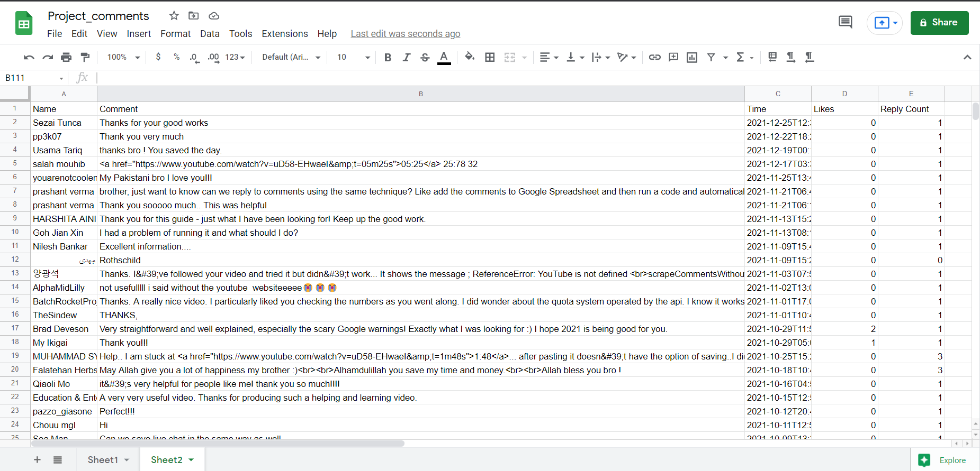
LIST IMAGES :-
https://docs.google.com/spreadsheets/d/1hFVoJz-EVJvJAERxjjVfkHG1J2JrEXxz4BZK3RStCDs/edit?usp=sharing

Slide 6
USE OF GOOGLE API
If in future of there are changes in YouTube comments or YouTube design, then this method would not work. To avoid this we have used google API so that if any changes in design and comments, that would not affect analysed data set.

Slide 7
Future implementations
In next parts of the implementation, preparation of data-frame to store the analysis of data is to be created.

