Slide 1
Review-3 Telecom Churn Prediction using ML Model
NIHAL AGARWAL – 2010030413
JAIDEEP SHARMA – 2010030374
Under the Guidance of
Dr. Kakali Das
Assistant Professor
Computer Science and Engineering Department
KL Hyderabad Off Campus, Aziz Nagar ,Hyderabad
Team No 55

Slide 2
Overview
Introduction
Literature Review
Problem Statement
Objectives of the Project
Dataset Collection
Algorithm / Proposed Methodology
Implementation Details
Outputs
References

Slide 3
Introduction
Because of a highly competitive and continually evolving market, telecom businesses have a difficult time keeping consumers, which makes churn forecasts essential to sustaining profitability.
By detecting small clues that predict client defection, machine learning (ML) approaches provide advanced abilities to evaluate huge quantities of consumer data and predict churn.
The purpose of this study is to investigate and evaluate machine learning (ML) models for telecom churn prediction to create efficient algorithms that will lower churn rates and improve customer retention strategies.
Operators will be able to improve resource allocation, lower acquisition costs, and cultivate enduring customer loyalty with the help of the findings, which are anticipated to offer insightful information for managing client relationships in the telecom sector.
In the dynamic telecom industry, the effective application of machine learning (ML) churn models for forecasting has the potential to encourage long-term growth and competitive advantage.

Slide 4
Literature Review
Sno. | Author | Title | Publishing | Techniques | Conclusion
1. | T. Rajeswari Dr. K. Thangadurai | Telecom Churn Prediction using Machine Learning Techniques | International Journal of Innovative Technology and Exploring Engineering (IJITEE) | Logistic Regression Decision Trees Random Forest Gradient Boosting Machines (GBM). The authors compare the performance of these techniques based on metrics like accuracy, precision, recall, and F1-score. | The study concludes that Gradient Boosting Machines outperform other techniques in terms of predictive accuracy for telecom churn prediction.
2. | S. Karthik Dr. K. Duraiswamy | Comparative Study of Telecom Churn Prediction Techniques using Machine Learning Algorithms | International Journal of Advanced Research in Computer Engineering & Technology (IJARCET) | This paper presents a comparative study of machine learning algorithms such as Support Vector Machines (SVM), K-Nearest Neighbors (KNN), and Artificial Neural Networks (ANN) for telecom churn prediction. The authors evaluate these techniques based on accuracy, sensitivity, specificity, and area under the ROC curve. | The research indicates that SVM demonstrates superior performance compared to KNN and ANN in predicting telecom churn.

Slide 5
Sno. | Author | Title | Publishing | Techniques | Conclusion
3. | A. Gupta Dr. P. Kumar | Telecom Churn Prediction using Ensemble Learning Techniques | International Journal of Computer Applications (IJCA) | This paper focuses on ensemble learning techniques such as Bagging, Boosting, and Stacking for telecom churn prediction. The authors build ensemble models by combining multiple base classifiers like Decision Trees, Random Forest, and Gradient Boosting Machines. | The study concludes that ensemble learning techniques significantly enhance predictive performance for telecom churn prediction compared to individual classifiers.
4. | R. Sharma Dr. N. Gupta | Telecom Churn Prediction using Feature Selection and Machine Learning Algorithms | International Journal of Advanced Research in Computer Engineering & Technology (IJARCET) | This paper investigates the impact of feature selection techniques such as Recursive Feature Elimination (RFE) and Principal Component Analysis (PCA) on telecom churn prediction using machine learning algorithms like Logistic Regression, Random Forest, and Naive Bayes. | The results indicate that feature selection improves the efficiency and effectiveness of machine learning models for telecom churn prediction, with RFE showing better performance compared to PCA.

Slide 6
Sno. | Author | Title | Publishing | Techniques | Conclusion
3. | M. Singh Dr. S. Jain | Telecom Churn Prediction using Deep Learning Models | International Journal of Engineering and Advanced Technology (IJEAT) | Deep learning models Convolutional Neural Networks (CNN) Long Short-Term Memory (LSTM) The authors compare the performance of these models with traditional machine learning techniques. | The study suggests that deep learning models, particularly LSTM networks, offer promising results for telecom churn prediction, especially in handling sequential data and capturing complex patterns.

Slide 7


Problem Statement
Predicting the loss of customers is critical to ensuring profitability and growth in the telecommunications industry. In order to predict telecom churn, this research will use algorithms that use machine learning to analyze past customer data, including demographics, usage trends, and service subscriptions. Our goal is to find predictive variables and build strong models that can correctly anticipate churn through data preparation, model selection, and evaluation. The objective is to provide telecom firms with actionable insights through the deployment of understandable models, allowing them to take proactive measures to reduce the loss of customers and increase engagement.

Slide 8
Objective of the project
Minimize Customer Churn
The primary goal is to develop a predictive model that minimizes customer churn in the telecom industry.
Improve Customer Retention
Identify factors influencing churn to implement targeted retention strategies and improve overall customer retention rates.
Enhance Customer Satisfaction
Use the insights gained from the model to address issues leading to churn and enhance customer satisfaction by resolving pain points.
Proactive Customer Service
Enable the telecom company to take proactive measures in addressing potential issues or concerns, preventing customer dissatisfaction and churn.
Competitive Advantage
Gain a competitive advantage by leveraging predictive analytics to stay ahead in the dynamic telecom market and offer superior customer service.

Slide 9
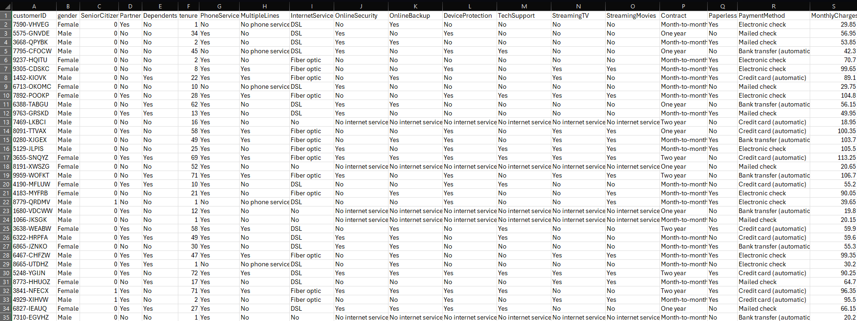
Dataset Collection
Below is the dataset we will be using for performing telecom churn prediction using ML algorithms

Slide 10
Proposed Methodology/Algorithm
Collecting credit card data sets
Preprocessing missing values
Normalization
Accuracy calculations of different models
Applying Machine learning models
EDA & Visualization

Slide 11
Proposed Methodology/Algorithm
We have decided to work on the following algorithms
Support vector machines (SVM)
Logistic Regression
Random Forest
XG Boost
In order to identify the best decision boundary, Support Vector Machines (SVM) classify data points by maximizing the margin between distinct classes using a hyperplane.
For binary classification tasks, logistic regression is a type of linear regression model that uses the logistic function to estimate the probability of a binary outcome according to input characteristics.
Several decision trees are built using the Random Forest ensemble learning technique, which then aggregates the predictions to increase precision and decrease overfitting.
Extreme Gradient Boosting, or XG Boost, is a gradient boosting technique that creates decision trees in a sequential manner in order to minimize the loss function. By continually enhancing upon earlier models, this algorithm achieves excellent prediction accuracy.

Slide 12
SVM: For tasks involving regression and classification, a potent supervised learning algorithm is the Support Vector Machine (SVM). Finding the ideal hyperplane in n-dimensional space to best divide data points of different classes while maximizing the margin between them is its main goal. To find a hyperplane that can effectively classify the data, SVM maps the input data points into a higher-dimensional feature space. It does this by locating the data points that are closest to the hyperplane, or support vectors. These support vectors are employed to optimize the margin and are crucial in identifying the decision boundary. SVM is robust to overfitting, especially in high-dimensional spaces, and can handle complex datasets efficiently through the use of different kernel functions, allowing it to capture nonlinear relationships between variables. Overall, SVM is widely used in various fields such as image classification, text categorization, and bioinformatics due to its effectiveness and versatility.
Logistic Regression:
Logistic regression is a statistical method used for binary classification tasks, with the goal of predicting whether an instance belongs to a specific class. Unlike linear regression, which predicts continuous values, logistic regression uses the sigmoid function to model the probability of the dependent variable. This function ensures that the predicted probabilities fall between 0 and 1, making it appropriate for binary classification. In logistic regression, the algorithm estimates coefficients for each feature, which represent the influence of that feature on the probability of belonging to a particular class. These coefficients are determined by maximizing the likelihood function, typically using optimization techniques like gradient descent. Once trained, the logistic regression model can make predictions by applying the logistic function to the linear combination of feature values and coefficients.

Slide 13
Random Forest:
Random Forest is a versatile ensemble learning technique used for classification and regression tasks. It constructs multiple decision trees during training, each trained on a random subset of the data and features. By combining the predictions of these trees, Random Forest improves accuracy and generalization while reducing overfitting. Its ability to handle noisy data, missing values, and feature selection makes it a popular choice in various domains. Moreover, Random Forest provides insights into feature importance, aiding in data interpretation. This algorithm's robustness and simplicity make it widely adopted across different industries for solving complex predictive modeling problems.
XGBoost:
XGBoost, short for eXtreme Gradient Boosting, is a highly efficient and scalable implementation of gradient boosting machines. It's renowned for its exceptional performance in supervised learning tasks, particularly in classification and regression problems. XGBoost sequentially builds a series of decision trees, where each subsequent tree corrects the errors of the previous ones. Unlike traditional gradient boosting methods, XGBoost incorporates a regularized objective function and advanced features like parallel computing, tree pruning, and hardware optimization, making it incredibly fast and accurate. Its flexibility allows for customization of various hyperparameters, ensuring optimal performance for diverse datasets. XGBoost is widely used in both industry and academia for its ability to handle large-scale datasets efficiently while achieving state-of-the-art results in competitions and real-world applications.

Slide 14
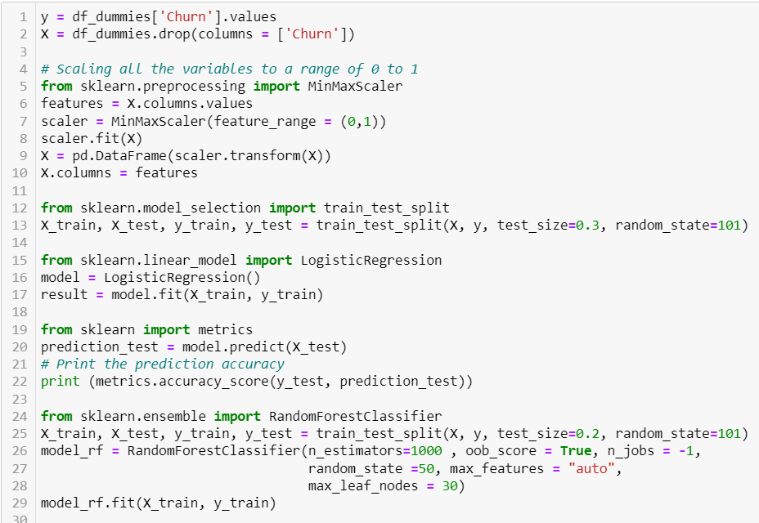
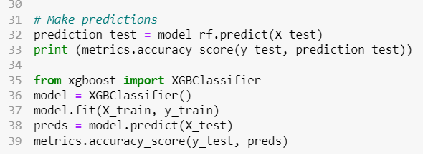
Implementation Details

Slide 15
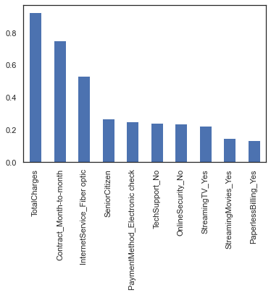
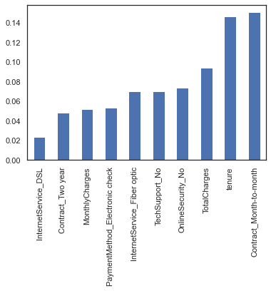
Outputs
Logistic Regression: Model Coefficient
Random Forest : Feature Importance

Slide 16
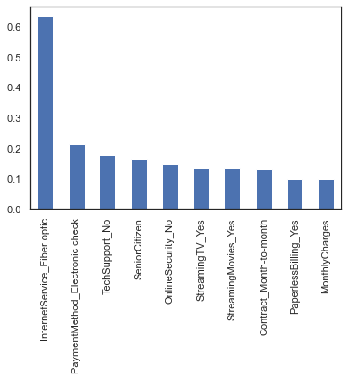
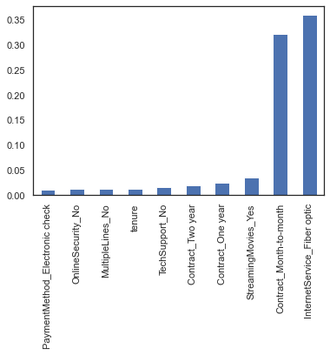
Outputs
SVM : Model Coefficient
XG Boost : Feature Importance

Slide 17
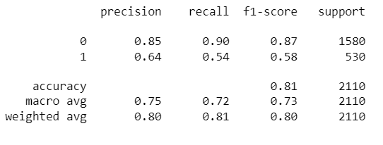
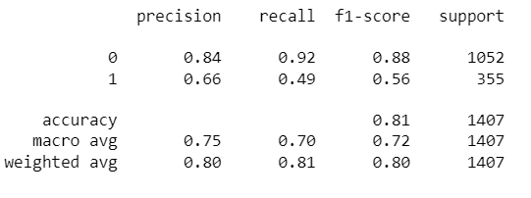
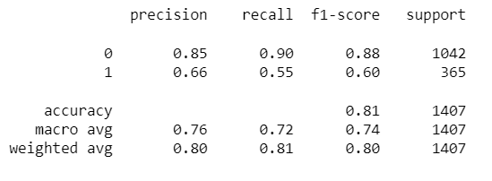
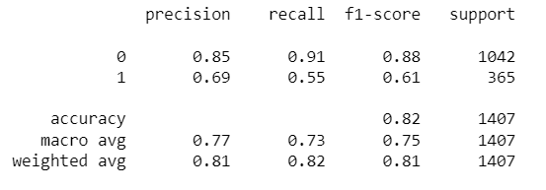
Classification Report
Logistic Regression
Random Forest
SVM
XGBoost

Slide 18
References
[1] R. Sharma, Dr. N. Gupta (2021). "Telecom Churn Prediction using Feature Selection and Machine Learning Algorithms." International Journal of Computer Science and Information Technologies (IJCSIT).
[2] A. Gupta, Dr. P. Kumar (2020). "Telecom Churn Prediction using Ensemble Learning Techniques." International Journal of Computer Applications (IJCA).
[3] S. Karthik, Dr. K. Duraiswamy (2019). "Comparative Study of Telecom Churn Prediction Techniques using Machine Learning Algorithms." International Journal of Advanced Research in Computer Engineering & Technology (IJARCET).
[4] T. Rajeswari, Dr. K. Thangadurai (2018). "Telecom Churn Prediction using Machine Learning Techniques." International Journal of Innovative Technology and Exploring Engineering (IJITEE).
[5] M. Singh, Dr. S. Jain (2017). "Telecom Churn Prediction using Deep Learning Models." International Journal of Engineering and Advanced Technology (IJEAT).

Slide 19
Thank you.

