Slide 1
Annuity IITGN Capstone Winter Projects Algorithmic Trading Strategy Development
Jaidev Sanjay Khalane

Slide 2
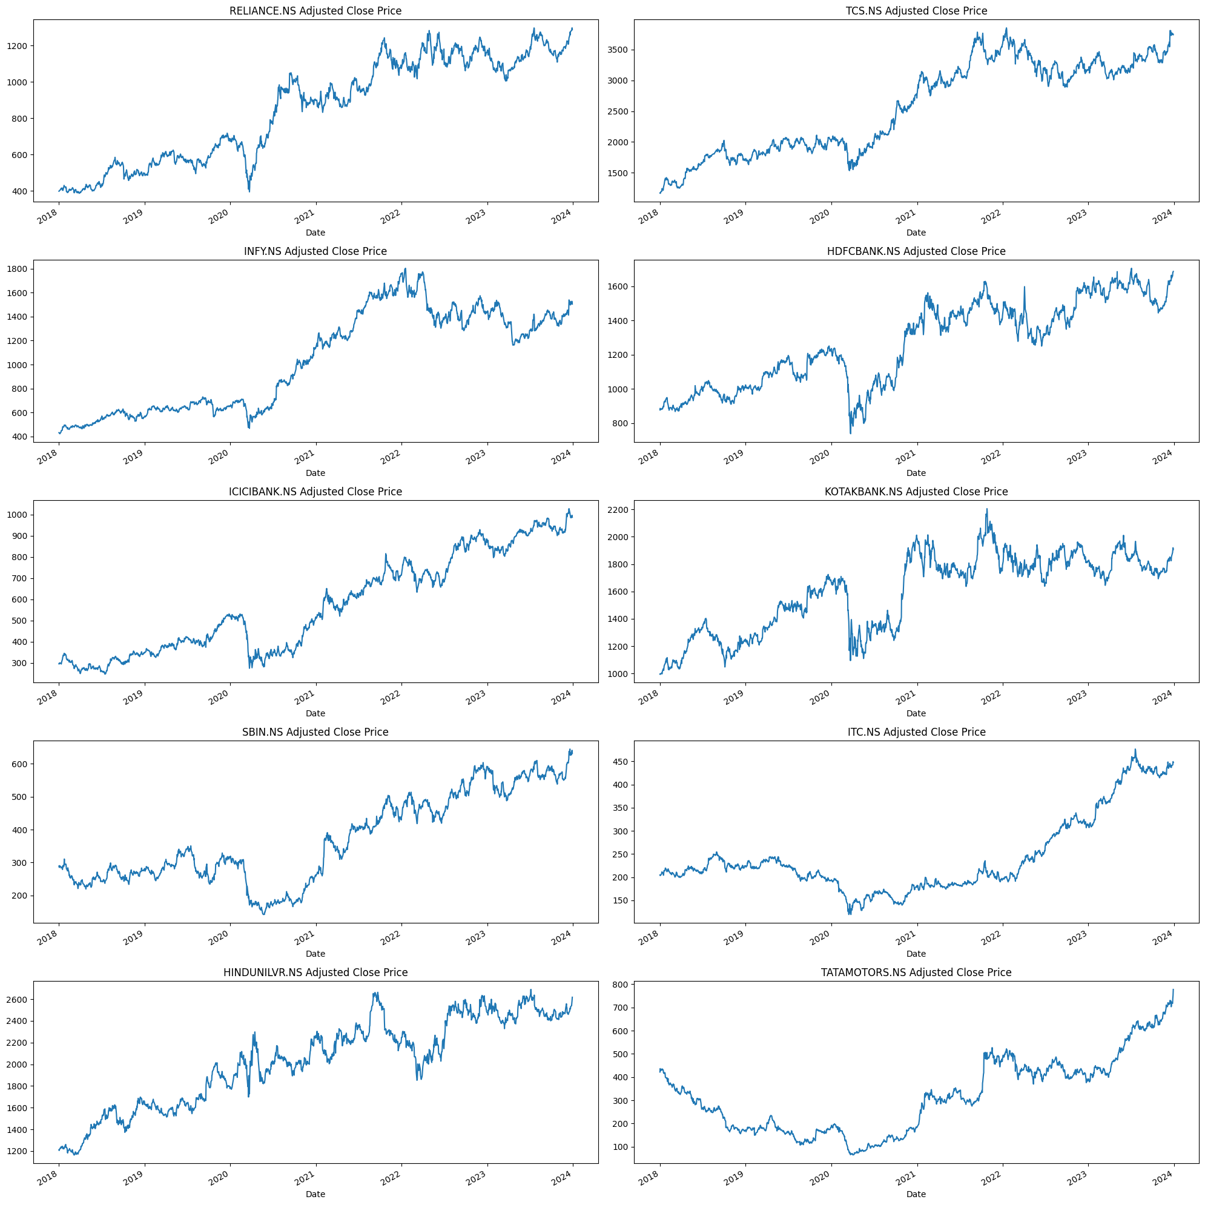
Step 1: Market Data Analysis

Slide 3
Step 2: Strategy Development
Simple Moving Average (SMA) crossover strategy: In this strategy, traders look for the crossover of two different SMA periods, for example, a 50-day SMA and a 200-day SMA. When the 50-day SMA crosses above the 200-day SMA, it signals a bullish trend and traders may consider buying the stock. Conversely, when the 50-day SMA crosses below the 200-day SMA, it signals a bearish trend and traders may consider selling the stock.
Exponential Moving Average (EMA) crossover strategy: This strategy is similar to the SMA crossover strategy, but instead of using simple moving averages, traders use exponential moving averages. EMAs give more weight to recent price movements, making them more responsive to changes in trend.
Moving Average Divergence-Convergence (MACD) strategy: This strategy uses the MACD indicator, which is derived from two exponential moving averages. Traders look for the crossover of the MACD line and the signal line, which is a 9-day EMA of the MACD line. When the MACD line crosses above the signal line, it signals a bullish trend, and when it crosses below the signal line, it signals a bearish trend

Slide 4
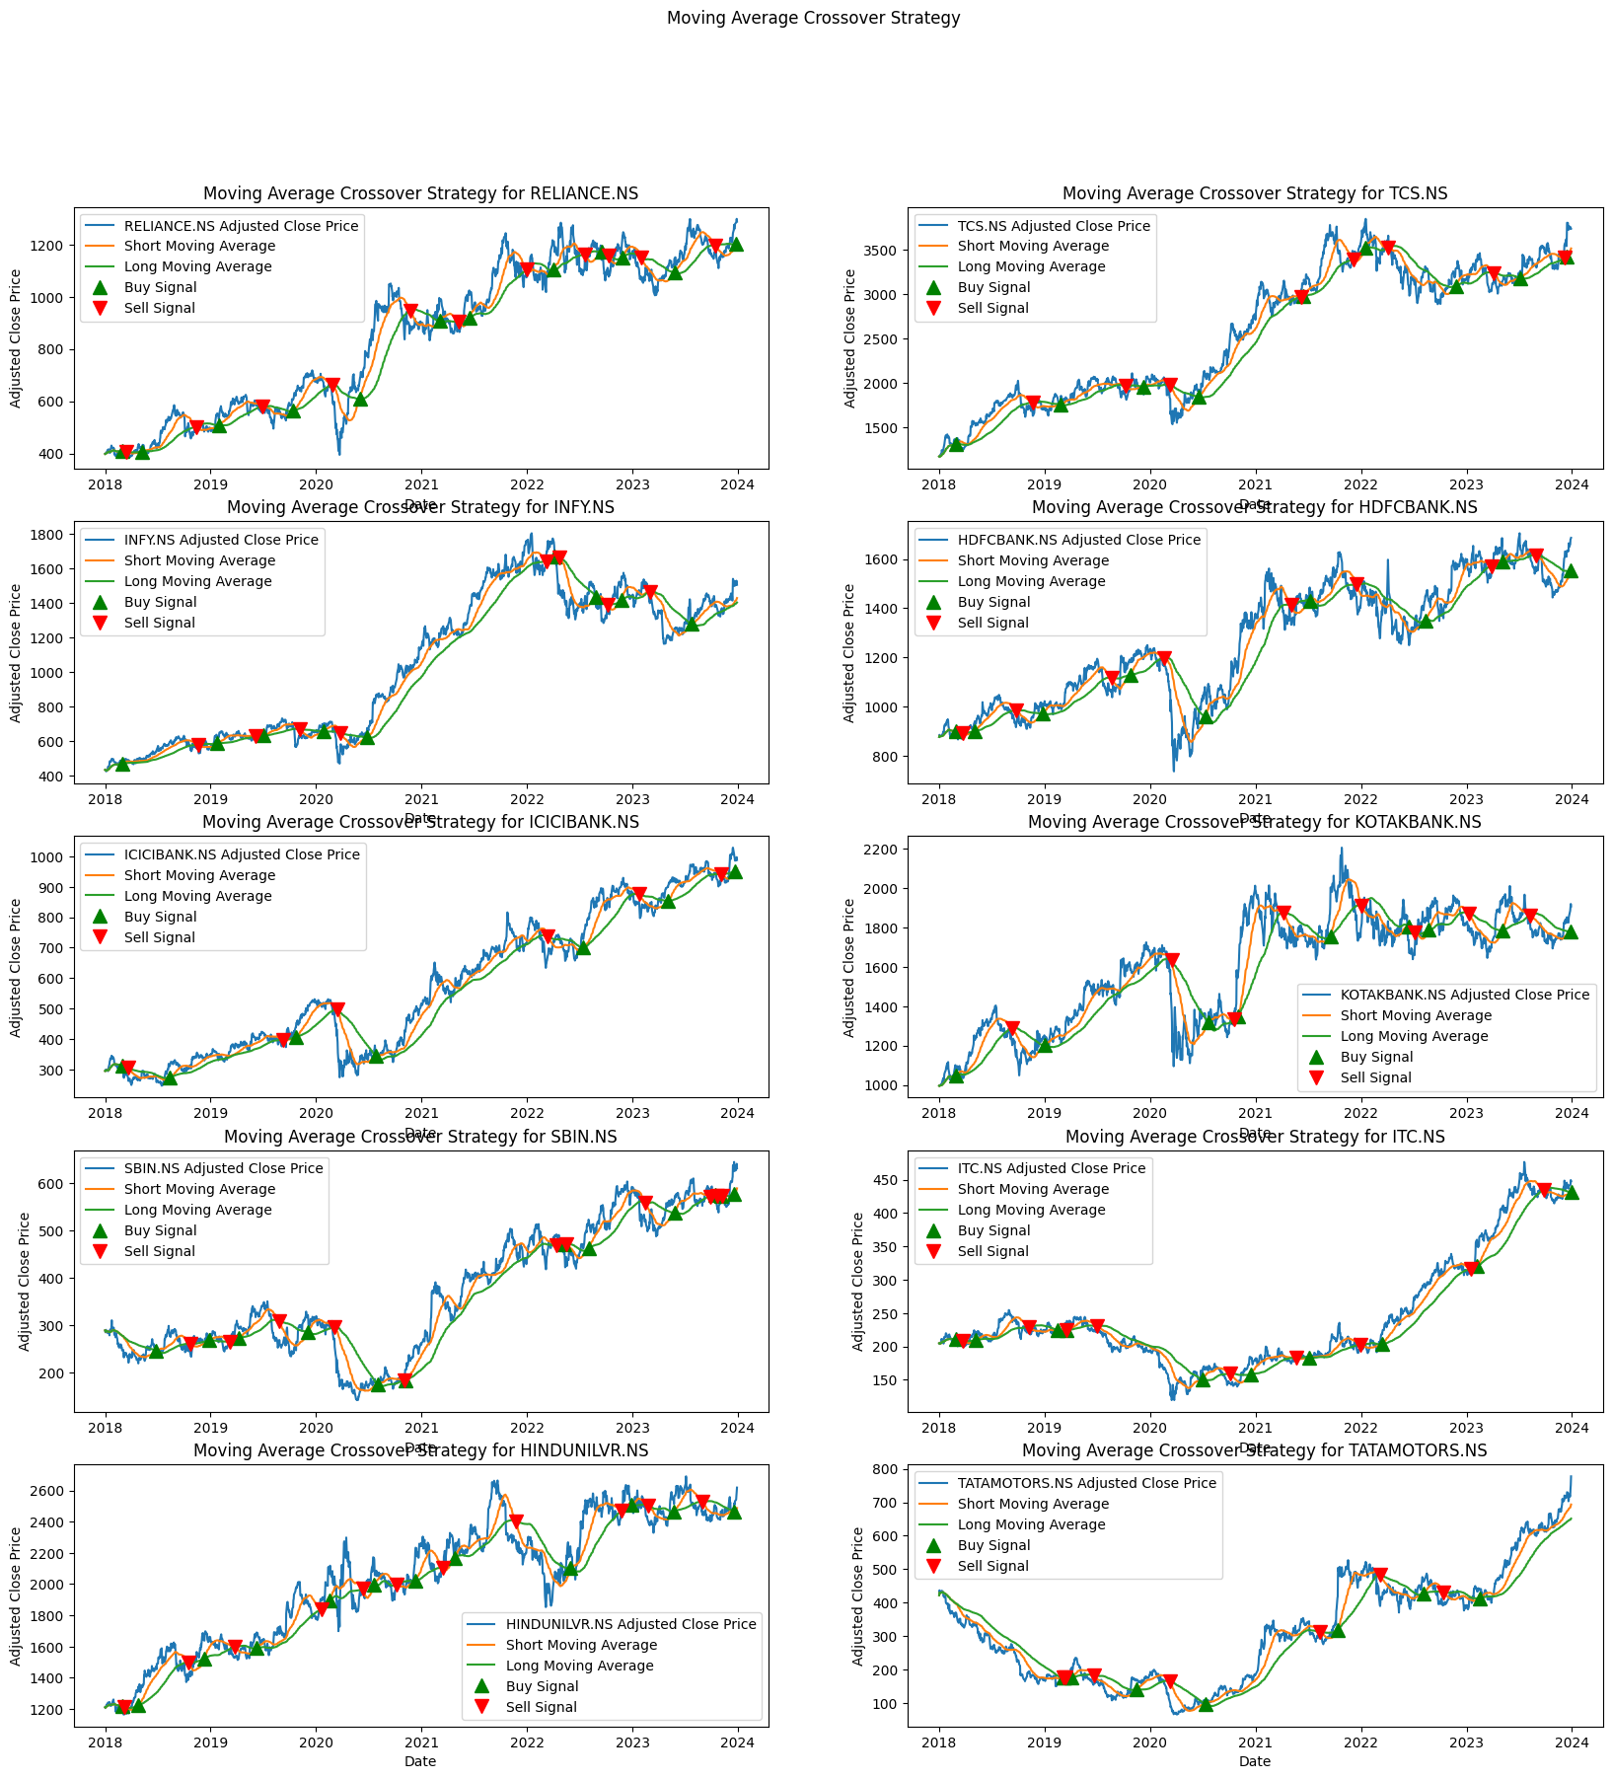
Moving Average Crossover Strategy

Slide 5
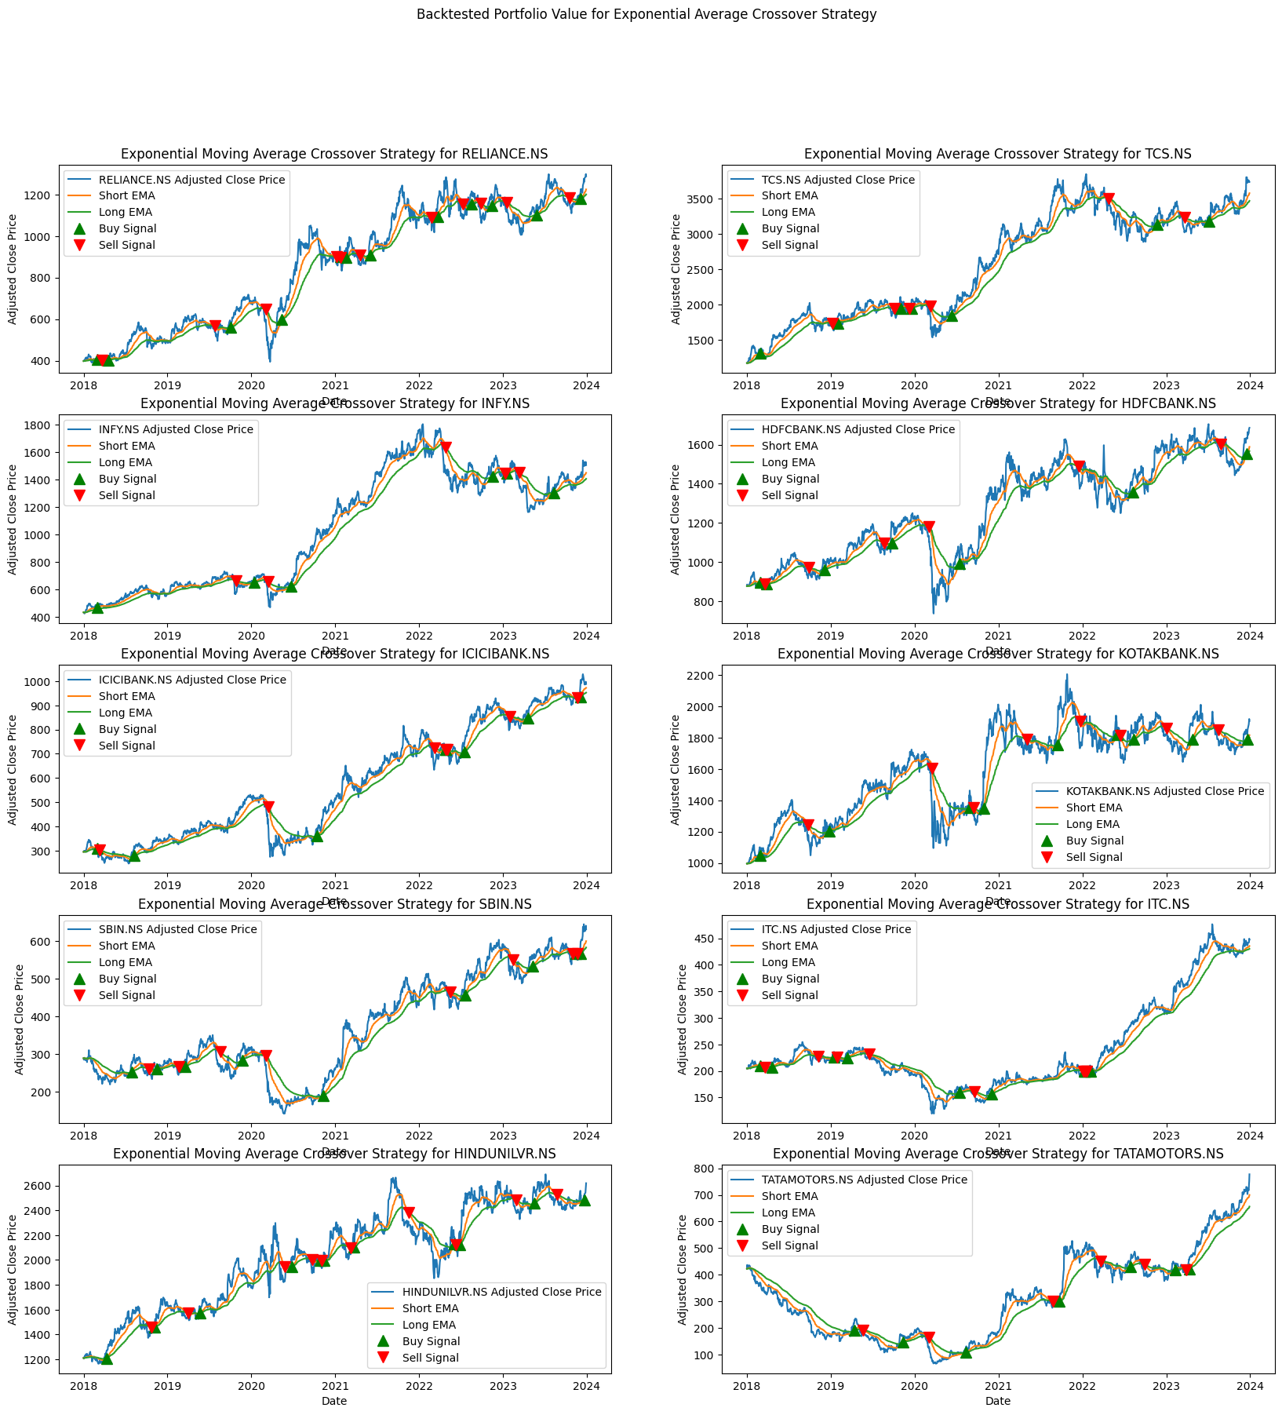
Exponential Moving Average Crossover Strategy

Slide 6
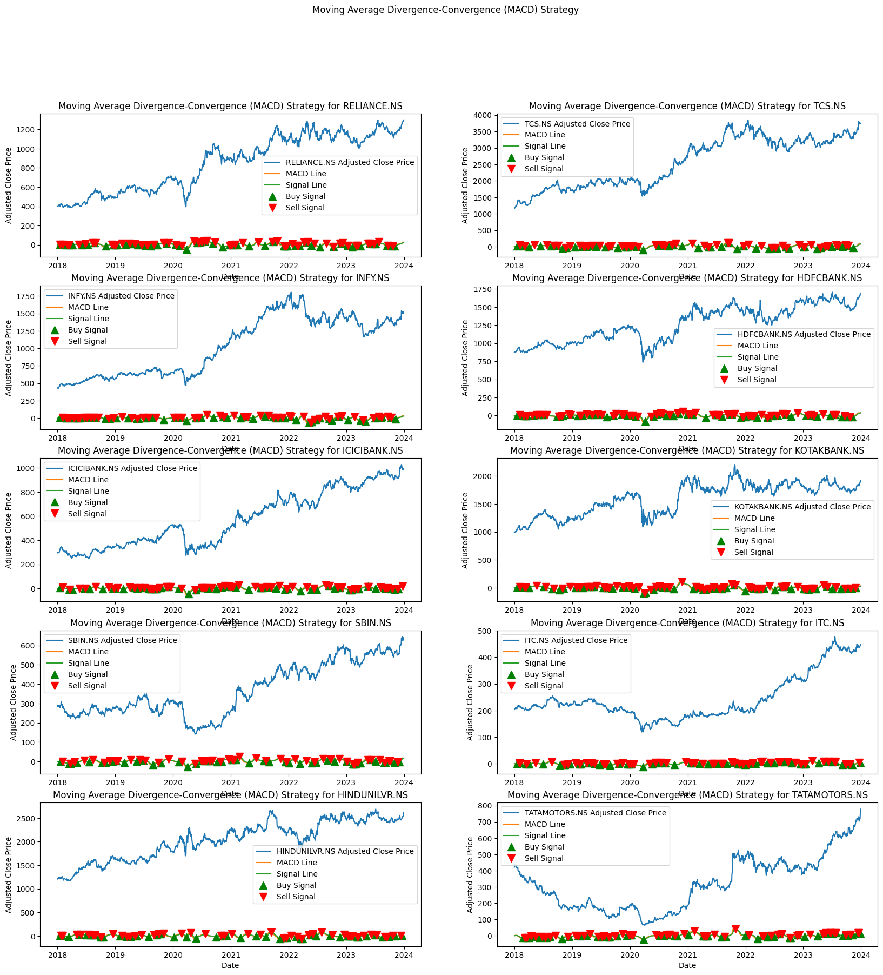
Moving Average Divergence-Convergence (MACD) Strategy

Slide 7
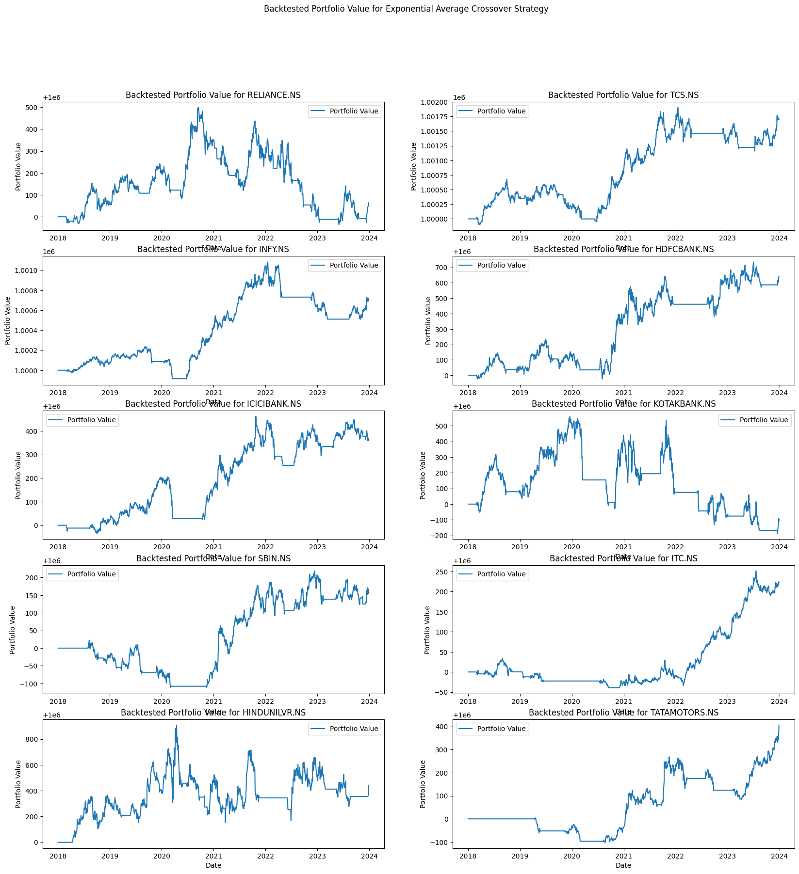
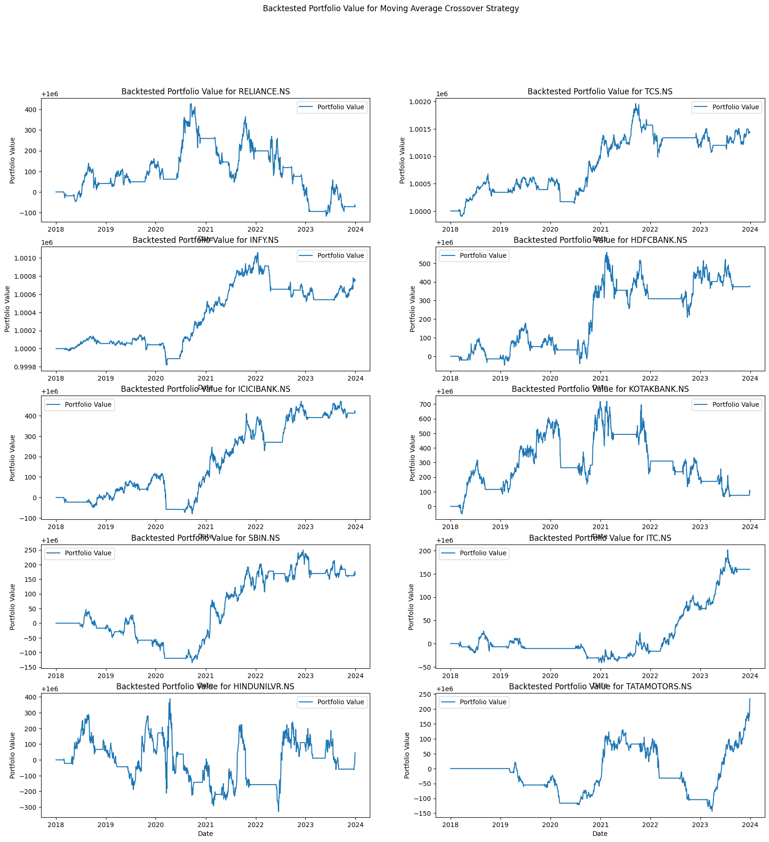
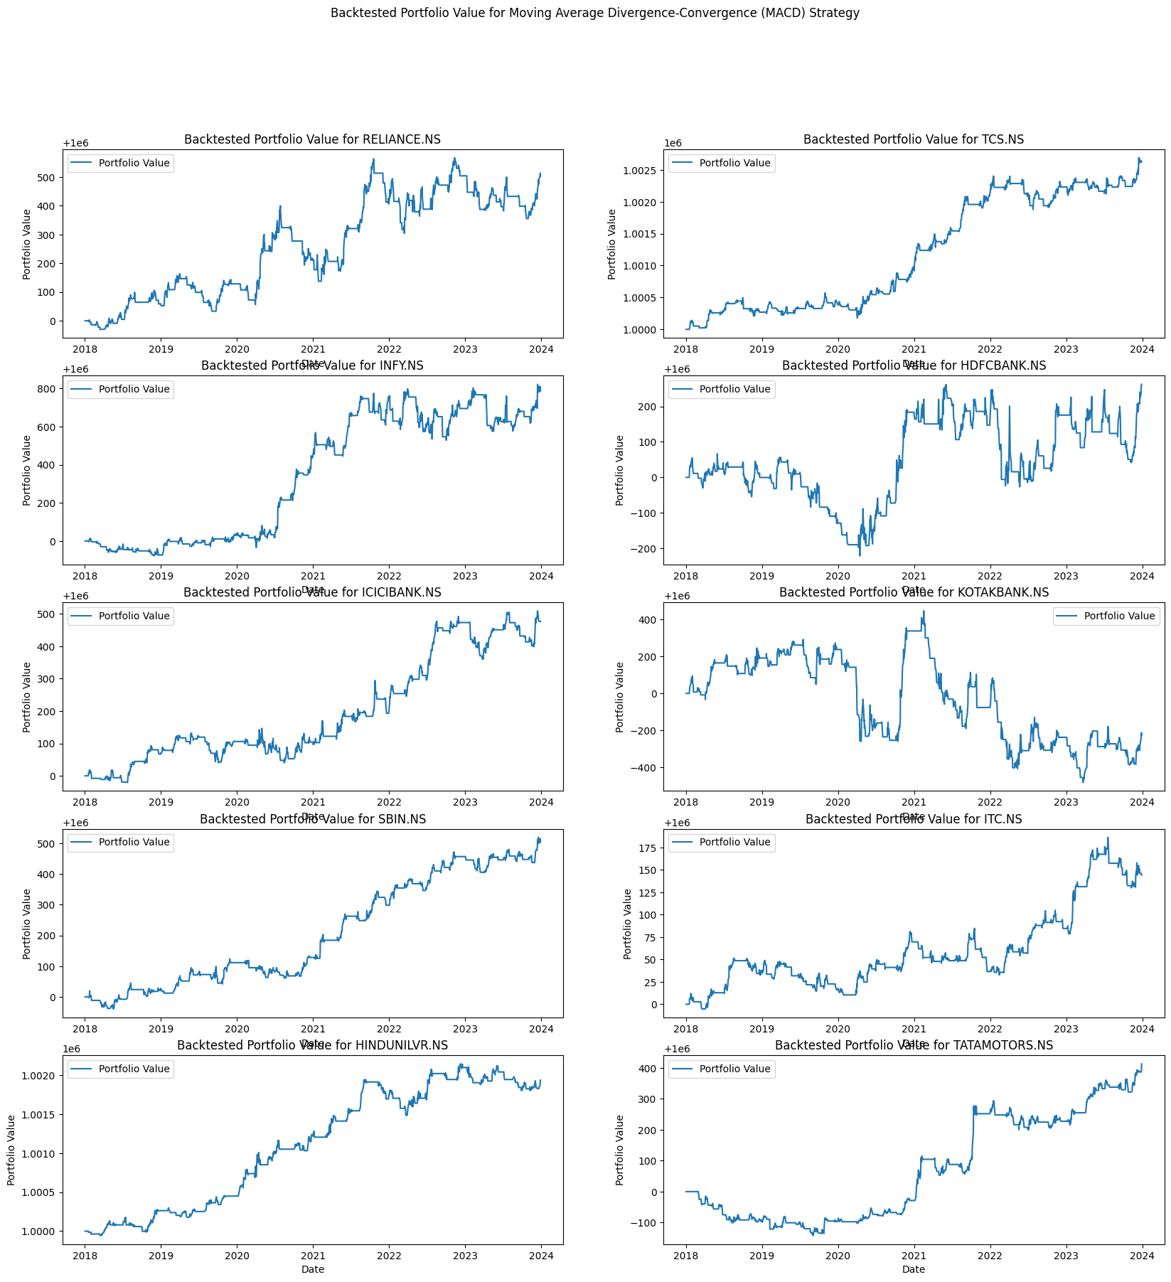
Step 3: Backtesting

Slide 8
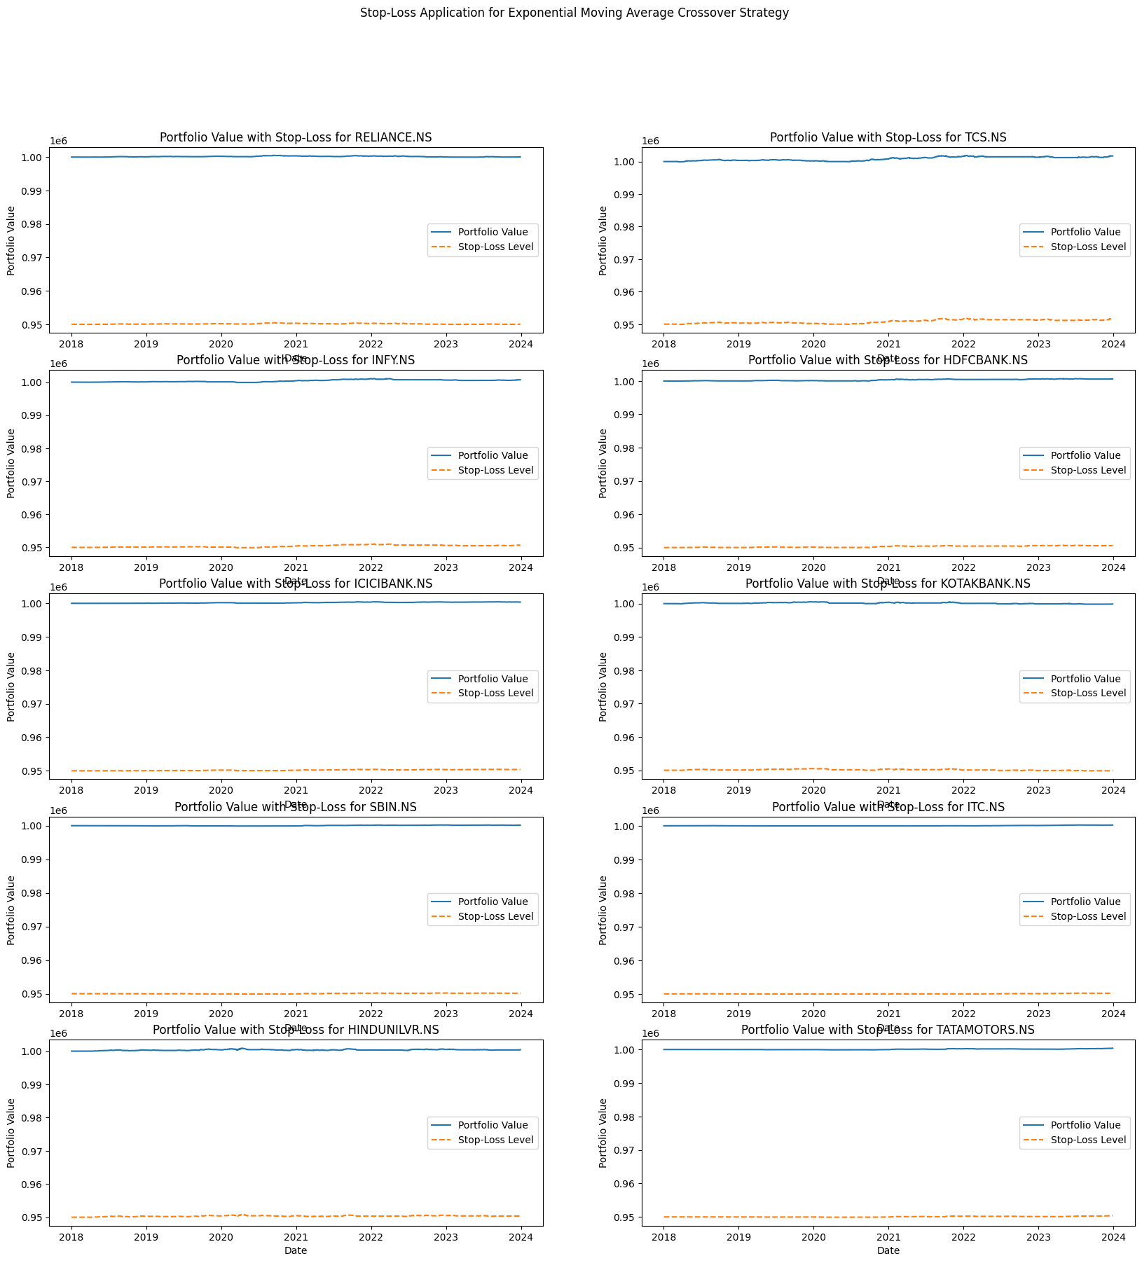
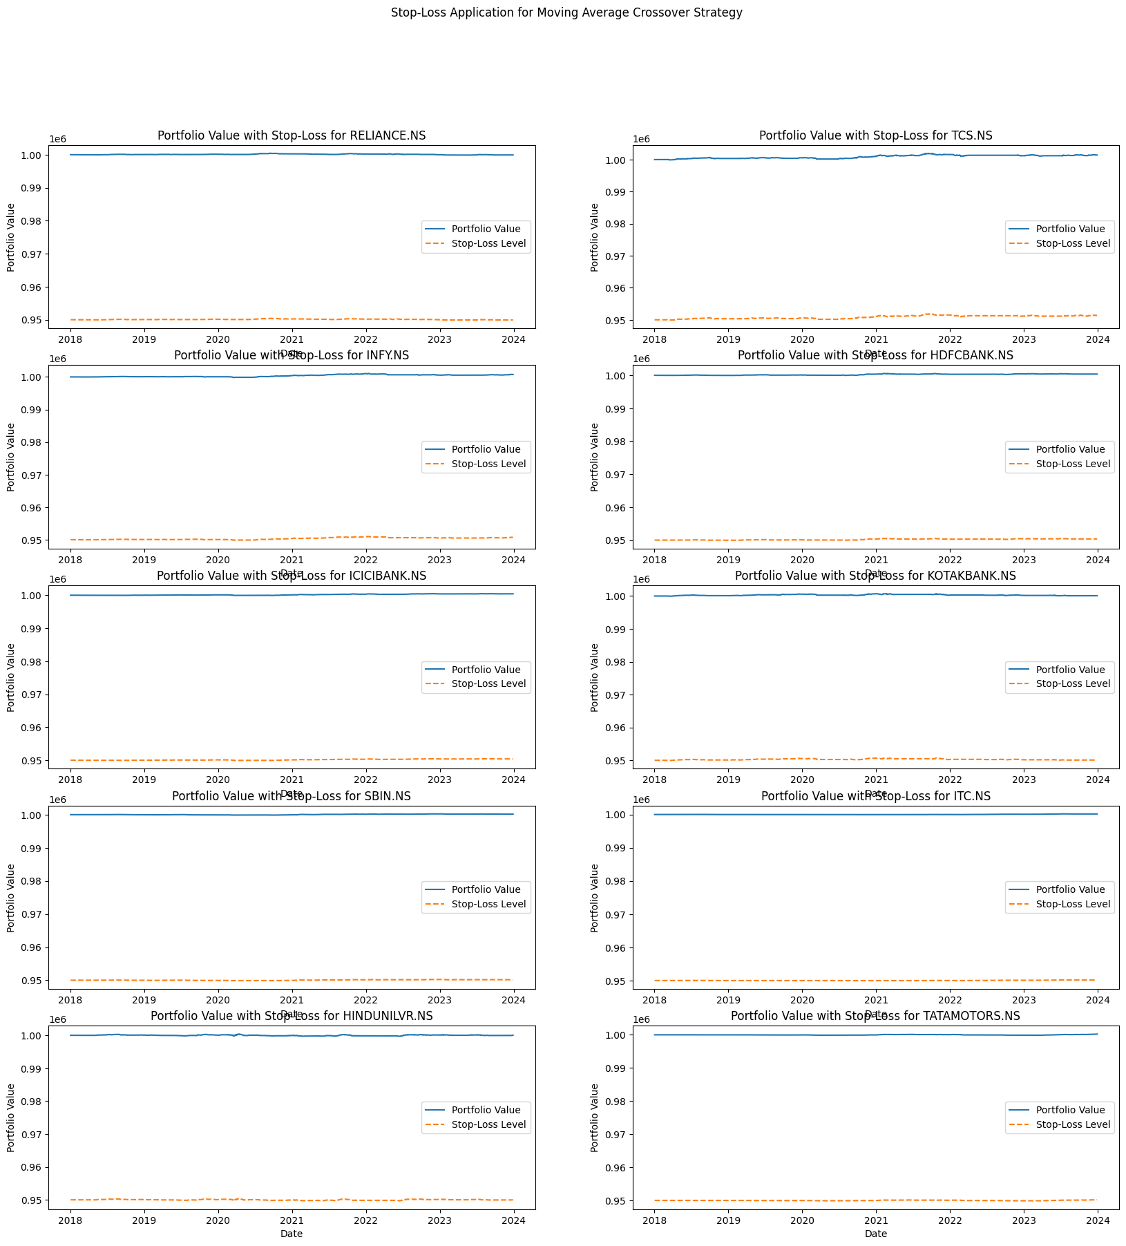
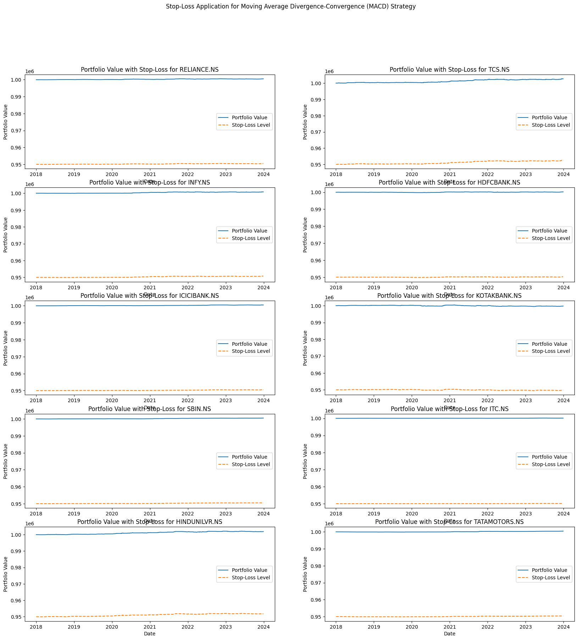
Step 4: Risk Management by Implementing Stop-Loss

Slide 9
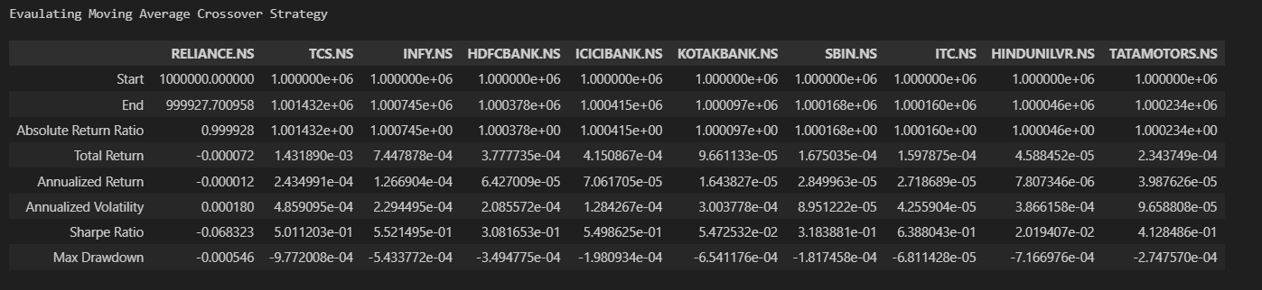
Step 5: Evaluation and Refinement - MACS

Slide 10
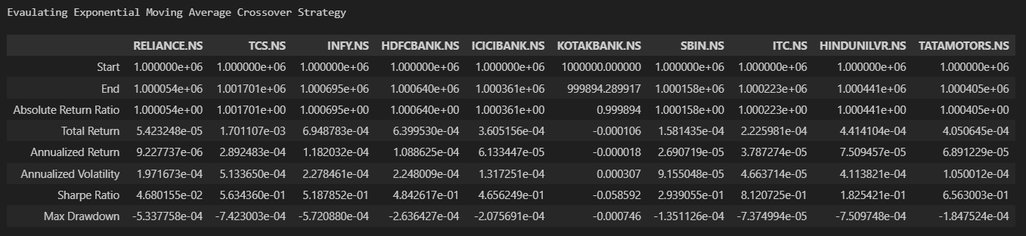
Step 5: Evaluation and Refinement - EACS

Slide 11
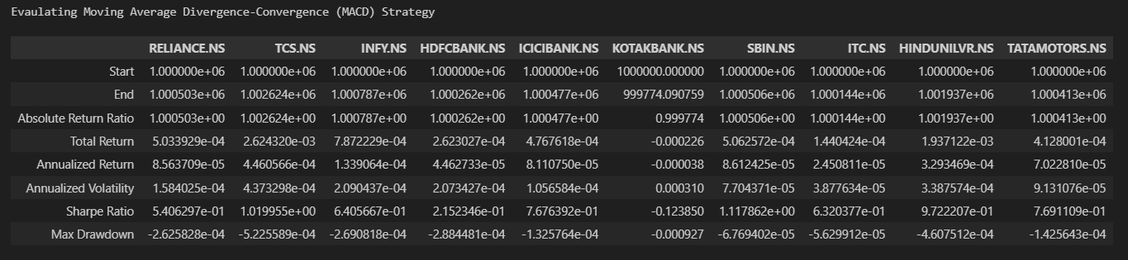
Step 5: Evaluation and Refinement - MACD

Slide 12

Overall Mean Returns

Slide 13
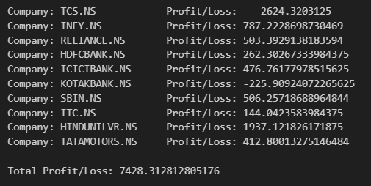
Step 6: Final Implementation

