Slide 1

Data Analysis of YouTube Channels
Prepared by: Ramagiri Jaidhar

Slide 2

Introduction
The dataset contains comprehensive information about various YouTube channels worldwide.
The YouTube data set was provided in a csv file (‘Global YouTube Statistics.csv’). The dataset comprises 29 variables.
It includes attributes like rank, Youtuber, subscribers, video views, category, uploads, Country of origin, channel type, and many others.
The objective is to analyze the data and extract meaningful insights about YouTube channels and Understand the trends, patterns, and correlations within the data.

Slide 3

Dataset Handling
Tools and Libraries
Used pandas for data manipulation and analysis.
Employed NumPy for numerical operations.
Visualized data using matplotlib.pyplot and seaborn.
Duplicate values are removed using drop_duplicates(‘rank’) function
Save the cleaned data to a new CSV file named (‘Cleaned Global YouTube Statistics.csv’)
Assigning the new file to df to remove SettingWithCopyWarning

Slide 4
Dataset Handling
Checking the missing values by isnull().sum() function
Missing values were addressed by filling in appropriate defaults or the most frequent values.
If there are more missing values in a column then deleting the missing rows to ensure the analysis is not biased.
Ensured consistency in data by standardizing country names, created_month and other categorical values.

Slide 5
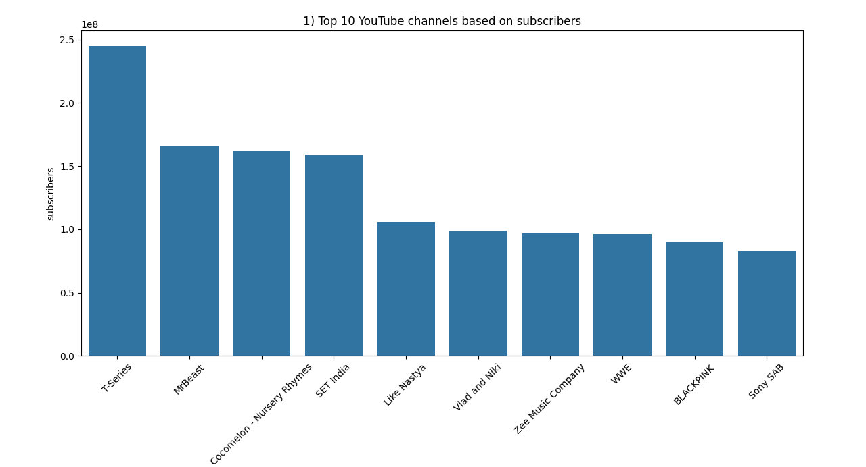
Top 10 YouTube Channels
Using nlargest() function we can find top 10 subscribed channels
Bar chart showing the top 10 YouTube channels based on the number of subscribers
T-series has the most subscribers (245000000).

Slide 6
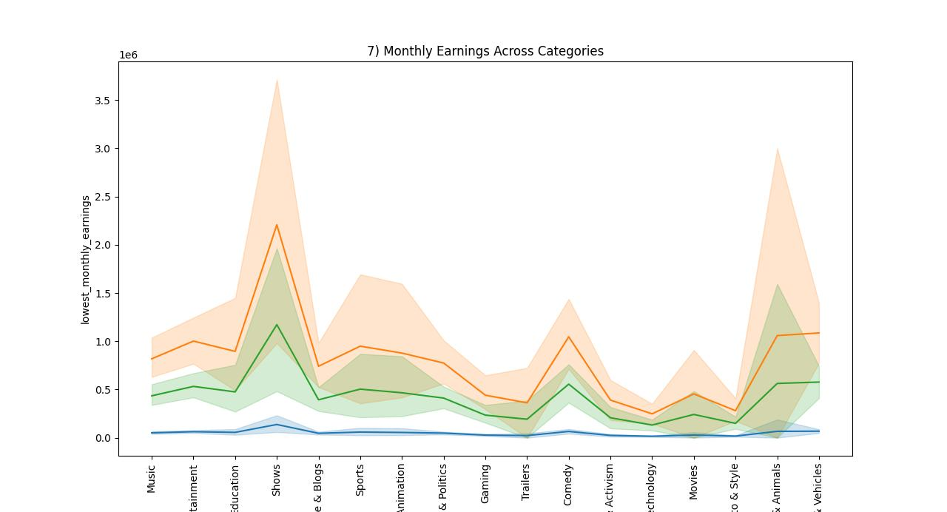
monthly and yearly earnings
By Taking the average of lowest_monthly_earnings and highest_monthly_earnings columns we can estimate the average monthly earnings(if they are in linear distribution) . Similarly, we can find average yearly earnings.
We can find How monthly earnings differ through category by using a line plot as shown
Highest monthly earnings – orange
Average monthly earnings – green
Lowest monthly earnings - blue

Slide 7
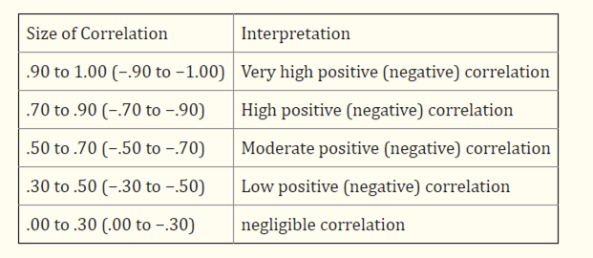
Correlation Analysis
Correlation acts like a measuring stick for the intensity of their relationship. Instead of just indicating direction (same together or opposite), it gives you a numerical score between -1 and 1 that tells you how strong that bond is.

Slide 8

Correlation Analysis
We can find the correlation coefficient with corr() function
After finding the coefficient we can check weather its highly correlated or moderately correlated or low correlated
Example:
Correlation between subscribers and video views: 0.85 (high positive correlated)
Correlation between education enrollment and number of YouTube channels: 0.06 (negligible correlation)
Correlation between number of subscribers and population: 0.09 (negligible correlation)
Correlation between subscribers gained in last 30 days and unemployment rate: -0.02 (negligible correlation)

Slide 9
Conclusion
Using the various functions offered by Python libraries such as pandas, NumPy, matplotlib, and seaborn, we can perform data analysis. However, Around 35% of the data is removed because of the duplicates or missing data to remove bias
This analysis highlights the significant impact of geographic and economic factors on YouTube channel performance. Further exploration could involve deeper dives into individual country data and more granular analysis of growth trends.

